Slide 1
Create Your DevOps Profile
Open in Desktop App
Choose a Template
Follow guidance on the template for proper formatting. Additional layouts available in Home > New Slide
Title Options: DevOps Architect, DevOps Specialist, DevOps Engineer, DevOps Advisory Leads or Coaches
Save as DevOps Profile – “Your Name ”.pptx
Post your profile to our Teams group

Slide 2
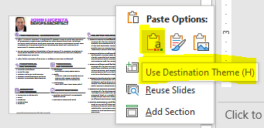
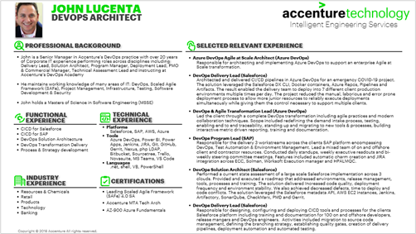
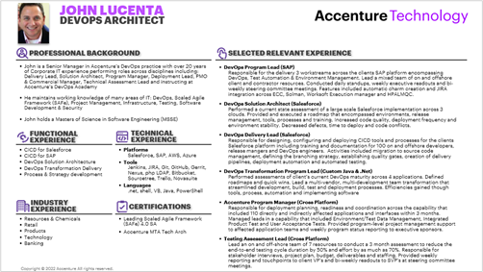
Migrate your Profile to the new branding
Open both the new template & your one pager in the desktop app
Copy your slide
Right Click + Paste in the template
Select use destination theme

Slide 3
Click Icon to add your Picture
This is a bulleted list of background experience. This should be a single list of bullet points
Pressing return when done with the first point will automatically format the spacing between bullets correctly
This is the Job/Role Title
This is the job description and is automatically formatted when you indent once to Level 2
Outdent to Level 1 in order to add another title with the proper formatting
Read this slide for details on how to fill out your profile and keep formatting
This is a bulleted list of functional experience. This should be a single list of bullet points
Title is the area such as Tools:
This is a comma separated list of relevant items such as tools and is automatically formatted when you indent once to Level 2
Outdent to Level 1
to add another area such as Languages: or Platforms:

Slide 4
Your Name
Your Title
Click Icon to add your Picture
This is a bulleted list of background experience. This should be a single list of bullet points
Pressing return when done with the first point will automatically format the spacing between bullets correctly
This is the Job/Role Title
This is the job description and is automatically formatted when you indent once to Level 2
Outdent to Level 1 in order to add another title with the proper formatting
Read this slide for details on how to fill out your profile and keep formatting
This is a bulleted list of functional experience. This should be a single list of bullet points
Title is the area such as Tools
This is a comma separated list of relevant items such as tools and is automatically formatted when you indent once to Level 2
Outdent to Level 1
to add another area such as Languages: or Platforms
This is a bulleted list of Industry experience. This should be a single list of bullet points such as Retail, Products, Resources etc.
This is a bulleted list of certifications. This should be a single list of bullet points

Slide 5
Sample Profiles

Slide 6

Robin Wooley
North America DevOps Lead
Robin Wooley is an Associate Director within Accenture’s Intelligent Engineering Services - Enterprise Transformation Services group and leads the North America DevOps practice.
IES provides development and foundational technology architectures that guide custom and package software implementations through high speed, automated delivery and perform integration of multiple systems to maximize flexibility, scalability, and performance.
Robin holds Bachelors and Masters degrees in Computer Science and brings 20 years of IT consulting and systems delivery experience leading technical architecture teams implementing large scale enterprise systems using advanced delivery methods.
North America DevOps Practice Lead
Responsible for NA DevOps practice providing DevOps services to clients through strategy, transformation, implementation, and dedicated as well as shared services run support. Leads five core practice areas: automated release of software through automation of build and deploy process, application asset management, software configuration management (SCM); continuous integration through advanced SCM concepts, automated unit testing, static code analysis, automated build and deploy processes; continuous delivery pipelines through automated QA, orchestration and automation of all software development lifecycle processes; automated operations focusing on automated event recovery, monitoring and anomaly detection; software defined infrastructure & cloud enablement through automated creation of environment, dynamic scaling, drift detection and remediation capabilities.
DevOps Delivery Lead
Delivery Lead for multi-speed portfolio of Retail applications delivering under mixed methodologies (waterfall, iterative, agile). Lead initial DevOps maturity assessment across global delivery teams and shaped and are actively delivering a continuous improvement roadmap to advance DevOps maturity through transformation ensuring adherence to regulatory requirements around PCI and SOX compliance.
Technology Delivery Release Lead
Lead Technology Architect for aggressive multi-year global business expansion program. Responsible for managing and working across complex technology work streams to deliver and support ‘green field’ installations of multiple integrated complex packaged systems bringing advanced release management, software configuration management, build and deploy management, environment management capabilities to support 100s of environments across 1000s of devices.
Program & Delivery Management
DevOps Assessment & Transformation
Software Configuration Management
Release Management
Environment Management
Platforms
E3 POS, Retalix POS, Oracle POS, Oracle Retail, SAP, JDA, Sabrix, Vertex, Infor Workforce Management, IBM Sterling Commerce
Products Retail
Health & Life sciences
Communications
Electronics & High Tech
Media & Entertainment
Cross Industry DevOps

Slide 7

John Lucenta
DevOps Architect
John is a Senior Manager in Accenture’s DevOps practice with over 20 years of Corporate IT experience performing roles across disciplines including: Delivery Lead, Solution Architect, Program Manager, Deployment Lead, PMO & Commercial Manager, Technical Assessment Lead and instructing at Accenture’s DevOps Academy
He maintains working knowledge of many areas of IT: DevOps, Scaled Agile Framework (SAFe), Project Management, Infrastructure, Testing, Software Development & Security
John holds a Masters of Science in Software Engineering (MSSE)
DevOps Program Lead (SAP)
Responsible for the delivery 3 workstreams across the clients SAP platform encompassing DevOps, Test Automation & Environment Management. Lead a mixed team of on and offshore client and contractor resources. Conducted daily standups, weekly executive readouts and bi-weekly steering committee meetings. Features included automatic charm creation and JIRA integration across ECC, Solman, Worksoft Execution manager and HPALMQC.
DevOps Solution Architect (Salesforce)
Performed a current state assessment of a large scale Salesforce implementation across 3 clouds. Provided and executed a roadmap that encompassed environments, release management, tools, processes and training. Increased code quality, deployment frequency and environment stability. Decreased defects, time to deploy and code conflicts.
DevOps Delivery Lead (Salesforce)
Responsible for designing, configuring and deploying CICD tools and processes for the clients Salesforce platform including training and documentation for 100 on and offshore developers, release mangers and DevOps engineers. Activities included migration to source code management, defining the branching strategy, establishing quality gates, creation of delivery pipelines, deployment automation and automated testing.
DevOps Transformation Program Lead (Custom Java & .Net)
Performed assessments of client’s current DevOps maturity across 4 applications. Defined roadmaps and quick wins. Lead a multi-vendor, multi-development team transformation that streamlined development, build, test and deployment processes. Efficiencies gained though tools, process, automation and implementing software
Accenture Program Manager (Cross Platform)
Responsible for deployment planning, readiness and coordination across the capability that included 110 directly and indirectly affected applications and interfaces within 3 months. Managed leads in a capability that included Environment/Test Data Management, Integrated Product Test and User Acceptance Tests. Provided program-level project management support to affected application teams and weekly program status reporting to executive sponsors.
Testing Assessment Lead (Cross Platform)
Lead an on and off-shore team of 7 resources to conduct a 3 month assessment to reduce the end-to-end testing cycle duration by 50% and effort by as much as 70%. Responsible for stakeholder interviews, project plan, budget, deliverables and staffing. Provided weekly reporting and touchpoints to client VP’s and bi-weekly readouts to SVP’s at steering committee meetings.
CICD for Salesforce
CICD for SAP
DevOps Solution Architecture
DevOps Transformation Delivery
Process & Strategy development
Platforms
Salesforce, SAP, AWS, Azure
Tools
Jenkins, JIRA, Git, GitHub, Gerrit, Nexus, php LDAP, Bitbucket, Sourcetree, Trello, Novasuite
Languages
.net, shell, VB, Java, PowerShell
Resources & Chemicals
Retail
Products
Technology
Banking
Leading Scaled Agile Framework (SAFe) 4.0 SA
Accenture MTA Tech Arch

