Slide 1
EDO DevOps Maturity Assessment
April 2018

Slide 2
What is DevOps?
Definition
DevOps: The realignment of IT around business value, eliminating waste and inefficiency in order to turn ideas into value, faster and with higher quality.
DevOps is…
DevOps is not…
Building a culture of communication and collaboration between all IT teams, including development and operations teams, but not stopping there.
Learning to identify misaligned incentives.
Agile implementation, delivery and rollout of features increasing business value.
Continuous quality improvement of software and reduction of time to market.
Highly dependent on automated processes for build, deployment, testing and environment provisioning.
New software or technology.
The introduction of a new tool stack.
New teams or processes.
Organizational changes.
Only relevant for start-ups and fast emerging companies.
Only relevant for custom development.
In DevOps, there are five elements to build in: Culture, Automation, Lean, Measurement, and Sharing (CALMS)

Slide 3
How to DevOp?
Requirement:
DevOps requires the realignment of incentives across the IT organization so that the each group from the business to production maintenance become equal partners in delivering value to the end user.
DevOps requires…
DevOps is inhibited by:
Blameless post-mortems.
A culture of individual empowerment.
Redefinition of individual and group responsibilities and goals.
Embracing what we used to see as “failure” as an opportunity to learn.
Learning to embrace early input and feedback like “does it build” to gain an economic advantage.
Blame-shifting between groups.
Thinking all problems are solved by tools, rules, and oversight.
Hierarchical silos and the handoffs between them.
Demanding that no problems are ever encountered.
Making large, sporadic changes rather than continually iterating minimal consecutive changes.
To implement change we deal with three areas, in this order: People, Process, and Tools.

Slide 4
DevOps Implementation
DevOps High Level focus (The 3 ways of DevOps)
DevOps Guiding Principles
Flow / Systems Thinking
Technical principles
Strong source control
Zero-touch build and deploy
Test early and often
Automate everything (in pipelines)
Elastic supply of cloud resources
Fine-grained service architecture (API-first)
Amplified Feedback Loop
Organization and culture principles
Cohesive teams with shared objectives
Lean principles and continuous delivery of value
Embrace failure, recover automatically, degrade gracefully
Experiment without regret
Continuous Improvement
Continual Experimentation & Learning
The DevOps implementation should follow guiding principles driven from the DevOps guideline

Slide 5


Context and Disclaimers
Disclaimers:
The Maturity Model is “a” perspective not “the” perspective
The Maturity Model is built on a lot of assumptions (like Agile>Waterfall) that may require discussion
Scores are reflective of a snapshot, many issues found are already being fixed
Key Observations slides are meant to:
Point out areas that pull scores down
Highlight areas with the most return on improvement investment
This project relies on interviews only (100 interviews in 3-4 weeks), and our results rely on the accuracy of those interviews
Our population sample is not random, slightly reducing the generality of statistical observations (Confidence Intervals indicated)
Context:
Results are scored according to a specific rubric that attempts to capture specific elements of DevOps practices that reflect our perspective of “best practices.”
Fortune 1000 interquartile range for maturity scores tends to be between 1.5 and 2.5. Above 2.5 would then be “good” and below 1.5 would be “not as good.”
Three layers of recommendations: Team, Platform, Organizational. App level covered in team meetings w/ key recommendations slides. Platform and Organizational covered herein.

Slide 6
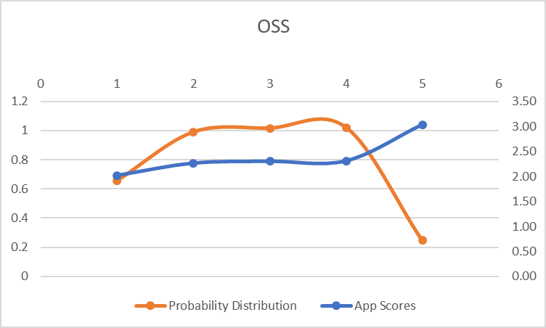
OSS Results
We can say with ~90% confidence:
99% of OSS apps would score between 1.43 and 3.34
95% of OSS apps would score between 1.81 and 2.96
66% of OSS apps would score between 2.19 and 2.58
To move OSS apps forward:
Concentrate on Usage of Metrics for Improvement
Concentrate on Building Automation and Pipelines
Concentrate on Moving to Agile Infrastructure
OSS MEAN | STANDARD DEVIATION | -3σ | -2σ | -1σ | +1σ | +2σ | +3σ
2.39 | 0.383075 | 1.433606 | 1.816681 | 2.199757 | 2.582832 | 2.965908 | 3.348983

Slide 7
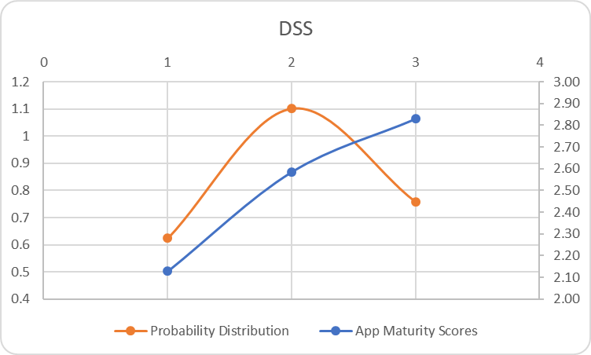
DSS Results
We can say with ~85% confidence:
99% of DSS apps would score between 1.52 and 3.29
95% of DSS apps would score between 1.87 and 2.93
66% of DSS apps would score between 2.22 and 2.58
To move DSS apps forward:
Empower Product Managers to own Product roadmap
Implement Strong Lean Governance and Make Quality Gates part of the Delivery Process
Develop Fastidious Development Habits through Documented Process and Consistent Repetition
DSS MEAN | STANDARD DEVIATION | -3σ | -2σ | -1σ | +1σ | +2σ | +3σ
2.51 | 0.3555 | 1.516412 | 1.871885 | 2.227359 | 2.582832 | 2.9383055 | 3.293779

Slide 8
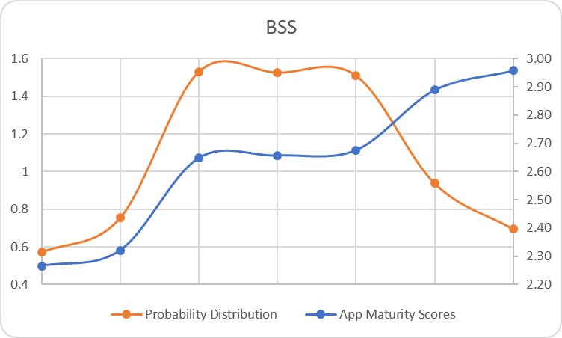
BSS Results
We can say with ~90% confidence:
99% of BSS apps would score between 1.85 and 3.41 (cox.com is outside the 3rd std dev, and we may have a bit more of a leftward tail toward -3σ)
95% of BSS apps would score between 2.11 and 3.15
68% of BSS apps would score between 2.37 and 2.89
To move BSS apps forward:
Continue to decouple releases from timelines (multi-speed releases - things go when they’re ready, manage WIP and inventory)
Work to complete QA Automation
Build out early Automated Quality Gates
Cox.com not calculated in analysis, as an outlier skews the overall data
BSS MEAN | STANDARD DEVIATION | -3σ | -2σ | -1σ | +1σ | +2σ | +3σ
2.63 | 0.2602 | 1.849965 | 2.11017 | 2.370375 | 2.89 | 3.1509905 | 3.411196

Slide 9
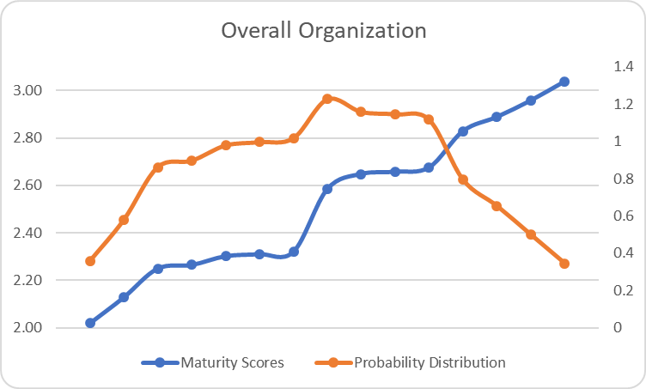
Overall Organization Results
We can say with ~93% confidence:
99.7% of apps would score between 1.62 and 3.48
95% of all apps would score between 1.94 and 3.16
68% of all apps would score between 2.26 and 2.84
Cox.com not calculated in analysis, as an outlier skews the overall data
ED&O MEAN | STANDARD DEVIATION | -3σ | -2σ | -1σ | +1σ | +2σ | +3σ
2.53 | 0.3193 | 1.624823 | 1.944159 | 2.263496 | 2.844427 | 3.1637631 | 3.4831

Slide 10

Differentiators
Teams below the mean...
Teams above the mean...
Feel powerless over their time and effort due to delivery demands
Don’t know what metrics to gather or what action to take on them
Aren’t sure what targets to shoot for
Aren’t aware of the support available for them from the organization
Have developed sustainable boundaries with business partners
Have reserved capacity to focus on improvement
Are using metrics and thinking about what they mean
Have improvement targets
Are partnering with shared services in improvement efforts

Slide 11
Organizational Recommendations
Focus on a Program and Change Management Initiative that includes a Collaborative Framework with a two-way engagement model
Form a steering committee to build, operate, and maintain the organization’s New IT vision
Balance between supply chain management and team empowerment, especially with open source
Teams need to know what support is available to them and central support organizations need to know what challenges teams are facing
Help Product Owners Roadmap according to the organizational vision
1
Encourage Anti-Fragile Principles: move towards automated recovery from issues – this enables HA and DR
2
Build an Intentional Culture that:
Prioritizes metrics and uses them for continuous improvement
Encourages partnerships across the delivery pipeline for delivering value
Rewards experimentation and sharing
Utilizes a systemic view of failure, and improves the system to reduce failure
Is a blameless, high-trust, psychologically safe environment
3
Eliminate Silo’d Infrastructure: ie Load balancers. Teams should be able to experiment and automate on everything in the value chain
4
Enable teams to set boundaries with the business: gather examples of successful strategies and socialize those
5
Revisit funding model: nudge the bar towards partnership with business; nudge and keep nudging, incrementally move the bar
6

Slide 12
Benefits Case
Benefits Case Matrix
Key Improvements
3
Collaborative Framework
1
1
H
Encourage Anti-Fragile Principles
2
6
4
Build Intentional Culture
Level of Potential Benefits
3
2
5
M
Eliminate Silo’d Infrastructure
4
Enable Teams to Set Boundaries
5
L
Revisit Funding Model
6
H (Difficult)
M
L (Easy)
Difficulty of Implementation

Slide 13
Organizational Recommendations
Collaborative Framework
Automation
1
4
Lean
6
Encourage Anti-Fragile Principles
2
2
5
Build Intentional Culture
Culture
3
3
Eliminate Silo’d Infrastructure
4
Measurement
Sharing
Enable Teams to Set Boundaries
1
5
Revisit Funding Model
6

Slide 14
Appendix

Slide 15
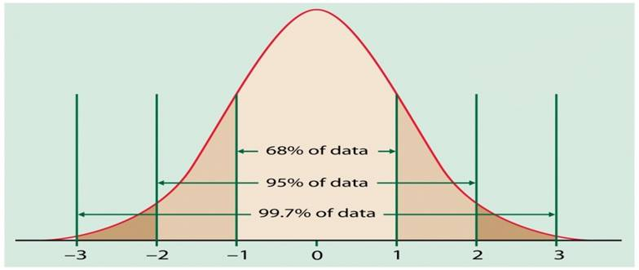
Normal Distribution
Normally distributed properties are grouped around the average and become rarer as values move farther away. This is a fundamental mathematical truth of statistics that lets us draw lots of conclusions once we know our measured properties are normally distributed.

Slide 16
Interview Status
Platform | Team Member Interviews |  |  |  | Cox Team Leads
 | Tech Arch & Ops | Delivery Approach & Release Mgmt | Development | Quality Engineering
BSS - Business Support Systems
ICE | Catalina Gard Muthu Chinnasamy Mahadev Kumar | Catalina Gard | Catalina Gard Muthu Chinnasamy Mahadev Kumar | Nupur Bhavin | John Murtagh Nicholas Sanders Ajay Kaimal Don Johnson
CX Connect Vantage | Naga Singari Ameya Shaligram | Eva Chou Naga Singari | Naga Singari | Amol Dhurandhar | Todd Dean Vasu Vasili Michael Bausha Mark Patsy
Cox.com | Hemanth Bhyrappa | Courtney Avin | Joe Beal Bill Henz Mark Barulic Dianne Doss Robert Sekman Daniel Brown | Bharat Viswanadha | Chris Coffey Joe Beal Roy Pereira
CB MyAccount | Pratik Premchand Jain Abdul Manam Thermus Butler Rishi Tank Yograj Patel | Pratik Premchand Jain Abdul Manam Thermus Butler | Pratik Premchand Jain | Folake Sokoya | Nate Owen Sairam Neelam Jason Character Mike Emry
BIS | Smruti Naik | Terry Kennedy Vikram Shah | Kathy Zhou Vance Jason Hill Mayuresh Krishna | Ashwin Anandagiri Terry Kennedy Vikram Shah | Avi Rodan Smruti Naik Terry Kennedy
Solution Center | David Clarke | Jaime Lightfoot Chris Philbeck | Santosh Subas | Patrick Parks Chris Philbeck | Joe Keller
IVR | Michael Rhodes Jack Montag Tom Luckhurst Tony Sidhu Mike Darnell | Michael Rhodes Mike Darnell | Mike Darnell | Tony Sidhu | Monterio Woodson
Pinpoint | Kartik Vemuri | Steve Reagan | Steve Reagan Kartik Vemuri | Vamsi Krishna | Joe Keller
Platform | Team Member Interviews |  |  |  | Cox Team Leads
 | Tech Arch & Ops | Delivery Approach & Release Mgmt | Development | Quality Engineering
OSS - Operations Support Systems
SAIL IMS Admin UI Cox Video MW | Naveen Sureshbabu | Terry Zasio | Michelle Usi Roger Terrell Lewis Stover Vijay Sachdeva; Brandon Houston Y. Chakravarthy Jun Tang Anthony Smith Shashubushan Rath Xipei Lu | Michelle Usi Rath Shashibhushan Brandon Houston Y Chakravarthy Roger Terrell Mark Harp | Erik Fields Daniel Munford Saravanan Somalinga Navarro Williams Jason Bruce Kevin Serikstad John Landis Moriah Spicer Josh Nelson
ResMail Open Exchange | Matthew Steininger Ponraj Sait | Matthew Steininger Ponraj Sait | Matthew Steininger Ponraj Sait Michael Putch | Matthew Steininger Ponraj Sait | Erik Fields Daniel Munford
IDM | Olugbenga Omotesu | Olugbenga Omotesu | Olugbenga Omotesu | Olugbenga Omotesu | Erik Fields Daniel Munford Jose Santana
BACON IMS Migration IVM CBSS | Karthik MS Matthew Grace | Jamie Pelkie Steve Huelsing Adam Johnston Chris Campuzano Tara Flack | Jamie Pelkie Steve Huelsing Adam Johnston Chris Campuzano Tara Flack | Jamie Pelkie Steve Huelsing Adam Johnston Chris Campuzano Tara Flack | Jamie Pelkie Dean Eelman Ben Charles Tara Flack
Granite GNIS | Robert Chisolm Jyotika Bhandarkar Adrienne Moore | Robert Chisolm Jyotika Bhandarkar | Robert Chisolm Jyotika Bhandarkar Adrienne Moore | Robert Chisolm Jyotika Bhandarkar Adrienne Moore | Rodney Raines
DSS – Data Support Services
BizView PlantViw HomeView | Karthikeyan, N. Amit Singh Chauhan Anil Yeluguri | Karthikeyan, N. Amit Singh Chauhan Anil Yeluguri | Karthikeyan, N. | Karthikeyan, N. | Cindy Hughes Philip Preiser Jon Flack
Mosaic | Herb Geozos | Angelise Carter | Vishrut Arya Steven Johnson Yogesh Vasisht | Vishrut Arya Sandeep Jagarlamudi JayaPrakash Veerthineni | Angelise Carter Greg Thomas
EDS | Kevin Doherty Kevin McNulty Chaitanya Vasamsetty Jake Edwards Phani Nalluri | David Blair Scott Gatlin | Pavan Surapaneni | David Blair | Michael Pray Andy Sweet Theresa Goriczynski

Slide 17
Assessment Outcomes
Observations of Current State
Gain insight into current level of maturity and capability of the existing organization
DevOps Maturity Rating
Understand maturity of current processes against leading standards
Categorize by application types per stack
Recommendations for Target State & Benefits Case
Outline desired target state aligned with delivery objectives
Outline investments vs. value
Highest impact first approach to address business needs
DevOps Metrics & KPIs to track adoption and improvement

Slide 18
What DevOps Maturity Looks Like
1
2
3
4
5
AD-HOC
REPEATABLE
CONSISTENT
OPTIMISED
LEADING
DELIVERY ORGANIZATION AND METHODOLOGY | Release scope poorly defined; subject to catastrophic and ad hoc change requests | Releases duration exceeds business need; releases face disruptive change | Release cadences well defined but exceeds business need; Requirements are stable; | Release on demand, multi-speed releases; time-box meets to business need (eg: monthly) | Small changes pushed through the pipeline ; Continuous deployment enables innovation
LEAN DELIVERY GOVERNANCE & PROCESSES | No defined or consistent applied delivery approach | Delivery approach is well defined, but largely manually governed | Industrialised project delivery; governance integrated into delivery and product management established | Blame free culture embedded in governance that uses real-time data rather than manual inputs | Continuous Delivery / Deployment supporting agile business change with automated governance
AUTOMATED RELEASE OF SOFTWARE | Mostly manual deployments | Some CIs automated, environment tailoring required, no enterprise tools | Fully automated Single-touch deployments into environments. | Functioning environments can be build from nothing programmatically. | Zero-touch zero- downtime deployments
CONTINUOUS INTEGRATION | No consistent use of version control – builds cannot be traced back to source code | Source code consistently managed in VCS; releases traceable to source | Developers integrate changes by checking into trunk on regular basis (daily) | Build is typically green – if build breaks developers do not make other changes until resolved | Build is typically green – if build breaks the CI tooling automatically reverses the failed change
CONTINUOUS DELIVERY (INCL AUTOMATED QA) | Fully manual test scripts | Testers run a harness / suite | Test harness / suite run automatically for some envs | Automated test suites enforce a quality gate | Tests run as functional monitoring
AUTOMATED OPERATIONS | No monitoring tools | Tools in place, but not configured beyond basic OS checks | Functional monitoring in place and DR is available | Environment and application health monitored and proactively managed | Service level monitoring (perf, usage) integrated with infrastructure and self-healing available
SW DEFINED INFRASTRUCTURE | Environments are managed ad-hoc without consistent blueprint | Environments follow standards but are manually created | Environments can be created automatically and follow common blueprint | SW defined infrastructure that closely resembles Production throughout SDLC | Utility based computing that leverages auto-scaling for several SDLC aspects
APPLICATION ARCHITECTURE | Big monolithic application architecture | Architecture based on platforms, business requires IT for every change | Resilient Architecture minimising single point of failures | Modular and scalable architecture, that allows for some business self service configuration | Microservice based architecture supported by end-to-end ownership in teams

Slide 19
Key Factors for Success
The responsibilities outlined below are key for successful and timely completion
Planning & Mobilization
Confirm Assessment Interviewees
Review & Accept DevOps Maturity Model
Interviews & Data Gathering
ACCENTURE:
Key Observations & Maturity Rating
ACCENTURE:
COX:
ACCENTURE:
Schedule Assessment Interviews
Conduct Status Meetings
Define Assessment Questions
Schedule and Conduct Interviews
Complete Follow Up Session (if needed)
Ensure Leadership Sponsorship - Notify Interviewees of Assessment
COX:
Interviewees attend sessions
Analyze, Evaluate and Document Key Observations
Document current & target maturity rating
COX:
Review and confirm Key Observations
Recommendations and Benefits Case
ACCENTURE:
Identify Key Improvements
Categorized by highest impact
Document investment vs. value
Provide DevOps Metrics and KPIs
COX:
Review and Confirm Readout

Slide 20
DevOps Assessment – Q&A
Cox needs to align on the goal of the assessment before we can move forward
Is it to baseline where we are with apps today so we can measure future progress?
Cox is seeking to understand the current state of DevOps and opportunities to realize efficiency benefits from improved automation and value levers by adoption of high impact first DevOps practices
What are we trying to know about our apps that this assessment will give us?
Cox will have meaningful insight into the maturity of it’s current-state DevOps capabilities, and will have a clear roadmap for further implementation and improvement. These will be aggregated through the following lenses:
Technology & Tools
DevOps Practices
People, Organization & Culture
Program & Change Management
Enterprise Governance & Metrics
How are we getting rated when we haven’t even agreed what DevOps means to us?
The review is based on the Accenture DevOps Maturity Model; which has been reviewed with various Cox leads and updated to include Cox-specific concerns
Cox needs to identify success criteria for the assessment effort
Assessment outcomes include:
Insight into current level of maturity and capability of the existing organization (based on prioritized apps by stack)
Outline desired target state aligned with delivery objectives
Highest impact first approach to address business needs
Outline investments vs. value
DevOps Metrics & KPIs to track adoption and improvement
Cox needs to prioritize DevOps framework listed on slide 7 and let Accenture know what is important to focus on (not everything on slide 7 is important to Cox). Add this as an early step in the project kickoff
The review is based on the Accenture DevOps Maturity Model; which has been reviewed with various Cox leads: John Landis; Jeff Drake; Christian Welin; Theresa G.; Brian Williams; DJ McCall; Chris Coffey
Also need assessment to provide Cox with information on how to manage teams to adopt DevOps, how to build/funnel the products/services/customer experience requests that then support / feed back into a DevOps model
The recommendations are aggregated into categories that include People, Org & Culture (team structures, talent, cross-pollination of skills) as well as Enterprise Governance (intake process to the DevOps teams)

