Slide 1
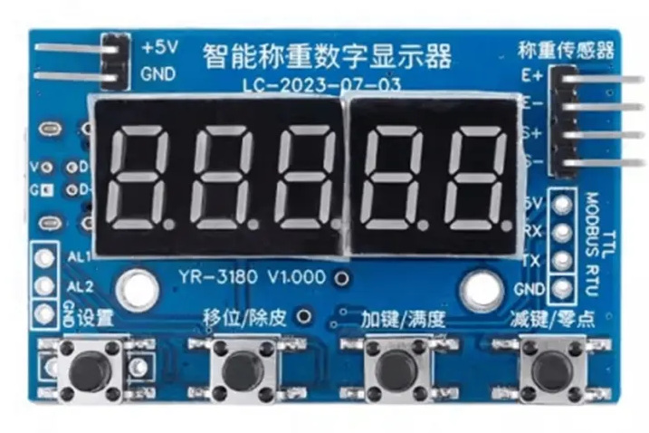
5V OUT
Load cell
1 kg to 20kg
GND
INA+
INA-
5V IN
TTL-232R-5V-WE
USB to TTL Serial Adapter Cable w/ Embedded Controller
TX (TTL)
RX (TLL)
GND

