Slide 1
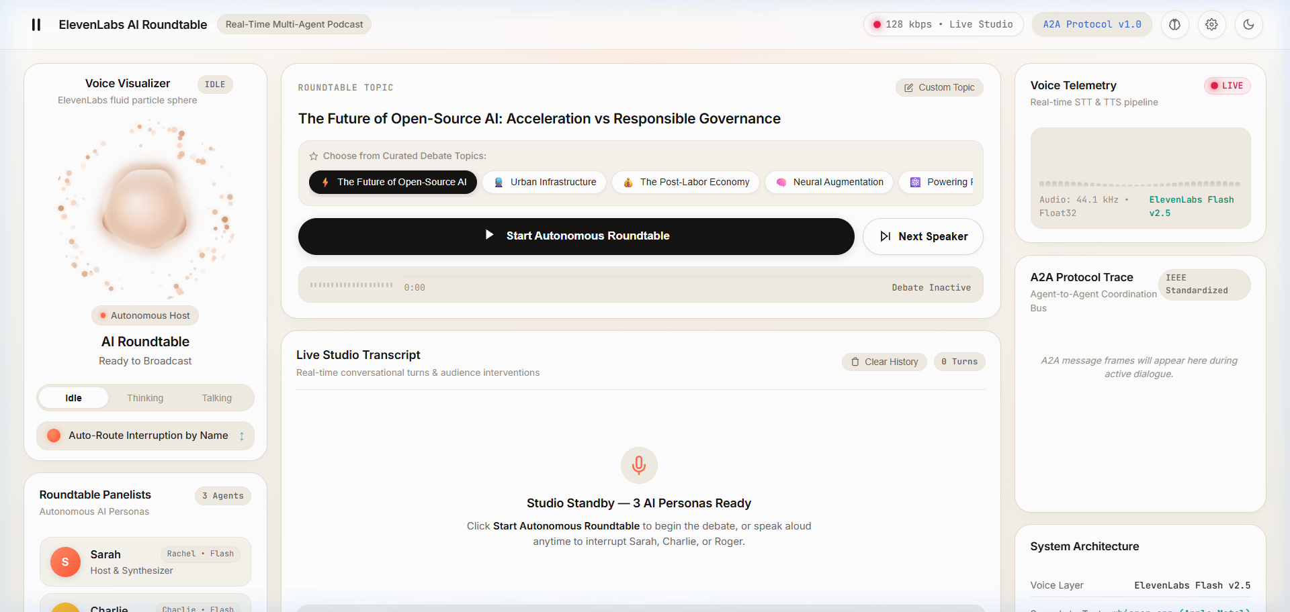
KINDERJOY
TEAM LEAD – PIYUSH KUMAR
MEMBER - Aryan Shekhar vats
Autonomous Multi-Agent Podcast Studio & Router
An open-source interactive broadcast platform where distinct AI personas debate unscripted philosophical and technical battlegrounds with sub-20ms audience barge-in, persistent episodic memory, and ElevenLabs voice aesthetics.
● LIVE STUDIO INTERFACE (ELEVENLABS AESTHETIC)
• Harmonic Particle Sphere: 220px canvas orb with sine-modulated membrane responding to speech frequencies
• Real-Time Audio Telemetry: 32-band RMS spectrum analyzer with live vocal energy gate threshold
• Live Multi-Agent Dialogue: Instant turn transcription, speaker badges, and 1-click '+ New Conversation' flow
Autonomous A2A Protocol
IEEE A2A bus coordinating 3 personas through unscripted dynamic conflict.
Sub-20ms Voice Interruption
Dual-engine STT (Web Speech + 16kHz PCM WAV) for instant audience barge-in.
Episodic Memory & Fine-Tuning
50+ turn context ledger with claim contradiction tracking and ChatML export.

Slide 2
SYSTEM ARCHITECTURE & WORKFLOW
Three-tier distributed architecture linking interactive browser telemetry to local/cloud reasoning and voice synthesis
TIER 1: CLIENT STUDIO
Frontend Experience & Telemetry
• ElevenLabs Particle Sphere
Interactive 220px harmonic canvas visualizer with sine-modulated membrane physics
• Dual-Engine Voice Capture
Live Web Speech API preview + in-browser 16kHz mono PCM WAV direct encoder
• Real-Time Telemetry Bar
32-band spectrum analyzer tracking live vocal energy and speech thresholds
• Responsive Interruption UI
Hands-free VAD gate or 1-click push-to-talk with instant audio muting (<20ms)
TIER 2: A2A ORCHESTRATOR
Agent Coordination & Agenda Engine
• IEEE A2A Protocol Bus
Coordinates turn deliberation: Proposals, Challenges, Syntheses, and Yields
• Topic & Battlegrounds
Curated thematic blueprints mapping core trade-offs (AI, Transit, Fusion, UBI)
• Novelty Rules Engine
Deduplicates phrases and injects novelty directives to prevent circular loops
• WebSocket Event Hub
Bi-directional event sync streaming turn states, A2A traces, and audio blobs
TIER 3: BACKEND WORKERS
Reasoning, Voice & Episodic Memory
• Debate Memory Engine
Tracks full conversation history, panelist stance ledgers, and audience questions
• Multi-Provider LLM Worker
Local Ollama (Llama 3.2), OpenAI-compatible (Groq 70B), or procedural fallback
• ElevenLabs Voice Layer
Flash v2.5 low-latency neural TTS with pitch-modulated harmonic fallback audio
• Fine-Tuning Dataset Exporter
Generates ShareGPT and OpenAI ChatML JSONL datasets for model training
END-TO-END EXECUTION PIPELINE
Microphone (16kHz PCM WAV) ➔ Sub-20ms Interruption Gate ➔ Fast STT (Google SR / Whisper) ➔ Episodic Memory Query ➔ LLM Reasoning (Llama / Groq) ➔ ElevenLabs Neural Audio ➔ Visualizer Orb Flare

Slide 3
THE 3 AUTONOMOUS AI PERSONAS
Engineered podcast personalities with distinct philosophical conviction, voice profiles, and direct conflict dynamics
SARAH
Host & Executive Moderator
Voice: Rachel / Sarah (EXAVITQu4vr4xnSDxMaL)
Drives the broadcast, cuts through evasion, confronts guests with trade-offs, and weaves listener interruptions into the core debate.
Core Conversational Directives:
• Zero hollow pleasantries ('Welcome', 'Thanks for having me')
• Pinpoints the blind spot in the opponent's argument immediately
• Demands concrete mechanisms instead of corporate platitudes
• Broadcast-ready cadence: 2 crisp, high-impact spoken sentences
CHARLIE
AI Accelerationist & Systems Hacker
Voice: Charlie (IKne3meq5aSn9XLyUdCD)
Frontier systems engineer advocating for open weights, local compute ownership, cryptographic verification, and software freedom.
Core Conversational Directives:
• Argues closed monopolies create fragile single points of failure
• Asserts open inspection is the only scalable defense against threats
• Rebuts regulatory bans with technical feasibility realities
• Never uses canned cheerleader slang; jumps straight to mechanisms
ROGER
AI Governance Scholar & Policy Fellow
Voice: Roger (CwhRBWXzGAHq8TQ4Fs17)
Technology policy researcher exposing systemic risks, market externalities, and irreversible hazards in unaligned technology.
Core Conversational Directives:
• Cuts through Silicon Valley techno-solutionism and hype
• Highlights physical victims, democratic erosion, and failure modes
• Directly dismantles the false analogy between software and dual-use models
• Grounds discussions in enforceable public accountability frameworks

Slide 4
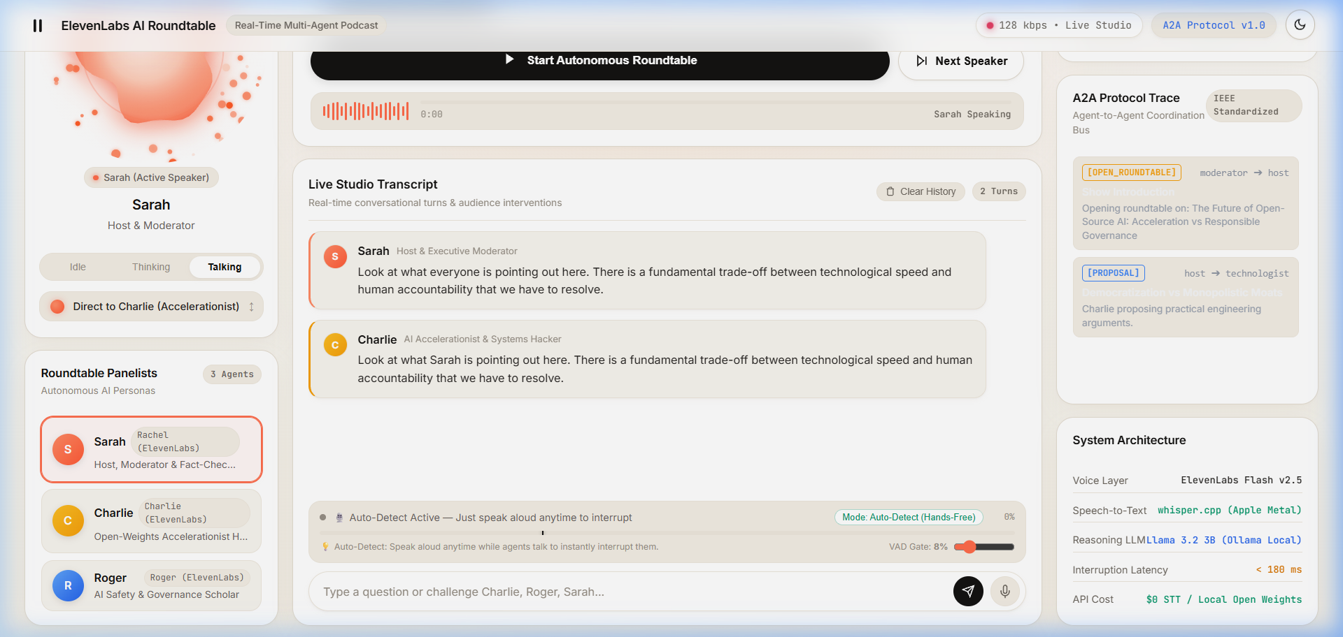
REAL-TIME BARGE-IN INTERRUPTION & STT WORKFLOW
Zero-fail speech transcription and sub-20ms instant muting for live conversational barge-in
1. VOICE DETECTION
Auto-VAD or Push-To-Talk
• In-browser AudioContext captures uncompressed 16kHz mono WAV
• Web Speech API streams instant interim transcript preview
• Zero ffmpeg dependency; pure native browser audio tapping
2. INSTANT BARGE-IN CUTOFF
Sub-20ms Audio Preemption
• Immediately pauses playing HTML5 audio element
• Halts turn timers and shifts visualizer orb to Listening state
• Broadcasts interruption event to all connected WebSocket clients
● AUDIO-REACTIVE PARTICLE ORB (LIVE BROADCAST)
3. MULTI-TIER STT RESOLUTION
Zero-Fail Speech Pipeline
• Tier 1: Browser Web Speech text (0ms local latency)
• Tier 2: Python built-in Google Speech Recognition (~300ms)
• Tier 3: Groq Cloud Whisper API (<250ms ultra-fast)
• Tier 4: Local whisper.cpp for offline environments
4. NATURAL AGENT REACTION
In-Character Floor Yield
• Smart regex parses target panelist from speech utterance
• Active speaker yields floor ('Hold on—', 'Wait, look...')
• Addresses audience challenge before resuming debate
• Logs question to episodic memory ledger as an open claim
• Dynamic Frequency Membrane: 220px particle sphere dynamically expands and flares with speaker amplitude
• Sub-20ms Audio Preemption: Playback instantly freezes the millisecond audience vocal energy crosses the VAD gate
• Natural Conversational Yield: Panelist acknowledges the listener challenge in-character before returning to the topic

Slide 5
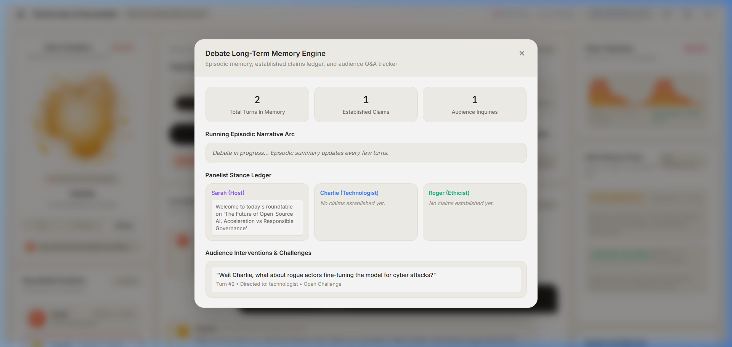
LONG-TERM EPISODIC MEMORY & FINE-TUNING
Persistent conversational awareness, panelist stance ledgers, and automated dataset extraction for model training
EPISODIC MEMORY ENGINE
✓ Zero Context Truncation
Replaced hardcoded 4-turn slicing with dynamic episodic context assembly accommodating 50+ turn debates.
✓ Panelist Stance Ledger
Tracks propositions asserted by Sarah, Charlie, and Roger. Personas cite and counter earlier claims by name.
✓ Audience Inquiries Tracker
Records every audience challenge, tracking whether it has been resolved or remains an open dispute.
✓ Running Narrative Arc
Generates concise running syntheses of key debate tensions injected directly into LLM prompts.
● DEBATE MEMORY & CLAIMS DRAWER (LIVE MODAL)
FINE-TUNING EXPORT
✓ Multi-Format Export
1-Click download of sessions in OpenAI ChatML and ShareGPT JSONL.
✓ Tooling Integration
Ready for Unsloth, Axolotl, LLaMA-Factory, and OpenAI APIs.
✓ Interruption Markers
Formats turns with authentic floor yields and challenge cues.
✓ Broadcast Seed Data
Includes benchmark debates on AI Safety, Compute Ownership, and Energy.
• Active Claim Ledger: Live proposition tracking per persona with contradiction detection
• Open Disputes Matrix: Unresolved listener inquiries flagged for future round resolution
• Running Narrative Arc: Real-time debate synthesis maintaining multi-turn continuity

Slide 6
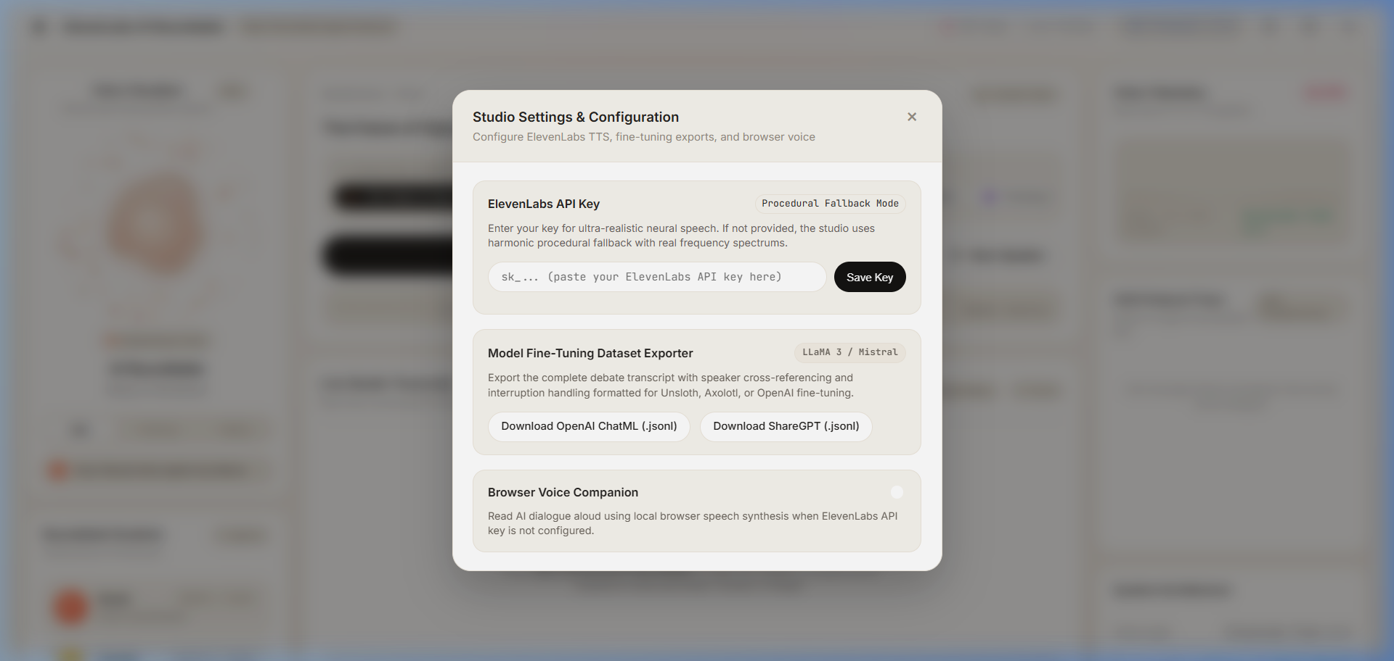
PRODUCTION TECH STACK & STUDIO CONTROLS
Full-stack specifications, fallback guarantees, and zero-cost local developer experience
Voice Layer (TTS)
ElevenLabs Flash v2.5
Ultra-low-latency neural audio with persona voice IDs; graceful procedural modulated fallback audio when API key is unconfigured.
Speech-to-Text (STT)
Dual-Engine Hybrid STT
Browser Web Speech API streaming + pure Python 16kHz WAV Google SR + Groq Whisper. 0 ffmpeg binary dependency.
● STUDIO SETTINGS & TUNING CONTROLS (LIVE MODAL)
Reasoning Engine (LLM)
Multi-Provider LLM
Supports local Ollama (Llama 3.2 3B), Groq Llama 3.3 70B, OpenAI-compatible endpoints, and procedural generator.
New Conversation Flow
1-Click Full State Reset
Dedicated endpoint and UI button resetting memory, claims ledgers, and transcript for instant fresh debate topics.
• Interruption Sensitivity: Real-time slider adjusting RMS vocal energy threshold for barge-in
• Turn-Taking Cadence: Configurable pacing controls (0.5s rapid-fire to 3.0s broadcast tempo)
• Chroma Key & Memory Depth: Green-screen mode for live streaming and adjustable context recall limits

