Slide 1
CABENATO
Final Project by Group 15

Slide 2
INTRODUCTION
Our project, CABENATO, is an online cab booking platform.
You just need to login and input the required details, like pickup location, drop location, date and time.
You get the flexibility to choose from a list of drivers available.
You’ll get a confirmation mail, once your booking is successful, which is used for verification purposes.
Signup process is very user friendly.
Pricing of the cars is also available of the home page itself.

Slide 3
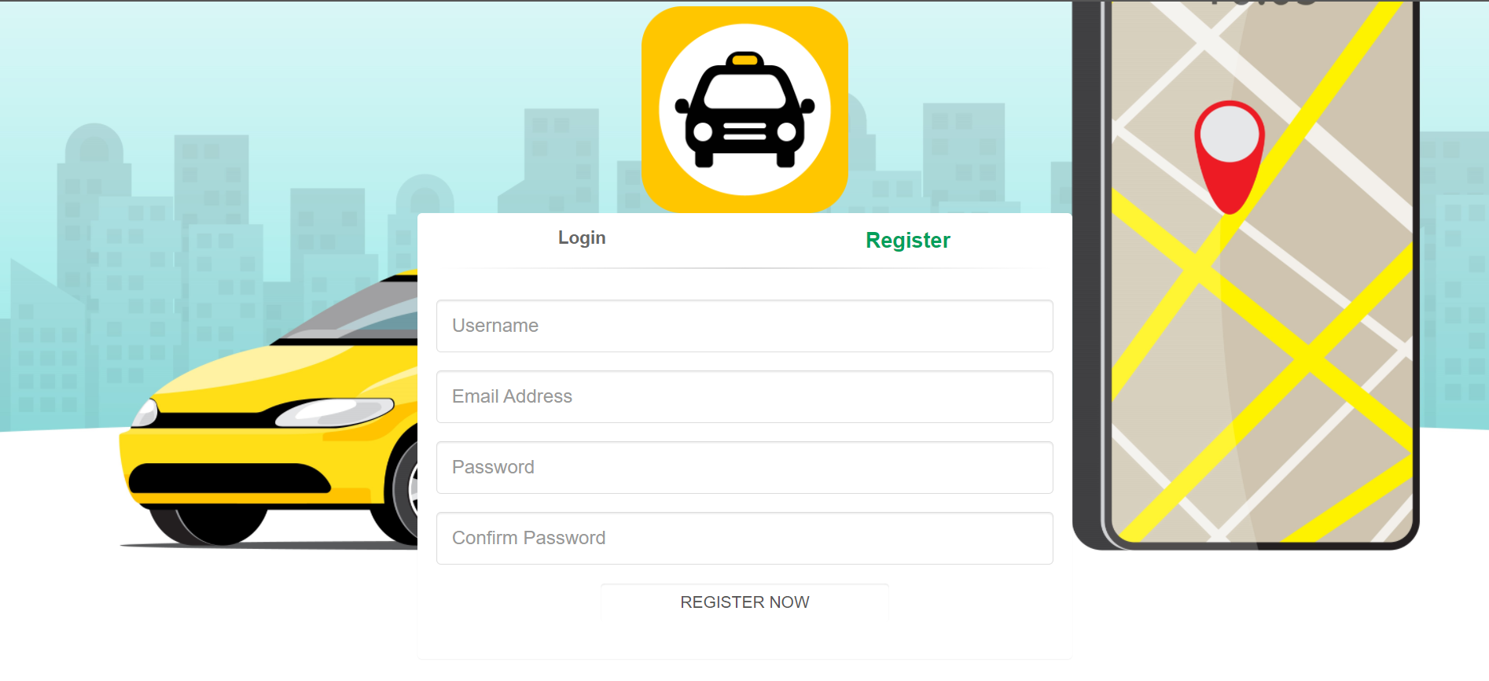

REGISTRATION
You just need to enter the basic information for login.
There are no constraints, except for password, which must be at least 8 characters long.
The email address must not be already registered.
Password and confirm password must be same.
Lastly, click on the REGISTER NOW button.

Slide 4
Technologies used
Bootstrap
PHP
My SQL
HTML
CABENATO
Java Script
CSS

Slide 5
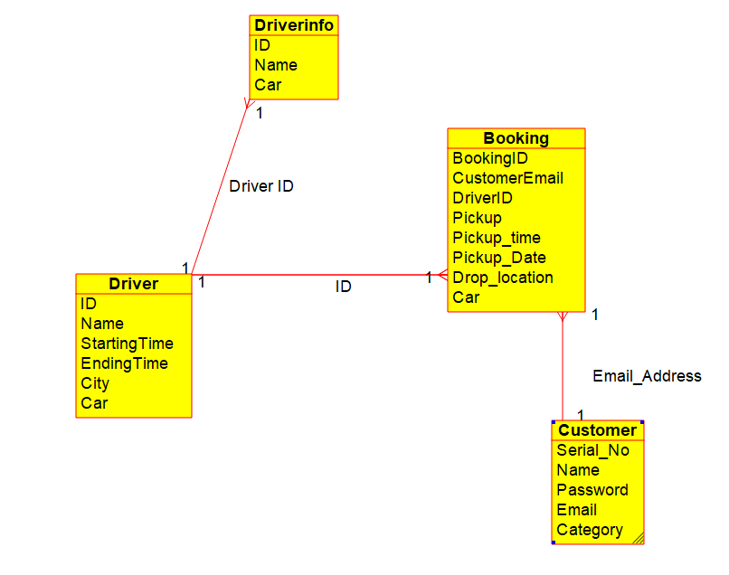
Database design
Foreign key:
Driver.ID

Slide 6
THANK YOU
Now its time to go for the demo, and once we are done with it, you are free to ask any questions.
Thank you everyone!
- Devansh Agrawal B20094
Shivam Kumar B20134
Arman B20083
Nilesh Rewasiya B20117
Komal B20111
Hemant Bansal B20288
Harikrit Khatait B20102

