Slide 1
emobility behaviour analysis
Open Energy Hackdays 2020
Group 5

Slide 2
Prerequisits
Private charging load curves from EKZ
~ 50 k Webscraped json-files, snapshots from ich-tanke-strom.ch
Self webscraped coordinates of all charging stations from ich-tanke-strom.ch
Group of 8

Slide 3
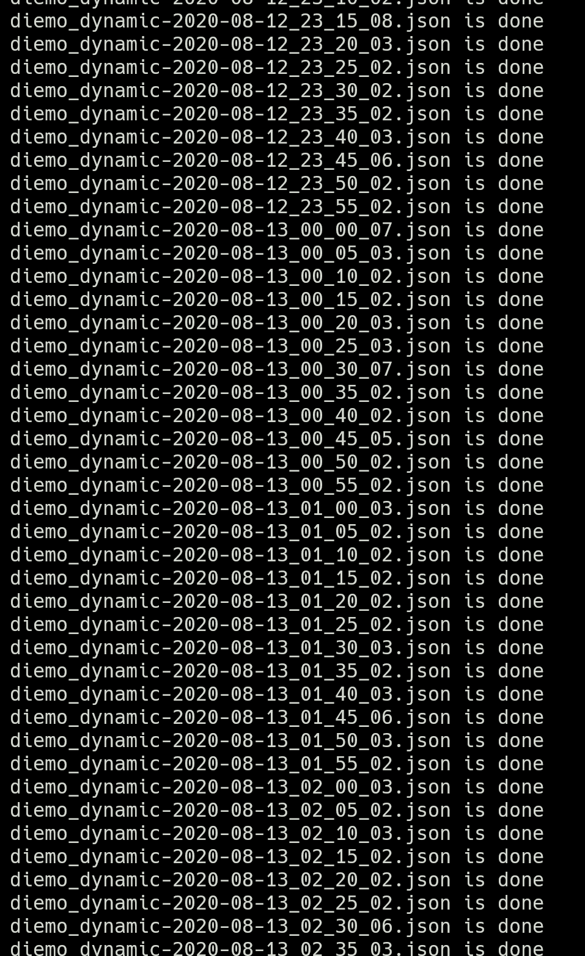
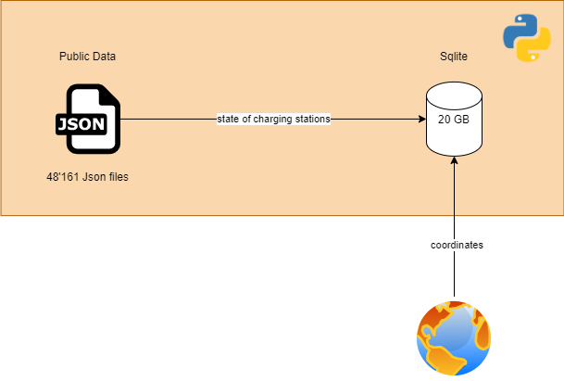
Data Engineering – public data

Slide 4
Analysis results

