Slide 1

Monte Carlo Methods
Waffle Univ. Reinforcement Learning Seminar
Presenter: Eunje Choi

Slide 2
Index
0. Intro
1. Monte Carlo Prediction
2. Monte Carlo Estimation of Action Values
3. Monte Carlo Control
4. Monte Carlo Control without Exploring Starts
5. Off-policy Prediction via Importance Sampling
6. Incremental Implementation
7. Off-policy Monte Carlo Control
8. Discounting-aware Importance Sampling
9. Per-decision Importance Sampling
10. Discussion

Slide 3
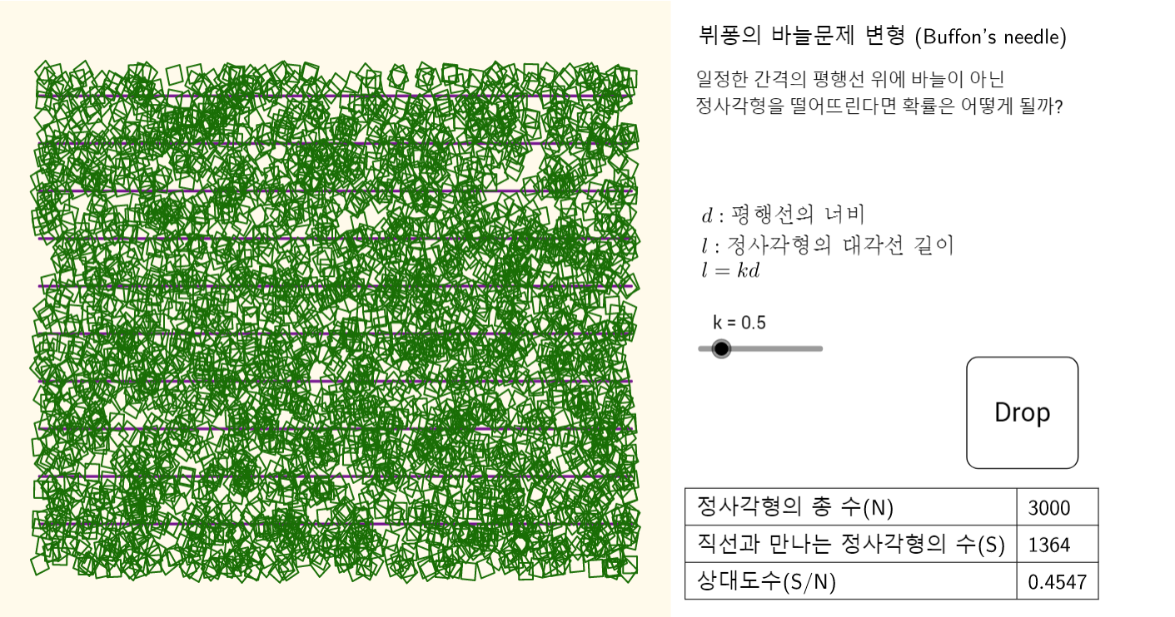
0. Intro
A long time ago..

Slide 4
0. Intro
Buffon’s needle problem

Slide 5
0. Intro
Monte Carlo method

Slide 6
0. Intro
Monte Carlo method IN RL

Slide 7
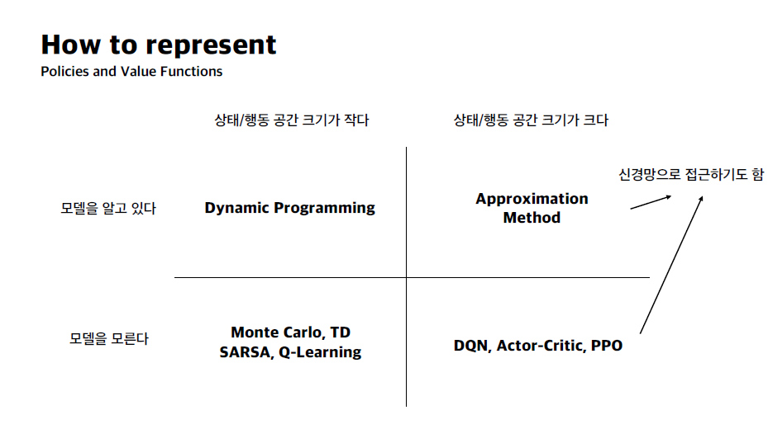
0. Intro
Recap on Week2 Seminar

Slide 8
0. Intro
1. Monte Carlo Prediction
2. Monte Carlo Estimation of Action Values
3. Monte Carlo Control
4. Monte Carlo Control without Exploring Starts
5. Off-policy Prediction via Importance Sampling
6. Incremental Implementation
7. Off-policy Monte Carlo Control
8. Discounting-aware Importance Sampling
9. Per-decision Importance Sampling

Slide 9
1. Monte Carlo Prediction
A

Slide 10
1. Monte Carlo Prediction
A

Slide 11
Thank you

