Slide 1
Sentiment Analysis on Yelp Dataset using Spark Structured Streaming and Kafka
Team 7 : Akshay Patel, Keshav Vyas

Slide 2
Goals
Processing Data at Scale, Can you imagine manually sorting through millions customer reviews, ratings, suggestions(tips)? There’s just too much data to process manually. Sentiment analysis helps user to consolidate right data for a business.
User can also find trending businesses which would help in finding the right business and potentially most popular and positive experience.
Big data pipeline which continuously ingest source data and provide new insights for easier decision making for the user.

Slide 3








Flow Diagram
Naïve Bayes Model Re-training
Speed Layer
Batch Layer

Slide 4
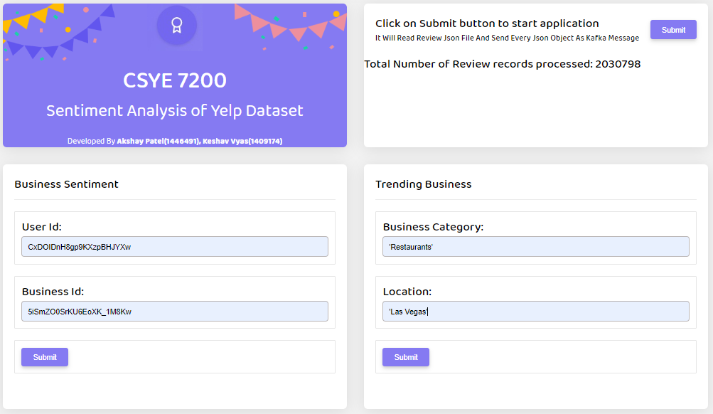
Use Case
(1) Click Submit to Start Kafka
(2) Click on Submit for Use Case 1 & 3
(3) Click on Submit for Use Case 2

Slide 5
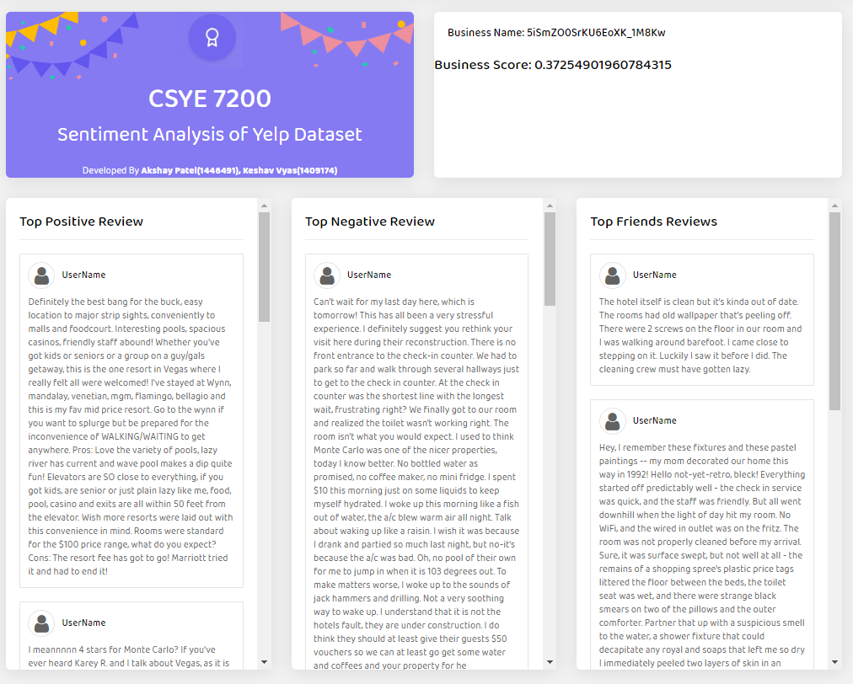

Slide 6
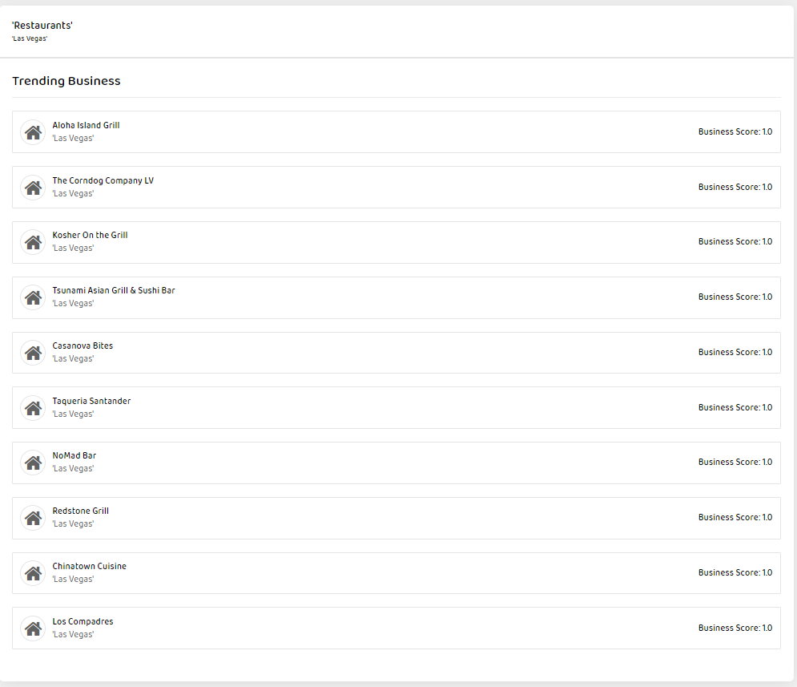

Slide 7
Review Sentiment Classification
User Review Text
Data Cleaning
Remove Stop Words
Tokenizer
Review Data
Naïve Bayes Model
Vectorize Features
Ngrams
yelp_sentiment
Model Re-training
Data Preprocessing
Model
Re-training
Saving in Directory

Slide 8
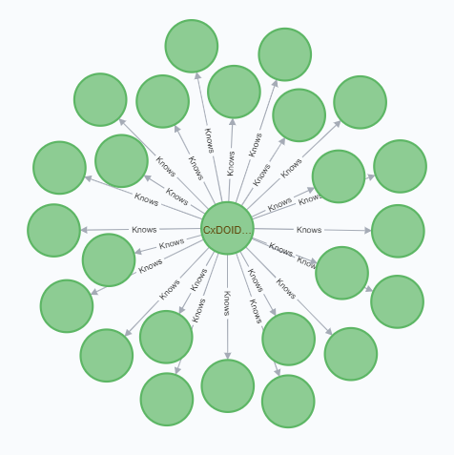
Create Friends’ Network
User Friends List
Create Edges Graph Frames
Load Into Graph Database
User Data
Neo4j
Calculate Business Score
Aggregation of sentiments
Calculate Business Score
Find Top Reviews
yelp_sentiment
yelp_score

Slide 9
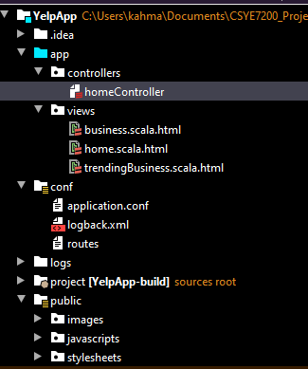
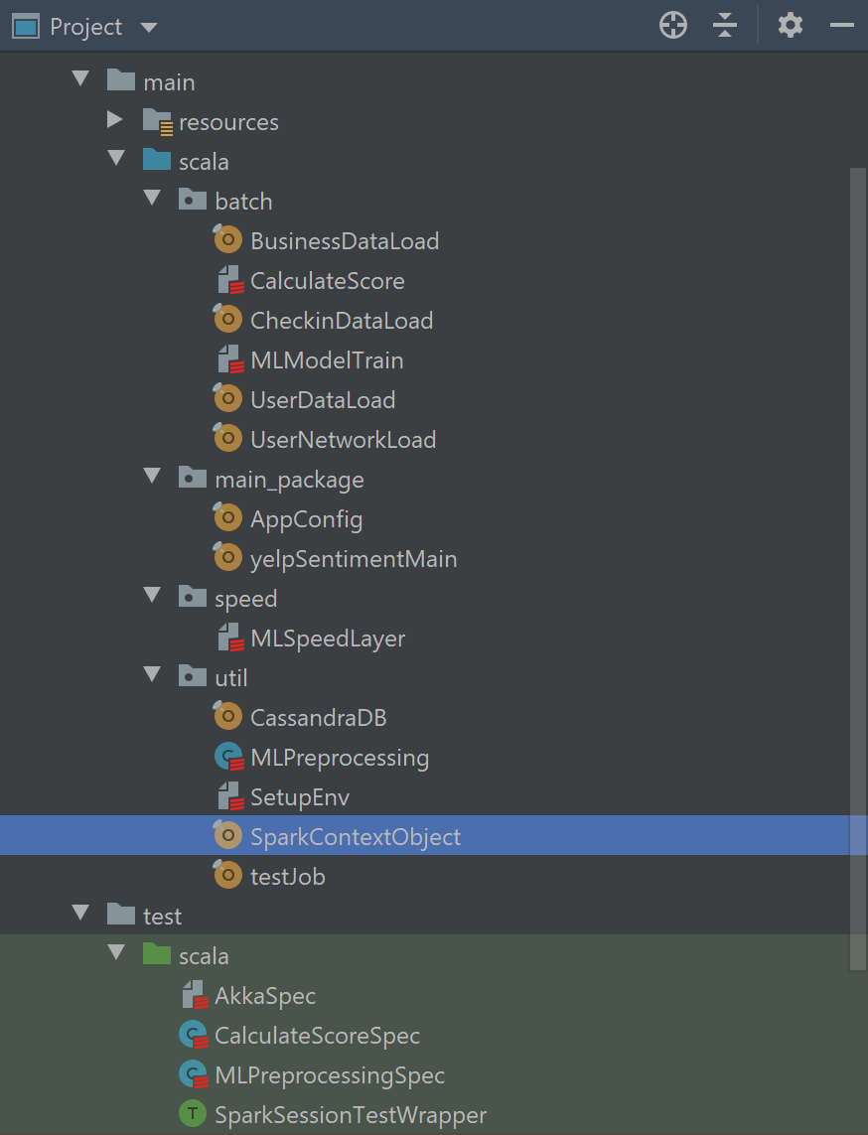
Programming in Scala
Coding Repository: https://github.com/vyaskeshav/CSYE7200_Project

Slide 10
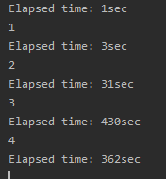

Acceptance Criteria
Review transaction should be sent through Kafka and processed by spark streaming API in less than 5 seconds
Positive/Negative review classification with at least 70% accuracy
Process user’s friends by a specific business and develop a user network in 5 seconds
Total Records: 2030798
Total Time: 827 Sec
Time per Record: 0.4 milliseconds
Total Records: 563 friends

Slide 11
Thank You

