Slide 1
Intro to Javascript

Slide 2
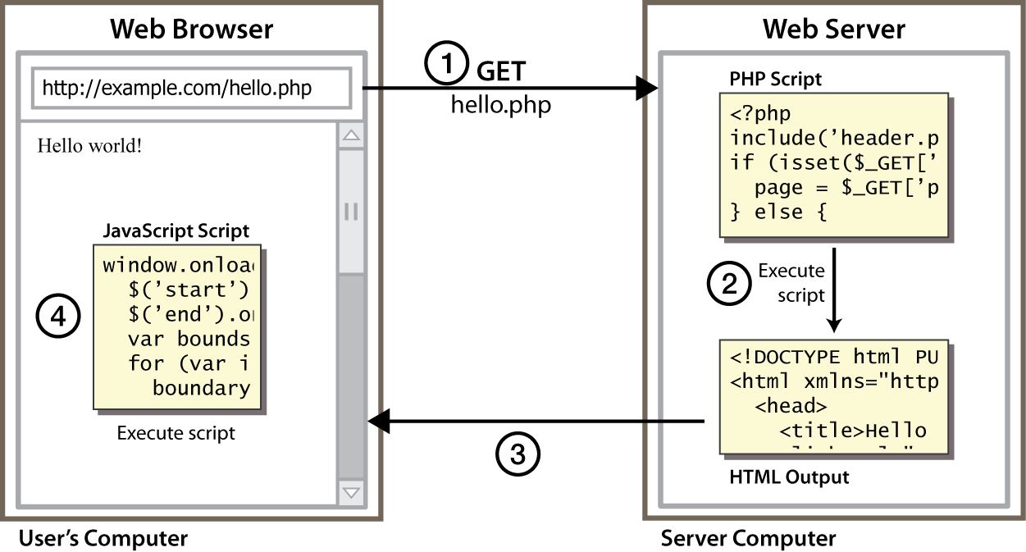
Client Side Scripting
Notes:
client-side script: code runs in browser after page is sent back from server
often this code manipulates the page or responds to user actions

Slide 3
Why use client-side programming?
PHP already allows us to create dynamic web pages. Why also use client-side scripting?
client-side scripting (JavaScript) benefits:
usability: can modify a page without having to post back to the server (faster UI)
efficiency: can make small, quick changes to page without waiting for server
event-driven: can respond to user actions like clicks and key presses

Slide 4
Why use client-side programming?
server-side programming (PHP) benefits:
security: has access to server's private data; client can't see source code
compatibility: not subject to browser compatibility issues
power: can write files, open connections to servers, connect to databases, ...

Slide 5
What is Javascript?
a lightweight programming language ("scripting language")
used to make web pages interactive
insert dynamic text into HTML (ex: user name)
react to events (ex: page load user click)
get information about a user's computer (ex: browser type)
perform calculations on user's computer (ex: form validation)

Slide 6
Client side scripting
To display error or information boxes
To validate user input
To display confirmation boxes
To process server data, such as aggregate calculations
To add programmable logic to HTML
To perform functions that don’t require information from the server
To produce a new HTML page without making a request to the server

Slide 7
Server Scripts
To maintain data shared among applications or clients
To maintain information during client accesses
To access a database
To access server files
To call server C libraries
To customize Java applets

Slide 8
Scripts
Client-side and server-side JavaScript scripts are both embedded in an HTML file
For server-side JavaScript scripts, this HTML file is compiled with the LiveWire compiler
Creates a file that is in a platform-independent and compiled bytecode format

Slide 9
What is Javascript?
a web standard (but not supported identically by all browsers)
NOT related to Java other than by name and some syntactic similarities

Slide 10
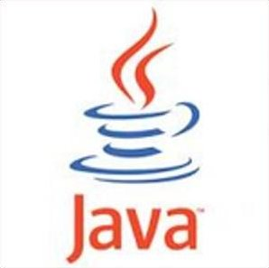
Javascript vs Java
interpreted, not compiled
more relaxed syntax and rules
fewer and "looser" data types
variables don't need to be declared
errors often silent (few exceptions)
key construct is the function rather than the class
"first-class" functions are used in many situations
contained within a web page and integrates with its HTML/CSS content

Slide 11
JavaScript vs. PHP
similarities:
both are interpreted, not compiled
both are relaxed about syntax, rules, and types
both are case-sensitive
both have built-in regular expressions for powerful text processing

Slide 12

JavaScript vs. PHP
differences:
JS is more object-oriented: noun.verb(), less procedural: verb(noun)
JS focuses on user interfaces and interacting with a document; PHP is geared toward HTML output and file/form processing
JS code runs on the client's browser; PHP code runs on the web server
JS <3

Slide 13
Linking to a JavaScript file: script
<script src="filename" type="text/javascript"></script> HTML
script tag should be placed in HTML page's head
script code is stored in a separate .js file
JS code can be placed directly in the HTML file's body or head (like CSS)
but this is bad style (should separate content, presentation, and behavior

Slide 14
Why JavaScript?
“Active” web pages
Web 2.0
AJAX, huge number of Web-based applications
Some interesting and unusual features
First-class functions - interesting
Objects without classes - slightly unusual
Powerful modification capabilities - very unusual
Add new method to object, redefine prototype, …
Many security and correctness issues
“The world’s most misunderstood prog. language”

Slide 15
JavaScript History
Developed by Brendan Eich at Netscape
Scripting language for Navigator 2
Later standardized for browser compatibility
ECMAScript Edition 3 (aka JavaScript 1.5)
Related to Java in name only
“JavaScript is to Java as carpet is to car”
Name was part of a marketing deal
Various implementations available
SpiderMonkey C implementation (from Mozilla)
Rhino Java implementation (also from Mozilla)

Slide 16

Motivation for JavaScript
Netscape, 1995
> 90% browser market share
“I hacked the JS prototype in ~1 week in May and it showed! Mistakes were frozen early. Rest of year spent embedding in browser” -- Brendan Eich, ICFP talk, 2006
Design goals
Make it easy to copy/paste snippets of code
Tolerate “minor” errors (missing semicolons)
Simplified onclick, onmousedown, etc., event handling
Pick a few hard-working, powerful primitives
First-class functions, objects everywhere, prototype-based
Leave all else out!

Slide 17
What is JavaScript?
created in 1995 by Brandon Eich of Netscape/Mozilla
"JS had to "look like Java" only less so, be Java’s dumb kid brother or boy-hostage sidekick. Plus, I had to be done in ten days or something worse than JS would have happened." - Brandon Eich
originally called "LiveScript" to match Netscape branding
renamed to JavaScript to capitalize on popularity of Java
submitted as a standard to ECMA in 1997 as "ECMAScript"
not directly related to Java
Eich claims he was most influenced by Self and Scheme
some JS syntax, libraries, etc. are ripped off by Java, C
D. Crockford: "JavaScript is Lisp in C's clothing."

Slide 18
JavaScript today
possibly the most used programming language today (!!)
mostly used for client-side web page scripting, but increasingly used to build server apps, other programs
current standardized version: ECMAScript 5 (2009)
Is JavaScript a bad programming language??
had bad browser behavior, slow, poor web coders, etc.
recent implementations are faster, better, more stable
JS in browser works with "DOM" (Document Object Model)
related JS+web technologies: Ajax, JSON, jQuery, etc.
spin-off languages: JScript (MS), ActionScript (Adobe), etc.

Slide 19


JavaScript vs. Java
+
= JavaScript
interpreted, not compiled
dynamic typing
first-class functions; nested functions; closures
a structured, imperative object-oriented, scripting lang.
prototype-based object and inheritance system
sophisticated first-class resizable array type
first-class regular expression support
more relaxed syntax and rules
fewer and "looser" data types
variables don't always need to be declared
key construct is first-class function rather than the class

Slide 20
Common Uses of JavaScript
Form validation
Page embellishments and special effects
Navigation systems
Basic math calculations
Dynamic content manipulation
Sample applications
Dashboard widgets in Mac OS X, Google Maps, Philips universal remotes, Writely word processor, hundreds of others…

Slide 21
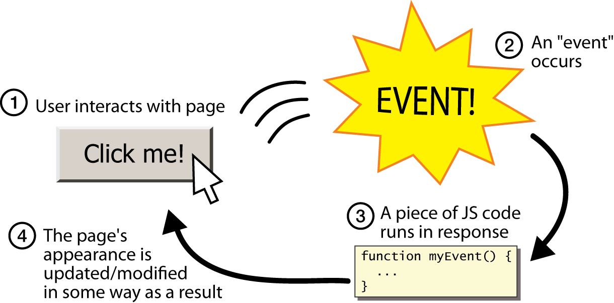
Event-driven programming
split breaks apart a string into an array using a delimiter
can also be used with regular expressions (seen later)
join merges an array into a single string, placing a delimiter between them

Slide 22
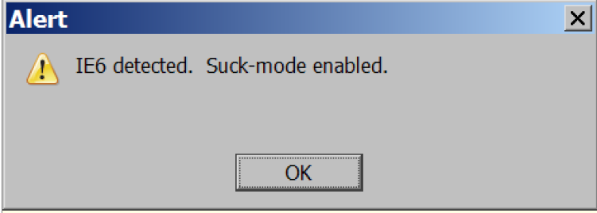
A JavaScript statement: alert
alert("IE6 detected. Suck-mode enabled."); JS
a JS command that pops up a dialog box with a message

Slide 23
Event-driven programming
you are used to programs start with a main method (or implicit main like in PHP)
JavaScript programs instead wait for user actions called events and respond to them
event-driven programming: writing programs driven by user events
Let's write a page with a clickable button that pops up a "Hello, World" window...

Slide 24
Buttons
<button onclick=“alert(‘You clicked m’)”>Click me!</button>
button's text appears inside tag; can also contain images
To make a responsive button or other UI control:
choose the control (e.g. button) and event (e.g. mouse 1. click) of interest
write a JavaScript function to run when the event occurs
attach the function to the event on the control
Notes:
Reset is not working here! Debug! test1.html

Slide 25
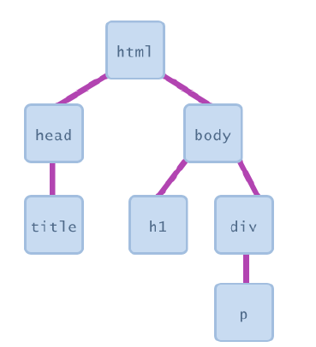
Document Object Model (DOM)
most JS code manipulates elements on an HTML page
we can examine elements' state
e.g. see whether a box is checked
we can change state
e.g. insert some new text into a div
we can change styles
e.g. make a paragraph red

Slide 26
More Javascript Syntax

Slide 27
Language Basics
JavaScript is case sensitive
onClick, ONCLICK, … are HTML, thus not case-sensitive
Statements terminated by returns or semi-colons
x = x+1; same as x = x+1
“Blocks” of statements enclosed in { …}
Variables
Define using the var statement
Define implicitly by its first use, which must be an assignment
Implicit defn has global scope, even if occurs in nested scope!

Slide 28
JavaScript Primitive Datatypes
Boolean: true and false
Number: 64-bit floating point
Similar to Java double and Double
No integer type
Special values NaN (not a number) and Infinity
String: sequence of zero or more Unicode chars
No separate character type (just strings of length 1)
Literal strings using ' or " characters (must match)
Special objects: null and undefined

Slide 29
Variables
var name = expression; JS
var clientName = "Connie Client";
var age = 32;
var weight = 127.4; JS
variables are declared with the var keyword (case sensitive)
types are not specified, but JS does have types ("loosely typed")
Number, Boolean, String, Array, Object, Function, Null, Undefined
can find out a variable's type by calling typeof

Slide 30
Number type
var enrollment = 99;
var medianGrade = 2.8;
var credits = 5 + 4 + (2 * 3); JS
integers and real numbers are the same type (no int vs. double)
same operators: + - * / % ++ -- = += -= *= /= %=
similar precedence to Java
many operators auto-convert types: "2" * 3 is 6

Slide 31
Comments (same as Java)
// single-line comment
/* multi-line comment */ JS
identical to Java's comment syntax
recall: 4 comment syntaxes
HTML: <!-- comment -->
CSS/JS/PHP: /* comment */
Java/JS/PHP: // comment
PHP: # comment

Slide 32
Math object
var rand1to10 = Math.floor(Math.random() * 10 + 1);
var three = Math.floor(Math.PI); JS
methods: abs, ceil, cos, floor, log, max, min, pow, random, round, sin, sqrt, tan
properties: E, PI

Slide 33
Special values: null and undefined
var ned = null;
var benson = 9;
// at this point in the code,
// ned is null
// benson's 9
// caroline is undefined JS
undefined : has not been declared, does not exist
null : exists, but was specifically assigned an empty or null value
Why does JavaScript have both of these?

Slide 34
Logical operators
> < >= <= && || ! == != === !==
most logical operators automatically convert types:
5 < "7" is true
42 == 42.0 is true
"5.0" == 5 is true
=== and !== are strict equality tests; checks both type and value
"5.0" === 5 is false

Slide 35
if/else statement (same as Java)
if (condition) {
statements;
} else if (condition) {
statements;
} else {
statements;
}
JS
identical structure to Java's if/else statement
JavaScript allows almost anything as a condition

Slide 36
Boolean type
var iLike190M = true;
var ieIsGood = "IE6" > 0; // false
if ("web devevelopment is great") { /* true */ }
if (0) { /* false */ } JS
any value can be used as a Boolean
"falsey" values: 0, 0.0, NaN, "", null, and undefined
"truthy" values: anything else
converting a value into a Boolean explicitly:
var boolValue = Boolean(otherValue);
var boolValue = !!(otherValue);

Slide 37
for loop (same as Java)
var sum = 0;
for (var i = 0; i < 100; i++) {
sum = sum + i;
} JS
var s1 = "hello";
var s2 = "";
for (var i = 0; i < s.length; i++) {
s2 += s1.charAt(i) + s1.charAt(i);
}
// s2 stores "hheelllloo" JS

Slide 38
while loops (same as Java)
while (condition) {
statements;
} JS
do {
statements;
} while (condition); JS
break and continue keywords also behave as in Java

Slide 39
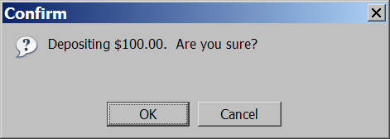
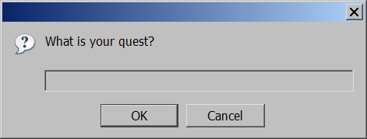
Popup boxes
alert("message"); // message
confirm("message"); // returns true or false
prompt("message"); // returns user input string JS

Slide 40
Arrays
var name = []; // empty array
var name = [value, value, ..., value]; // pre-filled
name[index] = value; // store element JS
var ducks = ["Huey", "Dewey", "Louie"];
var stooges = []; // stooges.length is 0
stooges[0] = "Larry"; // stooges.length is 1
stooges[1] = "Moe"; // stooges.length is 2
stooges[4] = "Curly"; // stooges.length is 5
stooges[4] = "Shemp"; // stooges.length is 5 JS
Notes:
two ways to initialize an array
length property (grows as needed when elements are added)

Slide 41
Array methods
var a = ["Stef", "Jason"]; // Stef, Jason
a.push("Brian"); // Stef, Jason, Brian
a.unshift("Kelly"); // Kelly, Stef, Jason, Brian
a.pop(); // Kelly, Stef, Jason
a.shift(); // Stef, Jason
a.sort(); // Jason, Stef JS
array serves as many data structures: list, queue, stack, ...
methods: concat, join, pop, push, reverse, shift, slice, sort, splice, toString, unshift
push and pop add / remove from back
unshift and shift add / remove from front
shift and pop return the element that is removed

Slide 42
String type
var s = "Connie Client";
var fName = s.substring(0, s.indexOf(" ")); // "Connie"
var len = s.length; // 13
var s2 = 'Melvin Merchant'; JS
methods: charAt, charCodeAt, fromCharCode, indexOf, lastIndexOf, replace, split, substring, toLowerCase, toUpperCase
charAt returns a one-letter String (there is no char type)
length property (not a method as in Java)
Strings can be specified with "" or ''
concatenation with + :
1 + 1 is 2, but "1" + 1 is "11"

Slide 43
More about String
escape sequences behave as in Java: \' \" \& \n \t \\
converting between numbers and Strings:
var count = 10;
var s1 = "" + count; // "10"
var s2 = count + " bananas, ah ah ah!"; // "10 bananas, ah ah ah!"
var n1 = parseInt("42 is the answer"); // 42
var n2 = parseFloat("booyah"); // NaN JS
accessing the letters of a String:
var firstLetter = s[0]; // fails in IE
var firstLetter = s.charAt(0); // does work in IE
var lastLetter = s.charAt(s.length - 1); JS

Slide 44
Splitting strings: split and join
var s = "the quick brown fox";
var a = s.split(" "); // ["the", "quick", "brown", "fox"]
a.reverse(); // ["fox", "brown", "quick", "the"]
s = a.join("!"); // "fox!brown!quick!the" JS
split breaks apart a string into an array using a delimiter
can also be used with regular expressions (seen later)
join merges an array into a single string, placing a delimiter between them

Slide 45
Number properties/methods
Number object "static" properties
Number.MAX_VALUE | largest possible number, roughly 10³⁰⁸
Number.MIN_VALUE | smallest positive number, roughly 10⁻³²⁴
Number.NaN | Not-a-Number; result of invalid computations
Number.POSITIVE_INFINITY | infinity; result of 1/0
Number.NEGATIVE_INFINITY | negative infinity; result of -1/0
Number instance methods
.toString([base]) | convert a number to a string with optional base
.toFixed(digits) | fixed-point real with given # digits past decimal
.toExponential(digits) | convert a number to scientific notation
.toPrecision(digits) | floating-point real, given # digits past decimal
global methods related to numbers
isNaN(expr) | true if the expression evaluates to NaN
isFinite(expr) | true if expr is neither NaN nor an infinity

Slide 46
The Math object
var rand1to10 = Math.floor(Math.random() * 10 + 1);
var three = Math.floor(Math.PI);
Math methods: abs, ceil, cos, floor, log, max, min, pow, random, round, sin, sqrt, tan
properties: E, PI

Slide 47
Math properties/methods
Math.E | e, base of natural logarithms: 2.718...
Math.LN10, Math.LN2, Math.LOG2E, Math.LOG10E | natural logarithm of 10 and 2; logarithm of e in base 2 and base 10
Math.PI | π, circle's circumference/diameter: 3.14159...
Math.SQRT1_2, Math.SQRT2 | square roots of ¹/₂ and 2
Math.abs(n) | absolute value
Math.acos/asin/atan(n) | arc-sin/cosine/tangent of angle in radians
Math.ceil(n) | ceiling (rounds a real number up)
Math.cos/sin/tan(n) | sin/cosine/tangent of angle in radians
Math.exp(n) | e^{n}, e raised to the nth power
Math.floor(n) | floor (rounds a real number down)
Math.log(n) | natural logarithm (base e)
Math.max/min(a, b...) | largest/smallest of 2 or more numbers
Math.pow(x, y) | x^{y}, x raised to the yth power
Math.random() | random real number k in range 0 ≤ k < 1
Math.round(n) | round number to nearest whole number
Math.sqrt(n) | square root

Slide 48
Strings
var s = "Connie Client";
var firstName = s.substring(0, s.indexOf(" "));
var len = s.length; // 13
var s2 = 'Melvin Merchant'; // can use "" or ''
String methods: charAt, charCodeAt, fromCharCode, indexOf, lastIndexOf, replace, split, substring, toLowerCase, toUpperCase
charAt returns a one-letter string (there is no char type)
length is a property (not a method as in Java)
concatenation with + : 1 + 1 is 2, but "1" + 1 is "11"
strings can be compared with <, <=, ==, !=, >, >=

Slide 49
String methods
String.fromCharCode(expr) | converts ASCII integer → String
.charAt(index) | returns character at index, as a String
.charCodeAt(index) | returns ASCII value at a given index
.concat(str...) | returns concatenation of string(s) to this one
.indexOf(str[,start]) .lastIndexOf(str[,start]) | first/last index at which given string begins in this string, optionally starting from given index
.match(regexp) | returns any matches for this string against the given string or regular expression ("regex")
.replace(old, new) | replaces first occurrence of old string or regular expr. with new string (use regex to replace all)
.search(regexp) | first index where given regex occurs
.slice(start, end) .substring(start, end) | substr. from start (inclusive) to end (exclusive)
.split(delimiter[,limit]) | break apart a string into an array of strings
.toLowerCase() .toUpperCase() | return new string in all upper/lowercase

Slide 50
More about Strings and numbers
escape sequences behave as in Java: \' \" \& \n \t \\
convert string to number with parseInt, parseFloat:
var count = 10;
var s1 = "" + count; // "10"
var s2 = count + " bananas, ah ah ah!";
var n1 = parseInt("42 is the answer"); // 42
var n2 = parseInt("0x2A", 16); // 42
var n3 = parseFloat("3.1415"); // 3.1415
var bad = parseInt("booyah"); // NaN
access the letters of a String with [] or charAt:
var firstLetter = s[0];
var firstLetter = s.charAt(0);
var lastLetter = s.charAt(s.length - 1);

Slide 51
The for loop (same as Java)
for (initialization; test; update) {
statements;
}
for (var i = 0; i < 10; i++) {
print(i + "\n");
}
var s1 = "hi, there!!!", s2 = "";
for (var i = 0; i < s1.length; i++) {
var c = s1.charAt(i);
if (c >= "a" && c <= "z") {
s2 += c + c;
}
}
// s2 stores "hhiitthheerree"

Slide 52
Logical operators
> < >= <= && || ! == != === !==
most logical operators automatically convert types:
5 < "7" is true
42 == 42.0 is true
"5.0" == 5 is true
=== , !== are strict equality tests; checks type and value
"5.0" === 5 is false

Slide 53
The if/else statement
if (test) {
statements;
} else if (test) {
statements;
} else {
statements;
}
identical structure to Java's if/else statement...
but JavaScript allows almost any value as a test!

Slide 54

Boolean type
var iLike341 = true;
var ieIsGood = "IE6" > 0; // false
if ("JS is great") { ... } // true
if (0 || "") { ... } // false
any value can be used as a test
"falsey" values: 0, 0.0, NaN, "", null, and undefined
"truthy" values: anything else
converting a value into a boolean explicitly:
var boolValue = Boolean(otherValue);
var boolValue = !!(otherValue);

Slide 55
&& and || in depth
a && b is a binary operator that returns:
if a is truthy, then b, else a
(this turns out to be a truthy/falsey value in the right cases)
a || b is a binary operator that returns:
if a is truthy, then a, else b
(this turns out to be a truthy/falsey value in the right cases)
Examples:
0 || 42 || 12 || -1 returns 42 (truthy)
NaN || null || "" returns "" (falsey)
1 + 1 && 6 && 9 returns 9 (truthy)
3 && 4 && null && 5 && 6 returns null (falsey)

Slide 56
null vs. undefined
var ned = null;
var benson = 9;
var caroline;
at this point in the code:
ned is null
benson is 9
caroline is undefined
undefined: has not been declared, does not exist
null: exists, but specifically assigned an empty value
Why does JavaScript have both of these?

Slide 57
The while loop (same as Java)
while (test) {
statements;
}
do {
statements;
} while (test);
break and continue keywords also behave as in Java

Slide 58
JavaScript keywords
break case catch continue debugger default delete do else finally for function if in instanceof new return switch this throw try typeof var void while with
Reserved words (these don't do anything yet):
class const enum export extends import implements interface let package private protected public static super yield

