Slide 1
Analyzing Official Review and User Ratings on Gamespot and Steam.com
NYC Data Science Academy
Web Scraping Project
Arthur Yu

Slide 2
Motivation
Do official reviews of games correlate with user ratings?
Does price of games influence user ratings?
Can we predict user rating of a game based on official review and price?

Slide 3
Websites
Gamespot: A video preview / review site
https://www.gamespot.com/reviews/?review_filter_type%5Bplatform%5D=19&review_filter_type%5Bgenre%5D=55&review_filter_type%5BtimeFrame%5D=&review_filter_type%5BstartDate%5D=&review_filter_type%5BendDate%5D=&review_filter_type%5BminRating%5D=&review_filter_type%5Btheme%5D=&review_filter_type%5Bregion%5D=&___review_filter_type%5Bpublishers%5D=&___review_filter_type%5Bdevelopers%5D=&review_filter_type%5Bletter%5D=&sort=date
Steam Store: An online store for video games
https://store.steampowered.com/search/?tags=9
Filtered for strategy games only

Slide 4
Scraped Data Structures
Gamespot.com:
Title
Release date
Developer(s)
Genre(s)
Gamespot rating
Number of user reviews
Average user rating
Steam.com:
Title
User Reviews
Number
Percentage positive
Price

Slide 5
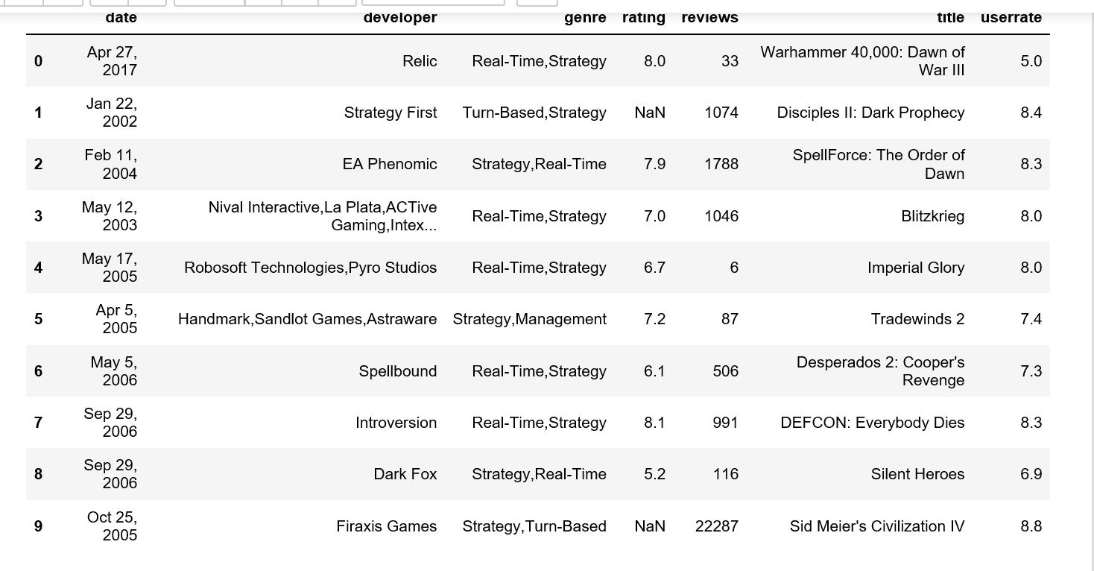
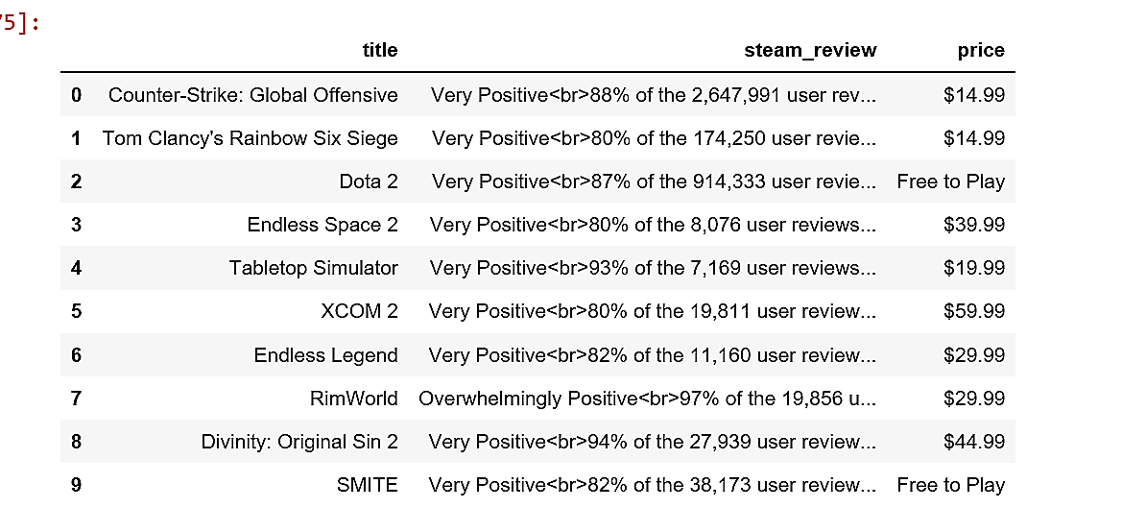
Raw Data

Slide 6
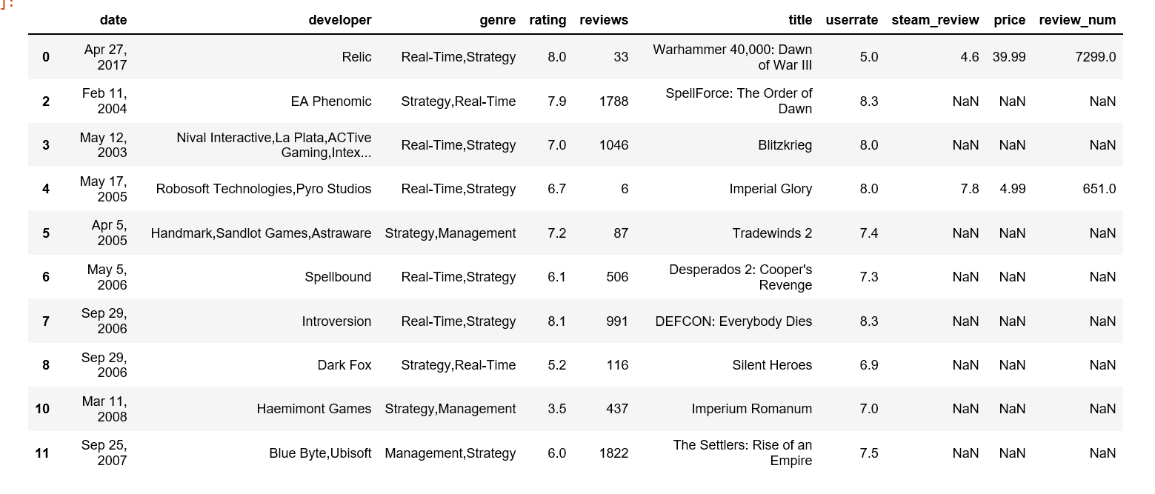
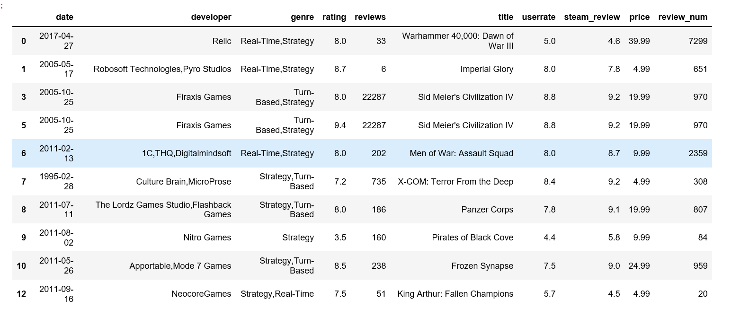
Preprocessing
Parse the Steam rating and number of reviews from string, add two columns
Turn numbers into numbers, dates into dates
Eliminate games with no Gamespot rating and Free-to-Play games
Merge two data sets

Slide 7
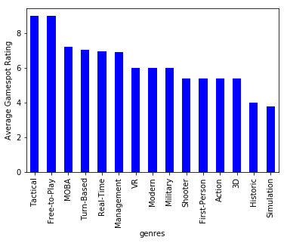
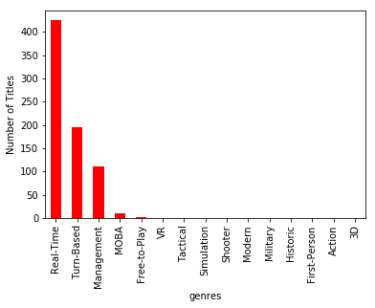
Categorical Data

Slide 8
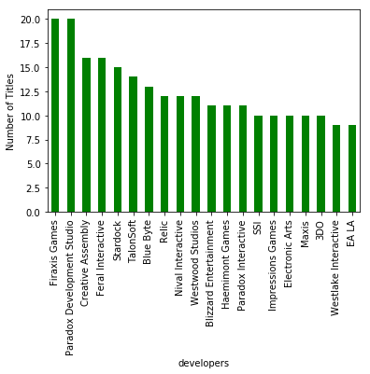
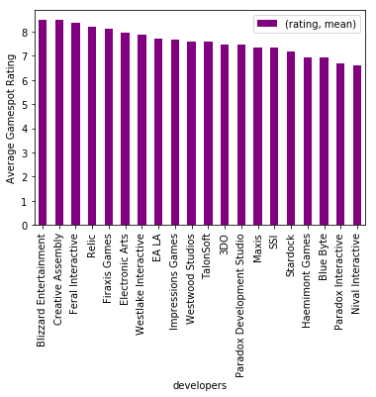
Categorical Data

Slide 9
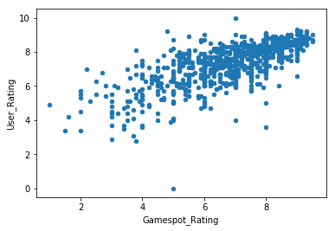
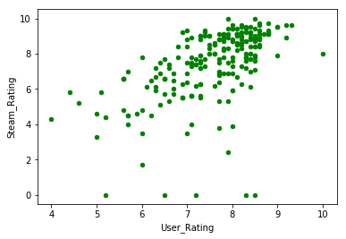
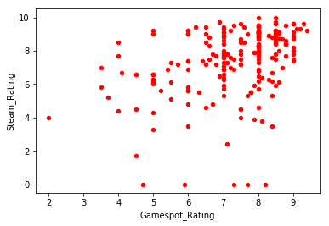
Gamespot Rating vs. User Ratings

Slide 10
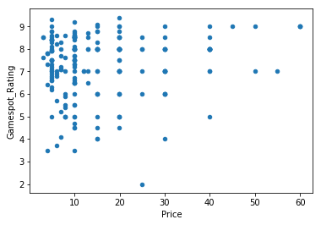
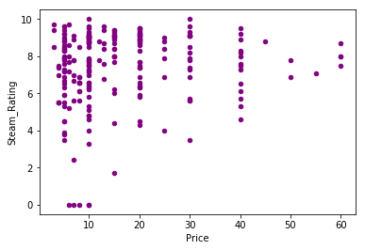
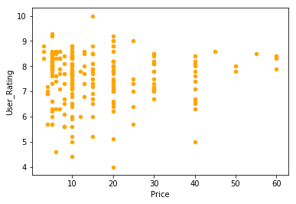
Price vs. Ratings

Slide 11
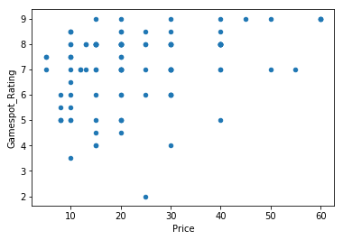
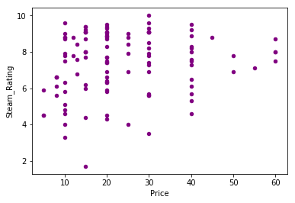
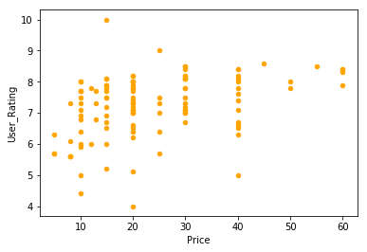
Price vs. Ratings

Slide 12
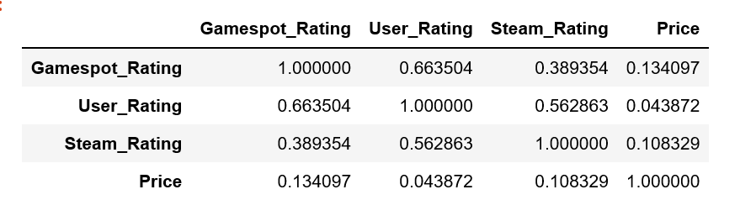
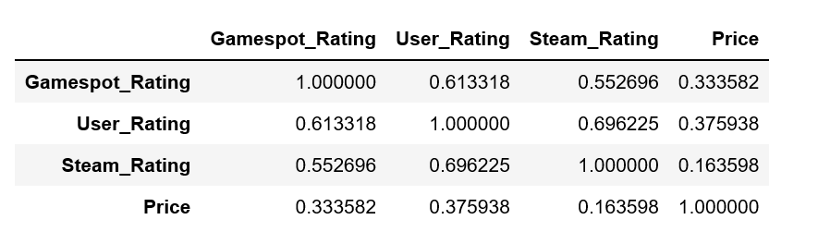
Correlations
Before Date Filter
After Date Filter

Slide 13
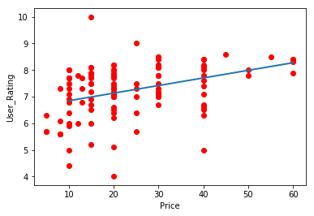
Simple Linear Model
Defined linear model function for price and user rating
Slope: 0.029
Intercept: 6.56
Defined t-test function
T-statistic: 4.29
P value: 7.26 x 10⁻⁵
Reject null hypothesis

Slide 14
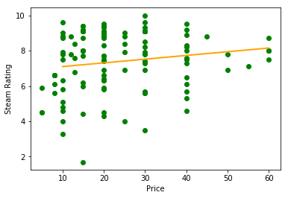
Simple Linear Model
For price and Steam rating
Slope: 0.021
Intercept: 6.89
T-test function
T-statistic: 1.755
P value: 0.086
Cannot reject null hypothesis

Slide 15
Conclusions / Future Work
Definite correlation between Gamespot rating and user rating
Steam rating is more volatile and unpredictable
Some evidence of correlation between price and user rating
More analysis on current data:
Effect of popularity (number of reviews)
Developer vs. price, genre vs. price
Not enough data to make predictive model
Not all games sold on Steam
Include more game genres
Need more complete pricing information

