Slide 1
Spectre
Alex Young

Slide 2
Part 1: Introduction

Slide 3

What is Spectre?
source: https://meltdownattack.com/

Slide 4
Who is impacted by Spectre?
All modern CPUs
Cloud-based servers

Slide 5
Why is Spectre important?
The widespread impact
Everything is ‘working as intended’
“As it is not easy to fix, it will haunt us for quite some time.”

Slide 6
When/Where was Spectre discovered?
Google Project Zero
University Researchers
Meltdown and Spectre

Slide 7
Part 2: Understanding how Spectre Works

Slide 8
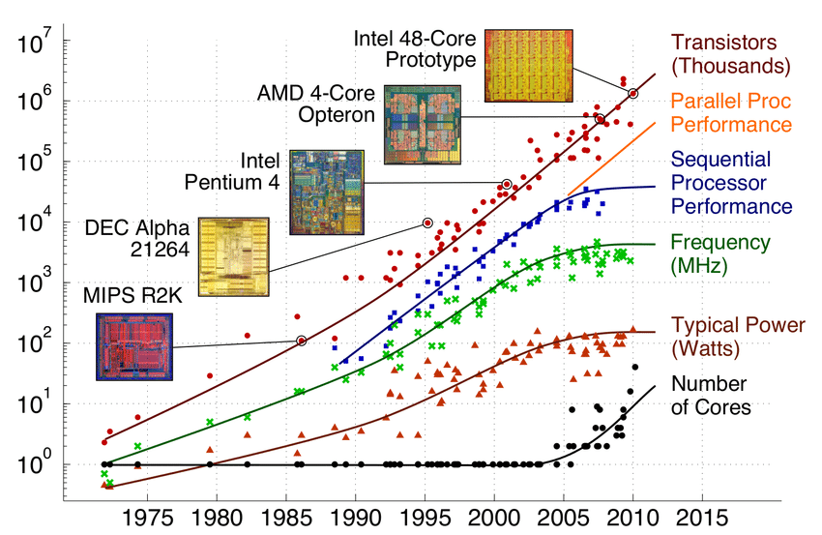
The Evolution of the CPU
source: https://www.researchgate.net/figure/Evolution-of-multi-core-processors-1_fig1_281534326

Slide 9
Out-of-order Execution
Reduce wasted clock cycles
Instructions that read from memory take more time

Slide 10
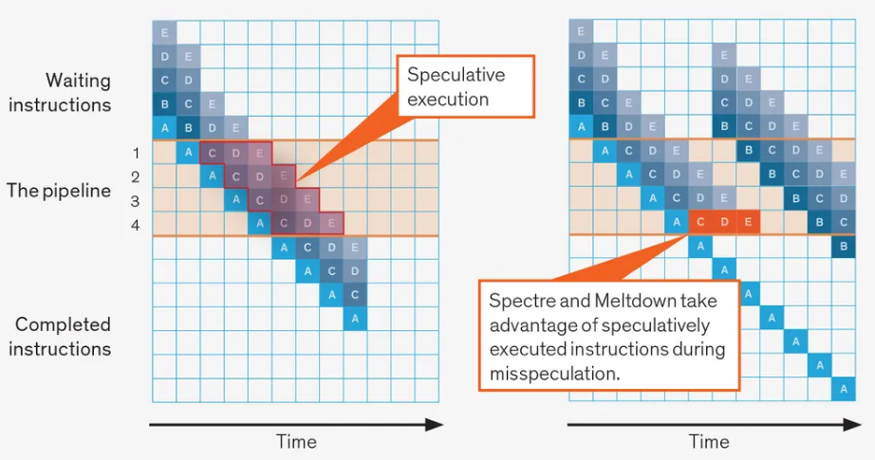
Speculative Execution
source: https://spectrum.ieee.org/how-the-spectre-and-meltdown-hacks-really-worked

Slide 11
The Cache
The CPU cache is a hardware cache used to quickly access memory
The cache can be targeted by shared resource attacks, specifically timing attacks

Slide 12
Putting it all together
Redirect speculative execution
Cache timing attack

Slide 13
Part 3: Spectre Attacks

Slide 14
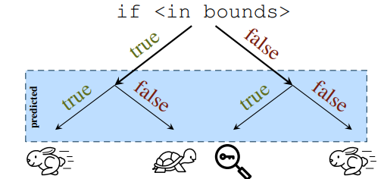
Branch Redirection
if (x < array1_size) y = array2[array1[x] * 4096]
x is initial ran using in-bounds values
x is ran using an out-of-bound location of the secret memory that we want to access
source: https://spectreattack.com/spectre.pdf

Slide 15
Flush and Reload
Flush+Reload, Evict+Reload
clflush
timing

Slide 16
Results
Can run 188 instructions (192 in buffer) ahead of instruction pointer
10 KB/s can be read

Slide 17
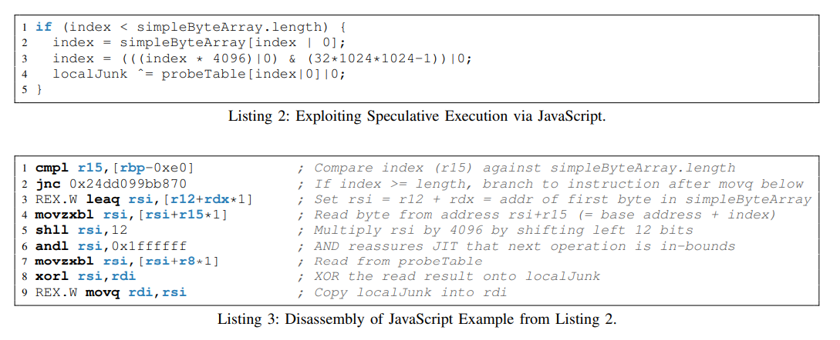
Variations
Poisoning Indirect Branches
9 more variants in 2019
Micro-Op cache
source: https://spectreattack.com/spectre.pdf

Slide 18
Part 4: Spectre Defense/Mitigation

Slide 19
Preventing Speculative Execution on Protected Data
Preventing speculative execution in general
Executing separate web pages in different processes
Using a bit mask on array indices to limit accessing out-of-bounds memory addresses

Slide 20
Further Defense
Preventing branches from being poisoned
Prevented side-channels attacks through the cache

Slide 21
Mitigation in Use
MIT DAWG
Linux KPTI

Slide 22
Part 5: Conclusion

Slide 23
Key Takeaways
Keep your software up to date
CPU design

Slide 24
Sources
https://spectreattack.com/spectre.pdf
https://spectrum.ieee.org/how-the-spectre-and-meltdown-hacks-really-worked
https://www.sciencedaily.com/releases/2021/04/210430165903.htm
https://www.techrepublic.com/article/spectre-and-meltdown-explained-a-comprehensive-guide-for-professionals/

Slide 25
Thank you for watching!

