Slide 1
Team 6 Weather and Crime in California by: James, Milad, Xavier, and Mkayambi
Is there a correlation between the weather and crime?
We have analyzed crime data from UC college campuses and the weather patterns in California.
Here is what we found!

Slide 2
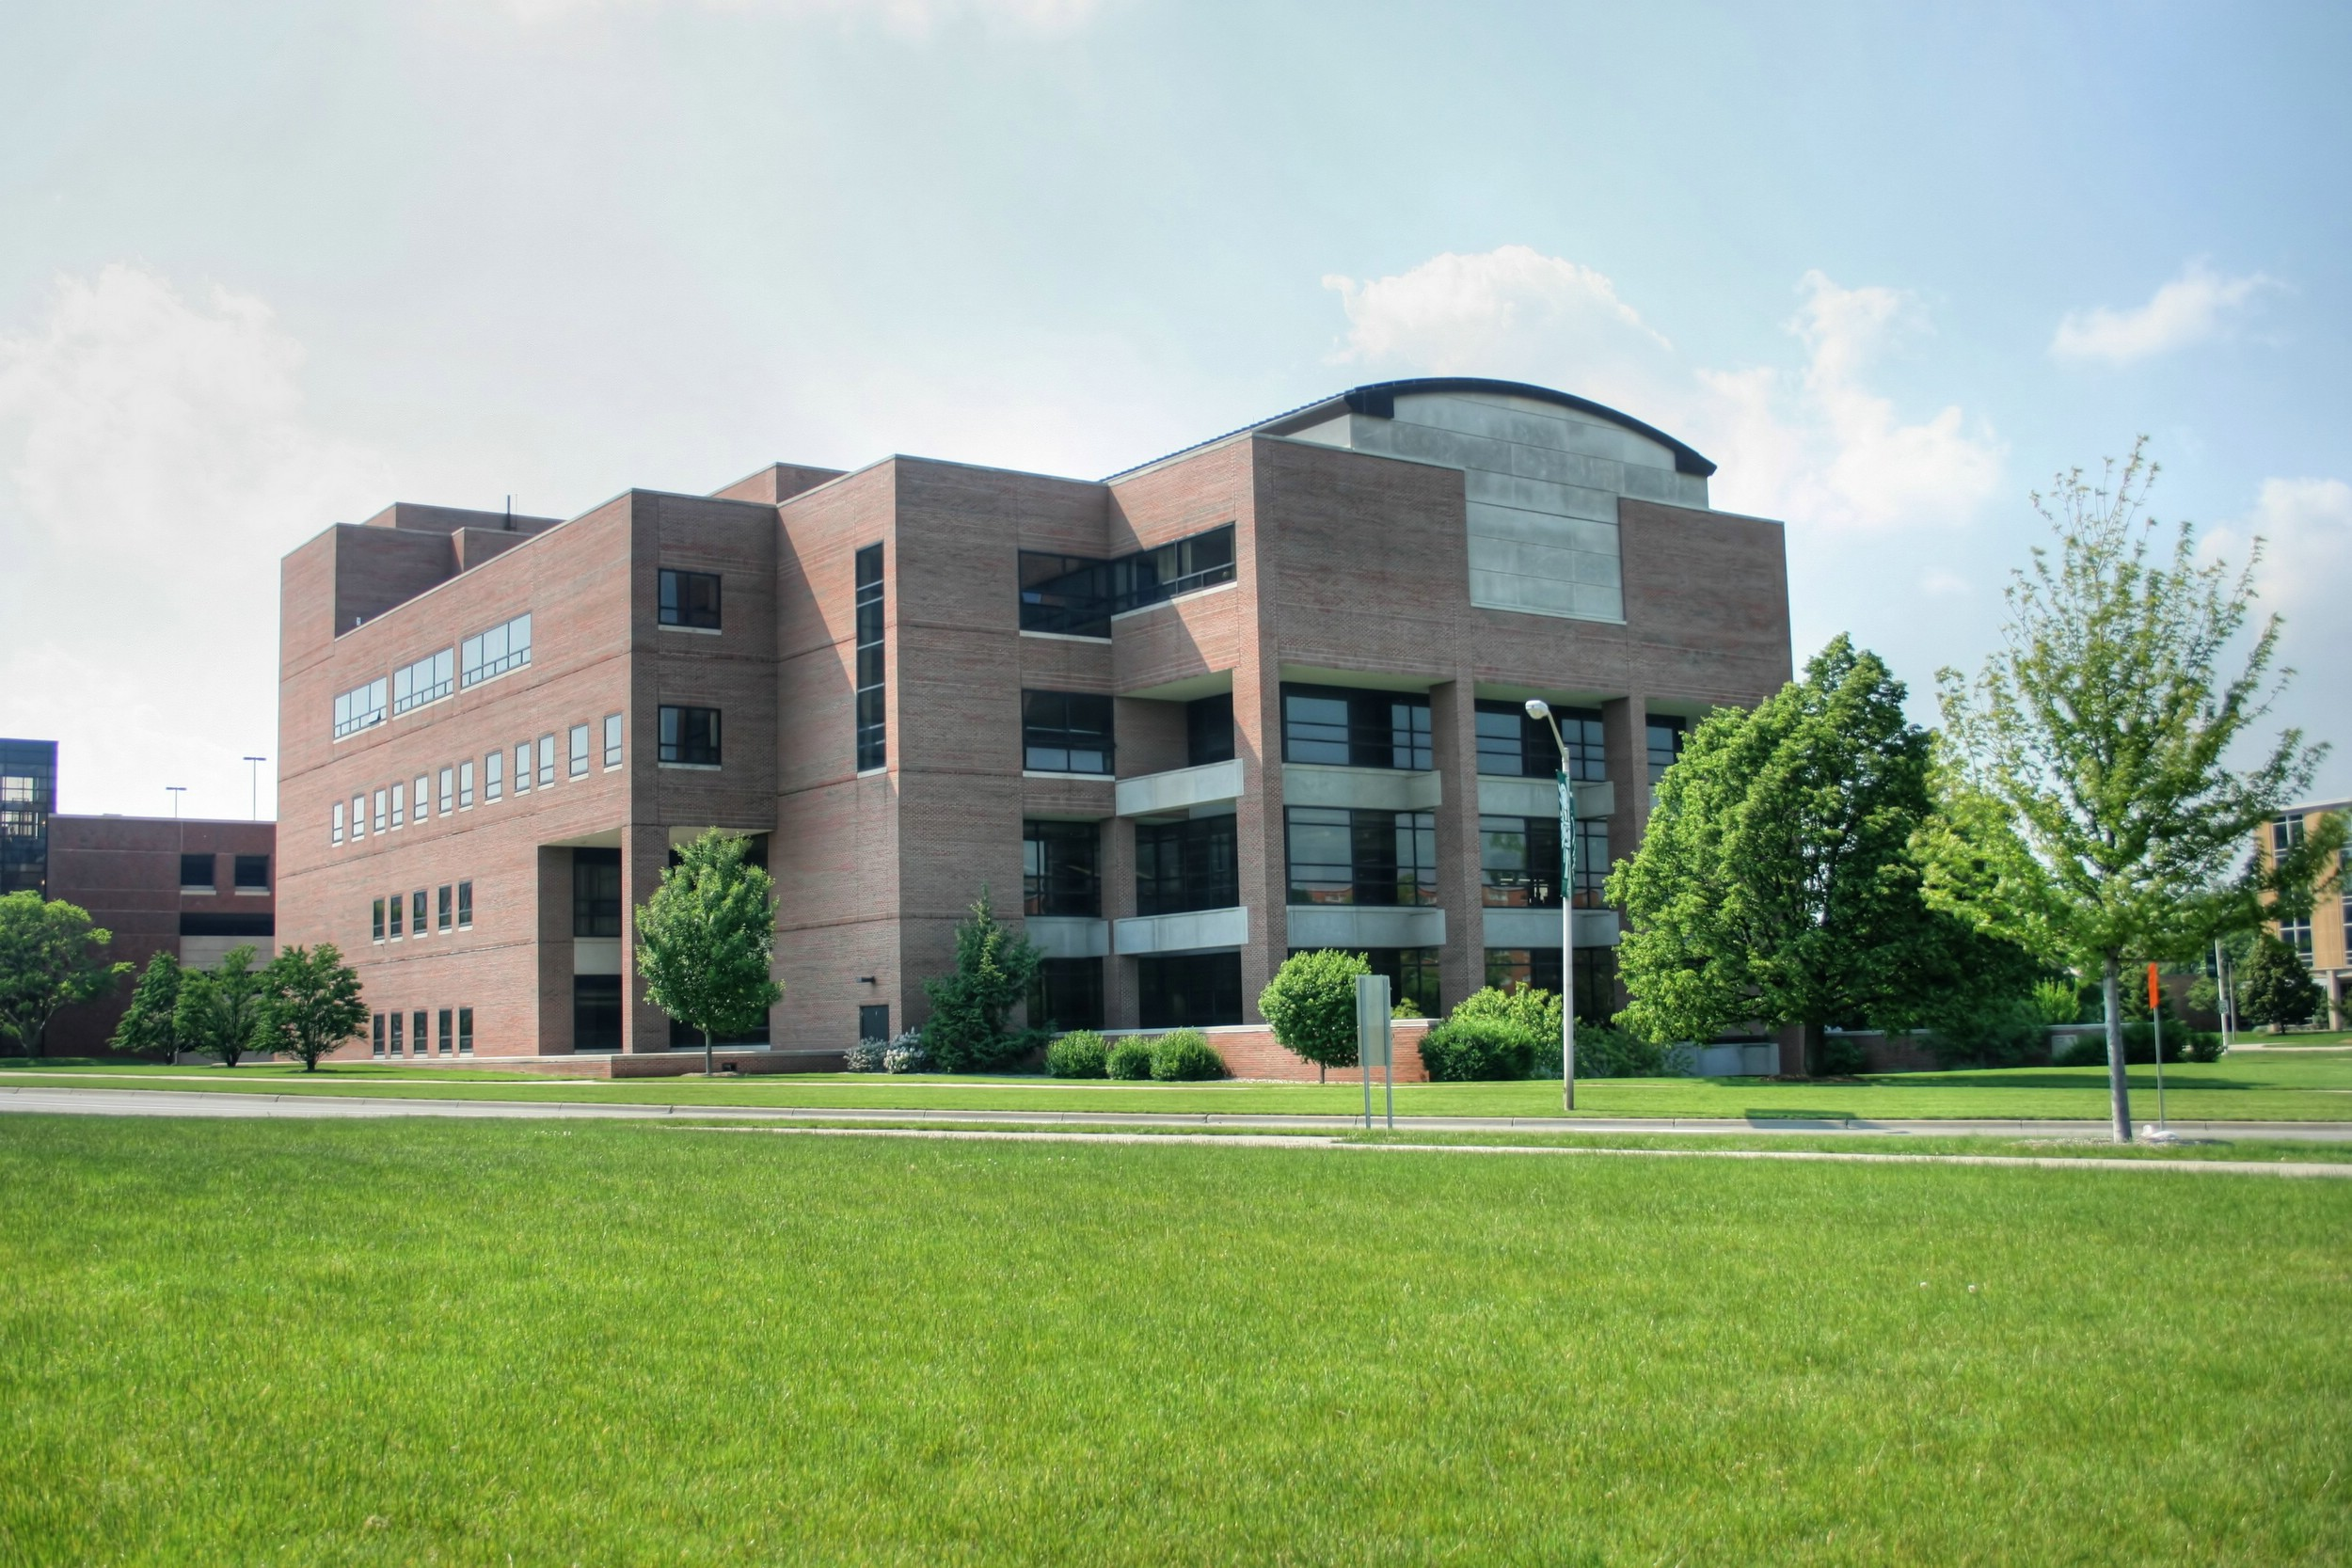
Crimes by campus
This Photo by Unknown Author is licensed under CC BY-SA

Slide 3
Crime Data by Campus
College | Student enrollment | Violent crime | Murder | Rape | Robbery | Aggravated assault | Property Crime | Burglary | Larceny-theft | Motor vehicle theft | Arson
California State University, Pomona | 23966 | 6 | 0 | 4 | 1 | 1 | 173 | 5 | 150 | 18 | 1
California State Polytechnic University,San Luis Obispo | 20186 | 3 | 0 | 2 | 0 | 1 | 163 | 7 | 149 | 7 | 1
California State University,Bakersfield | 8720 | 1 | 0 | 0 | 0 | 1 | 78 | 12 | 65 | 1 | 0
University of California,Davis | 34508 | 22 | 0 | 13 | 4 | 5 | 600 | 27 | 568 | 5 | 3
University of California,San Francisco | 3170 | 15 | 0 | 1 | 4 | 10 | 437 | 34 | 387 | 16 | 0
University of California,Berkeley | 37565 | 35 | 0 | 9 | 12 | 15 | 749 | 43 | 688 | 18 | 1

Slide 4
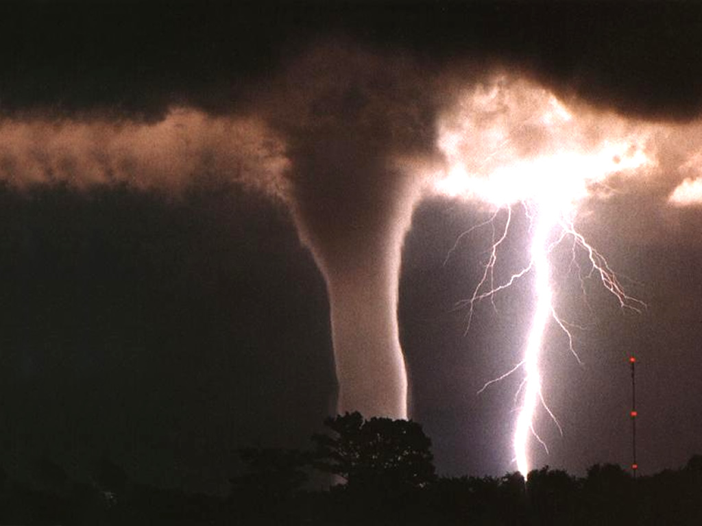
Weather
This Photo by Unknown Author is licensed under CC BY-SA

Slide 5
Weather Data Averages by Region
Region | Cloudiness (%) | Temperature (F) | Humidity (%) | Precipitation (%) | Wind Speed (mph)
Northern California | 0.3524 | 67.03 | 0.6628 | 0.01157 | 3.7376
Southern California | N/A | 74.82 | 0.6013 | 0.003891 | 2.2899

Slide 6

So what did the plots reveal?
This Photo by Unknown Author is licensed under CC BY-NC

Slide 7
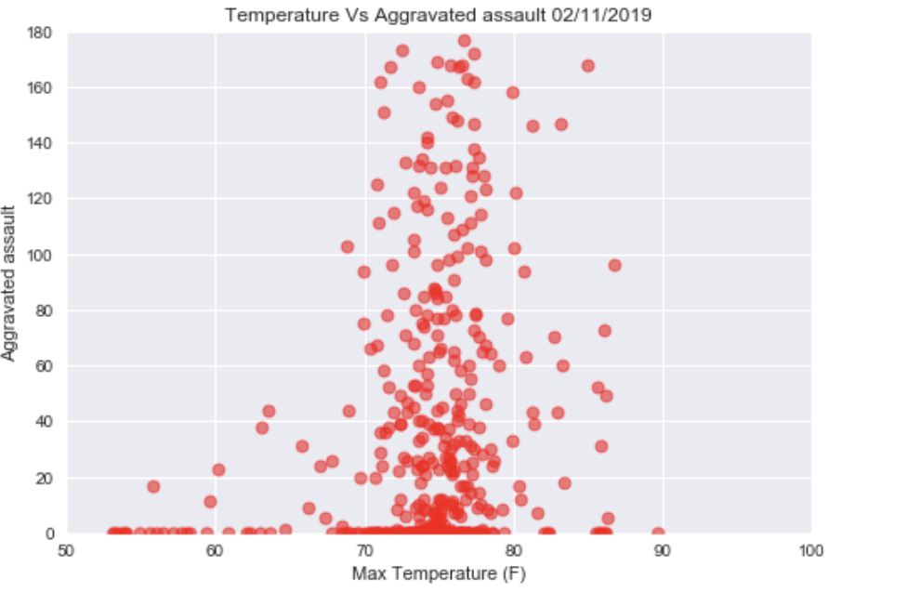
Temperature(F) vs. Assault

Slide 8
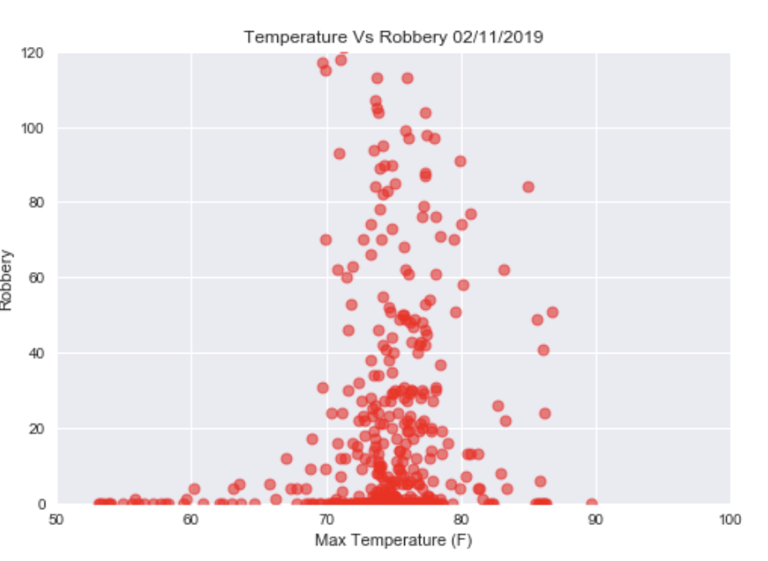
Temperature(F) vs. Robbery

Slide 9
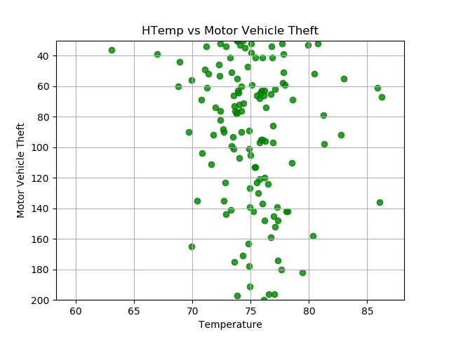
Temperature(F) vs. Motor vehicle theft

Slide 10
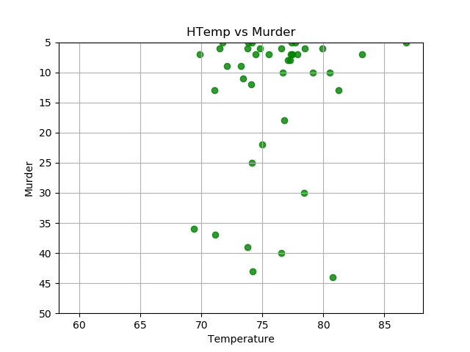
Manslaughter/Murder vs. Temperature(F)

Slide 11
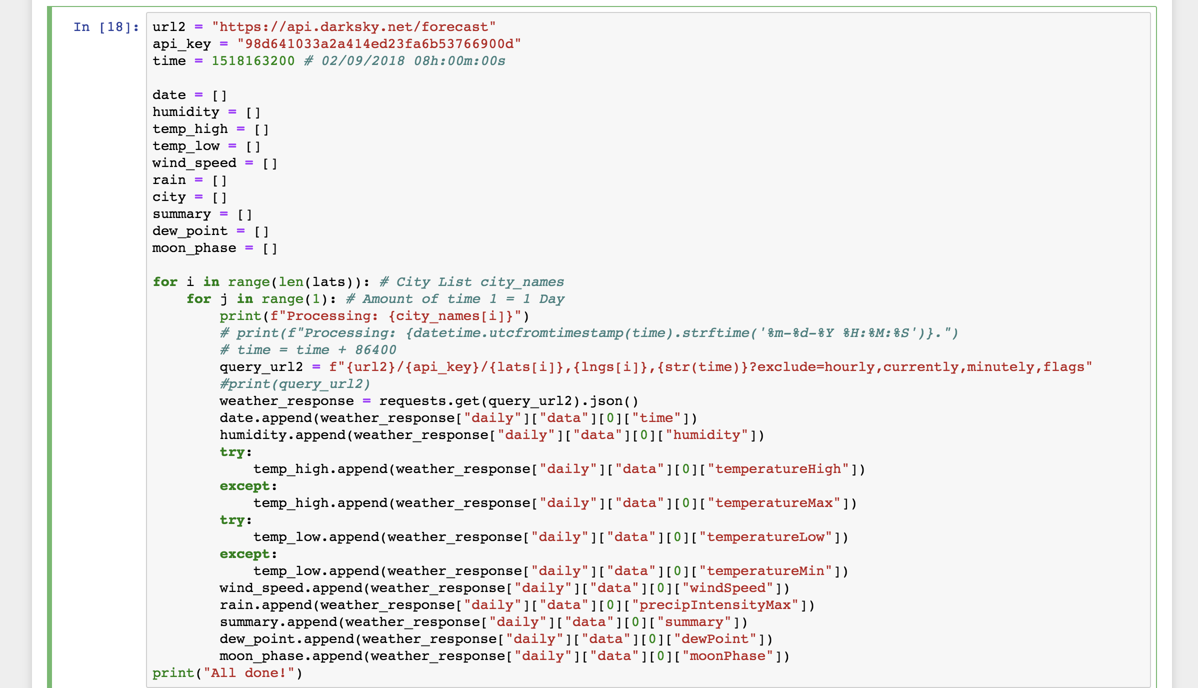
Insight of code used for weather data

Slide 12
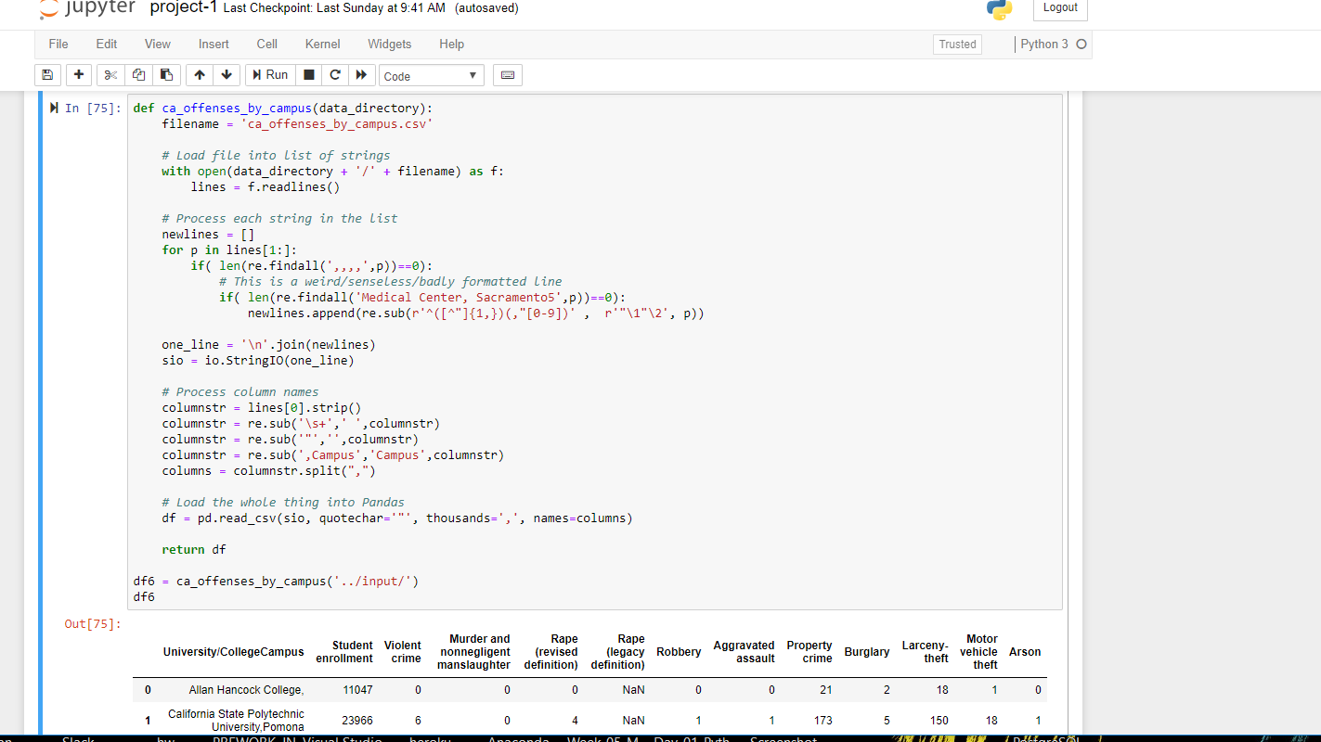
Insight of code used for crime data

Slide 13


This Photo by Unknown Author is licensed under CC BY-NC-ND

