Slide 1
Team 6 Weather and Crime in California by: James, Milad, Xavier, and Mkayambi
Is there a correlation between the weather and crime?
We have analyzed crime data from UC college campuses and the weather patterns in California.
Here is what we found!

Slide 2
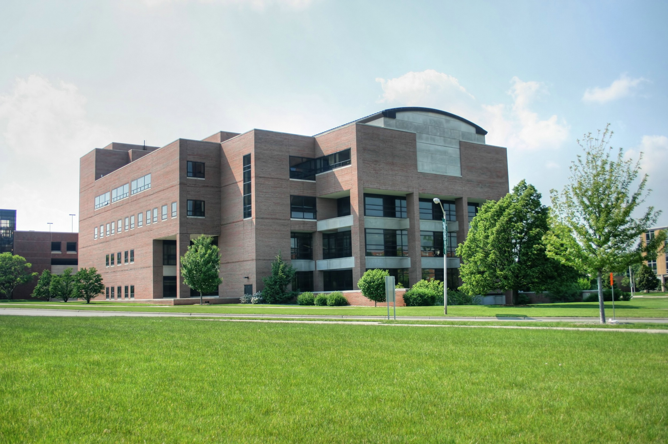
Crimes by campus
This Photo by Unknown Author is licensed under CC BY-SA

Slide 3
Crime Data by Campus
College | Student enrollment | Violent crime | Murder | Rape | Robbery | Aggravated assault | Property Crime | Burglary | Larceny-theft | Motor vehicle theft | Arson
California State University, Pomona | 23966 | 6 | 0 | 4 | 1 | 1 | 173 | 5 | 150 | 18 | 1
California State Polytechnic University,San Luis Obispo | 20186 | 3 | 0 | 2 | 0 | 1 | 163 | 7 | 149 | 7 | 1
California State University,Bakersfield | 8720 | 1 | 0 | 0 | 0 | 1 | 78 | 12 | 65 | 1 | 0
University of California,Davis | 34508 | 22 | 0 | 13 | 4 | 5 | 600 | 27 | 568 | 5 | 3
University of California,San Francisco | 3170 | 15 | 0 | 1 | 4 | 10 | 437 | 34 | 387 | 16 | 0
University of California,Berkeley | 37565 | 35 | 0 | 9 | 12 | 15 | 749 | 43 | 688 | 18 | 1

Slide 4
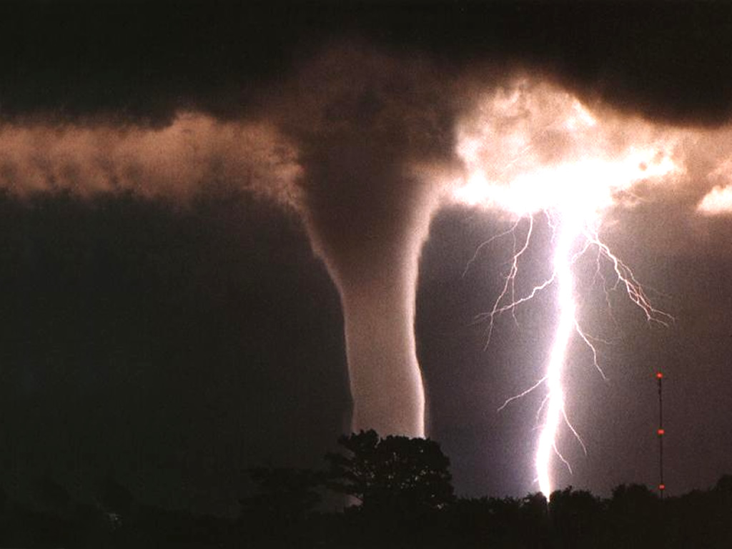
Weather
This Photo by Unknown Author is licensed under CC BY-SA

Slide 5
Weather Data Averages by Region
Region | Cloudiness (%) | Temperature (F) | Humidity (%) | Precipitation (%) | Wind Speed (mph)
Northern California | 0.3524 | 67.03 | 0.6628 | 0.01157 | 3.7376
Southern California | N/A | 74.82 | 0.6013 | 0.003891 | 2.2899

Slide 6


Based of the data. We can see that
This Photo by Unknown Author is licensed under CC BY-NC-ND

