Slide 1
Fastest Homomorphic Encryption in the West Hardware Acceleration
Master thesis presentation Jonas Bertels

Slide 2
Selecting the scheme: (B)FV vs. FHEW
Second Generation vs. Third generation

Slide 3
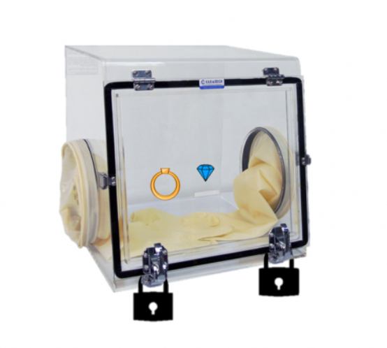
Somewhat homomorphic encryption
Notes:
Somewhat Homomorphic encryption explanation

Slide 4
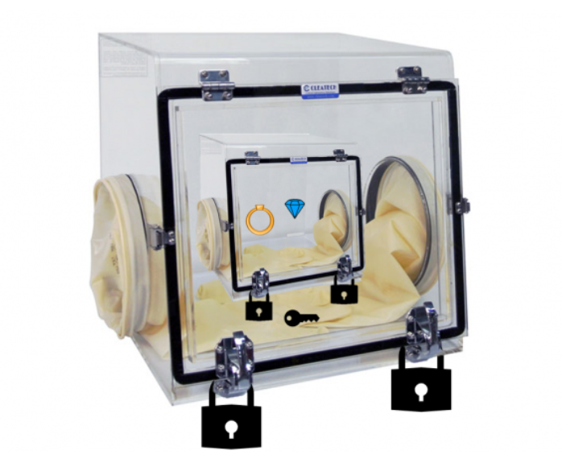
Fully Homomorphic encryption: bootstrapping
Notes:
Fully homomorphic encryption explanation

Slide 5
(R)LWE
For many vectors (a_{i},b_{i}) ϵ (R_{q}, R_{q}), b_{i} = a_{i} * s+ e_{i} with
e_{i} being a randomly sample error term
s being our secret key
a_{i} being a randomly sampled but known vector
… it is not possible to find s (“not computationally feasible” (Roy et al.))
So good public key
Notes:
So in other words, we can use this term as a good public key for s since we can’t reverse engineer the secret from the public key. And this is the case if the server spends all day requesting public keys from the user to be able to guess the secret key.

Slide 6
Second generation schemes (FV)
Addition: simple
Multiplication: not so simple
The correct result + large error term + some factors multiplied by q.
Now the result usually needs to be rescaled
And polymial*polynomial = larger order polynomial, so linearization is necessary
Notes:
Now why do we use this scheme? Because if we add the 2 ciphertexts or multiply the 2 cipherteksts, we still get the correct value after decryption! (if we’ve taken our modulus high enough).
Addition is the most straightforward: when we add, we add the 2 errors of the ciphertexts together and error growth is minimal.
Multiplication is much less straightforward. I did not write down all the terms of the multiplication, but to summarize: afterwards we need to rescale with a certain factor, and relinearize.

Slide 7
FV in SEAL
Microsoft SEAL is a homomorphic encryption library that contains FV
Tried implementing Arcsin(X/1500) *1/2 with arcsin(x) = x+x^3/6+3x^5/40
Went to CKKS
Notes:
To understand how FV actually worked and get an idea for the size of the parameters I was going to be working with, I installed micrsoft SEAL, a library for homomorphic encryption. I tried implementing a simple function (for calculating the angle you have to fire something at to reach a certain distance, which means calculating an arcsin, which can be approximated using a taylor expansion). Because there is no bootstrapping, it is necessary to determine in advance what size of polynomial coefficients will be for every multiplication done to calculate the polynomial series. Additionally, as the TA’s told me and I also found out by trying, it is hard to floating point operations with integers, when rescaling has to be done after every multiplication, requiring another multiplication with a constant factor.

Slide 8
Summary
Good for SIMD
Not good for depth of multiplications
Somewhat inflexible
Bootstrapping exists, but not practical to implement (i.e. bootstrapping in less than a second does not seem to exist for second generation)
Notes:
This required about a 100 lines of code for a rather simpel formula. It executed fairly quickly, and both FV and CKKS are good at allowing Single Instruction, Multiple Data, but as can be seen from this example, they only allow for a limited amount of computations, and algorithms that are already out there and require a lot of instructions will thus not easily translate in to programs that can homomorphically execute data.
They are however good at doing homomorphic encryptions for a given, low-depth application. This can also be seen in a hardware acceleration for the Fan-Vercauteren scheme done by COSIC in 2018. This implementation could do FV very quickly, at 400 homomorphic multiplications per second, but is limited to a multiplicative depth of 4. This is enough for a lot of applications, but can limit its flexibillity in a general role.

Slide 9
FHEW (Fastest Homomorphic Encryption in the West)
One NAND gate
Bootstrap immediately
137ms for 128 bit security for 1 NAND + bootstrap
No limit on function execution
Notes:
FHEW, called that way as a reference to the Fastest Fourier Transform in the West library, is part of the so-called third generation schemes. It attempts to tackle the long length of the bootstrapping process by only executing one NAND gate (other simple gate functions are also possible) and then immediately bootstrapping.This makes it a true fully homomorphic scheme, as the bootstrapping can actually be done within a reasonable amount of time, namely 137miliseconds for NAND + bootstrap for 128 bit security on a intel i7. In other words, while only one NAND gate can be done at a time (later papers show parellisation is possible), there is no limit on the depth of our circuit, and as all functions can be written as a combination of logic gates, no limit on the functions that can be executed.

Slide 10

LWE
LWE ciphertexts: (a, b) with
With q = 512 and n = 512, so a is a 512x1 vector with elements modulo 512 and b is an integer modulo 512
Start with 2 LWE ciphertexts, end with 1 LWE
Notes:
LWE ciphertexts look as follows and standard parameters are given. If we simply wanted to decrypt, we would calculate b-<a,s> and retreive our message through rounding, but this requires a secret key and gives us our result, which the server isn’t supposed to have.

Slide 11
High level explanation
We start with a ciphertext encrypted under a certain scheme (like LWE)
We decrypt the scheme to remove the noise (rounding removes noise)
But while we decrypt, we encrypt it under another scheme (RLWE) using encrypted secret keys

Slide 12
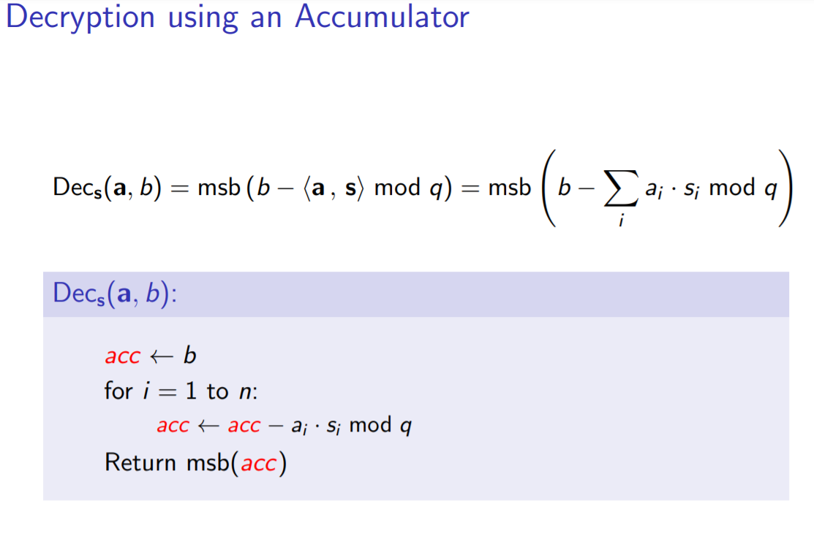
Notes:
Then we need to bootstrap: remember, bootstrappping is doing decryption operations homomorphically, i.e. doing the decryption operations with an encrypted secret key. This reduces the noise back down to the original level, completing our algorithm.

Slide 13
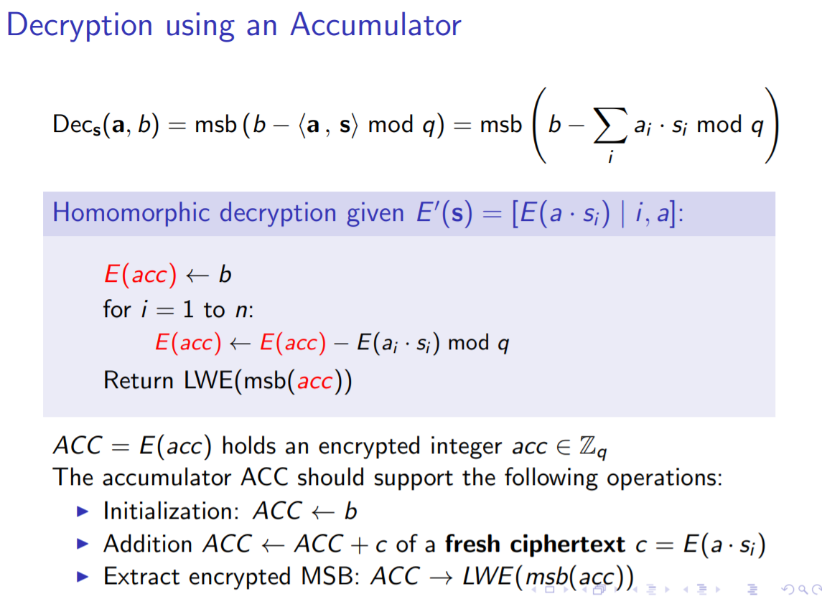
Notes:
Then we need to bootstrap: remember, bootstrappping is doing decryption operations homomorphically, i.e. doing the decryption operations with an encrypted secret key. This reduces the noise back down to the original level, completing our algorithm.

Slide 14
Intermezzo: why am I choosing this?
Flexible because fully homomorphic
Speed up is necessary
No hardware implementation yet (for FHEW or TFHE)
GPU implementations have been made (NNT implementations: 0.35 ms/bit for TFHE)

Slide 15
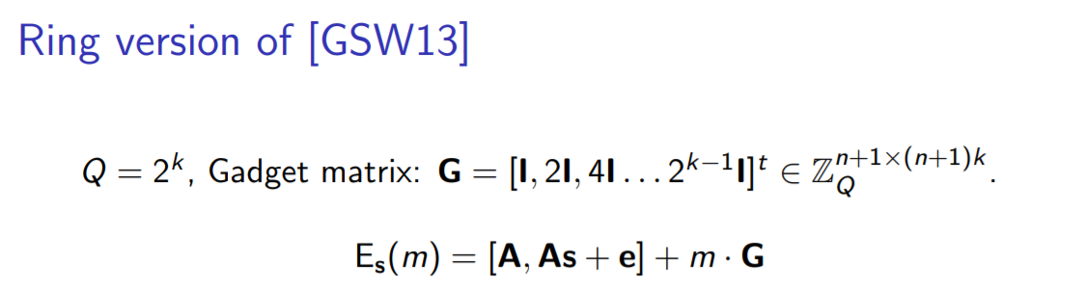
RGSW (a matrix)
Our Secret Keys are encrypted in yet another scheme: RGSW
Notes:
Now LWE is less efficient than RLWE so we take the input and turn it into RLWE. We also encrypt our secret keys using RGSW, which is a scheme that encrypts a message as 27 RLWE encryptions of 0, with message multiplied with shifted unity matrix 27 times. Q is a 27 bit prime. In our scheme, rather than multiplication with 2, we are multiplying with B_{r} =23, but this is simply an optimization and you can forget that.

Slide 16
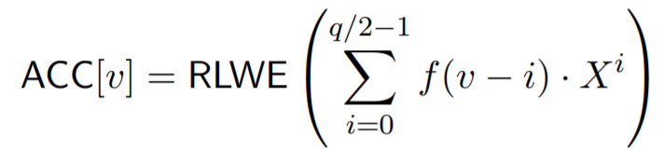
Initialize as encrypted Look-up table
9 | 8 | 7 | 6 | 5 | 4 | 3 | 2 | 1 | 0
0 | 0 | 0 | 0 | 0 | -f(4) | f(0) | f(1) | f(2) | f(3)
Notes:
Our function f is a rounding function that also computer part of the NAND gate before it rounds. We create a look-up table which represents our function. , so we can still do operations on the table such as rotations.
The v that you see here is the LWE value that we are decrypting.

Slide 17
Accumulation
9 | 8 | 7 | 6 | 5 | 4 | 3 | 2 | 1 | 0
0 | 0 | 0 | 0 | 0 | -f(4) | f(0) | f(1) | f(2) | f(3)
9 | 8 | 7 | 6 | 5 | 4 | 3 | 2 | 1 | 0
0 | 0 | -f(4) | f(0) | f(1) | f(2) | f(3) | 0 | 0 | 0
We rotate the RLWE encryption of the LUT by multiplying with the secret key matrix.
Notes:
What we return, namely (0, m) is a noiseless RLWE with an a that’s equal to 0. But it is an RLWE encryption so we can do operations with this and add noise.

Slide 18

Parameters
Most challenging: matrix-vector polynomial ring multiplication
Matrix: 1025x(3075)
Vector: 1025
Modulus Q: 27 bit prime
A case for NTT (2*(1-1/23)*512*2*(3+1)) = 7836 NTT’s
Notes:
With the matrix in this case having dimension 1025*6150 and the vector having dimension 1025. The only way to do this efficiently is to use the numerical fourier transform and the modulus of the values we’re multiplying being 27 bit.
The Br in this slide might become larger, as it increases the size of the bootstrapping key and the memory overhead from the bootstrapping key might become more important than the impact of doing a few more NTT. (If questions: d_{r} = log(q)/log(B_{r}) and d_{g} = log(d_{g}) / log(B_{g})

Slide 19
Hardware implementation changes
“SignedDigitDecompose is a bottleneck operation”
As an optimization, FHEW can decompose RGSW in base B_{r} = 23 or another base
Base B_{r} breaks integers mod Q into digits
Easier in HW with B_{r} = 2^n
Lower B_{r} means lower size bootstrapping key but more NTT’s
The tradeoff will shift after NTT becomes faster, so set B_{r} = 2

Slide 20
NTT multiplication

Slide 21
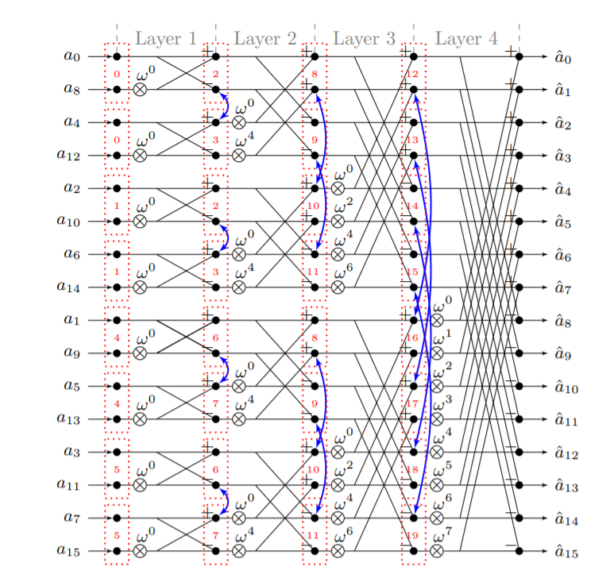
Notes:
Numeric-Theoretic Transform is a number theory variant of the fast fourier transform that allows us to do polynomial multiplications in n/2log(n) time.

Slide 22
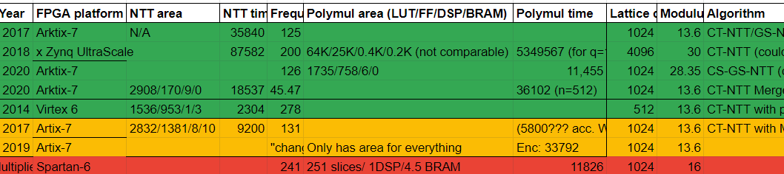
Latest NTT hardware implementations
Notes:
We’re looking for a lattice constant of 1024
Not going to do it from scratch
These are open source, we select the one which works for a modulus constant large enough, namely 28.65 bit, and implement that

Slide 23
Parameterized Hardware Accelerators for Lattice-Based Cryptography and Their Application to the HW/SW Co-Design of qTESLA (2020)
Artix-7
CS-NTT and GS-NTT⁻¹ but unify (no bit reversal)
n/2 · log2 (n) per NTT
(n, q)= (1024, 343576577)
11, 455 cycles @ 126 MHz for 1 polynomial multiplication
Uses Roy’s 2014 memory optimization
Very parametrized, so allows be used for multiple parameter sets

Slide 24
Parameterized Hardware Accelerators for Lattice-Based Cryptography and Their Application to the HW/SW Co-Design of qTESLA
Modulus reduction can be optimized (works for any q = 1mod 2n, uses Montgomery reduction)
Used 32 bit memory interface bus (very conservative)
“users can also improve the performance further by using a specialized bus or interconnect”

Slide 25
