Slide 1
Compact Ring-LWE Cryptoprocessor
Jonas Bertels

Slide 2
My Design
Protecting the channel and considering the user to also be the attacker

Slide 3
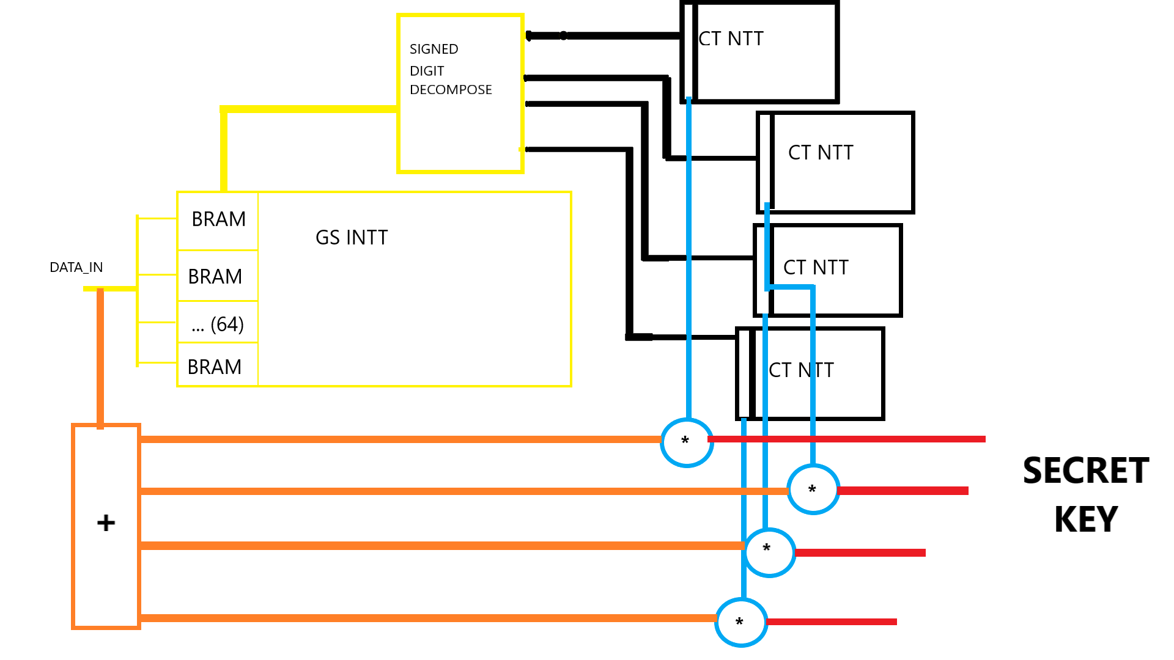
The old model: but attacker has quantum computer
Notes:
2 big reasons for RLWE right now:
1) RLWE is resistant to attacks by quantum computers, as opposed to classical cryptographic schemes, where this is not the case. It can be proven that to break cryptography based on LWE or RLWE, an attacker would also be able to break other more fundamental problems, and we assume that since the latter cannot be broken the former can also not be broken.£
Don’t prove hardness, but prove that it is equally hard as some know hard problem.
Examples are NewHope. We call these application Post-Quantum cryptography because they are meant to guarantee the future of crypto after quantum computers become strong enough to break standard cryptograpy.

Slide 4
BRAM TWICE AS LARGE?

Slide 5
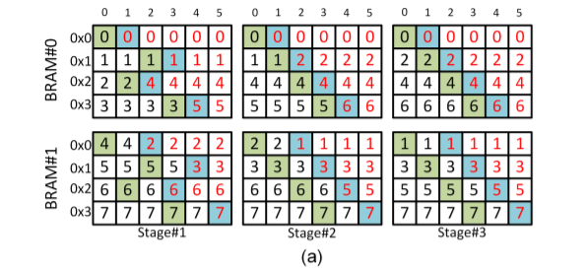
BRAM: 1 PE, RINGT_DEPTH=3
Notes:
We use a variant of LWE called Ring LWE, because this provides more efficient calculations.
The problem we are now faced with when using LWE is that we need to do very large polynomial multiplications.
If we want our fancy cryptography schemes to be used in the real world, we need to make them energy efficient and fast.
The hardware designers here will now that to make something efficient you can trade off the flexibility of a CPU for the efficiency of a custom coprocessor.
This allows you to benefit maximally from the inherent parallelism of doing operations like multiplication with large polynomials.
In this case the coprocessor was implemented on a FPGA.

Slide 6
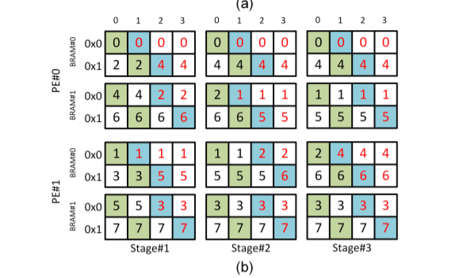
BRAM: 2 PE’s: RING_DEPTH = 3

Slide 7
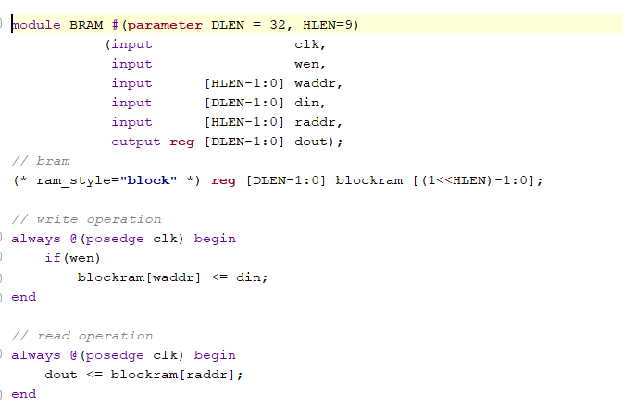
BRAM itself?

