Slide 1
Microprocessor Design
TAs: Sebastian Giraldo, Linyan Mei,
Jasper Marien, Nathan Laubeuf

Slide 2
Outline
Objectives of the sessions
Tools used
Architecture
Loading Programs
Exercises

Slide 3

Objective
Design a microprocessor in RTL (Verilog) using 32 nm technology
Evaluate different microarchitectures
Single Cycle Processor
Single Cycle Processor
(with Multiplication support)
Pipelined Processor
(without Data-Hazard resolution)
Pipelined Processor
(with Data-Hazard resolution)
Compare
Performance
Hardware Resources

Slide 4

Objective
Optional:
Single Cycle Processor (Not Functional)
Single Cycle Processor
Single Cycle Processor (Multiplication support)
Pipelined Processor
Pipelined Processor (Data-Hazard resolution)
Optimized
Pipelined Processor (Optional techniques)
SIMULATION + SYNTHESIS
reports
Comparison of Microarchitectures

Slide 5
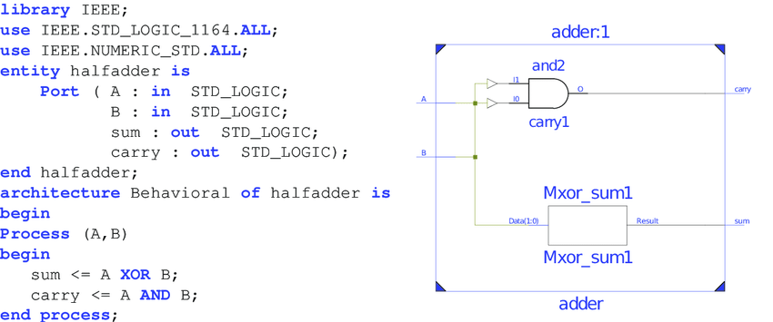
Tools used
Simulation: NC Verilog (Cadence)
“Check the correctness of the hardware description implemented”
Synthesis: Design Vision (Synopsys)
“Convert a hardware description into physical gates”

Slide 6
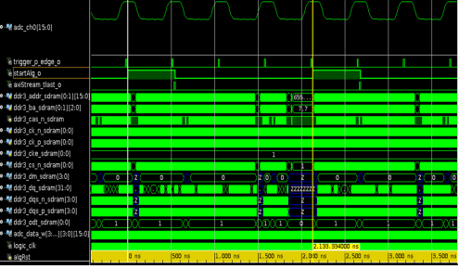
Tools used: Simulation
Script to be loaded: incisiv_15.20.058.rc
Command used: make nc_gui or make nc
Testbench (cpu_tb.v)
NC Verilog
Hdl files
Simulation Results

Slide 7
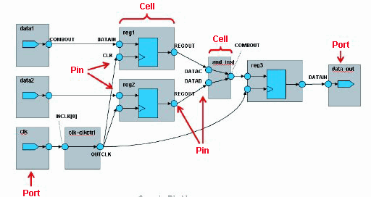

Tools used: Synthesis
Scripts to load tool: synopsys_2017.09.rc
Command used: source synthesis.sh
Libraries (lib)
Constraints (sdc)
Netlist
Design Vision
HDL files
Area/Timing/Power Reports

Slide 8
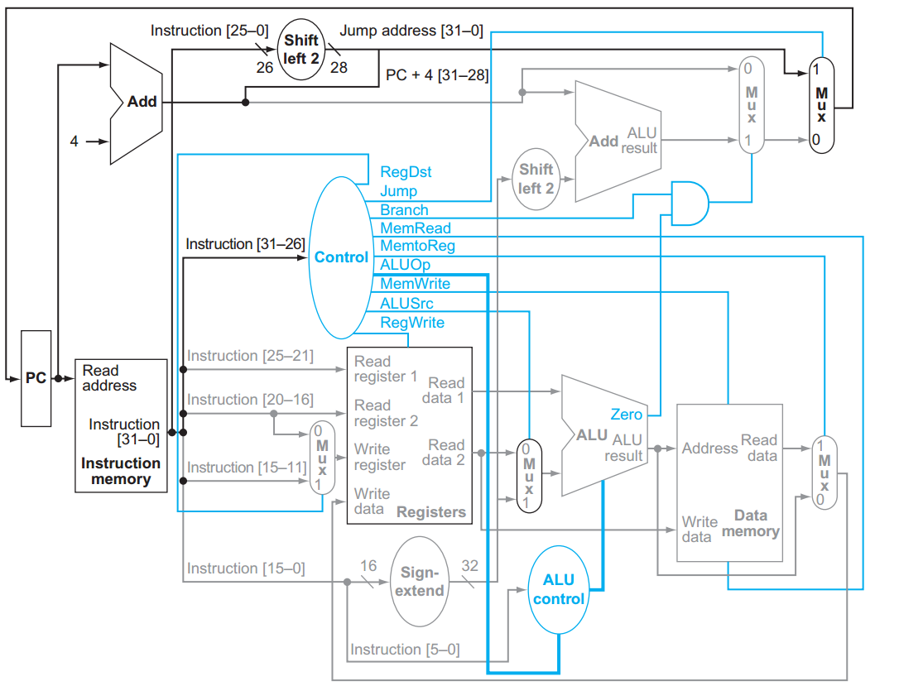
Architecture Used
Single Cycle Processor

Slide 9
Architecture Used
cpu_tb
cpu
control_unit
program_
counter
register_file
branch_unit
alu
alu_ctrl
instruction_
memory
data_memory
regfile_dest_mux
alu_operand_mux
regfile_data_mux

Slide 10
Architecture Used
Control unit
File: control.v

Slide 11
Architecture Used
Register file
File: register_file.v

Slide 12
Architecture Used
Program counter (PC)
File: pc.v
(Be careful, there is
more logic)

Slide 13
Architecture Used
Branch unit
File: branch_unit.v

Slide 14
Architecture Used
ALU
File: alu.v

Slide 15
Architecture Used
ALU control
File: alu_control.v

Slide 16
Architecture Used
Instruction memory
File: sram.v
Data memory
File: sram.v

Slide 17
Architecture Used
Regfile_dest_mux File:mux_2.v
Alu_operand_mux File: mux_2.v
Regfile_data_mux File: mux_2.v

Slide 18
Programs
MIPS language
2 extra instructions
NOP (opcode: 111111)
STOP (opcode: 111110)
5 programs
Simple_program
MULT1
MULT2
MULT3
OPTIONAL
How to load a program?
Go to SIM/data and modify
Imem_content.txt
Dmem_content.txt

Slide 19
Programs
Functions of Testbench (cpu_tb.v)
cpu_tb
dmem_content
Stimulation Logic
CPU
imem_content
Design Vision
Loading Data Memory
Loading Instr. Memory
Design Vision
Execution
Check
Start of Program
End
of Program

Slide 20
Programs
simple_program
addi $s0, $0, 7
addi $s1, $s0, 2
sw $s1, 0($0)
lw $s2, 0($0)
add $s3, $s0, $s2
beq $s1,$s2, FINAL
add $s4, $s0, $s1
FINAL: add $s4, $s2,$s3
a = 7
b = a + 2
save a
c = load a
d = a + c
if b != c:
e = a + b
else:
e = c + d

Slide 21
Programs
mult1
When there is no hardware support multiplication:
1 1 0
X 1 0 1
1 1 0
0 0 0
1 1 0
1 1 1 1 0
The same as the sum of:
110 (Shifting “110” by 0 positions)
0000 (Shifting “000” by 1 position)
11000 (Shifting “110” by 2 positions)
Algorithm:
Acc = 0
N = operand1
Traverse each bit of operand2 (LSB -> MSB)
If the bit of operand2 is 1, accumulate. Acc = Acc + N.
If the bit is 0, Acc = Acc.
Left shift N by 1 position.

Slide 22
Instr. Memory
Data Memory
1
2
3
4
5
6
7
8
9
a
Programs
add $20, $20, $22
SHIFTING_0: sll $22, $22, 1
sll $19, $19, 1
addi $23,$23,-1
beq $23, $0, M2
j LOOP_0
M2: add $9, $9, $20
addi $16, $16, -8
addi $8, $8, 8
beq $16, $0, FINISH
j M1
FINISH:
addi $16, $0, 40
addi $8, $0, 0
addi $9, $0, 0
M1: lw $17, 0($8)
lw $18, 4($8)
addi $23, $0, 32
addi $19, $0, 1
addi $20, $0, 0
add $22, $0, $17
LOOP_0: and $21, $18, $19
beq $21, $0, SHIFTING_0
mult1
It makes 5 multiplications with 10 integers.
The results are summed together.
** based on addition and shifting
$16: Total size of data memory
$8: Data Memory Pointer
$9: Final result
$17: Operand 1
$18: Operand 2
$23: Iteration over the num of bits (32)
$19: 0x00000001 under left shifting (mask)
$20: Accumulated result of each partial sum
$22: Operand 1 under left shifting
$21: Current bit of operand 2

Slide 23
Instr. Memory
Programs
lw $8, 0($0)
lw $9, 4($0)
lw $10, 8($0)
lw $11, 12($0)
lw $12, 16($0)
lw $13, 20($0)
lw $14, 24($0)
lw $15, 28($0)
lw $16, 32($0)
lw $17, 36($0)
Data Memory
1
2
3
4
5
6
7
8
9
a
mult2
mult $18, $8, $9
mult $19, $10, $11
mult $20, $12, $13
mult $21, $14, $15
mult $22, $16, $17
addi $23, $0, 0
nop
nop
nop
add $23, $23, $18
nop
nop
nop
add $23, $23, $19
nop
nop
nop
add $23, $23, $20
nop
nop
nop
add $23, $23,$21
nop
nop
nop
add $23, $23,$22
** Using of mult instruction

Slide 24
Instr. Memory
Programs
lw $8, 0($0)
lw $9, 4($0)
lw $10, 8($0)
lw $11, 12($0)
lw $12, 16($0)
lw $13, 20($0)
lw $14, 24($0)
lw $15, 28($0)
lw $16, 32($0)
lw $17, 36($0)
Data Memory
1
2
3
4
5
6
7
8
9
a
mult3
addi $23, $0, 0
add $23, $23, $18
add $23, $23, $19
add $23, $23, $20
add $23, $23,$21
add $23, $23,$22
mult $18, $8, $9
mult $19, $10, $11
mult $20, $12, $13
mult $21, $14, $15
mult $22, $16, $17
** Using of mult instruction
** No NOPS between
data-dependent
instructions

Slide 25
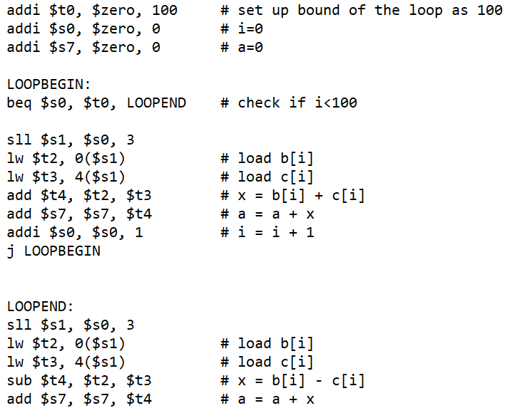
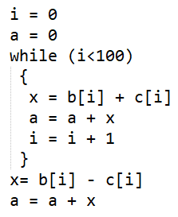
Instr. Memory
Programs
Data Memory
0
1
2
3
4
5
6
7
8
9
0
1
2
…
optional

Slide 26
Exercise
(testing programs)
Session 1:
Complete Single Cycle Processor (simpleprogram, mult1)
Add support for Multiplication (simpleprogram, mult1, mult2)
Session 2:
Pipelined Processor (without data-hazard resolution)
(simpleprogram, mult2)
Session 3:
Pipelined Processor (with data-hazard resolution)
(simpleprogram, mult2, mult3)
[Optional] Performance Optimization (SIMD, control-hazard detection, hardware loop counter, …)
(simpleprogram, mult2, mult3, optional)

Slide 27
REMARKS
The assignments must be completed in groups of 2 people.
Important: Make sure at least one student in a group has Verilog experience.
After completing each one of the exercises, the result must be shown to the TAs for its correspondent evaluation.
You will hand in the final version of the code together with a small report based on the template that you find in the folder. This counts for 2 points in the final H05d3A grade.
This report should be handed in through Toledo by April 10th, 2020.

