Slide 1
P&D Electronics and Chipdesign GMSK100
Group 4:
Jonas Bertels
Jasper Depuydt
Ruben Heyrman
Ziyu Zhou
Midterm Presentation

Slide 2
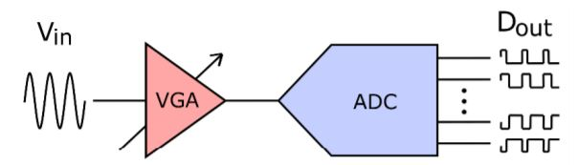
Analog
Variable gain amplifier: amplifies 1..100 mV input signal to desired level for ADC
ADC: converts analog input to digital N-bit output
SNR = 6.02N+1.76dB
Sampling at certain Fs

Slide 3
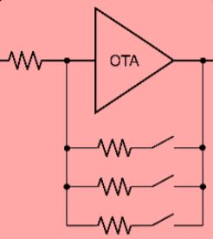
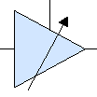
Variable Gain Amplifier
Specifications
Solution 1.0
Input = 1..100mV, output = 500 mV
-> Closed Loop gain = 5..500
Telescopic OTA
85 dB gain, 25 kHz BW
Resistorbank feedback
Gain = -Rf/Rin (ideal)

Slide 4
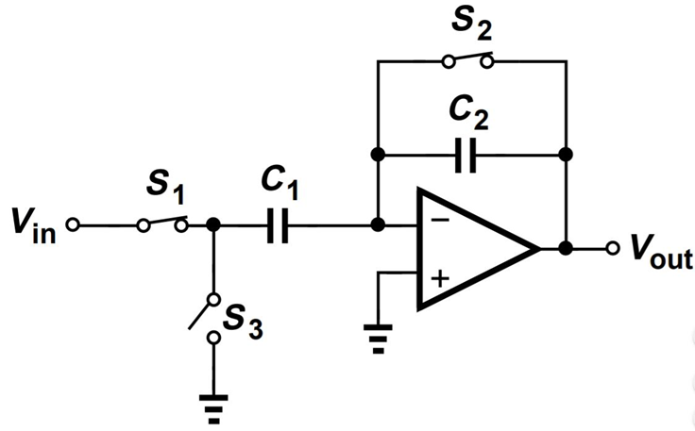
Variable Gain Amplifier
Specifications
Solution 2.0
Input = 1..100mV, output = 500 mV
-> Closed Loop gain = 5..500
S&H amplifier
Capacitorbank feedback
Gain = -C1/C2 (ideal)
Fs = 60 kHz (> 2x Fin)

Slide 5
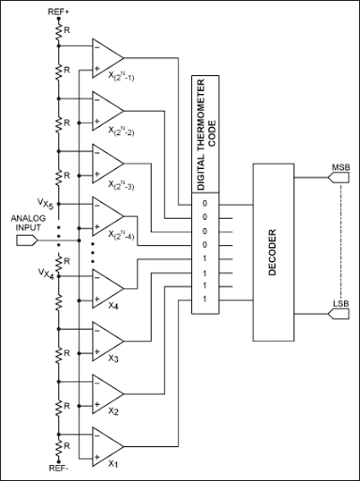
Flash ADC
3-bit -> SNR = 6.02N+1.76 dB = 20 dB
Thermometer code
Mux-based decoder = easy to implement and small enough delay for Fs
Resistorchain for Vref
7 StrongArm comparators (see next slide)
Vref decoupled

Slide 6
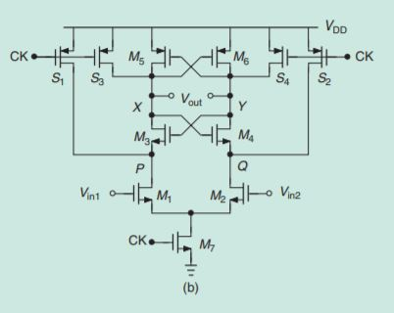
StrongArm Comparator
Vin2 = input
Vin1 = Vref
Combines functionality of comparator and latch
Capacitive load matching with invertors at X and Y

Slide 7
To do
Design new OTA
Implement S&H switchcap circuit
Optimize ADC

Slide 8
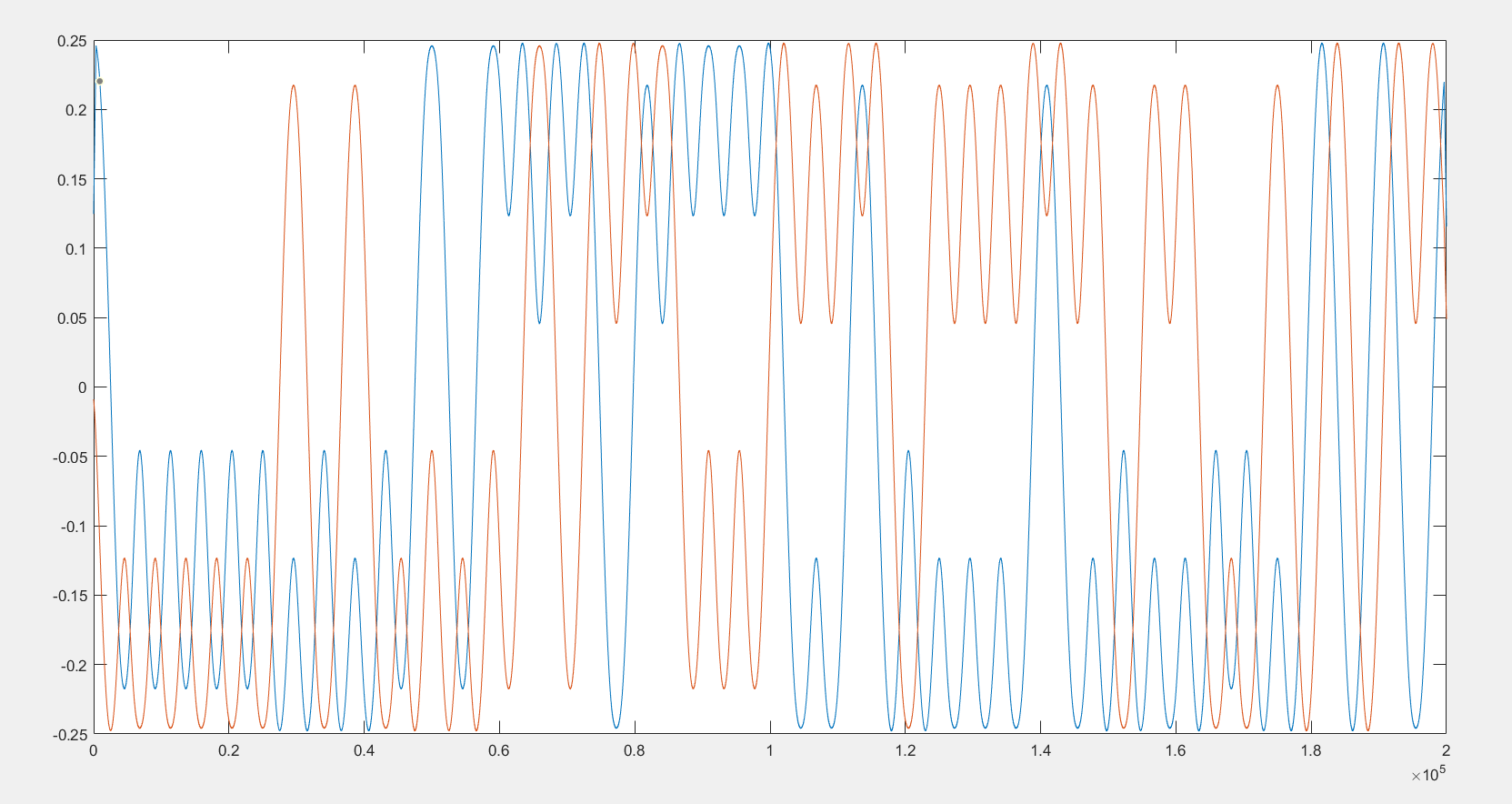
Digital

Slide 9
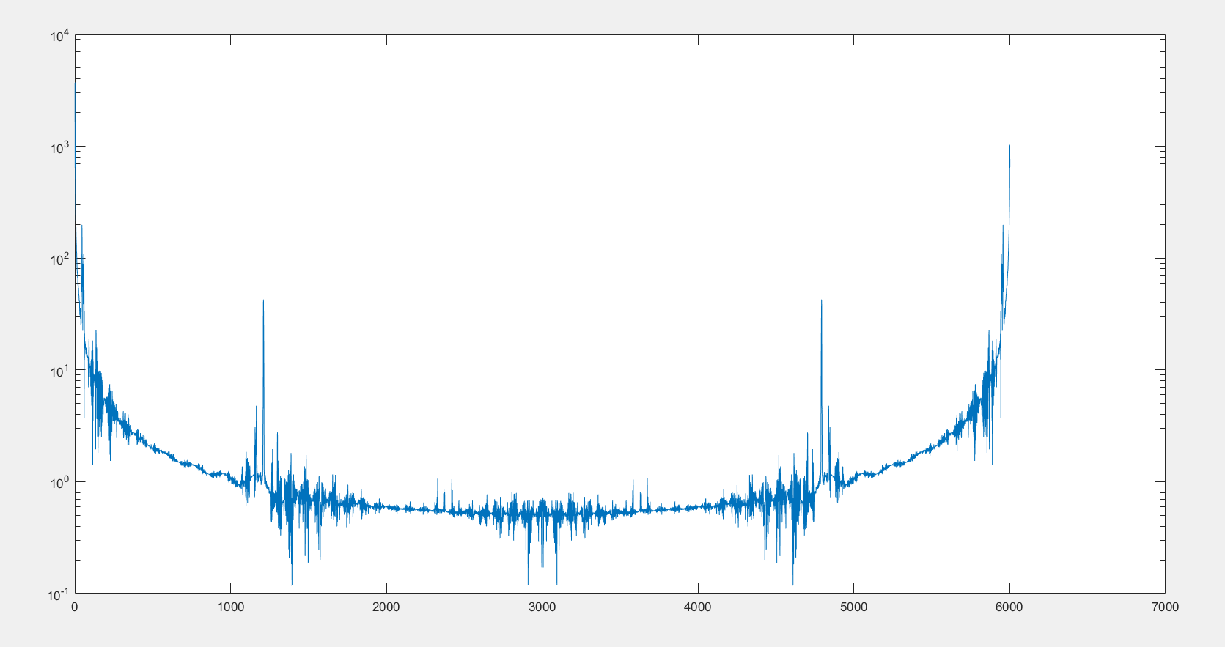
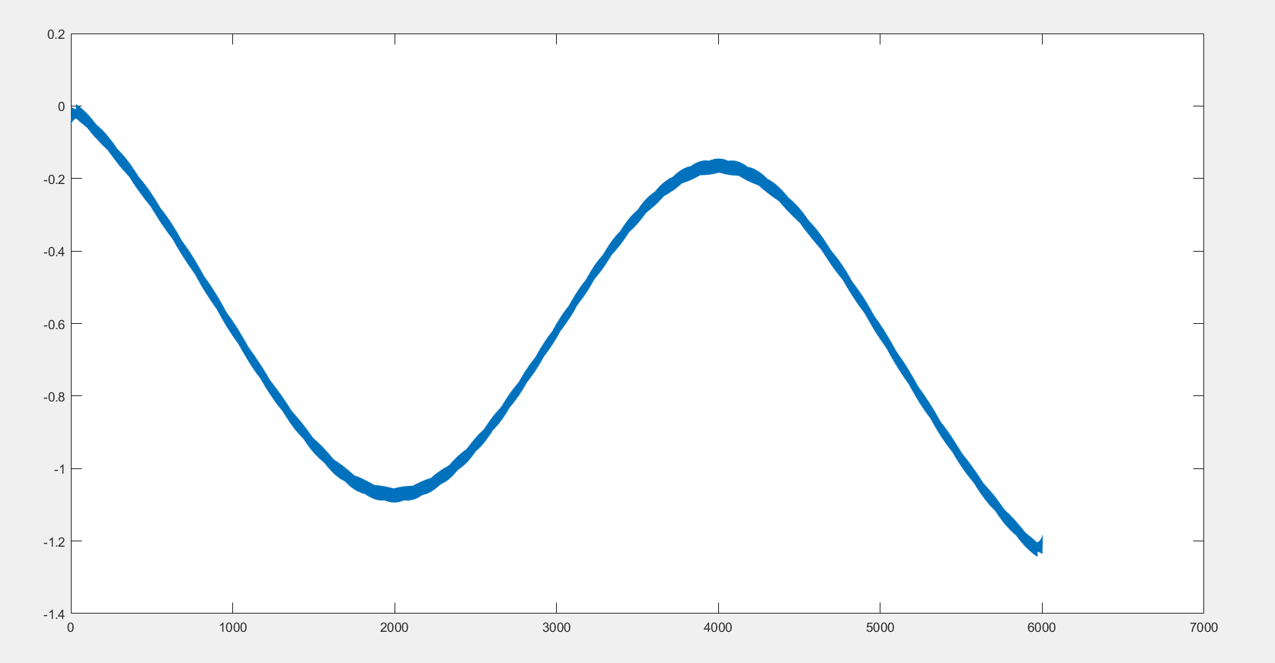
Finding the perfect matched filter in Matlab

Slide 10
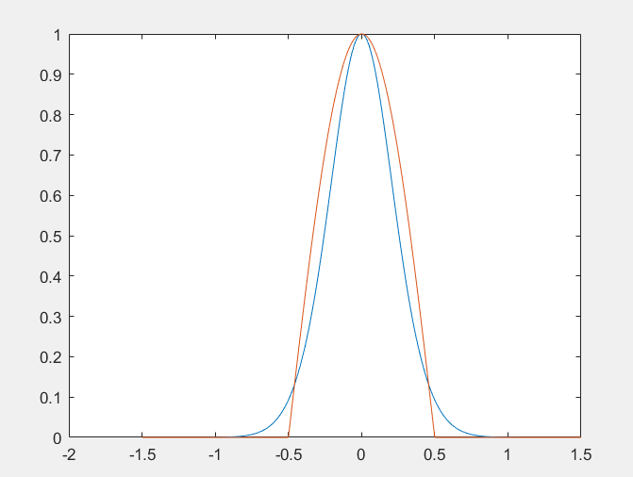
Matched filter pulse shape vs regular MSK

Slide 11
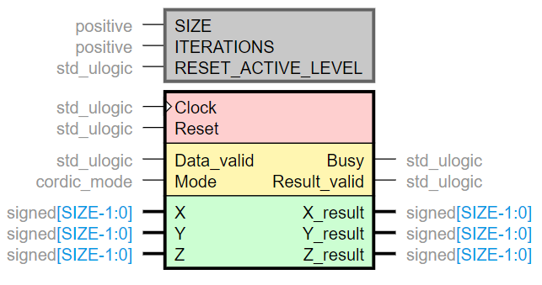
CORDIC:

Slide 12
VHDL: CORDIC ARCTAN ROTATE UNTIL (1,0)

Slide 13
If outside circle, mirror, possibly in combination with swapping x and y
Swap X/Y and + pi/2
Mirror X and Y, then add Pi degrees
Regular Algorithm
Swap X/Y and + pi/2

Slide 14
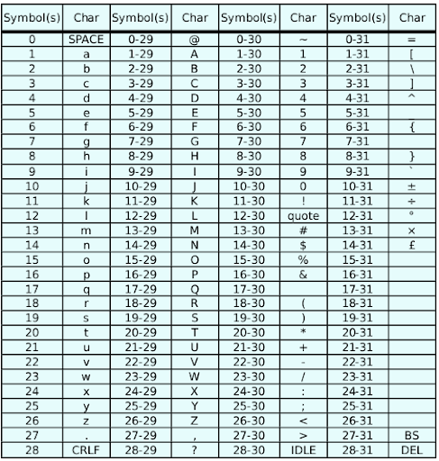
Varicode is just a table lookup (big if else statement)

Slide 15
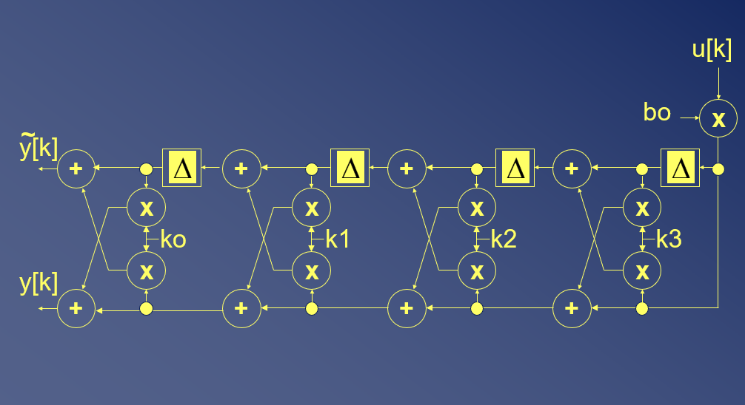
Differentiator and matched filter via lattice ladder

Slide 16
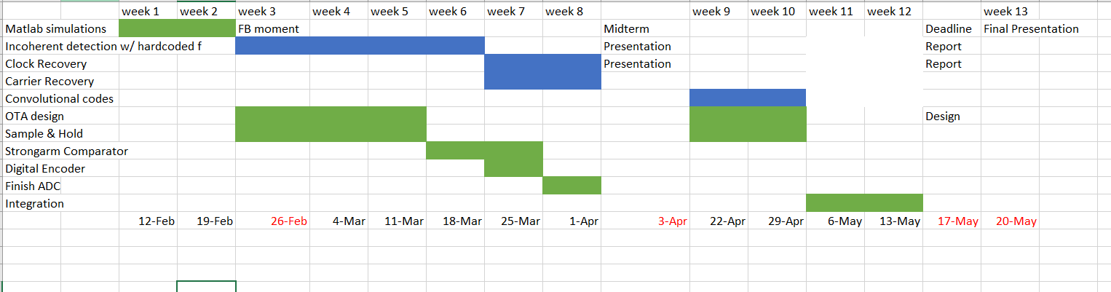
Planning

