Slide 1
Design of a GMSK 100 bit receiver
Project & Development Electronics and Chip Design
Group 4: Jonas Bertels, Jasper Depuydt, Ruben Heyrman, Ziyu Zhou

Slide 2

Analog Front-End

Slide 3
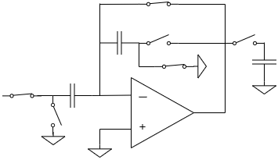
Switched-capacitor amplifier
50 kHz sampling
5 to 500 closed-loop gain
1V output swing

Slide 4
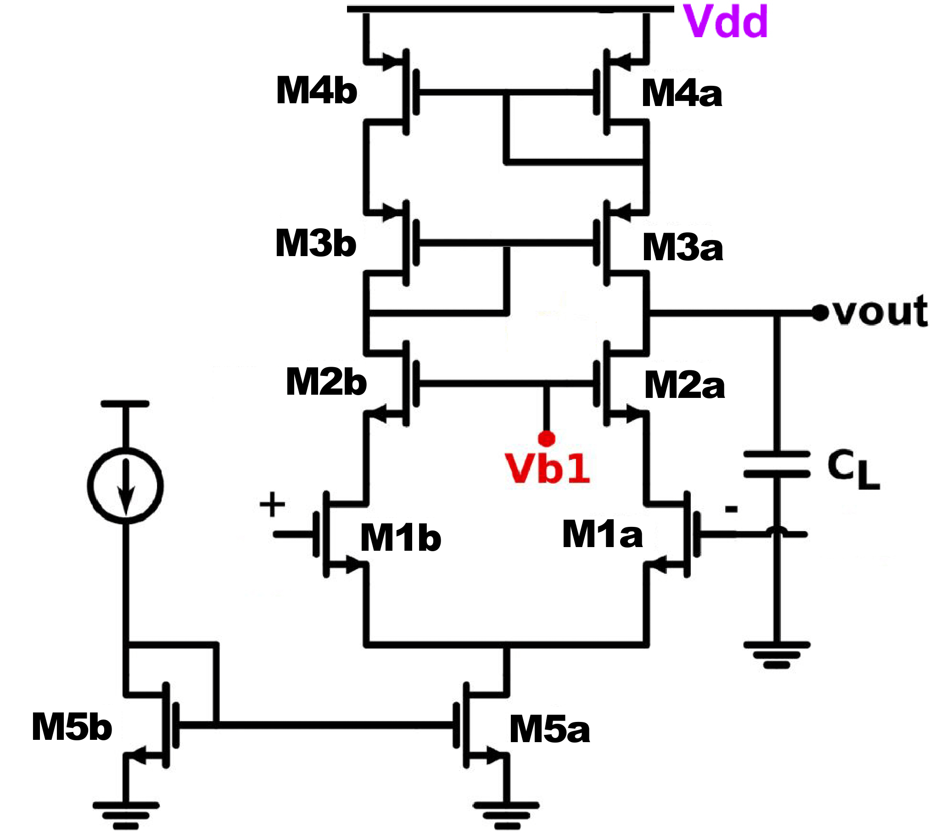

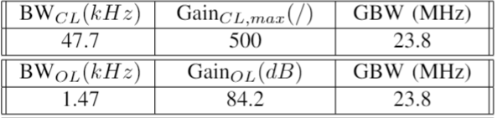
Telescopic OTA
Requirements
Calculated specifications

Slide 5
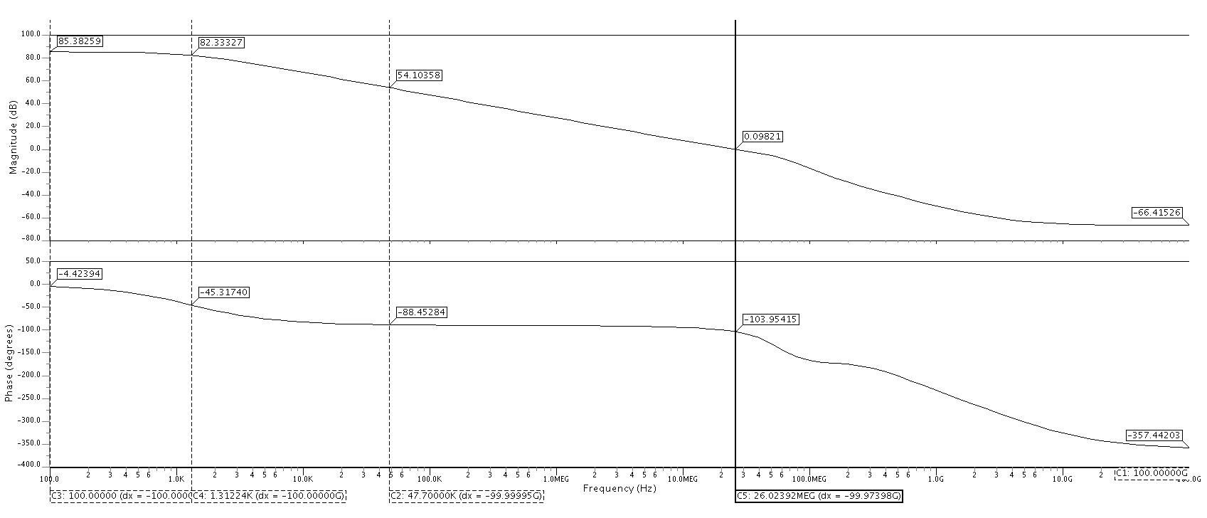


Slide 6
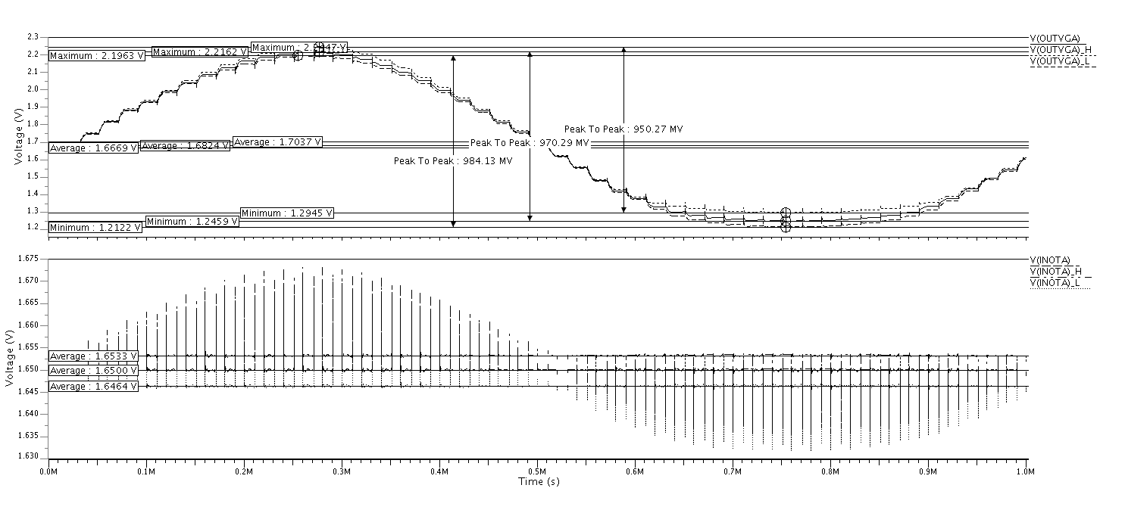
Transient result switched-capacitor amplifier

Slide 7
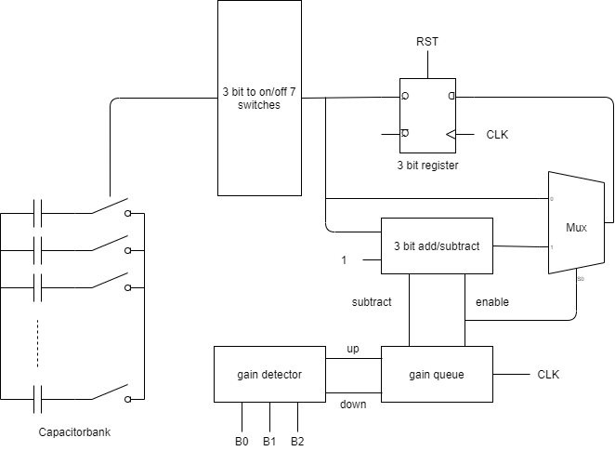
Variable gain circuit
Gain detector
Gain queue
Gain regulator

Slide 8
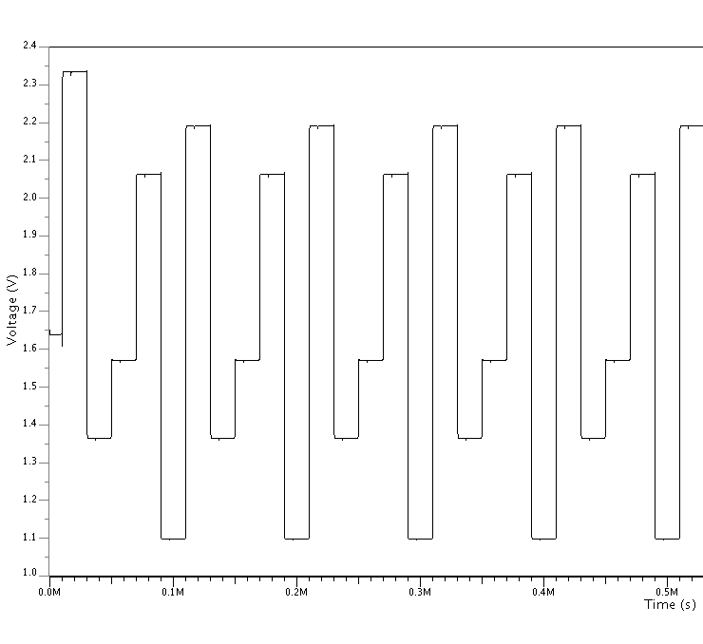
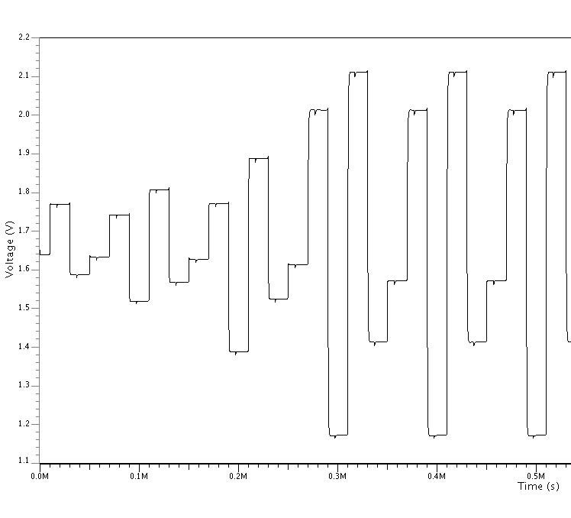
Results variable gain

Slide 9
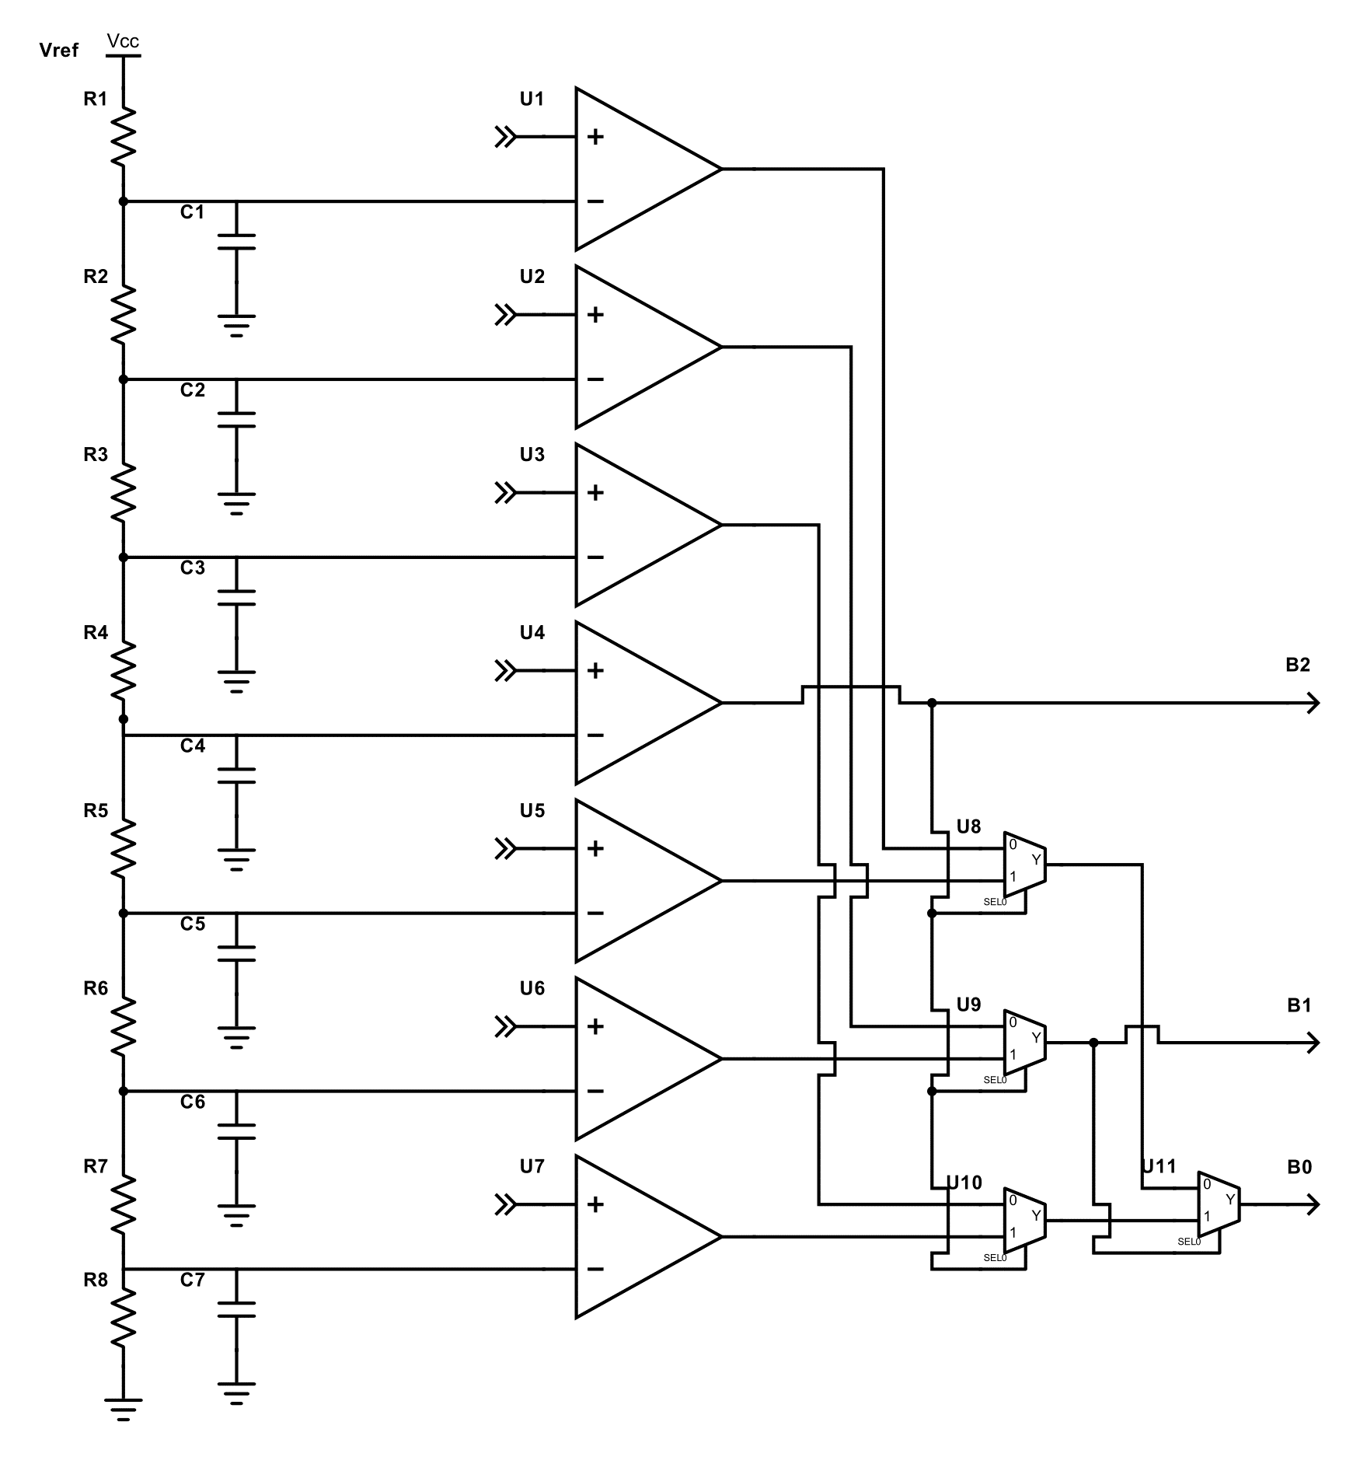
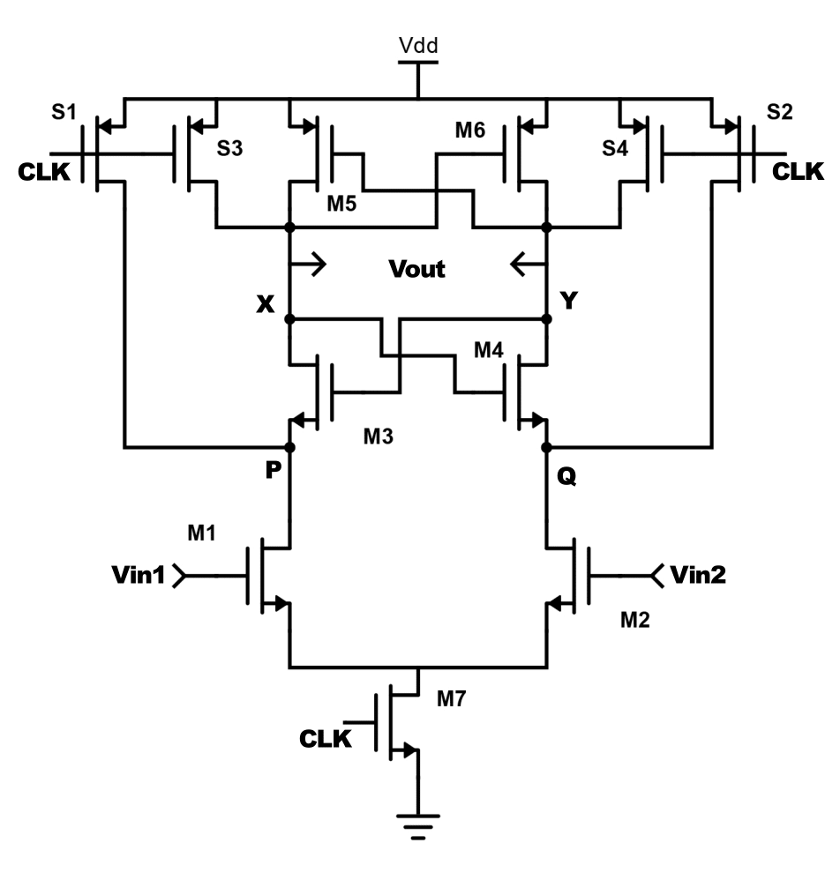
Flash ADC StrongArm Comparator

Slide 10
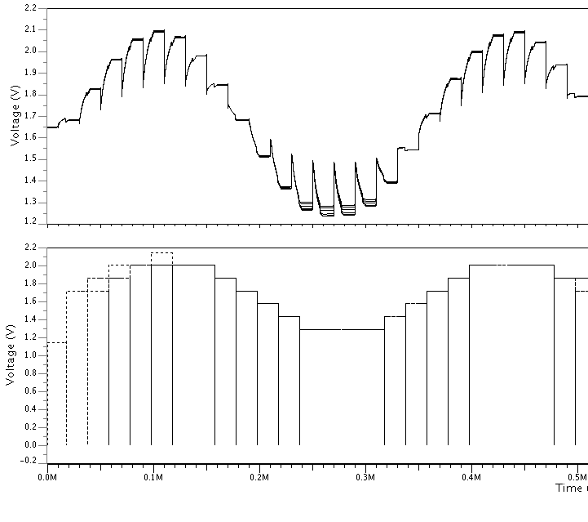
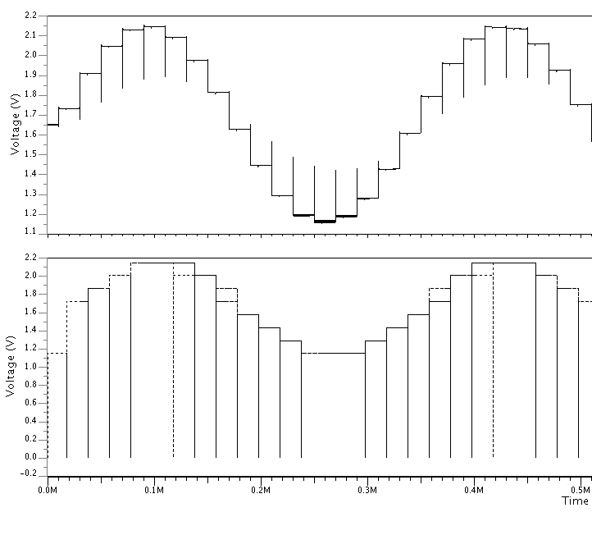
Results Analog Front-end

Slide 11
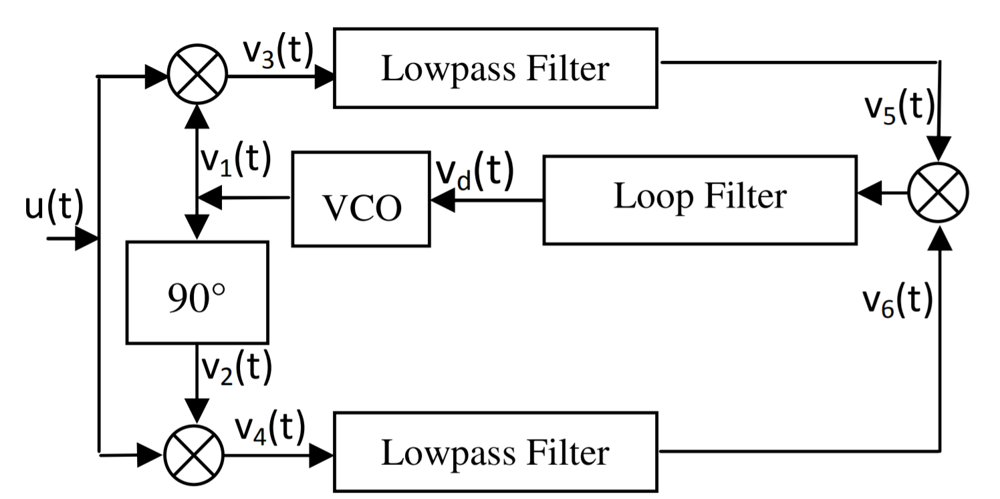
Digital: costas

Slide 12
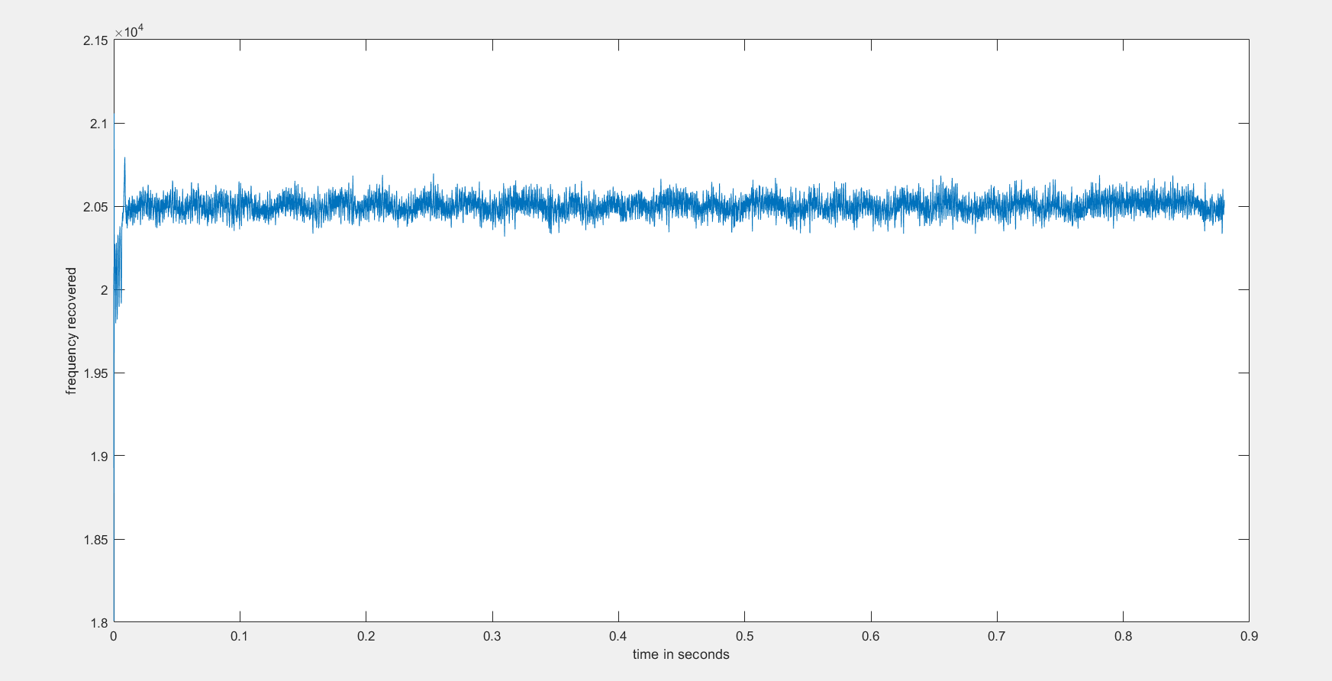
Frequency recovered from the costas loop

Slide 13
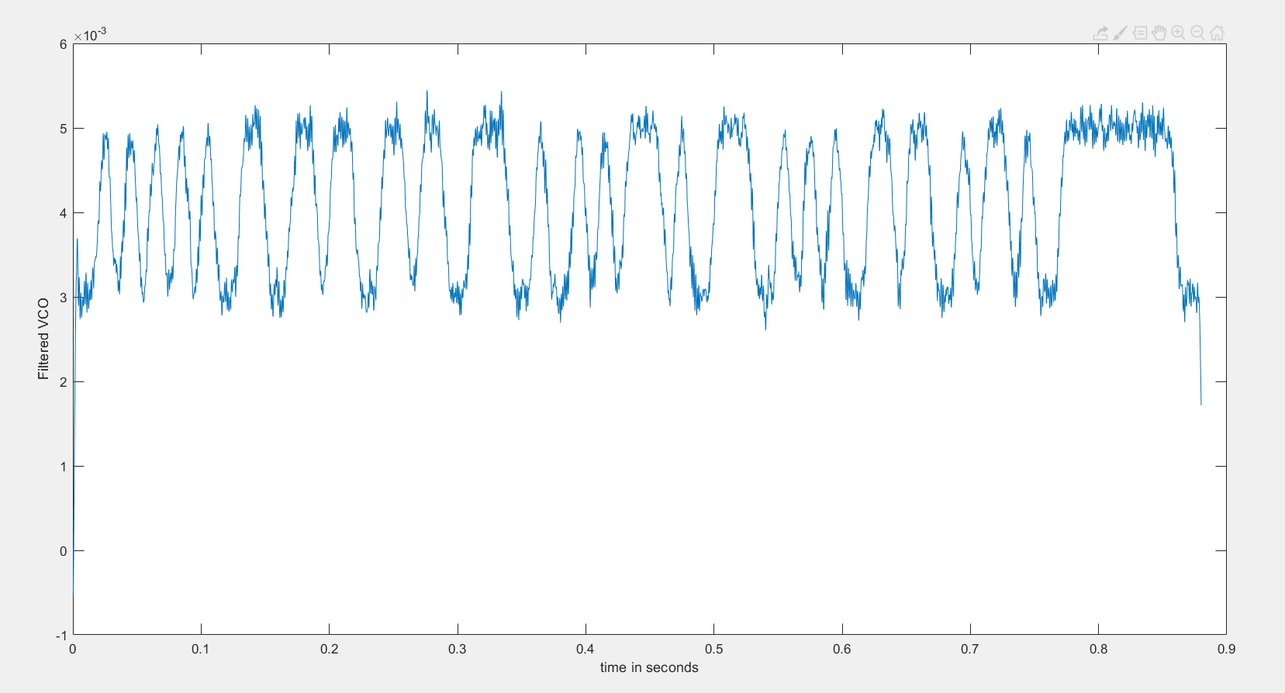
Filtered VCO

Slide 14
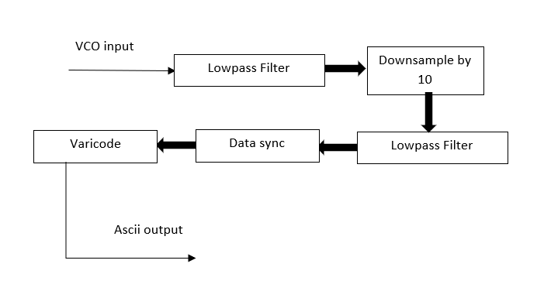
Filtering and ascii recovery

Slide 15
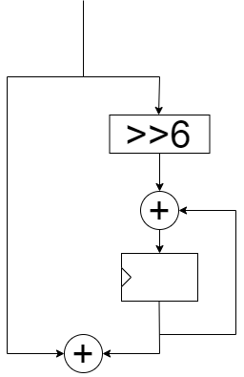
Loop filter

Slide 16
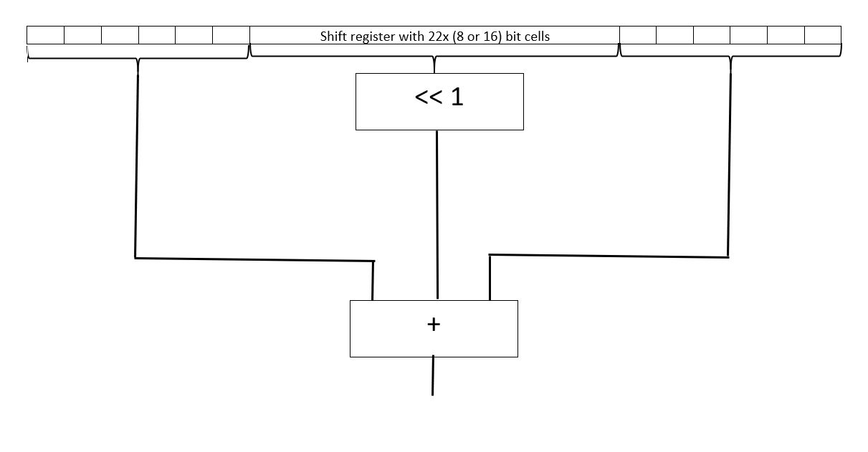
Hardware implementation of our filter

Slide 17
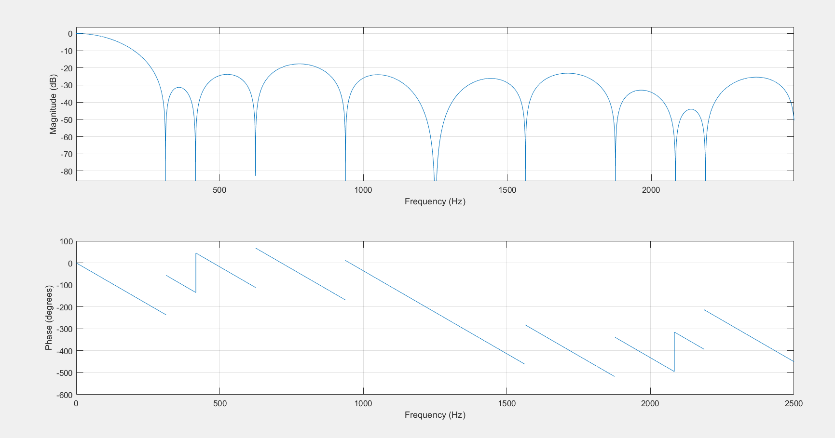
Frequency spectrum of filter

Slide 18
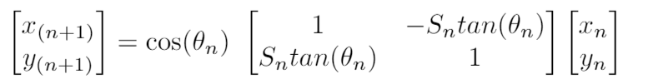
Cordic Matrix for single iteration
Hardware-efficient iterative method
Multiply by tan(θn) can be achieved by a bitwise shift

Slide 19
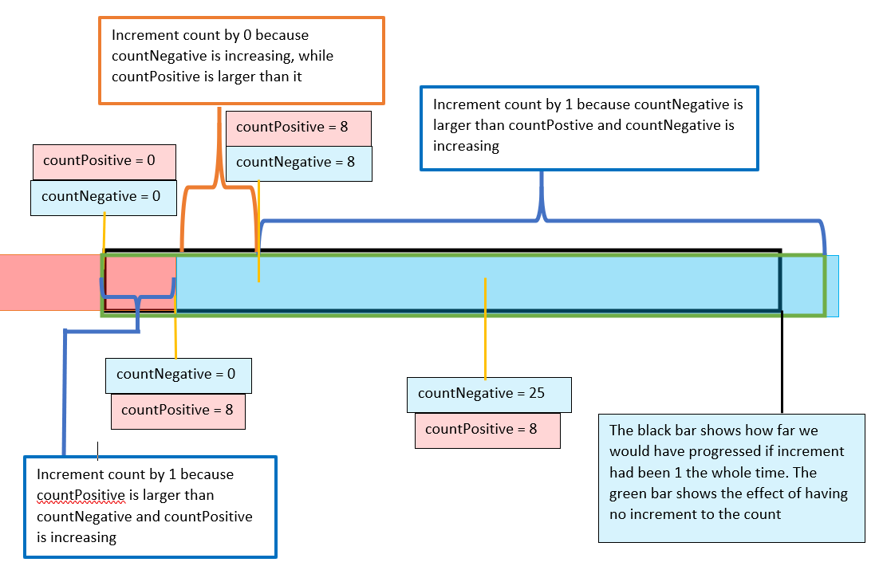
Data synchronization
Slow down the total count when running ahead
Speed up the count when running behind

Slide 20
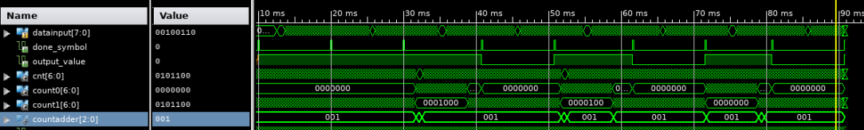
Data synchronization
Cnt : increments by counterassder on every new value
Count0 : increments on a positive value
Count1 : increments on a negative value
Countadder : slow down when “000” and speed up when ”010”

Slide 21
Result and resources
Logic | Used | Available | Utilization
Slice Register | 2570 | 4896 | 52 %
Total 4 input LUT’s | 3661 | 4896 | 74 %
RAMB 16’s | 1 | 12 | 8 %
MULT18X18SIOs | 3 | 12 | 24 %

Slide 22
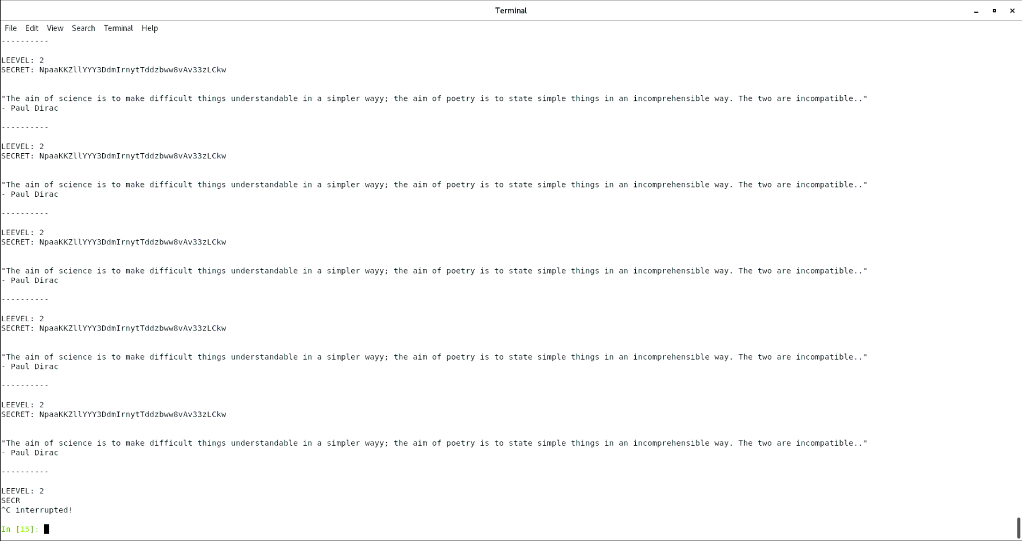
Result digital message & conclusion

