Slide 1
P&D Electronics and chip design GROUP 4

Slide 2

Gannt Chart

Slide 3
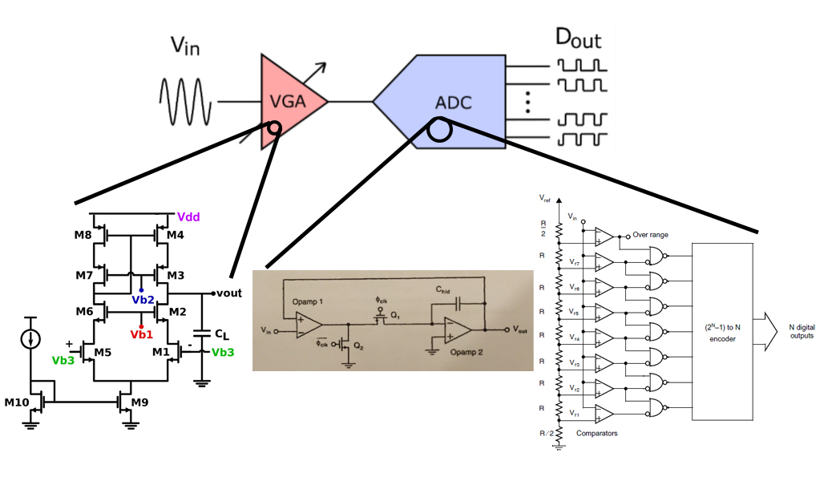
ANALOG FRONT-END

Slide 4
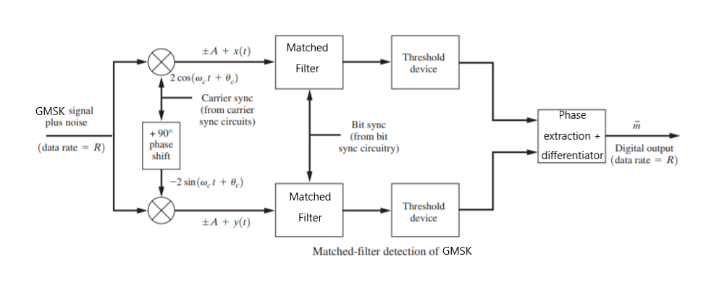
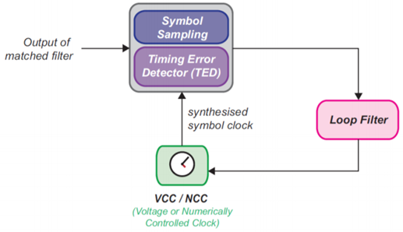
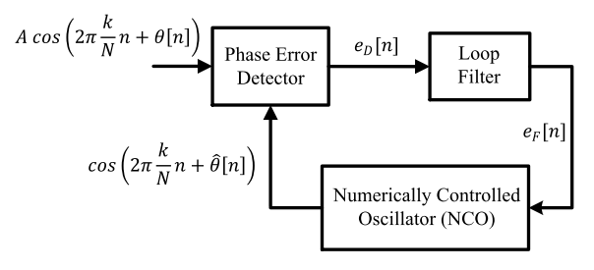
DIGITAL DECODING

