Slide 1
ITC 6000 Database Management Systems Final Project Presentation 2024 Term B Social Media Engagement Report
Ayush Anand
anand.ay@northeastern.edu

Slide 2
Overview
Project Overview
User Persona’s
Business Rules
ER Diagram
Solution Architecture and HA
Major SQL examples
Metrics
Security & Privacy Concerns
Next steps / Lessons learned

Slide 3
Project Overview
Objective:
Analyze audience engagement on platforms like Instagram and LinkedIn.
Provide insights into campaign performance, audience behavior, and influencer impact.
Key Features:
Track likes, shares, comments, and impressions.
Demographic insights (age, gender, location, interests).
Optimize campaigns for better ROI.

Slide 4
Personas
Marketers
Who: Thousands of marketing professionals.
As a Marketer, I want to:
Find top-performing campaigns to boost ROI.
Understand what content works best for their audience.
Track likes, comments, and shares to improve strategies.
Data Analysts
Who: Hundreds of data professionals.
As a Data Analyst, I want to:
Group audiences by age, gender, and location.
Use tools like SQL and visuals to find useful insights.
Create reports with data that help guide decisions.

Slide 5
User Personas (Continued)
Campaign Managers
Who: Dozens of team leads overseeing marketing strategies.
As a Campaign Manager, I want to:
Track how campaigns are doing in real time.
Distribute resources wisely for better results.
Plan post timings for maximum engagement.
Platform Administrators
Who: A handful of system administrators.
As a Platform Administrator, I want to:
Keep data accurate and systems running smoothly.
Control database access for security.
Perform audits to meet privacy rules.

Slide 6
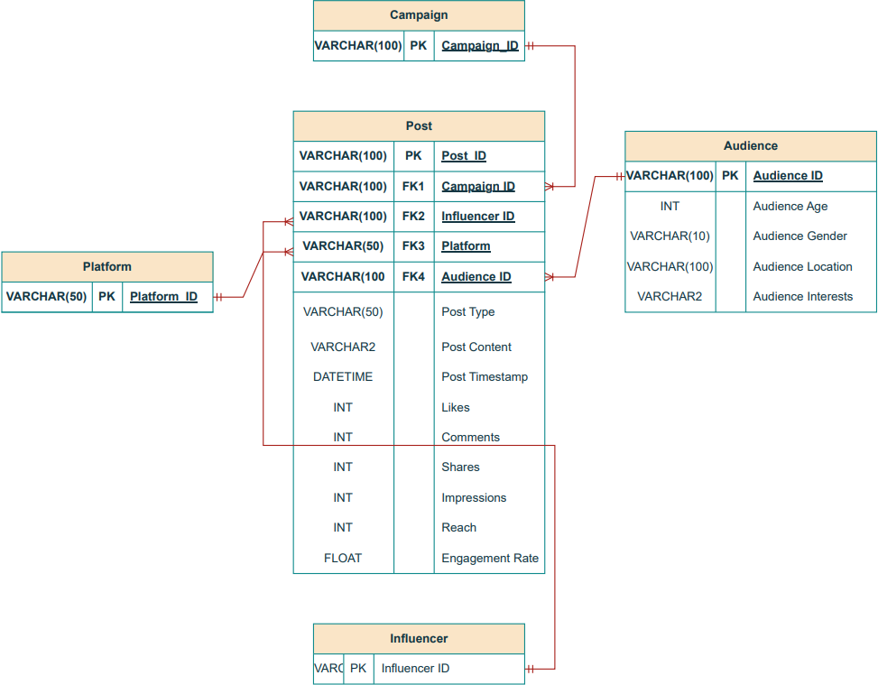
ER Diagram

Slide 7
Other Business Rules & Facts
Core Business Rules
Platforms:
A platform (e.g., Instagram, LinkedIn) can host multiple posts, but each post belongs to only one platform.
Posts:
Each post targets a specific audience segment based on demographics like age, gender, and interests.
A post may belong to a campaign or an influencer, but these are optional.
Campaigns:
Campaigns can include multiple posts, but each post belongs to only one campaign.
Influencers:
Influencers may promote multiple posts, but each post is linked to one influencer at most.

Slide 8
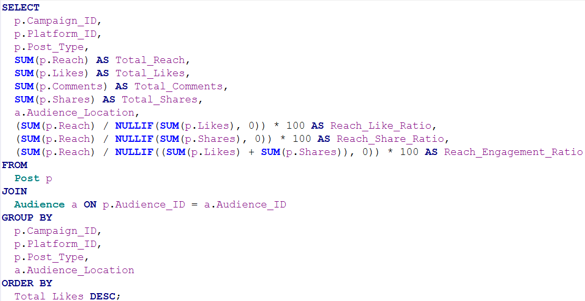
1. Aggregated Engagement by Campaign
Code Explanation:
The code calculates total reach, likes, comments, and shares for each campaign, platform, and location.
It adds three key ratios:
Reach_Like_Ratio: How reach turns into likes.
Reach_Share_Ratio: How reach turns into shares.
Reach_Engagement_Ratio: How reach turns into overall engagement (likes + shares).

Slide 9
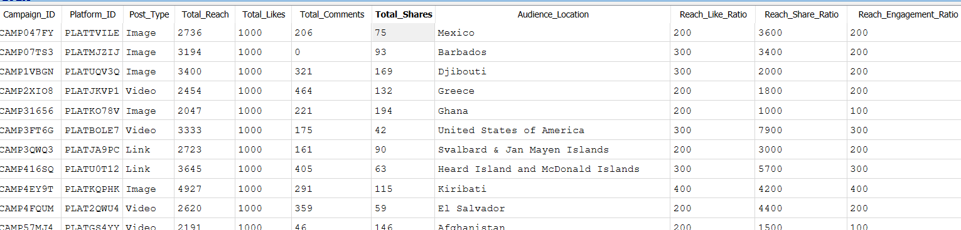
Key Insights from Results:
Top Locations
Best Post Types: Images perform better in some locations, like "Barbados."
Campaign Focus: Use high-performing locations and post types to improve future campaigns.

Slide 10
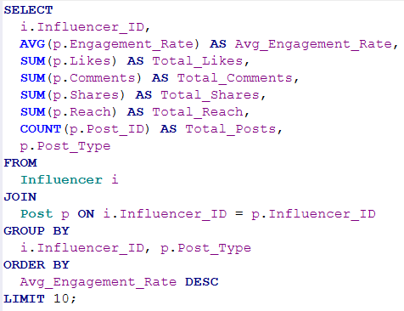
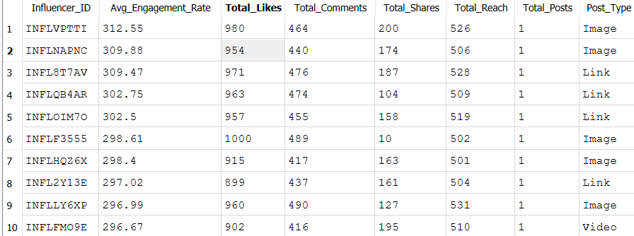
2. Influencer Engagement Analysis: Identifying Top Influencers
Code Explanation:
Calculates the average engagement rate of influencers.
Adds total likes, comments, shares, reach, and post count for deeper insights.
Groups data by influencer and post type.
Key Insights from Results:
Identifies top influencers with the highest engagement rates.
Highlights the type of posts (e.g., video, image) that work best for each influencer.
Provides a full picture of influencers’ contribution to overall campaign performance.

Slide 11
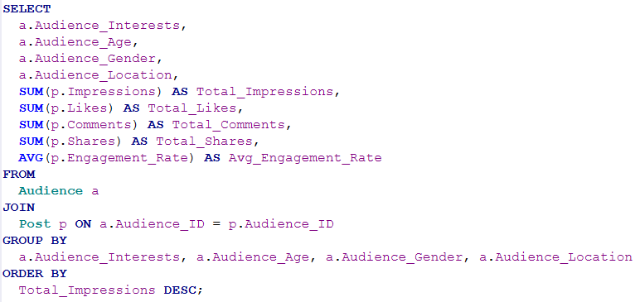
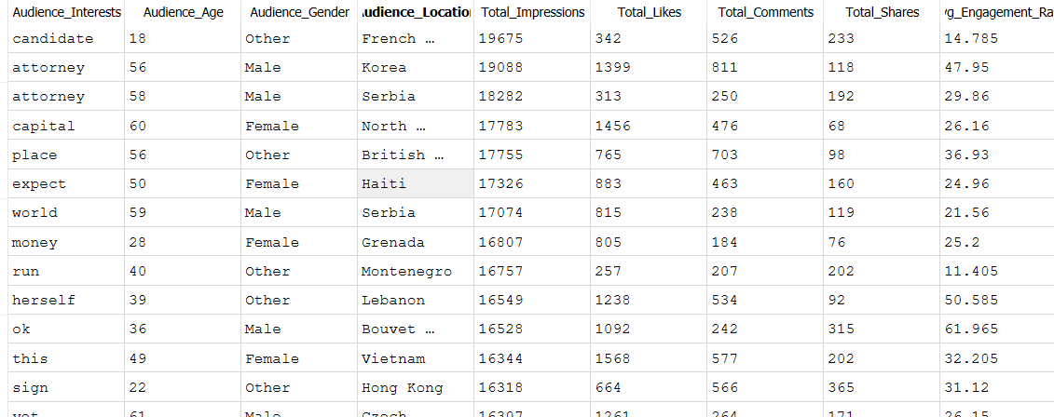
3. Audience Interests Analysis
Code:
Sums total impressions for posts by audience interests.
Adds demographic details (age, gender, location) and engagement metrics (likes, comments, shares).
Key Insights:
Reveals top-performing audience interests driving impressions and engagement.
Highlights the most effective demographic groups and locations for targeting.
Shows how audience preferences align with campaign results for better strategies.

Slide 12
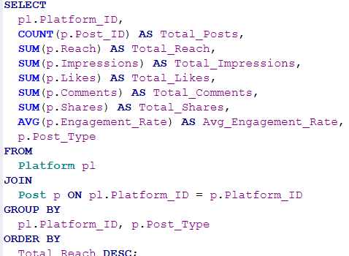
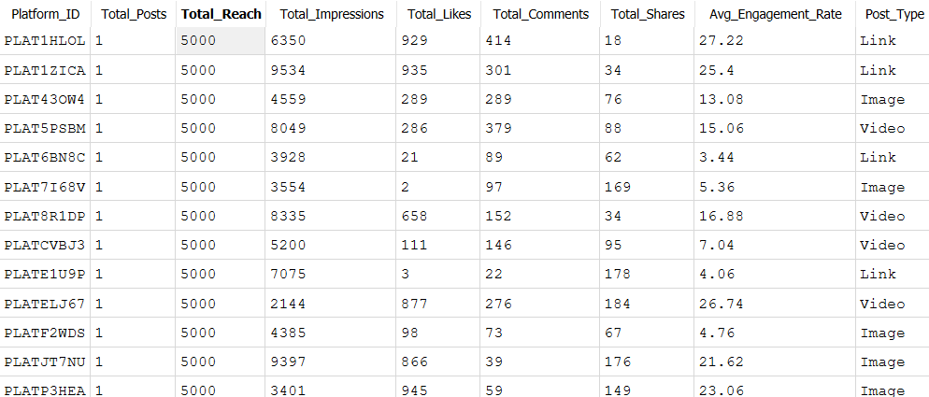
4. Platform Reach Analysis: Detailed Platform Reach Insights
Code:
Calculates total reach per platform.
Breaks down performance by post type (e.g., video, image).
Summarizes key metrics: impressions, likes, comments, shares, and engagement rate.
Key Insights:
Shows which platforms and post types drive the most reach and engagement.
Helps allocate resources to high-performing platforms and content strategies.

Slide 13
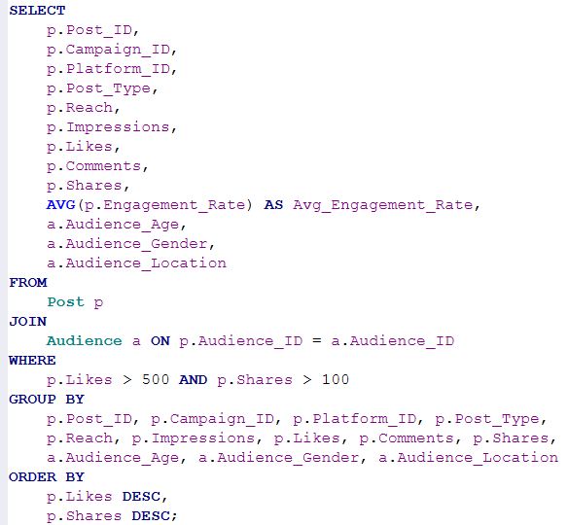
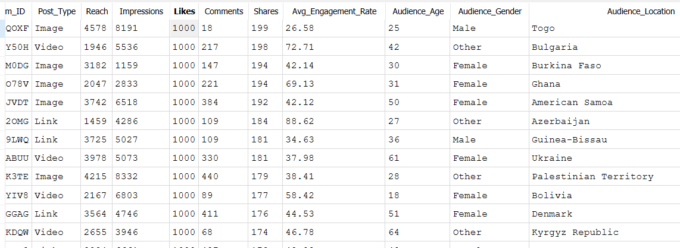
5. High-Performing Posts Analysis
Code:
Identifies top-performing posts by likes and shares.
Adds reach, impressions, engagement rates, post type, and audience demographics for deeper insights.
Key Insights:
Content Optimization:
Discover which post types (e.g., video, image) resonate most with the audience.
Audience Targeting:
Understand which age groups, genders, and locations are driving engagement.
Post Visibility:
Measure reach and impressions to assess audience exposure and content effectiveness.

Slide 14
Metrics and Analytics
Metrics and Analytics – Overview
Key Metrics for the Social Media Engagement Analysis Project
1. For Marketers
# of Likes, Comments, Shares: Measure post performance and audience engagement.
Engagement Rate: Percentage of interactions (likes, comments, shares) relative to impressions.
Campaign Reach: Total unique users reached by a campaign.
Content-Type Performance: Engagement comparison for images, videos, and text posts.
2. For Data Analysts
Audience Insights:
Demographics: Breakdown by age, gender, and location.
Interests: Engagement linked to audience preferences.
Platform Comparison:
Engagement rates and reach across platforms (e.g., Instagram vs. LinkedIn).
Influencer Metrics:
Average engagement rate of influencer-driven posts.
Total reach and impressions by influencer.

Slide 15
Metrics and Analytics
3. For Campaign Managers
Campaign ROI: Ratio of engagement metrics to campaign cost.
Peak Times Analysis: Identify days and times with the highest engagement.
Top-Performing Campaigns: Compare campaigns by total likes, shares, and comments.
4. Platform Administrators
Active User Metrics:
% of users who interacted with posts in the past 7 days.
Most active users by content creation.
Platform Health:
Total # of posts and interactions.
Average engagement rate by platform.

Slide 16
Security and Privacy
1. Sensitive Data Stored
Audience Demographics: Age, gender, location, and interests.
Engagement Metrics: Likes, comments, shares, impressions, and reach.
Influencer Details: Names and post performance metrics.
2. Privacy Concerns
Target for Hackers:
Audience data and engagement metrics could be misused for malicious targeting or phishing.
Influencer performance metrics might be sought by competitors or bad actors.
Compliance:
Ensure adherence to GDPR, CCPA, or other data privacy regulations.
3. Key Points for Security Team
Data Protection:
Emphasize encryption of sensitive data, especially demographics.
Access Control:
Ensure only authorized personnel can access the database.
Monitoring:
Regular audits and alerts for unusual activity to detect potential breaches early.

Slide 17
Next steps / Lessons Learned
1. Lessons Learned
Importance of Data Structure:
A well-designed database (e.g., proper relationships and joins) simplifies analysis and insights.
Audience Insights Matter:
Demographic and interest data play a huge role in campaign performance.
Scalability is Essential:
Cloud hosting ensures the system can handle increasing data volumes efficiently.

Slide 18
Next steps / Lessons Learned
2. Next Steps
Automation:
Automate data ingestion from social media platforms to reduce manual input.
Advanced Analytics:
Integrate machine learning for predictive analytics (e.g., future engagement trends).
Broader Metrics:
Include sentiment analysis to understand audience opinions better.
Platform Expansion:
Add more social media platforms for a comprehensive view.

Slide 19
Thank you!

