Slide 1

Exploratory Data Analysis
Aya SDOUR
07-03-2025

Slide 2
Background
XYZ Firm: A private equity firm in the US, interested in investing in the cab industry due to its remarkable growth and the presence of multiple key players.
Objective: Provide actionable insights to help XYZ identify the right cab company for investment.

Slide 3
1. Data Understanding
Features: 24 features (including 9 derived features)
Timeframe: 2016-01-31 to 2018-12-31
Total Data Points: 355,032
Assumptions:
Outliers are present in the Price_Charged feature, but due to the unavailability of trip duration details, these are not treated as outliers.
Profit calculations for rides are based solely on the Price_Charged and Cost_of_Trip features, keeping other factors constant.
The Users feature in the city dataset is treated as the number of cab users in the city, assuming it includes users of both Yellow and Pink cabs.

Slide 4
2. Forecasting Profit and Number of Rides
Features: Utilizes time series data for Price_Charged, Cost_of_Trip, and Number_of_Rides.
Timeframe: Forecasts generated for the next 12 months beyond the dataset's end date.
Total Data Points: 355,032 historical data points used for modeling.
Assumptions:
Seasonality and trends in ridership and profit are consistent with historical data.
External factors such as holidays and weather conditions are incorporated into the forecasting model.
Forecasting models assume stable market conditions without significant disruptions.

Slide 5
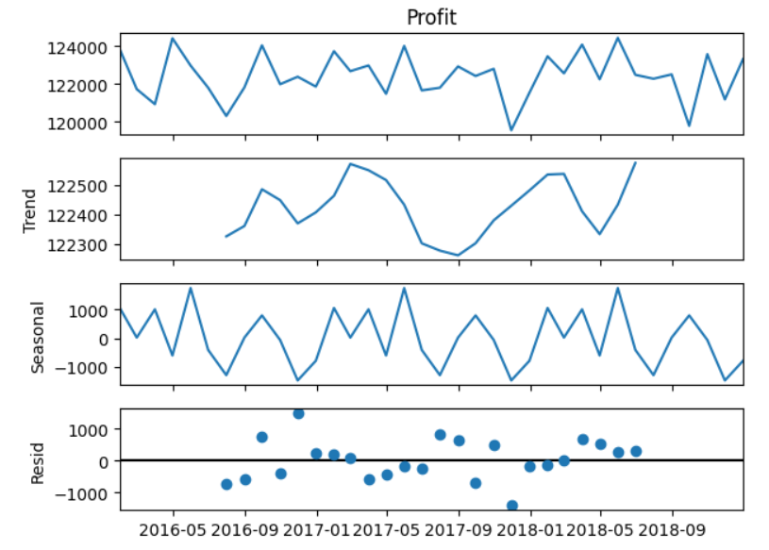
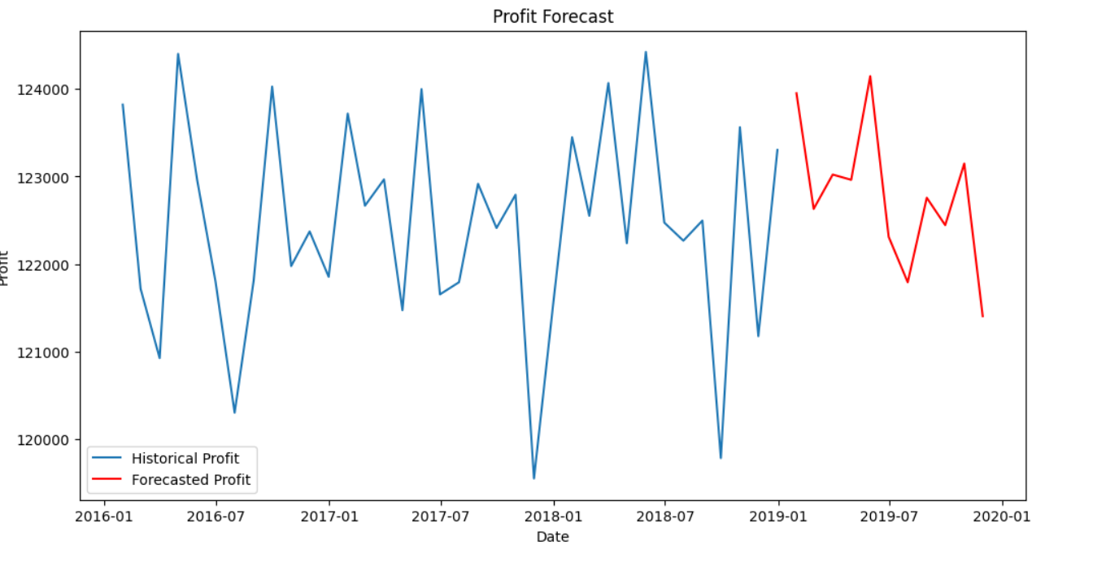

Slide 6
Trend: The long-term progression in the data, showing the overall direction of profit over time.
Seasonal: The repeating short-term cycle in the data, highlighting patterns that recur at regular intervals (e.g., monthly or yearly).
Residual: The random noise in the data, representing variations not explained by the trend or seasonality.
Historical Profit: The blue line represents the historical profit, aggregated by month.
Forecasted Profit: The red line shows the forecasted profit for the next 12 months, based on the Exponential Smoothing model.
Model: The Exponential Smoothing model captures trends and seasonality in the data to make future predictions.

Slide 7
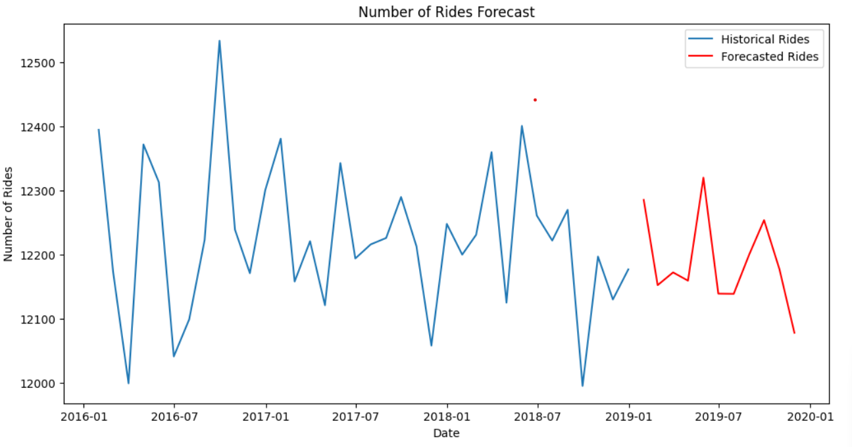
Historical Rides: The blue line represents the historical number of rides, aggregated by month.
Forecasted Rides: The red line shows the forecasted number of rides for the next 12 months, based on the Exponential Smoothing model.
Model: The Exponential Smoothing model captures trends and seasonality in the data to make future predictions.

Slide 8
3. Identifying the Most Profitable Cab Company
Features: Key metrics include Revenue, Customer_Growth, Market_Share, and Profit_Margin.
Timeframe: Analysis covers the entire dataset period from 2016-01-31 to 2018-12-31.
Total Data Points: 355,032 data points analyzed for performance metrics.
Assumptions:
Customer segmentation is based on demographic and behavioral data available in the datasets.
Operational costs are assumed to be consistent across the analysis period.
Market share calculations are based on the total number of rides and revenue generated by each company.

Slide 9
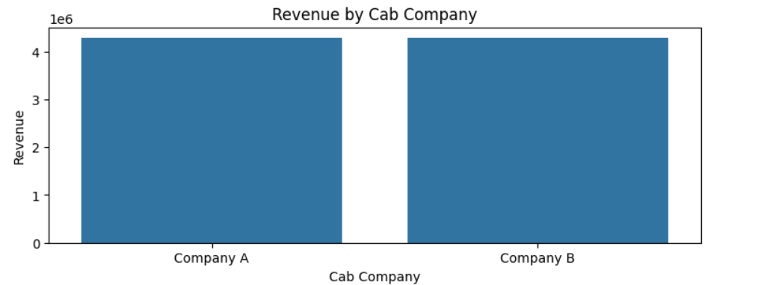
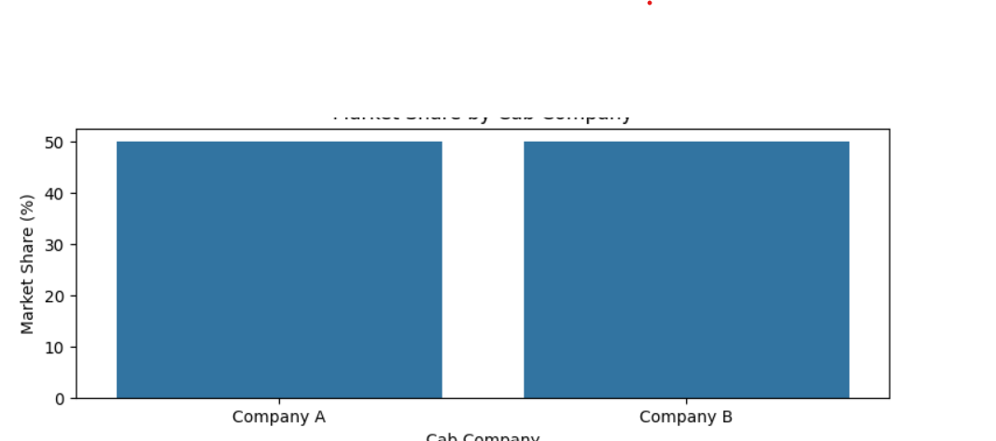
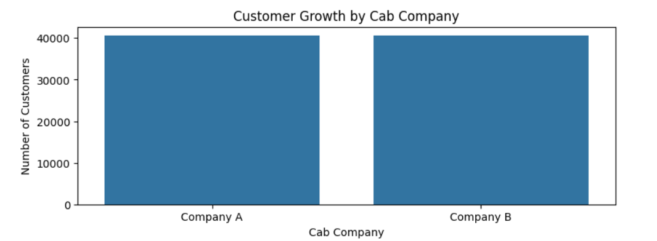

Slide 10
Revenue: Total income generated by each cab company. Higher revenue indicates better financial performance.
Customer Growth: Increase in the number of unique customers over time. A higher number indicates a growing customer base.
Market Share: Proportion of total market revenue captured by each company. A higher market share indicates dominance in the market.
Profit Margin: Profit as a percentage of revenue. A higher profit margin indicates better cost management and efficiency.

Slide 11
4. Recommendations for Investment
Features: Focuses on Investment_Potential, Risk_Assessment, and Growth_Opportunities.
Timeframe: Recommendations are based on historical data and forecasted trends.
Total Data Points: Insights derived from the analysis of 355,032 data points.
Assumptions:
The investment strategy prioritizes companies with higher profit margins and growth potential.
Risk assessment considers market stability and competitive dynamics.
Recommendations are data-driven and supported by comprehensive analysis and visualizations.

Slide 12
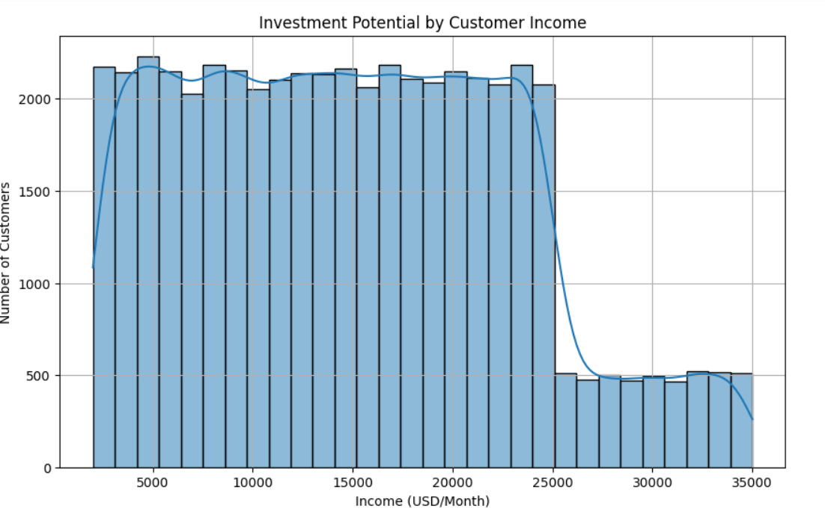
This histogram shows the distribution of customers by monthly income. Higher income segments represent a stronger market potential, indicating higher investment potential.

Slide 13
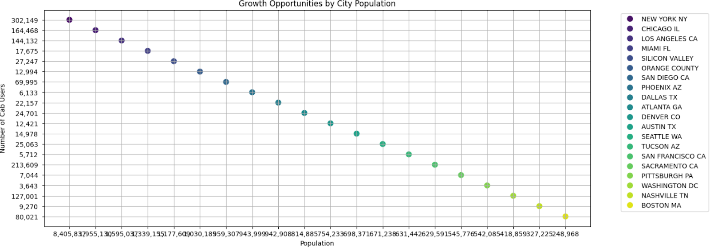
This scatter plot shows the relationship between city population and the number of cab users. Cities with large populations and relatively fewer cab users represent significant growth opportunities.

Slide 14
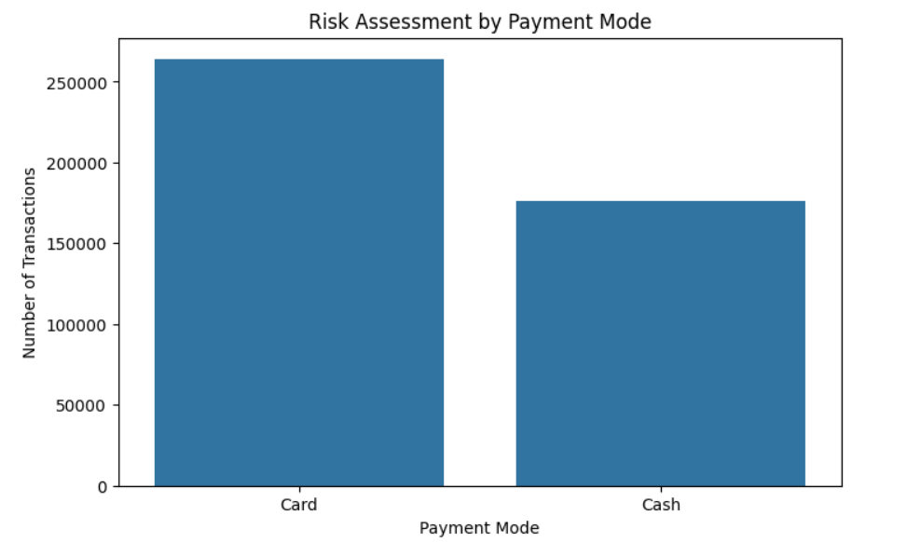
This bar plot shows the distribution of transactions by payment mode. A diverse range of payment modes can indicate lower risk, as it suggests adaptability to customer preferences.

Slide 15

Agenda
Executive Summary
Problem Statement
Approach
EDA
EDA Summary
Recommendations

Slide 16
Thank You

