Slide 1
OrganicLink A Computer Vision Marketplace for Irish Organic Producers with Automated Produce Quality Grading Aashrith Sai Yamsani Student ID : 25287419 Supervisor: Dr. Elfed Lewis
Master of Engineering in Computer Vision & Artificial Intelligence
Final Project Presentation | University of Limerick

Slide 2

Project Overview
Problem Statement
Problem Statement
Organic producers face difficulty trading directly with buyers because it is difficult to verify the quality of their produce remotely.
This Creates 4 main issues
Quality uncertainty - Buyers cannot physically inspect produce before purchase
Rejection & waste - Produce failing quality/cosmetic requirements may be rejected
Surplus & loss of value - Unsold/rejected produce may enter lower-value channels
Loss of organic premium - Organic produce may be sold through conventional channel
Organic producers face difficulty trading directly with buyers because produce quality cannot be reliably verified remotely.
Quality uncertainty - Buyers cannot physically inspect produce before purchase
Rejection & waste - Produce failing quality/cosmetic requirements may be rejected
Surplus & loss of value - Unsold/rejected produce may enter lower-value channels
Loss of organic premium - Organic produce may be sold through conventional channel
Project Aims
Build a web-based marketplace connecting organic producers directly with buyers, using computer vision to verify produce quality
and provide objective evidence for remote transactions.
Investigate the organic market-access and quality-verification problem
Develop automated produce identification and quality grading
Implement dual inspection at dispatch and delivery
Evaluate the system, including model performance and data integrity
Key Objectives
2

Slide 3
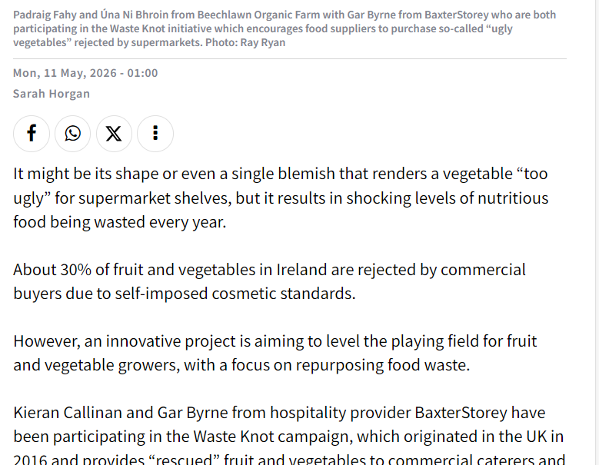
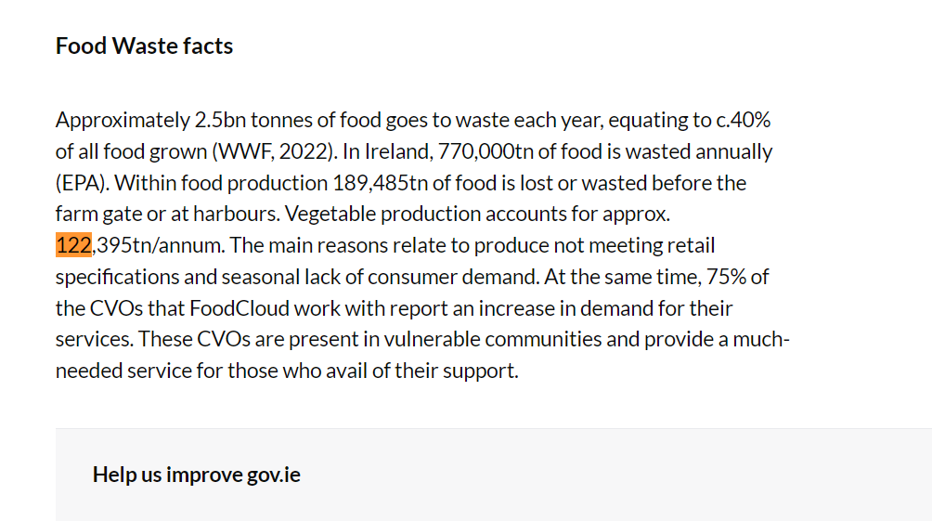
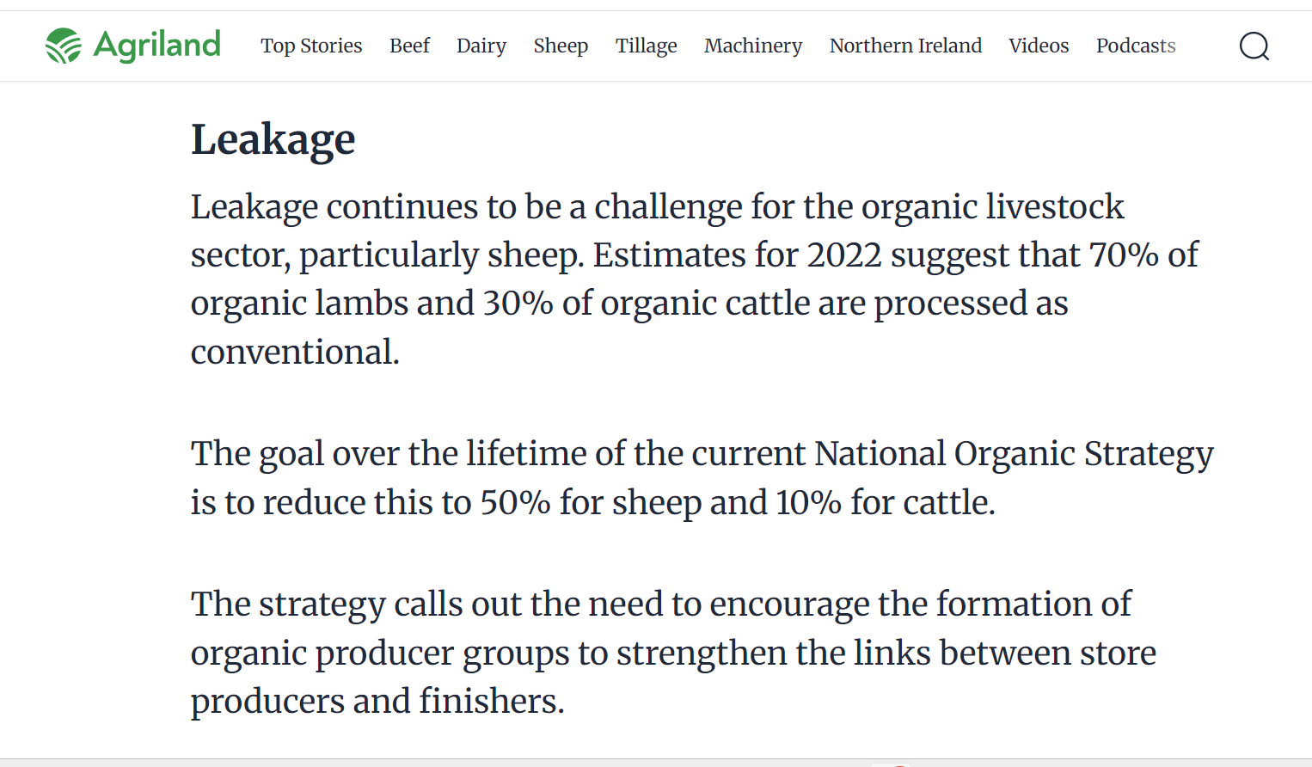
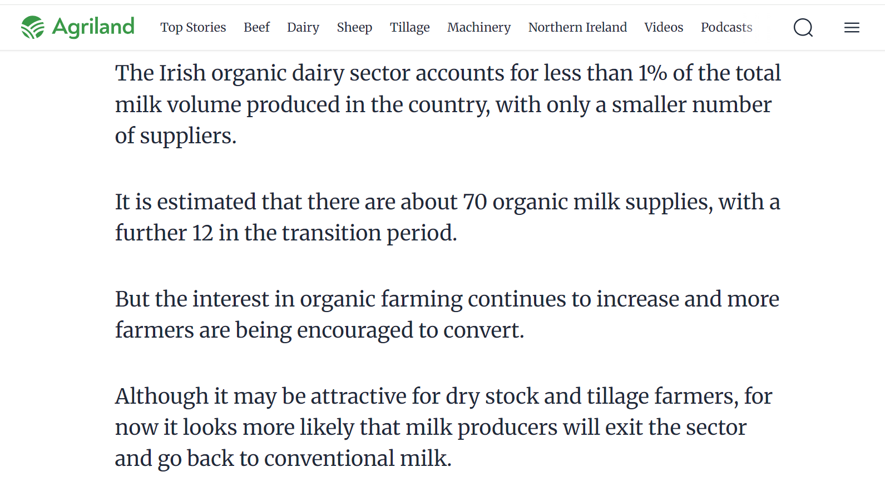
Industry Evidence & Problem Validation
Irish Examiner (2026)
DAFM / gov.ie
~30% of fruit & vegetables rejected on cosmetic grounds
189,485t food lost pre-farm-gate; 122,395t of that is vegetables, mainly failing retail specifications
Agriland — Leakage
Agriland — Organic Dairy
70% of organic lambs / 30% of organic cattle processed as conventional (2022) due to lack of processing hubs
Organic dairy is <1% of national milk volume, ~70 suppliers - too small and fragmented for reliable processing capacity
2

Slide 4
Project Origin: From the Digital Futures Lab to OrganicLink
Digital Futures Lab - Team 6
Stakeholder Validation
Midwest Bio District | Organic Dairy
Joe Kelleher — Organic Specialist, Teagasc
Initial challenge: surplus organic milk & limited processing capacity
Team of students from business, analytics, risk and finance backgrounds
Developed IOMS / Cooperative Digital Milk Coordination Platform
Goal: coordinate surplus milk with available processing capacity
Small and fragmented organic dairy sector
Limited number of processing hubs
Existing farmer - processor relationships
Processing capacity was the key bottleneck
Logistics and collection also create challenges
3

Slide 5
Dataset & Data Integrity
1
Dataset
2
Data Integrity
3
Dataset Selection
2 public Kaggle datasets
14 produce classes
Fresh / Defective labels
46,867 images
34.7% near-duplicates identified
Perceptual hashing used
Duplicate groups kept on one side of the split
2,929 held-out test images
Third dataset evaluated
Near-duplicate contamination: 34.7% → 61.8%
Excluded due to limited genuine variety

Slide 6
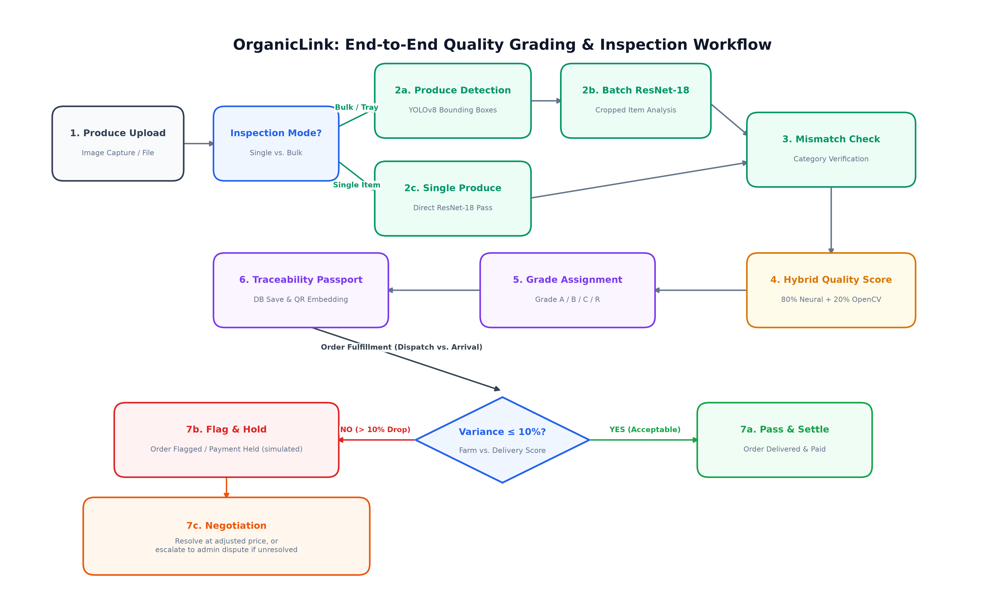
System Workflow
End-to-end flow: upload, grading, product-match check, dual-inspection decision
2

Slide 7




The Solution
A Computer Vision Marketplace for Irish Organic Producers with Automated Produce Quality Grading
1
2
3
4
→
→
→
Direct Marketplace
Automated Quality Grading
Dual Inspection
Traceability
Producer ↔ Buyer
Computer Vision
Dispatch ↔ Delivery
QR-based transaction history
Direct organic trade
Product listing & ordering
Produce identification
Fresh / defective assessment
Quality recorded at both stages
Variance-based verification
Link product to inspection
Support transaction evidence
4

Slide 8
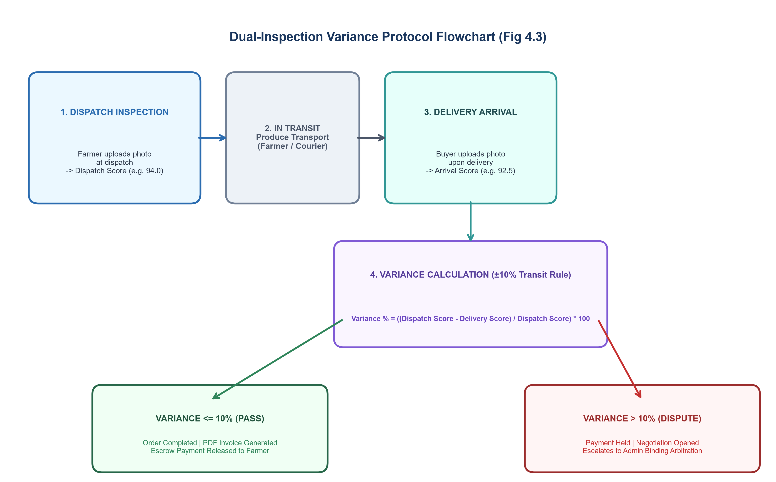
Core Contribution: Dual-Inspection Variance Protocol
Produce is graded at dispatch and again at delivery. If quality drops beyond tolerance, the transaction is automatically flagged, payment is held, and negotiation opens — replacing subjective disagreement with objective evidence.
5

Slide 9
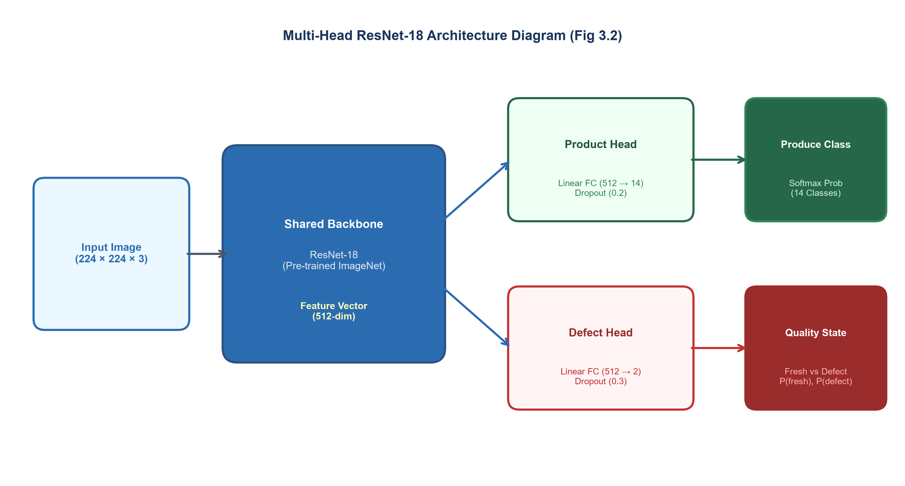
The Computer Vision
Multi-head ResNet-18: one shared backbone, two Headed
6

Slide 10
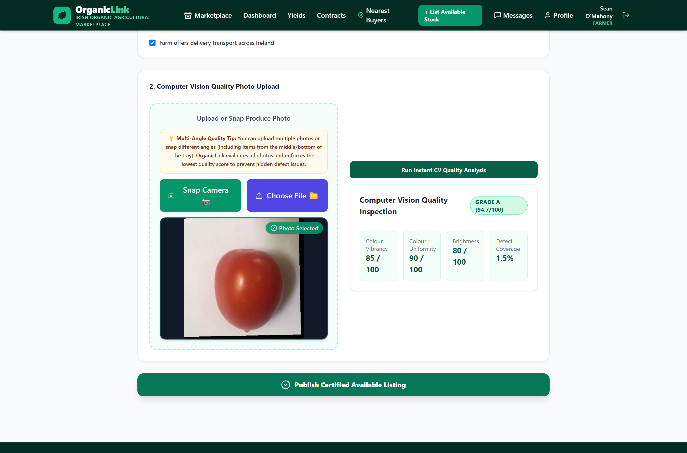
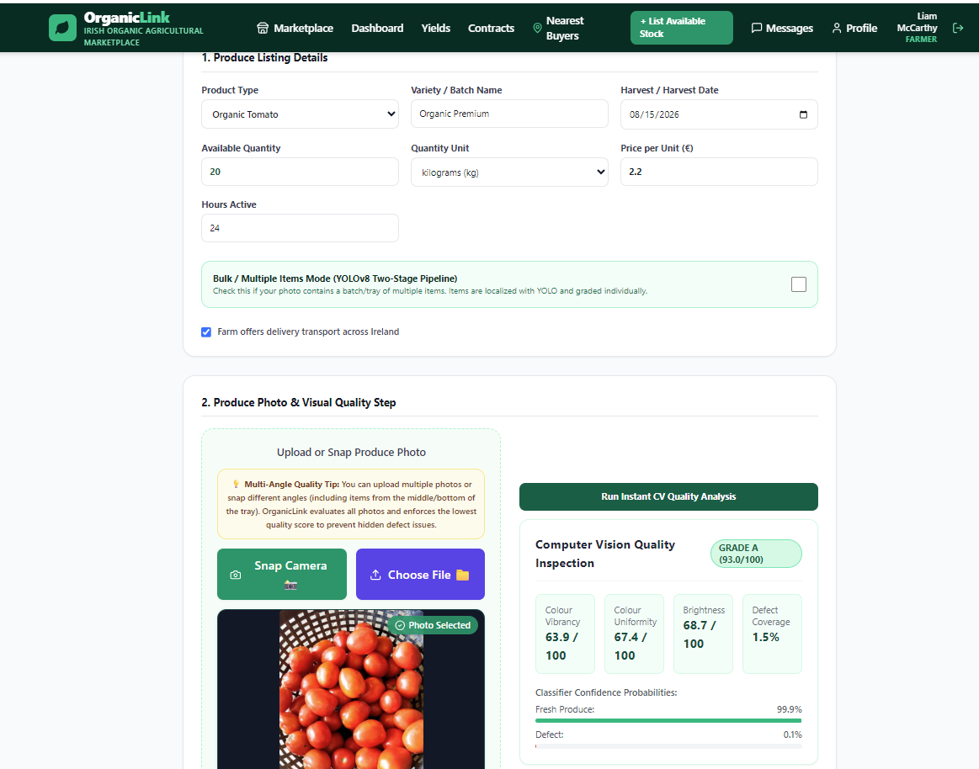
The Platform
Single-item grading (Grade A, colour metrics)
Bulk grading (per-item detection)
4

Slide 11
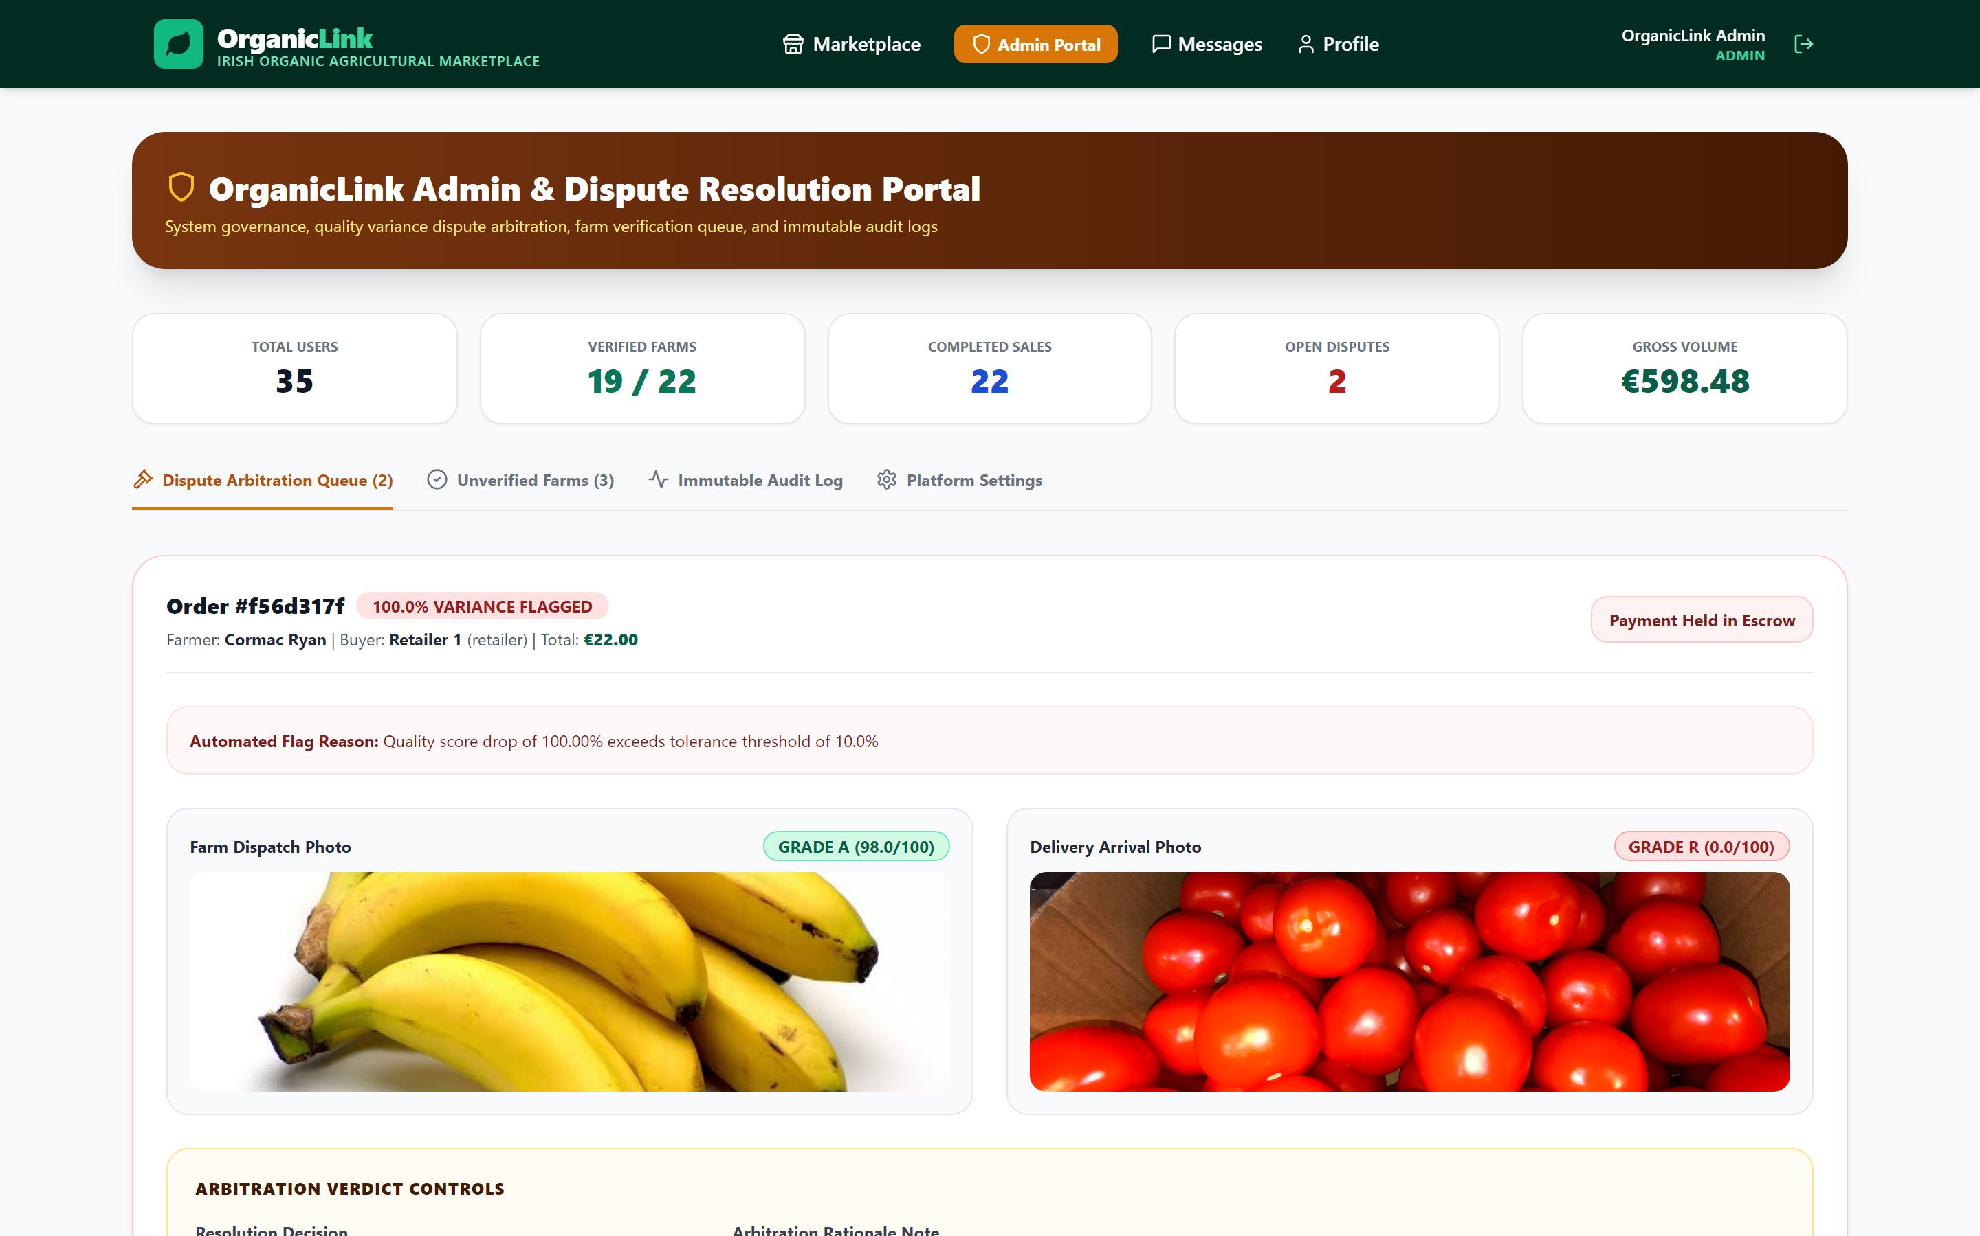
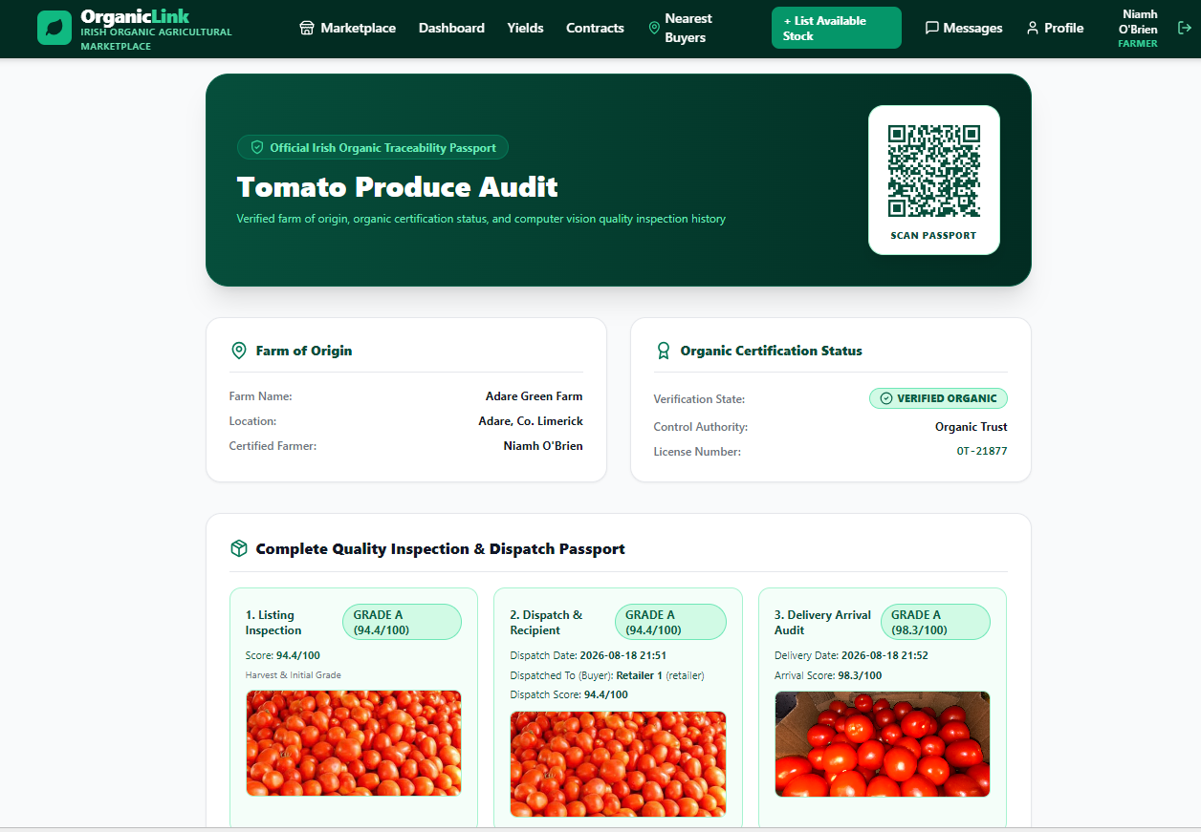
Dual-inspection variance flagged
QR traceability passport

Slide 12
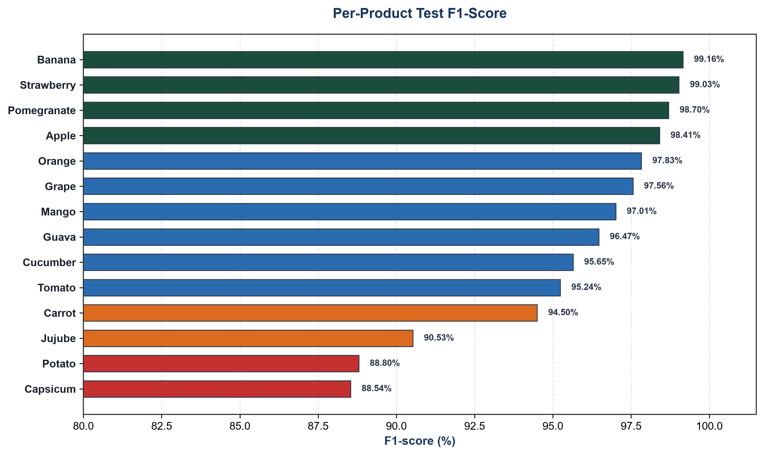
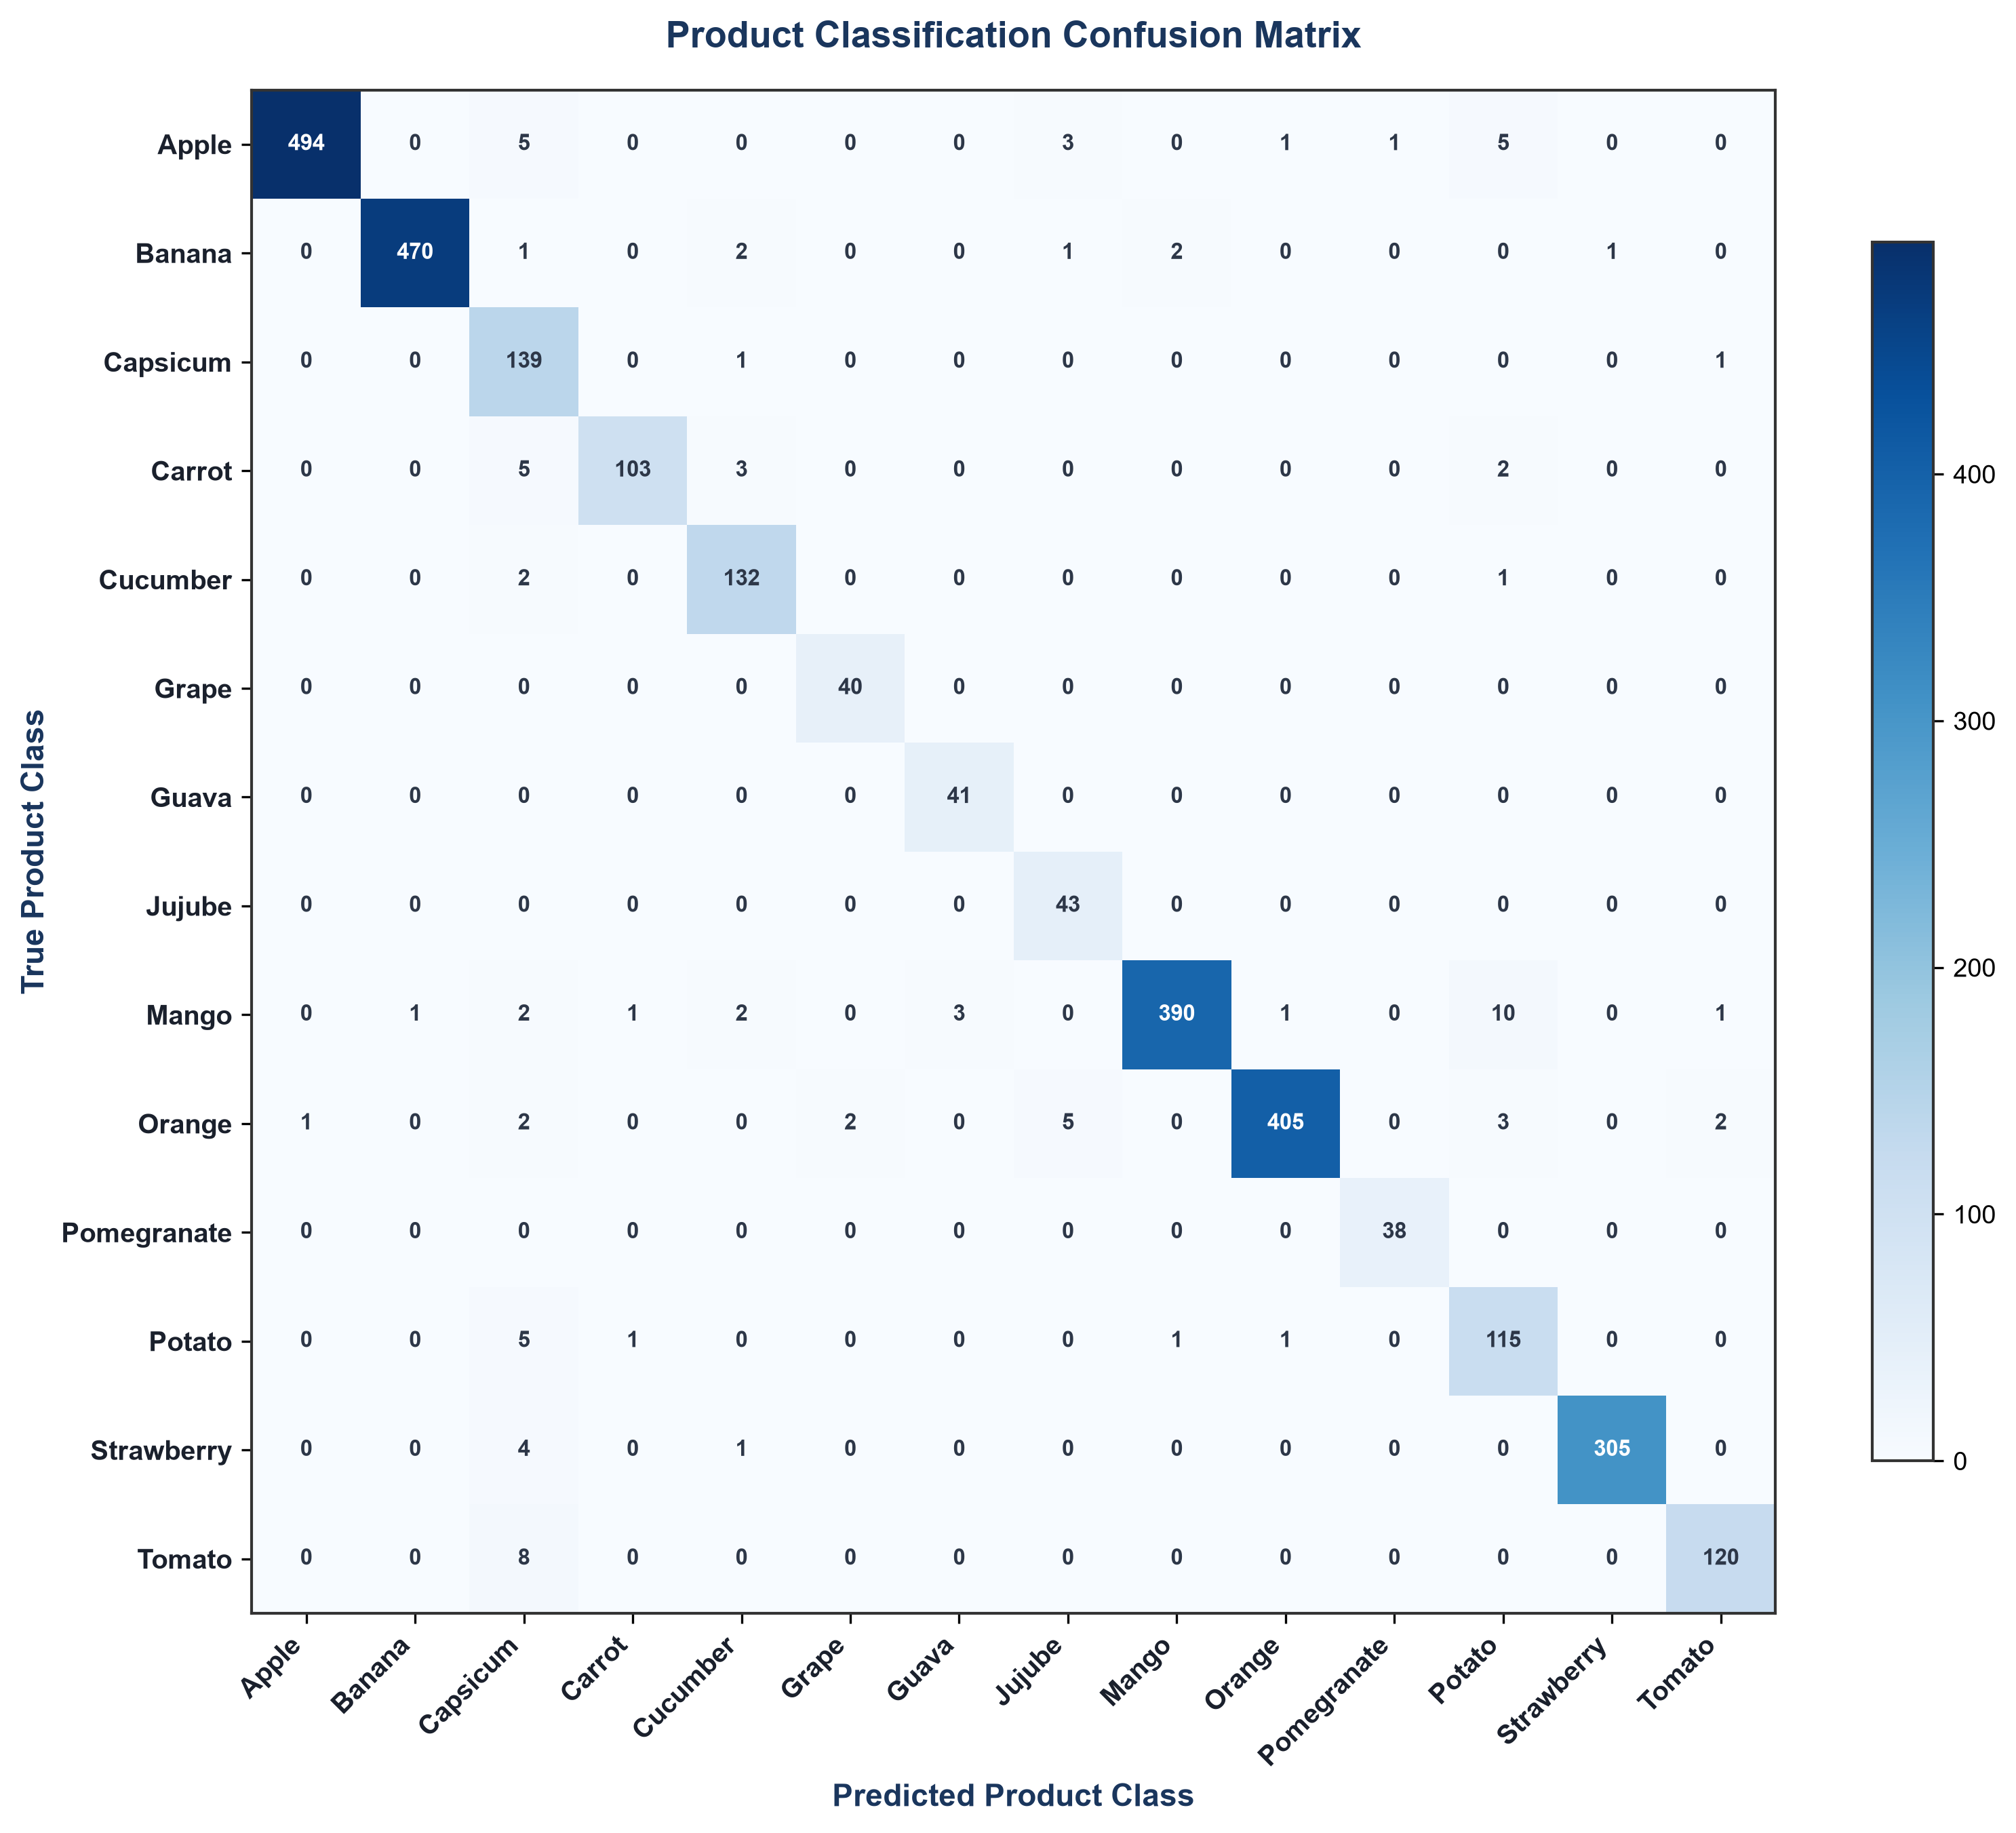
Results
Held-out test set, two curated datasets - evaluated honestly
96.8%
98.3%
34.7%
Product identification accuracy
Quality assessment accuracy
Near-duplicates found & controlled for via leakage-free split — confirming genuine generalisation
8

Slide 13
Technology Stack
BACKEND
FRONTEND
DATABASE
Python, FastAPI, JWT authentication, SQLAlchemy ORM
React (single-page application)
PostgreSQL
COMPUTER VISION
OTHER
PyTorch (ResNet-18 multi-head classifier), YOLOv8 (object detection), OpenCV (classical scoring)
ReportLab (PDF invoices), perceptual hashing (dataset deduplication), Docker (containerisation)
7

Slide 14






On Quality: Limitations & Evaluation Integrity
Detection limits
Dense, overlapping produce is harder to detect cleanly — future work: instance segmentation
Data availability
Some products (carrot, mango) grade less reliably — a data-availability limitation, not a design flaw
Visual similarity
Visually similar produce (apple / tomato) is occasionally confused
Training data scope
Only two datasets used; a third was excluded after near-duplicate contamination rose from 34.7% to 61.8%
Design boundary
Quality is graded by computer vision; organic provenance is verified separately by certificate and admin approval
Photo conditions
Reliability depends on reasonable photographic conditions
9

Slide 15
On Quality: Limitations & Evaluation Integrity
Dense, overlapping produce is harder to detect cleanly - future work: instance segmentation
Some products (carrot, Mango) grade less reliably - a data-availability limitation, not a design flaw
Visually similar produce (apple / tomato) is occasionally confused
Only two datasets used for training; a third was assessed and excluded after raising near-duplicate contamination from 34.7% to 61.8%
Quality is graded by computer vision; organic provenance is verified separately by certificate and admin approval - a deliberate design boundary
Reliability depends on reasonable photographic conditions
9

Slide 16
Conclusion & Future Work
A working, honestly evaluated trust layer for direct organic trade in Ireland
Novel dual-inspection protocol for objective, evidence-based dispute resolution
Future: instance segmentation for dense piles, more training data for weaker products
Future: real payment integration, cloud deployment, certificate-based path for meat and dairy
Thank you
Questions?
10

