Slide 1


EXAM 1
IS664 Database Programming
SPRING 2020
Professor HG Locklear
professorIS664@gmail.com
WIRELESS SENSOR NETWORK DATABASE

Slide 2
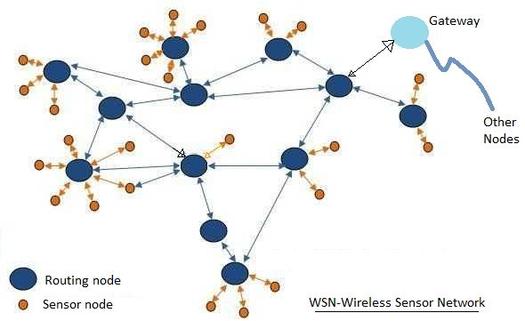
GENERAL
Our database paceWSN models a wireless sensor network.
A Wireless Sensor Network contains nodes that are part of individual networks and link to common gateway node that allows them to access a Master Node which is used to upload their data.

Slide 3
DATABASE SCHEMA (PaceWSN)
NODE_TYPE
1
HAS
1
NODE
1
HAS
1
HAS
1
1
NODE_BATTERY
IS
1
1
NETWORKS
NODE_NETWORK
1
1
1
HAS
HAS
NETWORK_TRANSMISSION
1
NETWORK_GATEWAY
1

Slide 4
DATABASE SCHEMA (PaceWSN)
NODE
IDNumber | NType | Location_X | Location_Y | AccessDistance | NStatus
NODE_TYPE
NType | Manufacturer | Cost | ServiceLife | CostLifeRatio
NETWORK_TRANSMISSION
Name | Link_Band | Link_Type
NODE_NETWORK
IDNumber | Network_A | Network_B | Network_C
NODE_BATTERY
NType | Battery
NETWORKS
Name | NET_Type
NETWORK_GATEWAY
Network_Name | NET_Type

Slide 5
DATABASE SCHEMA (PaceWSN)
Relation | Primary Key | Description | Referential Integrity | Generated Columns | DEFAULT VALUES | Other Constraints
NODE_TYPE | NType | Sensor Node Type Data | NONE | YES | NONE | No Attribute can be NULL
NODE | IDNumber | Individual Sensor Node Data | NODE_TYPE | YES | NStatus…Online | No Attribute can be NULL NStatus can only accept values of ‘Online’ or ‘Offline’
NODE_NETWORK | IDNumber | Node Connection to Networks Data C = Connected N = Not Connected | NODE | NO | NONE | No Attribute can be NULL Network_A, Network_B, and Network_C can only accept the values of ‘C’ or ‘N’
NETWORKS | Name | Network Type Data | NONE | NO | NONE | No Attribute can be NULL
NETWORK_GATEWAY | Network_Name | Gateway Node for each Network | NETWORKS NODE | NO | NONE | No Attribute can be NULL
NODE_BATTERY | NType | Battery Used by Node Type | NODE | NO | NONE | No Attribute can be NULL
NETWORK_TRANSMISSION | Name | Transmission Properties of Network | NETWORKS | NO | NONE | No Attribute can be NULL

Slide 6
GENERATED COLUMNS
Relation | Attribute | Data Type | Generated Column Formula | Stored or Virtual
NODE_TYPE | CostLifeRatio | DECIMAL(10,2) | Cost / ServiceLife | STORED
NODE | AccessDistance | DECIMAL(10,2) | 2D Euclidean Distance (KM) between this Node and the Master Node located at [100,100] | STORED

Slide 7
Queries
Create a single query for each of the questions listed below.
Display the result of each query as shown on the Expected Output Slide.
What is the ratio of offline to online nodes in all networks.
Which nodes are connected to Network A but not to Network C.
List all nodes that are offline in Network A.
List the status of all nodes in Network A manufactured by General Dynamics.
List any Type ‘C’ node that is more than 120 km but less than 135 km from the Master Node.

Slide 8
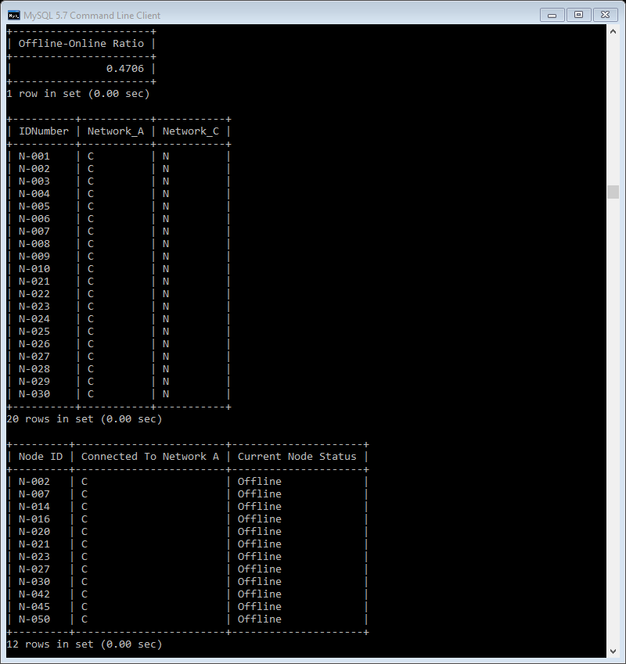
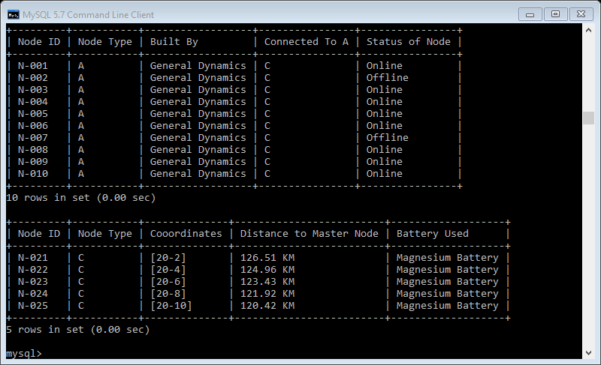
Expected Output
Q1
Q2
Q4
Q5
Q3

