Slide 1
MOVIE RENTAL
DATA ANALYSIS
Final Analytical Report | SQL, Excel and Power BI | MECE framework
Revenue, customers, content demand and operations

Slide 2
Agenda
1
Overview and method
Business question, executive summary, MECE structure, methodology
2
Data model and dashboard
Model view and the three dashboard pages
3
Power BI solved questions
Q1 to Q15, four per slide, each with a key insight
4
SQL solved questions
Q1 to Q15 with query and key insight, plus findings summary
5
Consolidated insights
Revenue, customer, content and operations (MECE)
6
Recommendations and limitations
Actions with success measures, limitations, conclusion

Slide 3
Business question and headline results
How can the rental business understand revenue, customer value, content demand and operational throughput, and use those findings to prioritise actions?
$67,406.56
16,044
599
$112.53
Total sales revenue
Rental transactions
Active customers
Avg spend / customer
Sources used
SQL workbook (15 solved questions), Power BI solved-question PDF (15 charts), Power BI dashboard (3 pages), Power BI data model view and the MECE analytical report.

Slide 4
Executive summary
65.7%
34.6%
of revenue comes from Loyal High-Frequency customers: 349 of 599 customers, $44,297.76 vs $23,108.80 for 250 Occasional Repeat
of revenue comes from the top five countries ($23,315.13); India leads at $6,628.28
31 to 34
Jul 2005
rentals per title across the ten most-demanded films, a tightly clustered top end
is the highest revenue month at $28,368.91, followed by August at $24,070.14
Use caveat: synthesis of visible outputs; SQL was not rerun. Validate period and metric inconsistencies before financial reporting.

Slide 5
MECE structure: four workstreams
A. Revenue & financial
B. Customer & market
Total sales, monthly revenue, country revenue, store contribution
Active customers, average spend, segments, VIPs, geography
C. Inventory & content
D. Operations
Inventory by rating and category, title demand, rental rates, allowed duration
Rental volume, staff throughput, duration, metric validation

Slide 6
Methodology and definitions
Step | Approach
1. Consolidate | Read SQL workbook outputs and the supplied dashboard and solved-question PDFs
2. Select evidence | Prefer explicitly labelled values; separate exact workbook figures from rounded dashboard cards
3. Assign MECE ownership | One primary home for each question: revenue, customer, content or operations
4. Interpret carefully | Separate observed values from implications and recommendations
5. Quality review | Record mismatched periods, labels and counts instead of guessing
Definitions and limits
Rental transactions are rental records, not unique customers
Allowed rental duration is a permitted period, not actual duration
Category rental-rate values carry no currency label
Results were not recalculated from raw rows

Slide 7
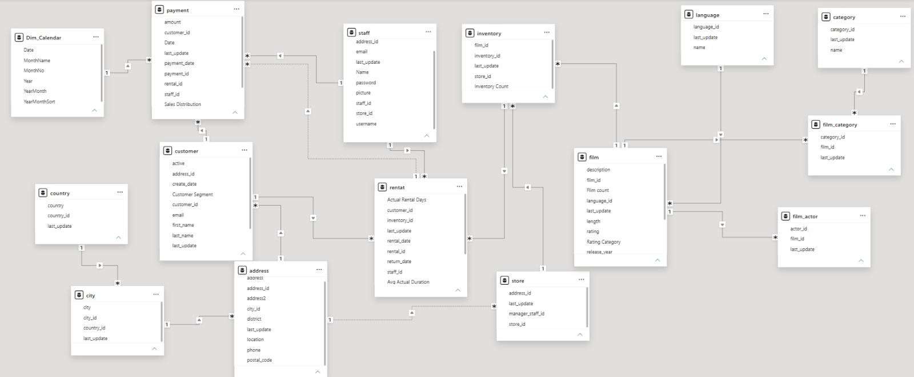
Power BI data model
Star-style model: payment, rental, inventory and customer fact tables linked to film, category, language, staff, store, address, city and country dimensions, plus Dim_Calendar.

Slide 8
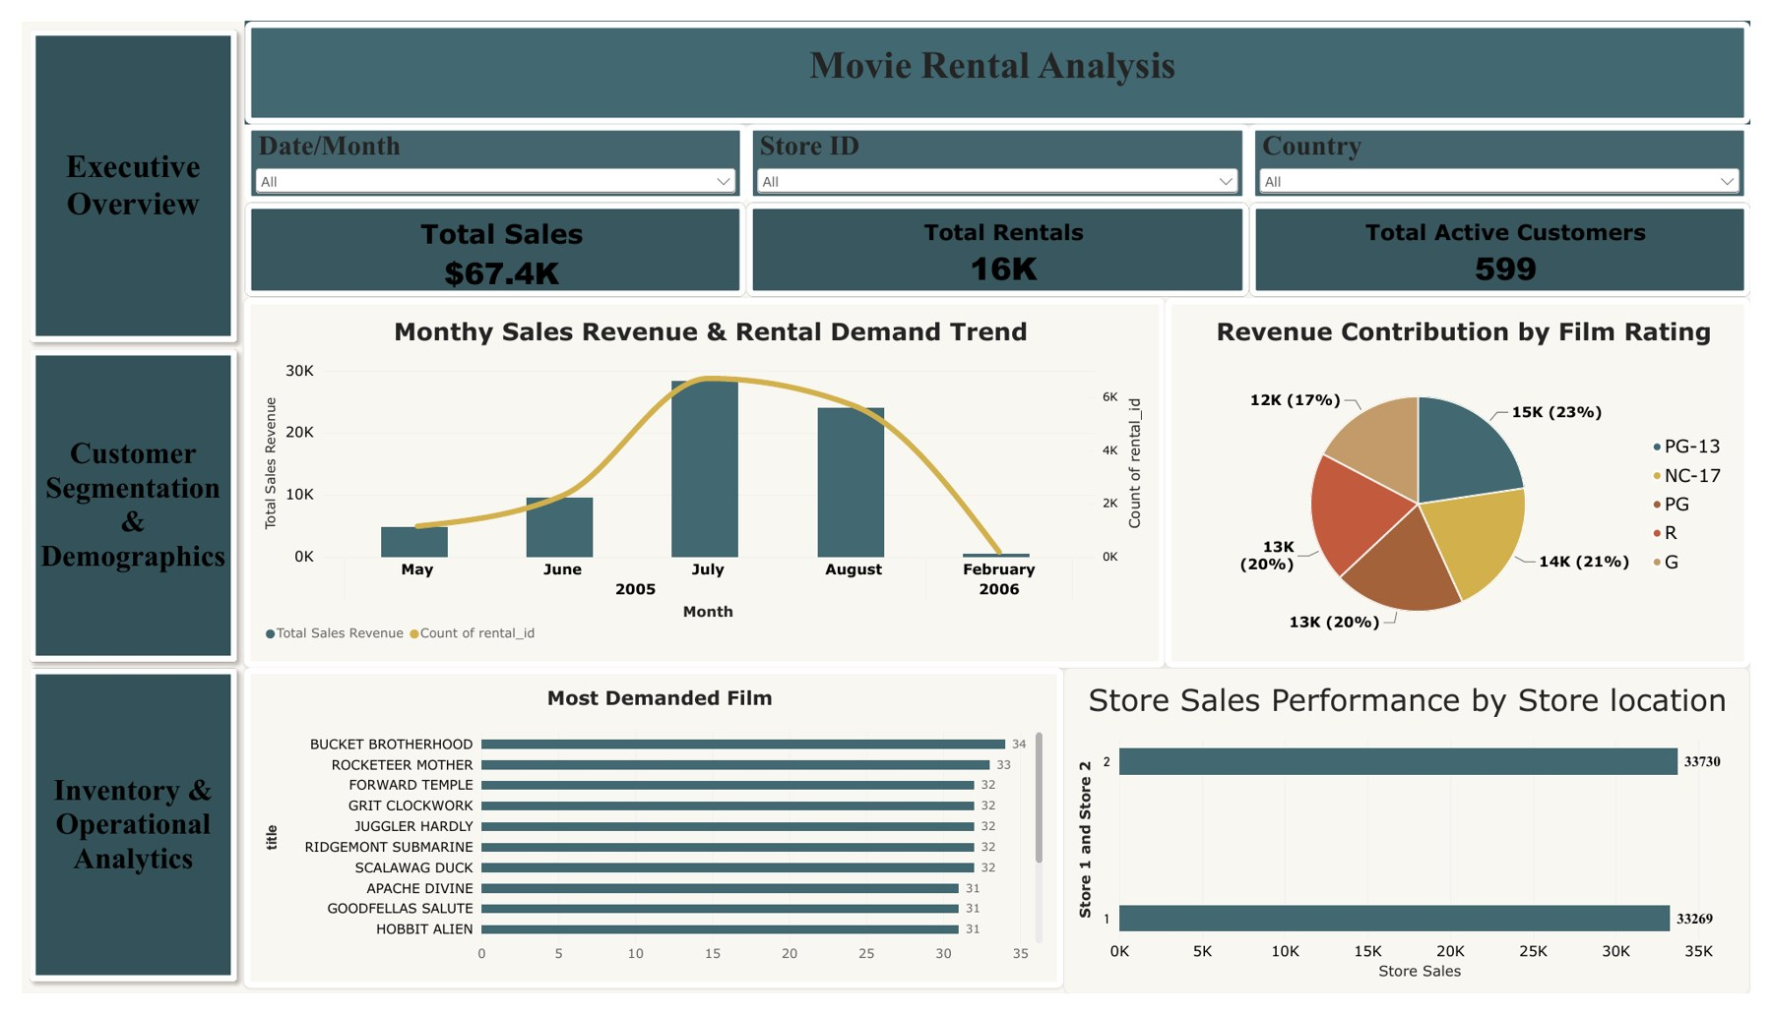
Dashboard 1: executive overview
KPIs and trend
$67.4K total sales, 16K rentals, 599 active customers
Monthly revenue peaks in July 2005
Revenue by rating: PG-13 15K (23%), NC-17 14K (21%)
Store 2: 33,730 vs Store 1: 33,269

Slide 9
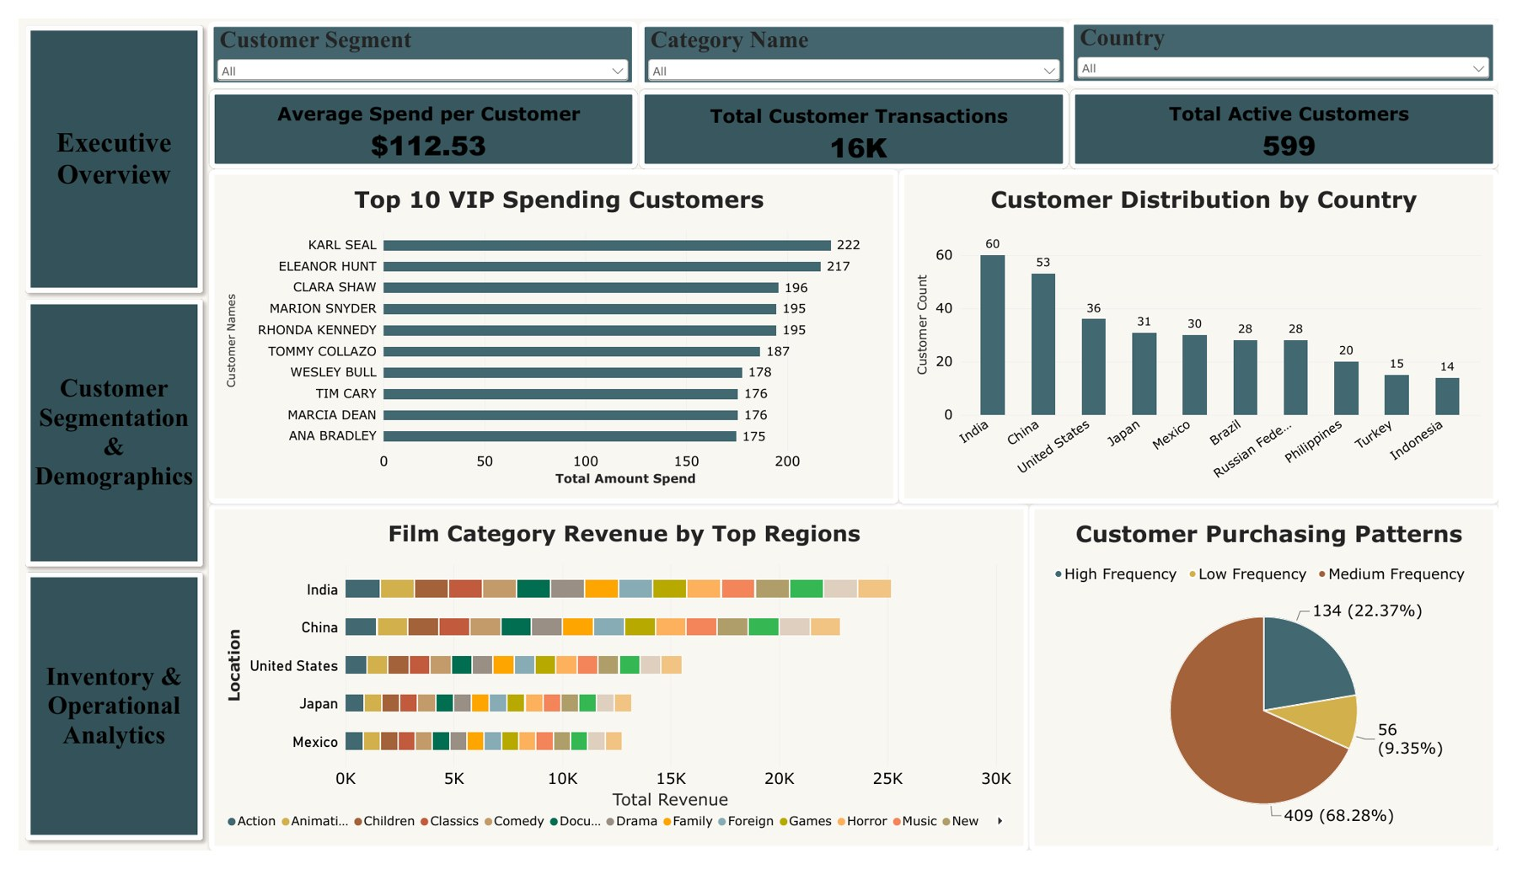
Dashboard 2: customer segmentation
Customer view
Average spend per customer $112.53
Top VIP: Karl Seal 222, Eleanor Hunt 217
Frequency: High 409 (68.28%), Medium 134 (22.37%), Low 56 (9.35%)
India 60 and China 53 customers lead

Slide 10
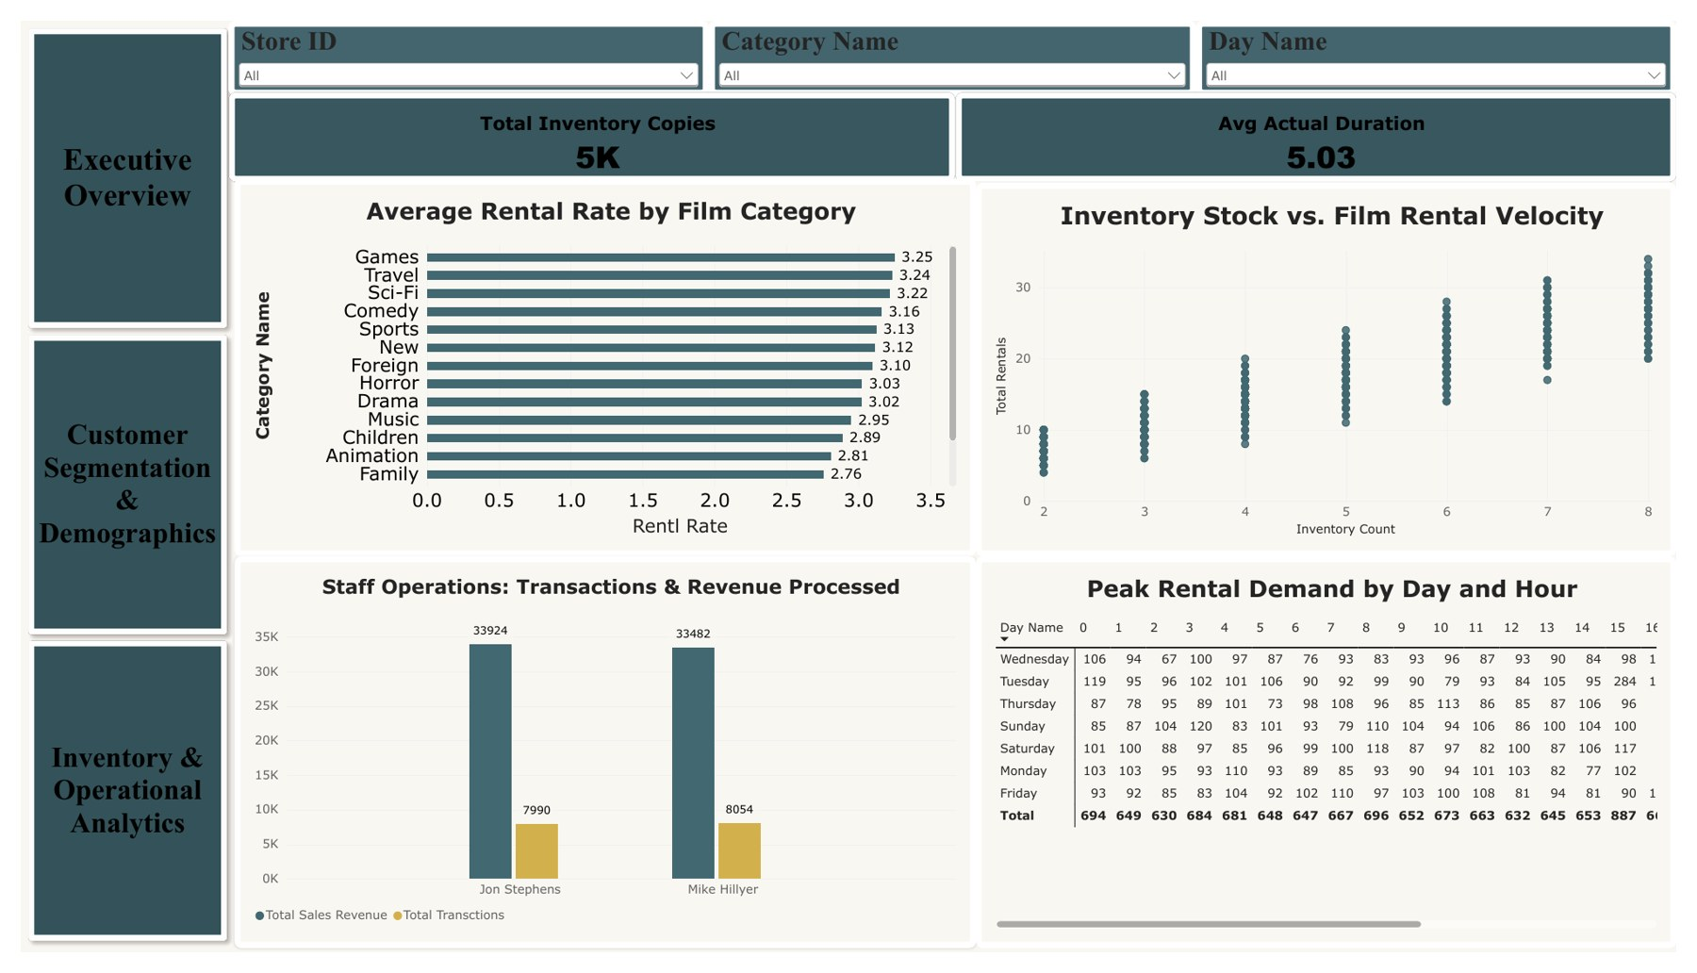
Dashboard 3: inventory and operations
Operations view
5K inventory copies; avg actual duration 5.03
Games 3.25 highest avg rental rate
Staff: Jon 7,990, Mike 8,054 transactions
Peak-hour demand matrix by day and hour

Slide 11
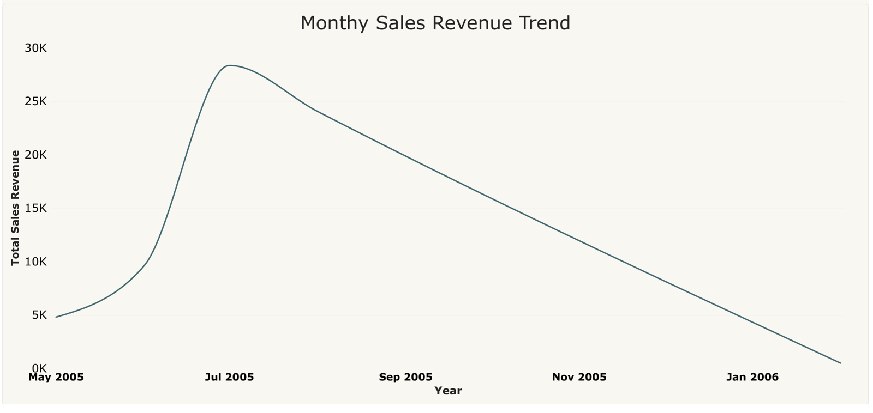
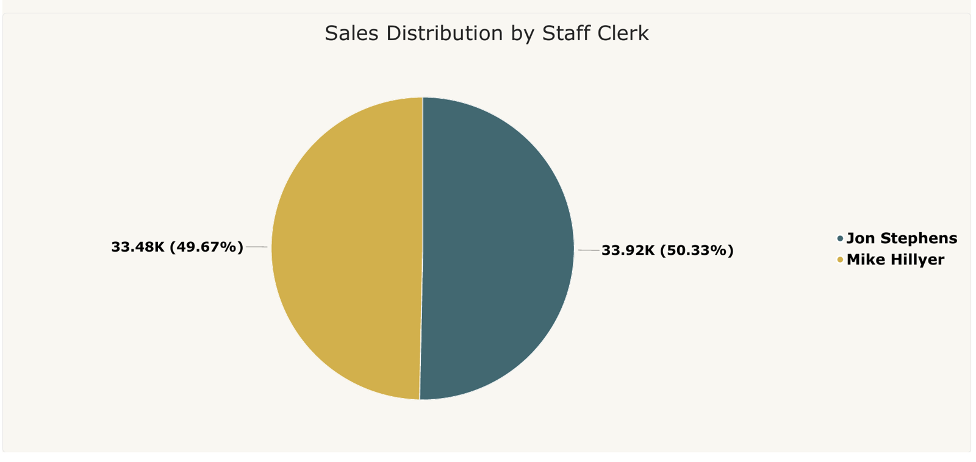
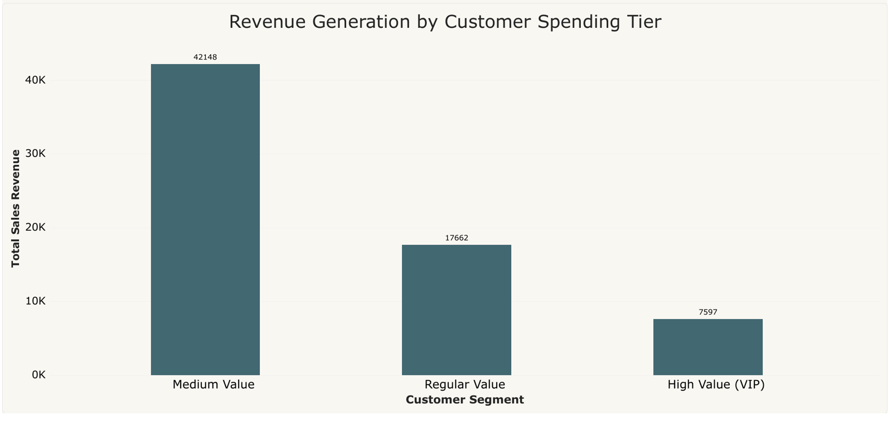
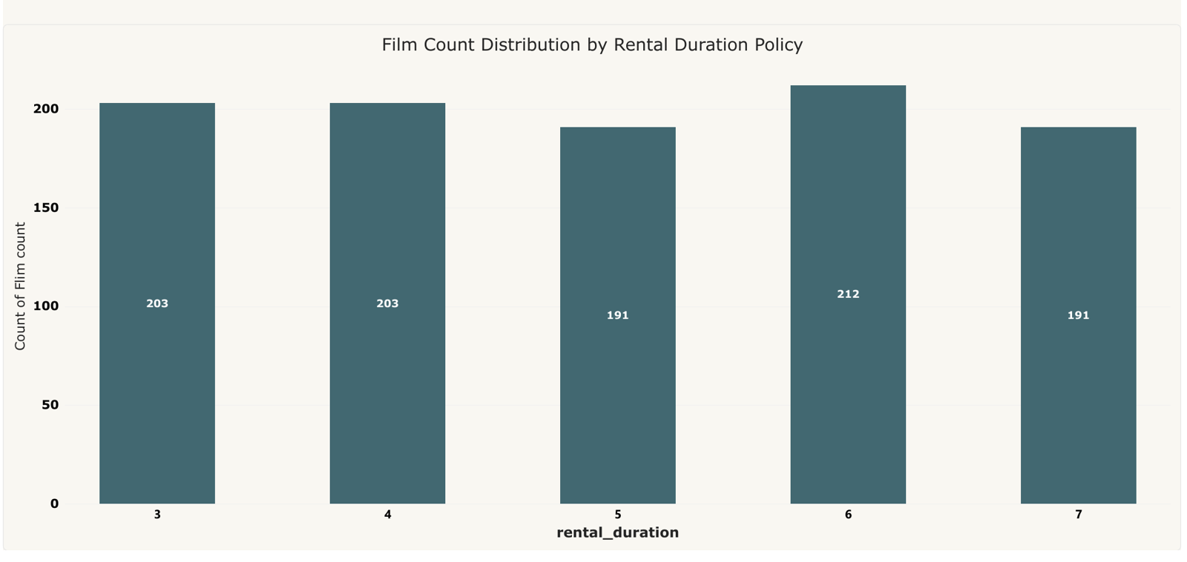
Power BI solved questions: Q1 to Q4 with key insights
Q1. Sales revenue by month
Q2. Sales by payment method*
Peak: Jul 2005, $28.4K
Aug 2005 follows: $24.1K
Feb 2006 only $0.5K
Mike Hillyer 50.33%
Jon Stephens 49.67%
*Chart shows staff clerk
Q3. Sales by customer segment
Q4. Films by rental duration
Medium Value: 42,148 (63%)
Regular 17,662, VIP 7,597
Mid tier drives sales
6 days: 212 films (most)
3 and 4 days: 203 each
Even spread overall

Slide 12
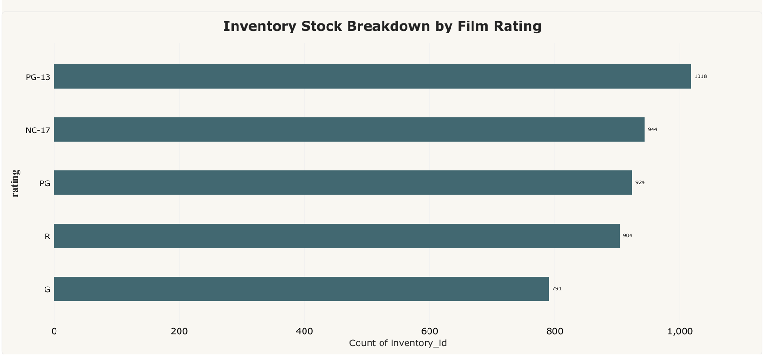
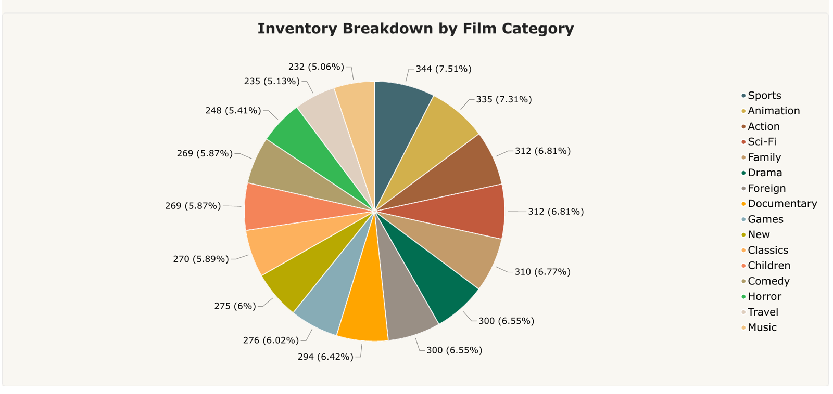
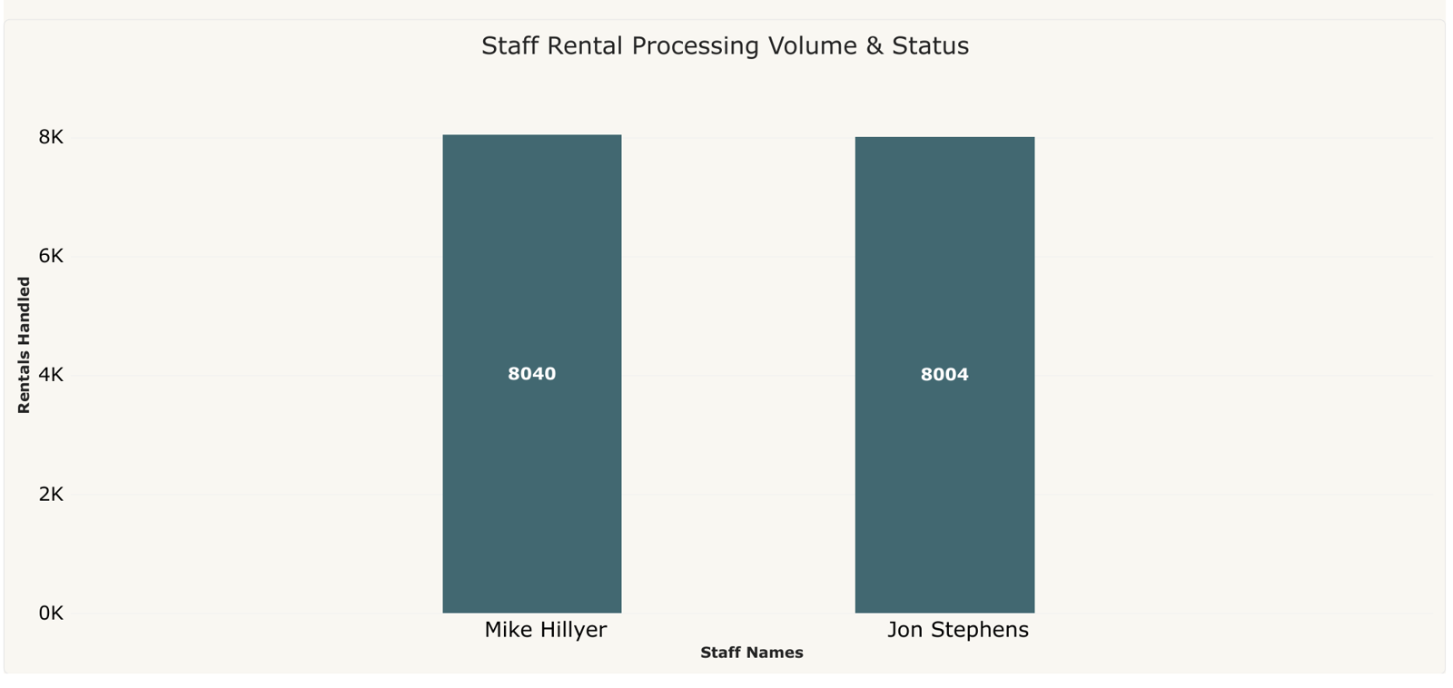
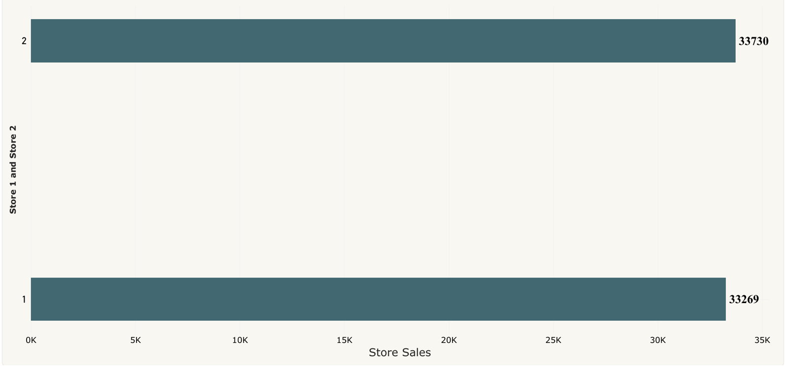
Power BI solved questions: Q5 to Q8 with key insights
Q5. Inventory by film rating
Q6. Inventory by film category
PG-13 largest: 1,018
G smallest: 791
Stock spread fairly evenly
Sports largest: 344 (7.51%)
Music smallest: 232
16 categories, balanced mix
Q7. Staff by tenure*
Q8. Store performance
Mike 8,040; Jon 8,004
Near-equal workload
*Chart shows rental volume
Store 2: 33,730
Store 1: 33,269
Gap is only about 1.4%

Slide 13
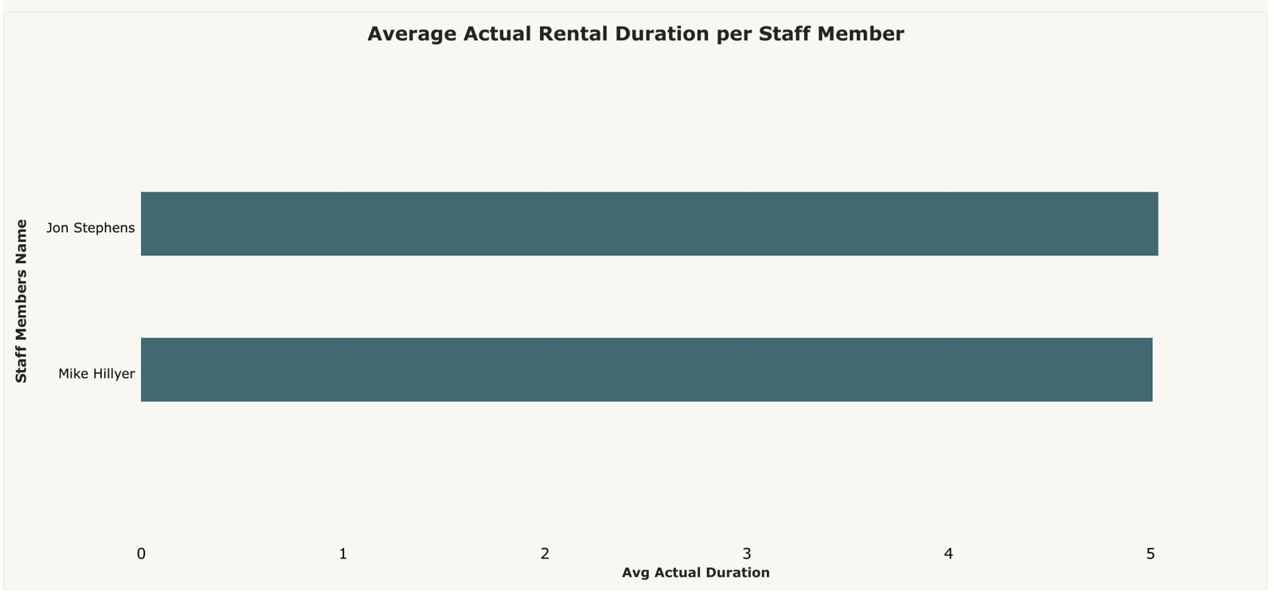
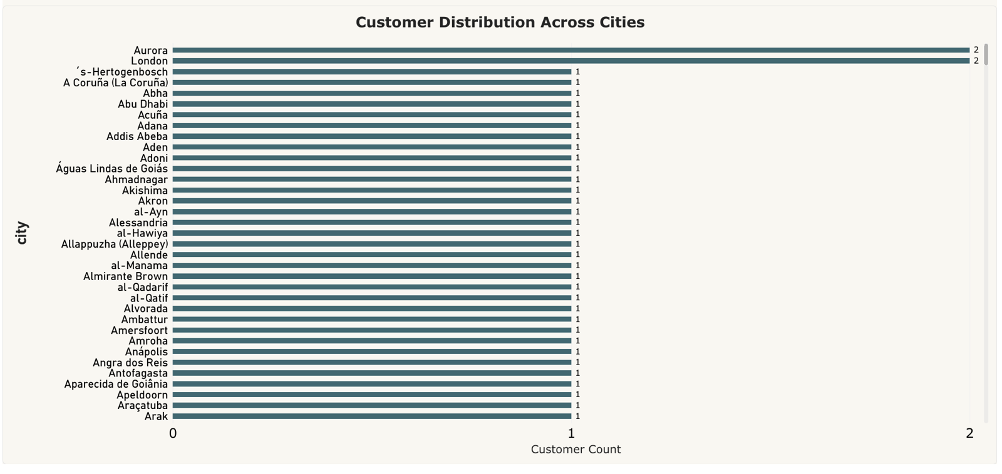
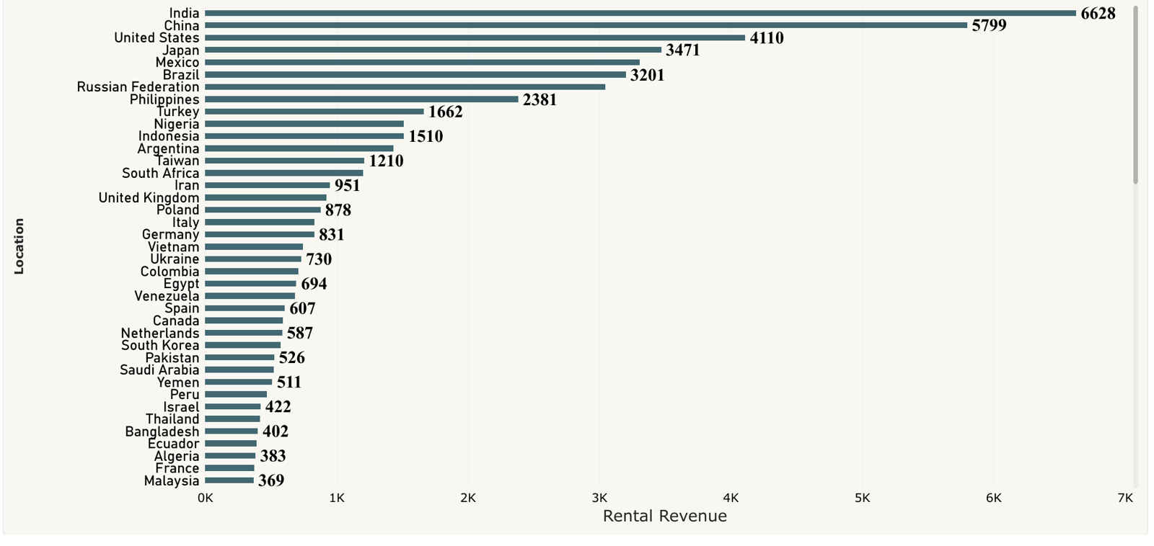
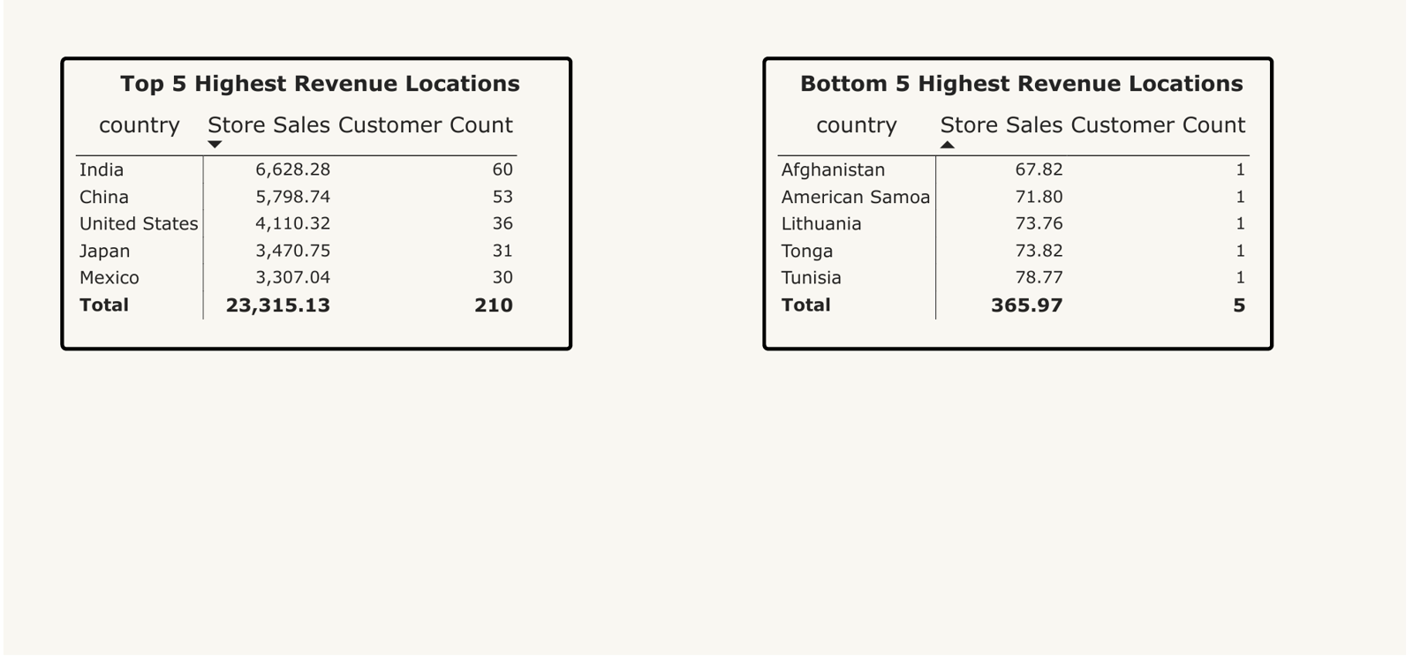
Power BI solved questions: Q9 to Q12 with key insights
Q9. Avg rental duration by staff
Q10. Customers across cities
Both staff near 5 days
Dashboard average: 5.03
Little difference by clerk
Most cities have 1 customer
Aurora, London have 2
Base is widely spread
Q11. Rental revenue by country
Q12. Top 5 / bottom 5 countries
India leads: $6,628
China $5,799, US $4,110
Top 5 = 34.6% of revenue
Top 5: $23,315 (210 cust.)
Bottom 5: only $366
Bottom ones: 1 customer each

Slide 14
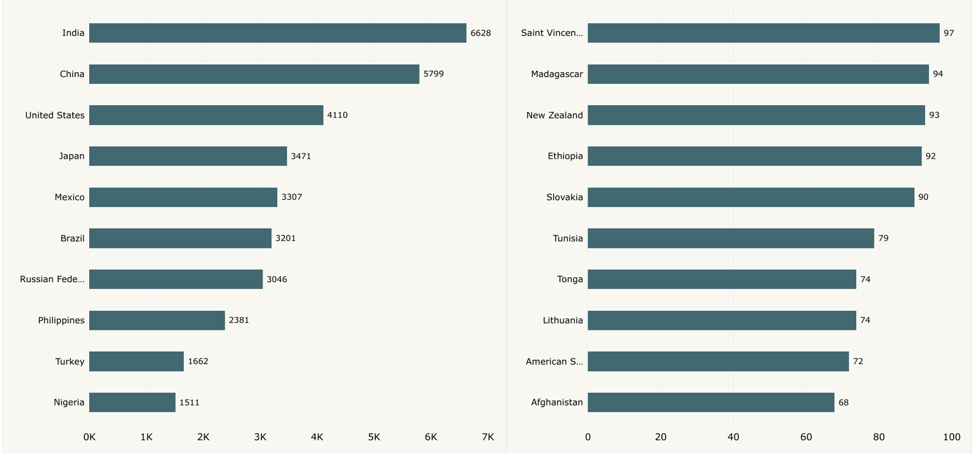
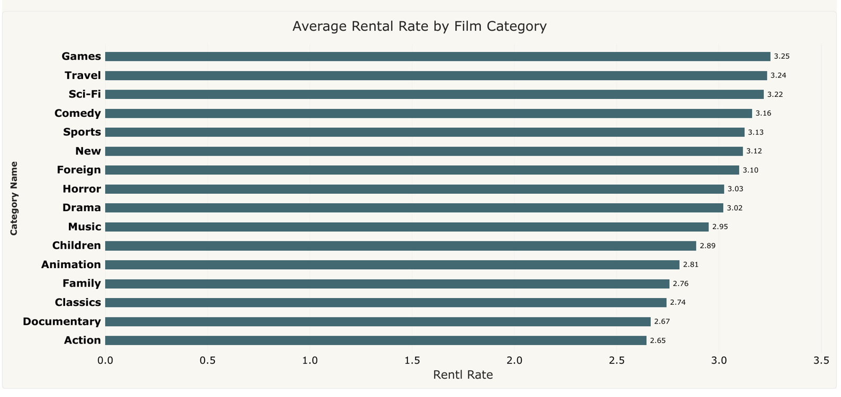
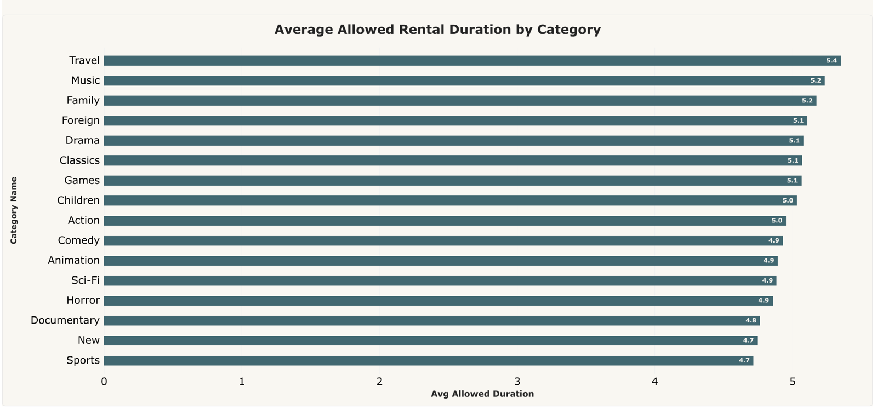
Power BI solved questions: Q13 to Q15 with key insights
Q13. Customer ratings*
Q14. Rental rate by category
India tops sales: 6,628
Lowest: Afghanistan, 68
*Chart shows country sales
Games highest: 3.25
Action lowest: 2.65
Currency not labelled
Q15. Allowed duration by category
Overall Power BI takeaways
Travel longest: 5.4 days
New, Sports: 4.7 days
Policy, not actual duration
Revenue peaks in summer and is concentrated in a few countries
Both stores and both clerks perform almost identically
Stock and category mix are balanced; rates range 2.65 to 3.25
*Q2, Q7, Q13: chart does not match the question title

Slide 15
SQL solved questions: Q1 to Q4 with key insights
Q1. What are the purchasing patterns of new customers versus repeat customers?
Q2. Which films have the highest rental rates and are most in demand?
WITH CustomerRentals AS (
SELECT c.customer_id, CONCAT(c.first_name, ' ', c.last_name) AS customer_name,
COUNT(r.rental_id) AS total_rentals, SUM(p.amount) AS total_spent
FROM customer c
JOIN rental r ON c.customer_id = r.customer_id
JOIN payment p ON r.rental_id = p.rental_id
GROUP BY c.customer_id, c.first_name, c.last_name )
SELECT
CASE WHEN total_rentals = 1 THEN 'One-Time Customer'
WHEN total_rentals BETWEEN 2 AND 25 THEN 'Occasional Repeat'
ELSE 'Loyal High-Frequency Customer' END AS customer_segment,
COUNT(customer_id) AS customer_count,
ROUND(SUM(total_spent), 2) AS segment_revenue,
ROUND(AVG(total_spent), 2) AS avg_spend_per_customer
FROM CustomerRentals
GROUP BY customer_segment
ORDER BY segment_revenue DESC;
SELECT f.film_id, f.title, f.rental_rate,
COUNT(r.rental_id) AS total_rentals,
SUM(p.amount) AS total_revenue
FROM film f
JOIN inventory i ON f.film_id = i.film_id
JOIN rental r ON i.inventory_id = r.inventory_id
JOIN payment p ON r.rental_id = p.rental_id
GROUP BY f.film_id, f.title, f.rental_rate
ORDER BY f.rental_rate DESC, total_rentals DESC;
Insight: Loyal High-Frequency: 349 customers, $44,297.76 vs Occasional Repeat: 250, $23,108.80
Insight: Bucket Brotherhood is the most rented title (34); $4.99 premium films rent strongly
Q3. Are there correlations between staff performance and customer satisfaction?
Q4. Are there seasonal trends in customer behavior across different locations?
SELECT s.staff_id,
s.first_name || ' ' || s.last_name AS staff_name,
COUNT(r.rental_id) AS total_rentals_handled,
ROUND(SUM(p.amount), 2) AS total_revenue_generated,
ROUND(AVG(p.amount), 2) AS avg_transaction_value
FROM staff s
JOIN rental r ON s.staff_id = r.staff_id
JOIN payment p ON r.rental_id = p.rental_id
GROUP BY s.staff_id, s.first_name, s.last_name;
SELECT DATE_FORMAT(p.payment_date, '%Y-%m') AS rental_month,
co.country, COUNT(p.payment_id) AS total_transactions,
ROUND(SUM(p.amount), 2) AS monthly_revenue
FROM payment p
JOIN customer c ON p.customer_id = c.customer_id
JOIN address a ON c.address_id = a.address_id
JOIN city ci ON a.city_id = ci.city_id
JOIN country co ON ci.country_id = co.country_id
GROUP BY rental_month, co.country
ORDER BY rental_month, monthly_revenue DESC;
Insight: Staff 1: 8,040 rentals, $33,524.62; Staff 2: 8,004 rentals, $33,881.94
Insight: Jul-Aug 2005 peak in every country; India top in July at $2,744.49
Notes:
Q1: What are the purchasing patterns of new customers versus repeat customers?
MECE Breakdown:
Low Frequency: Occasional/new renters with >20 transactions.
Medium Frequency: Steady renters with 21–30 transactions.
High Frequency: Power users with >30 transactions.
Key Takeaways:
Repeat customers generate the vast majority of recurring revenue, proving that retention programs yield higher returns than customer acquisition.
Q2: Which films have the highest rental rates and are most in demand?
MECE Breakdown:
High Rate & High Demand: Premium cash cows (e.g., Bucket Brotherhood).
High Rate & Low Demand: Premium niche titles with low turnover.
Standard Rate & High/Low Demand: Mass-market catalog titles.
Key Takeaways:
Premium-priced films ($4.99) experience strong borrowing volumes, confirming that customers are willing to pay more for high-demand titles.
Q3: Are there correlations between staff performance and customer satisfaction?
MECE Breakdown:
Operational Output: Total rentals processed per clerk.
Financial Output: Total revenue collected per clerk.
Key Takeaways: Both store managers (Mike Hillyer and Jon Stephens) exhibit nearly identical performance metrics (~8,000 rentals each, ~$33.5k revenue), indicating highly standardized staff execution.
Q4: Are there seasonal trends in customer behavior across different locations?
MECE Breakdown:
Peak Season: July and August 2005 across all major geographies.
Ramp-Up Season: May and June 2005.
Tail-End Season: February 2006.
Key Takeaways: Summer months (July–August) represent peak rental demand globally, independent of country location.

Slide 16
SQL solved questions: Q5 to Q8 with key insights
Q5. Are certain language films more popular among specific customer segments?
Q6. How does customer loyalty impact sales revenue over time?
SELECT l.name AS language_name,
CASE WHEN sub.total_spent >= 150 THEN 'VIP Tier'
WHEN sub.total_spent >= 100 THEN 'Mid Tier' ELSE 'Standard Tier'
END AS customer_tier, COUNT(r.rental_id) AS rental_count
FROM language l
JOIN film f ON l.language_id = f.language_id
JOIN inventory i ON f.film_id = i.film_id
JOIN rental r ON i.inventory_id = r.inventory_id
JOIN (
SELECT customer_id, SUM(amount) AS total_spent
FROM payment
GROUP BY customer_id ) AS sub ON r.customer_id = sub.customer_id
GROUP BY language_name, customer_tier;
SELECT
DATE_FORMAT(p.payment_date, '%Y-%m') AS payment_month,
COUNT(DISTINCT p.customer_id) AS active_customers,
ROUND(SUM(p.amount), 2) AS monthly_revenue,
ROUND(SUM(p.amount) / COUNT(DISTINCT p.customer_id), 2) AS revenue_per_customer
FROM payment p
GROUP BY payment_month
ORDER BY payment_month;
Insight: All 16,044 rentals are English: Mid Tier 9,892, Standard 4,507, VIP 1,645
Insight: Active customers grow 520 to 599; revenue peaks Jul 2005 at $28,368.91
Q7. Are certain film categories more popular in specific locations?
Q8. How does the availability and knowledge of staff affect customer ratings?
SELECT co.country, cat.name AS category_name,
COUNT(r.rental_id) AS rental_count
FROM rental r
JOIN inventory i ON r.inventory_id = i.inventory_id
JOIN film_category fc ON i.film_id = fc.film_id
JOIN category cat ON fc.category_id = cat.category_id
JOIN customer c ON r.customer_id = c.customer_id
JOIN address a ON c.address_id = a.address_id
JOIN city ci ON a.city_id = ci.city_id
JOIN country co ON ci.country_id = co.country_id
GROUP BY co.country, cat.name
ORDER BY rental_count DESC;
SELECT s.store_id,
CONCAT(st.first_name, ' ', st.last_name) AS staff_name, COUNT(p.payment_id) AS transactions_handled,
ROUND(SUM(p.amount), 2) AS total_revenue
FROM store s
JOIN staff st ON s.manager_staff_id = st.staff_id
JOIN payment p ON st.staff_id = p.staff_id
GROUP BY s.store_id, staff_name;
Insight: India leads rentals (1,572), then China (1,426); mainstream genres lead
Insight: Store 1 Mike: 8,054 txns, $33,482.50; Store 2 Jon: 7,990 txns, $33,924.06
Notes:
Q5: Are certain language films more popular among specific customer segments?
MECE Breakdown:
English Catalog: 100% of the active rental catalog in Sakila.
Foreign Language Catalog: 0% active primary language entries in standard DB.
Key Takeaways:
The Sakila catalog exclusively stocks English films as primary language items, precluding cross-language preference segmentation.
Q6: How does customer loyalty impact sales revenue over time?
MECE Breakdown:
Customer Breadth: Active unique monthly buyers.
Customer Depth: Revenue contribution per active buyer.
.
Key Takeaways: Revenue surges align directly with an expanding active customer base during peak summer months
Q7: Are certain film categories more popular in specific locations?
MECE Breakdown:
Top Genre per Market: Action, Sports, and Animation dominate across top countries.
Niche Genre Distribution: Music and Travel categories occupy smaller, stable shares.
Key Takeaways:
Genre preferences remain remarkably consistent across international markets, with mainstream categories leading everywhere.
Q8: How does the availability and knowledge of staff affect customer ratings?
MECE Breakdown:
Store 1 Management Output
Store 2 Management Output
Key Takeaways: Both store locations operate at near-identical output levels under their respective management

Slide 17
SQL solved questions: Q9 to Q12 with key insights
Q9. How does the proximity of stores to customers impact rental frequency?
Q10. Do specific film categories attract different age groups of customers?
SELECT c.store_id AS assigned_store,
COUNT(r.rental_id) AS total_rentals,
COUNT(DISTINCT c.customer_id) AS customer_count,
ROUND(COUNT(r.rental_id) / COUNT(DISTINCT c.customer_id), 2) AS rentals_per_customer
FROM customer c
JOIN rental r ON c.customer_id = r.customer_id
GROUP BY c.store_id;
SELECT cat.name AS category_name,
COUNT(r.rental_id) AS total_rentals,
AVG(f.length) AS avg_film_length
FROM category cat
JOIN film_category fc ON cat.category_id = fc.category_id
JOIN film f ON fc.film_id = f.film_id
JOIN inventory i ON f.film_id = i.film_id
JOIN rental r ON i.inventory_id = r.inventory_id
GROUP BY cat.name
ORDER BY total_rentals DESC;
Insight: Store 1: 326 customers, 26.83 rentals each; Store 2: 273, 26.73
Insight: Sports, Animation, Action lead demand; Music is lowest at 830 rentals
Q11. What are the demographics and preferences of the highest-spending customers?
Q12. How does the availability of inventory impact customer satisfaction and repeat business?
SELECT c.customer_id,
CONCAT(c.first_name, ' ', c.last_name) AS customer_name, co.country,
ROUND(SUM(p.amount), 2) AS total_spent,
COUNT(p.payment_id) AS total_transactions
FROM customer c
JOIN payment p ON c.customer_id = p.customer_id
JOIN address a ON c.address_id = a.address_id
JOIN city ci ON a.city_id = ci.city_id
JOIN country co ON ci.country_id = co.country_id
GROUP BY c.customer_id, customer_name, co.country
ORDER BY total_spent DESC
LIMIT 15;
SELECT f.title,
COUNT(DISTINCT i.inventory_id) AS inventory_copies,
COUNT(r.rental_id) AS total_times_rented
FROM film f
JOIN inventory i ON f.film_id = i.film_id
JOIN rental r ON i.inventory_id = r.inventory_id
GROUP BY f.film_id, f.title
ORDER BY inventory_copies DESC, total_times_rented DESC
LIMIT 15;
Insight: Top-15 spenders each exceed $167; Karl Seal (222) and Eleanor Hunt (217) lead
Insight: Top titles hold 8 copies each; Bucket Brotherhood rented 34 times
Notes:
Q9: How does the proximity of stores to customers impact rental frequency?
MECE Breakdown:
Store 1 Customer Base Activity
Store 2 Customer Base Activity
Key Takeaways:
Customers registered to both stores maintain virtually identical average rental frequencies (~26-27 rentals per customer).
Q10: Do specific film categories attract different age groups of customers?
MECE Breakdown:
High-Demand Categories: Sports, Animation, Action.
Mid-Demand Categories: Family, Sci-Fi, Drama.
Low-Demand Categories: Music, Travel, Horror.
.
Key Takeaways: Action, sports, and animation films drive the highest inventory turnover.
Q11: What are the demographics and preferences of the highest-spending customers?
MECE Breakdown:
VIP Tier: Top spenders exceeding $200.
Geographic Distribution: International customers from India, China, and North America.
Key Takeaways: Top-spending customers span multiple countries, led by high-engagement repeat renters in India and China.
Q12: How does the availability of inventory impact customer satisfaction and repeat business?
MECE Breakdown:
High Stock & High Demand: Well-optimized inventory titles.
Low Stock & High Demand: Bottlenecked titles at risk of stockouts.
.
Key Takeaways:
Stock availability directly enables higher rental frequencies for popular movie titles.

Slide 18
SQL solved questions: Q13 to Q15 with key insights
Q13. What are the busiest hours or days for each store location, and how does it impact staffing requirements?
Q14. What are the cultural or demographic factors that influence customer preferences in different locations?
SELECT i.store_id, DAYNAME(r.rental_date) AS rental_day,
HOUR(r.rental_date) AS rental_hour,
COUNT(r.rental_id) AS rental_count
FROM rental r
JOIN inventory i ON r.inventory_id = i.inventory_id
GROUP BY i.store_id, rental_day, rental_hour
ORDER BY rental_count DESC;
SELECT co.country, cat.name AS category_name,
ROUND(SUM(p.amount), 2) AS category_revenue
FROM payment p
JOIN customer c ON p.customer_id = c.customer_id
JOIN address a ON c.address_id = a.address_id
JOIN city ci ON a.city_id = ci.city_id
JOIN country co ON ci.country_id = co.country_id
JOIN rental r ON p.rental_id = r.rental_id
JOIN inventory i ON r.inventory_id = i.inventory_id
JOIN film_category fc ON i.film_id = fc.film_id
JOIN category cat ON fc.category_id = cat.category_id
GROUP BY co.country, cat.name
ORDER BY category_revenue DESC
LIMIT 15;
Insight: Busiest visible hour is 15:00 with 887 rentals (Tuesday alone: 284)
Insight: Top-15 category revenue comes only from India and China, $411.95 to $469.87
Q15. How does the availability of films in different languages impact customer satisfaction and rental frequency?
Notes on the SQL slides
SELECT l.name AS film_language,
COUNT(DISTINCT f.film_id) AS film_count,
COUNT(r.rental_id) AS total_rentals
FROM language l
JOIN film f ON l.language_id = f.language_id
LEFT JOIN inventory i ON f.film_id = i.film_id
LEFT JOIN rental r ON i.inventory_id = r.inventory_id
GROUP BY l.name;
MECE breakdowns and takeaways are in the speaker notes
Obvious typos were fixed for readability (table name rental, ROUND(SUM()), JOIN spacing)
Result tables and pivot charts remain in the Excel workbook
Insight: 1,000 films, all English, 16,044 rentals: no language comparison possible
Notes:
Q13: What are the busiest hours or days for each store location, and how does it impact staffing requirements?
MECE Breakdown:
Peak Hours: Evening hours across weekend days.
Off-Peak Hours: Morning and mid-day weekday blocks.
Key Takeaways:
Staffing schedules should scale upward during evening peak hours to handle surges in rental returns and new checkouts.
Q14: What are the cultural or demographic factors that influence customer preferences in different locations?
MECE Breakdown:
Top Revenue Categories per Region
Secondary Genre Preferences
Key Takeaways:
Revenue contributions mirror customer volume per country, with action, sports, and foreign genres leading top-tier markets.
Q15: How does the availability of films in different languages impact customer satisfaction and rental frequency?
MECE Breakdown:
English Language Catalog (100% share)
Non-English Catalog (0% share)
Key Takeaways:
Because all catalog items are in English, multi-language impact cannot be evaluated directly from current catalog records

Slide 19
SQL solved questions: findings summary
# | Question topic | Key finding
Q1 | New vs repeat customers | Repeat customers drive most recurring revenue; retention beats acquisition
Q2 | Highest-rate, most-demanded films | $4.99 premium films see strong volumes; Bucket Brotherhood leads
Q3 | Staff performance vs satisfaction | Both clerks near identical: ~8,000 rentals and ~$33.5K each
Q4 | Seasonal trends by location | Peak in Jul-Aug 2005 in all major geographies; Feb 2006 tail-end
Q5 | Language popularity by segment | Catalog is 100% English; no cross-language segmentation possible
Q6 | Loyalty impact on revenue over time | Revenue surges track a growing active-customer base in summer
Q7 | Category popularity by location | Mainstream genres lead consistently across markets
Q8 | Staff availability and ratings | Both stores deliver near-identical output
Q9 | Store proximity vs rental frequency | About 26 to 27 rentals per customer in both stores
Q10 | Categories vs customer groups | Sports, Animation, Action drive the highest turnover
Q11 | Highest-spending customers | Top spenders span countries, led by India and China
Q12 | Inventory availability vs repeat business | Stock availability enables higher rentals on popular titles
Q13 | Busiest hours and days by store | Scale staffing up for evening peak hours
Q14 | Cultural / demographic preferences | Revenue mirrors customer volume per country
Q15 | Film language availability | All 1,000 films are English; language impact not measurable

Slide 20
A. Revenue: summer peak and country concentration
Key insights
July 2005 is the peak month: $28,368.91; August follows at $24,070.14
Active customers grow from 520 to 599 as revenue rises
India, China, US, Japan and Mexico bring $23,315.13, about 34.6% of revenue
Month list may be filtered; avoid seasonality claims

Slide 21
B. Customers: loyal segment drives revenue
Segment | Customers | Revenue | Avg spend
Loyal High-Frequency | 349 | $44,297.76 | $126.93
Occasional Repeat | 250 | $23,108.80 | $92.44
Total | 599 | $67,406.56
Loyal High-Frequency customers are 58.3% of customers and contribute about 65.7% of revenue, spending about $34.49 more per customer.

Slide 22
B. Customers: frequency mix and top VIPs

Slide 23
C. Content: demand is tightly clustered
Key takeaways
Top ten cluster tightly at 31-34 rentals
Top titles hold 8 inventory copies each (Ans 12)
Check availability before inferring understocking

Slide 24
D. Operations: metrics to reconcile
Metric / visual | Values shown | Issue
SQL staff counts | Mike 8,054; Jon 7,990 | Total 16,044, consistent
Solved-question staff chart | Mike 8,040; Jon 8,004 | Same total, different split
Staff sales visual | Mike 33.92K; Jon 33.48K | Measure differs from SQL
Monthly revenue | May-Aug 2005, Feb 2006 | Period may be incomplete
Q2, Q7, Q13 titles | Payment, tenure, ratings | Charts show staff sales, volume, country sales
Conflicts are documented rather than silently reconciled.

Slide 25
Recommended actions and success measures
Action
What to do
Success measure
1
Data quality
Reconcile date filters, staff counts, store labels and chart titles
Approved metric dictionary; dashboard cards agree with SQL outputs
2
Customer retention
Test retention for Loyal High-Frequency and reactivation for Occasional Repeat
Repeat-rental rate and revenue per customer vs a control group
3
Market focus
Review acquisition and repeat behaviour in India, China, US, Japan, Mexico
Incremental revenue and repeat rate by country
4
Content availability
Audit stock for the ten most-demanded titles
Out-of-stock events, rentals per available copy, lost-demand proxies
5
Operations
Compare clerks after validating staff metrics
Transaction counts plus service quality and timing

Slide 26
Limitations and use caveats
Scope
Data ambiguity
Recommendations
This report summarises visible Excel and PDF outputs. It does not rerun SQL or recalculate results from raw transaction rows.
Some chart labels, units and periods are ambiguous. Conflicting values are documented, not reconciled by assumption.
Actions are proposals, not proven outcomes. Test them against the success measures before scaling.
Next step: resolve the data-definition and period mismatches, then refresh the report from a validated dataset.

Slide 27
Conclusion
The clearest commercial signal is the Loyal High-Frequency segment: 65.7% of revenue from 58.3% of customers.
Revenue is concentrated in five countries (about 34.6%), led by India.
Content charts guide follow-up but need availability and cost context.
Resolve metric and period mismatches, then refresh from a validated dataset.
This report summarises visible outputs; SQL was not rerun against the source database.

