Slide 1
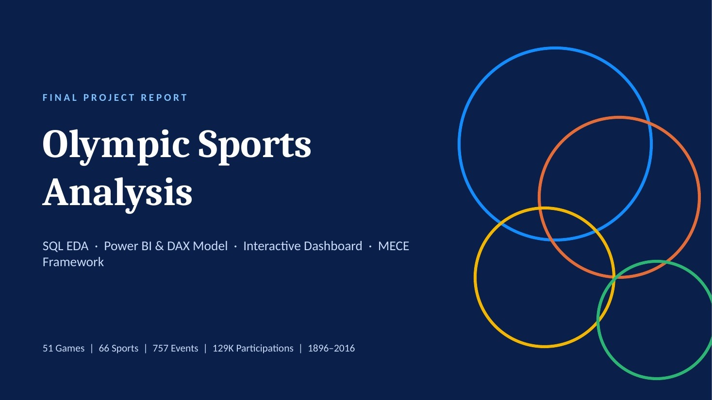

Slide 2
EXECUTIVE SUMMARY
What 120 Years of Olympic Data Tell Us
Four non-overlapping MECE pillars across 51 Games, 129K participations and 39K medals
Games Architecture
29 Summer and 22 Winter Games (56.86% / 43.14%); Athina and London lead as hosts with 3 Games each.
Sports & Events
66 sports and 757 events; Athletics and Shooting hold 83 events each, and 60.5% of events are for men.
I
II
Demographics
129K participations: 73.9% male and 26.1% female, with a mean athlete age of 25.78 years.
Geopolitics & Medals
39K medals; the USA leads with 5,414 (2,533 gold) and NOCs grew from 11 to a peak of 215 in 2012.
III
IV
NEXT STEPS
Close the gender gap in Athletics, Cycling and Shooting · Back Winter-sport infrastructure in emerging NOCs · Add predictive DAX models
Olympic Sports Analysis | Final Project Report

Slide 3
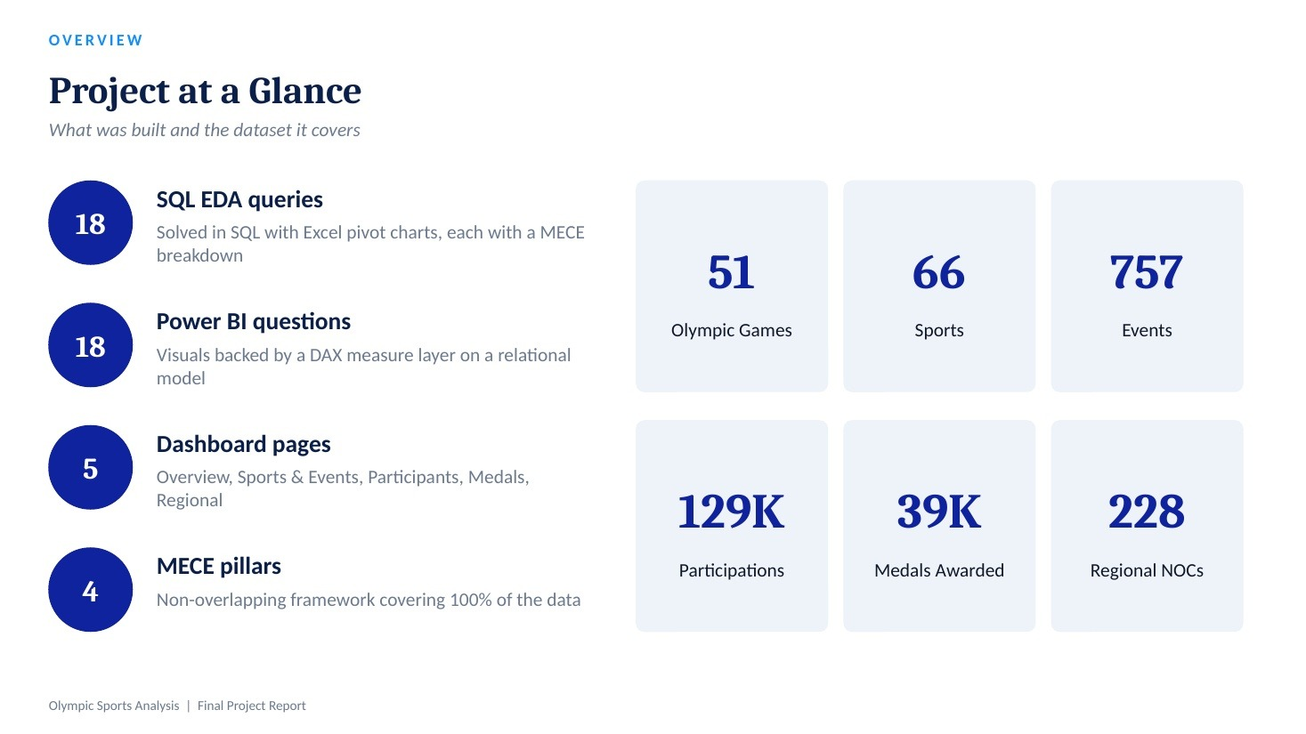

Slide 4
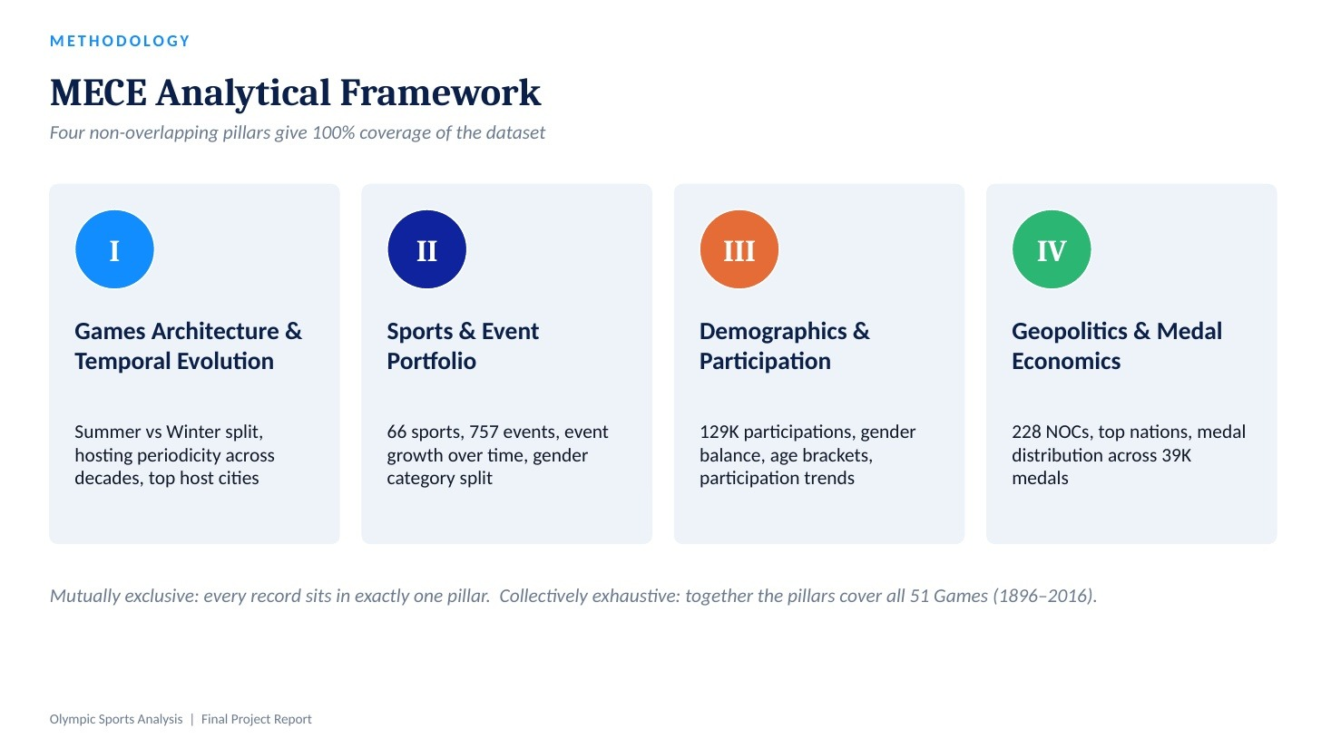

Slide 5
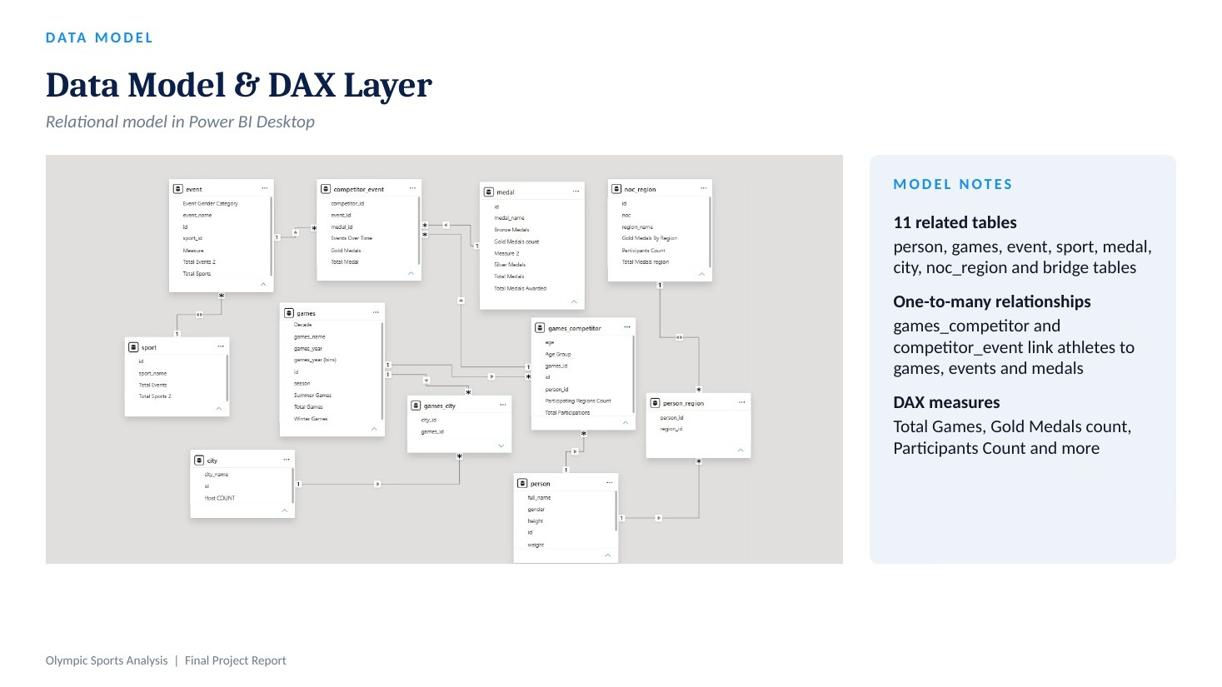

Slide 6


Slide 7
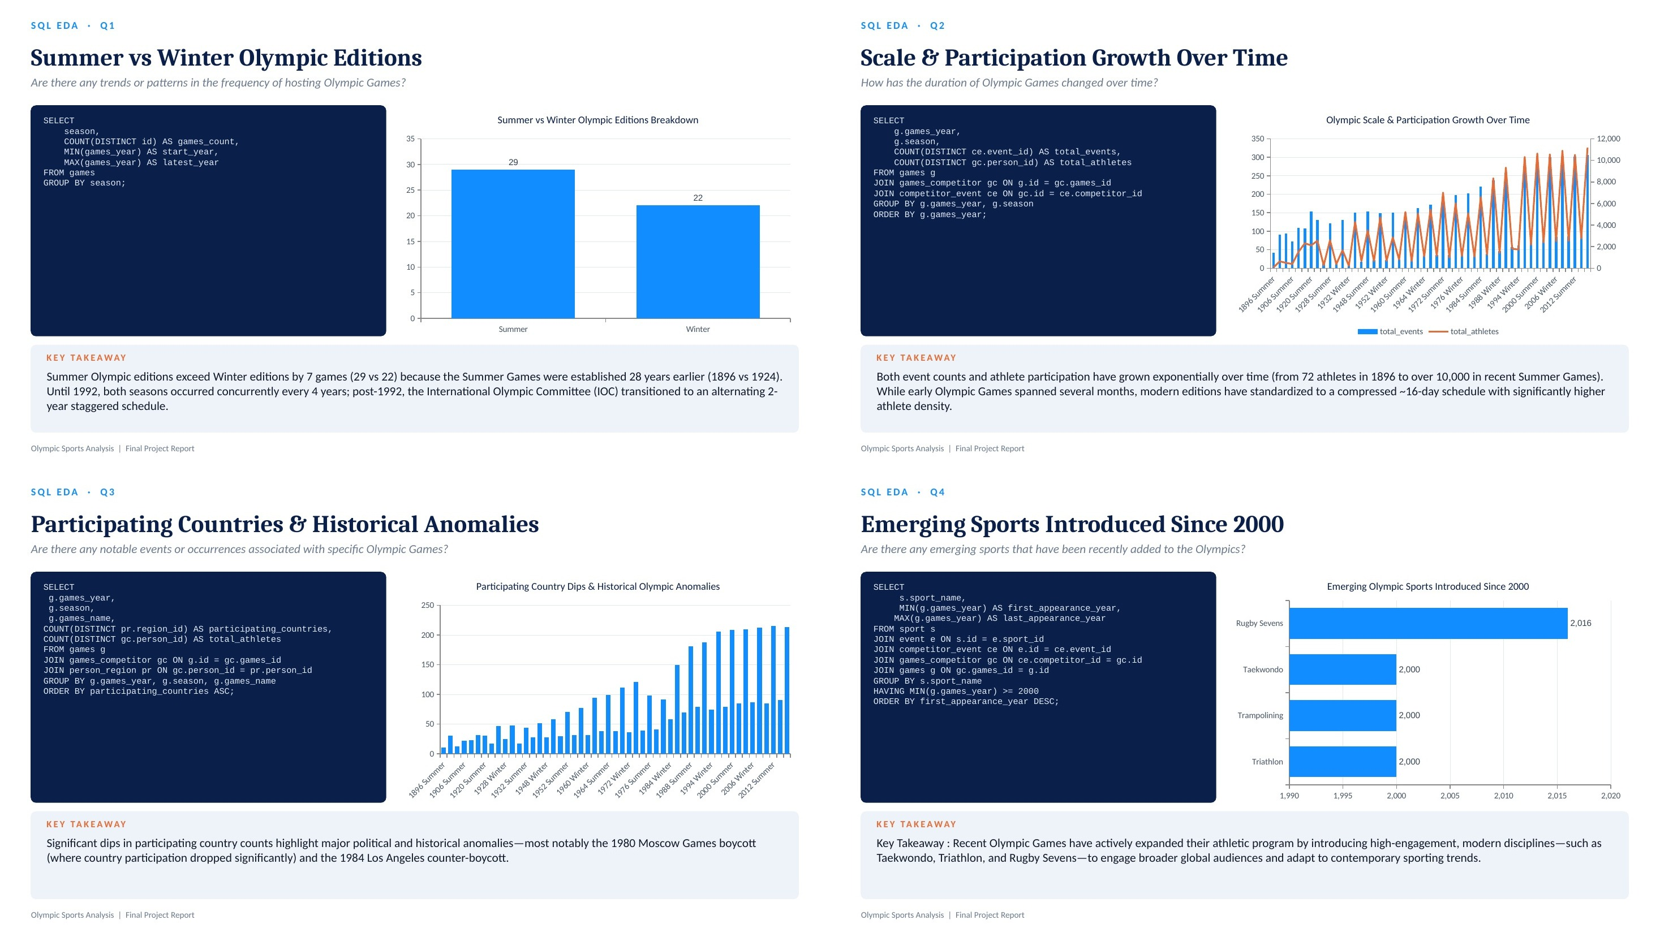

Slide 8
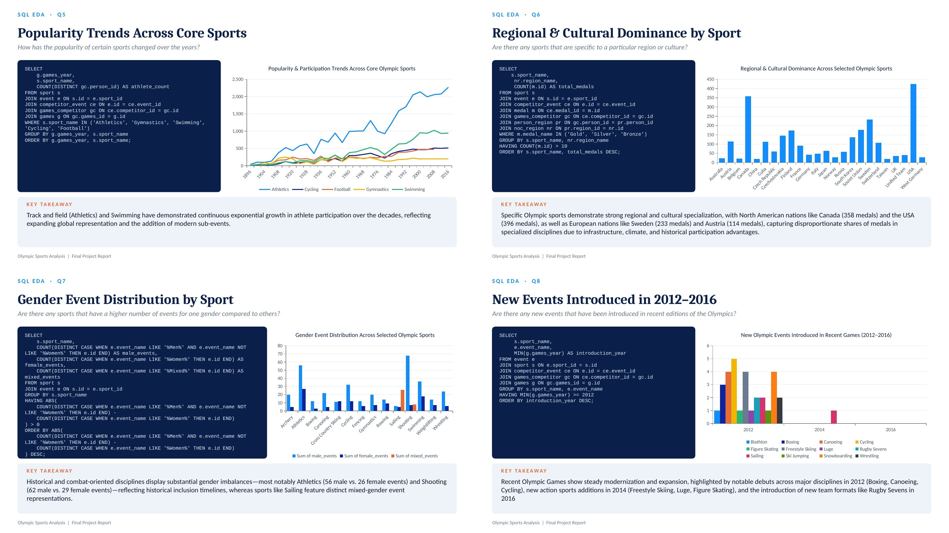

Slide 9
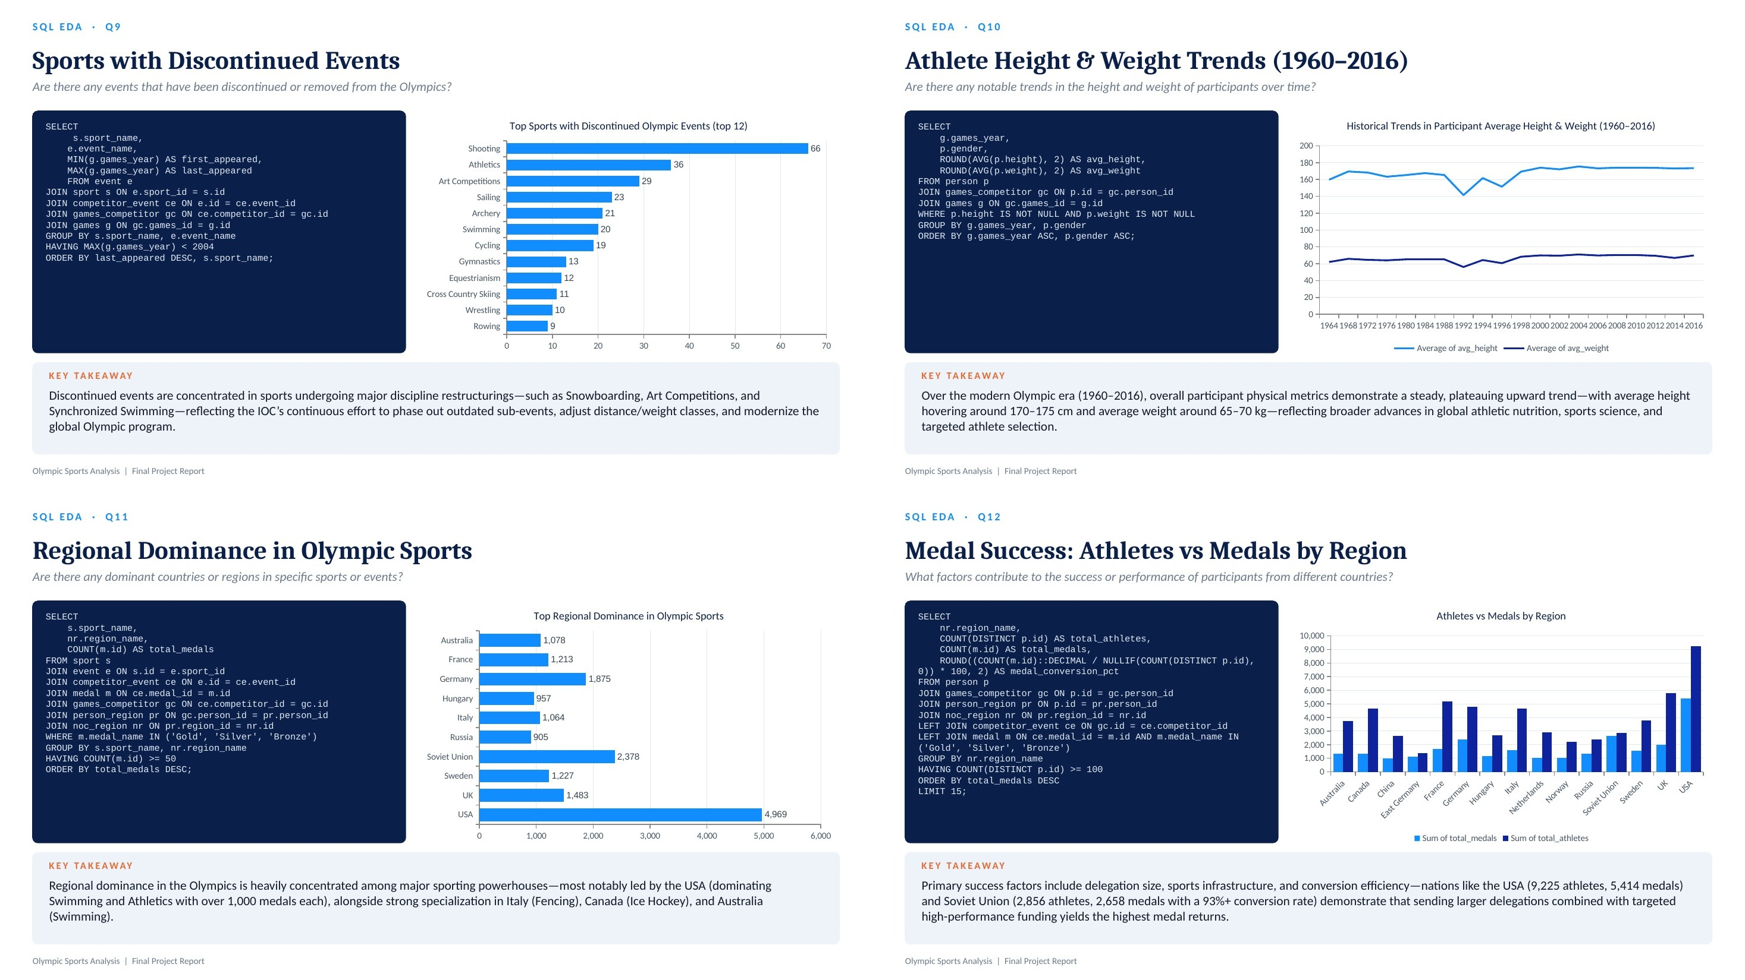

Slide 10
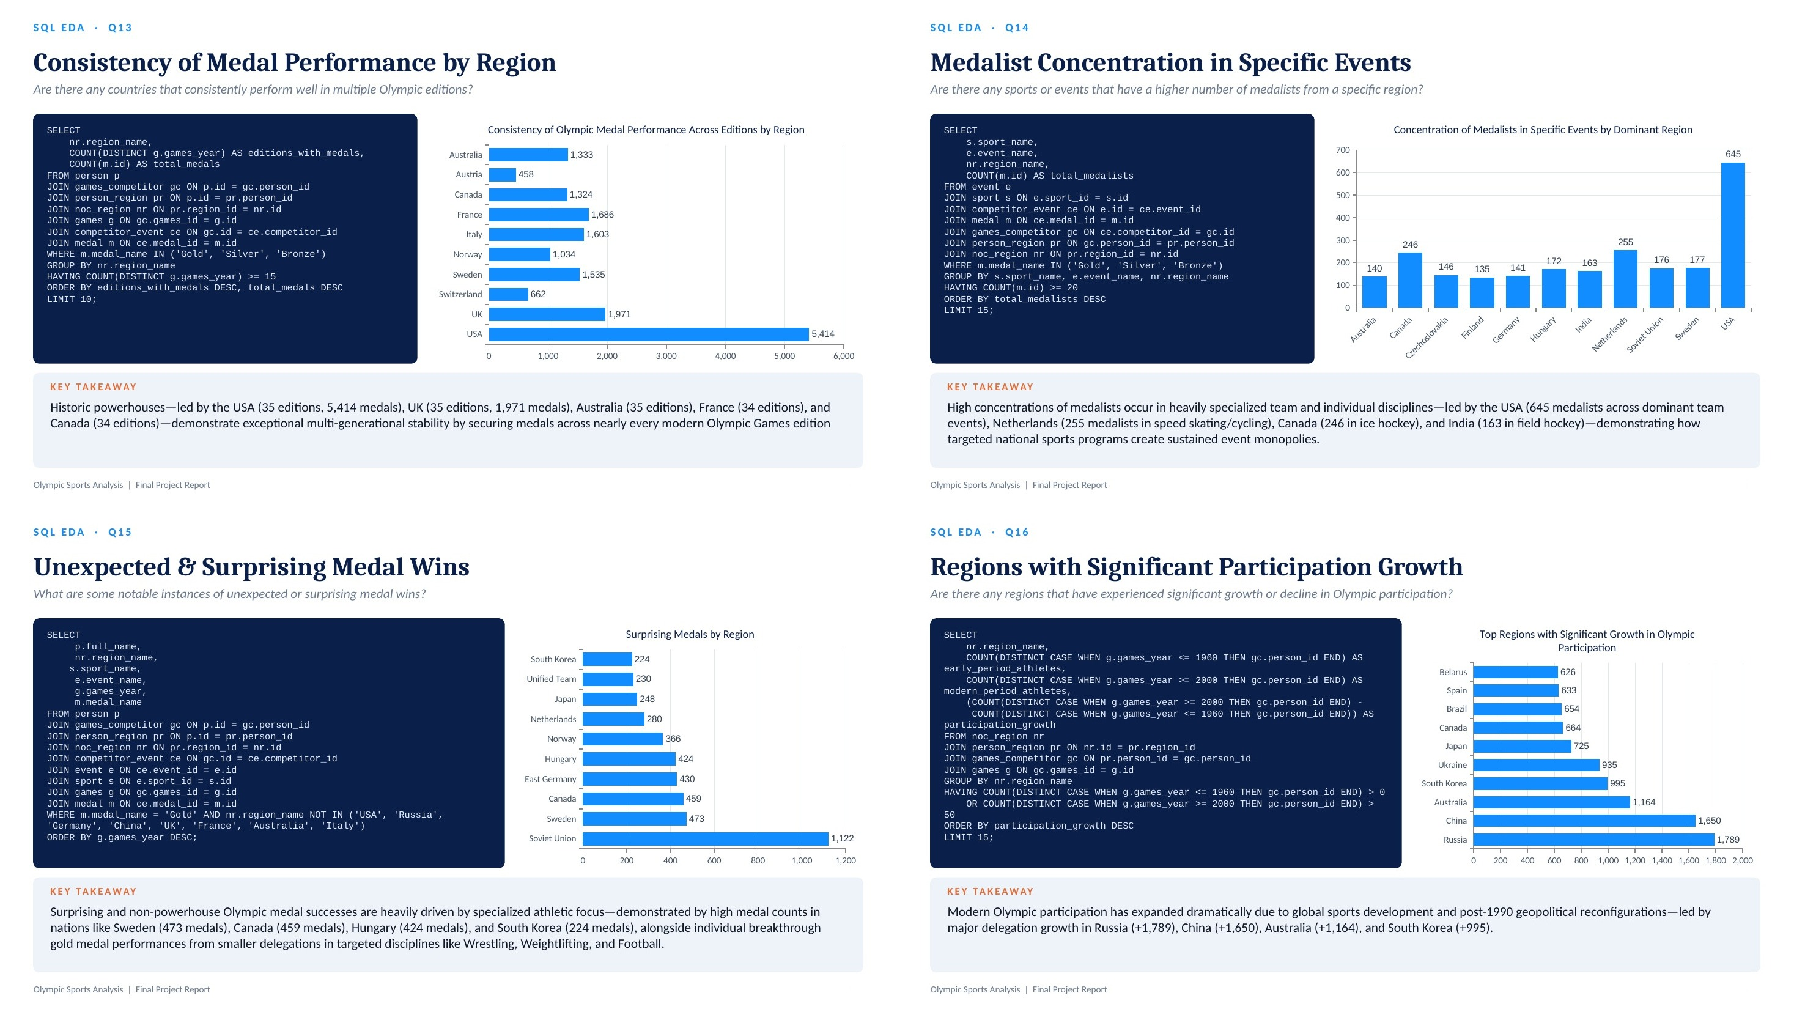

Slide 11
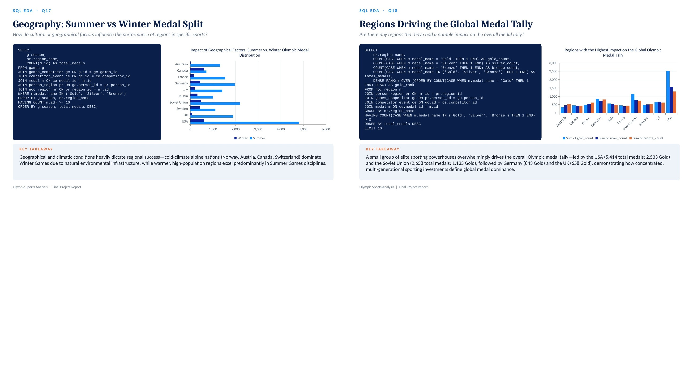

Slide 12


Slide 13
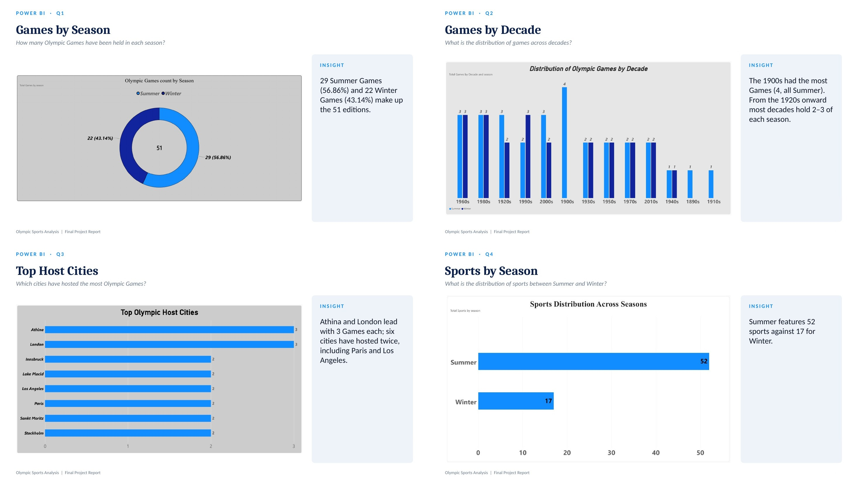

Slide 14
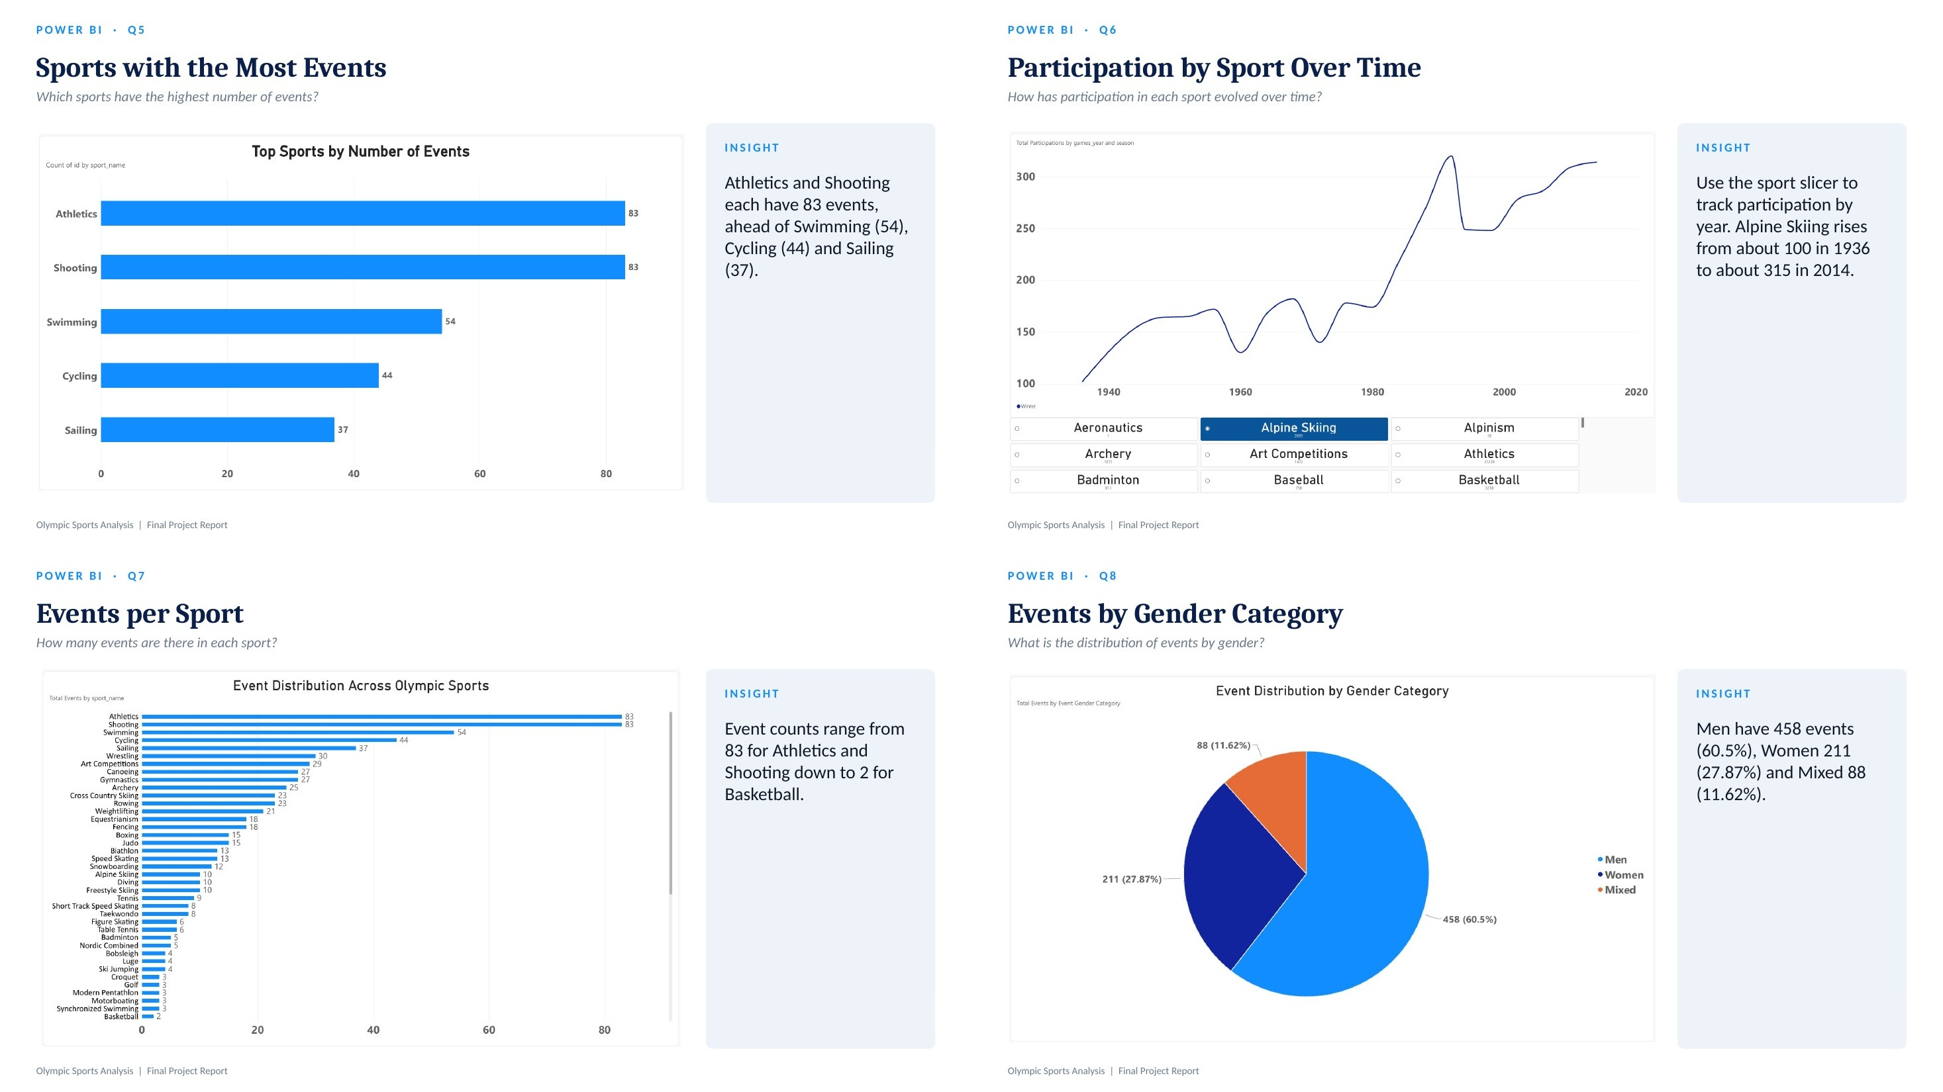

Slide 15
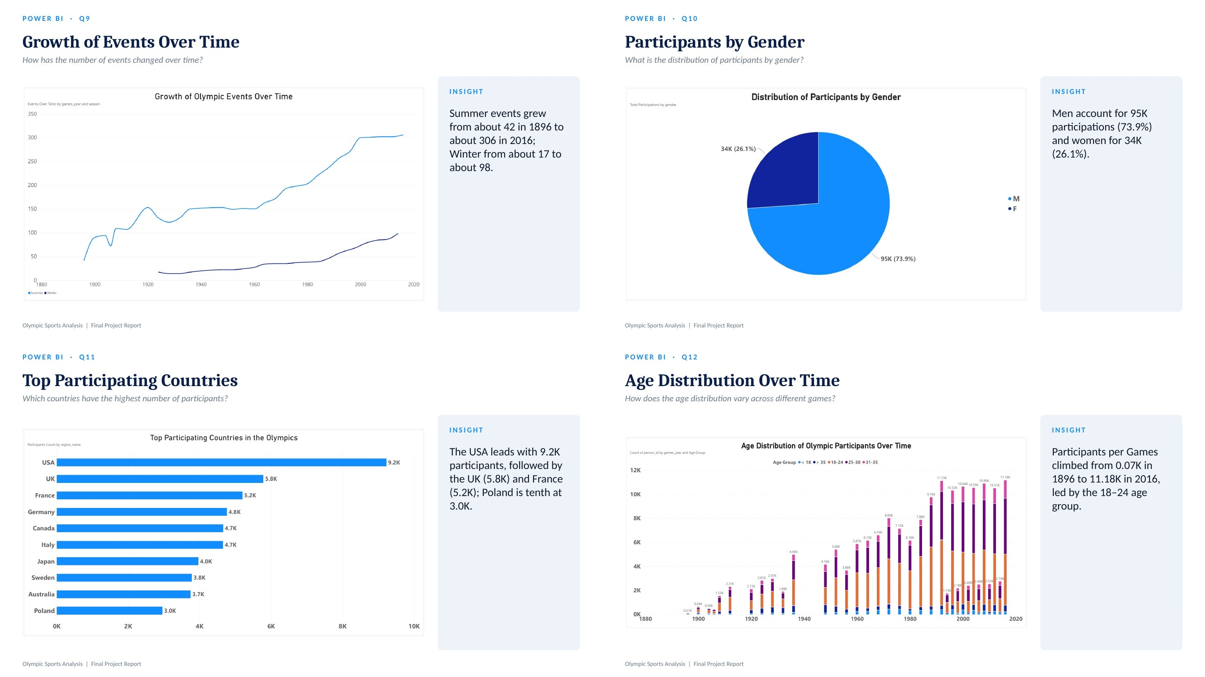

Slide 16
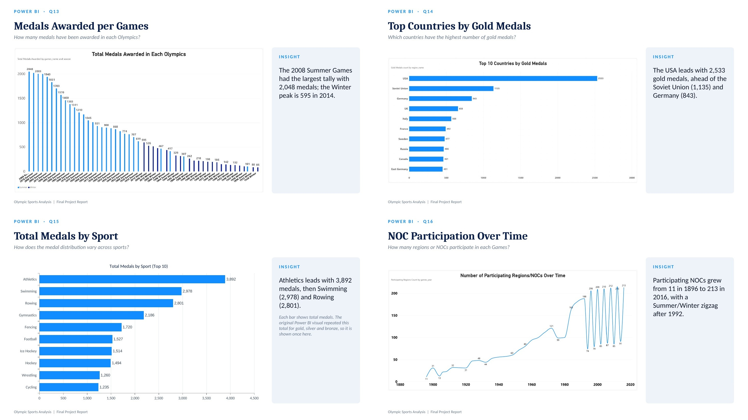

Slide 17
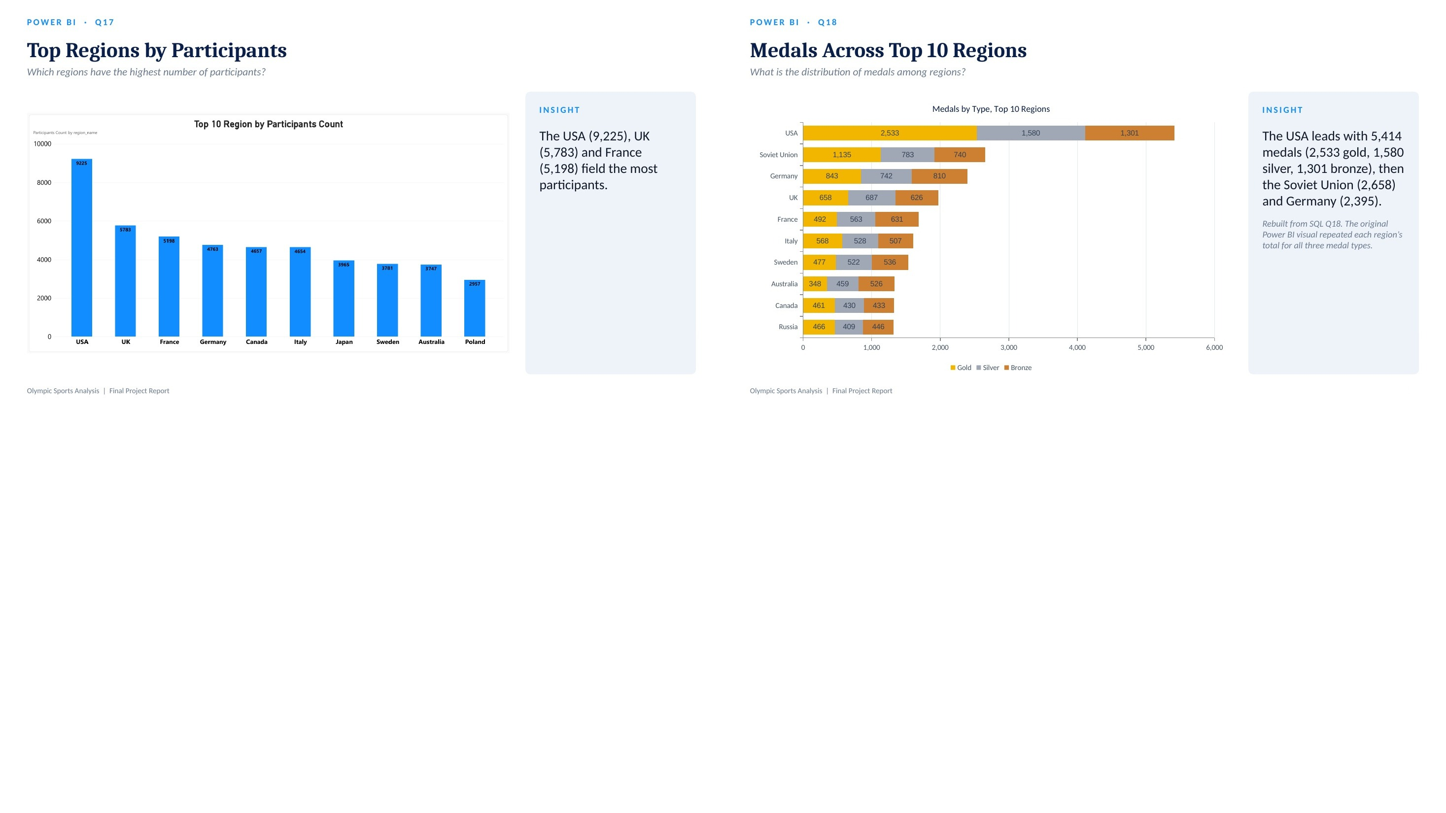

Slide 18


Slide 19
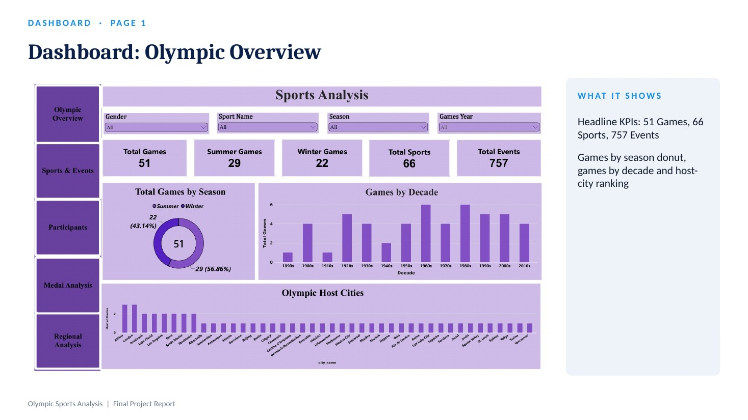

Slide 20
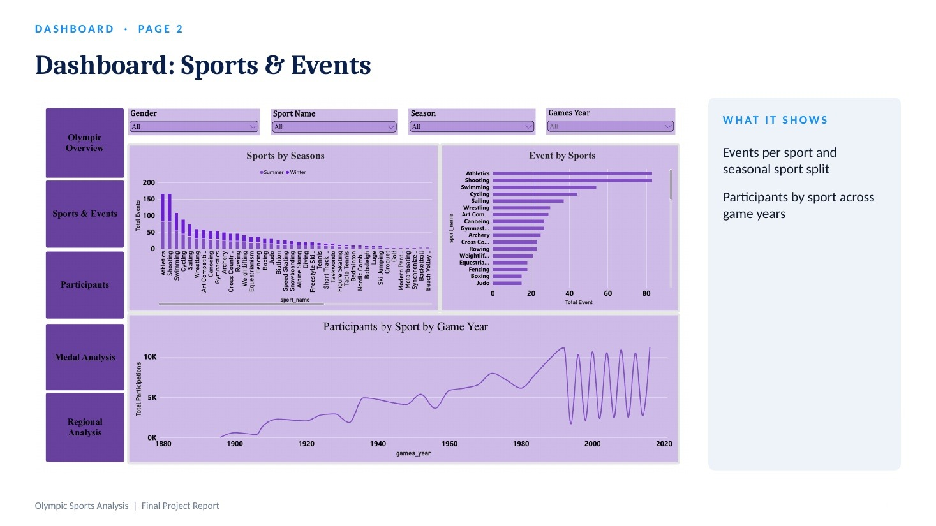

Slide 21
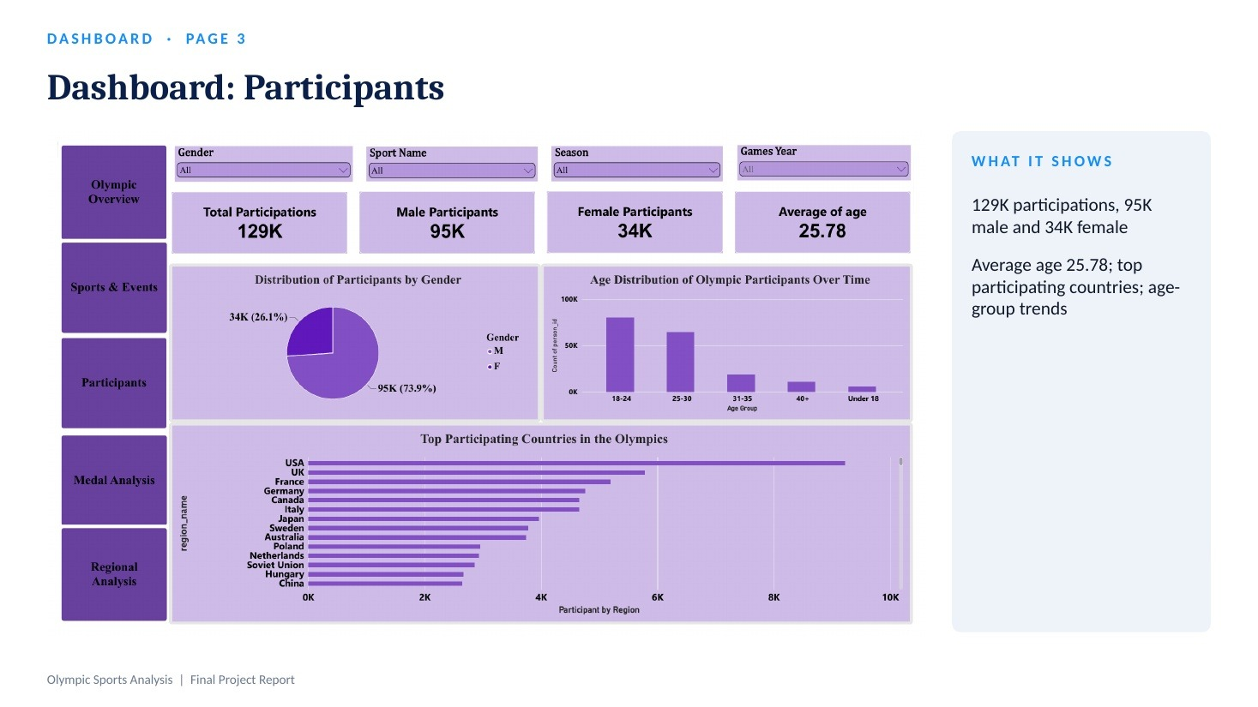

Slide 22
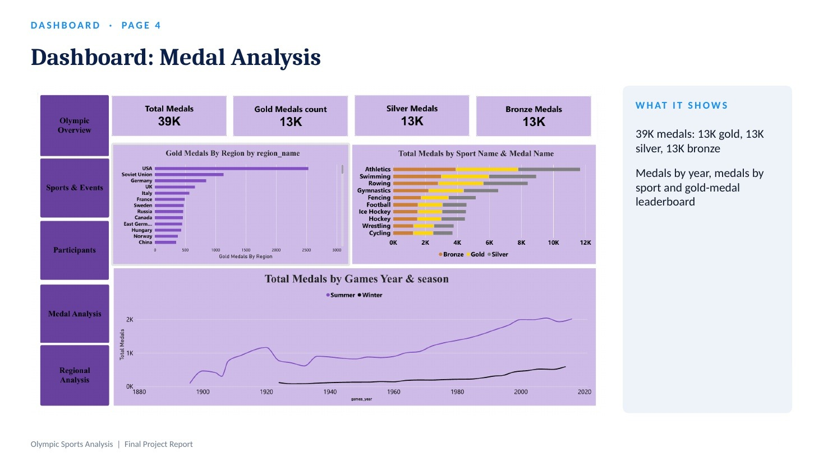

Slide 23
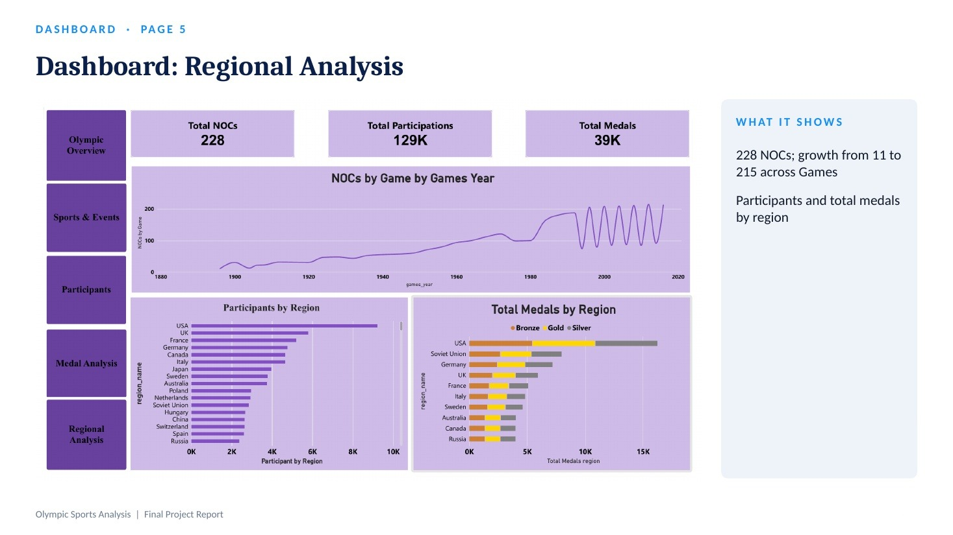

Slide 24
PILLAR I · GAMES ARCHITECTURE
Games Architecture & Hosting
Seasonal split and most frequent host cities (SQL Q1, Power BI Q1–Q3)
Host city | Games | Season | Years
London | 3 | Summer | 1908, 1948, 2012
Athina (Athens) | 3 | Summer | 1896, 1906, 2004
Los Angeles | 2 | Summer | 1932, 1984
Lake Placid | 2 | Winter | 1932, 1980
Innsbruck | 2 | Winter | 1964, 1976
Paris, Sankt Moritz, Stockholm | 2 each | Mixed | See Power BI Q3
Hosting is concentrated in historical European and North American cities; six cities have hosted the Games twice.
Olympic Sports Analysis | Final Project Report

Slide 25
PILLAR II · SPORTS & EVENTS
Sports Portfolio Concentration
Five flagship sports hold 301 of the 757 events (SQL Q7, Power BI Q5–Q8)
Sport | Events | Event share
Athletics | 83 | 10.96%
Shooting | 83 | 10.96%
Swimming | 54 | 7.13%
Cycling | 44 | 5.81%
Sailing | 37 | 4.89%
Top 5 sports = 301 of 757 events (39.8%). By gender category: Men 458 (60.5%) · Women 211 (27.87%) · Mixed 88 (11.62%).
Olympic Sports Analysis | Final Project Report

Slide 26
PILLAR III · DEMOGRAPHICS
Demographic Profile & Participation
Who competed across 129K participations (Power BI Q10–Q12, Dashboard page 3)
129K
participations across 51 Games
25.78
mean athlete age; 18–24 is the largest age group
26.1%
of participations are women (34K of 129K)
Participants per Games grew from 0.07K in 1896 to 11.18K in 2016, yet women remain 26.1% overall, the basis for Recommendation 1.
Olympic Sports Analysis | Final Project Report

Slide 27
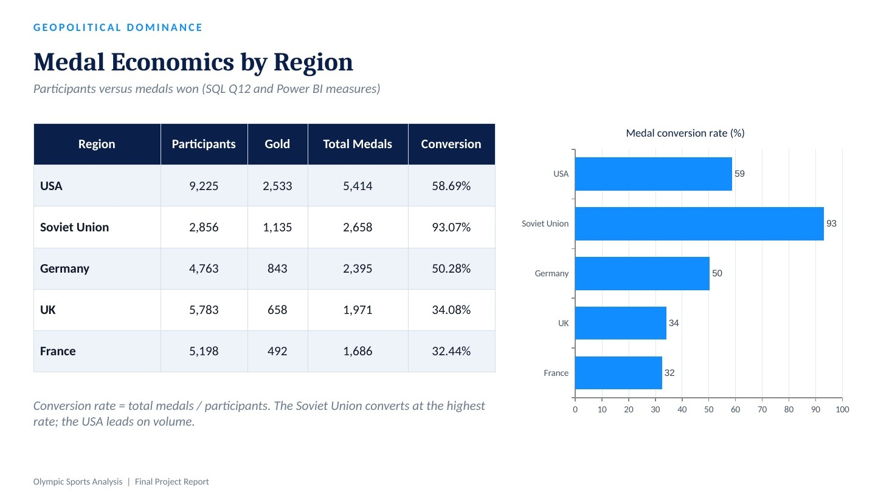

Slide 28
DATA NOTES
Data Notes & Limitations
How to read the numbers in this report
Medal conversion
Medals ÷ distinct athletes (SQL Q12); team and repeat medals can push it near 100%.
Historical regions
NOC regions stay separate: Soviet Union, Russia, East and West Germany.
1
2
Sport counts
52 Summer + 17 Winter exceeds 66 because some sports run in both seasons.
Art Competitions
Counted as a sport (29 events) although discontinued, so totals include it.
3
4
Gender categories
Event gender is read from event names (Men, Women, Mixed) in the SQL logic.
Coverage
51 Games from 1896 to 2016; later Games are not in the dataset.
5
6
Olympic Sports Analysis | Final Project Report

Slide 29
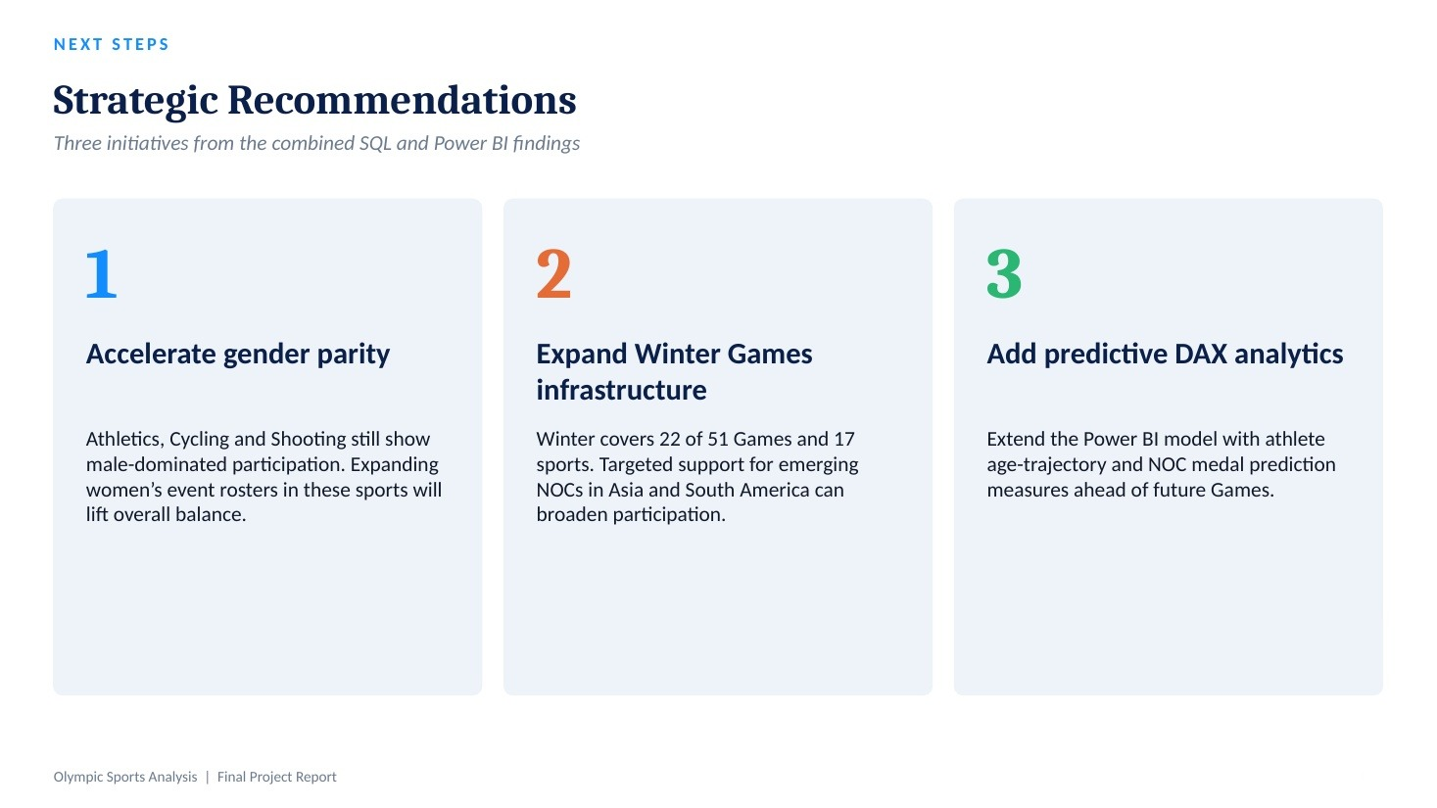

Slide 30
