Slide 1
bootstrap
Nada Mostafa Mohamed

Slide 2
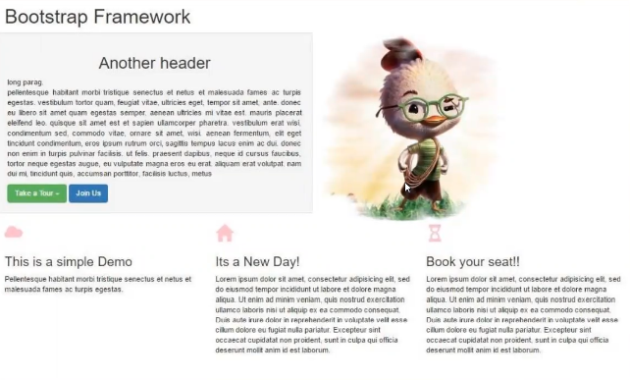

Slide 3
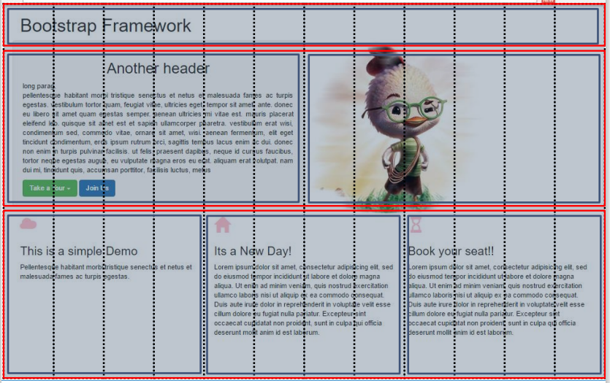

Slide 4
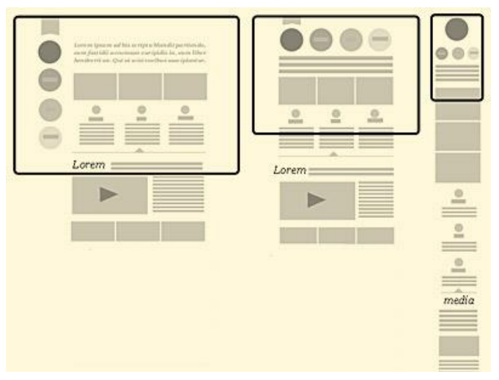
Task : Create a responsive website using bootstrap for the following wireframe

