Slide 1
Social Style Theory
Janice & Joseph Lukas

Slide 2
What’s a Personality? Based-on what?
How to measure personality based-on EQ?

Slide 3
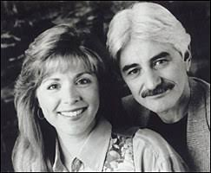
Paul and Barron Tieger
The Art of Speed-Reading People

Slide 4
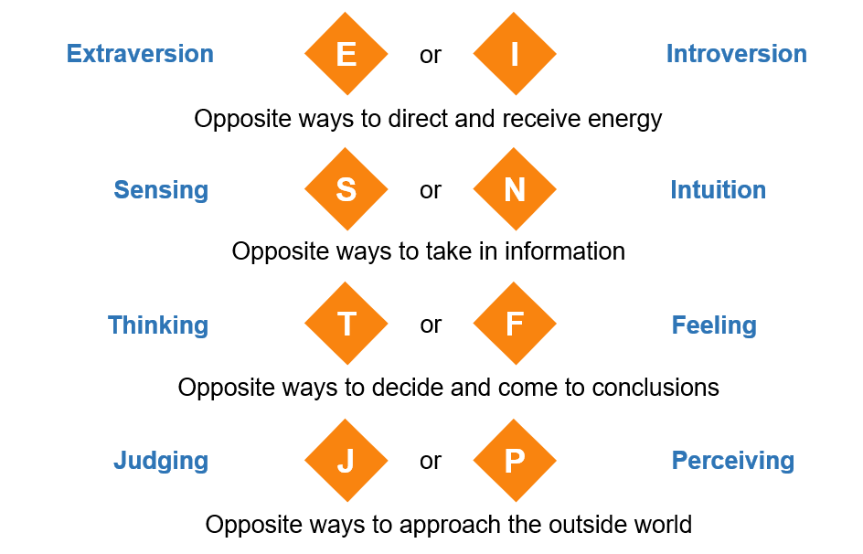

Slide 5
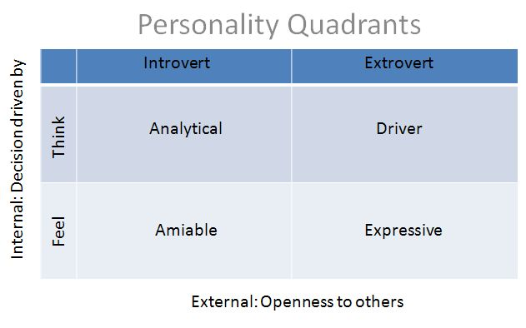

Slide 6
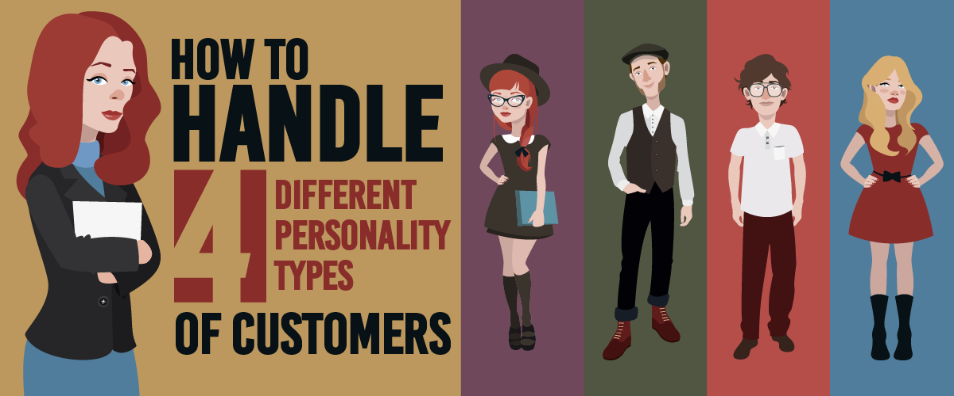

Slide 7
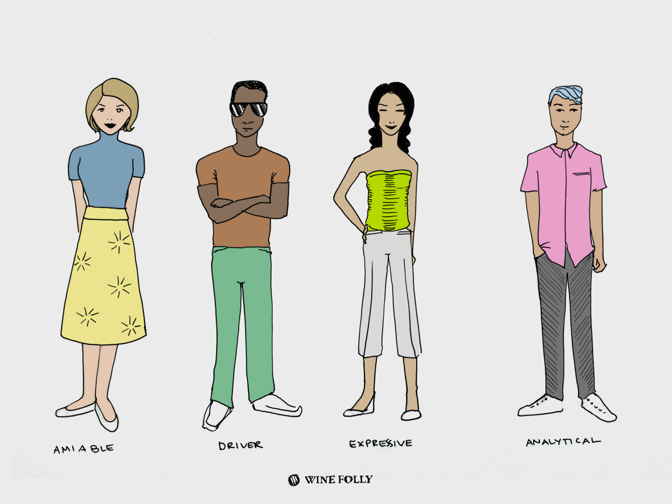
Supportive and Cooperative
Relationship-Oriented
Patient and Understanding
Good Listener
Avoids Conflict
Consistent and Dependable
May Be Reluctant to Make Decisions

Slide 8
Driver Personality Traits
Direct and Decisive
Results-Oriented
Assertive and Confident
Challenges and Conflict
Impatient
How to communicate with them
Focus on Results
Respect Their Time
Accept Constructive Criticism
Set Clear Expectations

Slide 9
Expressive Personality Traits
Outgoing and Sociable
People-Oriented
Creative and Innovative
May Overlook Details
Emotional and Expressive
How to communicate with them:
Friendly
Open
Flexible
engage in small talk
don't bore them with details

Slide 10
Analytical Personality Traits
Systemic and Detail-Oriented
Thorough Decision-Makers
Logical and Objective
Reserved and Introverted
Problem Solver
Critical Thinker
May struggle with Decision Paralysis
How to communicate with them:
be prepared and thorough
don't ask for quick decisions
allow time to discuss details

