Slide 1
Storing an image as 1D Array
CMPT 127
Instructor: Anoop Sarkar
www.cs.sfu.ca/CourseCentral/127/anoop

Slide 2
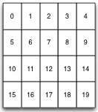

Slide 3
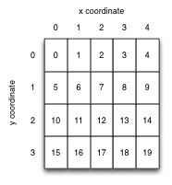

Slide 4




x + y * width
3 + 2 * 5
= 13

