Slide 1


Tree Yoga Detection
Presentation of Project2

Slide 2
Paper 1:
Team ID , Student full names and IDs
Paper 2:
Task description
Paper 3:
Demo
paper 4:
Contribution.

Slide 3
paper 5:
Data
paper 6:
Project architecture.
Paper 7:
Methods
Paper 8:
Result

Slide 4
Team ID, Sudent full names and IDs
Task description
Demo
Contribution
Data
Project Architecture
Methods
Result
4/35

Slide 5
paper1
Team ID , Student full names and IDs
Team ID :-
46
Student full names and IDs :
Salma Mohammed Saad (162020278)
Aya Ahmed Abdelaziz (162020152)
Esraa Ahmed Abdelghafour (162020099)
5/35
,Salma Mohamed Saad , Aya Ahmed Abdelaziz ,Esraa Ahmed Abdelghafor„ENG : Amjad Dife |

Slide 6
Team ID, Student full names and IDS
Task description
Demo
Contribution
Data
Project architecture
Methods
Result
6/35

Slide 7
paper2
Task description
Task description
7/35

Slide 8
paper2
Task description
It is a system that recognizes tree yoga exercise detection by using computer vision, specifically following deep learning to give the best results. The goal of this project is to enable computers to understand and interpret physical positions and then detect whether the exercise is correct or incorrect. This can be used to detect exercise, making it easier for people to know that they are exercising correctly and properly.

Slide 9
Team ID, Students full names and IDs
Task description
Demo
Contribution
Data
Project architecture
Methods
Results

Slide 10
Paper3 Demo
Demo
https://github.com/ayaAbdelaziz26/Team_46_gym
10/35

Slide 11
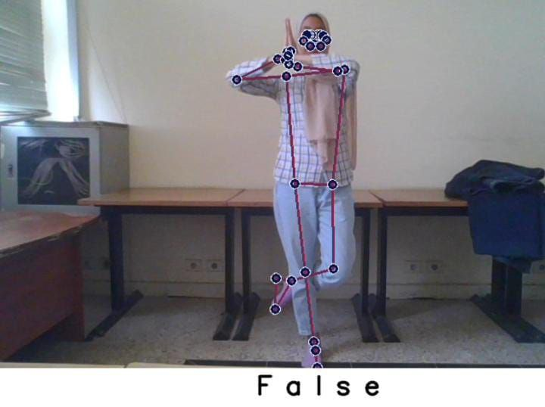
Paper3 Demo

Slide 12
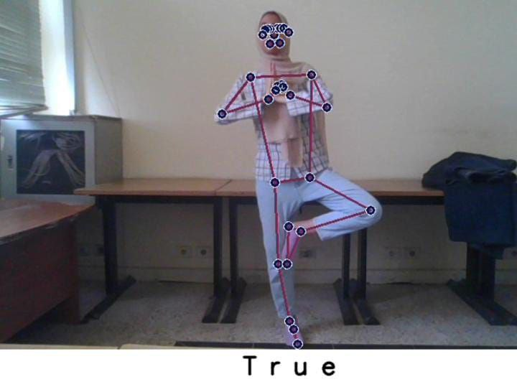
Paper3 Demo
12/35

Slide 13
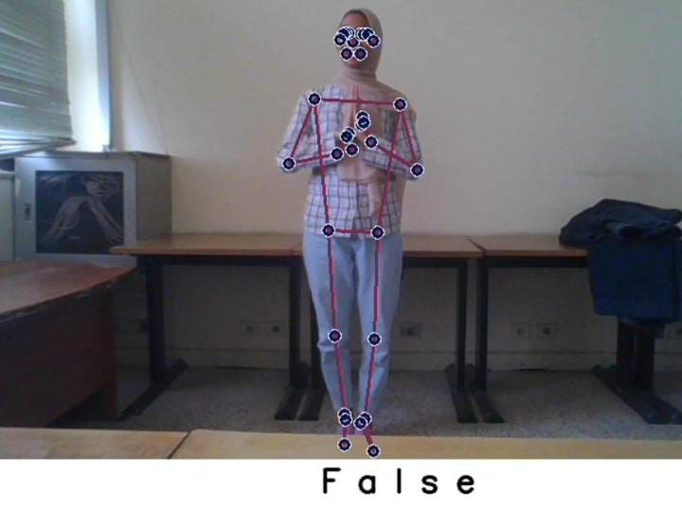
Paper3
Demo
1ź/3ź

Slide 14
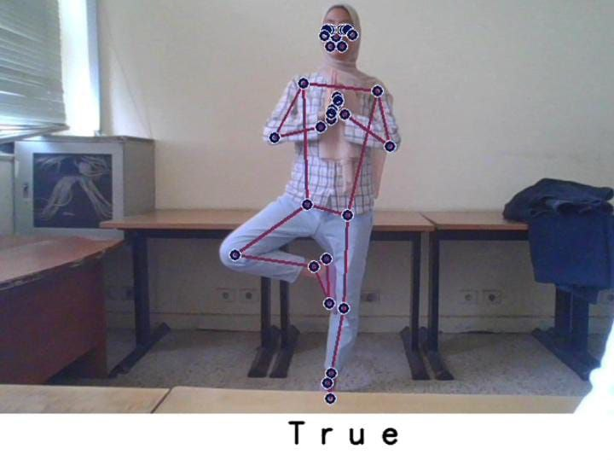
Paper3
Demo
1ź/3ź

Slide 15
Team ID, Students full names and IDs
Task description
Demo
Contribution
Data
Project architecture
Methods
Results

Slide 16
Contribution.
Paper4
Contribution.
16/35

Slide 17
Paper4
Contribution.
1. We use the activation function of hidden layers RELU6.
2. Training the model on a data set consisting of 7 videos for true exercise
3. We create a new dataset of 1360 frame for wrong exercise of yoga
17/35

Slide 18
Paper4 Contribution.
First accuracy was 100%, to solve this problem:
1- Change the activation function of hidden layers from RELU to RELU6 which Mitigates the "dying RELU" problem to some extent as the threshold prevents neurons from getting stuck at zero.
2-Add more dataset .
That solutions solve the problem and changed accuracy to 85%.
18/35

Slide 19
Team ID, Students full names and IDs
Task description
Demo
Contribution
Data
Project architecture
Methods
Results

Slide 20
Paper5
Data
Data
20/35

Slide 21
Paper5
Data
This project aims to build a deep learning model capable of classifying yoga poses using key point data extracted from videos or images. The Mediapipe library is used to extract these key points, and then an LSTM (Long Short-Term Memory) model is trained using this data.
21/35

Slide 22
Paper5
Data
-We use 7 videos from Kaggle dataset for the right exercises (Vrikshasana).
Link of the right dataset: Yoga Vid Collected (kaggle.com)
- For the wrong exercise we create a dataset capturing 1360 frame dividing into two folders.
22/35

Slide 23
Team ID, Students full names and IDs
Task description
Demo
Contribution
Data
Project architecture
Methods
Results
23/35

Slide 24
Project architecture
Paper6
Project architecture
24/35

Slide 25
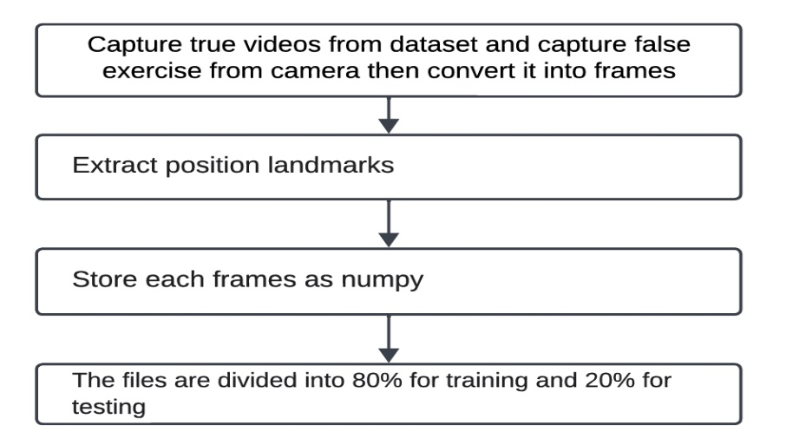
Paper6
Project architecture
Figure explain processes of the model to build the system
25/35

Slide 26
Team ID, Students full names and IDs
Task description
Demo
Contribution
Data
Project architecture
Methods
Results
26/35

Slide 27
Paper 7
Merthod
Methods
27/35

Slide 28
Paper 7
Methods
The model itself is built by sequentially adding layers. Each layer performs specific operations on internal data.The code includes several parts that work with Mediapipe and OpenCV, to analyze the video and extract points from the video footage, then train a model using TensorFlow
28/35

Slide 29
Paper 7
Methods
Here is an explanation of the most important functions used in the model:
1- Mediapipe_detection(image, model): Converts the image from BGR to RGB, makes predictions using the Mediapipe model, and then converts the image back to BGR
2- Draw_landmarks(image, results): To draw key points on the image using Mediapipe.
3- Draw_styled_landmarks(image, results): To draw key points with a specific design on the image.
z/35
29/35

Slide 30
Paper 7
Methods
4- Extract_keypoints(results): To extract keypoints from Mediapipe results.
5- Split data into training and test parts using train_test_split
30/35

Slide 31
Paper 7
Methods
Train a deep neural network using Sequential model
sequence :
1. Input layer : • Type : layers.Input . •It takes 680 frame and 44 point each have(x,y,z)axis.
2. Hidden layers : • Type : layers.LSTM , layers.Dense • Activation function : ‘relu6’.
3. Output layers: • Type : layers.Dense . • Purpose : • Activation function : ‘softmax’ .
31/35

Slide 32
Team ID , Student full names and IDs
Task description
Demo
Contribution.
Data
Project architecture.
Methods
Result
32/35

Slide 33
Paper 8
Result.
Result
33/35

Slide 34
Paper 8
Result
Accuracy of model training : 0.85714
Loss: 0.4470 8571
34/35

Slide 35

Tree Yoga Detection the last project of the last term in fci
Thank you for listening!

