Slide 1




Slide 2




Elite – G3
Manager : Ahmad Bakri
Programmer : Aya Dahbour
Technical : Yazeed Hamdan
Secretary : Amani Rabee

Slide 3

Business Description
Our business is an online bakery shop, and we aim to serve our customers by developing software that can be accessed via an internet portal or a mobile application.
The system introduces many services such as exploring and maintaining products on the menu, e.g. bread, cake, and pastries. With accessibility to deliver the order and flexibility in the payment process. Pricing ranging from 1$ to 30$.
The bakery, "Elite Bakery" is managed by a manager who has complete authority over the bakery team and production. It contains 4 bakers including a head baker, 2 employees dealing with customer support, and 2 delivery men. The system includes an easy-to-use shopping cart system. Customers may use this functionality to add or remove products, change quantities, examine individual item pricing, and check the total cart balance. Customers move to the checkout page after completing their order. They are then given the option of selecting one of many payment options.
Following order completion, the system has a feedback mechanism that allows users to submit their thoughts on the entire service.
The system provides these services to many types of customers such as public people, local markets, restaurants, and event venues. With maximum capacity of 50 per day whom can order 50-100 orders.

Slide 4
Feedback Scenario
Normal (positive feedback): After receiving her freshly baked pie from the bakery, Majd is immediately presented with a feedback notification on her device. She is given options: to give feedback now, be reminded later, or exit the prompt. Choosing to provide feedback, she rates the taste, presentation, and delivery service, awarding high scores in each category. Majd compliments the flakiness of the pastry and the promptness of delivery in her comment. Her feedback is quickly posted and becomes accessible to other customers, offering them genuine insights. The bakery team, inspired by her positive review, is considering adding similar recipes to their menu.
Normal (critical feedback): Sarah requests an especially personalized cake from the bakery, but when it arrives, she discovers that the design and flavor do not match her request. Disappointed, she submitted a scathing evaluation via the feedback notice. The bakery's customer care team swiftly contacts her, apologizes, and addresses the problem. Recognizing the gravity of the error, they work with the finance manager to Sarah a discount on the next order.
Alternative: Ahmad, upon receiving his custom birthday cake and pastries, sees a feedback notification on his device. However, busy with birthday preparations, he chooses the “Remind Me Later” option. Later, when he reopens the app, he receives a gentle reminder to provide feedback. He then praises the cake's quality, the custom design's excellence, and the delivery's punctuality.
Error: the delivery confirmation isn't registered correctly. This could prevent the feedback prompt from appearing or reflecting Ali's true experience accurately. If the system fails to recognize that the delivery has been completed, it might not trigger the feedback notification, thereby missing an opportunity to gather valuable customer insights.

Slide 5
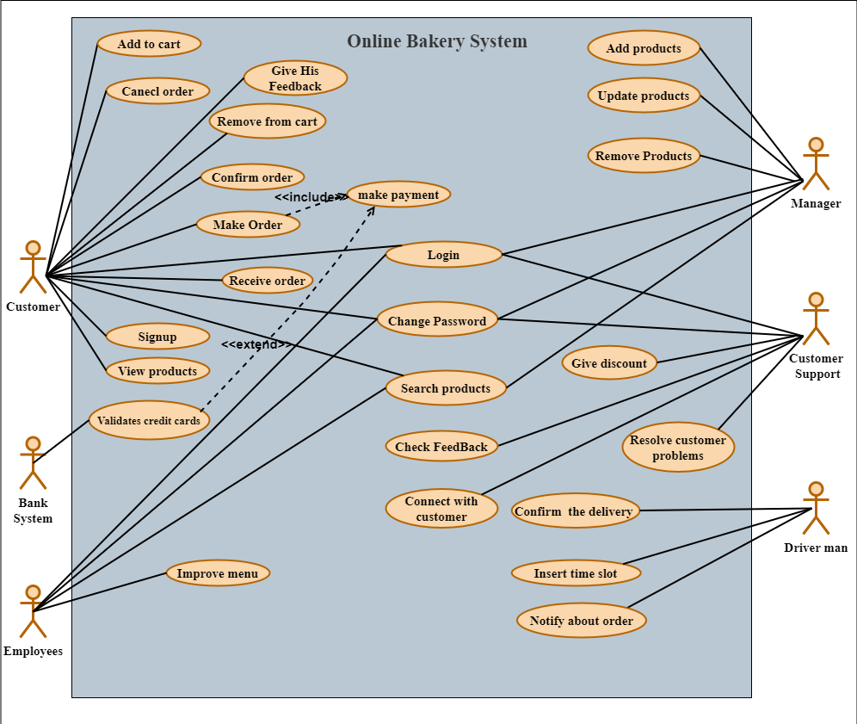


Use Case Diagram

Slide 6
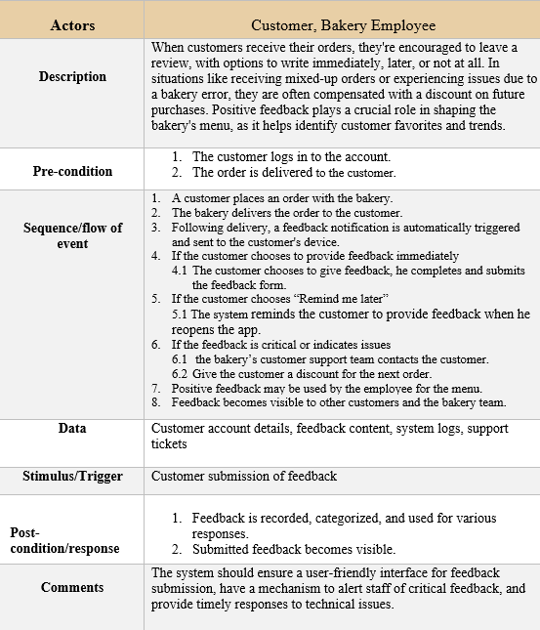
Detailed Description of Feedback Scenario

Slide 7
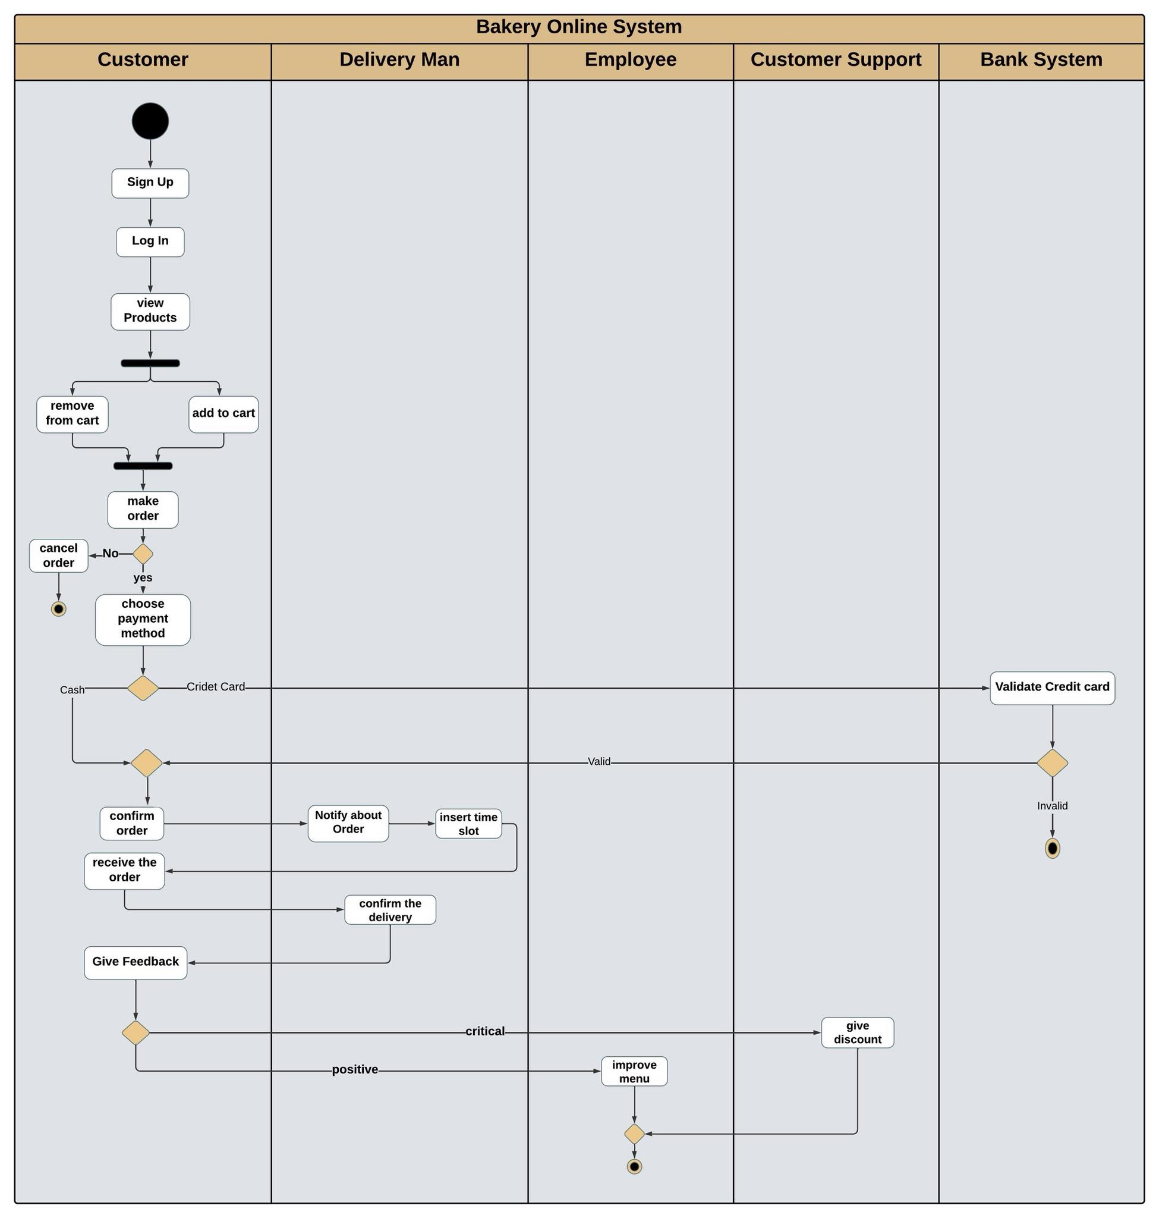
Activity Diagram

Slide 8
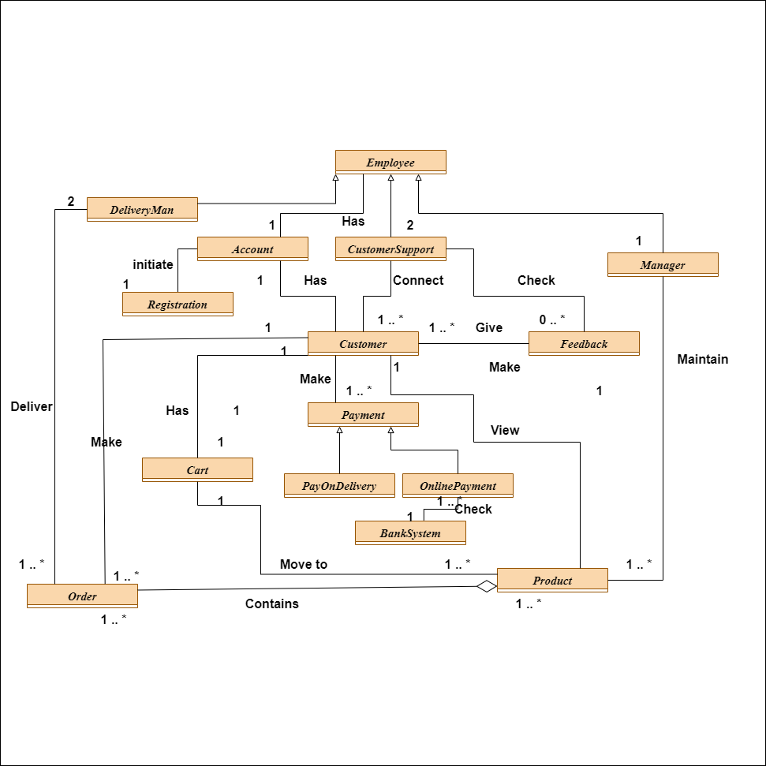
Analysis Class Diagram

Slide 9
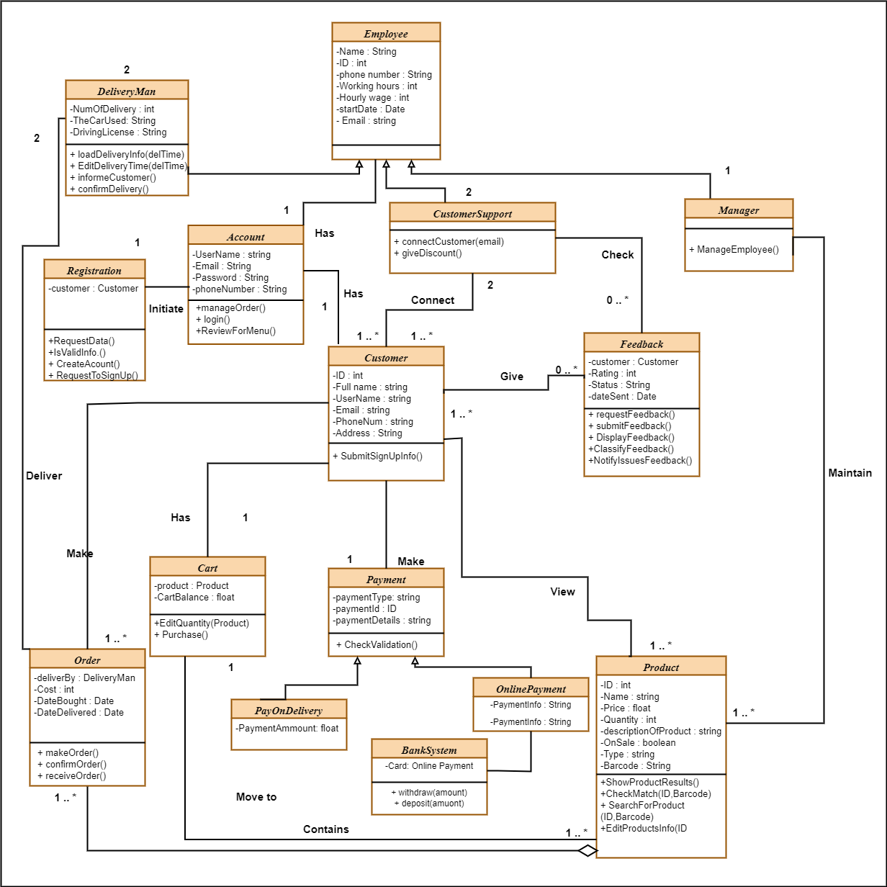
Detailed Class Diagram

Slide 10
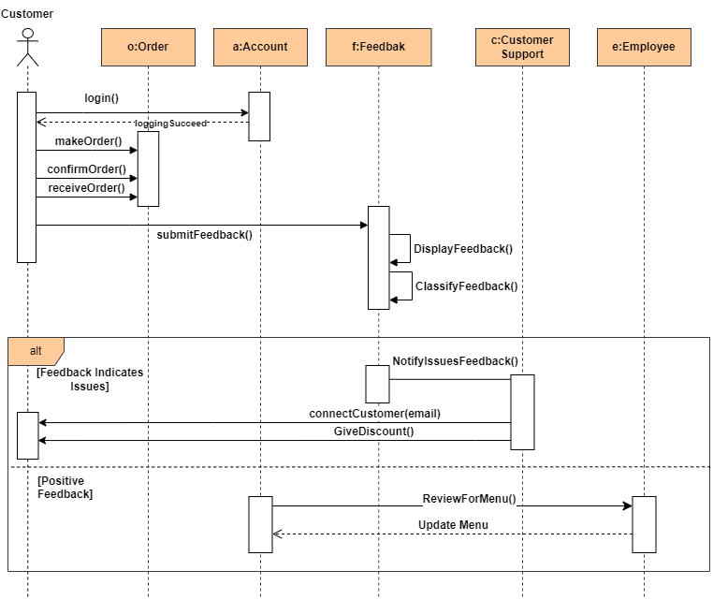
Sequence Diagram

Slide 11
Design Goals
High Cohesion
High Cohesion is represented by the grouping of related functionalities within the same layer or component. For example, in the Web Server, we see entities like Manager, Customer, Employee, Product, and Feedback, which are likely related to the operational functionalities of a business application. These are logically grouped together within the Web Server, indicating that they share a common context and likely interact with each other to complete tasks. Also , all classes and functions that related and depend to each other will be exist one component.
This shows High Cohesion as each component is focused on a specific set of responsibilities, leading to a modular and well-organized system.
Low Coupling Low Coupling is demonstrated by the way the components interact across the diagrams, to achieve low coupling, a three-layer architecture was used (web browser, web server, database), to reduce amount of traffic and commutation between layers, for each layer all components and classes that need to communicate to each others will be exist together in the same layer.
High Security:
To achieve high security, Database and security servers in the infrastructure layers were separated into two inner layers, this design guarantees the security, because if the system is hacked, the hacker will not be able to access system data contained in DB server. Also, this design guarantees us the safety because if an external problem occurs that affects one server, the other server will not be affected and will continue to serve.

Slide 12
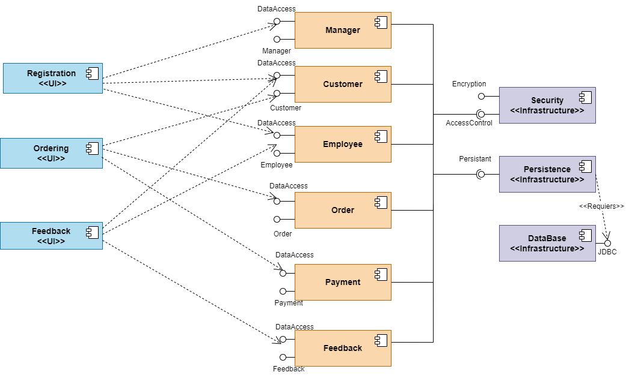
Component Diagram

Slide 13
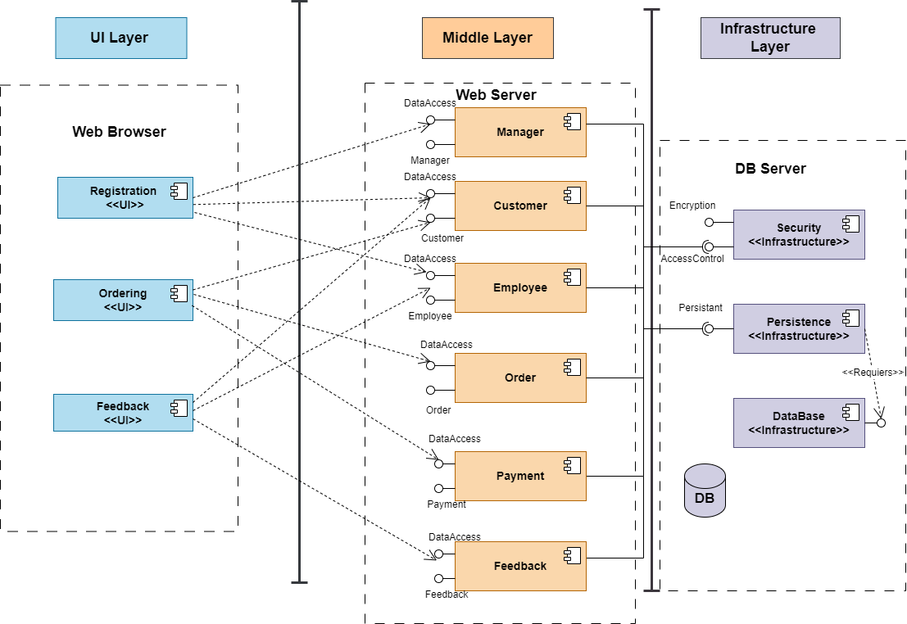
architecture layered Diagram

Slide 14
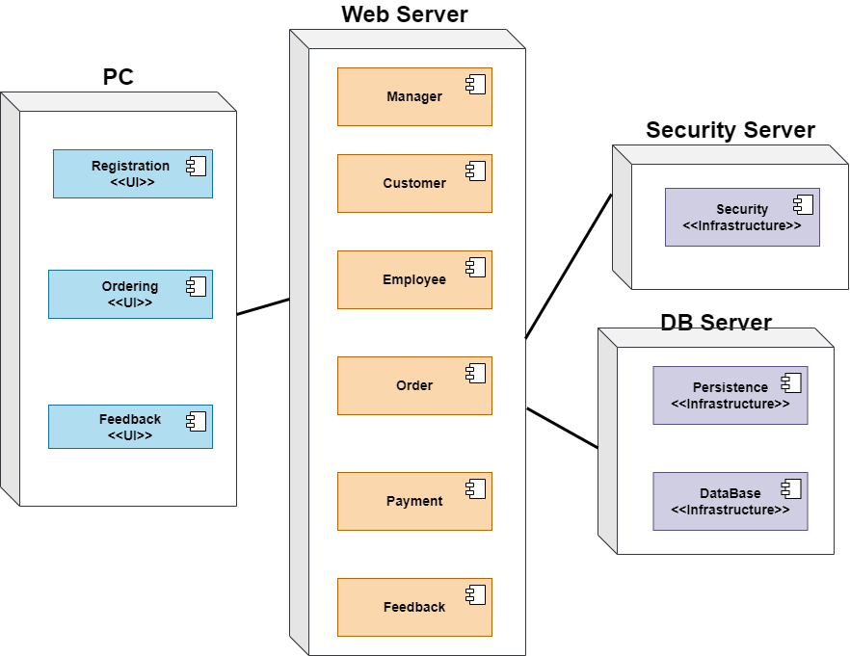
Deployment Diagram

