Slide 1
HR-Analytics Prediction
Submitted to:
Eng. Omar Samir

Slide 2
Aya Adel Dina Alaa Dai Alaa Nerdeen Ahmad
Team Members

Slide 3
Problem Description
01

Slide 4
Problem Description
The collection, processing and analysis of data has been largely manual.
This approach has been constraining HR.
The goal is to try to use predictive and descriptive analytics in identifying the employees most likely to get promoted.

Slide 5
Analysis and Solution
02

Slide 6
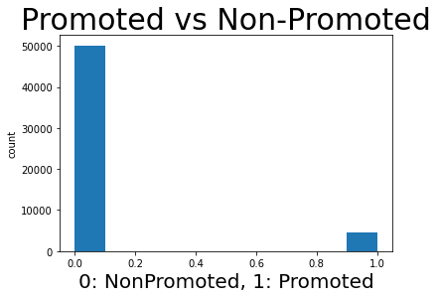
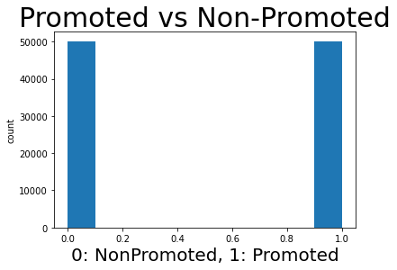

Data Preprocessing
Handling categorical data using one hot encoding
Handling unbalanced classes using SMOTE
Splitting data into train-test-validation (60% – 20% – 20%)
Normalize data values: $set= \frac{set−min⁡(set)}{\max\left(set\right)−min⁡(set)}$

Slide 7
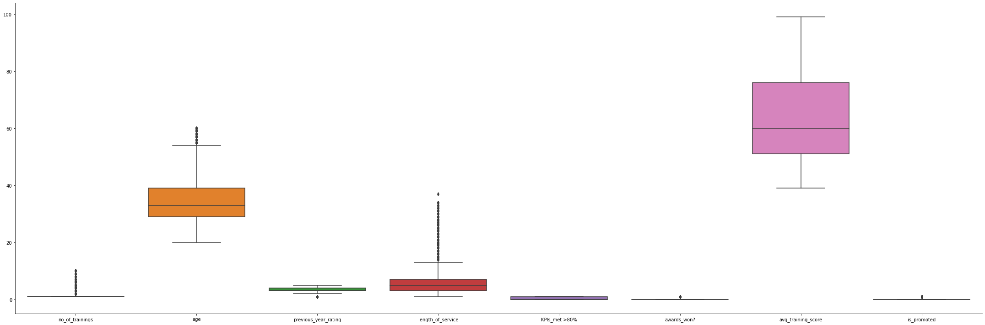
Data visualization
Univariate
Boxplots (Unsucessful) -> because features have different scales.
Histogram distributions for numerical columns
Bar plots for categorical columns
Bar Plot for the target column that shows there is a clear unbalancing problem in classes

Slide 8
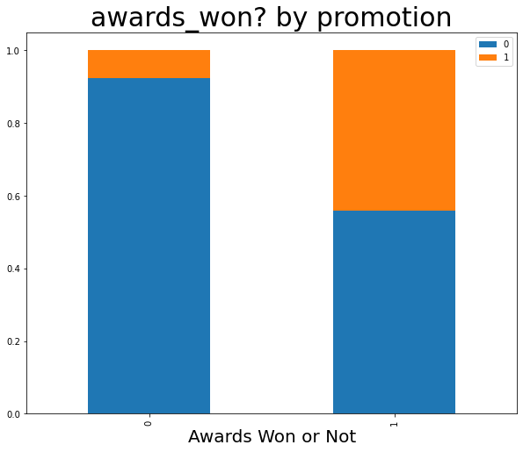
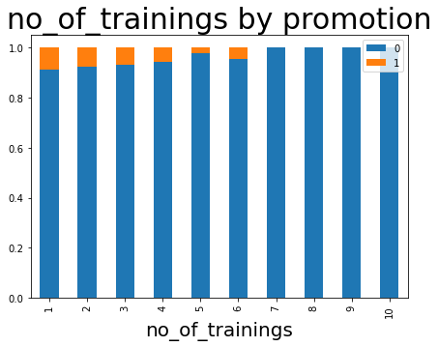
Data visualization
Multivariate
Heatmap to show correlation between columns
Crosstab plots between the target and features to show their effect on the target, for example:

Slide 9
Extracting Insights
From statistical Analysis:
The distribution of data for features 'no_of_trainings', 'age', 'length_of_service', 'avg_training_score' looks normal because it's clear that the mean and the median are close enough
From Visualization:
The more awards the employee has, the more likely he/she is to be promoted
From Descriptive Analysis (Association Rule Mining)
When average training score is low, the employee is not promoted with support = 0.2103 and confidence = 0.961
When the KPIs are not met, the employee is not promoted with support = 0.6223 and confidence = 0.96

Slide 10
Feature Selection
We used the insights extracted from data analysis and the Forward Selection method and found the best set of features which are:
- department
- region
- recruitment_channel
- age
- length_of_service
- no_of_trainings
- previous_year_rating
- KPIs_met >80%
- awards_won?
- avg_training_score

Slide 11
Model/ classifier training
We tried out multiple classifiers, but the one that performed the best is:
Random Forests (RF), It was trained on the train dataset with the following hyper parameters:
n_estimators = 100

Slide 12
Results and Evaluation
03

Slide 13
Results and Evaluation
On Train Data
 | Class 0 | Class 1
precision | 1.0 | 1.0
recall | 1.0 | 1.0
f1-score | 1.0 | 1.0
accuracy | 0. 9996

Slide 14
Results and Evaluation
On Validation Data
 | Class 0 | Class 1
precision | 0.95 | 0.97
recall | 0.97 | 0.95
f1-score | 0.96 | 0.96
accuracy | 0. 9621

Slide 15
Results and Evaluation
On Test Data (Final Evaluation of the model)
 | Class 0 | Class 1
precision | 0.95 | 0.97
recall | 0.97 | 0.95
f1-score | 0.96 | 0.96
accuracy | 0. 9582

Slide 16
Results and Evaluation
Why Random Forests is the best model?
It has the highest test set accuracy (better generalization)
Internally, it makes feature selection as it takes the majority vote of many decision trees each of them has different sets of features
It's stable, i.e. doesn't get affected by noise

Slide 17
Unsuccessful Trials
04

Slide 18
Unsuccessful trials
In Model Training: We tried out different models but all got less accuracies on the test set than the random forests
SVM (accuracy = 0.935)
KNN (accuracy = 0.933)
Naïve Bayes (accuracy = 0.75)
Logistic Regression (accuracy = 0.92)
Decision Trees (accuracy = 0.932)

Slide 19
Unsuccessful trials
In Feature Selection:
We tried to remove unimportant features based on the data analysis only but the combining it with the forward selection method got us better accuracies

Slide 20
Future Work & Enhancement
05

Slide 21
Enhancements and Future Work
More data Visualizations and analysis.
Try out different feature selection methods.
Try out different learning models.
Tuning the parameters of the tried out models to avoid problems like overfitting and under fitting.

Slide 22
Map Reduce Summary
06

Slide 23
Map Reduce
Technology used
Hadoop distributed system in the pseudo distributed mode
Model used
KNN
Methodology
Put the entire dataset in HDFS
Write one code file for the mapper
Write another code file for the reducer
Run Hadoop to predict the class of a given input features

