Slide 1


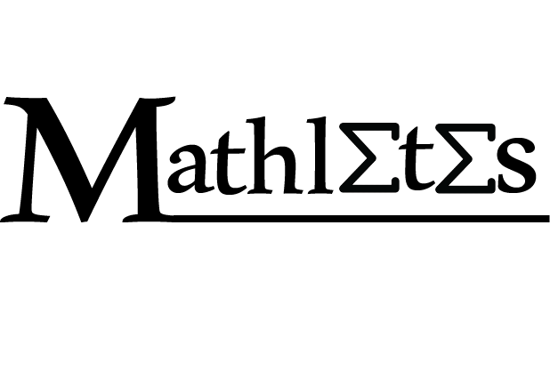

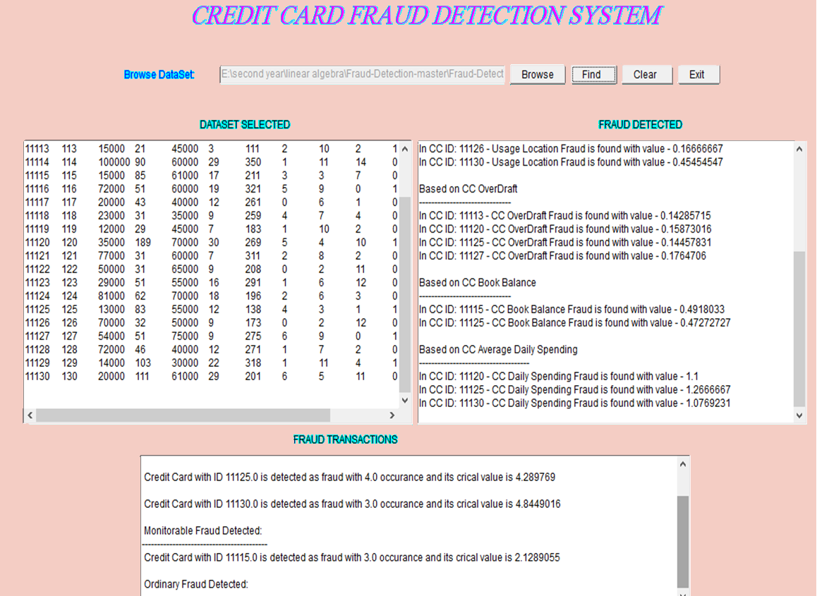

Credit Card Fraud Detection
Department Of Computer Engineering,
Faculty of Engineering,
Cairo university.
For MTH 255 Project
Submitted To:
Dr.Samah El-Tantawy
Some methods of solution
Abstract
Method | Advantage | Disadvantage
ANN | lack of need to be reprogrammed | poor explanation capability
Bayesian network | high accuracy | expensive
HMM | Fast in detection | low accuracy
Genetic algorithm | Works well with noisy data /fast in detection | Requires extensive knowledge to set up & operate & difficult to understand.
Data Description
With the fast development of economy, credit cards are more popular in commercial transactions. Credit card fraud emerges when someone uses other persons’ card without the knowledge of the card holder. Machine learning and artificial intelligence approaches have been suggested to defeat these problems. The method we used to detect fraud is genetic algorithm. The main goal of the genetic algorithm is to get the better solution to remove the fraud.
After calculating a few variables based on information of the card holders and their transactions, we generate the data set that we will load into the code.
Below is a sample of data set we used to generate our results.
AmtT | ODT | LocT | Loc | CUT | CCAge | OD | Avg.BB | CU | Cur.BB | Auth | CardID
0 | 0 | 0 | 3 | 0 | 125 | 4 | 60000 | 13 | 20000 | 111 | 11111
9000 | 0 | 2 | 4 | 6 | 264 | 20 | 55000 | 40 | 25000 | 112 | 11112
15000 | 1 | 2 | 10 | 2 | 111 | 3 | 45000 | 21 | 15000 | 113 | 11113
Credit card fraud emerges when someone uses other persons’ card without the knowledge of the card holder. Credit card contains a unique card number and the security of the credit card depends on the privacy of the credit card number which is confidential.
The Credit Card Frauds have various Techniques like lost Or Stolen Card, rigging card fraud, free Wi-Fi trap and fake call or email . Fraud detection problem is a classification problem, in which some of statistical methods, many data mining algorithms have proposed to solve it.
One of the problems surrounding credit card fraud is the ambivalence of the consumer .A $70 fee may be incurred. Many criminals can simply use the number to apply for a new credit card that.is attached to the consumer’s name, although they would know about that.
The detection of this problem is very difficult to implement in practice because there is not enough information available that provides experimental results on the real-world because the financial data which is sensitive is related with the fraud that has to be kept confidential for the purpose of customers’ privacy.
To achieve good results, Fraud detection system should be able to handle skewed distribution, because a very small percentage of all credit card is fraudulent, There should be a way to handle noise to refer to the error present in the data and the system should be able to end and minimize False alarm or mistakes.
Problem Definition
Genetic Algorithm
Select a starting generation
Generate new solutions from the chosen generation
4
Analysis and Results
Remove the low performance offsprings, keep the ones with highest fitness value
After generating the data set, we now load it into the code which will perform some steps and generate the results, we used ECLIPSE to run the code which is written in Java. We converted other types of data sets into ones that match our code.
Below is the interface that shows the results:
No
Is the number of generations enough?
Yes
Generate the best solution
BasicGeneticAlgorithm ( ) {
Initialize population;
Evaluate population;
While (termination criteria not met) {
Select solutions for next generation;
Perform crossover and mutation;
Evaluate population; }
}
//end of algorithm.
Conclusion and future work :
Genetic algorithm can be used for obtaining optimized solutions to search problems using the theory of natural selection, they are best used for searching through large and complex data sets like the data sets related to credit card frauds. Genetic algorithms have survived for over 40 years, and they are still go-to algorithms in engineering and optimization problems. New developments and extensions of genetic algorithms (such as quantum-inspired genetic algorithms, or QIGA) are gaining ground these days and are expected to continue being refined and explored to improve compute times and accuracy. QIGA is an interesting avenue of research, and has potential to solve some of the downsides of genetic algorithms.
Made by :
Areej Raafat
Asmaa sayed
Aya Samir
Aya Adel
Bassant Mohamed
Shaza Mohamed
Some of the references:
[1] Aravindh, M. S., & Bai, M. W. J. S. TECHNIQUES TO PREVENT CREDIT CARD FROM VARIOUS FRAUDLENT BY GENETIC ALGORITHM AND HIDDEN MARKOV MODEL.
[2] Trivedi, I, Monika& Mridushi,M. (2016, Jan).Credit Card Fraud Detection, International Journal of Advanced Research in Computer and Communication Engineering (Vol. 5)
[3] Al-Khatib, A. (2012). Electronic payment fraud detection techniques. World of Computer Science and Information

