Slide 1

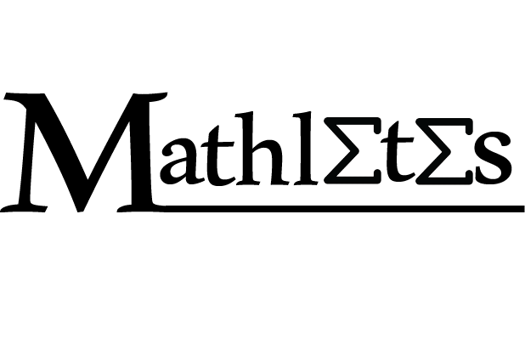
Credit card fraud detection using genetic algorithm

Slide 2
Team: Mathletes
Members:
Areej Raafat Zaher
Asmaa Sayed Saad
Aya Sameer Ahmed
Aya Adel Hassan
Bassant Mohamad Ali
Shaza Mohamad Abdulrahman

Slide 3
Agenda:
Introduction
Techniques used for credit card frauds
Problems in detecting
Detection methods
Evolutionary algorithms (Genetic Algorithm)
CC Fraud Detection using genetic algorithm
Results
Conclusion

Slide 4
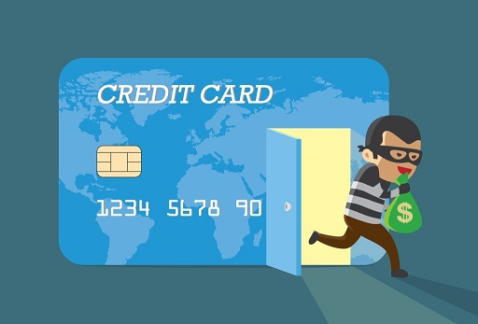
Introduction
What is fraud?
-Criminal activity
-Compromising someone’s rights for personal gain

Slide 5
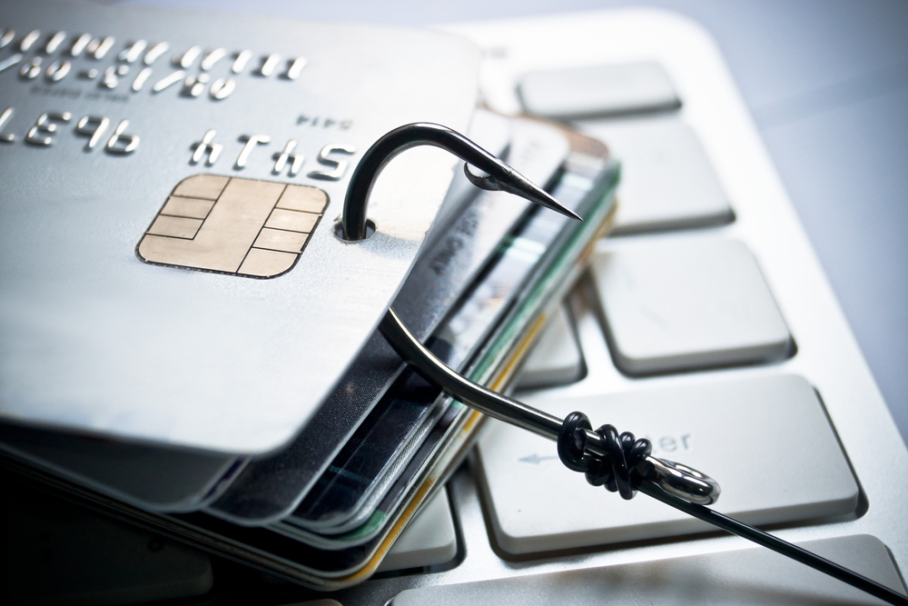
Techniques used for credit card frauds
1. Lost Or Stolen Card
2. Rigging Card Fraud
3. Free Wi-Fi Trap
4. Fake Call or Email

Slide 6
Problems in detecting
there is not enough information available that provides experimental results on the real-world data.

Slide 7
Problems in detecting
To achieve good results:
handle skewed distribution
handle noise to refer to the error present in the data
end or minimize data overlapping problems
have good metrics to estimate the classifier system

Slide 8
Detection methods
Method | Advantage | Disadvantage
Artificial Neural Network | lack of need to be reprogrammed | poor explanation capability
Bayesian network | high accuracy | expensive
Hidden Markov Model | Fast in detection | low accuracy
Genetic algorithm | Works well with noisy data /fast in detection | Requires extensive knowledge to set up & operate & difficult to understand.

Slide 9
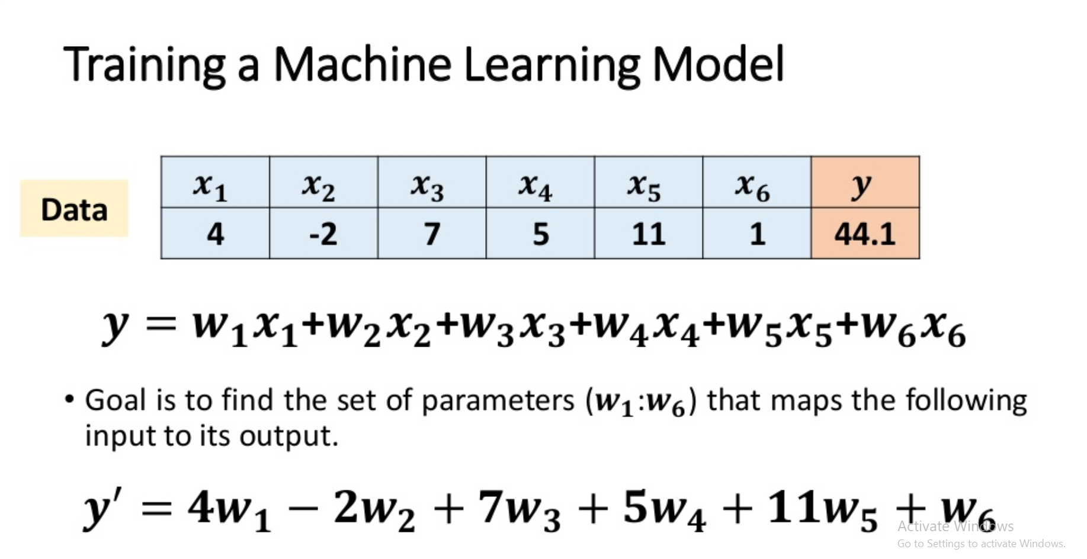
Evolutionary algorithms (Genetic Algorithm)

Slide 10
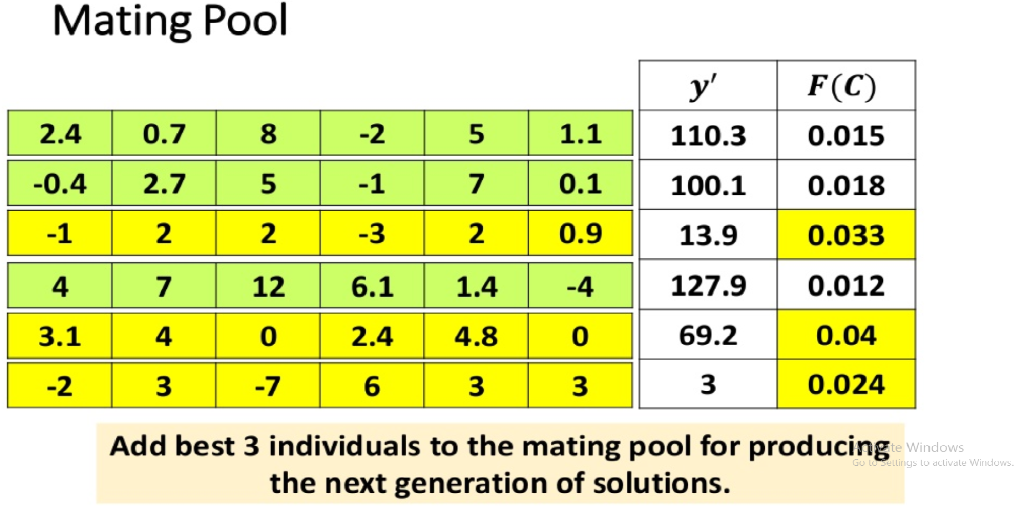
Evolutionary algorithms (Genetic Algorithm)

Slide 11
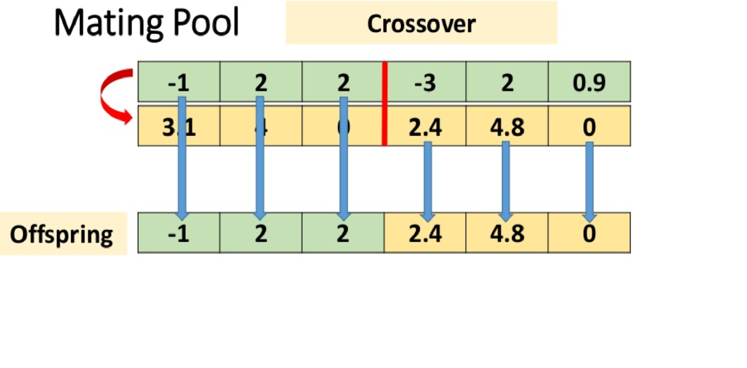
Evolutionary algorithms (Genetic Algorithm)

Slide 12
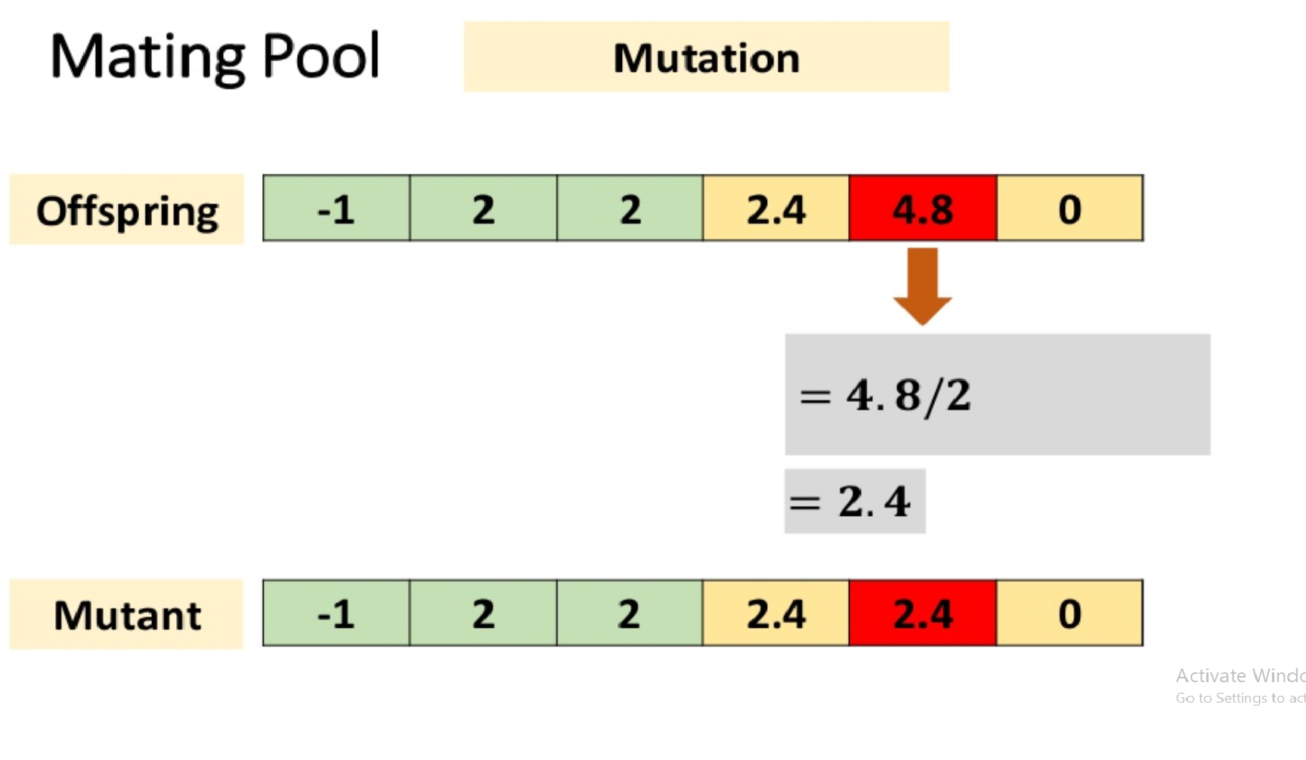
Evolutionary algorithms (Genetic Algorithm)

Slide 13
CC Fraud Detection using genetic algorithm
GA and its usage in detecting one of the most common problems, which is credit card fraud, and minimizing the number of the false alerts.
The main concept of this analysis is obtained through the behavior of the credit card holder and the transactions happening.

Slide 14
CC Fraud Detection using genetic algorithm
Preparing for the first step in the algorithm:
First we need to calculate a few variables to help generate the initial data set we will use in the code.

Slide 15
CC Fraud Detection using genetic algorithm
Those Main variables are:
1-Number of times card is used.
2-Location at which the credit card is in the hands of fraudsters.
3-The balance available at bank of credit card.
4-The average daily spending amount.

Slide 16
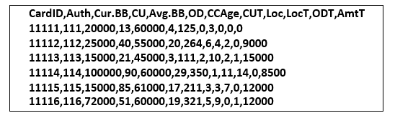
CC Fraud Detection using genetic algorithm
The previous variables and some extra ones help generate the data set as follows:

Slide 17
Results
Step 1: Get the data of the transactions, each transaction with n attributes, and finally generate the data set.
Step 2: Then we calculate the critical values or the previously mentioned variables.
Step 3: Using the genetic algorithm we then recalculate those critical values after limited number of generations.
Step 4: Then the fraud transactions are generated and busted.

Slide 18
Results
Quick analysis for step 3:
1-The initial population or generation is selected randomly from the data set
2- the fitness value is calculated in each population, and those fitness values are sorted out
3- The Crossover is calculated using single point probability.

Slide 19
Results
4- Mutation mutates the new generation using uniform probability measure
5- Then the best solution is passed to the further generation
6- repeating the previous 5 steps on the new population, until maximum number of generation is reached.

Slide 20
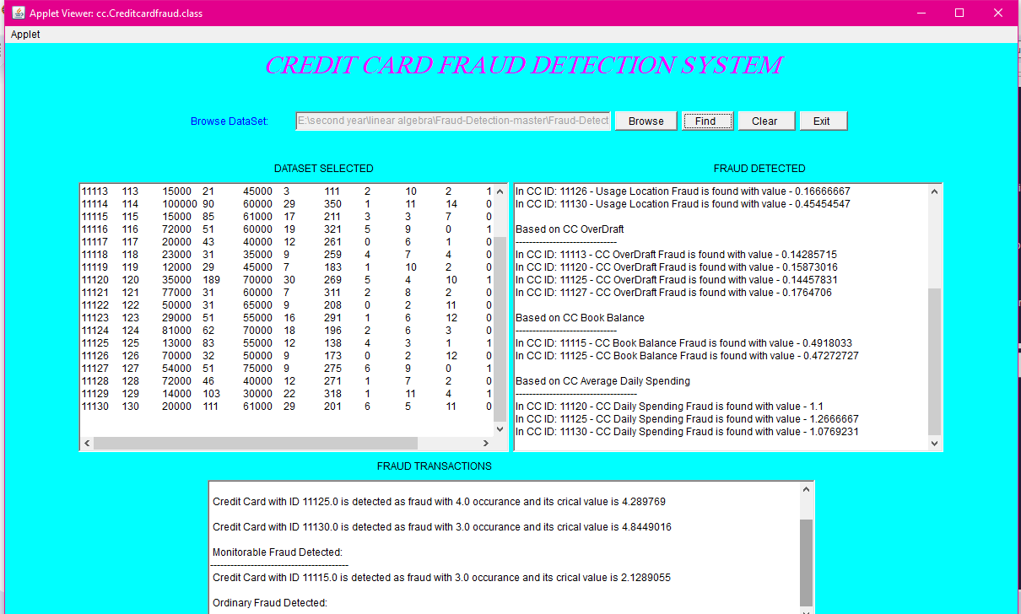
Results

Slide 21
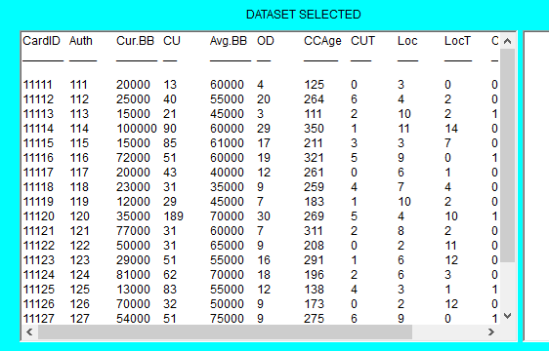
Results

Slide 22
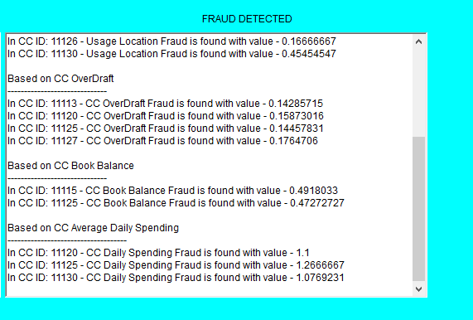
Results

Slide 23
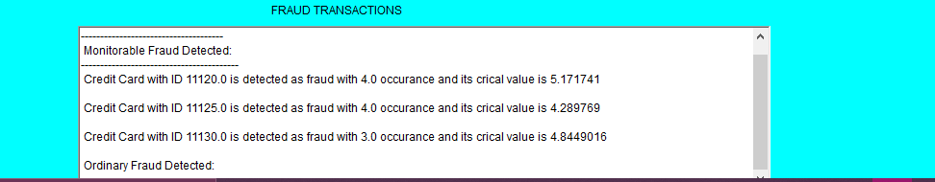
Results

Slide 24

Conclusion
Genetic algorithm can be used to predict the credit card fraud in a very short time after doing the credit card transactions.

Slide 25
Future Work
1-We can use a more updated and modified version of the genetic algorithm to obtain better results.
2-we can even modify it ourselves and this could be achieved, we won't say it's easy, but it's most definitely possible.

Slide 26
acknowledgement
Dr. Samah El-Tantawy
For being our mentor and advisor, and for giving us the wonderful opportunity to do this research, so thank you so much.

Slide 27
Any Questions?

