Slide 1

Task 1: Create a Habit Tracking App DLBDSOOFPP01 Object Oriented and Functional Programming with Python
Ayaulym Myrzatay
Github: https://github.com/ayaaiden/Ayaulym_Myrzatay_92003661_DLBDSOOFPP01_Phase_2

Slide 2
Tools and technologies used in the project
Python 3.10
Built in Json module
Object – oriented programming
Functional Programming (FP)
Unit testing with the unittest

Slide 3
Architecture of the project
Habit class: it represents a single habit ( by the name, frequency, and completions)
HabitTracker class: it manages multilple habits
Main.py: CLI interface and logic control
Test_main.py: Unit testing for the core functions

Slide 4
Key features of the project
Adding and listing of the habits (for example: daily or weekly)
Mark the habit as “done”
Filtering habits by the frequency
Track the completions timestamps
Persistent storage in the habits.json

Slide 5
Fuctional programming
1. For the functional programming I have used map, filter, and lambda in
1.1. Filtering by the frequency
1.2. Mapping the habits by the names
2. It ensured the side – effect– free functions for the analytics

Slide 6
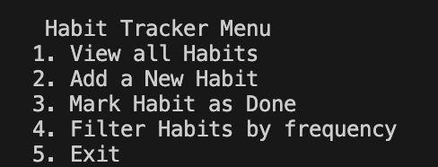
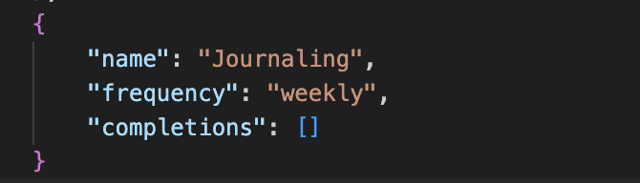
CLI FLOW
Example of the Habit: Journaling
Example of the Frequency: weekly
After the completion marked and saved into the JSON

Slide 7
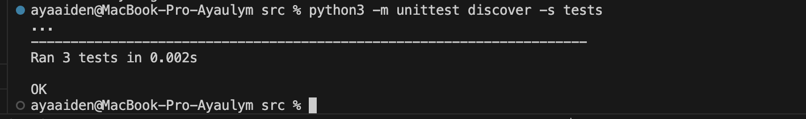
Testing and validation in the project
Tests are located in the test/test_main.py
Which runs via python3 –m unittest discover –s tests
Unit tests:
Creating the habit
Adding and finding habits
Marking them as “done”

Slide 8
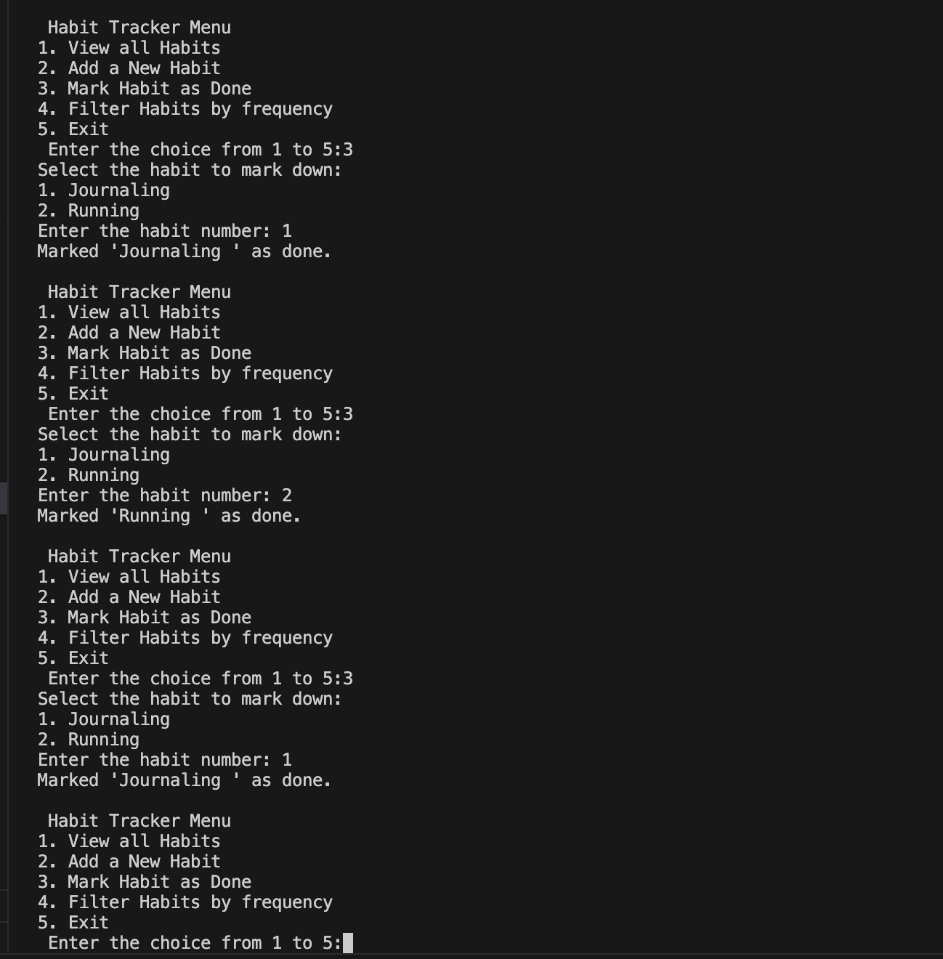
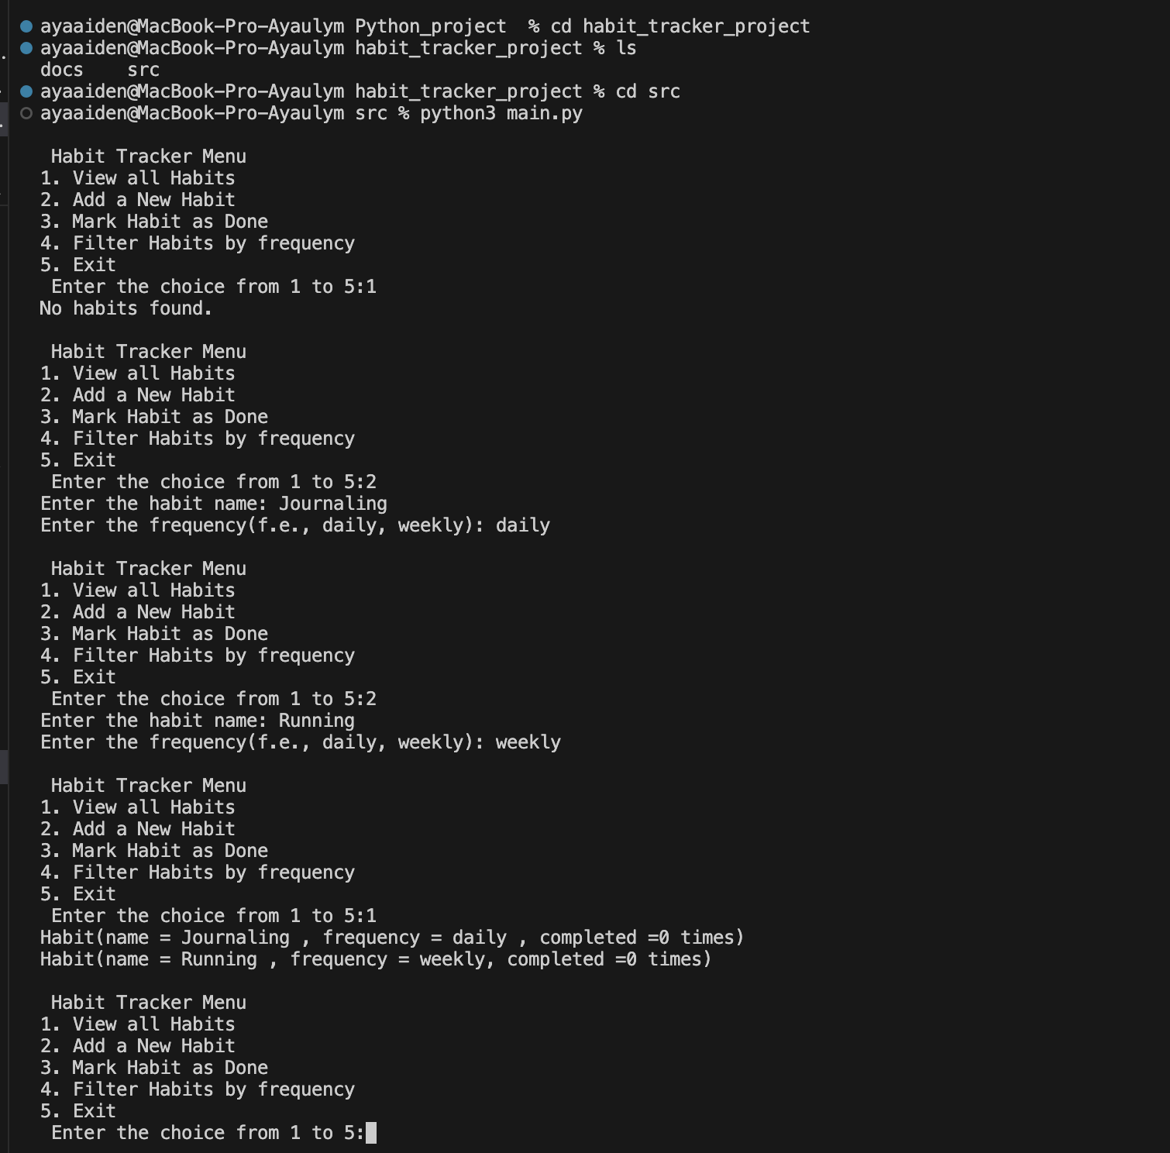
Screenshots of the programming

Slide 9
What I have learned & Practiced
Object - Oriented Programming (OOP)
File I/O and JSON serialization
Date/time handling with datetime
Exception handling
Unit testing with Python's unittest
CLI design and user input validation

