Slide 1
Grade Forecasting: Wellness, Fall 2025 and the Final Model
What we checked in the wellness survey, why Fall 2025 was hard to predict, how the final model is built, and how it did on students it had never seen
ENGR 190W capstone · Prenostik · Update, 12 November 2026
Notes:
This update covers four things: the wellness survey EDA, whether wellness or retro data helps the predictions, why Fall 2025 was hard to predict, and the final model with its one-time test on the locked students.
Technical: everything except the final test uses the 153 training students. The 38 locked test students were used once, at the end.
This version also includes a short beginner-friendly explanation of the earlier posterior simulation and Gibbs MCMC validation. Those diagnostics are separate from the weekly final model and its locked tests.

Slide 2
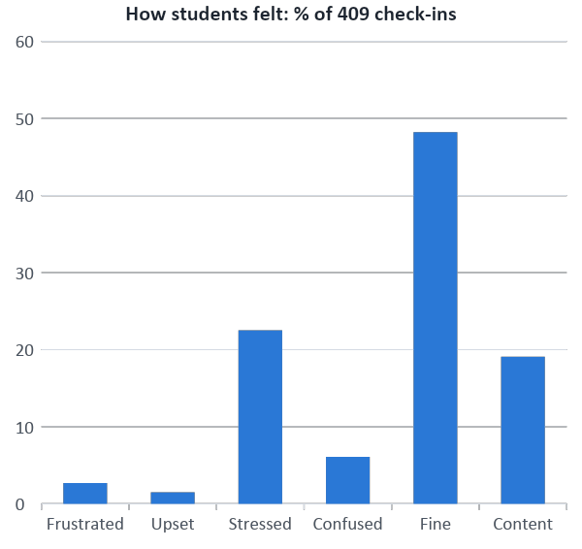
Wellness survey: what the data looks like
• Who answered: 105 of 153 training students (59–76% per quarter); 7,092 answers
• Taken inside MLC sessions: all 48 students who never answered had 0 MLC sessions
• Clean: answers 1–6, no blanks, no repeated rows, labels match the numbers
• Removed: 957 'retro' rows. They are write-a-sentence questions with no answers in the file
• Wording: cost questions are positive (higher = better); questions were reworded between quarters (174 short / 235 long check-ins), small effect
• Most answers are 5 (Agree): value 5.11, expectancy 4.79, cost 4.36 on average
Wellness score 1 to 6. Training students only.
Notes:
Plain: the survey data is clean. About two out of three students answered, and only students who go to MLC answer it, because it is done during MLC sessions. Most answers are 'Agree', so students look very similar.
Technical: linked by MLCStudent name to the gradebook ID through the original grade files, filtered to training students before any counting. Retro rows have answer 0 and no answer text (free-text questions: what went well / didn't / can improve). Wellness counted once per check-in. Fine 48.2%, Stressed 22.5%, Content 19.1%, Confused 6.1%, Frustrated 2.7%, Upset 1.5%.

Slide 3
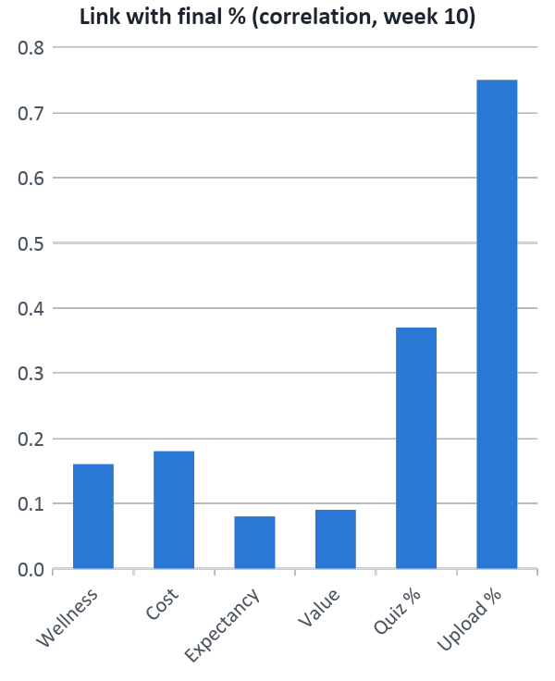
Wellness goes with grades, but only a little
Average wellness up to week 10
Group | Students | Avg final % | % C or lower | Avg missed
Low (below 4) | 27 | 79.9 | 14.8 | 4.2
Middle (4 to 4.9) | 36 | 79.8 | 8.3 | 2.6
High (5 or more) | 41 | 83.7 | 4.9 | 2.0
No survey | 49 | 80.7 | 10.2 | 4.3
Ever felt Stressed, Upset or Frustrated (up to week 10)
Group | Students | Avg final % | % C or lower | Avg missed
Had a bad check-in | 60 | 80.0 | 11.7 | 3.5
Never below 4 | 44 | 83.2 | 4.5 | 1.8
Students who felt Fine or Content averaged 3–4 points higher and missed about half as many assignments.
These are links, not proof of cause. Only MLC students answered.
Notes:
Plain: students who feel better do a bit better, about 3 to 4 points, and they miss fewer assignments. But the link is weak compared with assignment scores.
Technical: correlations with final % at week 10 among students who answered: wellness 0.16, cost 0.18, expectancy 0.08, value 0.09; for comparison quiz % 0.37, upload % 0.75 (missed −0.49, not shown). With about 100 students, correlations below about 0.2 could be chance. High vs middle wellness: 90% ranges of the averages do not overlap (81.7–85.7 vs 78.1–81.5). Group splits were not a pre-planned test.

Slide 4
Wellness and retro did not improve the predictions
Points off the real final % (weeks 5 / 8 / 10, tested before we moved to 2 / 5 / 9)
Wellness
Not in the prediction. Shown on the dashboard as an early warning sign.
Test | Without survey | With survey
Grades vs grades + survey (students who answered) | 4.9 / 4.1 / 3.6 | 5.3 / 4.7 / 4.0
Survey alone vs simple guess | guess 4.9 / 5.5 / 5.5 | 5.0 / 5.9 / 5.9
Expanded-file DAG arrows + Canvas activity | 4.7 / 3.8 / 3.4 | 4.9 / 4.0 / 3.3
Other team's MCMC model (their README) | engagement only | survey did not beat it
Retro
Left out. It is the same as MLC attendance: all 22 students without retro had 0 MLC sessions. Only 3 quarters have it.
Why: answers are very similar (mostly 5), 1 in 3 students has no survey, and stress already shows up in missed assignments, which the model uses.
Survey alone beat the simple guess at 0 of 3 weeks (rule set before the test).
Notes:
Plain: we tested the survey four different ways and it never made the predictions better. Retro is done inside MLC, so it tells us the same thing as MLC attendance.
Technical: (1) two-model approach, no filled-in values, same students; (2) survey-only NIG regression vs past-average guess; (3) Gaussian DAG with the expanded_assessment_history arrows, median fill in training, joint-Normal conditioning when predicting; LMS page views/actions from the shared table (our training IDs only; its split differs from ours). Retro: 60 of 82 students in the 3 retro quarters did retro; the 22 who did not had 0 MLC sessions. With retro, MLC students scored about 2.5 points higher than MLC students before retro existed; small groups, may be chance.

Slide 5
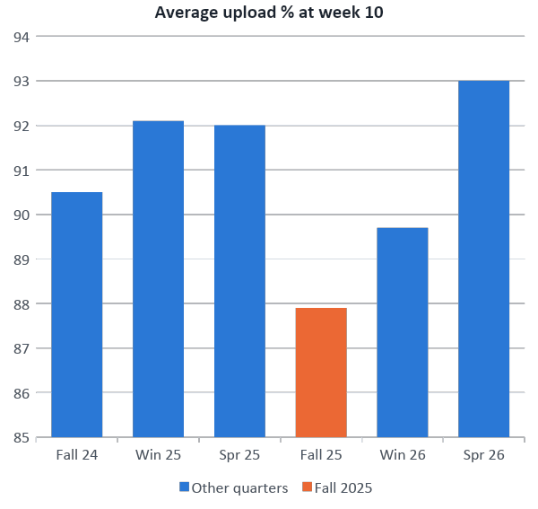
Fall 2025: why the first model guessed too low
• Grades were normal: average 79.9%, bunched together (1 A, 78% B)
• Uploads were the lowest: 87.9% vs 89.7–93.0% in other quarters
• So the model guessed every student too low: −6.8 points at week 10; its range caught only 61%
• Also: fewest assignments (72 vs 87–113); missed items had no link to grades that quarter
What we tried (points off) | Fall 25 | Win 26 | Spr 26
First model (week 10) | 6.8 | 2.6 | 2.5
Class median (week 10) | 2.8 | 3.8 | 4.3
Final model, week 9 | 2.2 | 2.1 | 2.0
Notes:
Plain: in Fall 2025 the whole class got lower upload scores but normal final grades, so the model thought everyone was weaker than they were. Comparing students with their classmates fixed Fall 2025 but made the other quarters worse, so we did not use it. The final model with the weighted grade predicts Fall 2025 well at week 9.
Technical: forward test round 1 learned from 3 quarters (71 students). Signed error −1.3 / −5.1 / −6.8 at weeks 5 / 8 / 10, all 7 misses above the range. Missed-item correlation with final % in Fall 2025: −0.09, −0.03, +0.03. Class-median version overall 3.8 vs 3.5 and right group 70% vs 85% at week 10, so the original was kept. Final model (week 9 = work due by week 8): Fall 2025 5.6 → 2.2, signed +1.2, range caught 100%. The reason uploads were lower is unknown (harder grading or different assignments).

Slide 6
How the final model is built
1 Clues
quiz %, upload %, other %, missed items, MLC sessions, from work due so far
2 Weighted grade
score in each course group so far, combined with the course weights
3 Bayesian model
Gaussian DAG, Normal-Inverse-Gamma prior, exact formula (no MCMC)
4 Forecast
final %, 90% range, chances of A / B / C, at weeks 2, 5 and 9
Course group (Fall 2026 weights) | Weight
Written Mastery II | 35%
Written Mastery I | 20%
Growth Mindset | 10%
Teamwork | 10%
Verbal Mastery I | 10%
Verbal Mastery II | 10%
Resilience & Agency | 5%
• Same weights used for all 6 quarters. Every dated assignment matched a group; extra credit left out.
• Week 9 uses work due by week 8. We assume papers are graded about a week after they are due (to confirm with the instructor). A week-10 test gave 0.6 points off: too good, because it used papers not yet graded.
• Tested and not kept: survey, retro, Canvas activity (3.5 → 3.4 at week 10), class median.
• Learning: forward in time, earlier quarters → next quarter; 153 training students.
Notes:
Plain: the model looks at a student's work so far, adds their grade so far counted the way the course counts it, and gives a predicted final grade with a range and grade chances.
Technical: one model per forecast week; each node is a Bayesian linear regression with a Normal-Inverse-Gamma prior (weights ~ Normal(0, sigma²) on standardized inputs, intercept prior SD 10, sigma² ~ Inverse-Gamma(2, 1)); closed-form posterior, Student-t predictive. Weighted grade = points earned / possible per group (missed = 0, capped at points possible), combined with the group weights over the groups that have started, re-scaled to 100%. Share of weight started by week 2 / 5 / 8: 15–25% / 45% / 90%. Assumption to confirm with the instructor: grading takes about a week; past quarters used the Fall 2026 weights.

Slide 7
How to interpret the Bayesian grade forecast
The model produces separate forecasts at Weeks 2, 5 and 9 using available student evidence.
Observed student evidence
Academic performance
Forecasted final grade
Quizzes, assignments, other grades,
weighted grade so far
Bayesian regression
Predicted final %
Posterior prediction
+ uncertainty
90% prediction interval
Engagement and completion
Probability of A / B / C
MLC sessions and missed items
What the arrows mean
Each arrow shows a predictor used to inform the final-grade forecast; it does not imply causation.
The 90% interval reflects uncertainty about a student’s final grade; associations are not causal effects.
Notes:
Transition: Before interpreting individual predictor weights, I will explain what posterior uncertainty means and how we checked sampling in the earlier consolidated study. The weekly model itself uses the exact formula.

Slide 8
Why sample? One fitted number hides uncertainty
Posterior = the distribution of plausible model settings after seeing the data.
1 Start with evidence
2 Keep plausible models
3 Summarize uncertainty
Observed grades and other student inputs
Many possible predictor weights and noise levels
How strong is a link? How uncertain is the forecast?
More draws describe uncertainty more precisely; they do not add student evidence.
POSTERIOR SAMPLING | Earlier consolidated study: 148-student fit; separate from the weekly final model
Notes:
We have just seen how the model turns a student's work into a forecast. The next question is: how sure are we about the model behind that forecast? A Bayesian model does not give us only one set of predictor weights. It gives us a distribution of plausible weights after seeing the data. That is called the posterior. A weight describes how a predictor is associated with the final grade while the other predictors are held fixed.
Think of sampling as taking many plausible versions of the fitted model, each consistent with its assumptions and the observed data. We can then ask whether an association is usually positive, whether it is large enough to matter, and how the uncertainty affects a forecast. We are drawing possible parameter values, not inventing additional students.
This short section explains the simulation checks in our earlier consolidated study. That fit used 148 earlier students. The weekly model uses 153 training students and different predictors, so the numerical checks I show are not new validation results for the weekly model.

Slide 9
Two routes to the same posterior
Direct sampling gives a reference; MCMC checks an iterative route against it.
Direct posterior draws
Gibbs MCMC
20,000 independent draws
Use the exact solution
Each draw is a fresh sample
Four chains of linked draws
Alternate weights and noise
Check against the exact solution
Why we did this: check the computation and understand uncertainty.
POSTERIOR SAMPLING | Earlier consolidated study: 148-student fit; separate from the weekly final model
Notes:
There are two ways we sampled the same posterior in this study. First, this model has an exact mathematical solution. We can draw directly from it. We took 20,000 independent draws, meaning that one draw does not depend on the previous draw.
Second, we ran MCMC. The letters mean Markov chain Monte Carlo. In plain language, it is a sequence of random updates designed to explore the posterior. A chain is one run of those updates. Successive draws can be related, unlike the independent draws on the left.
We used a method called Gibbs sampling: update the predictor weights given the current noise level, then update the noise level given those weights, and repeat. Noise means variation in final grades that the predictors do not explain.
Why do both? The exact solution is a reference answer for this model. Comparing Gibbs sampling with it gives us a strong numerical check and helps us understand sampling before considering models without exact solutions. The weekly forecast still uses the exact formula. MCMC did not replace it or make its predictions automatically better.

Slide 10
What we ran: four Gibbs sampling chains
A chain repeatedly updates plausible weights and unexplained grade variation.
Update weights
Update noise
Repeat and retain
Given the current noise level
Given the current weights
Explore the posterior distribution
4 chains × (1,000 warm-up + 4,000 retained updates)
16,000 retained MCMC draws in total
Fixed, filled-in predictor data; missing-value uncertainty was not sampled.
POSTERIOR SAMPLING | Earlier consolidated study: 148-student fit; separate from the weekly final model
Notes:
Here is what the Gibbs sampler actually did. We began four separate runs at different noise levels, rather than relying on a single starting point. In each run we repeatedly sampled predictor weights and then the unexplained variance. If we run long enough and the procedure is working, the retained draws should explore the same posterior regardless of where we started.
We discarded the first 1,000 updates from each chain as warm-up, so the initial settings would have less influence on our summary. We then kept 4,000 draws from each of the four chains: 16,000 retained MCMC draws in total. These are separate from the 20,000 independent direct draws on the previous slide.
The recorded experiment sampled the final-grade regression conditional on a fixed set of predictors. Missing predictor values had been filled using training-data medians, and that filled-in design stayed fixed during sampling. Therefore this experiment does not account for uncertainty in those missing values, and it is not joint sampling of every unknown in the full DAG. That matters when interpreting how complete the reported uncertainty is.

Slide 11
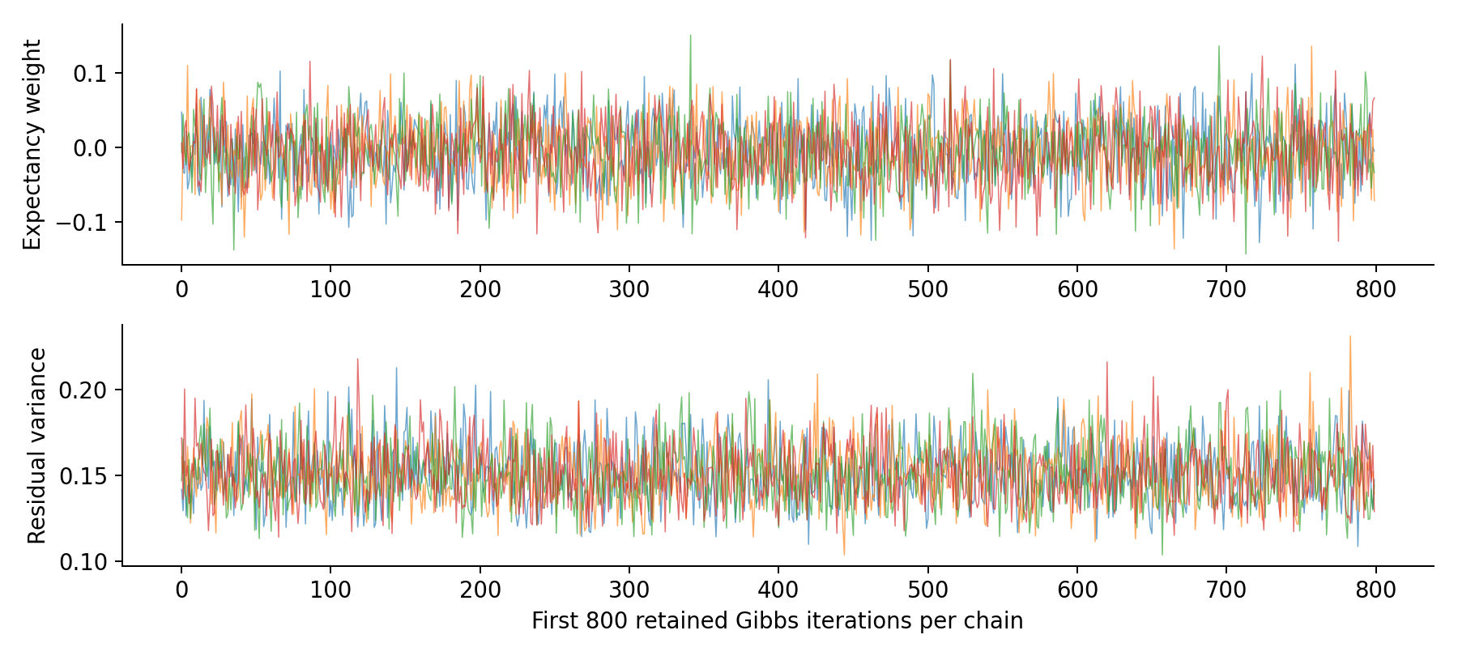
Did the sampling work? We checked three ways
The Gibbs results agreed with the exact posterior in the earlier fitted model.
1.0007
Largest R-hat: chains agree
12,194
Smallest bulk effective sample size
≤ 2.01 MCSE
Sampled means vs exact means
A check of numerical sampling—not proof of predictive accuracy or causation.
POSTERIOR SAMPLING | Earlier consolidated study: 148-student fit; separate from the weekly final model
Notes:
We did not just run the sampler and assume it worked. The chart shows part of the retained chains for one predictor weight and the unexplained variance. The colored lines overlap and move around a common region. That is a useful visual check, but it is not enough on its own.
R-hat compares variation within and between chains. Values near one indicate that the runs are behaving similarly; the largest value here was 1.0007. Effective sample size accounts for the fact that linked MCMC draws repeat information. The smallest bulk effective sample size was 12,194. This is an effective number of parameter draws, not a number of students.
We also compared the sampled parameter means with the exact mathematical means. The largest difference was about 2.01 Monte Carlo standard errors: the estimated numerical uncertainty caused by taking a finite number of draws. Together, these checks support agreement with the exact posterior for this fitted model. They do not prove that the model is correct, that a predictor is causal, or that future grade forecasts will be accurate.
Source: consolidated presentation slide 5; posterior_study/analysis.py and posterior_results/provenance.json. The trace displays the first 800 retained updates per chain.

Slide 12
What we learned—and how to use it
The computation was checked; forecast performance still needs its own evidence.
Uncertainty about a predictor
Credible interval: how uncertain is its fitted association?
Uncertainty about a student
Prediction interval: how uncertain is their eventual final grade?
Evidence of useful forecasting
Later-student tests: does the model actually reduce prediction error?
Next: interpret the weekly model’s associations, then its locked-test results.
POSTERIOR SAMPLING | Earlier consolidated study: 148-student fit; separate from the weekly final model
Notes:
The practical result is confidence in the posterior computation, within the assumptions of that earlier model. It also gives us a clearer language for uncertainty. A credible interval for a predictor weight describes uncertainty about an association. A prediction interval describes uncertainty about one student's eventual outcome, including unexplained student-to-student variation. Those intervals answer different questions, and we should not read them interchangeably.
The weekly model can calculate both kinds of quantities using its exact formulas, so it does not need MCMC to make forecasts. Sampling is useful here as a computational check and a way to understand the distribution, rather than a new source of predictive signal.
To show that a source of data improves forecasts, we still need comparisons on later students. To show that a coaching action changes grades, we need a causal study. Neither follows from well-behaved sampling.
As we return to the weekly model's coefficient plot, remember that its intervals describe conditional associations. In particular, a small estimated weight with an interval crossing zero does not establish a reliable positive or negative link. The weekly plot uses 90% intervals and the 153-student training fit; do not substitute the earlier study's coefficients or diagnostics for these results.

Slide 13
What the fitted model tells us at Week 9
Posterior associations with final grade, holding the other predictors fixed (153 training students).
Evidence change
Change in predicted final grade points
Estimate [90% interval]
Weighted grade
+10 points
+6.25 [+5.62, +6.89]
Assignment grade
+10 points
+4.26 [+2.76, +5.77]
Quiz grade
+10 points
+0.68 [-0.05, +1.41]
Other grade
+10 points
-0.77 [-3.51, +1.97]
Missed items
+1 item
+0.03 [-0.09, +0.15]
MLC participation
+1 session
+0.04 [-0.21, +0.29]
-4
0
4
8
Takeaway: weighted grade and assignment grade have clear positive associations; MLC and missed-item intervals include zero.
Notes:
The practical result is confidence in the posterior computation, within the assumptions of that earlier model. It also gives us a clearer language for uncertainty. A credible interval for a predictor weight describes uncertainty about an association. A prediction interval describes uncertainty about one student's eventual outcome, including unexplained student-to-student variation. Those intervals answer different questions, and we should not read them interchangeably.
The weekly model can calculate both kinds of quantities using its exact formulas, so it does not need MCMC to make forecasts. Sampling is useful here as a computational check and a way to understand the distribution, rather than a new source of predictive signal.
To show that a source of data improves forecasts, we still need comparisons on later students. To show that a coaching action changes grades, we need a causal study. Neither follows from well-behaved sampling.
Here we are back to the WEEKLY model: 153 training students, Week 9, and 90% credible intervals. A ten-point increase in weighted grade is associated with about 6.25 more predicted final-grade points, holding the other predictors fixed; its interval runs from 5.62 to 6.89. The assignment-grade association is also positive. Quiz, other-grade, missed-item and MLC intervals cross zero, so these individual conditional weights are less clearly determined. These are conditional model associations, not the effect of an intervention. The earlier MCMC diagnostics do not validate this particular fit. Next we assess the weekly model on the locked students.

Slide 14
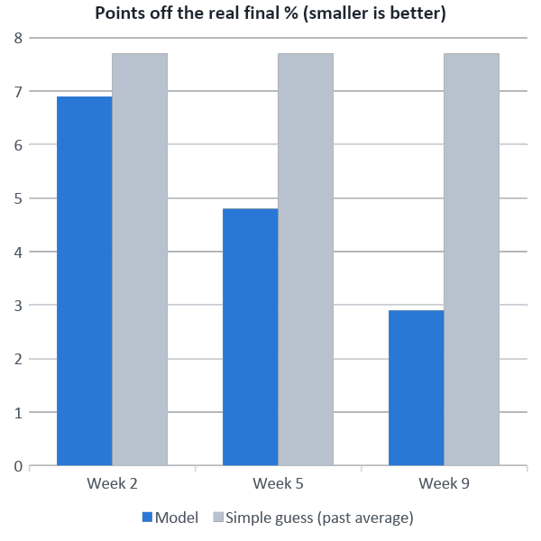
Final test: 38 students the model had never seen
Points off (MAE) | Week 2 | Week 5 | Week 9 | Guess
Practice test, 82 students* | 5.4 | 4.5 | 2.1 | 5.5
Final test, 38 locked | 6.9 | 4.8 | 2.9 | 7.7
New quarter, 21 locked | 7.4 | 4.6 | 3.3 | 8.5
Final test, 38 locked | Week 2 | Week 5 | Week 9 | Guess
90% range caught real grade | 87% | 89% | 89% | 95%
Right A / B / C group | 47% | 63% | 76% | 47%
Good from week 5 (about one grade step off), best at week 9. Week 2 is too early.
* Used to choose the model, so a bit optimistic. The locked-test numbers are the honest ones.
Notes:
Plain: on students it had never seen, the model was about 5 points off at week 5 and about 3 points off at week 9, against about 8 for guessing the average. Its 90% ranges were honest. At week 2 it is barely better than guessing.
Technical: Test A trains on all 153 training students and predicts all 38 locked students. Test B (new quarter) uses the 21 locked students in 2025 FAL, 2026 WTR, 2026 SPR, learning only from earlier quarters. The old grades-only model gave 6.9 / 5.2 / 3.4 on test A, so the weighted grade helped at weeks 5 and 9. RMSE at week 2 is 11.6 (a few large misses). Average lean +2.0 / +1.3 / +0.7 (slightly too high). Small groups: each number about ±1 point. Grade steps are 5 points wide.

Slide 15
What we conclude, and what comes next
• The model is useful from week 5 (about 5 points off) and best at week 9 (about 3); week 2 is too early
• Written work (uploads, weighted grade) and missed assignments drive the forecast
• Wellness: Fine/Content students did 3–4 points better and missed half as much work, but the survey adds no predictive value → dashboard warning sign
• Retro = MLC attendance; MLC goes with fewer missed assignments (about −0.7 per session), no direct effect
• Limits: small test groups (38 / 21), same course weights assumed for past quarters, week 9 assumes about one week of grading, links not causes
Next steps
Build the dashboard: prediction, what pushes it up or down, wellness warning
Notes:
Plain: the model works from week 5 on. Assignment work decides the grade. Wellness and retro do not improve the prediction, so wellness goes on the dashboard as a warning sign and retro is left out.
Technical: MLC → missed −0.7 / −0.6 / −0.7 per session (weeks 5 / 8 / 10, ranges exclude 0); direct MLC → final weight includes 0. Open: grading-time assumption for week 9, Fall 2026 weights for past quarters, Spring 2025 section difference (training students, 18 and 17).

