Slide 1
Posterior sampling: why we did it
A fitted estimate is useful. A distribution tells us how uncertain that estimate is.
1 Observe the data
2 Describe uncertainty
3 Sample and summarize
Use student evidence to fit the Bayesian model.
The posterior assigns probability to plausible weights and noise levels.
Draw possible model settings to study associations and grade uncertainty.
Sampling adds precision to our calculation—not more student evidence.
MLC | Posterior simulation study | 148-student fit; distinct from the weekly forecast model
1
Notes:
The purpose of this short presentation is to explain our posterior sampling study. Our question is: how sure are we about the model behind that forecast? A Bayesian model does not give us only one set of predictor weights. It gives us a distribution of plausible weights after seeing the data. That is called the posterior. A weight describes how a predictor is associated with the final grade while the other predictors are held fixed.
Think of sampling as taking many plausible versions of the fitted model, each consistent with its assumptions and the observed data. We can then ask whether an association is usually positive, whether it is large enough to matter, and how the uncertainty affects a forecast. We are drawing possible parameter values, not inventing additional students.
This short section explains the simulation checks in our earlier consolidated study. That fit used 148 earlier students. The weekly model uses 153 training students and different predictors, so the numerical checks I show are not new validation results for the weekly model.

Slide 2
Two ways to sample the same posterior
We used the exact solution as a reference for an iterative sampling method.
Direct posterior sampling
Gibbs MCMC
20,000 independent draws
Each draw is a fresh sample
Available because this model has an exact solution
Four chains of related draws
Repeated random updates
Compared with the exact posterior
Why both? Verify the numerical method and understand posterior uncertainty.
MLC | Posterior simulation study | 148-student fit; distinct from the weekly forecast model
2
Notes:
There are two ways we sampled the same posterior in this study. First, this model has an exact mathematical solution. We can draw directly from it. We took 20,000 independent draws, meaning that one draw does not depend on the previous draw.
Second, we ran MCMC. The letters mean Markov chain Monte Carlo. In plain language, it is a sequence of random updates designed to explore the posterior. A chain is one run of those updates. Successive draws can be related, unlike the independent draws on the left.
We used a method called Gibbs sampling: update the predictor weights given the current noise level, then update the noise level given those weights, and repeat. Noise means variation in final grades that the predictors do not explain.
Why do both? The exact solution is a reference answer for this model. Comparing Gibbs sampling with it gives us a strong numerical check and helps us understand sampling before considering models without exact solutions. The weekly forecast still uses the exact formula. MCMC did not replace it or make its predictions automatically better.

Slide 3
How Gibbs MCMC works
MCMC = Markov chain Monte Carlo: a sequence of random updates that explores a posterior.
Sample the weights
Sample the noise
Repeat the cycle
Given the current amount of unexplained grade variation.
Given the current predictor weights.
Run four chains from different initial noise levels.
Per chain: discard 1,000 warm-up updates; keep 4,000 draws → 16,000 retained draws.
These draws sample the outcome regression; filled-in predictor values stay fixed.
MLC | Posterior simulation study | 148-student fit; distinct from the weekly forecast model
3
Notes:
Here is what the Gibbs sampler actually did. We began four separate runs at different noise levels, rather than relying on a single starting point. In each run we repeatedly sampled predictor weights and then the unexplained variance. If we run long enough and the procedure is working, the retained draws should explore the same posterior regardless of where we started.
We discarded the first 1,000 updates from each chain as warm-up, so the initial settings would have less influence on our summary. We then kept 4,000 draws from each of the four chains: 16,000 retained MCMC draws in total. These are separate from the 20,000 independent direct draws on the previous slide.
The recorded experiment sampled the final-grade regression conditional on a fixed set of predictors. Missing predictor values had been filled using training-data medians, and that filled-in design stayed fixed during sampling. Therefore this experiment does not account for uncertainty in those missing values, and it is not joint sampling of every unknown in the full DAG. That matters when interpreting how complete the reported uncertainty is.

Slide 4
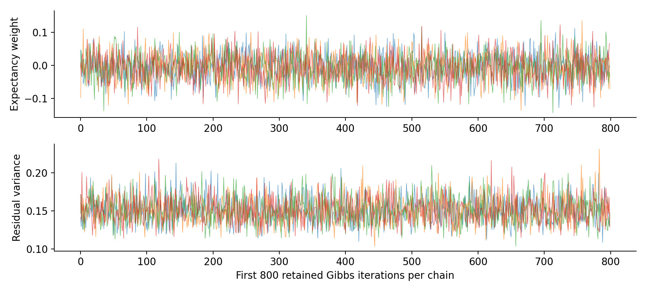
The sampling agreed with the exact solution
We checked chain behavior, effective information and agreement with the reference answer.
1.0007
Largest R-hat: chains behave similarly
12,194
Smallest bulk effective sample size
≤ 2.01 MCSE
Sampled means vs exact means
The numerical checks support sampling agreement within this fitted model.
MLC | Posterior simulation study | 148-student fit; distinct from the weekly forecast model
4
Notes:
We did not just run the sampler and assume it worked. The chart shows part of the retained chains for one predictor weight and the unexplained variance. The colored lines overlap and move around a common region. That is a useful visual check, but it is not enough on its own.
R-hat compares variation within and between chains. Values near one indicate that the runs are behaving similarly; the largest value here was 1.0007. Effective sample size accounts for the fact that linked MCMC draws repeat information. The smallest bulk effective sample size was 12,194. This is an effective number of parameter draws, not a number of students.
We also compared the sampled parameter means with the exact mathematical means. The largest difference was about 2.01 Monte Carlo standard errors: the estimated numerical uncertainty caused by taking a finite number of draws. Together, these checks support agreement with the exact posterior for this fitted model. They do not prove that the model is correct, that a predictor is causal, or that future grade forecasts will be accurate.
Source: consolidated presentation slide 5; posterior_study/analysis.py and posterior_results/provenance.json. The trace displays the first 800 retained updates per chain.

Slide 5
What the posterior tells us about the inputs
Earlier study: conditional associations with grades held fixed; 95% credible intervals.
Predictor
Mean points / SD
95% credible interval
LMS page views
+0.34
−0.21 to +0.88
LMS participation
−0.09
−0.63 to +0.44
EVC cost/support
−0.21
−0.84 to +0.41
EVC expectancy
−0.05
−0.70 to +0.60
EVC value
−0.13
−0.73 to +0.47
Wellness
+0.20
−0.39 to +0.78
SD = one standard deviation in the training data. These are associations, not causal effects.
All six intervals include zero: small, uncertain conditional associations.
MLC | Posterior simulation study | 148-student fit; distinct from the weekly forecast model
5
Notes:
Now we can use the posterior to describe uncertainty about individual predictor weights. These are results from the earlier consolidated study: the final regression fit used 148 earlier students and the larger grade bundle. They are separate from the weekly model and its 153-student training fit.
Each estimate is in final-grade percentage points for a one-training-standard-deviation increase in that predictor, holding the other predictors fixed. For example, LMS page views have a posterior mean of plus 0.34 points, with a 95% credible interval from minus 0.21 to plus 0.88. Under this model, 95% of the posterior probability for that coefficient lies in that interval. Because zero lies inside it, the direction is uncertain at this interval level.
All six non-grade predictor intervals include zero. In this fit, the posterior probability that any one of these six weights has an absolute magnitude above one final-grade point is below 1% for each weight. This supports describing the conditional associations as small and uncertain under the stated model. It does not prove that wellness or engagement never matter, and it does not measure what would happen if we intervened to change them.
The coefficient summaries use the analytic posterior; simulation agreement validates the numerical sampling procedure. Source: consolidated presentation slide 9 and posterior_results/coefficient_posteriors.csv.

Slide 6
What this establishes—and what it leaves open
A reliable sampling calculation and a useful forecasting model need different evidence.
Posterior uncertainty
Credible interval: uncertainty about a fitted predictor weight.
Student outcome uncertainty
Prediction interval: uncertainty about one student’s final grade.
Predictive usefulness
Later-student tests: does the model reduce real forecast error?
MCMC checked the calculation. The weekly forecast can still use the exact formula.
MLC | Posterior simulation study | 148-student fit; distinct from the weekly forecast model
6
Notes:
The practical result is confidence in the posterior computation, within the assumptions of that earlier model. It also gives us a clearer language for uncertainty. A credible interval for a predictor weight describes uncertainty about an association. A prediction interval describes uncertainty about one student's eventual outcome, including unexplained student-to-student variation. Those intervals answer different questions, and we should not read them interchangeably.
The weekly model can calculate both kinds of quantities using its exact formulas, so it does not need MCMC to make forecasts. Sampling is useful here as a computational check and a way to understand the distribution, rather than a new source of predictive signal.
To show that a source of data improves forecasts, we still need comparisons on later students. To show that a coaching action changes grades, we need a causal study. Neither follows from well-behaved sampling.
To close: we checked that simulation reproduces the exact posterior and used that posterior to describe uncertain conditional associations. Our next evidence for practical forecasting comes from later-student prediction tests, which are a separate analysis. The earlier study conditions on training-median-filled inputs, so its intervals omit uncertainty in those missing values. Good chain diagnostics cannot repair missing-data assumptions, establish grade-release timing, prove a coaching effect, or validate a different fitted model.
References: consolidated presentation slides 4, 5, 9 and 17; posterior_study/analysis.py; posterior_results/provenance.json; Vehtari et al. (2021), improved R-hat and effective sample size diagnostics, DOI 10.1214/20-BA1221.

