Slide 1
Predicting Earthquake Damage to Buildings
Nepal 2015 Gorkha earthquake (DrivenData: Richter's Predictor)
UE24CS352A Machine Learning mini-project, Team 18 (Problem 58)
Syed Ayaan Hasan (PES2UG24CS545) and Sriniket Deeduvanu (PES2UG24CS521)
Notes:
Introduce the project and the team. We predict how badly a building was damaged in the 2015 Nepal earthquake, using the DrivenData Richter's Predictor dataset. We compared four model families and picked the best one.

Slide 2
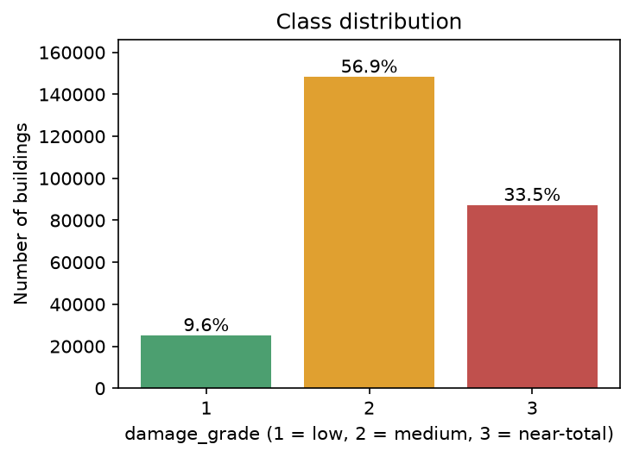
The problem
Input: a building's structure, age, use and location
Output: damage grade 1 (low), 2 (medium) or 3 (near-total destruction)
Score: micro-averaged F1, which equals accuracy when each building has one label
Always predicting grade 2 scores 0.5689, so that is our baseline
Notes:
Explain the task in plain words: given a building's features, say whether damage was low, medium or near-total. The classes are imbalanced, grade 2 is about 57 percent of buildings, so a model that always says 2 already gets 0.5689. Every model has to beat that number to be useful.

Slide 3
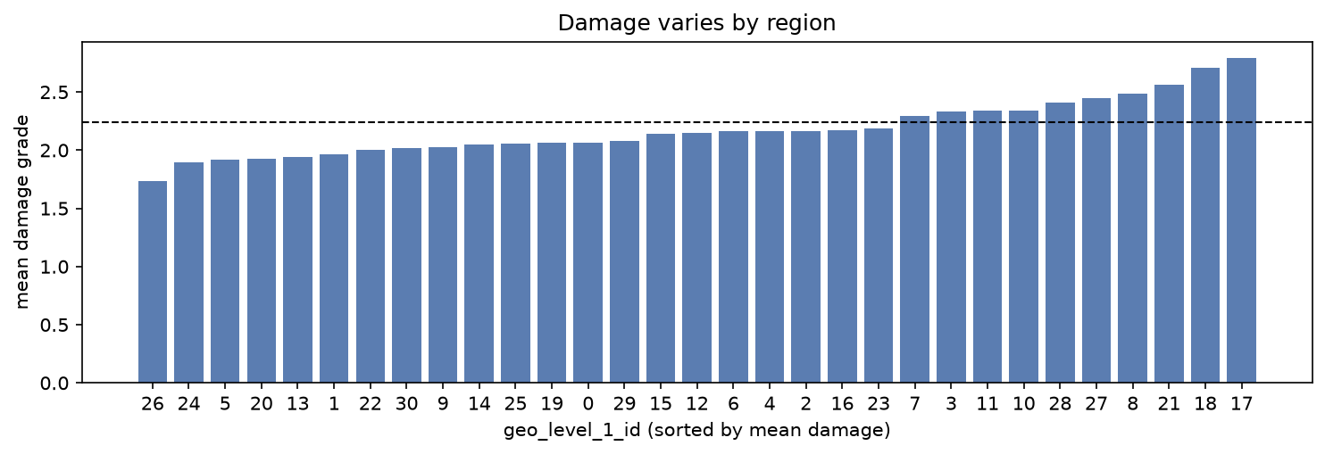
The data
260,601
38
3
0
buildings
features (8 categorical, 30 numeric)
location IDs, 31 / 1,414 / 11,595 values
missing values
Average damage depends heavily on the region, from about 1.7 to 2.8.
We split the training file once, 80/20 and stratified: 208,480 buildings to train, 52,121 to validate.
Notes:
The competition test file has no public labels, so we split the labelled training file once into 80 percent training and 20 percent validation and report validation scores for every model. There are no missing values. 6.2 percent of rows duplicate another building and we kept them. 1,496 buildings have a recorded age of 200 or more, which looks like a placeholder, so we capped age at 100 for KNN and the neural network. The chart shows why location will matter later.

Slide 4
How we compared models
Model | Preprocessing | What we tuned
KNN | One-hot, scaled, age capped at 100, geo_level_2 and 3 dropped | k from 1 to 51, vote weighting
Neural network | Same as KNN | Layer sizes (10 up to 256-128-64), L2 strength, 3 seeds
Random forest | Ordinal codes, raw age, all three geo IDs | Trees, depth, leaf size, class weights
Gradient boosting | Same as random forest | Learning rate, iterations, leaves per tree
Preprocessing is fitted on training data only. Every model uses the same split and the same validation set.
Notes:
KNN and the neural network need numbers on a common scale, so we one-hot encode and standardise. One-hot encoding geo_level_2 and geo_level_3 would add about 13,000 columns, so those two were dropped for these models. The tree models do not need scaling and can use the location IDs directly as numbers. Hyperparameters were picked by validation micro-F1.

Slide 5
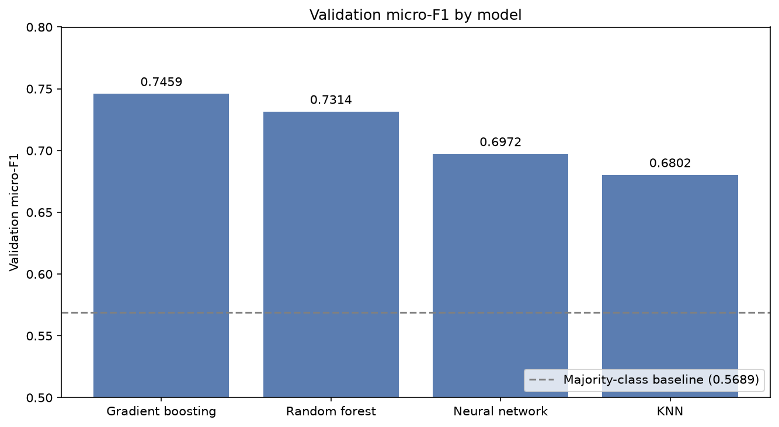
Results
Model | micro-F1 | macro-F1
Gradient boosting | 0.7459 | 0.6929
Random forest | 0.7314 | 0.6645
Neural network | 0.6972 | 0.6328
KNN | 0.6802 | 0.6066
Always grade 2 | 0.5689 | -
Gradient boosting is best on both metrics. Its 0.0145 lead over the random forest is several times the roughly 0.002 sampling error of the validation set.
Notes:
Gradient boosting reaches 0.7459 micro-F1 and 0.6929 macro-F1, the best on both. Random forest is second, then the neural network and KNN. The gap between boosting and the forest is much larger than the sampling error of a validation set this size, so we treat it as a real difference.

Slide 6
Why gradient boosting won
More capacity helped
63 leaves instead of 31: 0.7343 to 0.7413
Up to 500 iterations, stopped at 350: 0.7459
Forest leaf size 2 instead of 5: 0.7239 to 0.7307
What did not help
Forest leaf size 1 overfitted: train 0.987, validation 0.7234
Class weights lowered micro-F1 from 0.7239 to 0.6743
0.046
Gradient boosting: training score minus validation score
0.137
Random forest: training score minus validation score
Notes:
Across both tree models, adding capacity helped: more leaves and more iterations for boosting, smaller leaves for the forest. Leaf size 1 went too far and overfit, with 0.987 on training but 0.7234 on validation. Class weighting hurt micro-F1. The boosted model generalises better: its training score is only 0.046 above validation, against 0.137 for the forest.

Slide 7
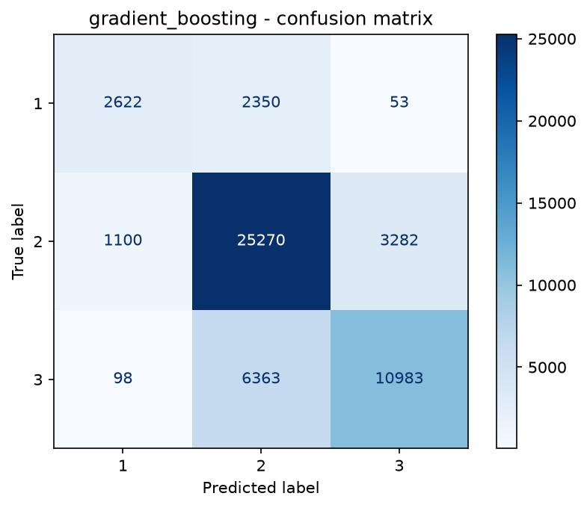
Where the model goes wrong
52%
85%
63%
grade 1 recall
grade 2 recall
grade 3 recall
Low damage is the hard class
Most mistakes are predictions of grade 2
Confusing grade 1 with grade 3 is rare: at most 118 buildings for any model
Notes:
Even the best model finds only 52 percent of grade 1 buildings. Most of its errors are buildings predicted as grade 2, the middle class. Mixing up grade 1 and grade 3 is rare for every model, at most 118 buildings.

Slide 8
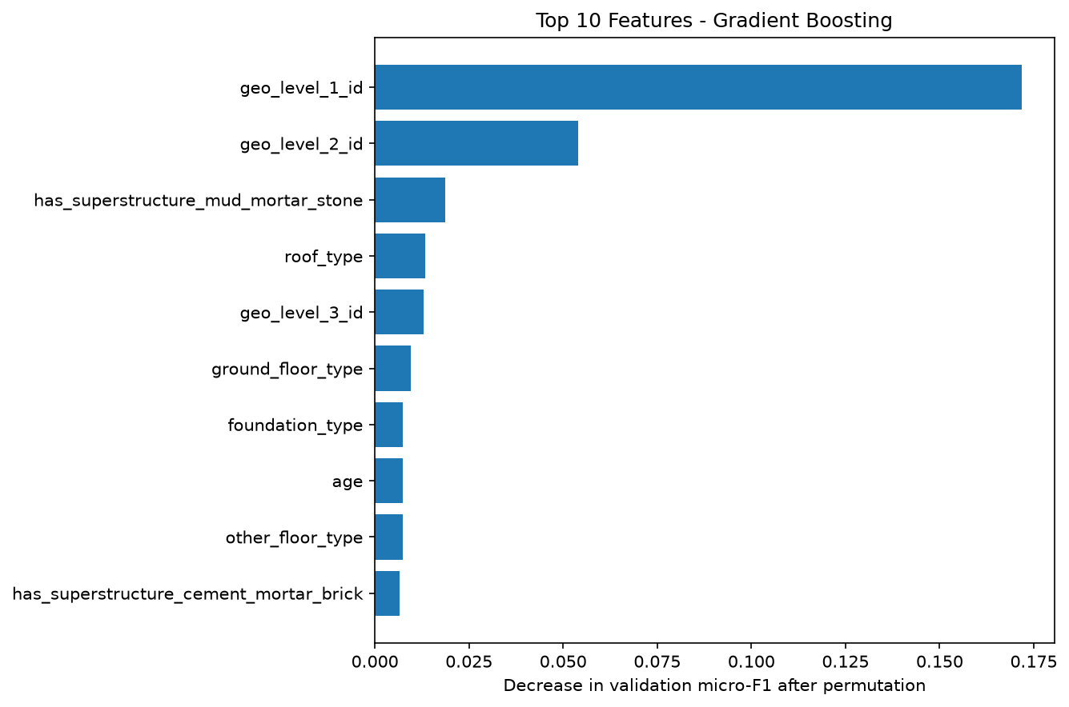
What drives the predictions
Location dominates
Shuffling geo_level_1_id drops micro-F1 by 0.175 for boosting and 0.142 for the forest
Next come geo_level_2_id, geo_level_3_id and the mud-mortar-stone flag
KNN and the network had to drop the fine location IDs, which likely explains why they trail by 3 to 7 points
Notes:
This is permutation importance on the validation set: how much the score drops when one column is shuffled. Location is by far the biggest factor. That fits with the tree models beating KNN and the network, since the trees could use all three location IDs and the other two models had to drop two of them. We say likely because we did not run a controlled test of that.

Slide 9
Summary
0.7459
0.177 above the always-grade-2 baseline
Tree models beat KNN and the neural network by 3 to 7 points
Location matters most, and low damage is the hardest class to catch
Validation micro-F1 of gradient boosting, our final model
Notes:
The final model is gradient boosting. It is 0.177 above the baseline, the tree models clearly beat KNN and the network, and location is the key signal.

Slide 10
Limitations and next steps
Limitations
Hyperparameters were chosen on the same split we report
One split, no cross-validation
Duplicate buildings may favour high-capacity models
We did not score the competition test set
Next steps
Target encoding or embeddings for geo_level_2_id and geo_level_3_id in the neural network
Tune the decision rule to raise grade-1 recall
Cross-validation
Notes:
Be upfront about the limits: the validation split was used both to tune and to report, there is a single split, and duplicates could help models that memorise. Next steps are to give the neural network usable location features, push up recall on low damage, and use cross-validation. Then invite questions.

