Slide 1
TEAM CONNECT · SINCE AI HACKATHON 2026
Fonecta's challenge “Connect Suggests – Customer Approves”
Connect Suggests
WHATSAPP
Connect Suggests
Connect Suggests · automated assistant
Hi Restaurang Fyren! Christmas and New Year hours – our suggestion:
• Sat 26 Dec closed (as you told us)
• Wed 6 Jan closed (as you told us)
If you do nothing, Google shows on these days: 11:00–23:00
Please answer by Sat 19 Dec so AI assistants show it in time.
Connect suggests. The owner approves once. Every year it needs them less.
Approve
Right holiday opening hours on Google, Apple Maps and AI assistants, approved by the owner in their own chat, with no login.
Approve + every year
Edit
Notes:
Connect Suggests: Connect suggests the right holiday hours, the owner approves once, and every year it needs them less.

Slide 2
Wrong holiday hours send customers to a locked door
THE PROBLEM
Fonecta Connect publishes each business's hours to 35+ apps. Owners forget one-off holiday hours, so the apps keep showing normal hours.
63%
“Copy last year” can only see 44% of the needed changes
44%
16%
36%
of the changes that are needed are “shown open, actually closed”: the app says open, the door is locked.
last season's entry
only two seasons back
only in other holidays
53%
So Connect also reads two seasons back and the owner's other holidays.
Apps update at different speeds
of suggestions in Fonecta's 2025 pilot got no reply (52% of owners never answered).
Reply rate per suggestion, by channel
Google
~2 minutes
Apple Maps
~2 days
AI assistants
~7 days
WhatsApp
65%
Text message (SMS)
50%
Email
40%
So every message has an “answer by” date that gives the slowest app time.
App notifications
32%

Slide 3
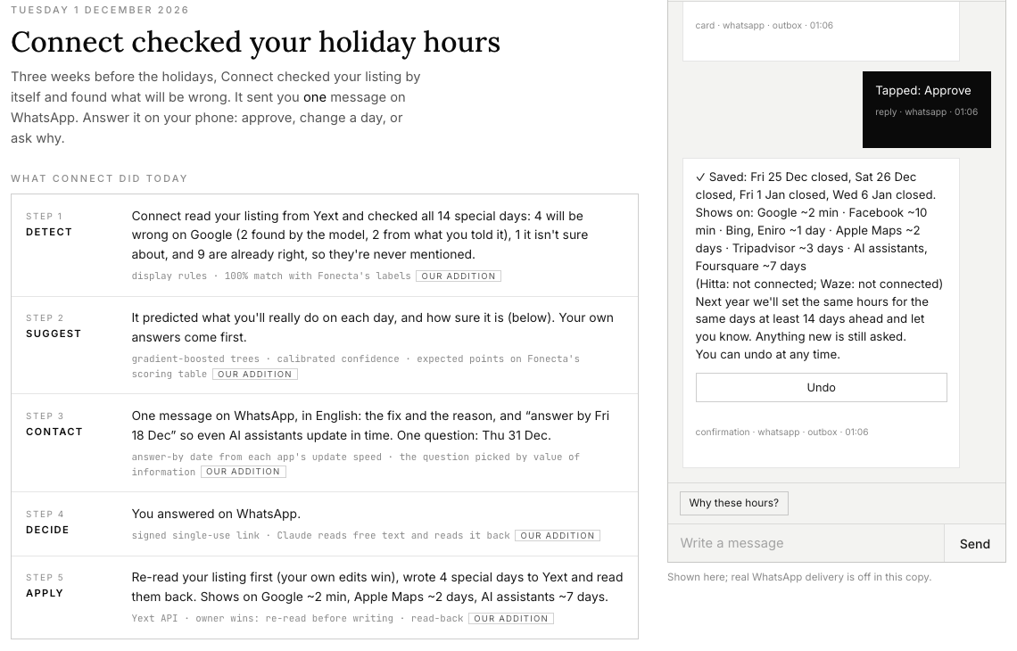
All five steps of the brief, working end to end
WHAT WE BUILT
Running on Fonecta's own stack: Yext, the service Fonecta Connect already publishes listings through, plus the owner's own chat.
1
Detect
Rebuild what each app will show on every special day, and find the days that will be wrong.
2
Suggest
Predict the real hours from the business's own past, with a reason and a confidence.
3
Contact
One message per season on the owner's channel (WhatsApp, email or text), in their language.
4
Decide
Approve, change a day or decline: one tap, or a reply in their own words. No login.
5
Apply
Write through Yext, read it back, and say where it shows: Google ~2 min, Apple Maps ~2 days.
The demo app after the owner tapped Approve on WhatsApp: Connect wrote the hours, and the listing on Google is updated. A full run takes about 28 seconds.

Slide 4
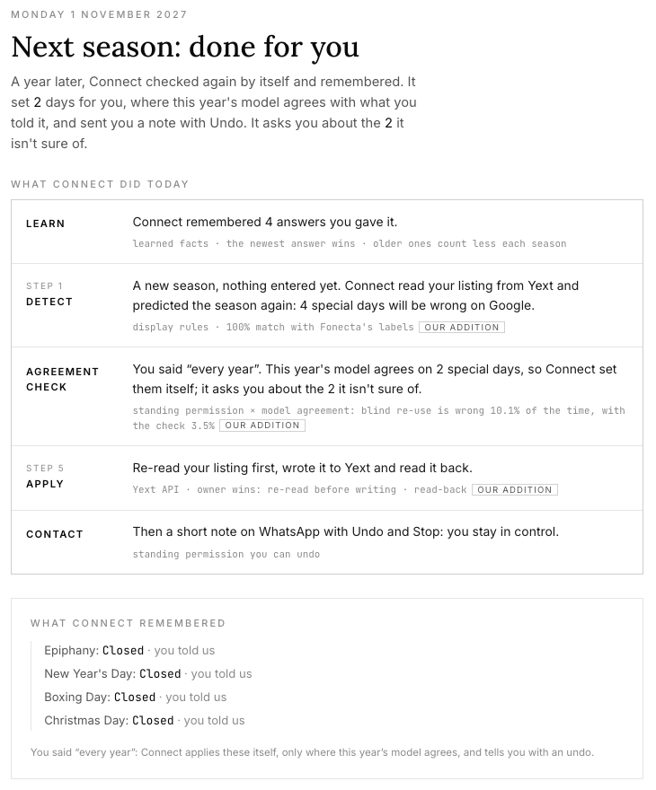
Approve once, checked every year
THE MAIN INNOVATION · SEASON AUTOPILOT
For the owners who never reply. The brief asked for standing permission; we added a safety check before any answer is reused.
1
One card, two equal buttons
Approve, or Approve + every year. One sentence explains the scope: the same days with the same hours; anything new is still asked.
2
The model-agreement check
Next season, Connect re-applies the owner's earlier answer only if this year's model gives it at least 50%. Otherwise it asks.
3
A note with Undo
The owner gets a short note in their chat, with Undo and Stop. They stay in control.
10.1% → 3.5%
Re-using last year's answer blindly gets open and closed wrong 10.1% of the time. With the agreement check: 3.5%.
The demo, one year later: Connect set 2 days itself and asks about the 2 it isn't sure of.

Slide 5
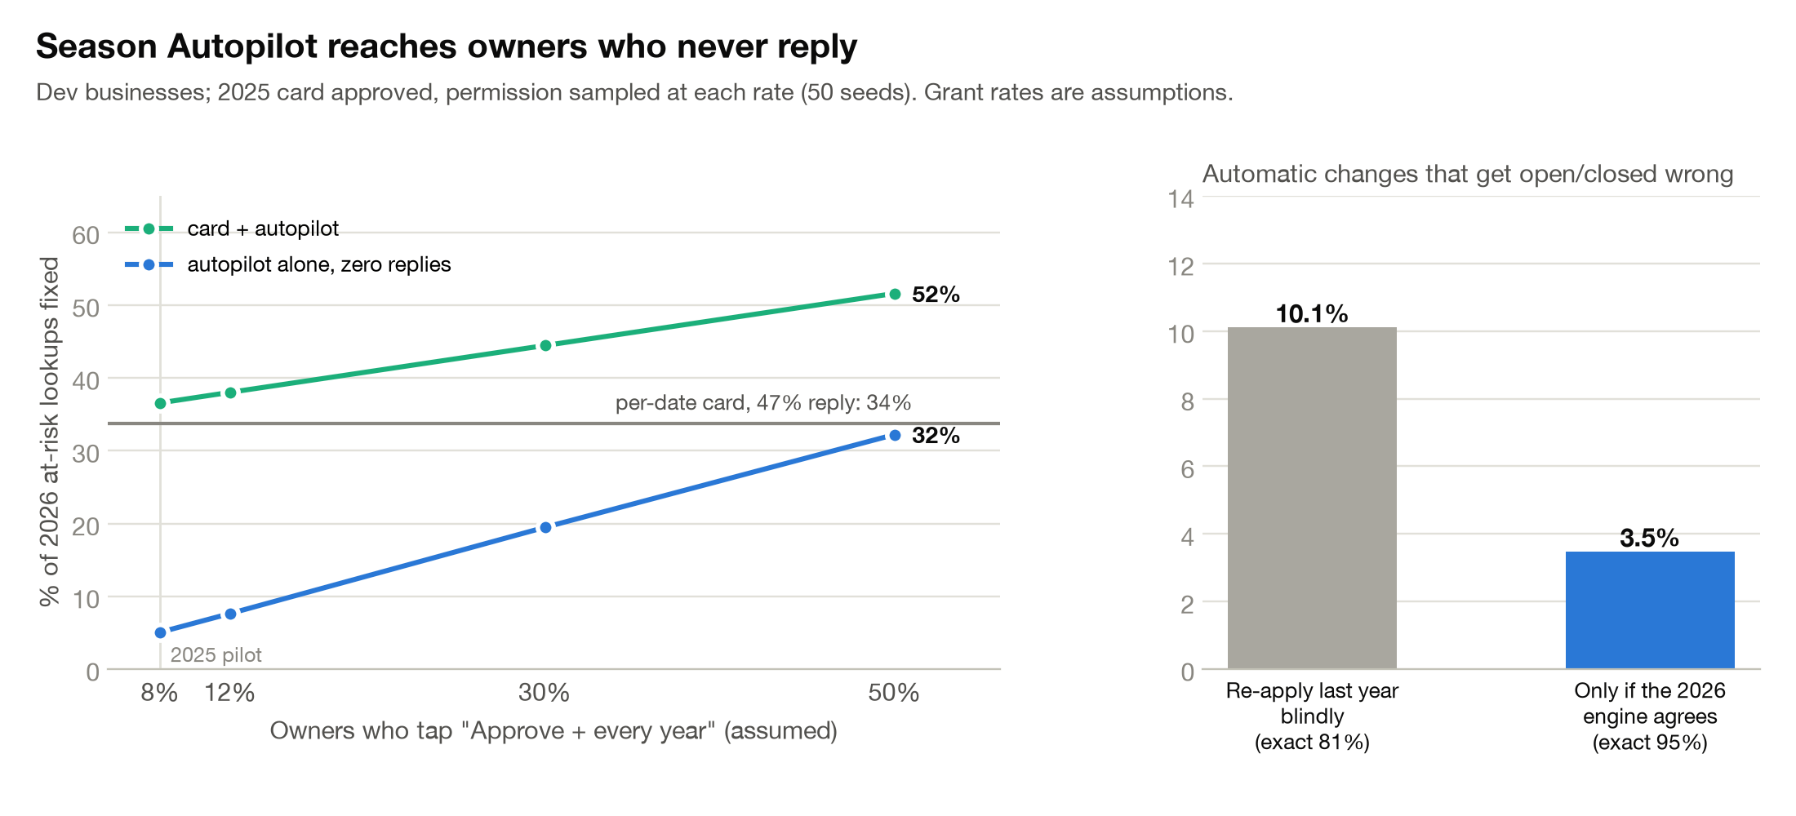
The check makes automatic changes safe
SEASON AUTOPILOT · MEASURED
Re-playing next season on businesses whose real hours are known. “Wrong” means open and closed mixed up.
10.1%
of automatic changes are wrong when last year's answer is re-used blindly
3.5%
are wrong with the model-agreement check
38.0% vs 33.8%
of next season's at-risk lookups fixed: with Autopilot vs the season card alone, if 12% of owners say “every year”
An assumption, not a measurement: the share of owners who say “every year” (12% is the rate in Fonecta's owner simulator). Only a live test can measure it. At-risk lookups = searches made on days the listing would be wrong.

Slide 6
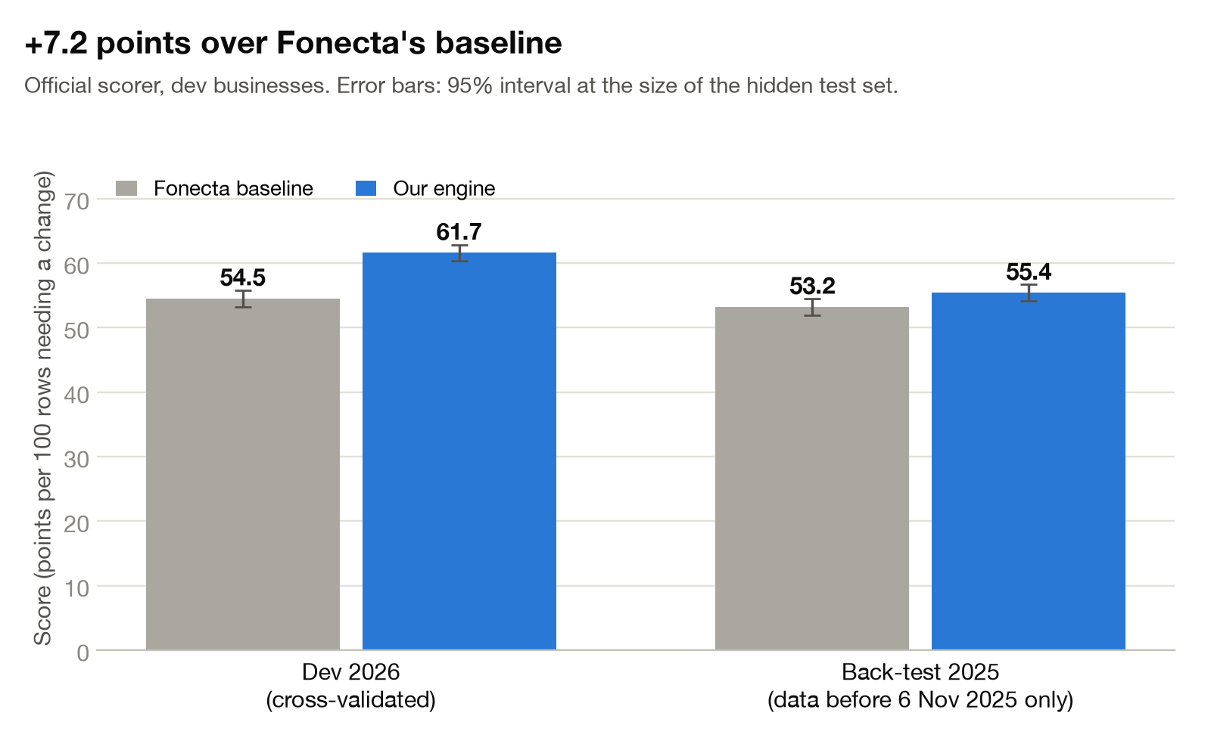
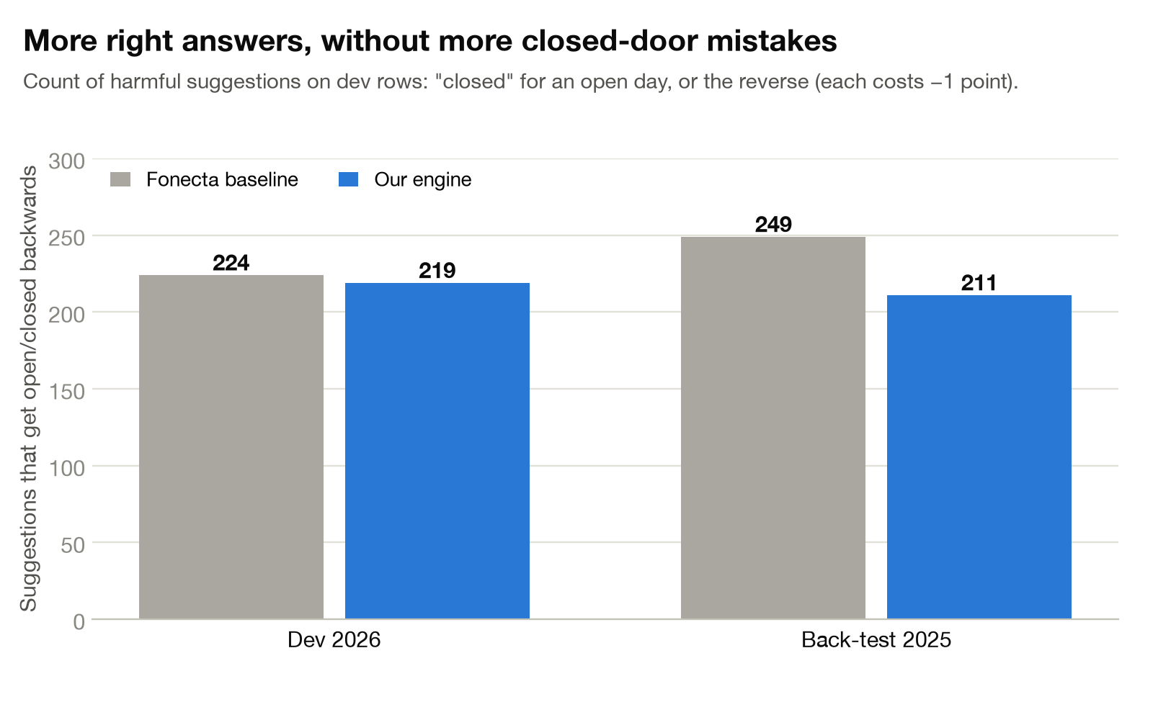
61.67 points against the baseline's 54.49
BENCHMARKS · FONECTA'S OWN SCORER
Fonecta's own scoring script, with models that never saw the businesses they scored. Baseline = Fonecta's own example solution.
61.67
86%
67%
219
55.42
score, against 54.49 (95% range 60.4–62.9)
of our suggestions are exactly right
of wrong days fixed, against 59%
harmful suggestions, against 224: fewer, but within noise
score in the 2025 back-test, against 53.23
Harmful = a suggestion that mixes up open and closed.
Back-test = replaying 2025 using only data from before 6 Nov 2025. There: 211 harmful against 249.
No history: 36.8 against 14.2 (slide 8).

Slide 7
Five reasons we score higher
WHY WE BEAT THE BASELINE
And one honest note on what doesn't add points.
1
An exact rebuild of what every app shows
22,218 of 22,218
Matches Fonecta's answer key on all 22,218 days. Fonecta's sample code gets 86 of them wrong.
days matched
2
Reading two seasons back
+5.9 points
Covers the years an owner didn't enter: 16% of needed changes only show up two seasons back.
from this alone
3
Learning from the true hours, not owners' entries
39% vs 2%
Owners enter 39% of special days but only 2% of normal days, so their entries give a skewed picture.
special vs normal days entered
4
Recomputing similar-business statistics
No leak
The provided file pools 2023–2025, so in a back-test it already contains the answers. We rebuild it from data known at the time.
proved by a test
5
Calibrated trees and a points-maximising rule
+7.2 points
Gradient-boosted trees predict each day; the rule picks the action worth the most expected points on Fonecta's scoring table, with a safety margin before switching a day between open and closed.
over the baseline in total
Honest note: linked holidays and habit types add no measurable points, so we don't credit them for the score.

Slide 8
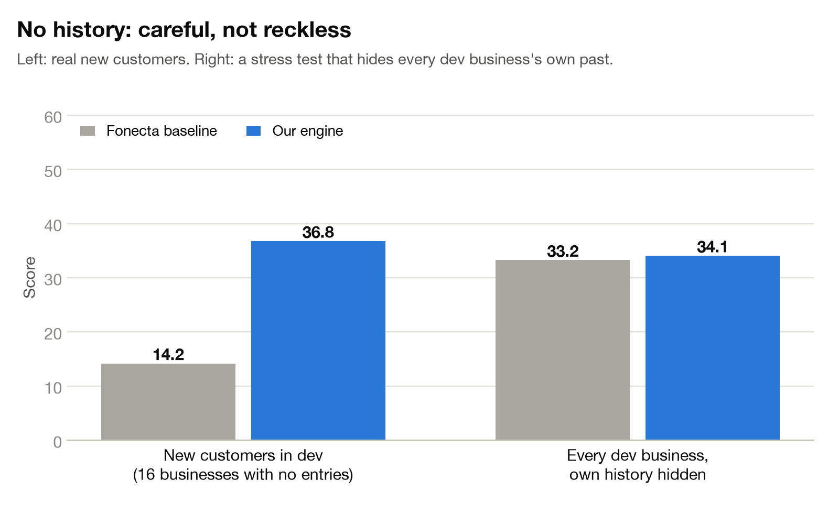
Zero information, and still no guessing
A BRAND-NEW BUSINESS
Example: Kahvila Kipinä, a café in Turku that joined on 12 Oct 2026. No holiday history and no earlier decisions.
1
Start from similar businesses
36.8 vs 14.2
What businesses of the same type and size usually do: the habit model's starting guess for that group, plus statistics from groups of at least 10 similar businesses, computed without the future leak.
score on the 16 tested businesses with truly no history (Connect vs the baseline), with 2 harmful suggestions against 4
2
Stay quiet unless it's near-certain
Only 1 of Kipinä's 14 special days gets a suggestion: New Year's Day closed, about 80% sure, based on similar cafés. The other 13 are left alone.
3
Spend the one question where it counts
The best candidates are New Year's Day (+0.90 expected points) and Christmas Day (+0.87). New Year's Day is already on the card, so it asks about Christmas Day.
4
Let onboarding fill the gap
The welcome message asks how the business handles public holidays. Two taps answer it for every public holiday, so the first card can say “as you told us” instead of guessing.
Mostly by not guessing where the baseline guesses. One answer from the owner is worth more than any amount of data from similar businesses.

Slide 9
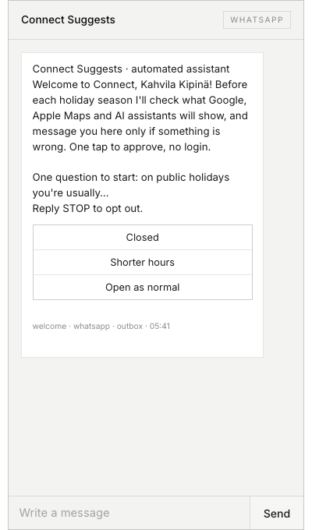
Everything happens in the owner's own chat
CUSTOMER EXPERIENCE
No app to install, no password, no form.
Joining takes two taps. Onboarding happens inside the owner's WhatsApp or email: no form, no password, no app.
Insert the real WhatsApp onboarding screenshot here
One message per season. Connect stays silent when the listing is already right.
An answer-by date for each app, and one smart question. The question goes to the date where an answer is worth the most: +0.50 points per business, against +0.09 for a random date.
No login to decide. One tap, or a reply in the owner's own words. Claude reads it and reads it back before saving.
The demo's web dashboard only shows what happens behind the scenes. A real owner does practically everything in their chosen chat: joining, approving, editing, declining, “closed today”, questions, Undo and Stop. The only other screen is the optional no-login card page.
Onboarding in the demo: one question, three buttons.
Placeholder: replace with a screenshot from a real phone.

Slide 10
Wrong suggestions are stopped in three layers
RELIABILITY
The owner always has the last word: nothing is written without their decision or their standing permission.
1
Before any message
→
2
When the owner decides
→
3
When writing to Yext
An exact rebuild of what each app shows today.
A decision rule with safety margins.
Hard rules: never contradict the owner's own entry; no past dates; valid hours only; a “no” is never suggested again; opted-out owners are never messaged.
A business that may have closed for good goes to a person: 1 of 2 caught, zero false alarms.
A guessed switch between open and closed needs an explicit tick.
A reply in the owner's own words is read back before saving.
Links are signed and single-use. Opening a link never approves anything, so email link scanners can't approve by accident.
The listing is re-read first, so the owner's own edits win.
Only holiday hours are written; weekly hours are never touched.
The hours are read back before the ✓ appears.
Every step goes into a tamper-evident audit log: each record is chained to the one before it.

Slide 11
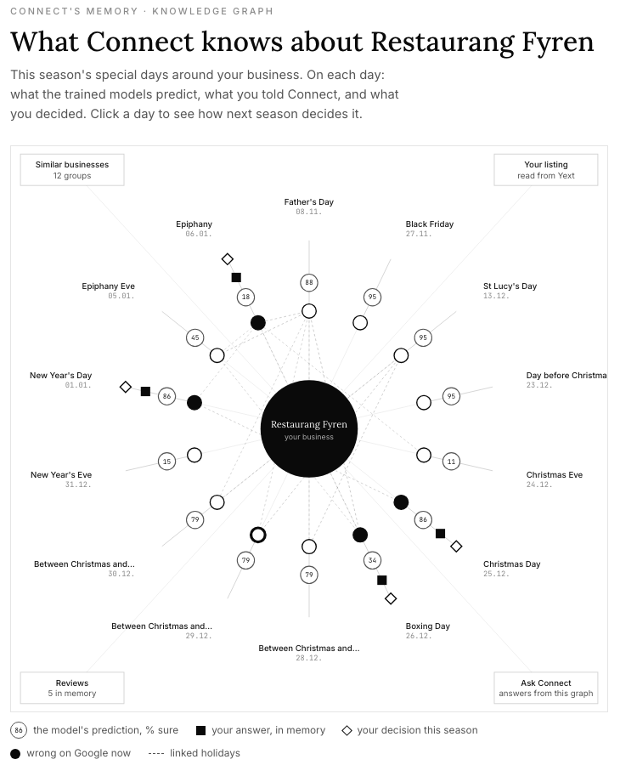
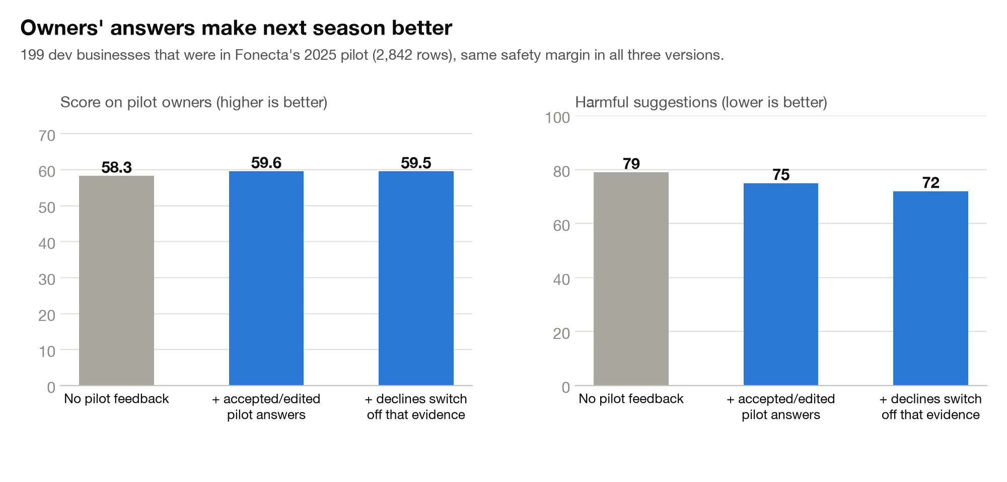
Every answer makes next season better
LEARNING
Owners' answers become remembered facts. “Every year” becomes a scoped permission, protected by the agreement check.
Owner's answer
approve, edit, decline or “every year”
Remembered facts
newest wins; older ones count less each season; a decline is never repeated
Agreement check
re-used only if this year's model gives it at least 50%
Next season
applied with Undo, or asked
A memory graph for every business
Stored in MongoDB (a database): the business's days, answers, decisions, similar businesses and reviews. Ask Connect answers owners' questions from it with graph RAG (retrieval-augmented generation over a graph): it retrieves the facts first, Claude answers only from them with a source for every sentence, and a checker rejects any date or time not in the facts.
58.3 → 59.6
79 → 72
score with last year's answers
harmful suggestions, once declines are never repeated
Measured on the owners from Fonecta's 2025 pilot.
Honest note: the prediction models don't read the graph. The graph is the memory for questions and for next season's check.

Slide 12
One loop, many conversations
EXTENSIBILITY
Detect → message → the owner decides → write to Yext. The same loop already runs six kinds of conversation.
Built and working
A new use needs only three parts
Holiday hours
the season card
Weekly hours that changed
every proposed week in testing was right
A detector
A message template
A Yext write
Replies to reviews
drafted for the owner to approve
“Closed today”
on Google within minutes, ends by itself
Next candidates (not built yet)
Seasonal hours
Event hours
Onboarding
two taps in the owner's chat
The Autopilot note
with Undo
Sorting map users' suggested edits
Phone and address changes
Photos
Attributes (listing details)

Slide 13
What it's built with, in plain words
TECHNOLOGY
scikit-learn gradient-boosted trees
Graph RAG over a MongoDB memory graph
Many small decision trees, each correcting the last, predict whether a day is closed, normal or special, and which hours.
Each business's facts are stored as a connected graph; answers are written only from facts retrieved from it.
Isotonic calibration
Yext Knowledge API
Adjusts the models' confidence, so “80% sure” is right about 8 times in 10.
The interface programs use to read and write listings in Yext, the service Fonecta Connect already publishes through.
EM habit model
WhatsApp Cloud API with a signed webhook
Sorts businesses into 10 typical holiday habits, found with EM (expectation–maximisation), a standard method for hidden groups.
Meta's official way to send and receive WhatsApp messages. Replies arrive at our web address (the webhook), signed so we know they came from Meta.
Logistic regression
Flask and HTMX
A simple, explainable model that spots when a business's normal weekly hours have changed, mostly from reviews.
A small Python web server, and a light library that updates parts of a page without reloading it.
Value-of-information question choice
SHA-256 hash-chained audit log
Picks the one question whose answer is worth the most expected points.
Each record stores a fingerprint of the one before, so any later change breaks the chain and is detected.
Claude Opus 5
Reads owners' replies in their own words and writes the answers; the facts always come from data.

Slide 14
Built to plug straight into Fonecta
FIT WITH FONECTA
Same backend, same customers, no new app.
Same Yext API as Fonecta Connect. Tested on Fonecta's own Yext test account, on the record SinceAi04, renamed Kahvila Aurora.
Going live is mostly configuration
A production Yext key
No new app for owners. It lives in the chat they already use: WhatsApp, email or text message.
Fonecta's WhatsApp number and message templates
An SMS or email provider
Honest status
Replies from a real phone work, through Meta's webhook.
SMS (text messages) are shown on screen only.
Review replies are drafted, not posted.
All data is synthetic.
Owner contacts and consent from the customer records
One public web address
A nightly scheduled run

Slide 15
Connect Suggests
Connect suggests. The owner approves once. Every year it needs them less.
61.67 vs 54.49
3.5% vs 10.1%
36.8 vs 14.2
score on Fonecta's own scorer, against the baseline
automatic changes that get open and closed wrong, with the agreement check vs without
for businesses with no history at all
Team Connect · Since AI Hackathon 2026 · Fonecta's challenge “Connect Suggests – Customer Approves”

