Slide 1

Neuro-Symbolic Program Synthesis with Language Models and Formal Methods
SS24
CSE 814 Term Project
Sol Zilberman & Ayaan Shaik
Computer Science & Engineering

Slide 2
Introduction

Slide 3
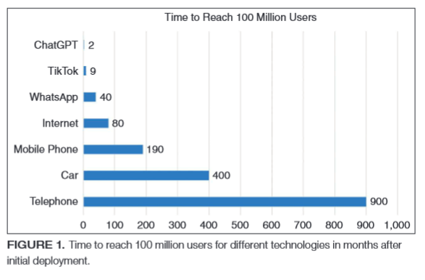
Motivation
Rapidly growing use of language models (AI-based techniques) for code generation
>1 million active users of AI-based code assistant [Github Research, Github Blog]
Despite initial success for downstream tasks:
research has shown the presence of faulty reasoning in LM-generated output (i.e., ‘hallucinations’) [10, 11, 14]
Ebert et. al.

Slide 4
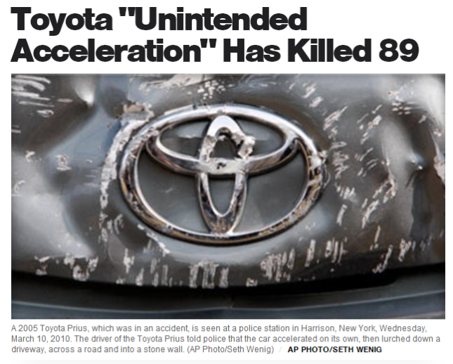
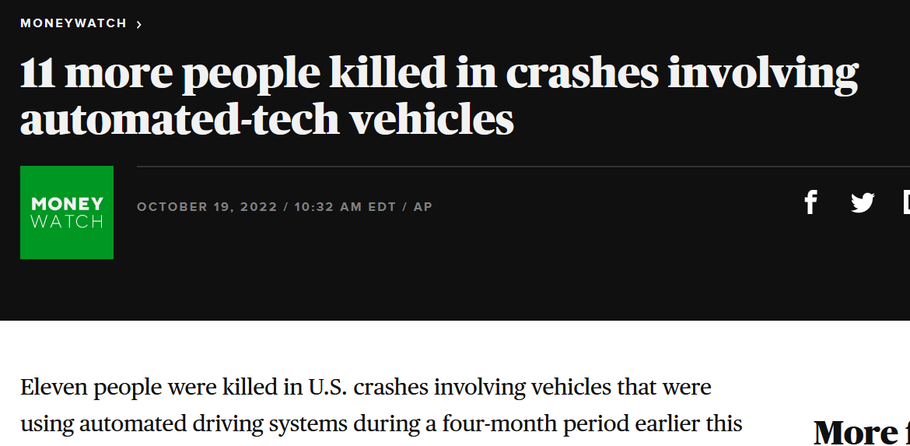
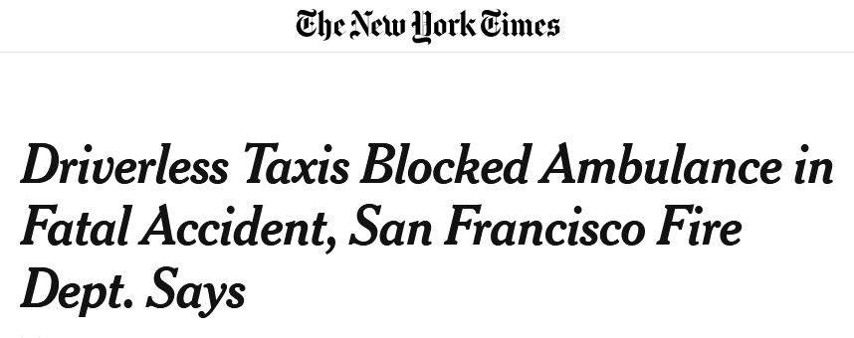
Software for Safety-Critical Systems
As LM-generated code deployed to diverse applications, increased risk of critical failure
Software failures can cause death, serious injuries, significant resource loss, environmental harm etc…
Existing limitations of LMs make them untrustworthy tools, especially for formal artifacts

Slide 5
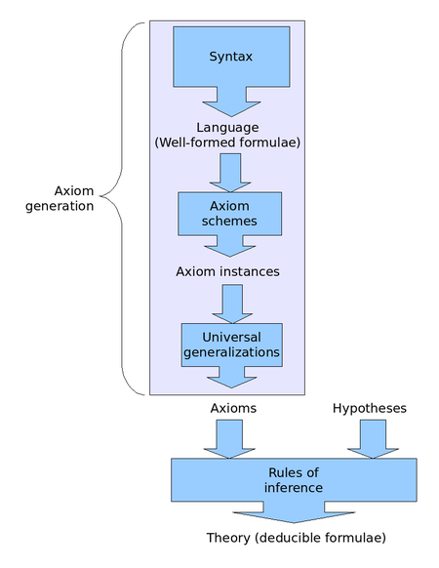
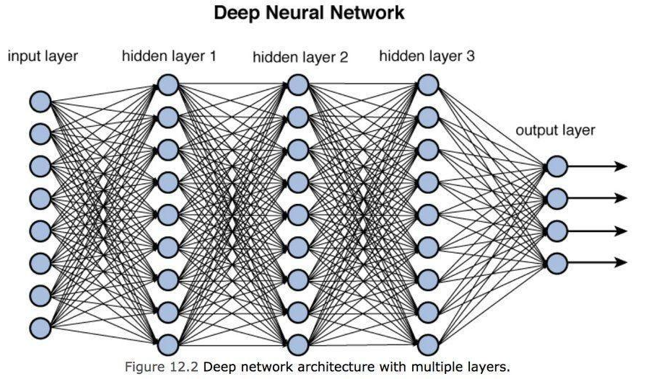
Problem Statement
Can we leverage generative capabilities of LMs and ground them in deductive reasoning framework for the task of program synthesis?
https://towardsdatascience.com/training-deep-neural-networks-9fdb1964b964
https://en.wikipedia.org/wiki/Hilbert_system

Slide 6
Background

Slide 7
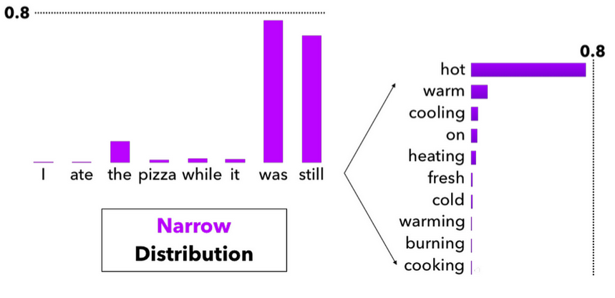
Background: Language Models
Language models are deep neural networks
take as input a sequence and output a probability vector over a vocabulary V.
Fundamentally stochastic systems
https://miro.medium.com/v2/resize:fit:1400/0*J37qonVPJvKZpzv2

Slide 8
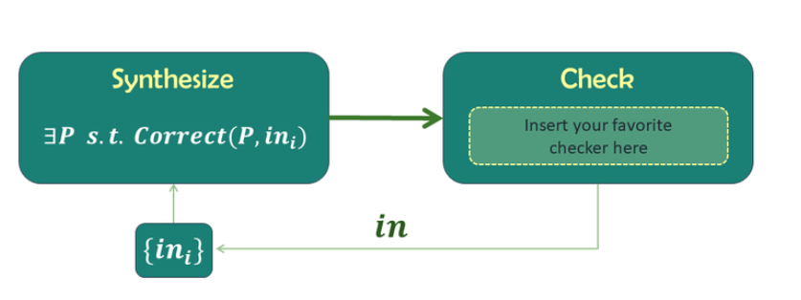
Background: Counterexample Guided Inductive Synthesis
General Synthesis Problem:
Find a program P that satisfies specification φ
Alternates between proposing candidate solutions and refining them using counter-examples from faulty candidates
https://people.csail.mit.edu/asolar/SynthesisCourse/Lecture10.htm
Notes:
https://people.csail.mit.edu/asolar/SynthesisCourse/Lecture10.htm

Slide 9
Existing Work
CEGIS
Largely enumeration-based (combinatorial) and may not scale with increasing variables [1,2]
LM-based Program Synthesis
Relies on stochastic techniques [11]
“Correctness” largely focuses on unit testing [3]
Lacks capabilities to generate formal artifacts [4]

Slide 10
Methodology

Slide 11
Proposed Solution
Leverage LLM as scalable program synthesizer
Leverage CEGIS as formal conceptual framework for generating correct programs

Slide 12
Proposed Framework
1. Prompt Builder ⚙️
2. LM (Generator)
Program C
Program Specification φ
Program C_{i}
3. Mutation Engine
Counter Example
❌
4. SMT Solver
✅
Correct
Program

Slide 13
Tooling
Learner component
GPT-4, GPT-3.5 Turbo, GPT-3, LLama
LLMs from Hugging Face
Verifier Component
Z3 Python API
Mutation engine
Python script
Enumerates multiple codes based on the learners output
Program Specification
Planning Domain Definition Language

Slide 14
Blocks World
Initial State
Arm
Goal State
C
B
B
C
A
A

Slide 15
Blocks World
unstack(B, C)
B
C
A

Slide 16
Blocks World
stack(B, A)
B
C
A

Slide 17
Blocks World
pickup(C)
C
B
A

Slide 18
Blocks World
stack(C, B)
C
B
Achieved goal state
A

Slide 19
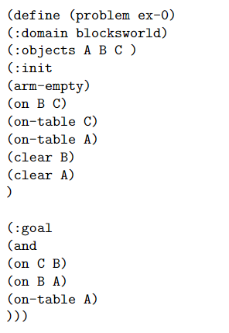
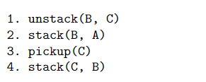
Example Case
Formal Specification
Correct generated code

Slide 20
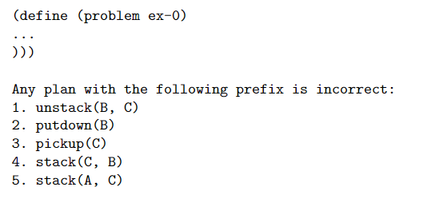
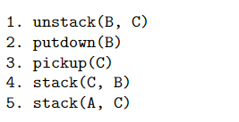
Counterexample Iteration
Generated code
Incorrect final state
Append counterexample
A
C
B

Slide 21
Empirical Study
Compare LLM-only vs LLM-CEGIS (ours)
Explore several SOTA LLMs as ‘synthesizer’
Evaluate scalability w.r.t. number of variables (e.g. blocks) considered

Slide 22
Results

Slide 23
Interesting Cases

Slide 24
Discussion

Slide 25
Timeline
Date | Task | Completed
Week 1 | Research literature and understand related works | ✅
Week 2 | Research literature and understand related works | ✅
Week 3 | Narrow Scope, Filter relevant papers, begin research on tooling/technical work | ✅
Week 4 | Experiment with existing tooling | ✅
Week 5 | Finalize proposed experiments and construct progress report | ✅

Slide 26
Remaining Work
Date | Task | Completed
Week 6 | Finish development tasks | 🔲 (WIP)
Week 7 | Empirical Study | 🔲
Week 8 | Empirical Study | 🔲
Week 9 | Result Analysis and Write-Up | 🔲
Week 10-12 | Finalize write-up/Presentation | 🔲

Slide 27
References
[1] A. Abate, C. David, P. Kesseli, D. Kroening, and E. Polgreen, “Counterexample Guided Inductive Synthesis Modulo Theories,” in Computer Aided Verification, 2018, pp. 270–288. doi: 10.1007/978-3-319-96145-3_15.
[2]P. He, L. Kang, C. G. Johnson, and S. Ying, “Hoare Logic-Based Genetic Programming,” Science China Information Sciences, vol. 54, no. 3, pp. 623–637, Mar. 2011, doi: 10.1007/s11432-011-4200-4.
[3]N. Jain et al., “Jigsaw: Large Language Models Meet Program Synthesis,” in Proceedings of the 44th International Conference on Software Engineering, May 2022, pp. 1219–1231. doi: 10.1145/3510003.3510203.
[4]S. K. Jha et al., Neuro Symbolic Reasoning for Planning: Counterexample Guided Inductive Synthesis Using Large Language Models and Satisfiability Solving. arXiv, 2023. [5]R. Lefticaru, F. Ipate, and C. Tudose, “Automated Model Design Using Genetic Algorithms and Model Checking,” in 2009 Fourth Balkan Conference in Informatics, 2009, pp. 79–84. doi: 10.1109/BCI.2009.15.
[6]J. Lehman, J. Gordon, S. Jain, K. Ndousse, C. Yeh, and K. O. Stanley, Evolution through Large Models. arXiv, 2022.
[7]Y. Li, J. Parsert, and E. Polgreen, Guiding Enumerative Program Synthesis with Large Language Models. arXiv, 2024.
[8]B. Romera-Paredes et al., “Mathematical Discoveries from Program Search with Large Language Models,” Nature, vol. 625, no. 7995, pp. 468–475, Jan. 2024, doi: 10.1038/s41586-023-06924-6.
[9]B. Romera-Paredes et al., “Mathematical Discoveries from Program Search with Large Language Models,” Nature, vol. 625, no. 7995, pp. 468–475, Jan. 2024, doi: 10.1038/s41586-023-06924-6. [10]vdimir, Vdimir/Py-Refinement-Lambda. 2023.
[10] Z. Ji et al., “Survey of Hallucination in Natural Language Generation,” ACM Computing Surveys, vol. 55, no. 12, p. 248:1-248:38, Mar. 2023, doi: 10.1145/3571730.
[11] Melis, Gábor, Chris Dyer, and Phil Blunsom. "On the state of the art of evaluation in neural language models." arXiv preprint arXiv:1707.05589 (2017).
[12] Ji, Ziwei, et al. "Survey of hallucination in natural language generation." ACM Computing Surveys 55.12 (2023): 1-38.
[13] Xu, Ziwei, Sanjay Jain, and Mohan Kankanhalli. "Hallucination is inevitable: An innate limitation of large language models." arXiv preprint arXiv:2401.11817 (2024).
[14] Dziri, Nouha, et al. "On the origin of hallucinations in conversational models: Is it the datasets or the models?." arXiv preprint arXiv:2204.07931 (2022).

Slide 28
Thank you

