Slide 1

Neuro-Symbolic Program Synthesis with Language Models and Formal Methods
SS24
CSE 814 Term Project
Sol Zilberman & Ayaan Shaik
Computer Science & Engineering

Slide 2
Introduction

Slide 3
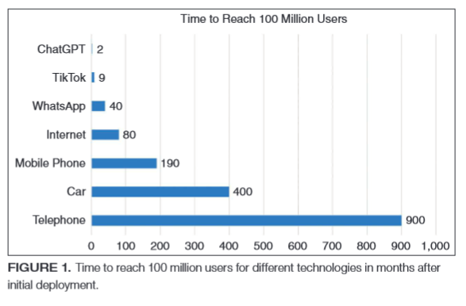
Motivation
Rapidly growing use of language models for code generation
>1 million active users of AI-based code assistant [Github Research, Github Blog]
Research has shown the presence of faulty reasoning
(i.e., ‘hallucinations’) [10, 11, 14]
Ebert et. al.

Slide 4
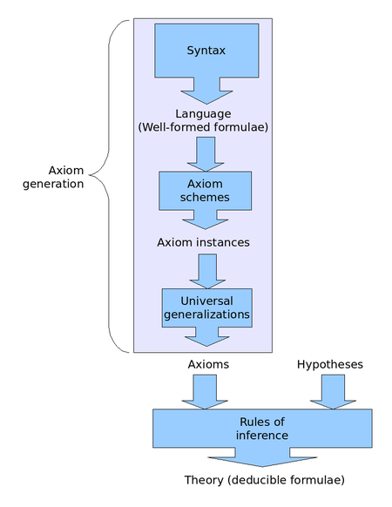
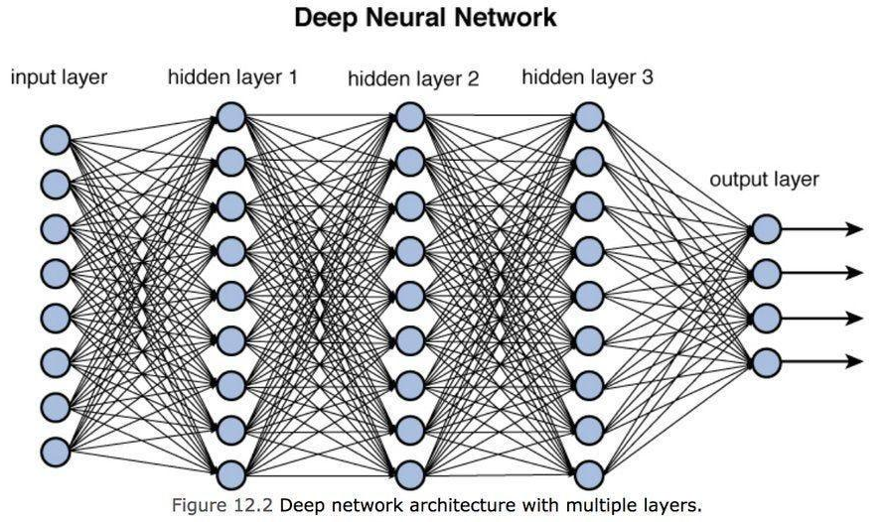
Problem Statement
Can we leverage generative capabilities of LMs and ground them in deductive reasoning framework for the task of program synthesis?
https://towardsdatascience.com/training-deep-neural-networks-9fdb1964b964
https://en.wikipedia.org/wiki/Hilbert_system

Slide 5
Methodology

Slide 6
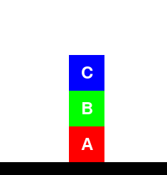
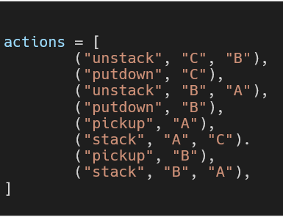

Proposed Solution
Use counter-example guided synthesis (CEGIS) to iteratively synthesize programs
Leverage LLM as program generator
Apply to proof-of-concept Blockworld problems
CEGIS
Initial:
Goal:

Slide 7
Proposed Framework
1. Prompt Builder ⚙️
2. LM (Generator)
Program C
Program Specification φ
Program C_{i}
3. Mutation Engine
Counter Example
❌
4. SMT Solver
✅
Correct
Program

Slide 8
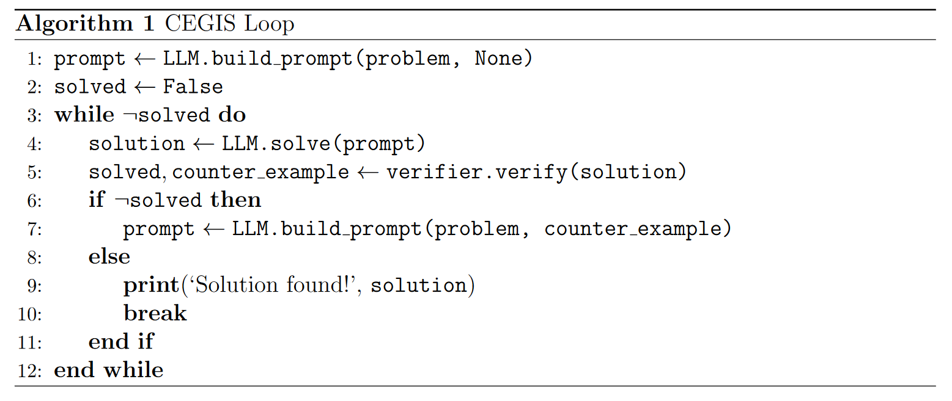
Implementation

Slide 9
Experiment Implementation
Learner component
GPT-4, GPT-3.5 Turbo
Access LLMs via web requests
Verifier Component
Z3 Python API
Mutation engine
Enumerates multiple codes based on the learners output
Experiment Infrastructure: Python3 codebase

Slide 10
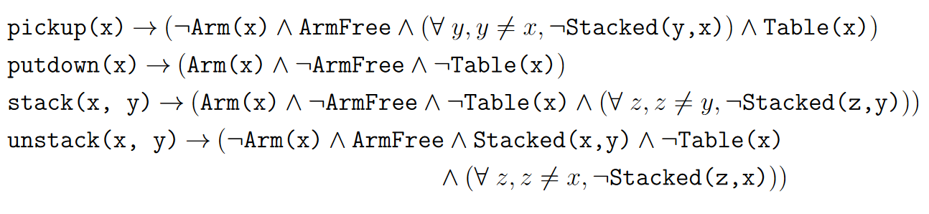
Blocksworld Specification
Formally specifying the rules and requirements of BlocksWorld

Slide 11
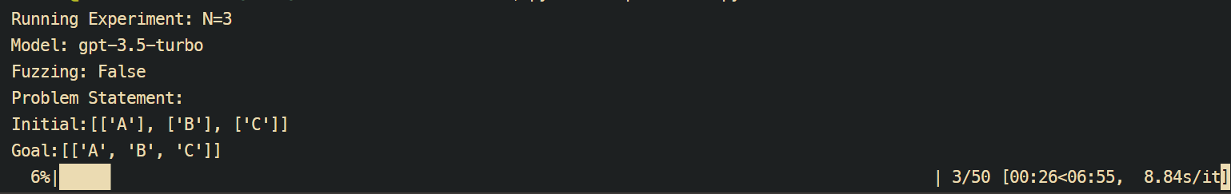
Experiment Setup
Generate 10 random problems for worlds of size N=[2,3,4,5]
Record success rate, # of iterations per problem
Report average results over all trials

Slide 12
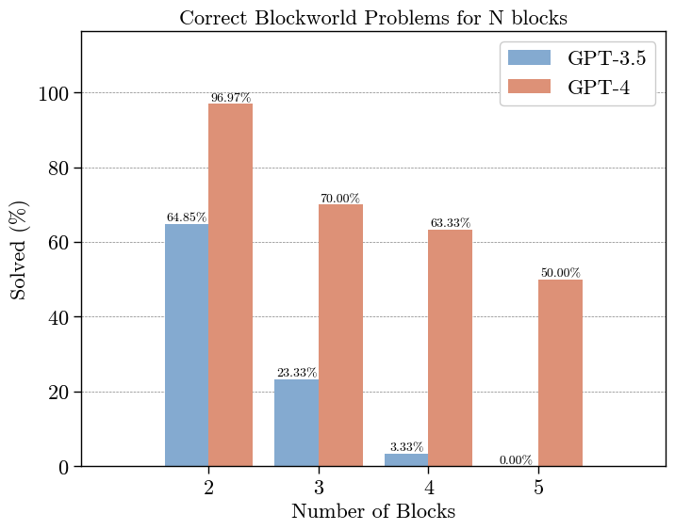
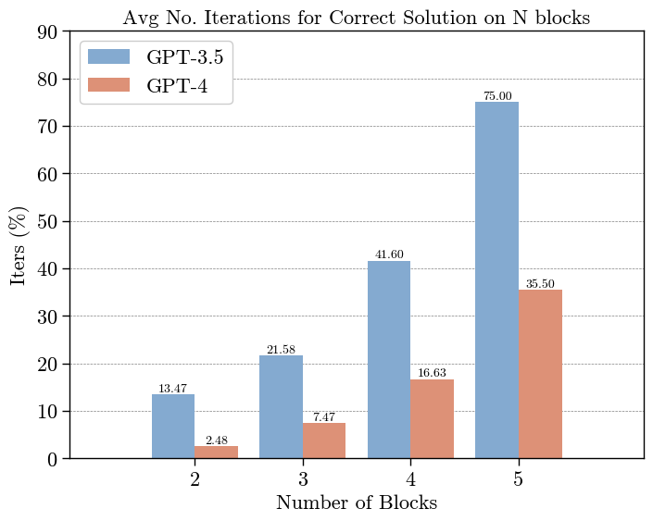
Results 1

Slide 13
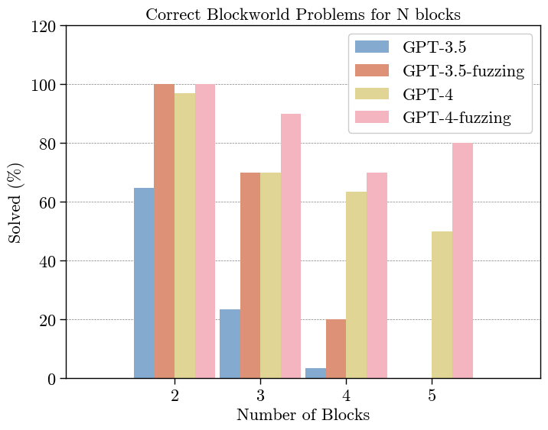
Results 2

Slide 14

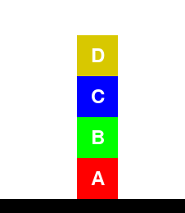
Interesting Cases
Initial:
Goal:

Slide 15
Interesting Cases
Initial:
Goal:

Slide 16
Discussion & Conclusion
LLMs often fail to find correct solution on initial attempts and exhibit faulty reasoning on simple tasks.
Integration of formal verification with LLMs shows promising results to improve correctness of output.
Addition of mutation engine helped correct some of the fine-grained mistakes made by the LLMs

Slide 17
Threats to Validity
LLMs generate text based on stochastic algorithms so repeated trials may yield slightly different results. We averaged our results over several trials to reduce impact.
We cannot guarantee our instruction prompt is the optimal prompt for this task. We followed techniques commonly used in the literature for prompting LLMs [3,9]

Slide 18
References
[1] A. Abate, C. David, P. Kesseli, D. Kroening, and E. Polgreen, “Counterexample Guided Inductive Synthesis Modulo Theories,” in Computer Aided Verification, 2018, pp. 270–288. doi: 10.1007/978-3-319-96145-3_15.
[2]P. He, L. Kang, C. G. Johnson, and S. Ying, “Hoare Logic-Based Genetic Programming,” Science China Information Sciences, vol. 54, no. 3, pp. 623–637, Mar. 2011, doi: 10.1007/s11432-011-4200-4.
[3]N. Jain et al., “Jigsaw: Large Language Models Meet Program Synthesis,” in Proceedings of the 44th International Conference on Software Engineering, May 2022, pp. 1219–1231. doi: 10.1145/3510003.3510203.
[4]S. K. Jha et al., Neuro Symbolic Reasoning for Planning: Counterexample Guided Inductive Synthesis Using Large Language Models and Satisfiability Solving. arXiv, 2023. [5]R. Lefticaru, F. Ipate, and C. Tudose, “Automated Model Design Using Genetic Algorithms and Model Checking,” in 2009 Fourth Balkan Conference in Informatics, 2009, pp. 79–84. doi: 10.1109/BCI.2009.15.
[6]J. Lehman, J. Gordon, S. Jain, K. Ndousse, C. Yeh, and K. O. Stanley, Evolution through Large Models. arXiv, 2022.
[7]Y. Li, J. Parsert, and E. Polgreen, Guiding Enumerative Program Synthesis with Large Language Models. arXiv, 2024.
[8]B. Romera-Paredes et al., “Mathematical Discoveries from Program Search with Large Language Models,” Nature, vol. 625, no. 7995, pp. 468–475, Jan. 2024, doi: 10.1038/s41586-023-06924-6.
[9]B. Romera-Paredes et al., “Mathematical Discoveries from Program Search with Large Language Models,” Nature, vol. 625, no. 7995, pp. 468–475, Jan. 2024, doi: 10.1038/s41586-023-06924-6. [10]vdimir, Vdimir/Py-Refinement-Lambda. 2023.
[10] Z. Ji et al., “Survey of Hallucination in Natural Language Generation,” ACM Computing Surveys, vol. 55, no. 12, p. 248:1-248:38, Mar. 2023, doi: 10.1145/3571730.
[11] Melis, Gábor, Chris Dyer, and Phil Blunsom. "On the state of the art of evaluation in neural language models." arXiv preprint arXiv:1707.05589 (2017).
[12] Ji, Ziwei, et al. "Survey of hallucination in natural language generation." ACM Computing Surveys 55.12 (2023): 1-38.
[13] Xu, Ziwei, Sanjay Jain, and Mohan Kankanhalli. "Hallucination is inevitable: An innate limitation of large language models." arXiv preprint arXiv:2401.11817 (2024).
[14] Dziri, Nouha, et al. "On the origin of hallucinations in conversational models: Is it the datasets or the models?." arXiv preprint arXiv:2204.07931 (2022).

Slide 19
Thank you

Slide 20
Blocks World
Initial State
Arm
Goal State
C
B
B
C
A
A

Slide 21
Blocks World
unstack(B, C)
B
C
A

Slide 22
Blocks World
stack(B, A)
B
C
A

Slide 23
Blocks World
pickup(C)
C
B
A

Slide 24
Empirical Study
Compare LLM-only vs LLM-CEGIS (ours)
Explore several SOTA LLMs as ‘synthesizer’
Evaluate scalability w.r.t. number of variables (e.g. blocks) considered

Slide 25
Blocks World
stack(C, B)
C
B
Achieved goal state
A

Slide 26
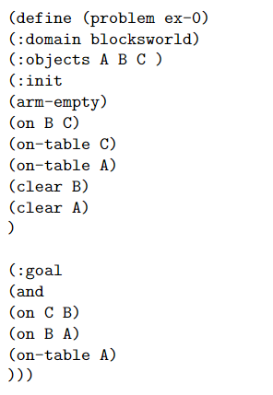
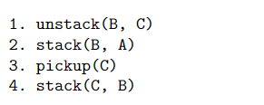
Example Case
Formal Specification
Correct generated code

Slide 27
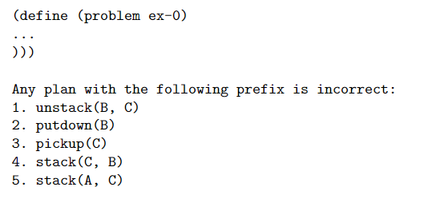
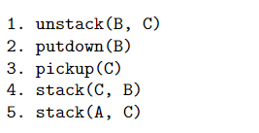
Counterexample Iteration
Generated code
Incorrect final state
Append counterexample
A
C
B

Slide 28
Background

Slide 29
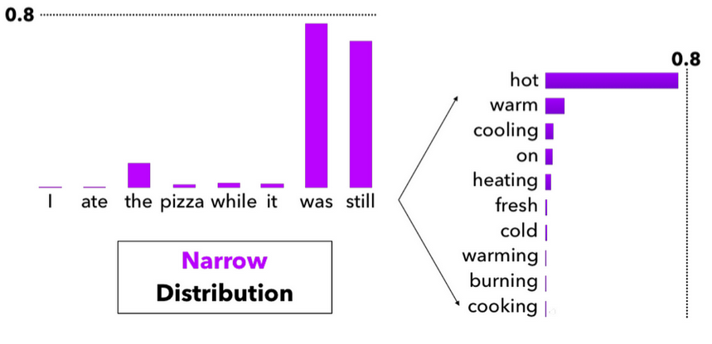
Background: Language Models
Language models are deep neural networks
take as input a sequence and output a probability vector over a vocabulary V.
Fundamentally stochastic systems
https://miro.medium.com/v2/resize:fit:1400/0*J37qonVPJvKZpzv2

Slide 30
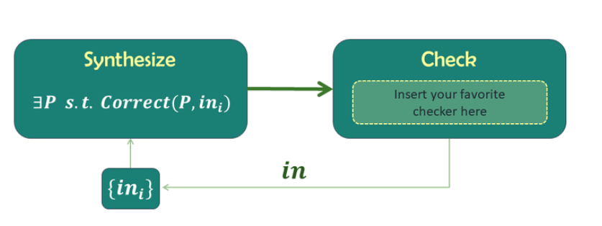
Background: Counterexample Guided Inductive Synthesis
General Synthesis Problem:
Find a program P that satisfies specification φ
Alternates between proposing candidate solutions and refining them using counter-examples from faulty candidates
https://people.csail.mit.edu/asolar/SynthesisCourse/Lecture10.htm
Notes:
https://people.csail.mit.edu/asolar/SynthesisCourse/Lecture10.htm

Slide 31
Existing Work
CEGIS
Largely enumeration-based (combinatorial) and may not scale with increasing variables [1,2]
LM-based Program Synthesis
Relies on stochastic techniques [11]
“Correctness” largely focuses on unit testing [3]
Lacks capabilities to generate formal artifacts [4]

Slide 32
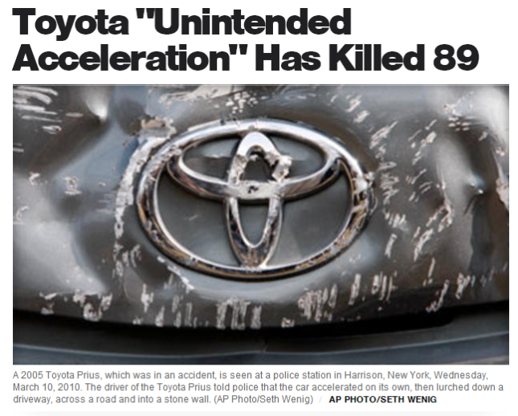
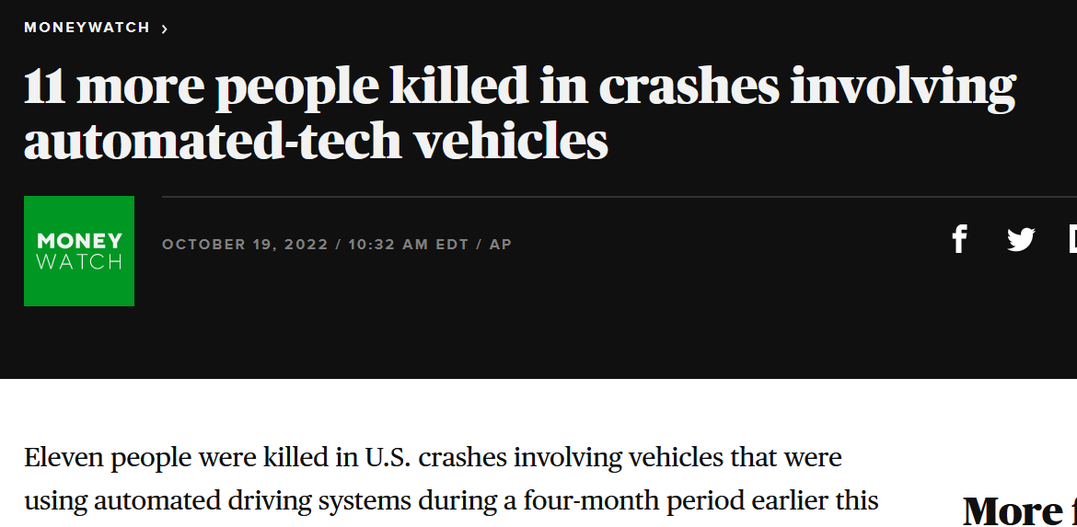
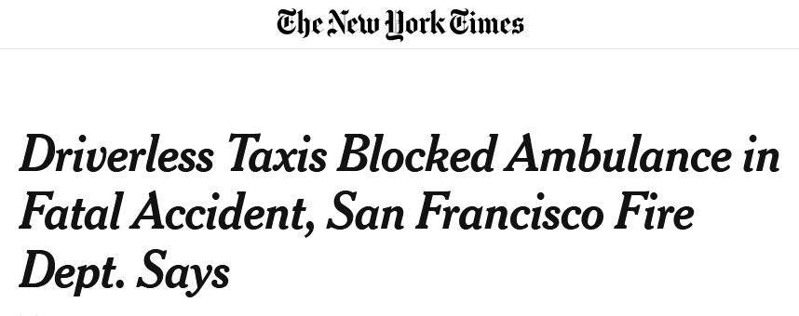
Software for Safety-Critical Systems
As LM-generated code deployed to diverse applications, increased risk of critical failure
Software failures can cause death, serious injuries, significant resource loss, environmental harm etc…
Existing limitations of LMs make them untrustworthy tools, especially for formal artifacts

Slide 33
Timeline
Date | Task | Completed
Week 1 | Research literature and understand related works | ✅
Week 2 | Research literature and understand related works | ✅
Week 3 | Narrow Scope, Filter relevant papers, begin research on tooling/technical work | ✅
Week 4 | Experiment with existing tooling | ✅
Week 5 | Finalize proposed experiments and construct progress report | ✅

Slide 34
Remaining Work
Date | Task | Completed
Week 6 | Finish development tasks | 🔲 (WIP)
Week 7 | Empirical Study | 🔲
Week 8 | Empirical Study | 🔲
Week 9 | Result Analysis and Write-Up | 🔲
Week 10-12 | Finalize write-up/Presentation | 🔲

Slide 35
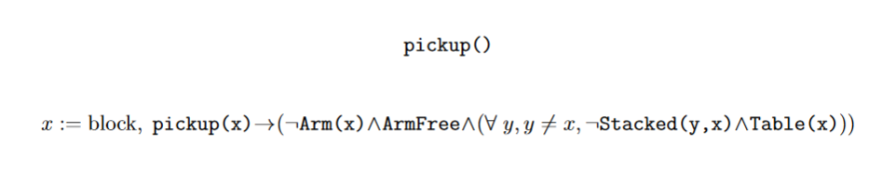
Pickup()

Slide 36
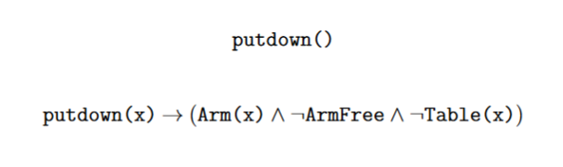
Putdown()

Slide 37
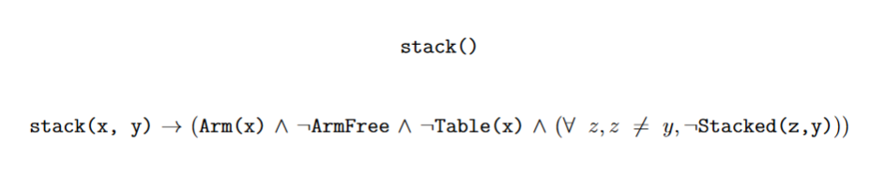
Stack()

Slide 38
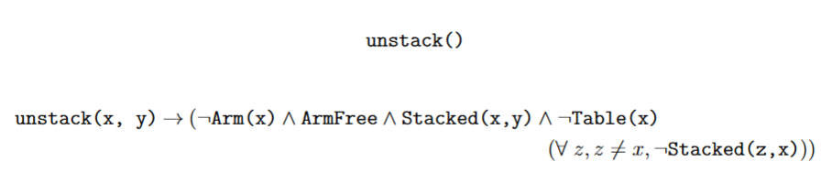
Unstack()

Slide 39
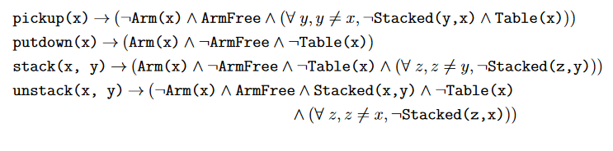
Formalization w/ Z3

