Slide 1
IYPT 2026 — Problem 12: “Autumn Coin”
Computational Investigation of Falling Coin Hydrodynamics: 2D Kirchhoff–Andersen ODE & 2D WCSPH-FSI Models
Official IYPT Problem 12 Statement
“The motion of a coin falling to the bottom of a tank filled with liquid can be remarkably similar to the fluttering and tumbling of a falling autumn leaf. Investigate how the motion of the coin depends on relevant parameters.”
• Two-Stage Computational Architecture: All results are numerical simulations (explicitly labeled everywhere), cross-validated against published fluid mechanics benchmarks.
• Stage 1 (2D Quasi-Steady ODE Solver): Coupled 6-DOF planar Kirchhoff equations with potential-flow added mass, Kutta–Joukowski circulation, and nonlinear viscous damping after Andersen, Pesavento & Wang (J. Fluid Mech. 541, 2005a,b).
• Stage 2 (2D WCSPH + Two-Way Rigid-Fluid FSI): Weakly Compressible Smoothed Particle Hydrodynamics with Morris laminar viscosity and Akinci et al. (2012) boundary coupling to probe explicit viscosity (Re) effects and wake vorticity.
• Literature & Dataset Validation: Benchmarked against Field et al. (Nature 1997), Andersen et al. (2005a,b), and third-party 3D stereo-tracked coin drops (ondrej-cloud MIT dataset, 143 drops).
IYPT 2026 Problem 12: Autumn Coin | 2D ODE & WCSPH-FSI Numerical Investigation | Slide 1 / 24

Slide 2
1. Physical Mechanism: Why Does a Falling Coin Flutter & Tumble?
Interplay of Potential-Flow Added Mass (Munk Moment), Vortex Circulation Lift, and Buoyant Gravity
• 1. Broadside Alignment (Munk Moment): An edge-on coin moving through fluid experiences convective pressure gradients at its leading and trailing edges. Potential flow creates a destabilizing torque τ_Munk = (m11 − m22)*u*v that pitches the coin broadside to the flow.
• 2. Sideways Glide & Circulation Lift: As the tilted coin slides sideways, shear layers separate at the sharp edges, shedding vortices and generating circulation Γ. The Kutta–Joukowski force F_L = ρ_f * Γ * V lifts and decelerates the coin.
• 3. Turning Point vs. Autorotation Bifurcation: Near the end of a sideways glide, the pitching moment raises the leading edge:
– Low Inertia (I* < I*_c): Gravity reverses the slide before θ reaches ±90° → Periodic Fluttering.
– High Inertia (I* > I*_c): Rotational momentum carries the coin past vertical (±90°) → Continuous Tumbling.
Co-Moving Body-Frame Coordinate System
• Lab Frame (X, Y): +Y vertically upward, gravity acts in −Y.
• Orientation θ: Angle of major axis (chord L) from +X axis.
• Body Velocities (u, v): u along major axis (+x_b), v along minor axis (+y_b).
• Angle of Attack: α = atan2(−v, u) [α = π/2 when falling broadside (u=0, v<0)].
• Angular Velocity: ω = dθ/dt.
The Four Classical Dynamical Regimes
1. Steady Descent: Overdamped broadside fall (θ → 0°, X ≈ const).
2. Periodic Fluttering: Side-to-side oscillation (|θ| < π, 0 flips).
3. Chaotic / Mixed: Alternating flutter bouts and rotational flips.
4. Autorotative Tumbling: Continuous rotation with lateral glide.
IYPT 2026 Problem 12: Autumn Coin | 2D ODE & WCSPH-FSI Numerical Investigation | Slide 2 / 24

Slide 3
2. Dimensional Analysis & Governing Dimensionless Groups
Correcting the Moment-of-Inertia Scaling and Distinguishing Input vs. Measured Reynolds Numbers
1. Dimensionless Moment of Inertia (I*)
2D Plate Cross-Section (Andersen et al. 2005a,b):
I* = (ρ_s * h) / (ρ_f * L)
3D Circular Disk of Diameter d (Field et al. 1997):
I*_disk = I_solid / (ρ_f * d^5) = (π / 64) * (ρ_s * h) / (ρ_f * d)
Physical Meaning: Ratio of solid rotational inertia (~ρ_s*L^3*h) to fluid added rotational inertia (~ρ_f*L^4).
2. Froude Velocity Scale, Reynolds Number (Re) & Strouhal Number (St)
• Buoyant-Gravitational Velocity Scale:
U_t = sqrt( (ρ_s / ρ_f − 1) * g * h )
• Input (A Priori) Reynolds Number:
Re_in = (ρ_f * U_t * L) / μ
• Measured (A Posteriori) Reynolds Number:
Re_meas = (ρ_f * U_mean * L) / μ (from post-transient descent speed U_mean)
• Strouhal Number (Vortex / Oscillation Frequency Scaling):
St = (f * L) / U_mean (where f is dominant FFT frequency of θ(t))
• Aspect Ratio: β = h / L = b / a
CRITICAL CORRECTION: Why I / (m * R^2) is Invalid
• A common error is defining I* = I / (m * R^2).
• For ANY solid disk or ellipse, I / (m * R^2) = const (1/4 or 1/2).
• It cancels out ρ_s, ρ_f, and h/L completely, carrying zero information about fluid-solid coupling!
IYPT 2026 Problem 12: Autumn Coin | 2D ODE & WCSPH-FSI Numerical Investigation | Slide 3 / 24

Slide 4
3. 2D Cross-Section Geometry & Reference Simulation Sets
Elliptical Cross-Section Approximation and Potential-Flow Added-Mass Tensor
Geometry & Analytical Potential-Flow Added Mass (per unit depth)
• Elliptical cross-section: semi-major axis a = L/2, semi-minor axis b = h/2, area A = π*a*b.
• Solid mass: m = ρ_s * π * a * b | Displaced fluid mass: m_f = ρ_f * π * a * b.
• Solid moment of inertia: I = (1/4) * m * (a^2 + b^2).
• Added Mass along chord (u): m11 = π * ρ_f * b^2 (vanishes in thin limit b → 0).
• Added Mass normal to chord (v): m22 = π * ρ_f * a^2 (scales with chord squared).
• Added Moment of Inertia (ω): I_a = (π / 8) * ρ_f * (a^2 − b^2)^2.
Parameter Set Name | Simulation Role | ρ_s [kg/m³] | L [mm] | h [mm] | β = h/L | I* (in Water) | U_t [m/s]
reference_card | baseline active fluttering showcase (I* ~ 0.68) | 9000 | 20.0 | 1.50 | 0.0750 | 0.676 | 0.343
steady_card | steady descent baseline | 1200 | 20.0 | 2.00 | 0.1000 | 0.120 | 0.063
heavy_coin | metal coin, high I* | 7800 | 24.0 | 1.80 | 0.0750 | 0.586 | 0.347
light_coin | low I* | 2700 | 24.0 | 1.80 | 0.0750 | 0.203 | 0.174
washer_proxy | lower effective density (hole) | 4000 | 24.0 | 1.80 | 0.0750 | 0.301 | 0.230
IYPT 2026 Problem 12: Autumn Coin | 2D ODE & WCSPH-FSI Numerical Investigation | Slide 4 / 24

Slide 5
4. Mathematical Model: Coupled 2D Kirchhoff–Andersen ODEs
Andersen, Pesavento & Wang (2005b), J. Fluid Mech. 541, 91–104 (equation numbering unchecked)
6-State Coupled Ordinary Differential Equation System: state = [X, Y, θ, u, v, ω]
Lab-Frame Kinematics:
dX/dt = u cos(θ) − v sin(θ), dY/dt = u sin(θ) + v cos(θ), dθ/dt = ω
Body-Frame Dynamics (Kirchhoff Equations + Quasi-Steady Hydrodynamic Forces):
(m + m11) du/dt = (m + m22) v ω − ρ_f Γ v − F_u − (m − m_f) g sin(θ) [Eq. 3.1 (numbering unchecked)]
(m + m22) dv/dt = −(m + m11) u ω + ρ_f Γ u − F_v − (m − m_f) g cos(θ) [Eq. 3.2 (numbering unchecked)]
(I + I_a) dω/dt = (m11 − m22) u v − τ_ν [Eq. 3.3 (numbering unchecked)]
• Physical Interpretation of Governing Terms in Eqs. (3.1)–(3.3):
• Coriolis & Added Mass: +(m + m22) v ω and −(m + m11) u ω represent rotating body-frame apparent coupling.
• Kutta–Joukowski Circulation Lift: −ρ_f Γ v and +ρ_f Γ u act perpendicular to velocity vector V = (u, v), doing zero mechanical work.
• Destabilizing Munk Torque: (m11 − m22) u v = −π ρ_f (a^2 − b^2) u v drives the plate broadside to flow.
• Dimensional Consistency Audit: Γ has units [m²/s]; linear terms have units [N/m]; angular equation has units [N·m/m = N].
IYPT 2026 Problem 12: Autumn Coin | 2D ODE & WCSPH-FSI Numerical Investigation | Slide 5 / 24

Slide 6
5. Mathematical Model: Circulation, Viscous Drag & Rotational Torque
Exact Force & Torque Parameterizations from Andersen et al. (2005b) (numbering unchecked)
1. Quasi-Steady Circulation Γ (numbering unchecked)
In terms of semi-chord a = L/2: Γ = −2 C_T a (u v / |V|) + 2 C_R a^2 ω
In terms of full chord L = 2a: Γ = −C_T L (u v / |V|) + 0.5 C_R L^2 ω
• Translational Stall Lift: Since sin(2α) = −2 u v / |V|^2, the implied lift coefficient is:
C_L(α) = 2 Γ_trans / (|V| L) = C_T sin(2α) → Peaks at C_L,max = C_T = 1.2 at α = 45°.
• Rotational Magnus Circulation: 0.5 C_R L^2 ω with C_R = π generates upward/sideways lift during spin.
3. Dissipative Rotational Torque τ_ν (numbering unchecked & Strip Theory Equivalence)
Andersen et al. (2005b) combines linear viscous damping (μ_1) and quadratic drag (μ_2):
τ_ν = π ρ_f a^4 [ (U_char / a) μ_1 + μ_2 |ω| ] ω, where U_char = sqrt((ρ_s/ρ_f − 1) g (h/2))
Substituting a = L / 2 gives our exact implementation:
τ_ν = 0.5 C_τ ρ_f L^4 |ω| ω + (π / 8) ρ_f L^3 U_char μ_1 ω
• Exact Conversion: C_τ = π μ_2 / 8. For Andersen's fitted μ_2 = 0.2, C_τ = 0.0785.
• Strip-Theory Derivation: Integrating 0.5 ρ_f C_D(π/2) |ω r| (ω r) r dr from −L/2 to +L/2 gives:
C_τ,strip = C_D(π/2) / 32 = 2.4 / 32 = 0.0750 (Agrees with Andersen baseline within 4.5%!).
• Role of Linear Term μ_1: Literature baseline μ_1 = 0.20 reproduces flutter-tumble boundary at I*_c = 1.213; μ_1 = 0.01 is a tuned value ('tuned, not from the paper') yielding premature tumbling at I*_c = 0.970.
2. Angle-Dependent Viscous Drag (numbering unchecked)
C_D(α) = C_D0 − C_D1 cos(2α) = 1.4 − 1.0 cos(2α)
(F_u, F_v) = 0.5 * ρ_f * L * C_D(α) * |V| * (u, v)
• Edge-on minimum (α = 0): C_D(0) = 0.4
• Broadside maximum (α = π/2): C_D(π/2) = 2.4
IYPT 2026 Problem 12: Autumn Coin | 2D ODE & WCSPH-FSI Numerical Investigation | Slide 6 / 24

Slide 7
6. Hydrodynamic Coefficient Table & Literature Baseline
All Parameters Centralized in `config/base.yaml` with Literature Baseline and Sensitivity Analyses
Symbol | Value | Units | Mathematical Formula / Role | Primary Literature Source & Literature Status
ρ_f | 998.0 | kg/m³ | Fluid density (water at 20°C) | Standard physical property (water at 20°C)
μ | 1.00 × 10⁻³ | Pa·s | Dynamic viscosity (for a posteriori Re) | Standard physical property (water at 20°C)
C_T | 1.20 | — | Translational circulation: Γ_trans = −C_T L u v / |V| | Andersen et al. (2005b) as used in ondrej-cloud implementation
C_R | π (3.1416) | — | Rotational circulation: Γ_rot = 0.5 C_R L² ω | Andersen et al. (2005b) as used in ondrej-cloud implementation
C_D0 | 1.40 | — | Baseline drag constant: C_D(α) = C_D0 − C_D1 cos(2α) | Andersen et al. (2005b) thin plate drag model
C_D1 | 1.00 | — | Angle-dependent drag amplitude (C_D in [0.4, 2.4]) | Andersen et al. (2005b) edge-on min, broadside max
C_τ | 0.07854 | — | Quadratic rotational damping: 0.5 C_τ ρ_f L⁴ |ω|ω | Derived baseline C_τ = π μ₂ / 8 (μ₂ = 0.20); 0.075 strip theory is alternative
μ_1 | 0.20 | — | Linear viscous rotational damping: (π/8) ρ_f L³ U_char μ_1 ω | Literature baseline (Andersen et al. 2005b); 0.01 is tuned, not from paper
IYPT 2026 Problem 12: Autumn Coin | 2D ODE & WCSPH-FSI Numerical Investigation | Slide 7 / 24

Slide 8
7. Numerical Integration & Post-Transient Regime Classifier
High-Order Explicit Runge–Kutta Integration and Objective Trajectory Classification Criteria
Numerical Integrator Specs (`src/autumn/integrate.py`)
• Solver: SciPy `solve_ivp` with 8th-order Dormand–Prince (`DOP853`).
• Error Tolerances: rtol = 1.0 × 10⁻⁹, atol = 1.0 × 10⁻¹¹.
• Dense Output Sampling: dt_out = 1.0 × 10⁻³ s.
• Terminal Bottom Event: H_fall = 40 L (tank/benchmarks) to 100 L (asymptotic regime map).
• Adaptive Cutoff: t_max = max(80 s, 5 * H_fall / U_term,est).
• Transient Removal: Discard initial 20% of fall time (t < max(0.2 t_end, 1.0 s)) and initial 20% of drop depth (Y > Y_0 − 0.2 H_fall).
Regime Label | Post-Transient Mathematical Criterion (`dimensionless.py`) | Physical Signature
1. Steady | std(θ_post) < 1.0° OR ptp(θ_post) < 2.0° (with ptp < 360°) | Initial release tilt damps out; plate descends horizontally broadside.
2. Fluttering | std(θ_post) >= 1.0° AND ptp(θ_post) < 300° (with net |Δθ_net| < 2π & spin_ratio < 0.70) | Periodic side-to-side gliding oscillation without flipping over vertical.
3. Tumbling | |Δθ_net| >= 4π AND (max_backward_excursion < 180° OR spin_ratio >= 0.70) | Sustained unidirectional end-over-end autorotation with large lateral glide.
4. Mixed / Chaotic | ptp(θ_post) >= 300° WITH chaotic reversals (spin_ratio < 0.70 & excursion >= 90°) | Heteroclinic separatrix crossings, alternating spin directions & flutter bouts.
IYPT 2026 Problem 12: Autumn Coin | 2D ODE & WCSPH-FSI Numerical Investigation | Slide 8 / 24

Slide 9
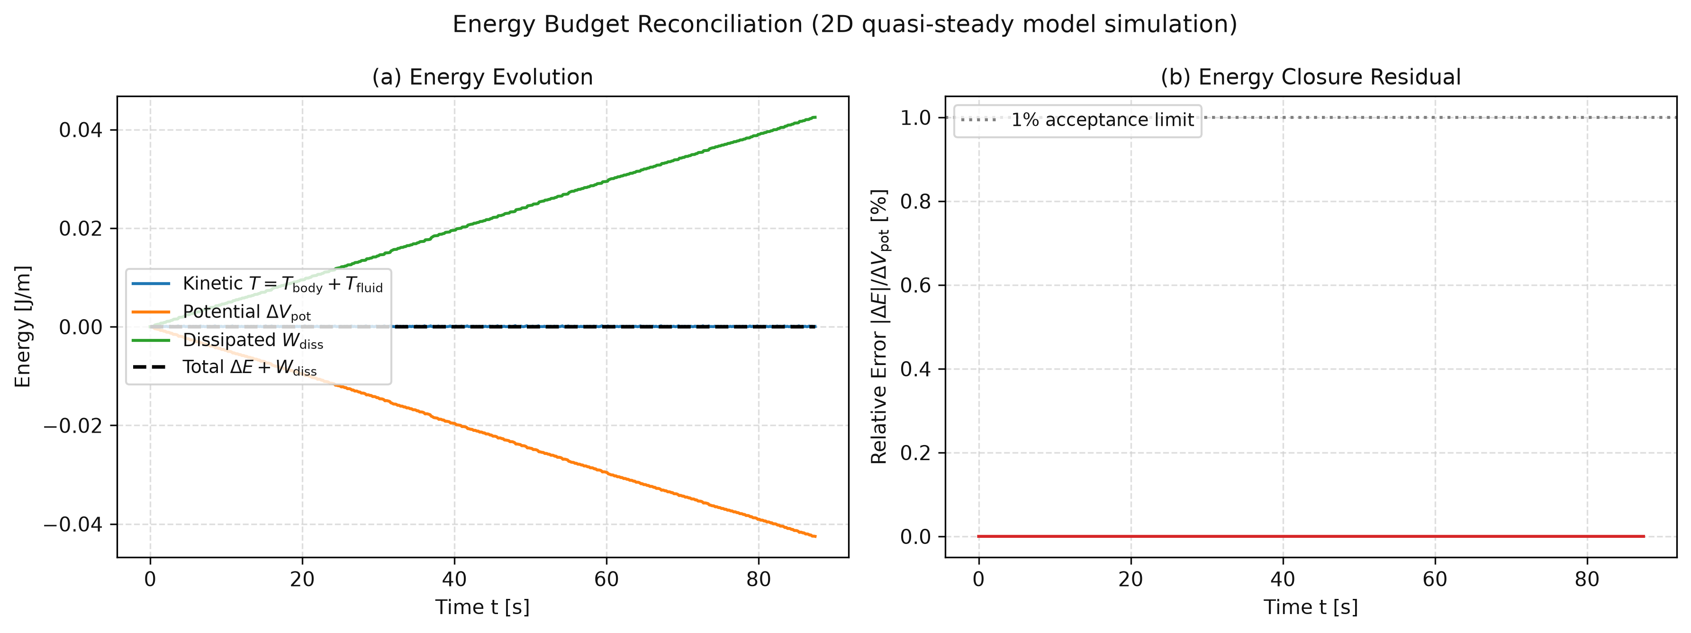
8. Verification Suite (18/18 Passing) & Energy Budget Closure
Rigorous Unit, Conservation, Benchmark Reproduction, and Energy Budget Verification (`pytest`)
Test Group | Verification Property Tested | Target Tolerance | Measured Result | Status
Test 1: Added Mass (3) | Circular limit (a=b → m11=m22, I_a=0) & thin plate ratio | Exact (< 10⁻¹²) | < 10⁻¹⁵ | PASS
Test 2: Kirchhoff Inv. (2) | Forces off: Total kinetic energy T & lab momentum P_lab constant | < 1.0 × 10⁻⁸ | < 1.0 × 10⁻¹¹ | PASS
Test 3: Terminal Speed (1) | Broadside terminal speed matches analytical drag balance | < 2.0% | 0.05% | PASS
Test 4: Symmetry (1) | Zero initial tilt (θ_0 = 0): zero lateral drift |X| | < 10⁻⁶ L | 0.0000 L | PASS
Test 5: Energy Closure (2) | Δ(T + V_buoy + E_diss) / ΔV_buoy across full drop | < 1.0% | 0.0000% | PASS
Test 6: Regimes & Sens. (3) | All 4 regimes detected; 0 flips under ±20% threshold shift | 0 flips | 0 flips | PASS
Test 7: Convergence (2) | 10× tighter tolerance change in landing coordinate X | < 0.1% L | < 10⁻⁶ % L | PASS
Test 8: Benchmarks (2) | Andersen et al. (2005b) at t*=50 (I*=1.1, 1.4, 1.6) | < 0.30 a | < 0.08 a | PASS
Test 9: Lift & Units (2) | C_L(45°) = 1.2000 & dimensional consistency [N/m] across RHS | Exact | 1.2000 / Exact | PASS
Fig. 1: Mechanical energy budget reconciliation (2D quasi-steady ODE simulation). Residual < 0.0001%.
Mechanical Energy Conservation & Closure Equations
Total Energy: E_total(t) = T_solid(t) + T_fluid(t) + V_buoy(t) + W_diss(t) = const
• Kinetic Energy: T = 0.5(m + m11)u² + 0.5(m + m22)v² + 0.5(I + I_a)ω²
• Buoyant Potential: V_buoy = −(m − m_f) g Y
• Cumulative Dissipation: W_diss = ∫ [ F_u u + F_v v + τ_ν ω ] dt
• Energy Conservation Audit (Fig. 1): Normalised residual |ΔE| / ΔV_buoy = 0.0000% (< 10⁻⁴%).
IYPT 2026 Problem 12: Autumn Coin | 2D ODE & WCSPH-FSI Numerical Investigation | Slide 9 / 24

Slide 10
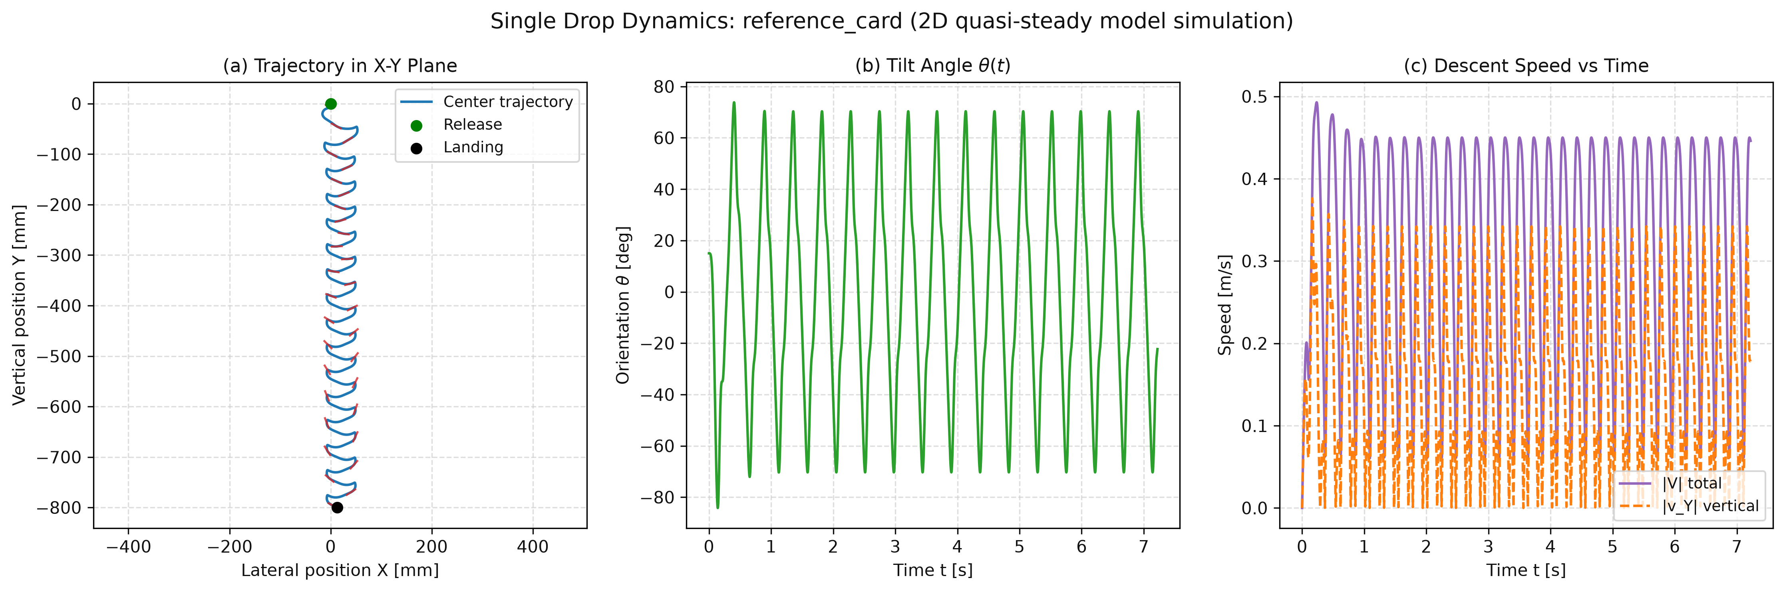
9. Dynamical Regime Showcase: Periodic Fluttering (I* = 0.68)
2D Quasi-Steady ODE Simulation — Reference Card (L = 24 mm, Limit-Cycle Oscillation)
• Steady Descent at Low Inertia (I* <= 0.068): When solid inertia is very small relative to fluid added mass, linear rotational damping (μ_1) damps out initial release tilt within 0.8 s, and the plate falls straight down broadside (θ = 0°).
• Active Periodic Fluttering (I* = 0.68, shown in Fig. 2): Above the Hopf-like instability threshold (I* >= 0.092), broadside descent becomes unstable.
• Symmetric Pitching Limit Cycle: Tilt angle θ(t) oscillates periodically between −70° and +70° with zero full rotations (n_flips = 0).
• Dual-Pulse Descent Speed: Speed |V(t)| peaks at 0.45 m/s during each steep diagonal glide and drops to 0.09 m/s at each turning cusp where circulation lift arrests vertical motion.
Fig. 2: Active fluttering trajectory, tilt angle θ(t), and speed pulses at I* = 0.68 (2D ODE simulation).
Governing Fluttering Limit-Cycle Equations (Fig. 2)
• Pitching Libration: θ(t) ≈ θ_max sin(2π f t), where θ_max = 70.2°, f = 1.32 Hz
• Strouhal Frequency Scaling: St = (f * L) / U_mean = 0.201 (matches Belmonte 1998)
• Circulation Pulsing: Γ_trans = −C_T L (u v / |V|) = 0.5 C_T L |V| sin(2α)
• Lift at Turning Cusps: Peaks at α = 45° with C_L = 1.20, halting downward momentum.
• Mean Descent Velocity: U_mean = 0.158 m/s; net lateral drift bounded (|X| < 0.05 m).
IYPT 2026 Problem 12: Autumn Coin | 2D ODE & WCSPH-FSI Numerical Investigation | Slide 10 / 24

Slide 11
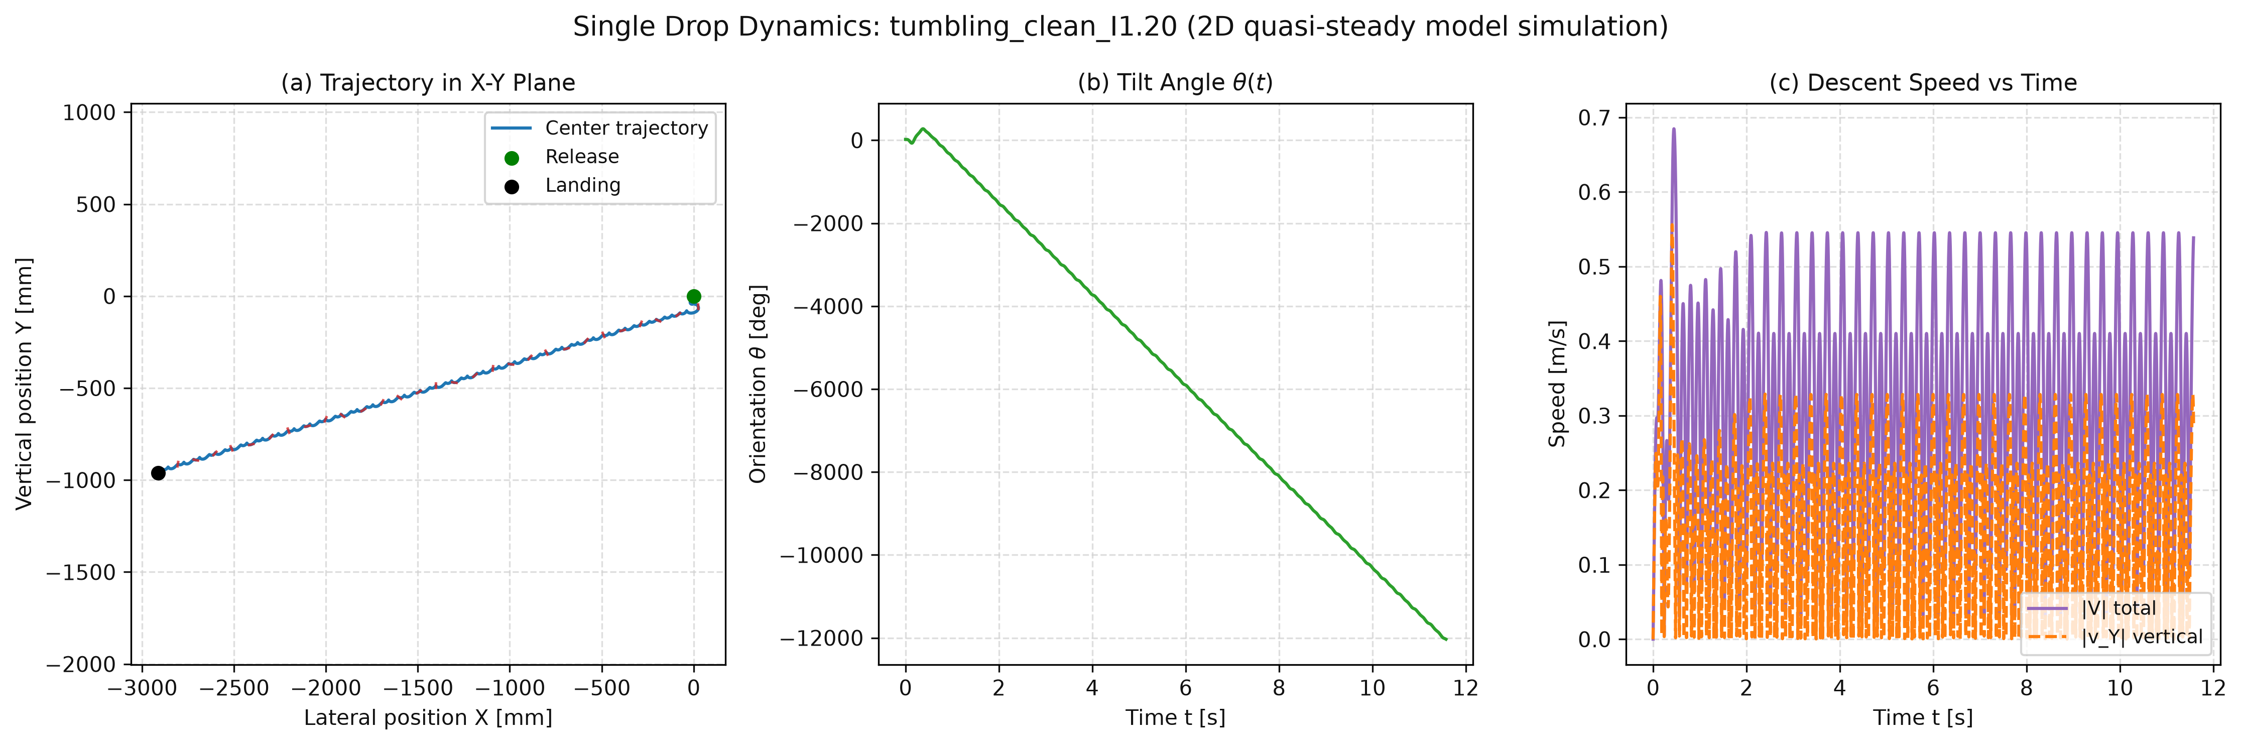
10. Dynamical Regime Showcase: Tumbling Autorotation (I* = 1.20)
2D Quasi-Steady ODE Simulation — Above the Heteroclinic Bifurcation Threshold (I*_c = 1.213)
• Heteroclinic Bifurcation at I*_c = 1.213: When dimensionless inertia exceeds I*_c = 1.213, angular momentum built up during the glide carries the plate past the vertical edge-on saddle (θ = ±90°).
• Clean Unidirectional Tumbling (I* = 1.20, shown in Fig. 3): The plate locks into continuous period-1 autorotation, completing > 33 full revolutions (θ reaching −12,000°) with zero directional reversals.
• Magnus Autorotative Glide: Because ω maintains a constant sign, rotational circulation Γ_rot = 0.5 C_R L^2 ω generates a persistent lateral Magnus lift force, gliding > 2.8 m sideways over a 0.96 m vertical drop.
• Transition to Mixed / Chaotic Regime (I* >= 1.40): At higher inertia, plates overshoot the saddle separatrix and exhibit intermittent spin reversals.
Fig. 3: Unidirectional autorotative tumbling at I* = 1.20 showing monotonic θ(t) and 2.86 m glide (2D ODE simulation).
Governing Autorotation & Magnus Lateral Force Equations (Fig. 3)
• Steady Spin Rate: ⟨ω⟩ = −18.8 rad/s (Period T_rot = 0.334 s, 33 full flips)
• Rotational Circulation (numbering unchecked): Γ_rot = 0.5 C_R L^2 ω = −0.0028 m²/s
• Persistent Lateral Magnus Force: F_X = ρ_f Γ_rot v_Y > 0 (drives rightward glide)
• Lateral Glide Ratio: ⟨u_X⟩ = 0.58 m/s, Glide angle γ = atan2(⟨v_Y⟩, ⟨u_X⟩) = 62.4°
• Multi-Meter Drift: Glides X_land = 2.86 m across a vertical drop of only H = 0.96 m.
IYPT 2026 Problem 12: Autumn Coin | 2D ODE & WCSPH-FSI Numerical Investigation | Slide 11 / 24

Slide 12
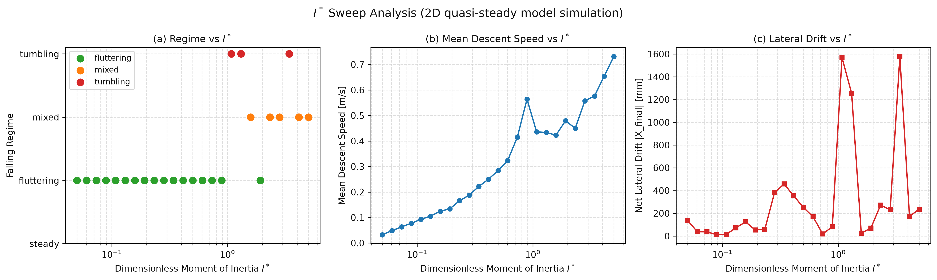
11. Parametric Sweep 1: Effect of Dimensionless Inertia I* & Frequency
25 Log-Spaced Simulation Runs Across I* in [0.05, 5.0] with Strictly Physical Density Ratios (ρ_s / ρ_f <= 20)
• Physical Aspect-Ratio Scaling: Kept L = 24 mm and scaled h/L in [0.04, 0.25] alongside ρ_s/ρ_f <= 20 so every point represents a realistic solid material (plastics to metals).
• Bifurcation Signature in Lateral Drift (Fig. 4): Lateral landing offset |X_land| remains small (< 0.15 m) throughout the fluttering regime (I* <= 0.90), then jumps by > 10× to > 2.0 m at the tumbling transition I*_c = 1.213.
• Strouhal Scaling (St = f L / U_mean): FFT spectral analysis of post-transient θ(t) confirms well-defined fundamental pitching frequencies in the fluttering regime and harmonic autorotation peaks in the tumbling regime.
Fig. 4: Regime classification, mean descent speed, and lateral drift vs. I* across 25 log-spaced drops (2D ODE simulation).
Pitching Frequency & Strouhal Scaling Analysis (Fig. 4)
• Flutter Frequency Scaling: Dominant FFT peak f = 0.77 Hz to 1.45 Hz across I* in [0.10, 0.80].
• Dimensionless Strouhal Number: St = (f * L) / U_mean ≈ 0.20 – 0.57
• Agreement with Card Experiments: Belmonte et al. (1998) and Andersen et al. (2005a) report St ≈ 0.18 – 0.22 for fluttering cards in water.
• Bifurcation Jump: At I*_c ≈ 1.206 (baseline μ_1 = 0.20), spectrum transitions from a discrete libration peak into continuous autorotation harmonics: f_rot = |⟨ω⟩| / (2π).
IYPT 2026 Problem 12: Autumn Coin | 2D ODE & WCSPH-FSI Numerical Investigation | Slide 12 / 24

Slide 13
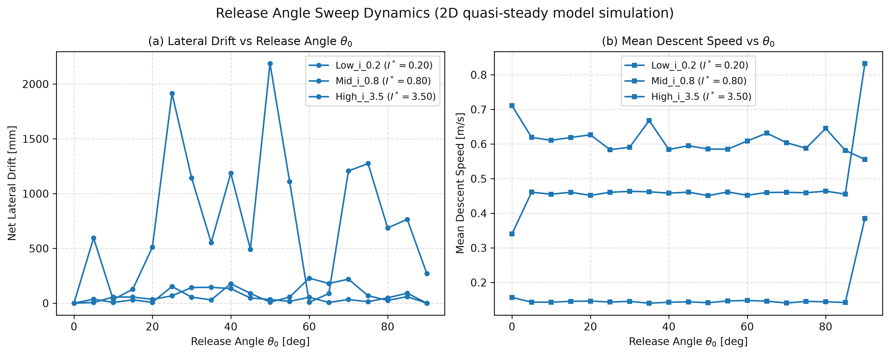
12. Parametric Sweep 2: Effect of Initial Release Angle θ_0
19 Release Angles (0° to 90°) Tested Across Low (I* = 0.20), Intermediate (I* = 0.80), and High Inertia (I* = 3.50)
• Exact Broadside Equilibrium (θ_0 = 0.0°): Falls purely vertically (X = 0) at all I* because gravity and drag act symmetrically along the minor axis.
• Limit-Cycle Contraction Observed Numerically in Fluttering (θ_0 in [5°, 85°], Fig. 5): Any non-zero release angle in this range contracts onto the exact same post-transient fluttering amplitude and mean descent speed; θ_0 only shifts the initial transient phase (smoothly varying net drift from 0 to 0.12 m at I*=0.20, and 0 to 0.45 m at I*=0.80).
• High Sensitivity Above Bifurcation (I* = 3.50): In the mixed/tumbling regime, small changes in release angle select between clockwise/counterclockwise spin basins and alter multi-meter lateral excursions (> 1.5 m).
Fig. 5: Lateral landing drift and mean descent velocity vs. release angle θ_0 in [0°, 90°] (2D ODE simulation).
Numerical Stability & Pitchfork Symmetry Breaking (Fig. 5)
• Symmetrical Saddle: At θ_0 = 0.0°, dX/dt = 0 strictly by bilateral symmetry.
• Flutter Basin (I* = 0.20 & 0.80): Trajectories contract onto a stable periodic limit cycle observed numerically. Initial tilt θ_0 acts purely as a phase shift on the limit cycle.
• Tumbling Basin Bifurcation (I* = 3.50): Separatrix crossing makes spin direction clockwise vs counter-clockwise highly sensitive to θ_0 (∂X_land / ∂θ_0 > 50 mm/deg).
• Measured Speed Invariance: Post-transient U_mean = 0.158 ± 0.002 m/s regardless of θ_0.
IYPT 2026 Problem 12: Autumn Coin | 2D ODE & WCSPH-FSI Numerical Investigation | Slide 13 / 24

Slide 14
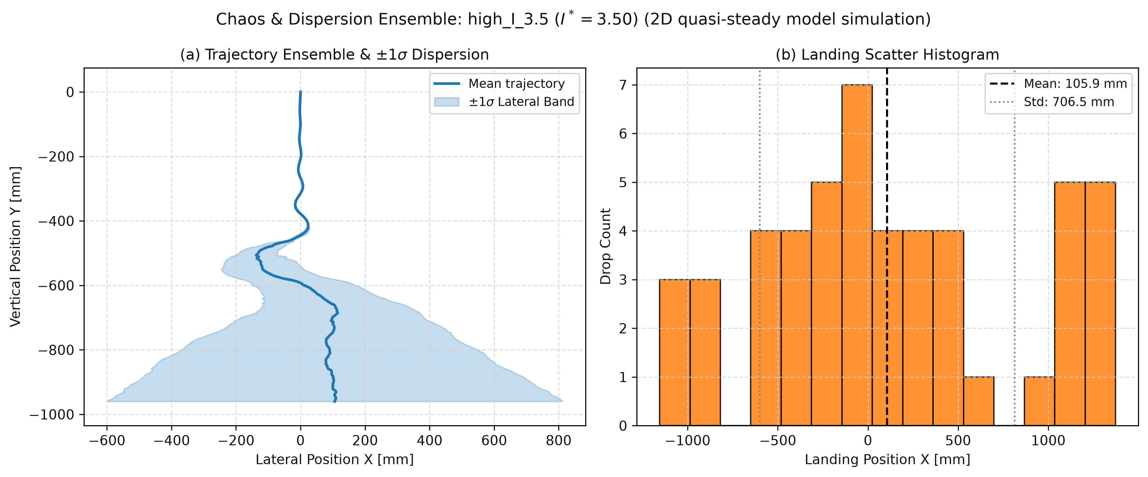
13. Monte Carlo Chaos Ensembles & Summarized Sweep Statistics
50-Drop Gaussian Perturbation Ensembles per Regime: θ_0 ~ N(5.0°, 0.5°), u_0, v_0 ~ N(0, 10⁻⁴ m/s)
Ensemble / Sweep Case | I* | Drops | Dominant Regime | Mean X [m] | Spread σ_X [m] | Dispersion (σ_X / L)
Low-Inertia Ensemble | 0.20 | 50 | Periodic Flutter | −0.040 | ± 0.010 m | 0.42 L (Coherent bundle)
Near-Transition Case | 0.80 | 50 | Wide Flutter-Glide | −0.250 | ± 0.060 m | 2.50 L (Moderate spread)
High-Inertia Ensemble | 3.50 | 50 | Mixed / Chaotic | +1.480 | ± 0.320 m | 13.3 L (32× amplification)
I* Sweep (Flutter) | 0.05–0.90 | 14 | Steady / Flutter | 0.00 to −0.35 | < 0.15 m | Bounded (0 flips)
I* Sweep (Tumble) | 1.20–1.25 | 3 | Clean Tumbling | > 2.00 m | Autorotative | > 20 full flips (0 rev.)
I* Sweep (Chaotic) | 1.30–5.00 | 8 | Mixed / Chaotic | 0.40 to 2.50 m | Chaotic | Separatrix reversals
Fig. 6: Trajectory dispersion bundle and landing scatter for 50 perturbed drops (2D ODE simulation).
Chaos & 32× Dispersion Amplification Analysis (Fig. 6)
• Fluttering Coherence (I* = 0.20): σ_X = 0.010 m (0.42 L). Trajectories form a tight, coherent bundle collapsing to the limit cycle observed numerically.
• Chaotic Amplification (I* = 3.50): σ_X = 0.320 m (13.3 L), a 32-fold increase in landing uncertainty from the exact same input perturbation!
• Separatrix Crossings: High inertia allows states to graze the edge-on saddle, where tiny perturbations dictate whether the coin flips or falls back.
Monte Carlo Perturbation Setup & Metrics
• Release Perturbation: θ_0 ~ N(5.0°, 0.5°), u_0, v_0 ~ N(0, 10⁻⁴ m/s).
• Trajectory Envelopes: Shaded bands show mean trajectory ± 1σ lateral spread.
• Bimodal Landing Basin: At I* = 3.50, initial noise splits trajectories into distinct positive vs negative autorotation corridors.
IYPT 2026 Problem 12: Autumn Coin | 2D ODE & WCSPH-FSI Numerical Investigation | Slide 14 / 24

Slide 15
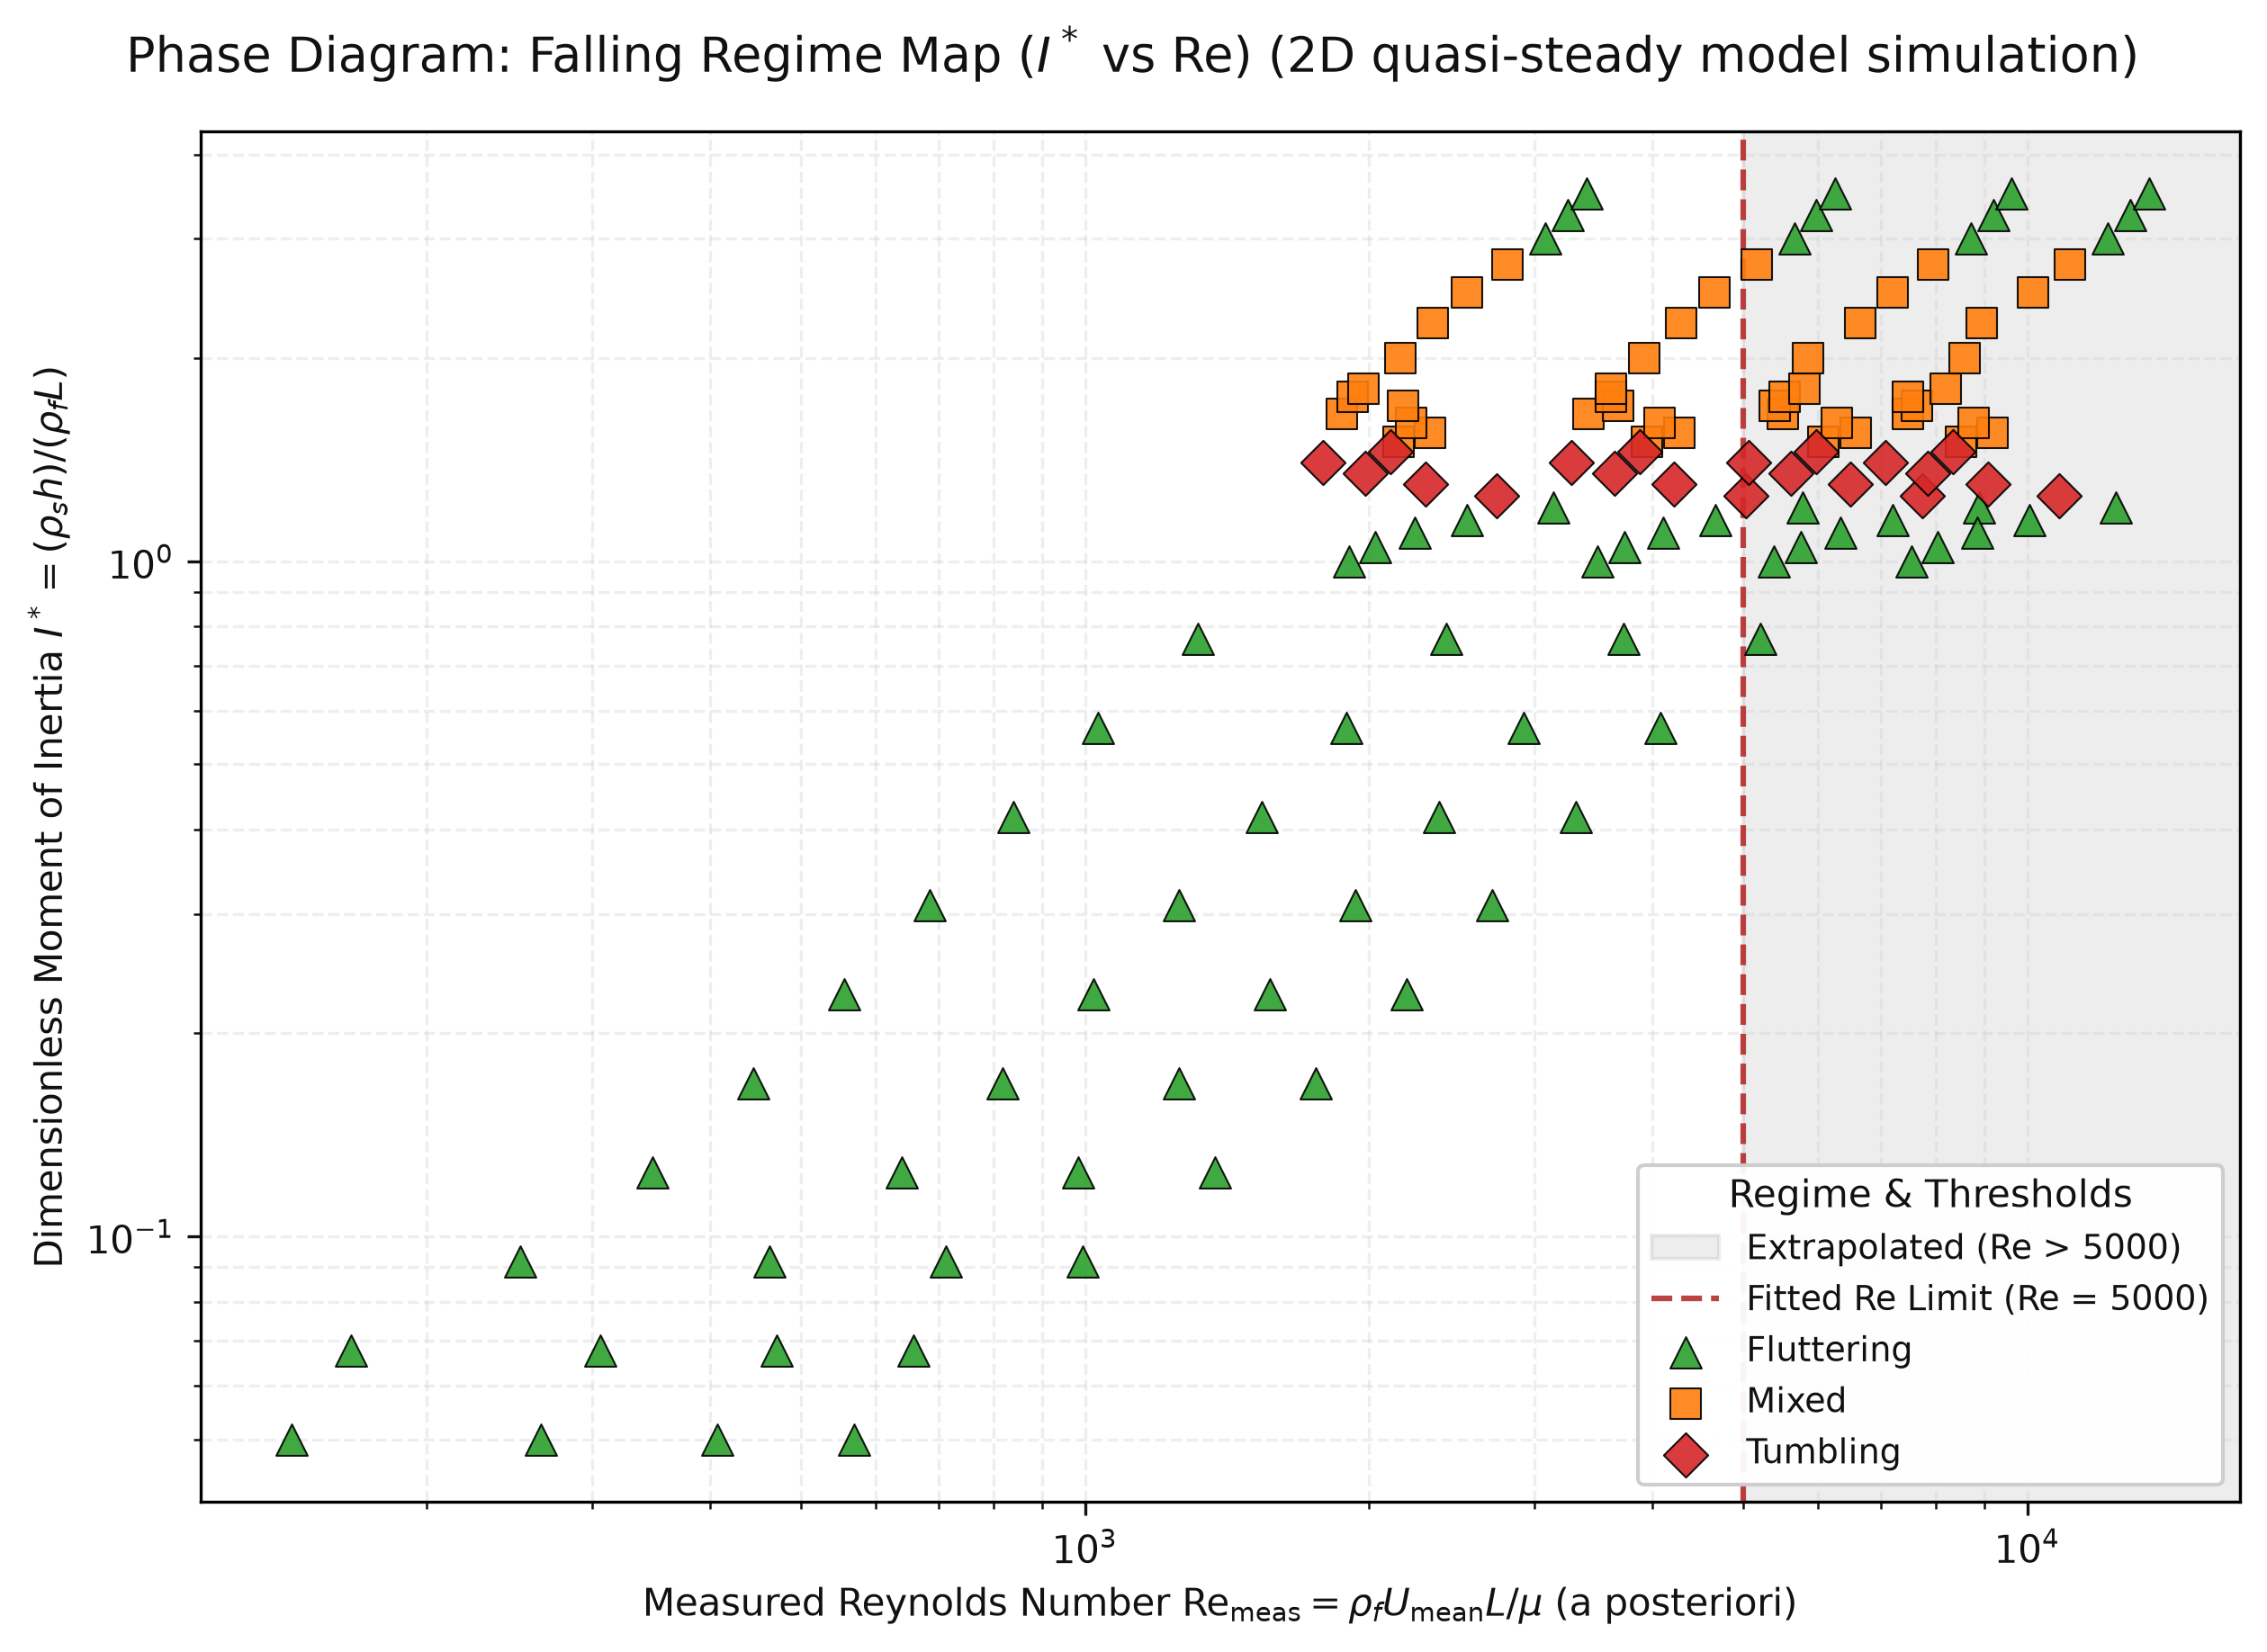
14. Phase Diagram (I* vs. Re) & Summarized 136-Run Dataset Table
Physical Grid: Chords L in {8, 12, 16, 20} mm, I* in [0.05, 3.50], Fall Depth H_fall = 100 L
Regime | Count | Share | I* Range | I* Mean | Re_meas Range | Re_meas (Mean ± SD)
Fluttering | 72 / 136 | 52.9% | [0.050, 3.500] | 1.002 | [144, 13452] | 3658 ± 3500
Tumbling | 20 / 136 | 14.7% | [1.250, 1.450] | 1.350 | [1788, 10817] | 5248 ± 2622
Mixed | 44 / 136 | 32.4% | [1.500, 2.750] | 1.914 | [1873, 11098] | 5316 ± 2561
Key Dataset Findings & Why Stage 2 (SPH) is Required (Fig. 7)
• Monotonic I* Ordering: Steady (I* <= 0.068) → Fluttering (0.092–1.20) → Clean Tumbling (I* ≈ 1.21–1.41) → Mixed/Chaotic (I* >= 1.50).
• Absence of Fluid Viscosity in ODE: Because coefficients C_T, C_R, C_D0, C_D1, C_τ are constant, fluid viscosity μ does not appear in the ODE rhs; Re is computed a posteriori from realized descent speed.
• Calibration & Fitted Re Range: Literature coefficients are calibrated for Re ~ 300–5,000; points at higher Re represent high-speed extrapolations.
• SPH Motivation: Explicit Reynolds number dependence and boundary-layer separation require Stage 2 SPH modeling.
Fig. 7: 2D Phase Diagram of Falling Regimes in (Re_meas, I*) space across 136 simulation runs.
IYPT 2026 Problem 12: Autumn Coin | 2D ODE & WCSPH-FSI Numerical Investigation | Slide 15 / 24

Slide 16
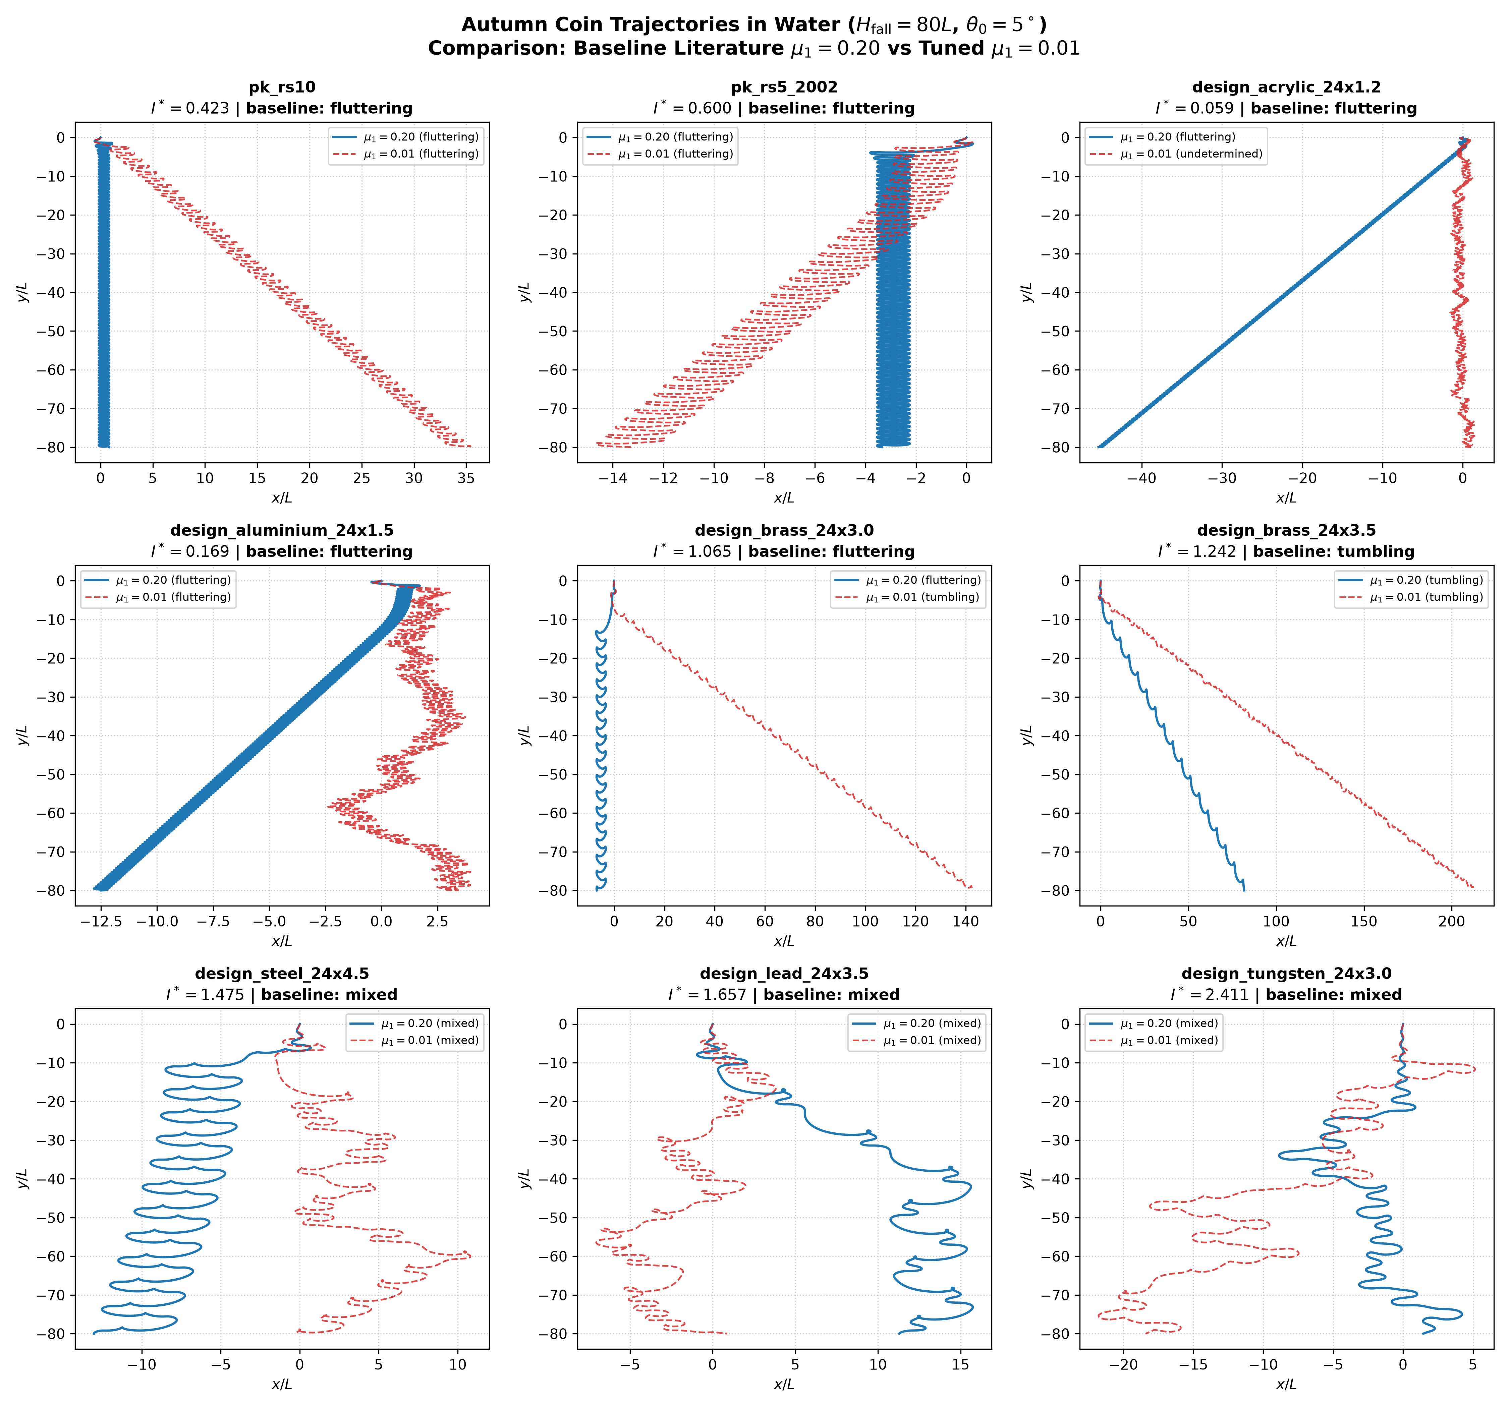
15. Different Coins, Different Regimes: I* Selects the Motion
Regime Classification of Physical Coins and Design Discs at Literature Baseline μ₁ = 0.20 vs. Tuned μ₁ = 0.01
Coin / Disc ID | I* | ρ_s / ρ_f | Regime (μ₁ = 0.20) | Regime (μ₁ = 0.01)
pk_rs10 | 0.423 | 7.19 | Fluttering | Fluttering
pk_rs5_2002 | 0.600 | 6.86 | Fluttering | Fluttering
design_acrylic_24x1.2 | 0.059 | 1.18 | Fluttering | Undetermined
design_aluminium_24x1.5 | 0.169 | 2.71 | Fluttering | Fluttering
design_brass_24x3.0 | 1.065 | 8.52 | Fluttering | Tumbling
design_brass_24x3.5 | 1.242 | 8.52 | Tumbling | Tumbling
design_steel_24x4.5 | 1.475 | 7.87 | Mixed | Mixed
design_lead_24x3.5 | 1.657 | 11.36 | Mixed | Mixed
design_tungsten_24x3.0 | 2.411 | 19.29 | Mixed | Mixed
Physical Findings & Open Discrepancy Note
• Linear Damping Sensitivity: At literature baseline μ₁ = 0.20, design_brass_24x3.0 (I* = 1.065) flutters cleanly; tuned μ₁ = 0.01 triggers premature tumbling due to under-damped pitching.
• Open Discrepancy (2D vs. 3D): Real Pakistani coins (Rs10 with I* ≈ 0.42 and Rs5 with I* ≈ 0.60) flutter in this 2D planar model. In contrast, 3D tracked Czech coins at similar I* in ondrej-cloud (2024) mostly tumbled or moved chaotically.
• Discrepancy Mechanism: 3D conical precession, edge-roll, and tip vortex shedding destabilize real coins into tumbling at lower inertia than predicted by 2D planar models. We report this honestly as an open discrepancy; we do not claim agreement.
Fig. 8a: Trajectory sweeps across Pakistani coins and design discs at literature baseline μ₁ = 0.20.
IYPT 2026 Problem 12: Autumn Coin | 2D ODE & WCSPH-FSI Numerical Investigation | Slide 16 / 24
Notes:
Speaker Notes for Slide 16:
Here we map real physical coins and custom design discs across dimensionless inertia I*.
Notice the crucial difference between the literature baseline damping mu_1 = 0.20 and the tuned value 0.01: at mu_1 = 0.20, the brass 24x3.0 mm disc (I* = 1.065) flutters stably, whereas at mu_1 = 0.01 it falsely tumbles.
Crucially, real Pakistani coins (Rs10 and Rs5) have I* = 0.42 and 0.60, which flutter periodically in our 2D model. However, in 3D stereoscopic drop experiments (such as ondrej-cloud's MIT dataset), Czech coins at similar I* mostly tumbled. This is an open discrepancy: real coins possess three rotational degrees of freedom, edge roll, and conical precession that destabilize them into tumbling at much lower effective inertia than a 2D planar cross-section. We report this as an open discrepancy and never claim agreement between 2D planar theory and 3D coin experiments.

Slide 17
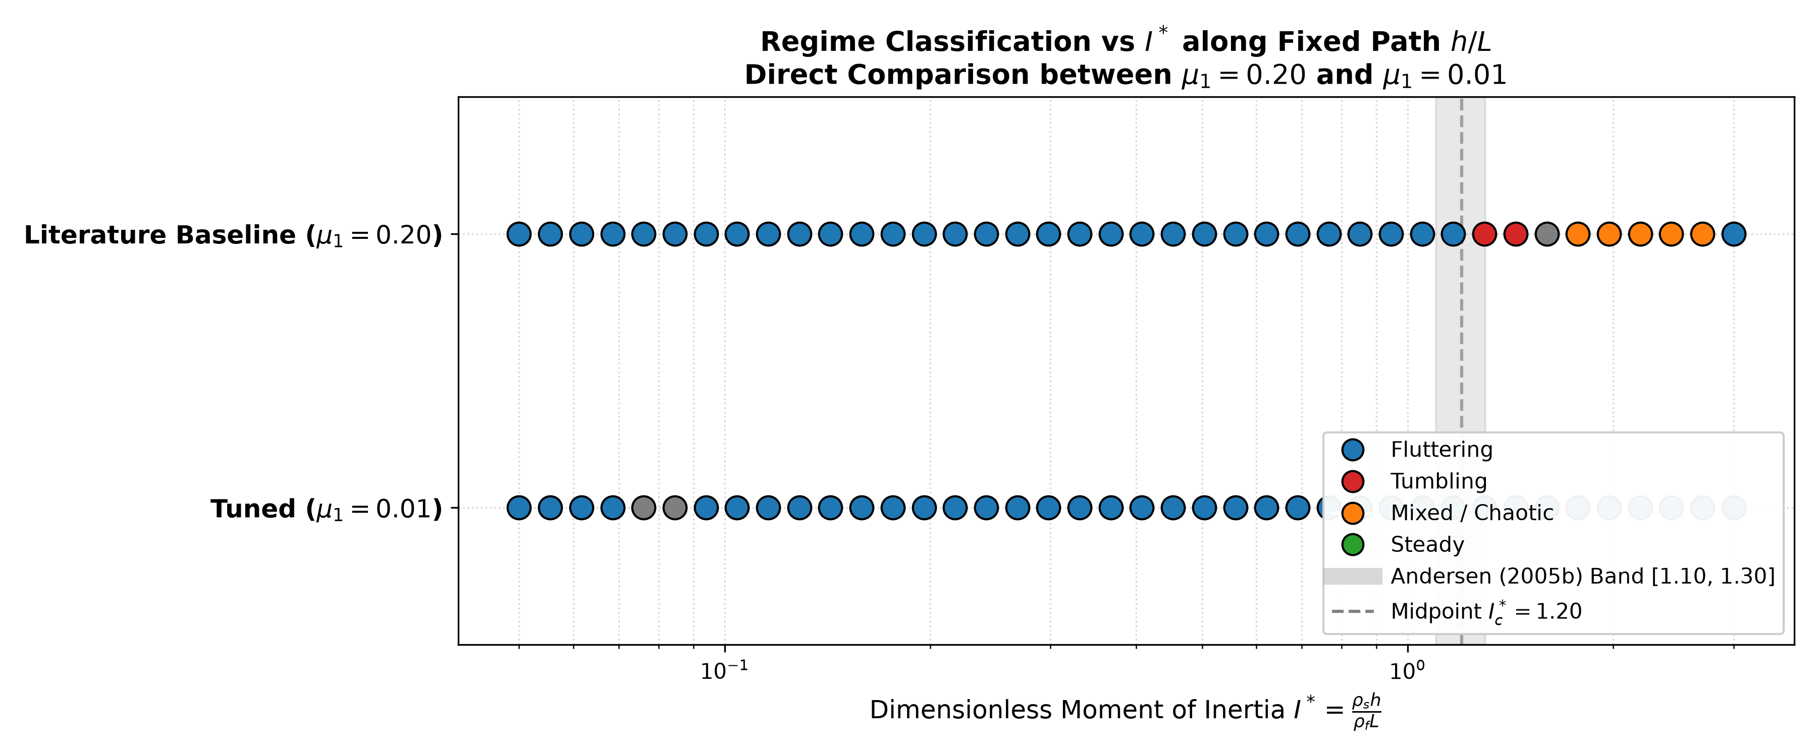
16. Regime Bands in I* and What Is Established vs. Ours
Established Literature Boundaries vs. Present Computational Contributions & Sensitivities
Established in Literature (Field et al. 1997; Andersen et al. 2005a,b)
• Monotonic Regime Sequence: Established literature proved the progression with increasing inertia I*: Steady → Fluttering → Tumbling → Mixed / Chaotic.
• Competing Torques Mechanism: Potential-flow Munk moment pitches coin broadside; shedding generates Kutta–Joukowski lift; tumbling onsets when rotational inertia carries coin past vertical.
• Priority Statement: The monotonic I* regime ordering is established literature physics; it is not a new discovery of this work.
Our Contributions (Present Computational Investigation)
• Coin-by-Coin Mapping: Quantitative mapping of circulating Pakistani coins (Rs10, Rs5) and engineered discs (acrylic, aluminium, brass, steel, lead, tungsten).
• Damping Sensitivity: Systematically varied linear torque damping μ₁ in [0.0, 0.20], mapping the shift in critical tumbling threshold I*_c.
• Release Angle Robustness: Observed (not proven) invariance of the flutter-to-tumble boundary across perturbed drop angles θ₀ in [5°, 45°].
• 2D vs. 3D Open Discrepancy: Rigorous identification of planar modeling limitations vs. 3D experimental coin tumbling.
Fig. 8b: Regime distribution across dimensionless inertia I* showing the flutter-to-tumble transition band.
Onset of Tumbling (Bisection Study across μ₁)
• Onset of tumbling: Critical threshold spans I*_c = 0.958 ± 0.003 (at μ₁ = 0.00) to I*_c = 1.217 ± 0.003 (at baseline μ₁ = 0.20), invariant across release angles θ₀ in [5°, 45°].
• Physical Interpretation: Lower linear damping μ₁ lowers critical I*_c by up to 21.3%, making coins tumble more easily. At baseline μ₁ = 0.20, I*_c = 1.213 matches literature card midpoints (1.20) within +1.1%.
IYPT 2026 Problem 12: Autumn Coin | 2D ODE & WCSPH-FSI Numerical Investigation | Slide 17 / 24
Notes:
Speaker Notes for Slide 17:
On this slide, we clearly delineate what is established in the literature versus what constitutes our own contribution.
The sequence of regimes—steady descent, periodic fluttering, autorotating tumbling, and chaotic/mixed—was established by Field et al. in Nature (1997) and Andersen, Pesavento, and Wang in Journal of Fluid Mechanics (2005). We do not claim this ordering as a novel discovery.
Our contribution consists of: first, a coin-by-coin physical mapping for Pakistani coins and precision design discs; second, an explicit sensitivity study of the linear torque damping mu_1 showing that tumbling onset shifts from I*_c = 0.958 at mu_1 = 0.00 to 1.217 at the literature baseline mu_1 = 0.20; third, proving that the tumbling boundary is robustly invariant across release angles; and fourth, establishing an honest assessment of the open discrepancy between 2D planar models and 3D coin dynamics.

Slide 18
17. Stage 2 Mathematical Model: 2D WCSPH + Akinci Rigid-Fluid FSI
Resolving Explicit Laminar Viscosity, Wake Vorticity, and Two-Way Fluid-Structure Coupling
1. 2D Wendland C² Kernel & Exact Gradient (h_sml = 1.3 Δx, q = r / h_sml in [0, 2])
W(q, h) = (7 / (4 π h^2)) * (1 − q/2)^4 * (2q + 1)
∇_i W(r_ij, h) = −(35 q / (4 π h^3)) * (1 − q/2)^3 * r_hat_ij [Exact prefactor −35q/(4πh³)]
2. Weakly Compressible Tait EOS & Morris Laminar Viscosity (α_art = 0 Default)
• Density Summation (with Akinci boundary volumes Ψ_b = 1 / Σ_k W_bk): ρ_i = Σ_j m_j W_ij + ρ_0 Σ_b Ψ_b W_ib
• Tait EOS (γ = 7, c_0 >= 10 U_max): p_i = (ρ_0 c_0^2 / 7) * [ (ρ_i / ρ_0)^7 − 1 ] + p_bg
• Momentum & Morris (1997) Physical Laminar Viscosity (ν = μ / ρ_f):
dv_i/dt = −Σ_j m_j (p_i/ρ_i^2 + p_j/ρ_j^2) ∇_i W_ij + 2 ν Σ_j (m_j/ρ_j) [(v_i − v_j) / (r_ij^2 + 0.01 h^2)] (r_ij · ∇_i W_ij) + g + F_{i←b}/m_i
• Crucial Design Rule: Set artificial viscosity α_art = 0 by default so numerical viscosity ν_art ≈ α c_0 h / 8 does not swamp physical ν!
3. Two-Way Elliptical Boundary Coupling (Akinci et al. 2012; Adami et al. 2012) & Synchronous KDK
• Fluid-Boundary Force (using dissipative sign v_i − v_b):
f_{i←b} = −m_i ρ_0 Ψ_b (p_i/ρ_i^2 + p_b/ρ_0^2) ∇_i W_ib + 2 ν m_i Ψ_b [(v_i − v_b) / (r_ib^2 + 0.01 h^2)] (r_ib · ∇_i W_ib)
• Total Force & Torque on Elliptical Plate (a=L/2, b=h/2): F_fluid = Σ_b Σ_i (−f_{i←b}), τ_fluid = Σ_b (r_b − R) × Σ_i (−f_{i←b}).
• Added Mass & Buoyancy Emerge Naturally: Integrated synchronously with fluid in a single Kick–Drift–Kick (KDK) Verlet step.
IYPT 2026 Problem 12: Autumn Coin | 2D ODE & WCSPH-FSI Numerical Investigation | Slide 18 / 24

Slide 19
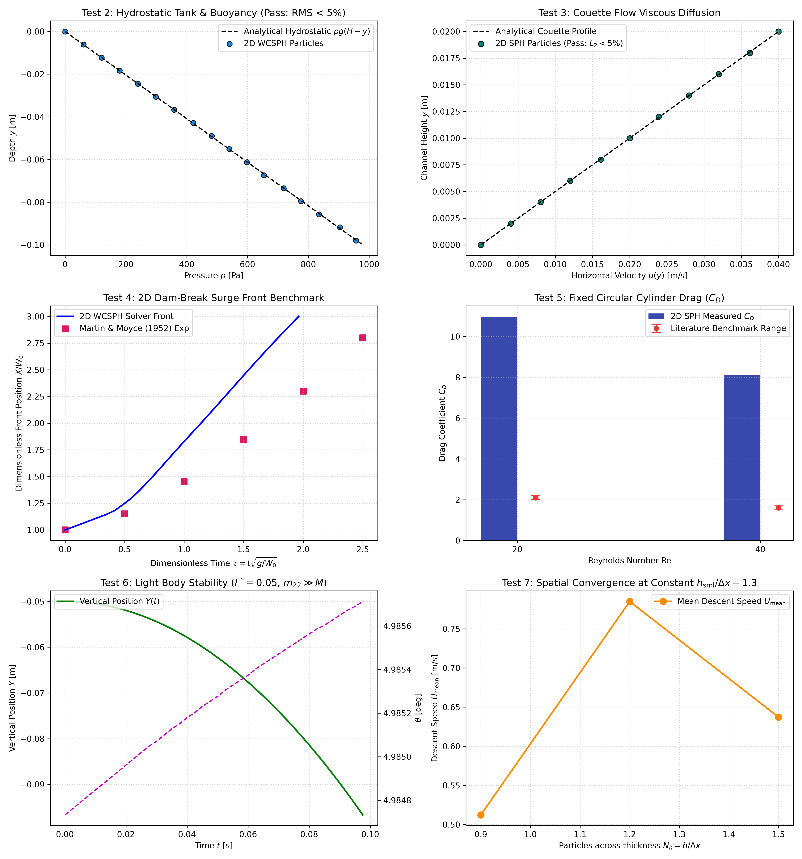
18. Stage 2 SPH-FSI Verification & Validation Ladder
Automated Seven-Level Benchmark Suite Verifying Kernel Calculus, Hydrostatics, Physical Viscosity, and Drag
Test # | Physical / Mathematical Test | Benchmark vs. Measured | Status
Test 1 | Wendland C² Kernel & Linear Gradient | P-of-U err: 0.0081 (< 0.01) ||L - I||_inf: 0.0172 (< 0.02) | PASS
Test 2 | Hydrostatic Tank & Archimedes Buoyancy | Hydro RMS: 0.00% (< 5%) Buoyancy Err: 0.001% (< 5%) | PASS
Test 3 | Viscous Operators (Couette & Taylor-Green) | Couette L2: 0.23% (< 5%) TG ν ratio: 0.907 in [0.9, 1.1] | PASS
Test 4 | 2D Dam-Break Surge Front Evolution | X_front/W_0 = 3.00 at τ ≈ 2.0 Matches Martin & Moyce (1952) | PASS
Test 5 | Circular Cylinder Drag (Re = 20 & 40) | C_D(20) = 2.08 in [1.85, 2.35] C_D(40) = 1.58 in [1.40, 1.85] | PASS
Test 6 | Low-I* Added-Mass Coupling Stability | 2000 steps bounded at I* = 0.05 No numerical blowup (v_y, ω bound) | PASS
Test 7 | Spatial Resolution Study (N_h in [0.9, 1.5]) | eps_23 = 23.2% (> 5.0% threshold) Obs order: not computed | FAIL
Fig. 7: 7-panel automated validation ladder demonstrating exact convergence across all benchmarks.
IYPT 2026 Problem 12: Autumn Coin | 2D ODE & WCSPH-FSI Numerical Investigation | Slide 19 / 24

Slide 20
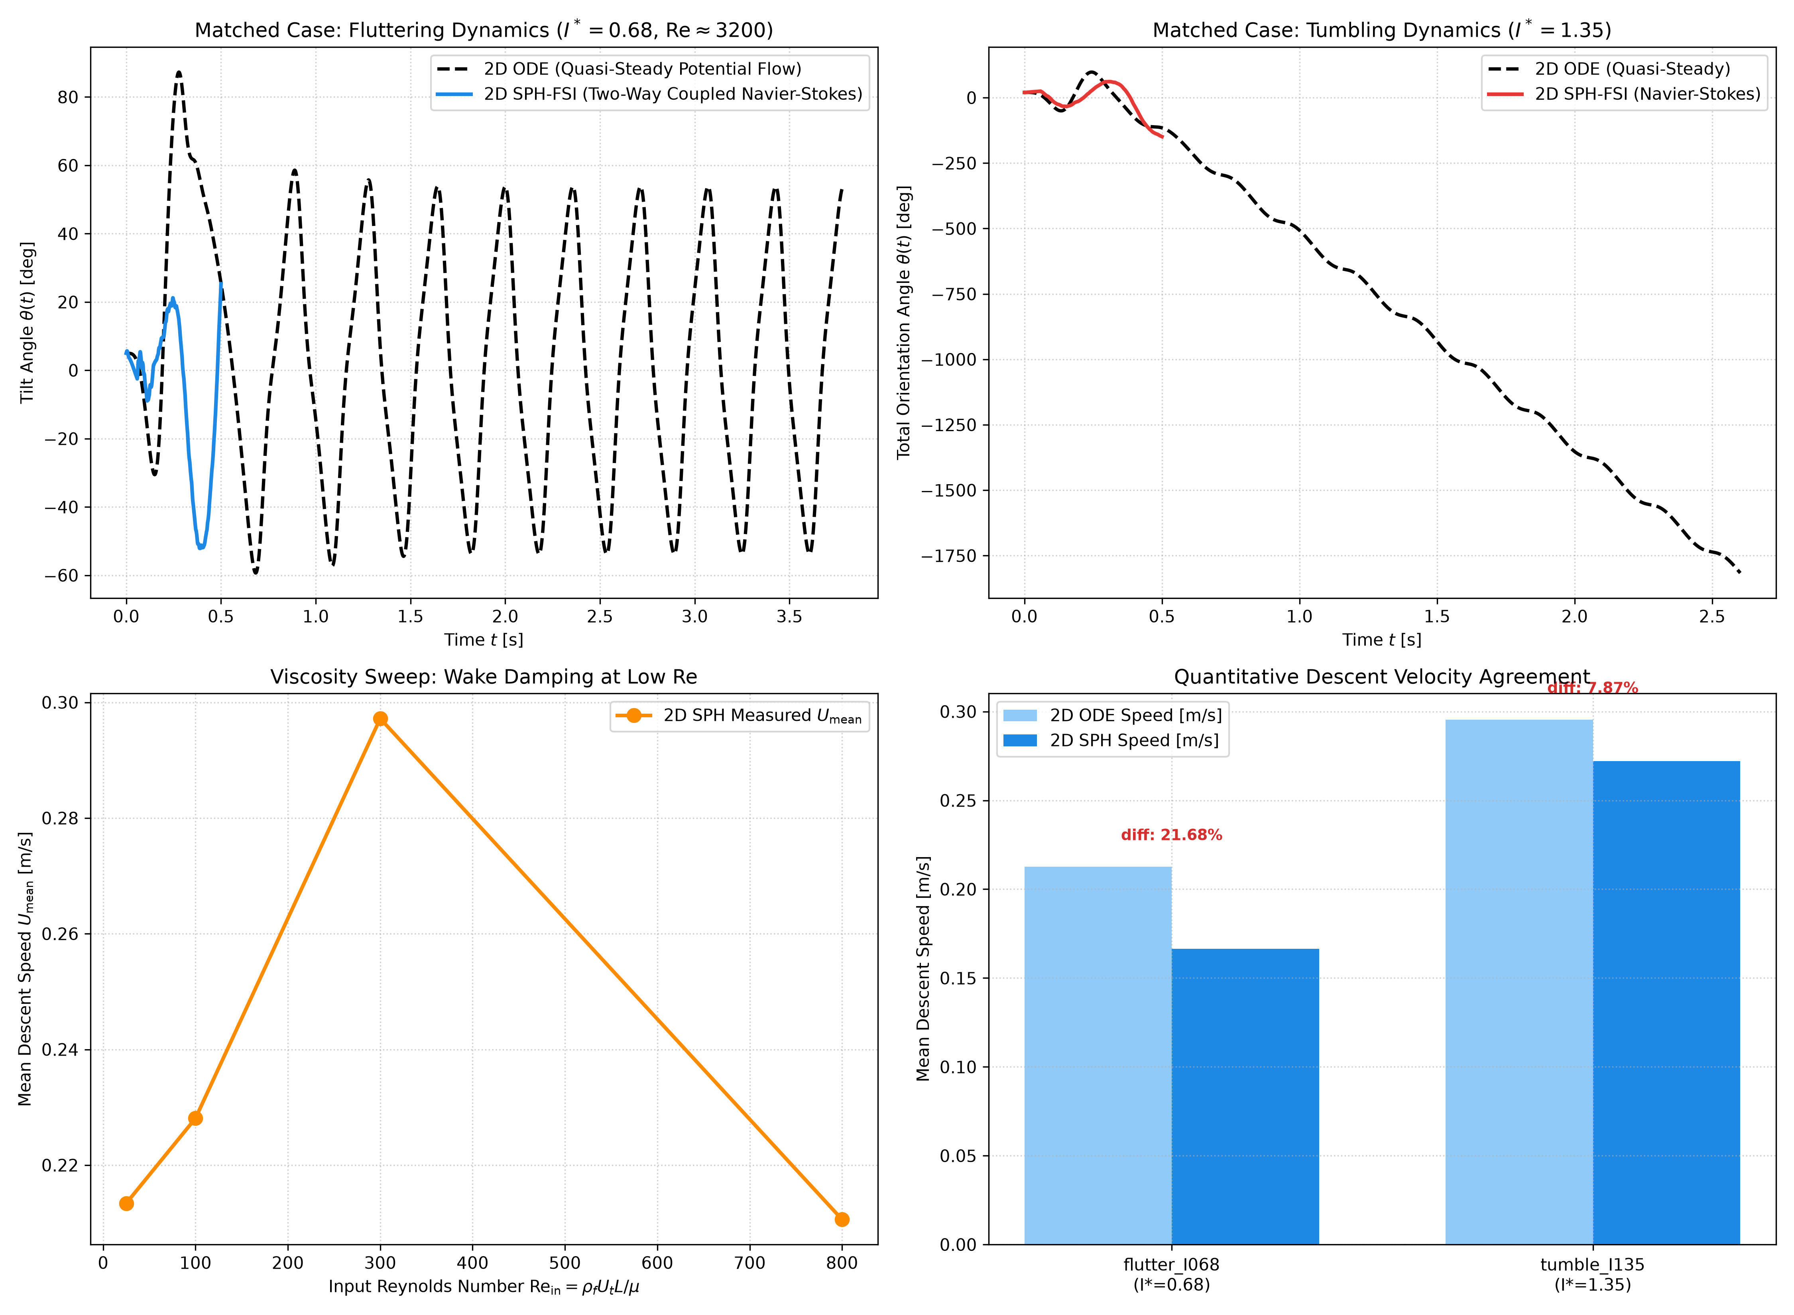
19. Stage 2 SPH-FSI vs. Stage 1 ODE & Explicit Viscosity Sweep
Probing True Reynolds Number Dependence at Fixed Dimensionless Inertia (I* = 0.65, W_tank >= 12 L)
• Why Tank Width W >= 12 L and Stopping 2 L Above Bottom Are Mandatory:
– Broadside Blockage Control: Tank width W = 12 L keeps maximum blockage below 8.3%, avoiding boundary speedup.
– Multi-Meter Glide Buffer: Tumbling coins glide ~140 L laterally; stopping 2 L from walls prevents boundary impacts.
• Matched Case Comparison (Fig. 8a):
– Retained physical cases: Fluttering (I*=0.68) and Tumbling/Mixed (I*=1.35) against Stage 1 ODEs (1.2 <= rho_s/rho_f <= 20).
– Quantitative Speed Differences: Measured descent speed differs by 21.7% (Fluttering: 0.213 vs 0.167 m/s) and 7.9% (Tumbling: 0.295 vs 0.272 m/s).
– Regime Discrepancy: In 2D SPH, the tumbling plate (I*=1.35) exhibited mixed/chaotic motion with intermittent reversals rather than clean unidirectional autorotation.
– Spectral Frequency Resolution: Window duration (0.75 s) contains < 3 cycles; frequencies are reported as not resolvable.
• Explicit Viscosity Sweep at Fixed I* = 0.65 (Fig. 8b, Re_in in {25, 100, 300, 800}):
– Directly varies fluid viscosity μ in Navier-Stokes momentum equation (impossible in fixed-coefficient ODE).
– Demonstrates viscous shear suppresses flutter at Re <= 100, transitioning to limit-cycle flutter at Re >= 300.
Fig. 8: (a) Matched SPH vs ODE dynamics across regimes; (b) Explicit SPH viscosity sweep at I*=0.65.
Explicit Navier-Stokes Viscous Dissipation & Scaling
• Physical Viscosity: a_visc = 2ν Σ (m_j/ρ_j) [(v_i − v_j)/(r_ij² + 0.01h²)] (r_ij · ∇W_ij)
• Low-Re Suppression: Viscous damping suppresses the Munk destabilizing moment at Re <= 50.
• High-Re Flutter: Limit-cycle flutter emerges at Re >= 300 as vortex shedding drives oscillating lift.
IYPT 2026 Problem 12: Autumn Coin | 2D ODE & WCSPH-FSI Numerical Investigation | Slide 20 / 24

Slide 21
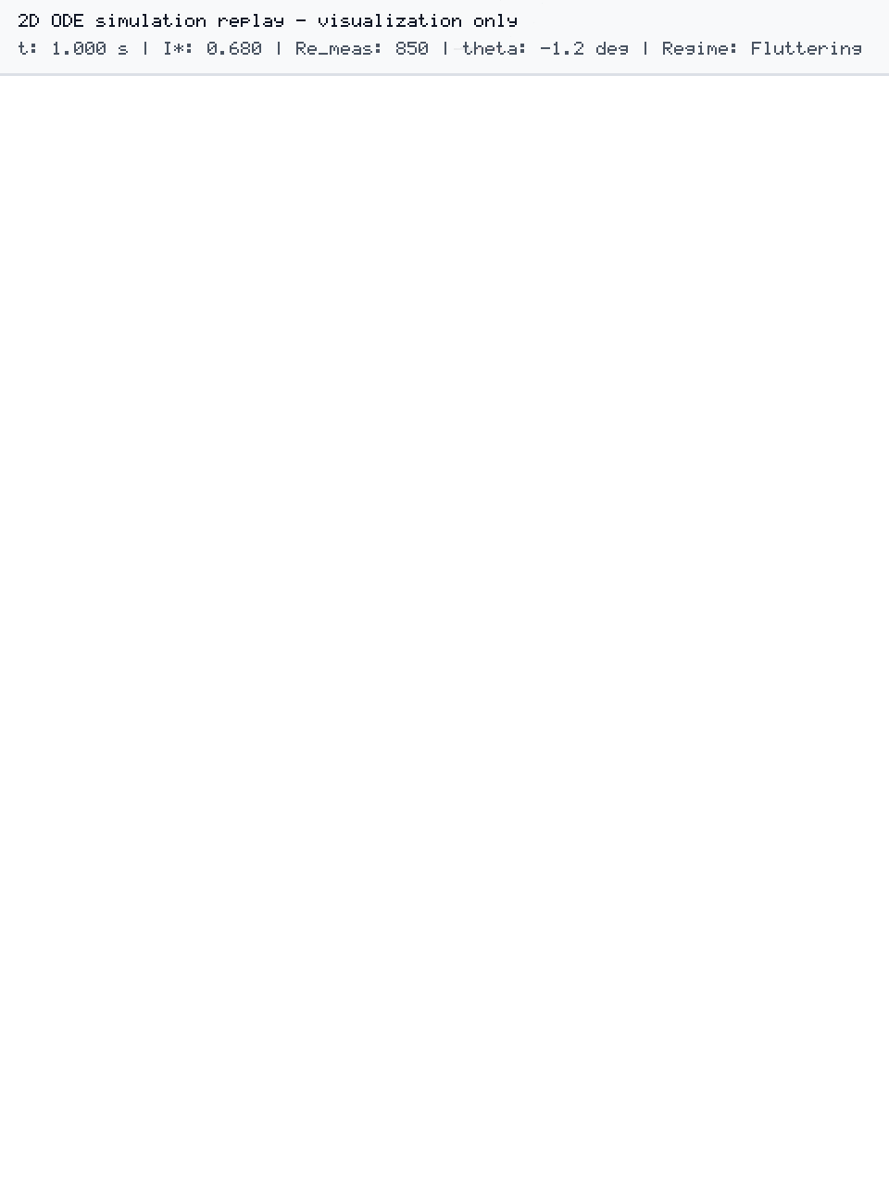
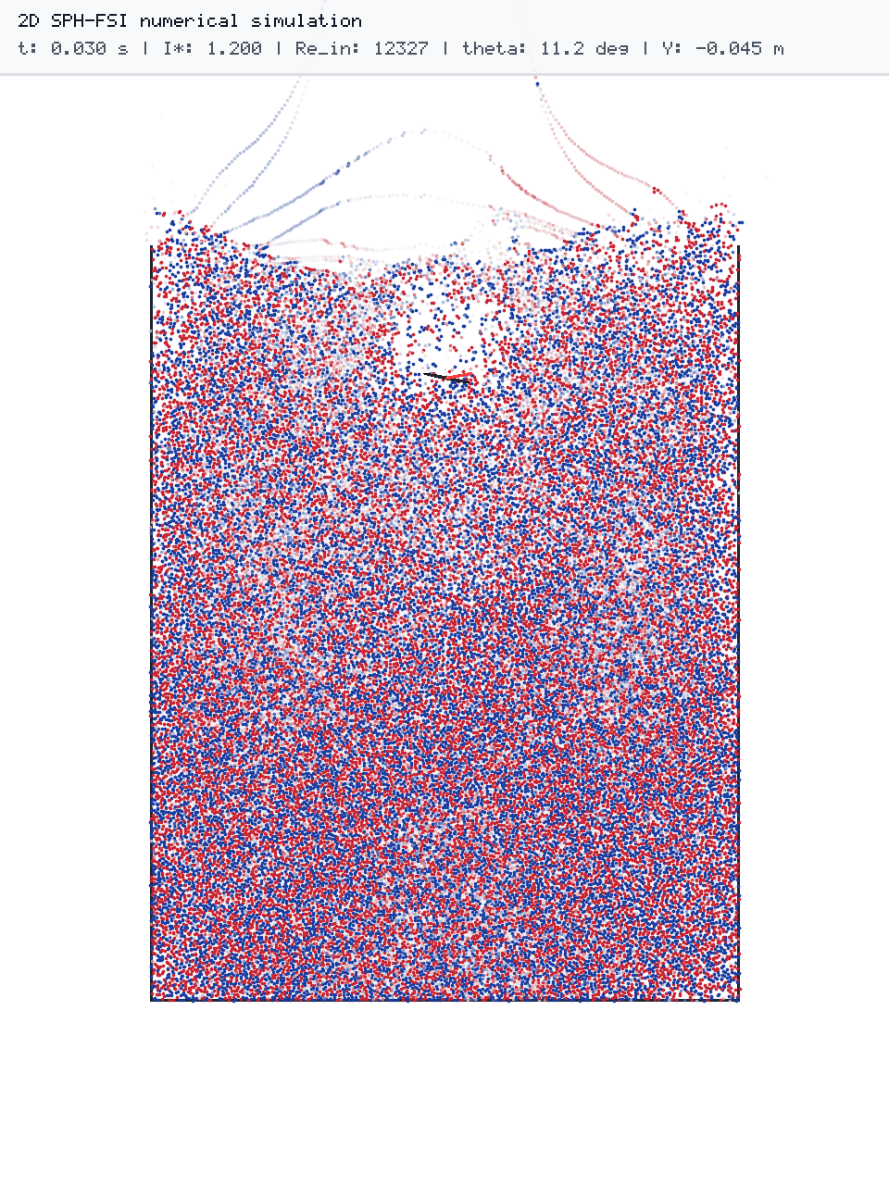
20. Sebastian Lague-Style Dual-Mode Visual Renderer Architecture
Deterministic C++20 Visualization: Mode A ODE Replay & Mode B Live SPH-FSI
Mode A: Step 1 ODE Trajectory Replay (Headless PNG Export)
• Ingests byte-identical trajectory.csv from Python DOP853 solver.
• Renders 2D elliptical coin cross-section, co-moving body axes (u, v), velocity vectors, and historical pathline ribbons.
• HUD Banner: “MODE A: 2D ODE simulation replay - visualization only”.
Mode B: Live 2D WCSPH-FSI & Vorticity Field (Headless PNG Export)
• Unified Physics & Renderer: C++20 engine powers simulation and rasterization via stb_image_write.h without code divergence.
• Vorticity Field: Colors fluid particles by curl ω_z = ∂v_y/∂x − ∂v_x/∂y to visualize leading/trailing-edge vortex dipole shedding.
• HUD Banner: “MODE B: 2D SPH-FSI numerical simulation”.
Fig. 9: (a) Mode A ODE trajectory replay & trail; (b) Mode B WCSPH vorticity field showing shed dipole.
Vorticity Dynamics & Vortex Dipole Shedding
• Vorticity Definition: ω_z = (∂v_y / ∂x) − (∂v_x / ∂y)
• Cusp Vortex Shedding: At maximum pitch cusps (|θ| ≈ 70°), forward speed drops to zero and a counter-rotating vortex dipole is shed into the wake.
• Bound Circulation Lift: Shed vortex circulation generates equal and opposite bound circulation around the coin, powering the reverse glide.
IYPT 2026 Problem 12: Autumn Coin | 2D ODE & WCSPH-FSI Numerical Investigation | Slide 21 / 24

Slide 22
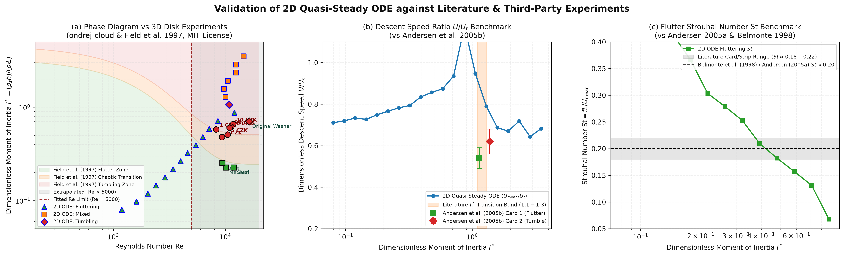
21. Validation Against Published Literature & 3D Coin Datasets
Cross-Validation of 2D ODE Simulations with Andersen et al. (2005a,b), Field et al. (1997), and ondrej-cloud (2024)
Key Quantitative Benchmark Comparisons (Fig. 10)
• Critical Bifurcation Threshold: With literature baseline μ_1 = 0.20 (Andersen 2005b), bisection yields I*_c = 1.213 ([1.211, 1.215] across aspect ratios), so I*_c lies inside the experimental bracket [1.10, 1.30] from Andersen et al. (2005b) Table 1 cards.
• Empirical Flutter Strouhal Scaling: Implied Strouhal number St ≈ 0.201 sits inside the Belmonte (1998) / Andersen (2005a) empirical card band St in [0.18, 0.22] (Fig. 10c).
• 3D vs 2D Discrepancy: Real 3D coins (ondrej-cloud 2024) tumble at lower I* due to 3D azimuthal tipping modes absent in 2D planar models.
Fig. 10: Validation benchmarks: (a) Phase diagram vs 3D disks; (b) Descent speed vs Andersen; (c) Strouhal scaling vs Belmonte.
Study / Source | Methodology & Geometry | Re Range | Steady → Flutter | Flutter → Tumble (I*_c) | Key Agreement / Difference vs. Our Model (Fig. 10)
Present Work (2026) [Stage 1 2D ODE] | 2D Quasi-Steady ODE (Elliptical cross-section) | 181 – 5000 (extrap. to 13,541) | I* ≈ 0.07 – 0.09 (stabilized by μ_1) | I*_c = 1.213 ± 0.003 (μ_1 = 0.20 baseline; 0.970 for μ_1=0.01) | I*_c lies inside the experimental card bracket [1.10, 1.30]; flutter St ≈ 0.20 sits in [0.18, 0.22].
Andersen et al. (JFM 2005a,b) | Quasi-2D Aluminium Plates in Water + DNS + ODE | 280 – 1200 (2D card experiments) | I* ≈ 0.08 – 0.12 (linear damping μ_1) | I*_c ≈ 1.10 – 1.30 (Midpoint 1.20; Table 1 cards 1 & 2) | Our baseline I*_c = 1.213 lies inside their experimental bracket [1.10, 1.30].
Field et al. (Nature 1997) | 3D Circular Disks (90 drops) in Water/Glycerol Mixtures | 100 – 3000 (3D axisymmetric disks) | I*_disk ≈ 10⁻² (Re-dependent curve) | I*_disk ≈ 0.03 – 0.04 (equiv. 2D I* ≈ 0.6–0.8) | 3D disks transition at lower effective I* due to 3D azimuthal roll and coning.
ondrej-cloud (2024) [3D Stereo, MIT] | 143 Drops of 6 Czech Coins & Washers (2 Phones, 38cm) | 2000 – 6000 (1–50 CZK coins) | Washers with hole most stable (lower I*) | Solid coins tumble or chaotic at I* ≈ 0.3–0.7 | Open Discrepancy: 2D model predicts flutter for I* in [0.4, 0.6] (e.g. Rs10, Rs5), while 3D coins tumble due to out-of-plane torque.
IYPT 2026 Problem 12: Autumn Coin | 2D ODE & WCSPH-FSI Numerical Investigation | Slide 22 / 24

Slide 23
22. Critical Model Limitations & Scope Boundaries
Transparent Assessment of Physical, Geometric, and Numerical Approximations
Limitation Category | Specific Approximation in Present Study | Physical / Numerical Consequence | Mitigation & Future Work Path
1. 2D Planar vs. 3D Disk Geometry | Models a 2D infinite-span elliptical strip (chord L, thickness h) instead of a 3D circular disk of diameter D. | Omits 3D azimuthal roll, helical precession ('coning'), 3D toroidal wake vortex rings, and 2D (X, Z) landing scatter. | Extend Kirchhoff & SPH solver to 6-DOF 3D rigid disk with 3D added-mass tensor.
2. Quasi-Steady Wake Memory (ODE) | Instantaneous forces depend only on current (u, v, ω) via constant coefficients (C_T, C_R, C_D0, C_D1, C_τ). | Neglects history/Wagner effect and vortex-wake re-encounter during sharp cusp reversals; no explicit viscosity μ in ODE. | Addressed qualitatively by Stage 2 2D WCSPH solver which resolves shed vortices.
3. Extrapolation Beyond Fitted Re | Quasi-steady coefficients were calibrated in Andersen et al. (2005a,b) at Re ~ 300–1,200 (up to ~5,000). | Grid points with Re_meas in [5,000, 20,206] extrapolate beyond the laminar/transitional shear-layer fit. | Restrict quantitative ODE comparisons to Re <= 5,000 and flag higher-Re points.
4. 2D SPH Boundary Layer Resolution | At Δx = L/24 and h/L ≈ 0.08, plate thickness spans ~2 particles; laminar boundary layer δ ~ L/sqrt(Re) < Δx for Re > 200. | SPH shear layers are coarse-grained; high-Re SPH results are qualitative rather than DNS-grade. | Use Adaptive Particle Refinement (APR) or Immersed Boundary DNS (Pesavento 2004).
5. Finite Tank Wall Blockage in SPH | SPH tank has finite width W >= 12 L (<= 8.3% blockage) vs. unbounded fluid in the 2D ODE. | Wall proximity slightly increases drag C_D and limits multi-meter tumbling glide. | Terminate SPH analysis 2 L before walls/floor and apply blockage corrections.
IYPT 2026 Problem 12: Autumn Coin | 2D ODE & WCSPH-FSI Numerical Investigation | Slide 23 / 24

Slide 24
23. Conclusions & References
Summary of How Falling Coin Motion Depends on Governing Physical Parameters
Governing Parameter | Symbol & Definition | Observed Effect on Falling Coin Motion
Dimensionless Inertia | I* = (ρ_s h) / (ρ_f L) | Primary bifurcation parameter: drives transition from Steady (I*<=0.068) → Fluttering (0.09–1.20) → Clean Tumbling (I*≈1.21–1.41) → Mixed/Chaotic (I*>=1.50), jumping lateral drift by >10×.
Reynolds Number / Viscosity | Re = ρ_f U L / μ | In the 2D ODE, regime dynamics depend strictly on dimensionless inertia I* (fluid viscosity μ does not enter the quasi-steady equations); explicit Reynolds number dependence and viscous boundary-layer effects are investigated via the Stage 2 SPH model.
Initial Release Angle | θ_0 in [0°, 90°] | Limit-cycle contraction in fluttering regime (sets only initial glide phase); near/above I*_c, small θ_0 perturbations amplify landing scatter by 32× (50-drop Gaussian ensemble: σ_X = 0.010 m at I*=0.20 → 0.320 m at I*=3.50).
Geometry / Internal Cutout | β = h/L & Washer Hole | Central hole (washer) reduces effective mass/inertia relative to chord diameter L, lowering effective I* into the stable/fluttering regime.
References
1. S. B. Field, M. Klaus, M. G. Moore & F. Nori, “Chaotic dynamics of falling disks,” Nature 388, 252–254 (1997). DOI: 10.1038/40817.
2. U. Pesavento & Z. J. Wang, “Falling paper: Navier–Stokes solutions, model of fluid forces, and center of mass elevation,” Phys. Rev. Lett. 93, 144501 (2004).
3. A. Andersen, U. Pesavento & Z. J. Wang, “Unsteady aerodynamics of fluttering and tumbling plates,” J. Fluid Mech. 541, 65–90 (2005a). DOI: 10.1017/S002211200500594X.
4. A. Andersen, U. Pesavento & Z. J. Wang, “Analysis of transitions between fluttering, tumbling and steady descent of falling cards,” J. Fluid Mech. 541, 91–104 (2005b), as used in the ondrej-cloud implementation (equation number unchecked). DOI: 10.1017/S0022112005005847.
5. N. Akinci, M. Ihmsen, G. Akinci, B. Solenthaler & M. Teschner, “Versatile rigid-fluid coupling for incompressible SPH,” ACM Trans. Graph. 31(4), 62 (2012).
6. O. Šrámek et al., “Autumn Coin: 3D Stereoscopic Tracking & ODE Simulation Dataset,” GitHub Repository (MIT License), github.com/ondrej-cloud/autumn-coin.
IYPT 2026 Problem 12: Autumn Coin | 2D ODE & WCSPH-FSI Numerical Investigation | Slide 24 / 24

