Slide 1
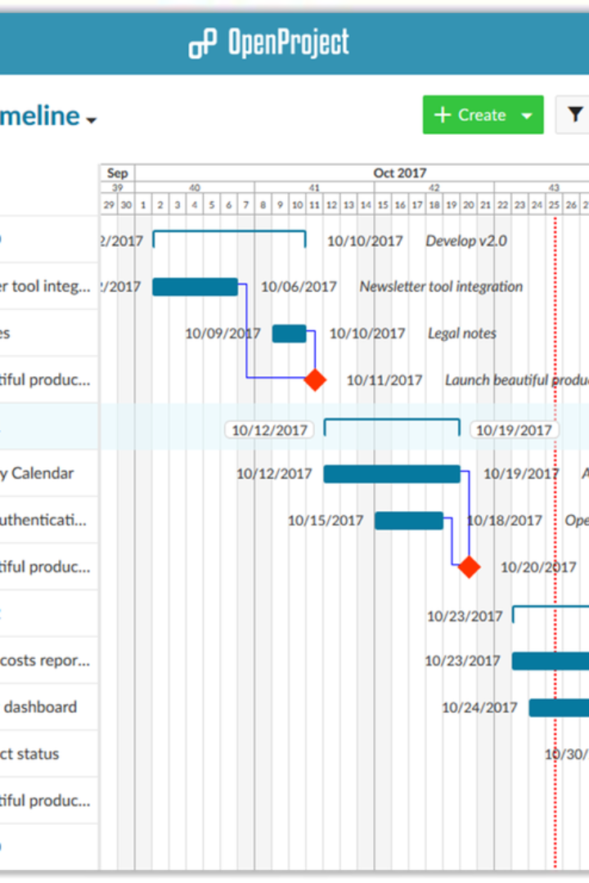
Project Planning
CRM System Implementation
by aya chkioua

Slide 2

Project Context
1
Business Landscape
Our company, is a rapidly growing tech firm seeking to enhance
customer relations through a CRM System Implementation Competitive market
dynamics necessitate a robust and efficient CRM system.

Slide 3

Project Objectives
Project Goals
Implement a cutting-edge CRM system within a six-month timeframe.
Improve customer interactions and streamline data management for a 30% increase in operational efficiency.

Slide 4
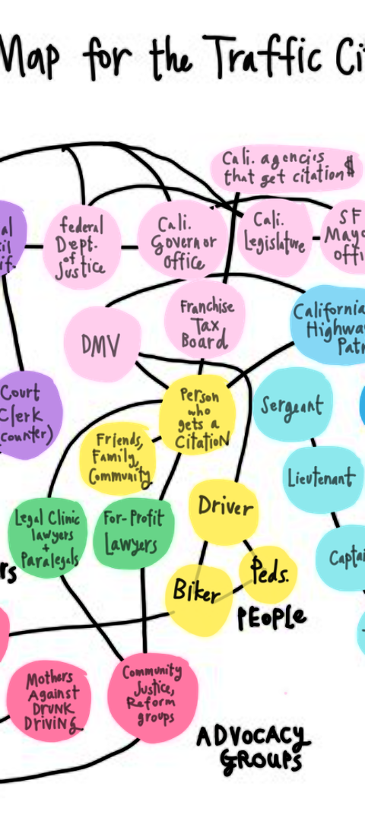
Stakeholder Landscape
Key Stakeholders
Identify and briefly describe the main stakeholders.
Sales and Marketing Teams: Key users of the CRM system.
Customer Support: Directly impacted by the system's functionality
IT Department: Responsible for implementation and maintenance
.Customers: End-users impacted by system changes
.Executive Leadership: Overseeing project alignment with strategic goals.

Slide 5
Planning Methodologies
Agile
Waterfall
Hybrid Approach
For iterative development and flexibility in responding to changing requirements.
Applied in structured phases like software customization.
For efficient collaboration among development teams.

Slide 6
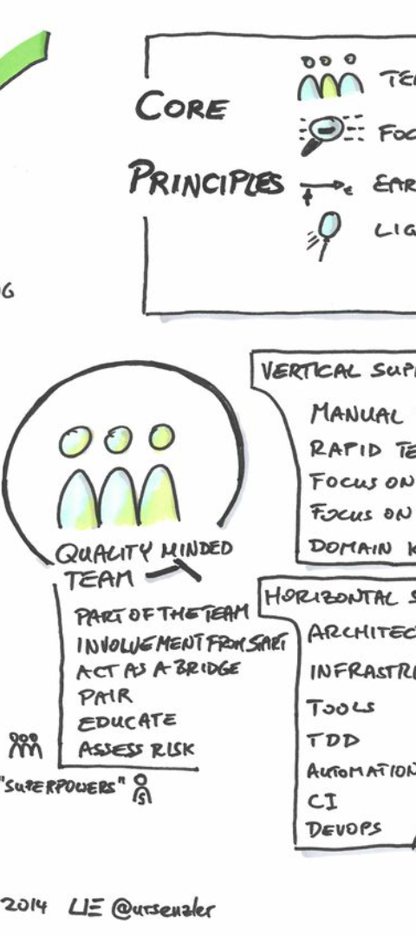
Agile Methodology
1
Iterative Development
Implementation in sprints with regular feedback loops.
Quick adaptability to evolving customer needs.

Slide 7
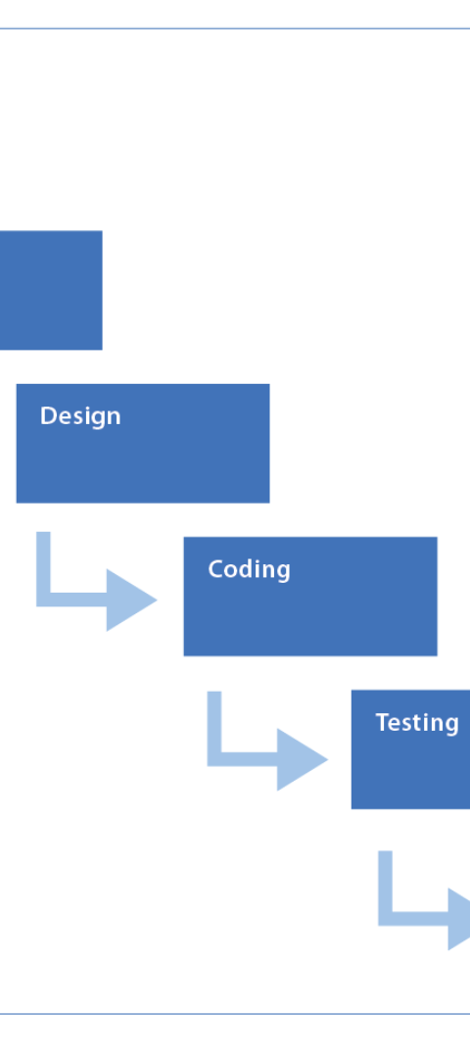
Waterfall Methodology
1
Structured Phases
Sequential approach to system customization.
Clearly defined stages for efficient progress.

Slide 8
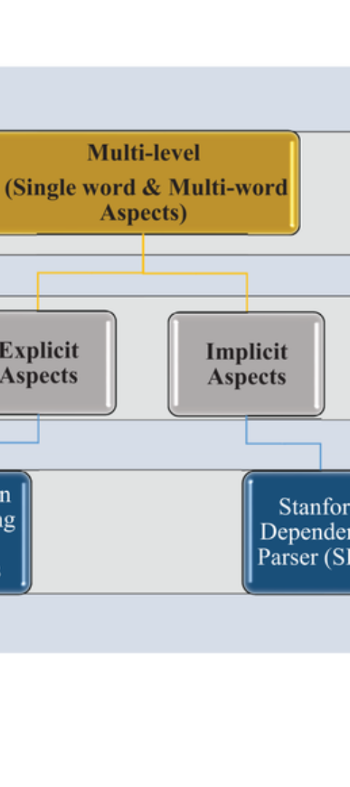
Hybrid Approach
1
Balanced Strategy
Utilizing a hybrid approach to combine the strengths of Agile and Waterfall.
Adapting methodologies to project phases for optimal results.

Slide 9
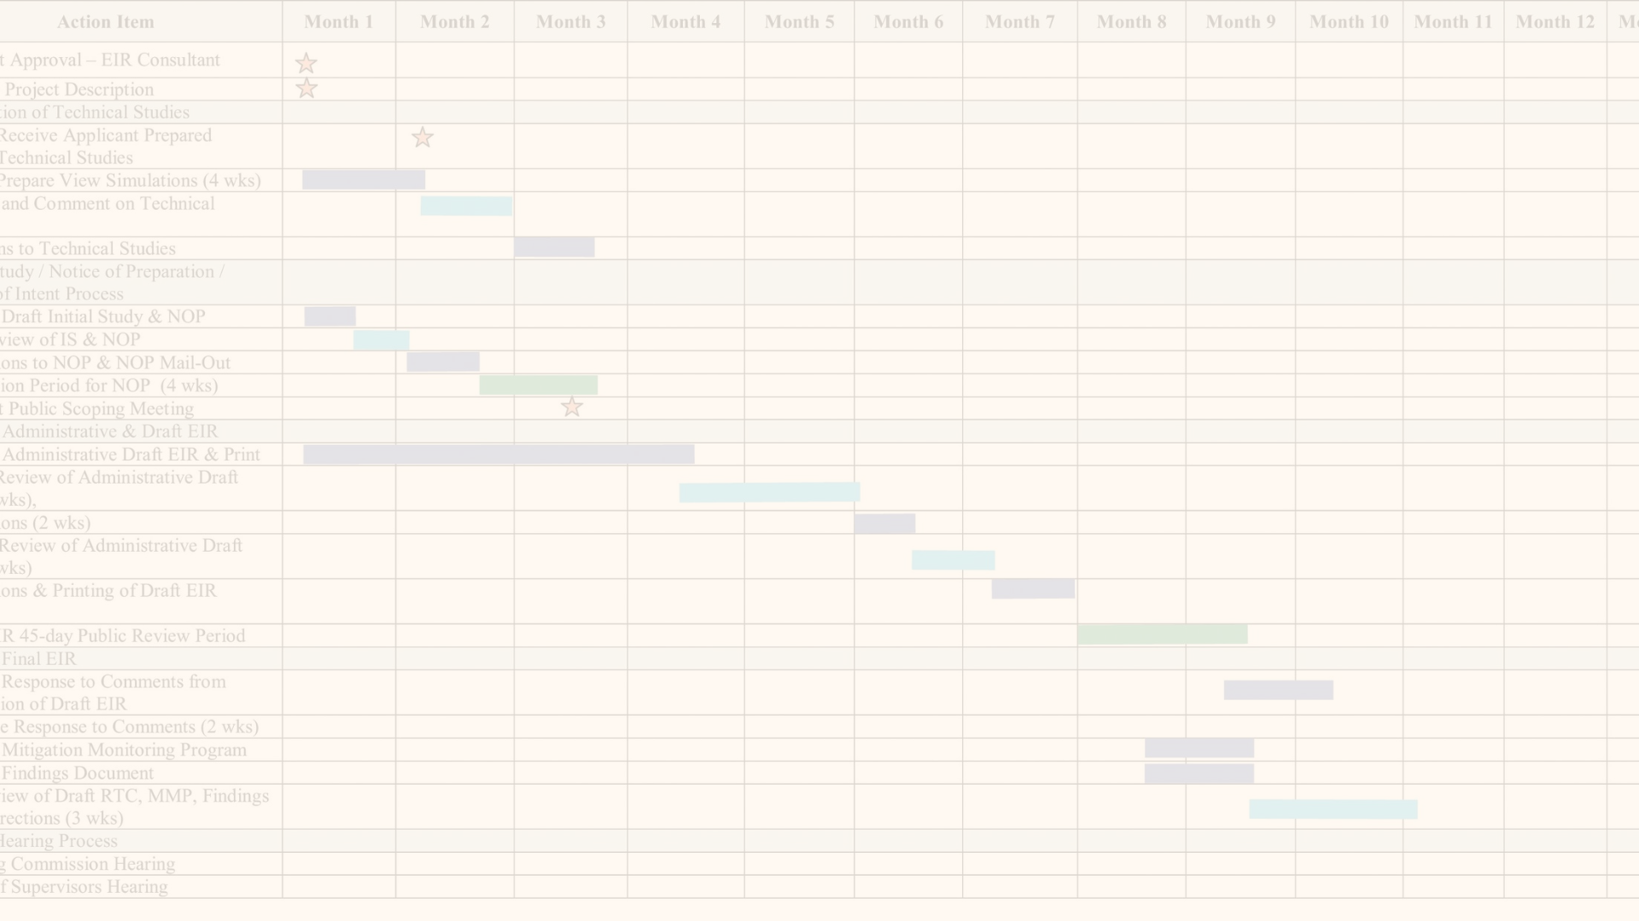
Gantt Charts and Timelines
Project Timeline
Display a Gantt chart with key milestones.
Milestones include software acquisition, customization, employee training, and system deployment.

Slide 10
Resource Allocation
Identified roles and responsibilities for each team member.
Allocated budget and resources for software acquisition, customization, and training.
Ensured ongoing support for post-implementation.

