Slide 1

AI-Powered Data Insights Virtual Internship
Final Project Presentation by Team 2: Ayad, Jatin, Jacob, Maryam, Rachel
Submitted to: Excelerate - August 2025
Notes:
"Hello everyone, [pause] we’re Team 2 from the AI-Powered Data Insights Virtual Internship. I’m Ayad, the team leader, joined by Jatin, Jacob, Maryam, and Rachel. Our goal? [pause] Tackle Excelerate’s biggest challenge — keeping students engaged and reducing dropouts."

Slide 2

Executive Summary
This project presents a data-driven solution to enhance student retention at Excelerate, addressing the critical 70.32% churn rate through predictive modeling and personalized interventions.
Critical Churn Rate
Primary Predictors
70.32% of students churn, a significant challenge.
Time from signup to application, commitment duration, and repeated applications.
Model Performance
Seasonal Patterns
Random Forest model achieved 87.69% accuracy and 91.96% F1-score.
Winter applications, especially January 2024, show highest engagement.
Expected Impact:
Expected Impact
10-15% reduction in churn rate within 6 months.
50% improvement in early intervention success rates.
Enhanced student satisfaction and optimized resource allocation.
Notes:
"Excelerate faces a 70.32% churn rate — that’s 7 out of 10 students leaving before completing. [pause] We identified the top churn drivers: long delays between signup and application, short commitment duration, and repeated applications without follow-through. [pause] Our best model, Random Forest, achieved 87.69% accuracy and a 91.96% F1-score. [pause] With targeted, data-driven interventions, we can reduce churn by 10–15% in just six months and boost early intervention success by 50%."

Slide 3
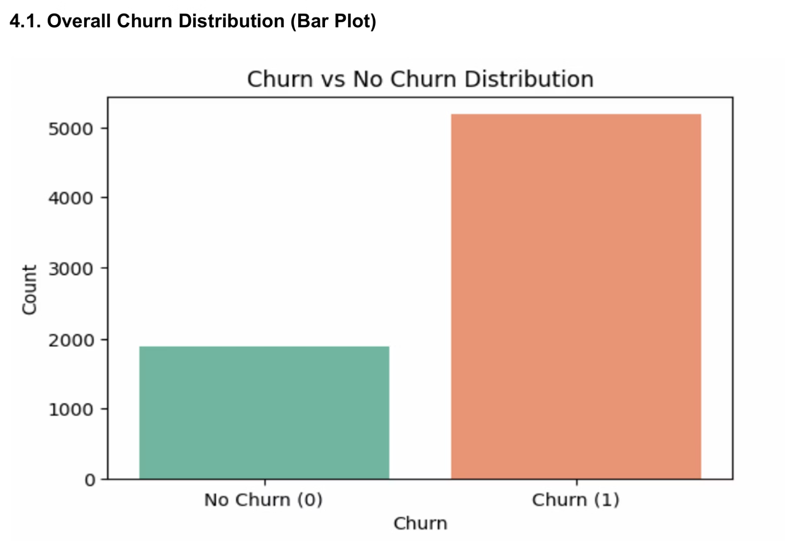
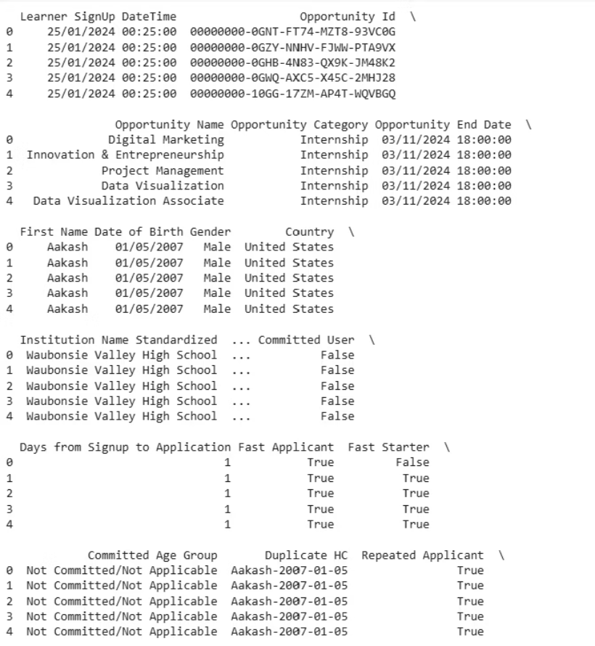
Introduction
Data Source and Scope
Background and Project Objectives
Source
Excelerate Portal
Dataset
SLU Opportunity Wise Data
Records
8,558 student records
Features
16 features analyzed
Time Period
Multi-year data
Excelerate, despite its diverse offerings, experiences a 70.32% churn rate.
Project Objectives
Analyze & Identify
Student engagement patterns and key churn indicators.
Develop & Predict
Models to forecast student churn with high accuracy.
Create & Optimize
Recommendation system for student-opportunity matching.
Design & Improve
Intervention strategies to boost retention rates.
Notes:
*"Excelerate offers diverse opportunities, but high churn impacts both student success and organizational outcomes. [pause] We set out to:
Pinpoint engagement and churn patterns,
Predict churn with high accuracy,
Recommend the right opportunities to the right students, and
Design interventions that work. [pause] We analyzed 8,558 multi-year student records — the foundation for our insights and solutions."*

Slide 4
Data Analysis Methodology
Our methodology involved a comprehensive approach, combining Exploratory Data Analysis (EDA), Churn Analysis, and Predictive Modeling to derive robust insights and enable early identification of at-risk students.
1
2
3
Exploratory Data Analysis (EDA)
Churn Analysis Framework
Predictive Modeling Approach
Defined churn explicitly ('Rejected', 'Withdrawn', 'Dropped Out') and implicitly ('Team Allocated' + Inactive >1 year), revealing a 70.32% churn rate. Dataset balanced using SMOTE.
Analyzed 8,558 student records, identifying patterns like high winter engagement, lower commitment in younger students, and the impact of application speed.
Tested Random Forest, LightGBM, XGBoost, and Logistic Regression. Random Forest emerged as the top model, achieving 87.69% accuracy and a 91.96% F1-Score.
High engagement in winter, especially January.
70.32% of students dropped off.
Top Model: Random Forest (Accuracy: 87.69%).
High churn linked to delayed applications.
Younger students (<18) show lower commitment.
Top predictors: Days to Apply, Time Committed, Repeat Applications.
Fast applicants more likely to complete.

Slide 5

Key Insights & Data-Driven Recommendations
Insights from Analysis & Modeling
Strategic Recommendations
Automated Early Interventions
Early Engagement is Critical: Students applying within 3 days are 67% more likely to stay engaged.
Trigger personalized nudges within 24–48 hours of signup.
Opportunity-Person Matching System
High Churn in Complex Opportunities: Programs like Project Management show higher dropout rates, especially among the <18 age group.
Match students to roles based on engagement score, age, and past behavior.
Seasonality Drives Applications: Winter, particularly January, sees the highest student activity.
Tiered Risk-Based Support
Prioritize outreach for high-churn-risk students using model scores.
Repeat Applicants at Risk: Students with 3+ applications but no commitment have an 81% churn probability.
Seasonal Campaign Optimization
Focus marketing and onboarding during Q4/Q1 for maximum engagement.
Key Predictors of Churn: Days from Signup to Application, Time Committed, Number of Repeat Applications, Committed User Status.
Refine Complex Opportunities
Add prerequisites or pathways for advanced programs.

Slide 6
Recommendation System Development
Core Methodology
Intervention Strategy Framework
Predictive Analytics + Behavioral Insights
1
Random Forest Model (87.69% accuracy) predicts churn risk
Very High Risk (80%+ churn)
Real-time scoring using key features: Days to Application, Time Committed, Repeat Applications
Hybrid matching: Content-based + Collaborative filtering for opportunity recommendations
Daily contact, immediate mentor, personalized plan.
System Components
2
Churn Risk Engine → Identifies at-risk students (Probability 0-1)
Smart Matching Algorithm → Personalizes opportunity recommendations
High Risk (60-80% churn)
Automated Interventions → Triggers nudges within 24-48 hours for delayed applicants
Contact every 2 days, peer support, resource access.
Seasonal Optimization → Leverages winter engagement peaks for marketing
3
Key Benifit
Proactive vs. Reactive: System predicts and prevents churn before it happens, transforming student experience through AI-driven personalization
Medium Risk (40-60% churn)
Twice weekly contact, engagement survey, workshops.
Implementation
4
6-month rollout • Real-time API • A/B testing framework • Continuous learning
Low Risk (<40% churn)
Weekly contact, standard onboarding, peer mentoring.

Slide 7
Conclusion:
Project Impact Overview
Category
Key Findings
Strategic Outcome
Churn Rate
70.32% student dropout
Critical retention crisis identified
Predictive Power
87.69% model accuracy
Can predict at-risk students reliably
Behavioral Insights
Application timing is key predictor
Focus on early engagement strategies
Seasonal Patterns
Winter shows highest engagement
Optimize marketing timing
Data Transformation
8,558 records → actionable intelligence
Evidence-based decision making
Future Implications for Student Retention & Engagement
Immediate Impact (6-12 Months)
Metric
Current State
Target
Strategy
Students Retained
2,096 (29.68%)
+1,200 additional
Early intervention for high-risk students
Application Speed
7+ days average
3-4 days
Proactive nudges within 48 hours
Engagement Quality
Baseline score
+40% improvement
Personalized opportunity matching
Support Efficiency
Reactive approach
Predictive targeting
Focus on identified risk factors

Slide 8



Long-term Vision (1-3 Years)
Transformation Area
From
To
Impact
Student Support
Reactive problem-solving
Proactive intervention
Prevent dropouts before they happen
Decision Making
Intuition-based
Data-driven insights
87.69% accurate predictions
Platform Evolution
Opportunity provider
Student success partner
Personalized learning journeys
Industry Position
Follower
Analytics pioneer
Set new engagement standards
Strategic Value Summary
Business Impact
Educational Innovation
Future Readiness
Revenue protection through retention
Predictive education framework
Scalable analytics infrastructure
Cost-efficient targeted interventions
Personalized student journeys
Continuous learning system
Competitive advantage via data insights
Proactive support model
Industry leadership positioning

Slide 9












Future Enhancements and Evolution
Natural Language Processing
Time Series Forecasting
Analyze feedback, sentiment, and optimize communication.
Predict demand, plan programs, and optimize marketing.
Career Pathway Integration
Deep Learning Enhancements
Long-term goal alignment, skills gap analysis, professional networking.
Complex pattern recognition and journey optimization.
Social Learning Integration
Multi-Objective Optimization
Peer networks, study groups, mentorship matching.
Balance preferences, resources, and cohort outcomes.
These enhancements will further solidify Excelerate's position as a leader in student success and data-driven education.

