Slide 1
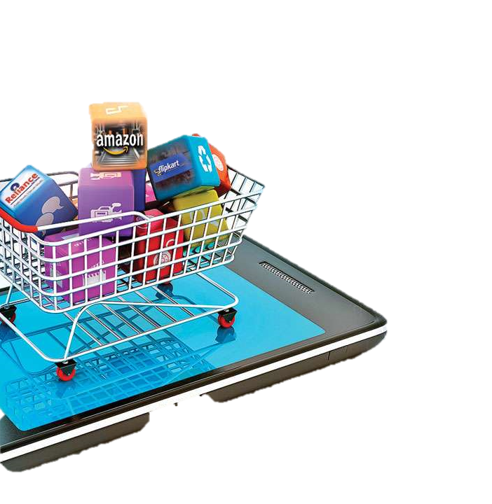
E-COMMERCE CUSTOMER BEHAVIOR
Team 2
ITI 3 MONTHS DIPLOMA,
DATA ANALYSIS TRACK, SMART VILLAGE
‹#›

Slide 2
Topics
Business Problem Data Validation
Customer Behavior
Product Insights Brand Analysis Price Trends KPI for customer Loyalty Association Analysis
Conclusion
‹#›

Slide 3

Business Problems
1- Finding the right products
2- Lacking insights in customer behavior and buying patterns
3- Not meeting customer expectation and needs

Slide 4



Data Validation
Duplications
Missing Values
Outliers
Remove View duplicated rows
User Session Category code Brand
Outliers in Price
‹#›

Slide 5
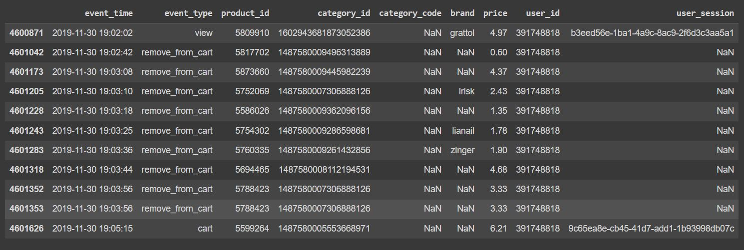
Missing values (User Session):
‹#›

Slide 6
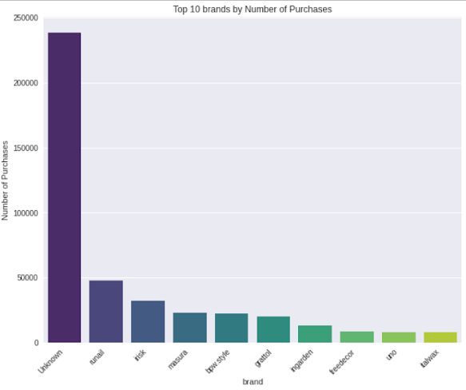
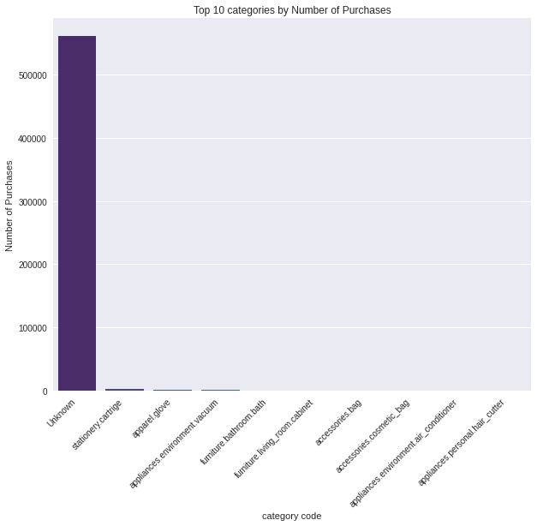
Filling missing values with unknown
‹#›

Slide 7
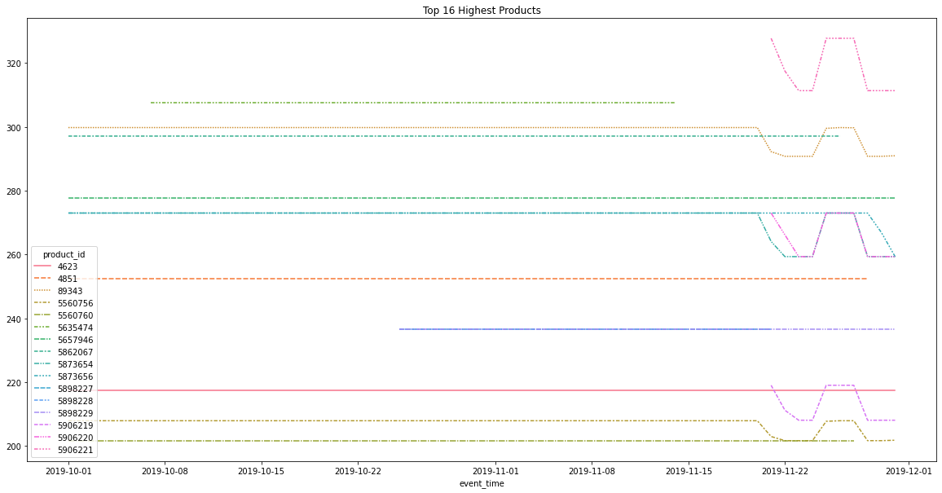
The Highest Price Validation
‹#›

Slide 8
Customer Interactions
‹#›

Slide 9
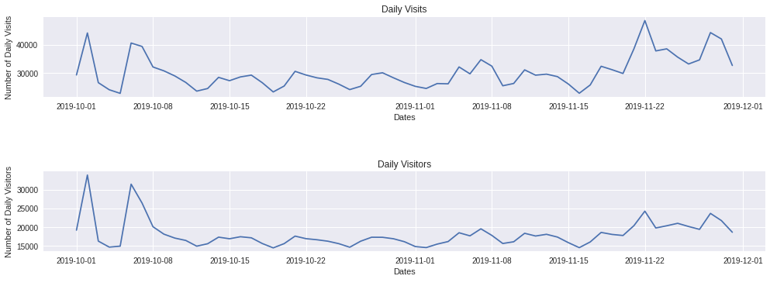
Daily Visits and Visitors
‹#›

Slide 10
Interactions per Day of Week
‹#›

Slide 11
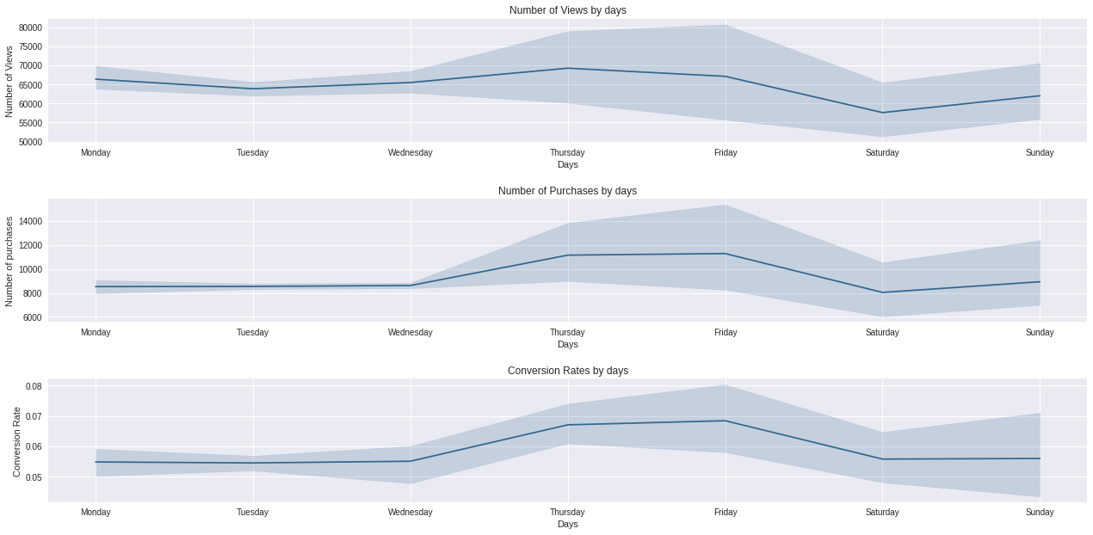
Daily Views and Purchase
‹#›

Slide 12
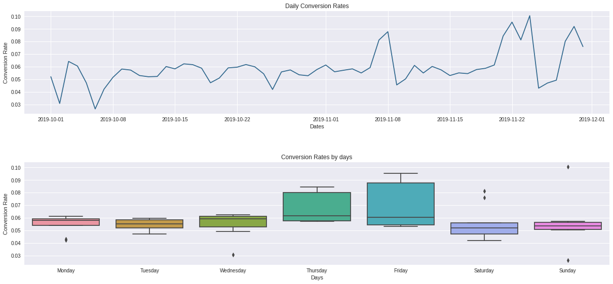
Daily Conversion Rate
‹#›

Slide 13
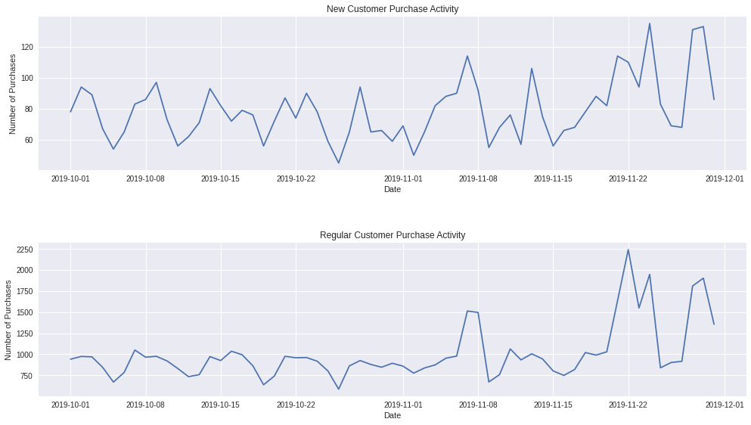
New users VS Regular users
‹#›

Slide 14
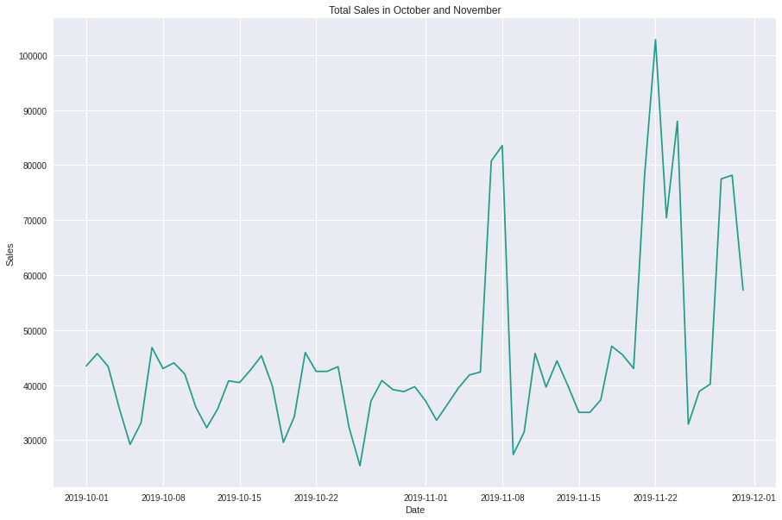
Total Sales in October and November
‹#›

Slide 15
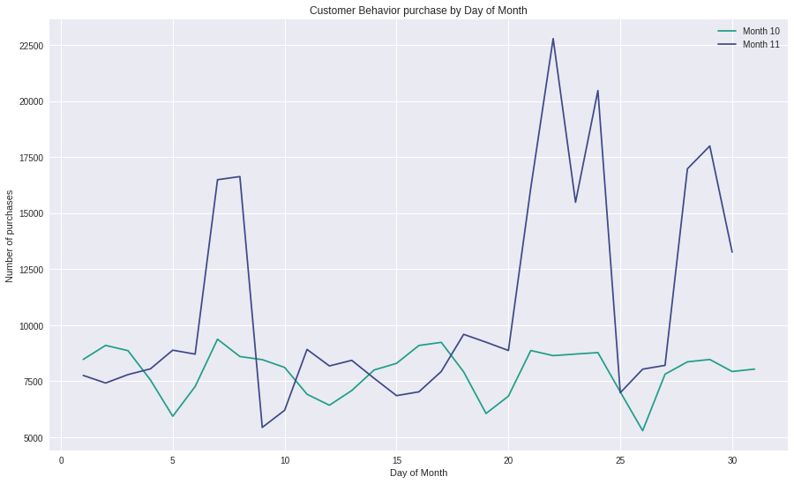
October VS November Sales
‹#›

Slide 16
Top 10 purchased products VS on Friday (Quantity)
‹#›

Slide 17
Top 10 viewed and purchased products
‹#›

Slide 18
Fridays VS Black Friday (Quantity)
Revenue in November 22, 2019:
$102,783.33
‹#›

Slide 19
Top Purchased Brands
‹#›

Slide 20
Top 5 purchased categories (Quantity)
‹#›

Slide 21
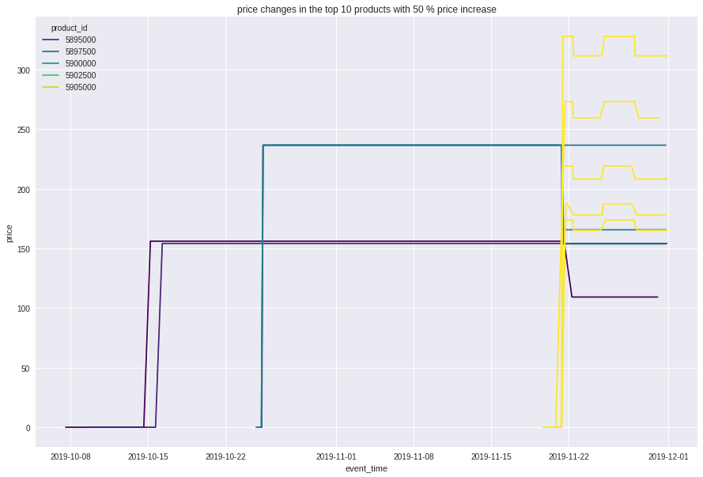
Top 10 products in price increase
‹#›

Slide 22
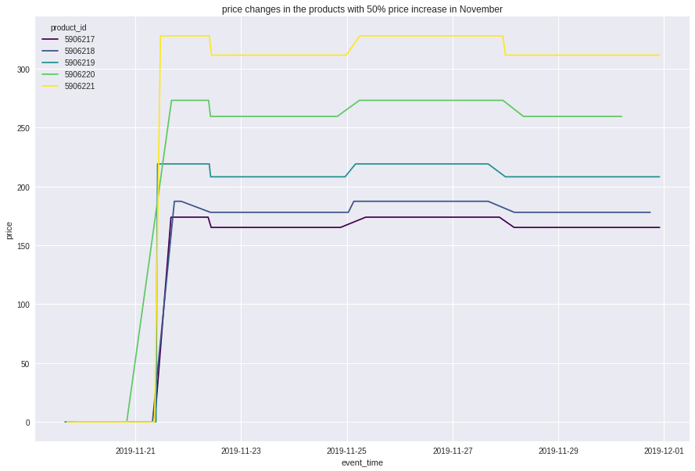
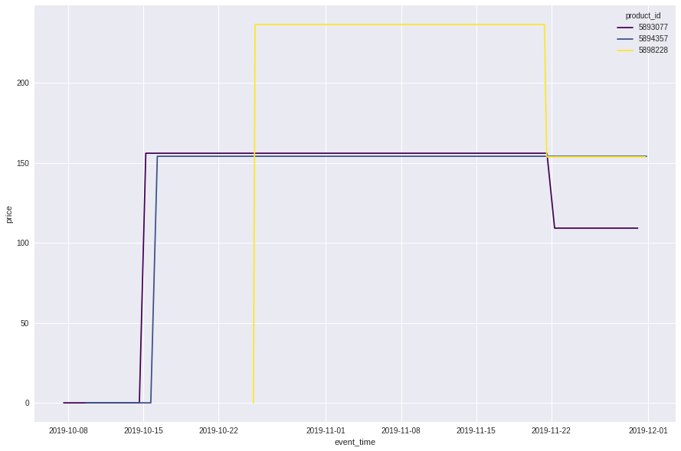
Top Price Changes
‹#›

Slide 23
RFM Model
Top Customers
Reward them,
Will promote your brand,
Most likely to send referrals
High Value Customers
Ask for reviews,
loyalty program,
Make recommendations
Medium Value Customers
Offer coupons
personalized recommendations
Low Value Customers
Provide helpful resources on site,
Send personalized emails
‹#›

Slide 24
Customer Lifetime Value (CLV)
CLV = Average order value * No. of repeat purchase * Customer Lifetime
Customer id | Average order value | Purchase Frequency | Customer lifespan | Customer value | clv
557790271 | 6.200616 | 438 | 0.333333 | 2715.87 | 905.29
570967715 | 8.378889 | 108 | 1 | 904.92 | 904.92
549368055 | 4.345577 | 208 | 1 | 903.88 | 903.88
563937307 | 9.736047 | 86 | 1 | 837.30 | 837.30
518278060 | 4.604128 | 172 | 1 | 791.91 | 791.91
‹#›

Slide 25

Recommendation Analysis:
Association Rule
Apriori
FP Growth
‹#›

Slide 26
Support Analysis
Item | Count | Percentage
5809910.0 | 700 | 0.006773
5854897.0 | 412 | 0.003986
5833330.0 | 338 | 0.003270
5751422.0 | 317 | 0.003067
5809912.0 | 308 | 0.002980
‹#›

Slide 27
Apriori Algorithm
antecedents | consequents | Support | Confidence | Lift | Antecedents Brand | Consequents Brand
5751383.0 | 5751422.0 | 0.008555 | 0.348592 | 12.725241 | uno | uno
5833330.0 | 5833335.0 | 0.005876 | 0.201183 | 12.449704 | bpw.style | bpw.style
5833323.0 | 5833330.0 | 0.005876 | 0.361702 | 12.383482 | bpw.style | bpw.style
5816170.0 | 5809912.0 | 0.005271 | 0.317708 | 11.936756 | grattol | grattol
5833325.0 | 5833330.0 | 0.006481 | 0.337838 | 11.566448 | bpw.style | bpw.style
5849033.0 | 5751422.0 | 0.005358 | 0.248996 | 9.089532 | uno | uno
5809910.0 | 5809912.0 | 0.012357 | 0.204286 | 7.675306 | grattol | grattol
5816170.0 | 5809910.0 | 0.007000 | 0.421875 | 6.974196 | grattol | grattol
‹#›

Slide 28
FP Growth
antecedents | consequents | antecedent support | consequent support | support | confidence | lift | conviction
5751422.0 | 5751383.0 | 0.027394 | 0.024542 | 0.008555 | 0.312303 | 12.725241 | 1.418441
5751383.0 | 5751422.0 | 0.024542 | 0.027394 | 0.008555 | 0.348592 | 12.725241 | 1.493082
5849033.0 | 5751422.0 | 0.021517 | 0.027394 | 0.005358 | 0.248996 | 9.089532 | 1.295075
5833330.0 | 5833335.0 | 0.029208 | 0.016160 | 0.005876 | 0.201183 | 12.449704 | 1.231622
5833335.0 | 5833330.0 | 0.016160 | 0.029208 | 0.005876 | 0.363636 | 12.449704 | 1.525530
5809912.0 | 5809910.0 | 0.026616 | 0.060491 | 0.012357 | 0.464286 | 7.675306 | 1.753750
5809910.0 | 5809912.0 | 0.060491 | 0.026616 | 0.012357 | 0.204286 | 7.675306 | 1.223283
5833330.0 | 5833325.0 | 0.029208 | 0.019184 | 0.006481 | 0.221893 | 11.566448 | 1.260516
5833325.0 | 5833330.0 | 0.019184 | 0.029208 | 0.006481 | 0.337838 | 11.566448 | 1.466093
5816170.0 | 5809910.0 | 0.016592 | 0.060491 | 0.007000 | 0.421875 | 6.974196 | 1.625097
5816170.0 | 5809912.0 | 0.016592 | 0.026616 | 0.005271 | 0.317708 | 11.936756 | 1.426639
5833330.0 | 5833323.0 | 0.029208 | 0.016246 | 0.005876 | 0.201183 | 12.383482 | 1.231514
5833323.0 | 5833330.0 | 0.016246 | 0.029208 | 0.005876 | 0.361702 | 12.383482 | 1.520907
‹#›

Slide 29
QUESTIONS
‹#›

Slide 30
THANK YOU
Presented by:
Esraa Mohamed
Naira Anwer
Aya Gamal
Sandra Samir
‹#›

