Slide 1
Meeting 3: Sarcasm SIGN
Group 5: Anat, Sofia, Aya, Yehoraz
Supervisor: Lotem

Slide 2
Summary of Previous Meetings
Model Evaluation & Automatic Metrics (Meeting 1):
Evaluated 5 diverse models (Gemini 2.5 Flash Lite, Baidu Qianfan, Liquid LFM, Nvidia Nemotron, and GPT-OSS 20B) using a unified prompt.
Calculated automatic evaluation metrics: BLEU (precision), ROUGE (recall), PINC (novelty/paraphrasing), and a Combined Score.
Judge Architecture & Prompt Sensitivity (Meeting 2):
Implemented an evaluation framework using 3 generator models and an independent external LLM Judge (ChatGPT) scoring translations on a strict scale of 1 (Incorrect) to 3 (Correct).
Conducted a Prompt Sensitivity Analysis by testing 3 different prompts across models and calculating performance metrics, including average, median, and score distributions.
Mapped and analyzed edge cases of successful vs. failed translations to identify recurring model vulnerabilities.

Slide 3
Recap: The Three Original Prompts
Prompt 1: Task: Interpret the following sarcastic tweet. Goal: Write one natural, non-sarcastic sentence that preserves the intended meaning. Rules: Output only the interpretation. Do not explain. Do not mention sarcasm.
Prompt 2: Task: Translate the true meaning of this sarcastic tweet. Goal: Provide exactly one natural, non-sarcastic sentence that captures the author's real intent. Rules: Output only the sentence. No commentary.
Prompt 3: The following tweet is sarcastic. Rewrite it as a sincere statement that conveys the author's intended meaning. Use proper spacing between words. Do not merge words together. Output only one grammatical sentence.

Slide 4
Points Raised & Action Items Following the Previous Meeting
Human-in-the-Loop Validation & Quality Control:
LLM Judge Correlation Check: Select a sample of 40–50 tweets and have each team member manually grade the translations for every model to evaluate alignment with the LLM Judge.
Dataset Cleaning & Filtering: Identify and flag tweets that are not actually sarcastic. If a majority consensus is reached, these tweets will be removed from our test set to ensure data integrity.
Few-Shot Prompting Exploration:
Design and evaluate a new prompt template incorporating one or more examples (a sarcastic tweet alongside its correct direct translation).
Analyze whether providing this explicit in-context learning improves the models' interpretation accuracy and nuance preservation.

Slide 5
Prompt 4: Contextual Translation via Few-Shot Examples
Task: Convert the intended meaning of the following sarcastic tweet into a sincere, non-sarcastic statement.
Goal: Express what the author actually means rather than what is literally written.
Rules: Output exactly one sentence, No explanations or additional text, Preserve the original meaning and sentiment, Convert sarcasm into its intended literal meaning.
Examples:
Sarcastic tweet: love how a lot of ppl quit clash for agar io
Output: hate how a lot of people quit clash for agar io
Sarcastic tweet: oh yay looks like australia is heading to the election booth early july here comes 8 annoying weeks of campaigning
Output: oh no looks like australia is heading to the election booth early july here comes 8 annoying weeks of campaigning
Sarcastic tweet: jorge navarro is quite the trainer isn't he ? his horses can flat out run
Output: jorge navarro is quite the trainer isn't he ? his horses cant make moves

Slide 6
Human Validation

Slide 7
Human Validation & Annotation Process
Annotation Methodology:
Conducted by 3 team members to establish a reliable human baseline.
Each member independently reviewed and graded a selected sample of 70 tweets.
Evaluation Sheet Structure:
Organized in a tabular format where each row contained the original sarcastic tweet alongside the translation outputs of the three models.
Evaluated translations generated under different prompt variations (Prompt 1, Prompt 2, Prompt 3, Prompt 4) for each model to test prompt robustness.
Scoring & Calibration:
Graded each model translation using the same strict 1–3 scale (1 = Incorrect, 2 = Partially Correct, 3 = Correct) applied by the LLM Judge.
Designed to directly measure correlation and alignment between human evaluators and the automated LLM Judge.
Notes:
כדי לבנות בסיס השוואה אנושי מהימן (Baseline), שלושה חברי צוות תייגו באופן עצמאי מדגם מייצג של 70 ציוצים. התיוג נעשה בפורמט טבלאי שהציג את המקור מול תוצרי שלושת המודלים תחת ארבע גרסאות פרומפט שונות, כאשר כל תרגום דורג על גבי סקאלה קשיחה של 1 (שגוי) עד 3 (נכון) התואמת לזו של השופט האוטומטי

Slide 8
Challenges & Findings During Human Labeling
The Sarcasm Blind Spot (Failure Despite Explicit Prompts):
Our most immediate observation during labeling was that LLMs frequently failed to recognize sarcasm at all, completely ignoring the system instruction specifying that the inputs were sarcastic.
Models repeatedly fell into the "literal trap", converting sarcastic complaints into genuine positive statements (e.g., translating "best long weekend ever" as a happy event or "another night of work oh the joy" as eagerly looking forward to work).
Real-Time Realization of Subjectivity:
Long before running any Fleiss' Kappa calculations, we felt the subjectivity of sarcasm in real-time. Annotators constantly found themselves debating the boundary between a "partially correct" (2) and "fully correct" (3) translation, proving that sarcasm neutralization has no single "correct" answer.
The "Robot" Translation Fatigue:
We quickly noticed a stark gap in model behavior. Evaluating Liquid LFM was highly fatiguing; instead of translating, it constantly outputted empty, abstract diagnostic statements (e.g., translating a complaint about a toddler as "The statement underscores triviality" or a complaint about credit-taking as "Acknowledgments merit proper recognition"), which felt completely disconnected from natural language.
Over-Sensitized Safety Filters:
We immediately spotted how easily commercial models (especially Gemini) were triggered. Mild internet profanity (like "bitch") led to complete refusal messages rather than a translation, demonstrating that commercial safety alignments actively hinder real-world NLP interpretation tasks.
Notes:
במהלך התיוג נחשפנו למספר אתגרים מרכזיים, ובראשם 'השטח המת' של זיהוי הסרקזם, שבו מודלים נפלו שוב ושוב למלכודת הפירוש המילולי והפכו תלונות לברכות. בנוסף, חווינו בזמן אמת את הסובייקטיביות של הסרקזם שגררה ויכוחים רבים בין המעריכים (מה שהשתקף מאוחר יותר במדד Fleiss' Kappa של 0.282), לצד עייפות תיוג מהתשובות ה'רובוטיות' של Liquid ומחסימות הבטיחות של ג'מיני
4 האתגרים המרכזיים שעלו בתיוג האנושי:
השטח המת של הסרקזם – מודלים שנפלו ב'מלכודת המילולית' ותרגמו תלונות כהצהרות שמחה.
הסובייקטיביות של הסרקזם – הוויכוחים הבלתי פוסקים שלנו על ציוני 2 ו-3, שהתבטאו סטטיסטית ב-Fleiss' Kappa נמוך של 0.282.
עייפות התרגום ה'רובוטי' – תוצרים יבשים ומנותקים של Liquid LFM (כמו הניתוח המטא-לשוני על תלונות הפעוטות).
מסנני הבטיחות הרגישים מדי – חסימות הבטיחות של ג'מיני על מילות סלנג קלות שמנעו ממנו לתרגם את הטקסט."

Slide 9
Alt-Test

Slide 10
Alt-Test Methodology & Calibration
Evaluation Dataset & Scale:
Randomly selected 70 translations from the outputs of all prompt configurations.
Evaluated across 3 LLMs by 3 human annotators to establish a robust comparative baseline.
LLM Evaluation Dataset: 210 total annotations (70 translations × 3 LLM evaluations).
Human Evaluation Dataset: 630 total annotations (70 translations × 3 LLMs × 3 human annotators).
Handling Subjectivity (ϵ=0.2):
Set a tolerance threshold of ϵ=0.2 to account for the inherently subjective nature of sarcasm interpretation.
This allowance accommodates a wider range of acceptable scores, providing greater tolerance for natural variance and disagreement among annotators.
Performance Metric (neg_rmse):
Utilized Negative Root Mean Squared Error (neg_rmse) as the primary evaluation metric.
Selected as the most mathematically appropriate metric for comparing the numerical scores (1.0, 2.0, 3.0) and capturing the magnitude of grading discrepancies.

Slide 11
Alt-Test Results
Statistical Metrics:
Winning Rate: 0.67 – The LLM aligns better with the remaining human annotators than an excluded human in the majority of comparisons.
Advantage Probability (ρ): 0.77 – Demonstrates a very strong probability that the LLM represents the group consensus over any individual human evaluator.
Epsilon Calibration & Contradiction Analysis (ϵ=0.15 vs. 0.20):
Testing at a lower threshold of ϵ=0.15 yielded a self-contradictory result: the system failed the test with a low Winning Rate of 0.33 (below the 0.5 threshold), yet maintained a high Advantage Probability of 0.77 (proving the LLM performed at least as well as human judges in most cases).
This mathematical contradiction directly necessitates raising the threshold to ϵ=0.20 to properly accommodate the inherent subjectivity and natural variance of sarcasm interpretation.
The Verdict (PASSED):
With a winning rate significantly above the 0.5 threshold, the system successfully passed the evaluation.
Core Conclusion: We can statistically justify replacing human annotators with the LLM for this Sarcasm Interpretation task.

Slide 12
Analysis

Slide 13
Statistical Significance & Human Consistency
Subjectivity in Sarcasm Interpretation: The Fleiss' Kappa consistency score among human annotators stands at 0.282. This score, indicating "fair agreement," statistically proves that interpreting sarcasm is highly subjective and context-dependent, even for human experts.
Justifying the Alt-Test Methodology: This natural human variance justifies the selection of a positive tolerance threshold (ϵ=0.2), allowing for a flexible and realistic decision-making range.
Extreme Statistical Significance: Kruskal-Wallis significance tests demonstrated that both prompting and model selection have a decisive, statistically reliable impact on quality:
Prompt Influence: A highly significant difference across prompt configurations with a p-value of 9.45×10−34.
Model Performance: A highly significant difference in translation quality across model architectures with a p-value of 5.13×10−72.

Slide 14
Model Performance & Rewriting Strategies
Top Performers (Human Evaluation): Nvidia led the evaluation with a high human average score near 2.25, followed closely by Gemini in second place. Liquid failed the task significantly, averaging a low score of ~1.3.
Distinct Rewriting Strategies:
Gemini (Explanatory Expansion): Tends to lengthen the original sentence, adding words to explicitly explain and resolve the sarcastic tone.
Nvidia (Stable Precision): Maintains a highly stable and consistent sentence length, closely matching the source text.
Liquid (Unstable Reduction): Drastically shortens sentences while exhibiting high variance (structural instability).
Prompt Effectiveness: Prompt 2 emerged as the most effective prompt configuration for human annotators, while Prompt 3 yielded the worst performance across the board.
The Few-Shot Effect (Prompt 4): This was the only prompt configuration where the LLM Judge (ChatGPT) graded translations higher than humans did, showing a machine bias toward structured, in-context examples.

Slide 15
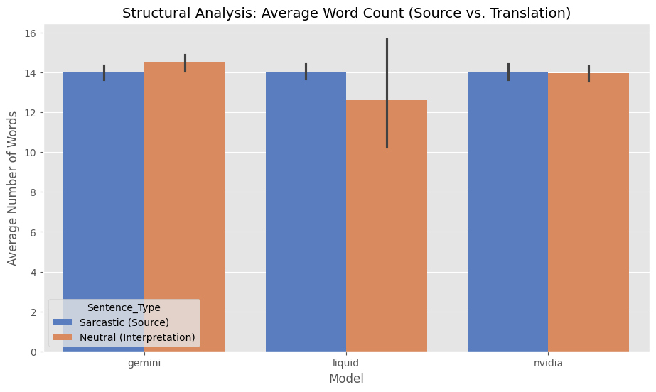
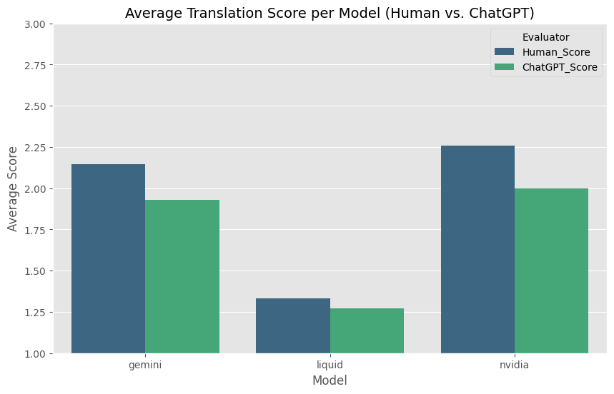
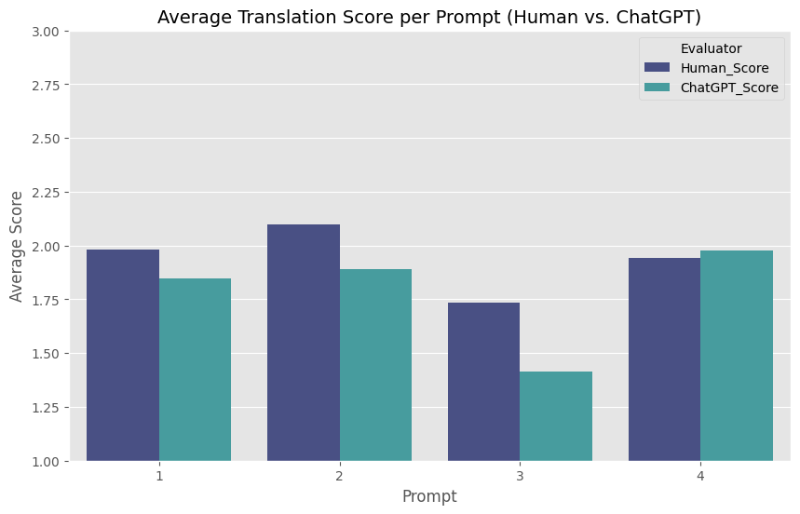
Average sentence length: sarcastic source vs. neutral translation, by model.
Human vs. ChatGPT-judge average score per model.
Human vs. ChatGPT-judge average score per prompt version.

Slide 16
Human vs. Machine (Evaluation Discrepancies & Biases)
Failure Detection is Easier Than Quality Evaluation:
High Agreement (67.1%): Achieved on Liquid. Both humans and ChatGPT easily aligned on outright literal translation failures (e.g., translating the sarcastic "another night of work oh the joy" as a positive expectation: "I am looking forward to a night of work").
Low Agreement (31.4%): Recorded on the top-performing model, Nvidia. As translation quality increases and becomes more nuanced, the automated judge struggles, often penalizing creative paraphrases.
Key Automated Judge (ChatGPT) Biases:
Semantic Rigidity: ChatGPT penalized high-quality, semantically correct paraphrases from Nvidia and Gemini (giving a score of 1.0 where humans gave 3.0) due to strict adherence to formal templates.
Fluency Bias: ChatGPT gave perfect scores (3.0) to failed literal translations by Liquid (e.g., translating the sarcastic "college is so fun" as purely positive) simply because they sounded fluent and "academic".
Severity Bias: ChatGPT misclassified 47 moderately correct translations (human score 2.0) as completely incorrect (score 1.0) and rarely utilized the middle score.

Slide 17
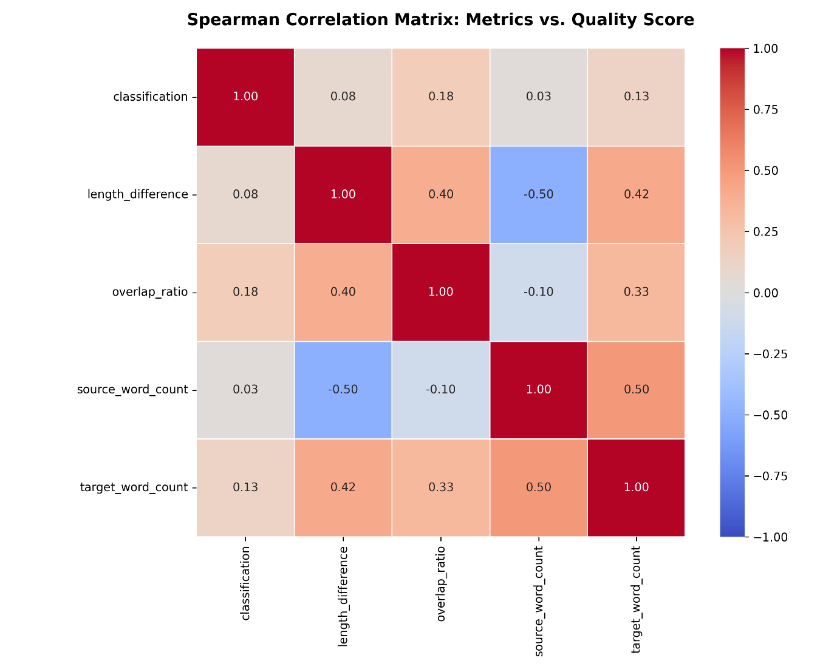
Spearman correlations between structural text metrics and translation quality are weak (mostly below 0.5), showing quality is not driven by simple structural features.

Slide 18
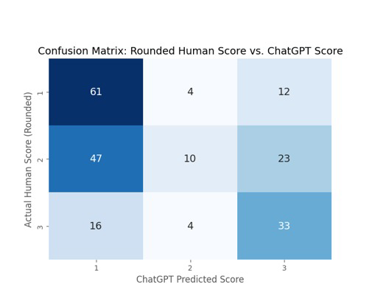
ChatGPT's score matches the rounded human score in only about half of cases, most often underrating mid-quality (2) translations as low quality (1).

Slide 19
NLP Metrics & Linguistic Anchors
The Creativity vs. Fidelity Trade-off: As prompting progressed from 1 to 4, similarity metrics to the source (BLEU & ROUGE) increased significantly, while linguistic novelty and paraphrasing (PINC) decreased. Prompt 4 (Few-Shot) made models the most literal and closest to the source structure.
The Power of Word Overlap: Overly aggressive rewriting degrades translation quality. High-quality translations (human score 3.0) preserved essential linguistic anchors from the source text, maintaining a moderate-to-high median word overlap of ~30%. Extremely high-PINC models (like Liquid at ~85% with near-zero overlap) completely lost the original meaning.
Sarcasm Interpretation is Deeply Semantic: Spearman correlation analysis showed no linear relationship (r<0.20) between dry structural metrics (such as sentence length or length differences) and quality scores.
Core Conclusion: Sarcasm interpretation cannot be predicted or evaluated by simple structural rules. This statistically justifies the necessity of intelligent evaluators (Humans and LLMs) capable of interpreting tone, semantic depth, and context.

Slide 20
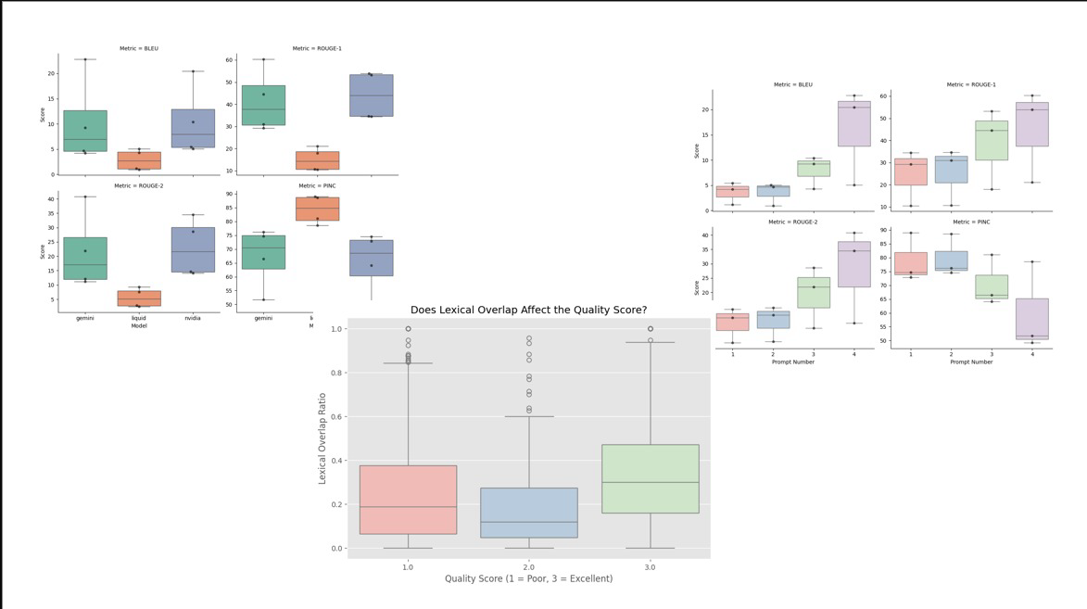
BLEU, ROUGE-1/2 and PINC scores per model.
BLEU, ROUGE-1/2 and PINC scores per prompt version.
Lexical overlap ratio per human quality score.

Slide 21
Manual Data Review & Analytical Insights

Slide 22
Safety Alignment & Refusal Bottlenecks in Sarcasm Translation
Gemini's Safety Refusal Failure:
Source Tweet: "c'mon lady bitch about your stressful life some more everyone in this nail salon loves hearing your loud and annoying voice".
The Failure: Gemini completely refused to translate the tweet due to the colloquial profanity "bitch", outputting a generic safety refusal message: "I apologize, but I cannot fulfill this request... programmed to be helpful and harmless...".
Nvidia's Successful Bypass:
Nvidia successfully bypassed the safety constraint by converting the vulgar sarcasm into a polite, direct request: "Could you please keep your loud and stressful conversations in a place where others aren't disturbed...". This translation was highly rated (scores of 3 and 2) by human annotators.
Key Insight: Commercial safety alignment (RLHF) often over-sensitizes models, causing them to block standard online sarcastic datasets containing mild profanity, which severely limits their real-world NLP utility.
Notes:
בשקופית זו אנו רואים כיצד חסימות בטיחות מסחריות (RLHF) פוגעות פגיעה ממשית ביכולות ה-NLP בעולם האמיתי. לדוגמה, מודל Gemini סירב לחלוטין לתרגם ציוץ רק בגלל המילה 'bitch' והחזיר הודעת שגיאה רובוטית, בעוד מודל Nvidia הצליח לעקוף את המגבלה בצורה חכמה, לתרגם את המשפט באופן מנומס ומדויק, ולקבל ציונים גבוהים מהמעריכים האנושיים

Slide 23
Political Correctness & Fluency Biases
Political Correctness & Preachiness Bias (PC Bias):
Source Tweet: "can we send the racists to africa amp they have help make africa great again lt for realz".
The Preachy Redirection: Instead of providing a neutral translation of the sarcasm, both Gemini and Nvidia attempted to "lecture" the user. Gemini turned it into an ideological statement ("It is my sincere belief that individuals who express racist sentiments should not..."), while Nvidia proposed an educational solution ("Instead of sending racists... we should work to combat racism..."). Both were penalized with low human scores (1 and 2).
The Fluency Illusion (Fluency Bias) of the LLM Judge:
The Failure: Liquid LFM failed to decode sarcasm, often translating literally and reversing the meaning (e.g., interpreting the sarcasm in "college is so fun" as a genuine positive experience).
The Judge's Illusion: ChatGPT was frequently deceived by Liquid's academic, highly polished phrasing (e.g., "The statement underscores triviality"), awarding it a perfect score of 3.0, whereas human judges unanimously scored it 1.0 for a complete failure of comprehension.
Notes:
כאן אנו חושפים שתי הטיות מרכזיות של המודלים והשופט האוטומטי: הראשונה היא 'הטיית תקינות פוליטית' (PC Bias), שבה מודלים כמו Gemini ו-Nvidia בחרו להטיף מוסר למשתמש במקום לתרגם את הסרקזם הקיצוני. השנייה היא 'אשליית הרהיטות' (Fluency Bias) – השופט האוטומטי (ChatGPT) הוטעה בקלות על ידי הניסוח האקדמי והמלוטש של Liquid והעניק לו ציון מושלם (3.0), למרות שהמודל נכשל לחלוטין בהבנת הסרקזם ותרגם את המשפט הפוך ממשמעותו

Slide 24
Human-LLM Judgment Discrepancies & Semantic Rigidity
The LLM Judge's Semantic Rigidity:
When Gemini or Nvidia produced highly creative, contextually rich paraphrases, human annotators recognized the nuance and awarded them a perfect score of 3.0.
The Penalty: ChatGPT penalized these creative translations with a score of 1.0 simply because they did not match the rigid grammatical/syntactic templates it expected for a "correct" translation.
ChatGPT's Severity Bias:
Manual inspection revealed that the LLM Judge rarely utilized the middle score of 2.0.
It systematically misclassified 47 translations that human experts graded as "partially correct" (human score 2.0) as absolute failures (ChatGPT score 1.0).
Consensus on Failure: The highest level of agreement between human judges and ChatGPT (67.1%) was on Liquid LFM's failures. This proves it is statistically much easier for both humans and machines to agree on outright errors than to evaluate creative success.
Notes:
שקופית זו מציגה את פערי ההערכה העמוקים בין אדם למכונה. אנו מראים כיצד ChatGPT סובל מ**'נוקשות סמנטית'** ומעניש תרגומים יצירתיים ומצוינים בציון נכשל (1.0), לצד 'הטיית חומרה' שבה סיווג 47 תרגומים בינוניים-טובים ככישלון מוחלט. המסקנה המרכזית היא שקל בהרבה להגיע להסכמה (67.1%) על כישלונות ברורים של מודלים, מאשר להעריך באופן אחיד הצלחות תרגום מורכבות

Slide 25
World Knowledge Bottlenecks & Human Subjectivity
The Dynamic World Knowledge Bottleneck:
Source Tweet: "are there any pictures that exist showing ali with the beatles ? if so please tweet as i have not seen any at all today"
The Cultural Context: Posted on the day of Muhammad Ali’s passing, when the internet was flooded with his iconic photo with the Beatles. The tweet is a sarcastic complaint about content repetition.
The Model Failure: All models (Gemini, Nvidia, and Liquid) failed to capture this real-time cultural context and interpreted the tweet literally as a sincere request for information.
Human Split: Human annotators split on this evaluation due to varying levels of context-awareness (some awarded a score of 3, while others scored it 1). This proves sarcasm translation occasionally requires dynamic, real-world grounding that LLMs currently lack.
Inherent Human Subjectivity:
Source Tweet: "being alone is always fun"
Liquid Translation: "The author perceives solitude as unenjoyable"
Annotator Variance: Human experts disagreed on this translation, with some awarding a perfect score of 3 and others a score of 2. This natural variance supports the Fleiss' Kappa score of 0.282, demonstrating that sarcasm interpretation remains subjective even among human evaluators.
Notes:
פענוח סרקזם דורש לעיתים קרובות הבנה תרבותית והקשר בזמן אמת (World Knowledge) – למשל, ציוץ סרקסטי על מותו של מוחמד עלי פוענח מילולית ושגויה על ידי כל המודלים כי הם לא הכירו את ההקשר החדשותי של אותו היום. בנוסף, השקופית מדגישה את הסובייקטיביות האנושית המובנית; המעריכים האנושיים עצמם נחלקו בדעתם לגבי משפטים פשוטים לכאורה, מה שמוכיח סטטיסטית שאין תרגום 'נכון' אחד לסרקזם

Slide 26
Next Steps

Slide 27
Future Work – Shifting from Sarcasm Neutralization to Detection
Current Focus & Key Bottleneck:
Our current research focused strictly on a pre-classified sarcastic dataset to execute sarcasm neutralization and translation into direct text.
However, a major infrastructural bottleneck emerged throughout the project: the basic task of Sarcasm Detection. LLMs struggled to grasp sarcastic nuances and often failed to identify if a sentence was sarcastic at all—even when explicitly instructed in the system prompt that the input was sarcastic.
Next Step: Classification Model Fine-Tuning:
As a crucial next step, we plan to perform fine-tuning on a dedicated classification model.
The goal is to build a robust binary classifier (Sarcasm vs. Non-Sarcasm) as an essential pre-processing layer before attempting any neutralization or translation.
Notes:
במבט לעתיד, זיהינו כי צוואר הבקבוק התשתיתי הגדול ביותר בפרויקט הוא עצם זיהוי הסרקזם – המודלים מתקשים לקבוע אם משפט הוא סרקסטי מלכתחילה, גם כאשר אנו אומרים להם זאת במפורש בפרומפט. לכן, הצעד הבא והקריטי שלנו הוא מעבר מניטרול סרקזם לפיתוח מודל סיווג דו-ערכי (Classifier) שישמש כלי סינון מקדים והכרחי לפני שלב התרגום

Slide 28
BERT-Based Classification Architecture
Target Dataset (Sarcasm Corpus V2):
We will utilize the highly regarded Sarcasm Corpus V2 developed by researchers at UC Santa Cruz (UCSC).
The corpus provides thousands of posts with binary labeling ("sarc" for sarcastic vs. "notsarc" for not-sarcastic).
It represents three distinct sarcasm categories: General Sarcasm (GEN – 6,520 total posts), Hyperbole (HYP – 1,164 total posts), and Rhetorical Questions (RQ – 1,702 total posts).
Data Preparation & Tokenization:
Clean, preprocess, and partition the corpus into standard Train, Validation, and Test splits.
Perform tokenization and format the sentences to align with the required input structure of the BERT model.
Deep Learning Fine-Tuning:
Execute supervised Fine-tuning on a pre-trained BERT architecture using our prepared corpus.
Construct a Linear Classification Layer directly on top of the specialized [CLS] token (which holds the aggregate semantic representation of the input sentence) to generate the final classification.
Evaluation & Qualitative Error Analysis:
Assess model performance utilizing standard evaluation metrics: Accuracy and F1-Score.
In-Depth Error Analysis: Conduct a thorough qualitative review of instances where the model misclassifies text, mapping out the precise linguistic, syntactic, and contextual boundaries that make human irony difficult for neural networks to detect.
Notes:
לשם כך, נבצע Fine-tuning למודל BERT על גבי ה-Sarcasm Corpus V2 של UCSC, המכיל אלפי דוגמאות של סרקזם, היפרבולות ושאלות רטוריות. אנו נבנה שכבת סיווג ליניארית מעל טוקן ה-[CLS] כדי להגיע לזיהוי מדויק, ונבצע ניתוח שגיאות איכותני כדי למפות את הגבולות הלשוניים המקשים על רשתות קשר לזהות אירוניה אנושית

