Slide 1
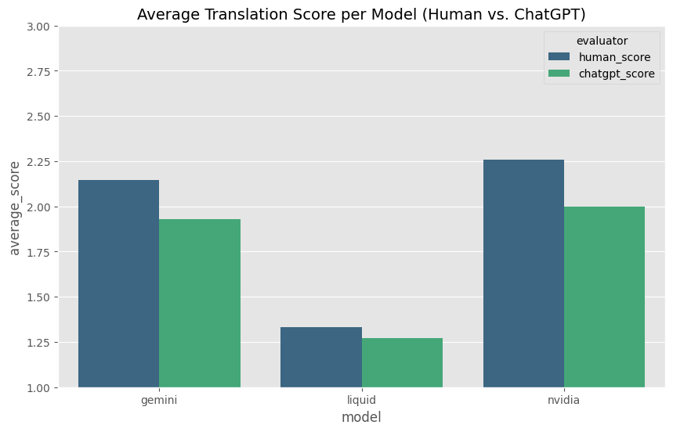
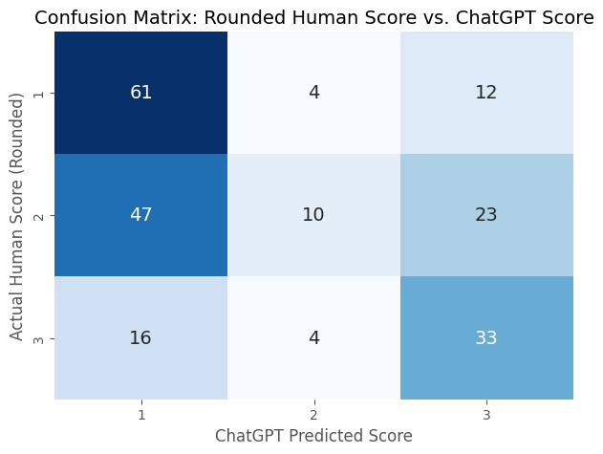
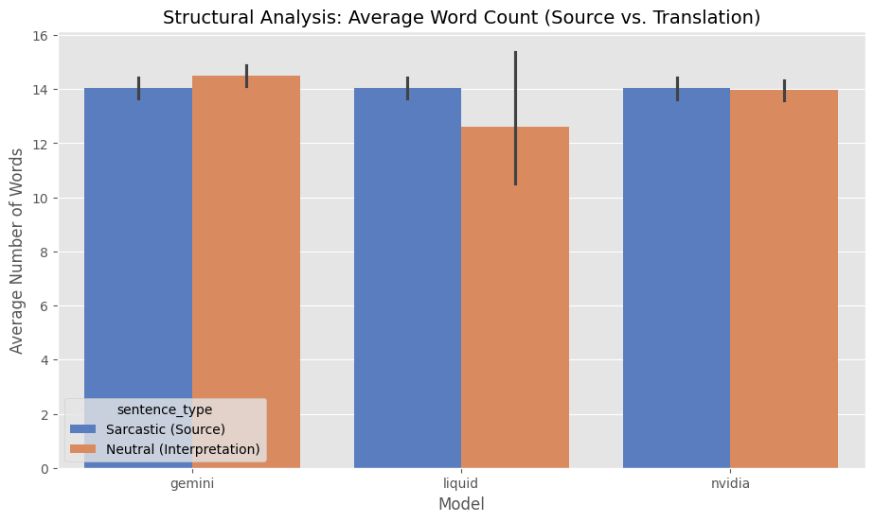
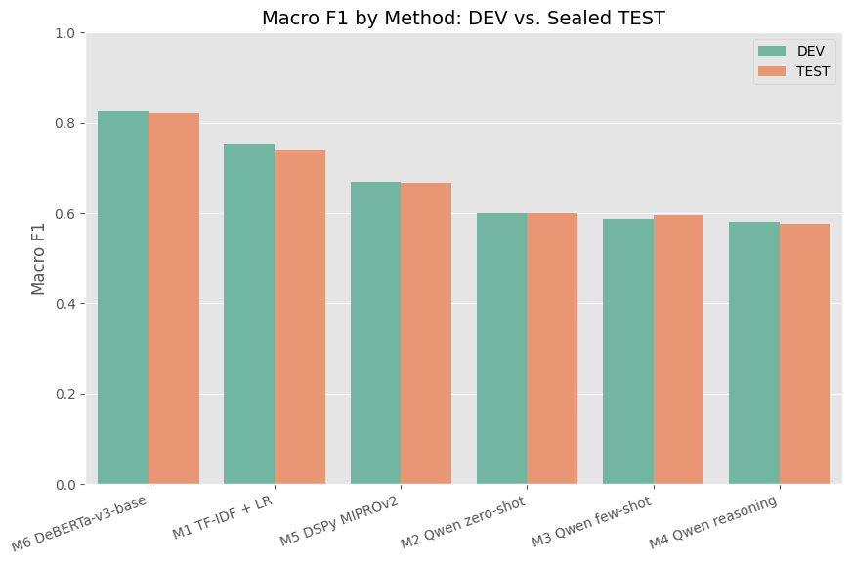
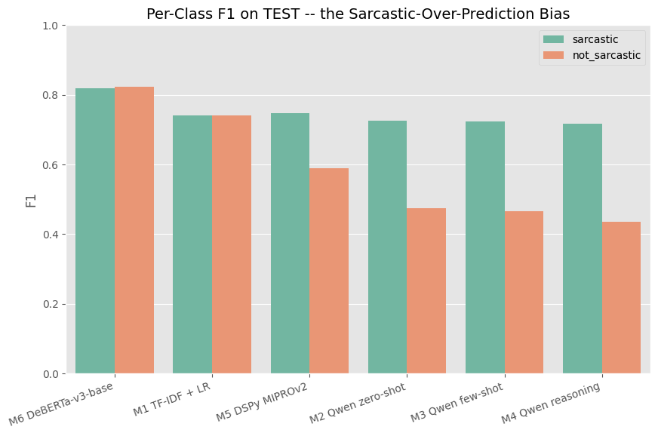
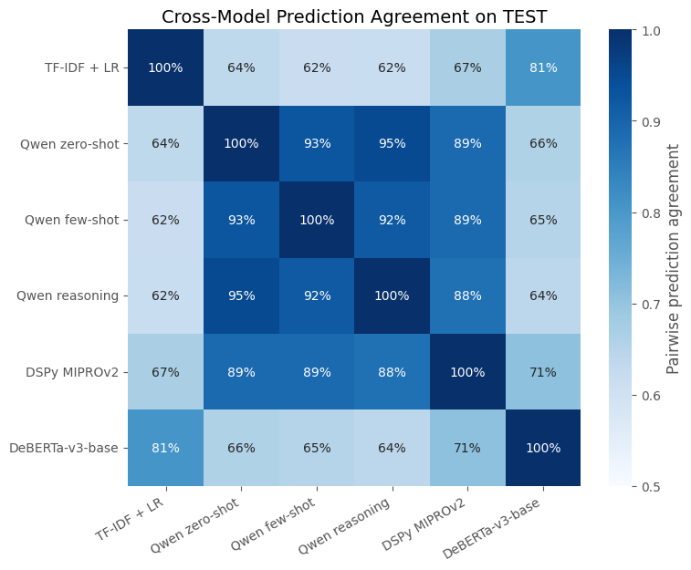
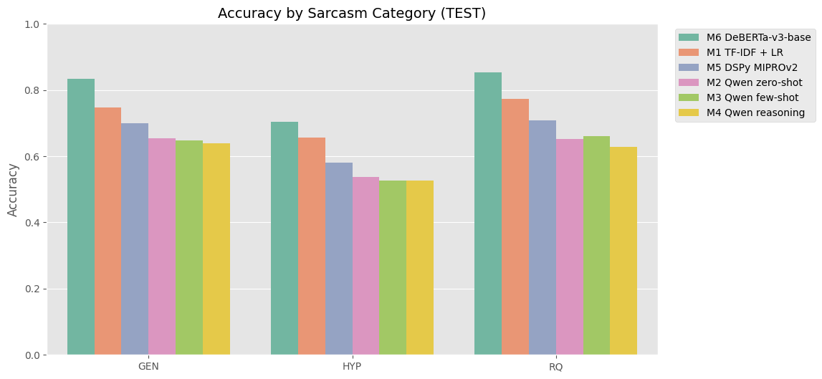
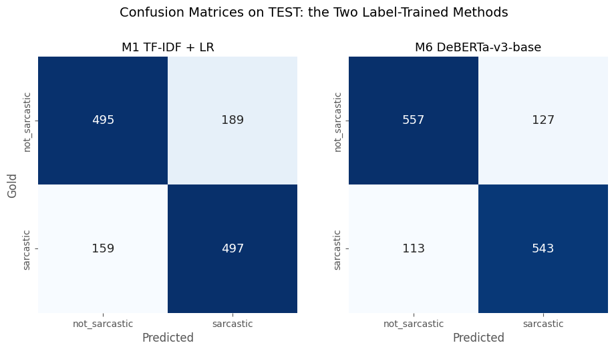
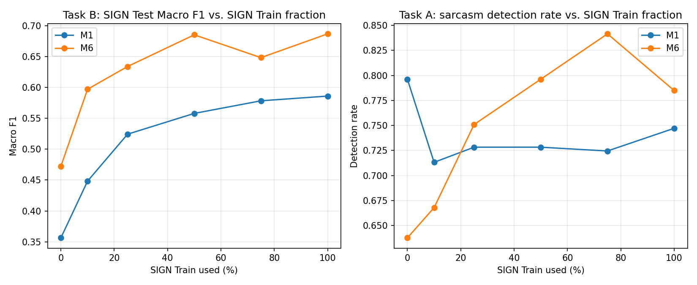
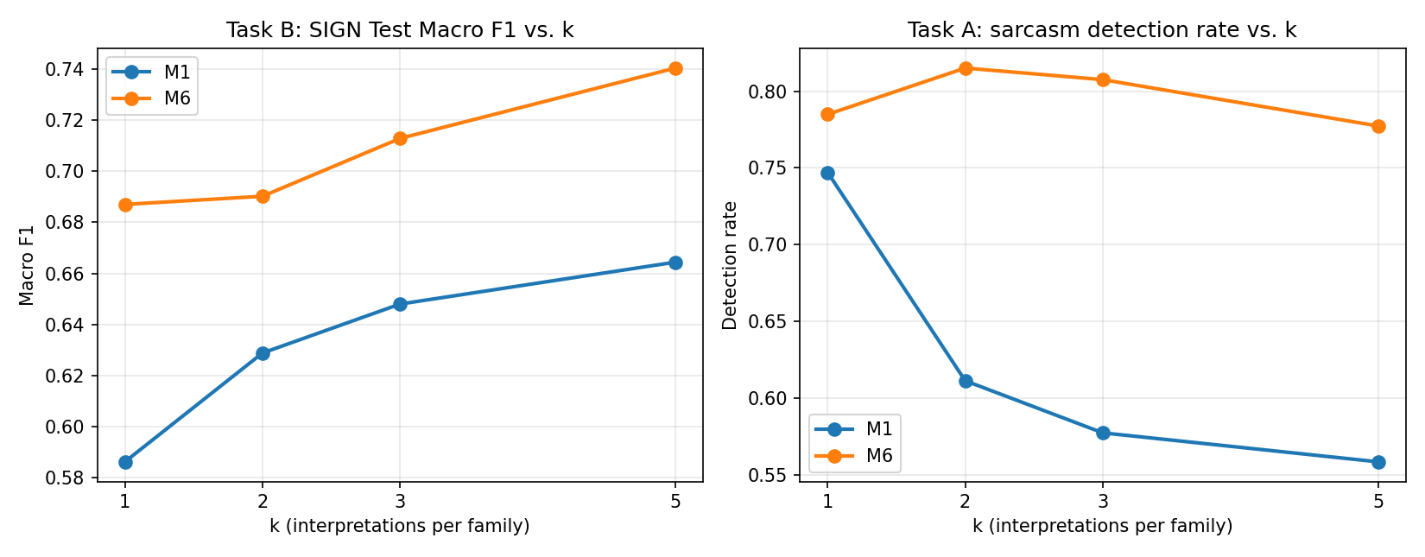
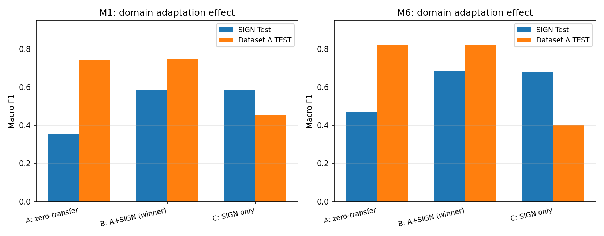
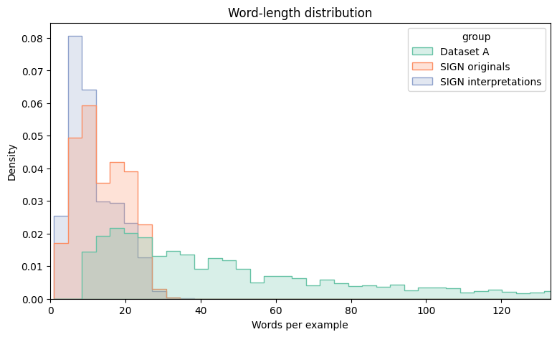
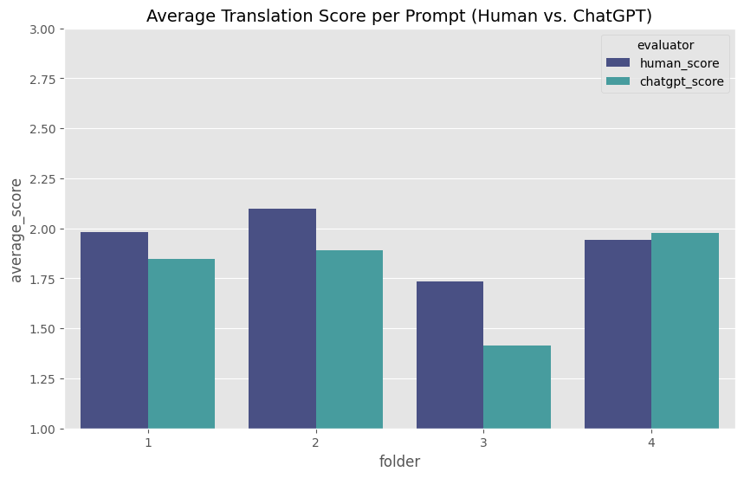
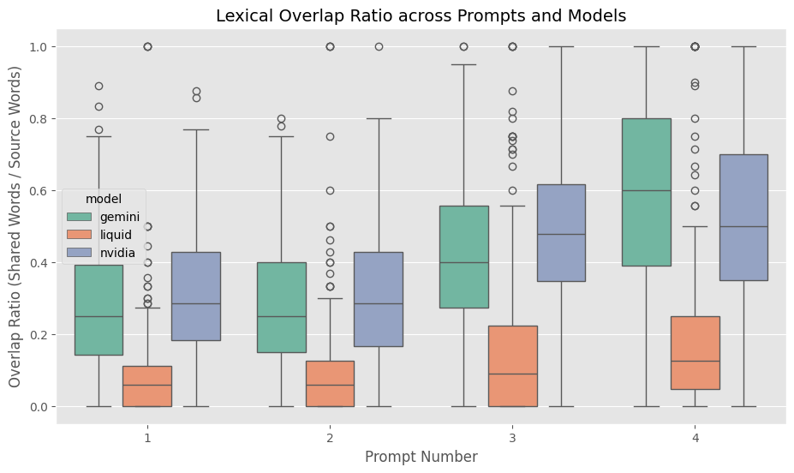
Sarcasm Interpretation and Detection
A TwoPhase Study in SarcasticText Neutralization and Classification - from LLM Prompting to a FineTuned Transformer Encoder
Aya Grabarsky · Sofia Torgovezky · Anat Linor Lorman · Yehoraz BenYehuda
Supervised by Lotem Peled Cohen | Technion – Israel Institute of Technology | August 2026
ABSTRACT
Sarcasm inverts literal meaning, causing sentiment and moderation systems to fail silently and confidently. This project first builds and statistically validates an LLMjudge benchmark for rewriting sarcastic text as sincere text (Part I) - then, motivated by that benchmark's own error analysis showing models repeatedly fail to even recognize sarcasm, runs a controlled sixmethod comparison for sarcasm detection itself (Part II). Both phases converge on one conclusion: a model adapted to labeled, indomain data outperforms a generalpurpose LLM used zero/fewshot.
PART I - SARCASM INTERPRETATION BENCHMARK
Problem & Setup
Evidence
Key Results
■ Task: generate a sincere rewrite of a sarcastic tweet and test whether an LLM judge can replace human annotators.
■ Data & models: SIGN paper's test tweets (Peled & Reichart, 2017); 5 candidates surveyed → 3 used (Gemini, Nvidia Nemotron, Liquid LFM), 4 prompt variants each.
■ Evaluation: automatic metrics (BLEU/ROUGE/PINC), an LLM judge (GPT-OSS 20B, 1–3 scale), and 3 human annotators on 70 tweets.
■ Best model: Nvidia led human-rated quality (~2.25/3), Gemini close second, Liquid a distant last (~1.3).
■ Rewriting strategies: Gemini = explanatory expansion; Nvidia = stable precision; Liquid = unstable reduction (near-zero source overlap).
■ Judge vs. human: 67.1% agreement on outright failures down to 31.4% on nuanced quality – semantic rigidity & fluency bias found.
Statistical Validation
Fig. 1 - Human vs. LLMjudge score, by model
Conclusion → Pivot
■ Alt-Test: leave-one-annotator-out test (Calderon et al., 2025) – Winning Rate 0.67, Advantage Probability 0.77 at ε=0.2 → PASSED.
■ Fleiss’ κ = 0.282: “fair agreement” among human annotators – sarcasm translation is subjective even for people.
Fig. 3 - Confusion matrix: human vs. LLMjudge score
The recurring failure was models not recognizing sarcasm in the first place – no rewriting-prompt fix helps a misread input. This motivated Part II: treat detection as its own rigorously-compared problem.
Fig. 4 - Word count, source vs. interpretation, by model
PART II - SARCASM DETECTION: A SIXMETHOD COMPARISON
ID | Approach | TEST Macro F1
M1 | TFIDF + Logistic Regression (classical baseline) | 0.7403
M2 | Qwen34B zeroshot prompting | 0.6005
M3 | Qwen34B fewshot prompting (8 random demos) | 0.5947
M4 | Qwen34B structured stepbystep reasoning | 0.5758
M5 | DSPy MIPROv2 - optimized prompt + demos | 0.6681
M6 | Finetuned microsoft/debertav3base | 0.8209
Dataset & Setup
Evidence
Key Results
■ Dataset: Sarcasm Corpus V2 (Oraby et al., 2016) - 9,386 humanannotated forum posts, ~50/50 balanced, 3 overlapping categories (GEN/HYP/RQ).
■ Split: one canonical 70/15/15 TRAIN/DEV/TEST split (seed 42) - grouped by duplicate text (the only leakage vector) + stratified by label.
■ Sealing policy: TEST evaluated exactly once per method, only after every configuration was fully frozen on DEV.
■ Shared evaluator: one implementation of Accuracy / perclass PRF1 / Macro F1 / confusion matrix used identically by all six methods.
■ Base LLM fixed: M2–M5 all run the same local Qwen34BInstruct2507, isolating prompting technique from basemodel capability.
■ Winner - M6 (finetuned DeBERTa): 0.8209 Macro F1 - 15–25 points over every promptedLLM variant of the same base model, while running far faster & cheaper.
■ More prompting ≠ better: plain zeroshot beat both fewshot and structured reasoning; only DSPy's automated MIPROv2 search improved on it.
■ Universal LLM bias: every prompted method overpredicts “sarcastic” - 94–97% sarcastic recall vs. only 28–44% notsarcastic recall.
■ Two clear families: the 4 LLM methods agree with each other 88–95% of the time; M1+M6 (trained methods) agree with each other 81% - but only 62–71% with the LLM family.
■ Hardest cases: 89/1,340 TEST examples (6.6%) are misclassified by every one of the 6 methods, including the winner.
Fig. 5 - Macro F1 by method, DEV vs. sealed TEST
Fig. 6 - Perclass F1 - the sarcasticoverprediction bias
Fig. 8 - Accuracy by category (GEN/HYP/RQ), all six methods
Fig. 7 - Pairwise prediction agreement, all six methods
Recommendation
M6 for production - best accuracy, most balanced predictor, and dramatically cheaper/faster than any prompted LLM. M1 (TFIDF + LR) as a CPUonly fallback at 0.74 Macro F1.
Fig. 9 - Confusion matrices on TEST: M1 vs. M6, the two label-trained methods
PART III - SIGN GENERALIZATION
Setup & Method
Evidence
Key Results & Conclusion
■ Question: do Part II's six frozen classifiers generalize to SIGN (tweets + up to 5 human sincere interpretations each)? Task A = detect the sarcastic original; Task B = tell it apart from its own interpretation.
■ Recipe: zero-transfer first, then combine Dataset A TRAIN + SIGN Train (beats SIGN-only, avoids forgetting Dataset A) - swept across % of SIGN Train used and k interpretations per family.
■ Rigor: family-safe splits (no tweet-family ever leaks across train/eval); a manual row-by-row review of predictions found ~28% of "sincere" interpretations are exact duplicates of their own sarcastic original - a real data-quality ceiling, disclosed not filtered.
■ Domain shift confirmed: SIGN tweets average 13.9 words vs. Dataset A's 48.7; punctuation/casing almost entirely stripped -- forum debate vs. tweet-length text, a real genre gap (Phase 2).
■ Family-aware views: beyond the two tasks, a Primary-Reference view (original vs. the single best interpretation) and a Full-Family view (original + all 5) test whether easier sub-cases hide behind the headline numbers.
■ Zero-transfer: collapses on Task B (M6: 0.82 -> 0.47 Macro F1) but still detects most originals (M1 79.6%, M6 63.8%) - the failure is discrimination, not detection.
■ Domain adaptation: combining SIGN Train with Dataset A (not replacing it) closes most of the SIGN gap while Dataset A stays intact - M6 0.82 -> 0.82 exactly, M1 0.74 -> 0.75.
■ Sharpest finding: more SIGN data or interpretations improve M6 on both Task A and Task B; the same signal forces M1 to trade Task A for Task B (74.7% -> 55.9% detection as k grows) - a real model-capacity contrast, repeated across 3 independent experiments.
■ Family evaluation: getting an entire family right (original + all 5 interpretations) is near-unsolved for every method (0-3.8%) -- one interpretation right per family is plausible, all five is not.
■ Cross-phase link: zero-shot Qwen3-4B detects 93.6% of SIGN originals (Task A) -- far above its own weaker Dataset A score -- pointing to a calibration limitation in prompted classification, not an inability to recognize sarcasm.
Conclusion: sarcasm detection transfers reasonably out-of-domain; the real gap is contrastive discrimination, closed by combining (not replacing) training data - at a real cost for a capacity-limited model, near-zero cost for a fine-tuned one.
Fig. 9 - Learning curve: Macro F1 & detection rate vs. % SIGN Train used (M1 vs. M6)
Fig. 10 - Interpretation-count ablation: Macro F1 & detection rate vs. k (M1 vs. M6)
Fig. 11 - Domain adaptation effect on SIGN Test vs. Dataset A TEST (M1 vs. M6)
Fig. 12 - Word-length distribution: Dataset A vs. SIGN originals/interpretations
OVERALL CONCLUSION
Both phases point to the same lesson: for sarcastictext processing, a model specifically adapted to labeled, indomain data - whether judging rewrite quality or classifying sarcasm directly - outperforms a generalpurpose LLM prompted zero/fewshot. Adding “intelligence” to prompts (examples, reasoning chains, more elaborate phrasing) did not help, and at times actively hurt, in either phase.
REFERENCES
[1] Peled & Reichart (2017). Sarcasm SIGN: Interpreting Sarcasm with Sentiment Based Monolingual Machine Translation. ACL 2017. [2] Oraby et al. (2016). Creating and Characterizing a Diverse Corpus of Sarcasm in Dialogue. SIGDIAL 2016. [3] Calderon, Reichart & Dror (2025). The Alternative Annotator Test for LLMasaJudge. ACL 2025. [4] He, Gao & Chen (2023). DeBERTaV3. ICLR 2023. [5] Khattab et al. (2024). DSPy: Compiling Declarative Language Model Calls into SelfImproving Pipelines. ICLR 2024. [6] Qwen Team, Alibaba Cloud (2025). Qwen3 Technical Report.

