Slide 1
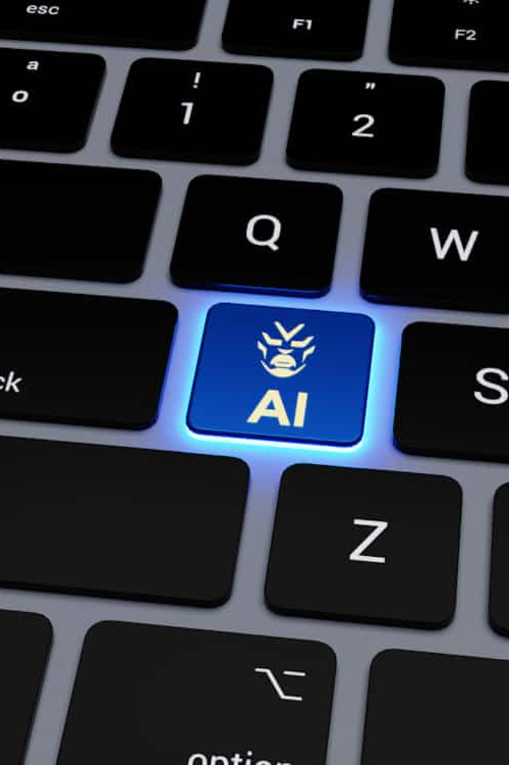
Introduction to Machine Learning
Machine learning (ML) is a type of artificial intelligence (AI) that allows computers to learn and improve from experience without being explicitly programmed
by AYANABHA CHATTERJEE

Slide 2

What is Machine Learning?
1
Machine learning uses algorithms and models to help systems learn from data and perform tasks without rule-based programming.
2
ML algorithms identify patterns in data to make predictions, classifications, and decisions, improving with more data.
3
Machine learning automates model building, enabling systems to adapt to new data without human input.

Slide 3
Traditional Programming vs. Machine Learning
Traditional Programming
Machine Learning
Key Difference
Relies on explicit, rule-based instructions provided by developers to solve problems.
Learns from data to identify patterns and make predictions, without being explicitly programmed.
ML systems adapt and improve automatically, while traditional programs require manual updates by developers.

Slide 4

The Machine Learning Process
Data Collection
Model Deployment
Gathering and preparing the relevant data needed to train the machine learning model.
Integrating the trained model into real-world applications to make predictions and drive decisions.
1
2
3
Model Training
Applying machine learning algorithms to the data to build and optimize the predictive model.

Slide 5
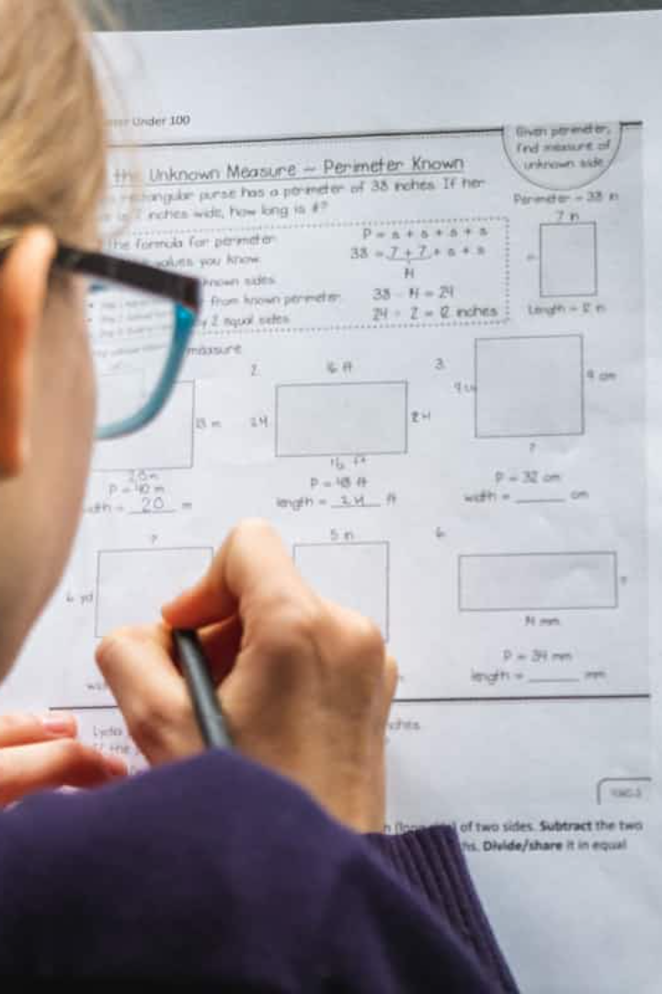
Types of Machine Learning
Supervised Learning
Unsupervised Learning
Algorithms that learn from labeled training data to make predictions or decisions.
Algorithms that discover hidden patterns and structures in unlabeled data.
Reinforcement Learning
Algorithms that learn by trial-and-error, maximizing a reward signal from the environment.

Slide 6




Applications of Machine Learning
Computer Vision
Identify and classify objects, faces, and scenes in digital images and videos.
Natural Language Processing
Analyze, understand, and generate human language for tasks like translation and sentiment analysis.
Predictive Analytics
Forecast future trends and behaviors to optimize business strategies and decision-making.

Slide 7
Advantages and Challenges of Machine Learning
Advantages
Challenges
Responsible Development
Automates complex tasks
Requires large datasets
Addressing challenges through ethical AI practices and human-centered design.
Improves with more data
Potential for bias and errors
Identifies hidden insights
Interpretability issues

Slide 8
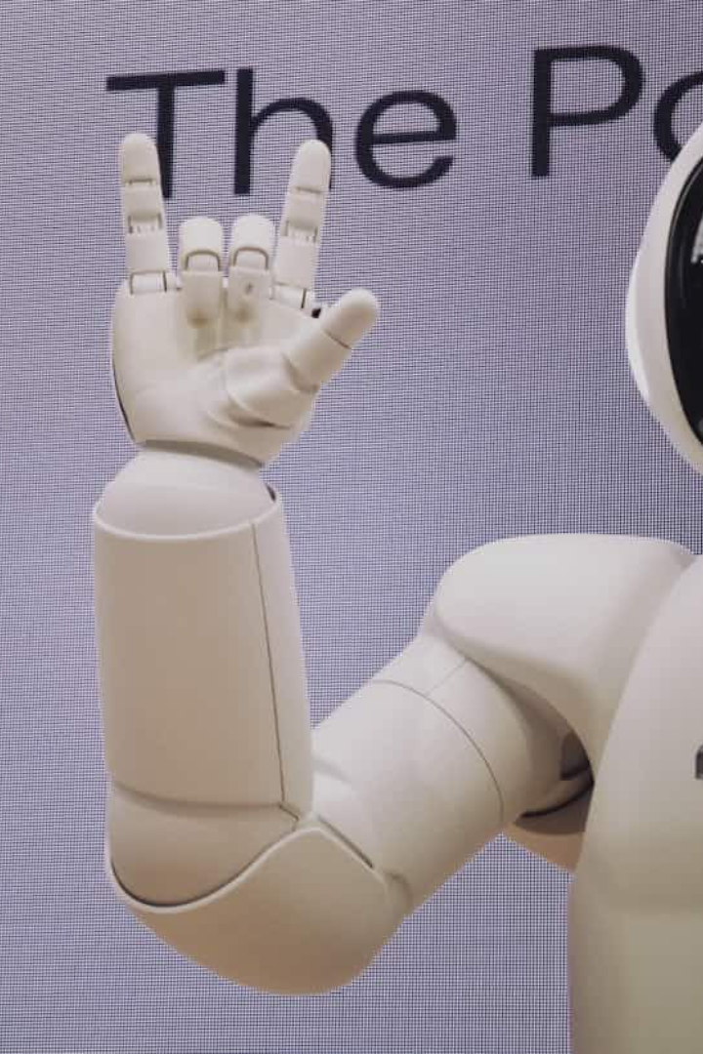



The Future of Machine Learning
Continued Advancements
Breakthroughs in algorithms, hardware, and data availability will drive rapid progress.
Widespread Adoption
Machine learning will become ubiquitous across industries, powering innovative applications.
Ethical Considerations
Ensuring machine learning is developed and deployed responsibly to benefit society.

Slide 9


