Slide 1
Egypt Property Prices
Spark-Based Predictive Pricing Pipeline
Business Goal
Estimate fair price per square meter
Support buyers, investors, and agencies
Turn listing data into valuation insight
Technical Goal
End-to-end PySpark/Spark ML pipeline
Pseudo-distributed local-cluster execution
Reusable code deliverable

Slide 2
Business Problem
Why this matters
Egyptian real-estate prices vary heavily by location, size, type, amenities, and listing quality.
Manual comparison is slow and inconsistent for buyers and agencies.
A price-per-square-meter predictor helps flag underpriced, overpriced, and fairly priced listings.
The result is a decision-support tool, not a replacement for expert appraisal.

Slide 3
Business Users & Value
Primary Users
Property buyers
Real-estate agencies
Investors
Market analysts
Business Value
Objective price benchmark
Faster listing screening
Market transparency
Better negotiation support

Slide 4
Big Data Compliance
Framework: Apache Spark with Python/PySpark.
Mode: pseudo-distributed single-machine multi-process Spark using local-cluster[2,2,2048].
Pipeline coverage: ingestion, preprocessing, feature engineering, model training, tuning, evaluation, prediction.
Dataset: propertyfinder.csv, about 69 MB and 39,713 initial listings.
Fully distributed cluster deployment is listed as future bonus work.

Slide 5
Spark Pipeline
Raw CSV → Spark cleaning → Spark features → VectorAssembler → Spark ML tuning → Evaluation → Reports & predictions
Cleaning removes invalid rows, standardizes fields, and creates price_per_sqm.
Feature engineering adds room ratios, log area, amenities, listing flags, and target encodings.
Spark ML trains and evaluates regression models using distributed transformations.

Slide 6
Preprocessing Summary
Cleaning Results
Initial rows: 39,713
Final cleaned rows: 19,316
Dropped columns: 24
Payment rows removed: 20,261
Outliers removed: 130
Main Steps
Parse numeric columns
Impute bedrooms/bathrooms
Standardize payment methods
Remove critical nulls
Filter outliers using Spark quantiles

Slide 7
Feature Engineering & Insights
Location: latitude, longitude, city, town, district, property type encodings.
Property structure: area, log area, bedrooms, bathrooms, rooms, area per room.
Amenities: pool, gym, security, parking, garden, balcony, private pool, spa, A/C.
Listing quality: premium, verified, new construction, direct-from-developer, image count.
Expected strongest signals: location, property type, area, room structure, and premium amenities.

Slide 8
Spark ML Models
Spark Linear Regression: distributed baseline.
Spark Decision Tree: interpretable non-linear baseline.
Spark Random Forest: selected ensemble model.
Spark Gradient-Boosted Trees: configurable but disabled by default because it is slow in local pseudo-distributed mode.
Target: log1p(price_per_sqm), transformed back for business-scale RMSE.

Slide 9
Results & Evaluation
Latest completed Spark holdout results
Spark Random Forest: R2 = 0.5432, RMSE = 59,584 EGP/sqm
Spark Decision Tree: R2 = 0.4707, RMSE = 60,799 EGP/sqm
Spark Linear Regression: R2 = 0.4540, RMSE = 64,537 EGP/sqm
Best model selected by highest test R2.
Updated code now writes train, validation, and test metrics after rerun.

Slide 10
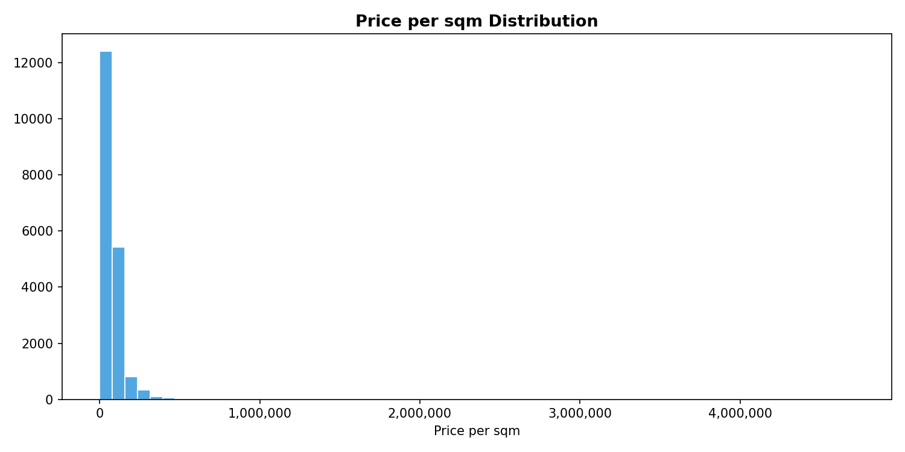
Visualization: Target Distribution

Slide 11
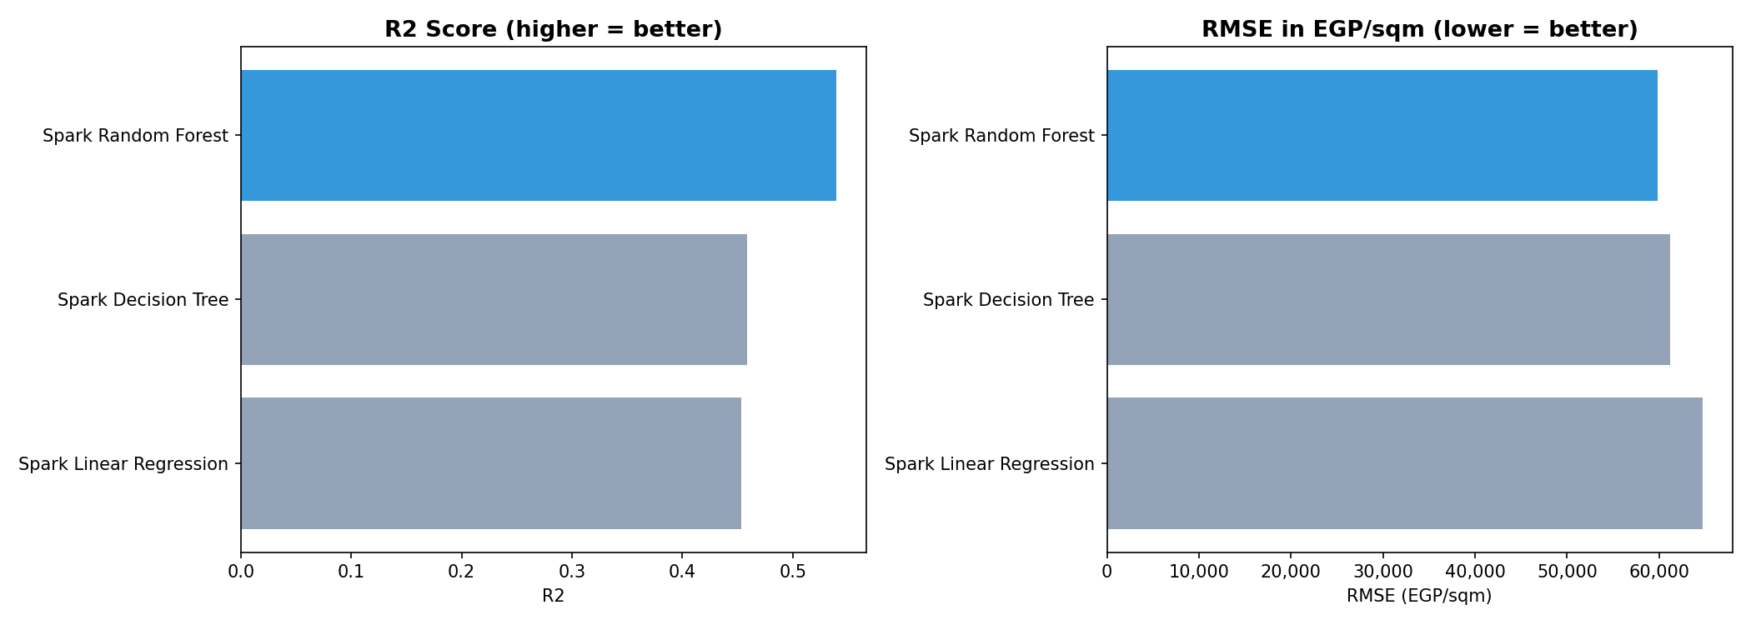
Visualization: Model Comparison

Slide 12
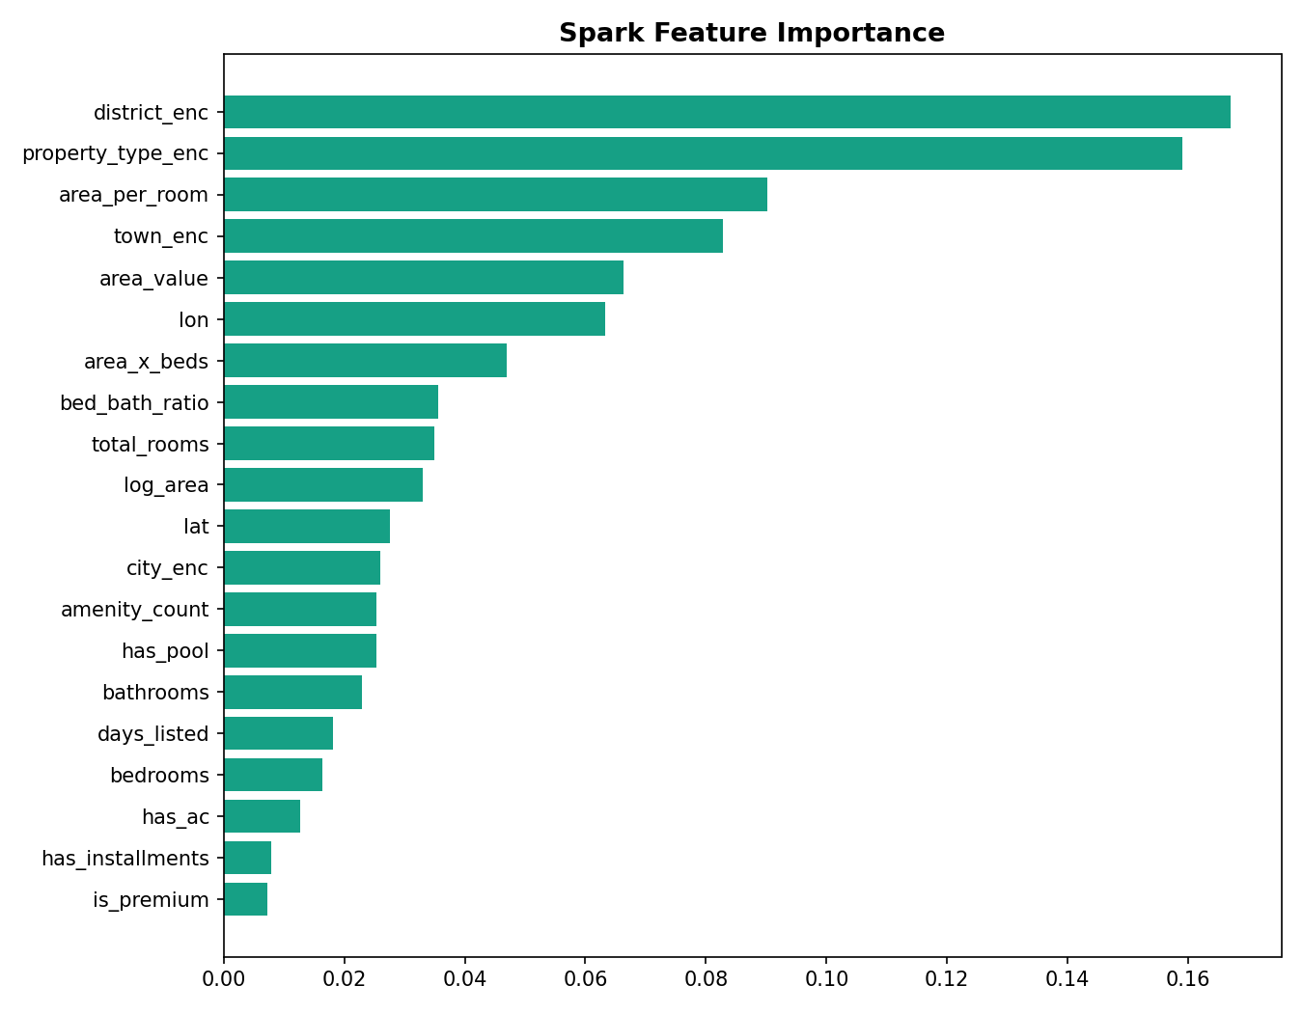
Visualization: Feature Importance

Slide 13
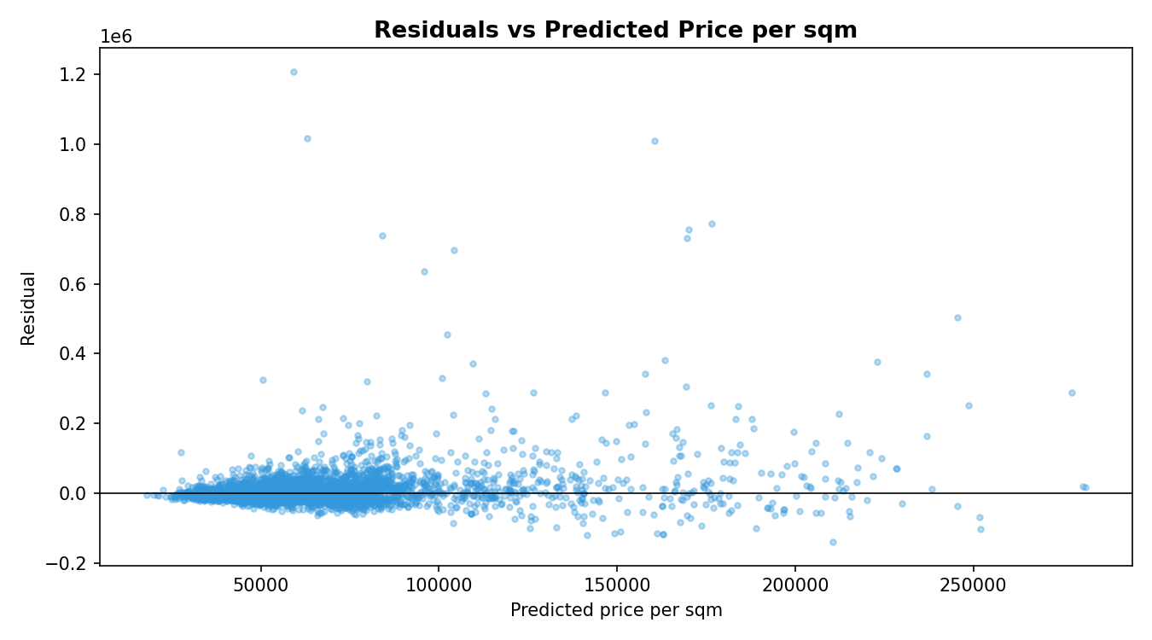
Visualization: Residuals

Slide 14
Unsuccessful Trials
Local scikit-learn and XGBoost paths were removed to keep the final solution big-data focused.
Spark GBT was too slow as a default local-cluster experiment, so it remains disabled by config.
Windows Spark model saving required Hadoop winutils/HADOOP_HOME setup.
Notebook experiments were removed so the final deliverable is reusable Spark code.

Slide 15
Future Work
Refresh reports after rerunning the new train/validation/test split pipeline.
Add richer Spark aggregations by city, district, property type, and amenities.
Enable longer Spark GBT experiments on stronger hardware.
Add a business-facing prediction dashboard.
Deploy on a fully distributed Spark cluster for bonus credit.

