Slide 1

Superstore Gold-Membership
Analysis
Group 7: Ayah Halabi, Jiayi Liang, Setara Nusratty, Jingwan Wang, Vivian Xia

Slide 2

Abstract
Background:
A superstore is launching a year-end sale featuring a gold membership offer, for only $499 which is $999 on other days.
Management aims to reduce campaign costs by building a predictive model to classify customers likely to purchase the membership
Data base:
From 2014 with sample size of 2,240 and 22 variables, including customers’
Demographic Information
Shopping behaviors
Others
Methodology: Logistic Regression
Important Predictors: Teenhome, Marital_Status, NumWebPurchases, Order_Recency, customer_tenure_months
Notes:
Background
Context:
A superstore is launching a year-end sale featuring a gold membership offer:
20% discount on all purchases for $499 (regularly priced at $999).
Targeted exclusively at existing customers.
Campaign will be conducted via phone calls.
Management aims to reduce campaign costs by building a predictive model to classify customers likely to purchase the membership.
Objective:
Predict the likelihood of a customer giving a positive response to the campaign.
Identify key factors influencing customer responses:
Analyze customer demographics and shopping behaviors.
Build a logistic regression model to:
Estimate the probability of a positive response.
Determine significant predictors impacting customer decisions.

Slide 3
Research Questions
What are the key predictors of a customer's positive response to the gold membership offer?
Is there any interaction between demographic factors (e.g., age, marital status) and shopping behaviors (e.g., frequency of purchases, spending patterns) in predicting customer responses?
Notes:
Background
Context:
A superstore is launching a year-end sale featuring a gold membership offer:
20% discount on all purchases for $499 (regularly priced at $999).
Targeted exclusively at existing customers.
Campaign will be conducted via phone calls.
Management aims to reduce campaign costs by building a predictive model to classify customers likely to purchase the membership.
Objective:
Predict the likelihood of a customer giving a positive response to the campaign.
Identify key factors influencing customer responses:
Analyze customer demographics and shopping behaviors.
Build a logistic regression model to:
Estimate the probability of a positive response.
Determine significant predictors impacting customer decisions.

Slide 4

Table of contents
01
02
03
04
05
Data Cleaning
EDA Result
Modeling Result
Data Introduction
Data Cleaning
Variable Transformation
Random Forest
Logistic Regression
Interaction/No Interaction
Conclusions
Appendix
Insights
Future Steps
Limitations
Notes:
AH

Slide 5

01
Data Cleaning

Slide 6
Dealing with nulls/missing values
There are only 24 null values in the Income variable within our entire database
Remove all the nulls

Slide 7
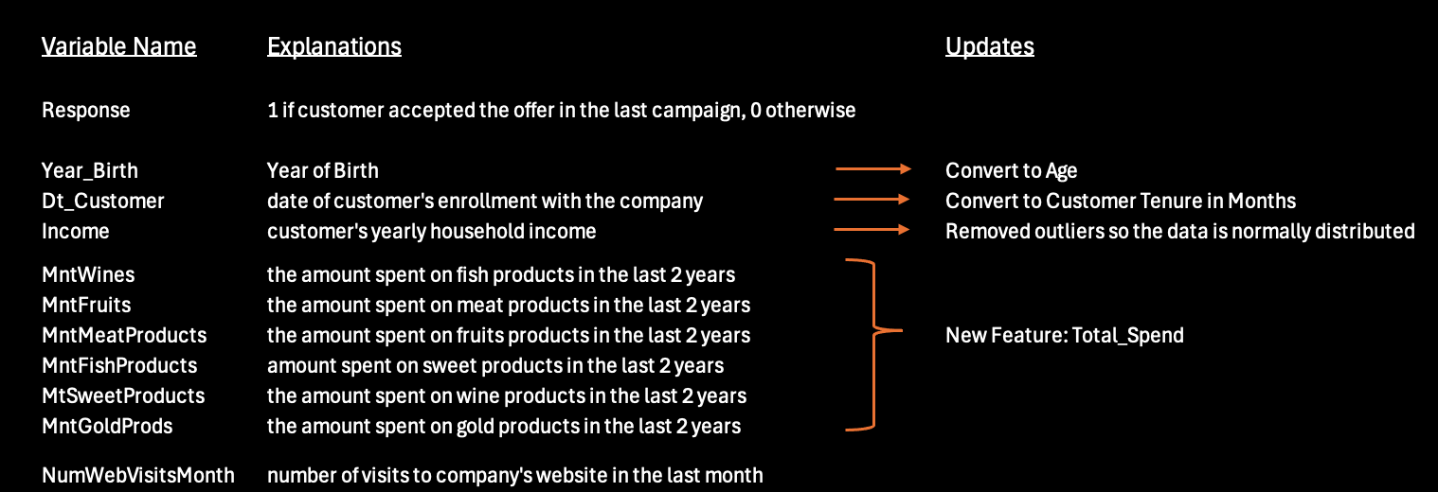
2. Reformat Variables - Numerical

Slide 8
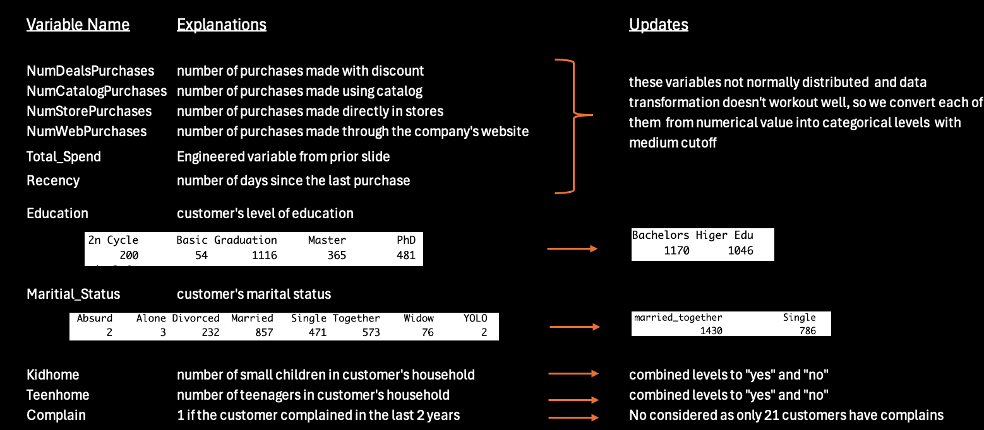
3. Reformat Variables - Categorical

Slide 9
Exploratory Data Analysis
02

Slide 10

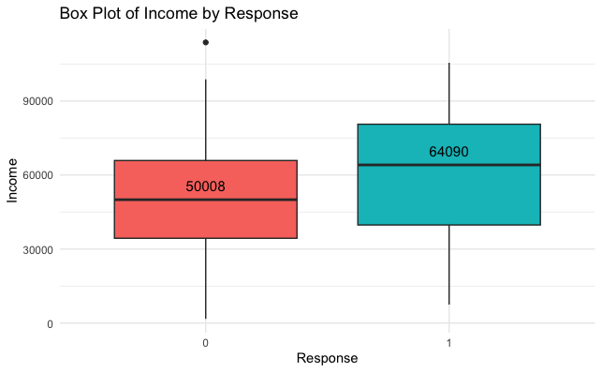
Initial Model
For customers who did not join the gold membership, the median income is approximately 50,008.
For customers who joined the gold membership, the median income is approximately 64,090.
Overall income range for Response = 1 group is higher.
Likely a strong predictor
Notes:
Update box plot with percentages

Slide 11
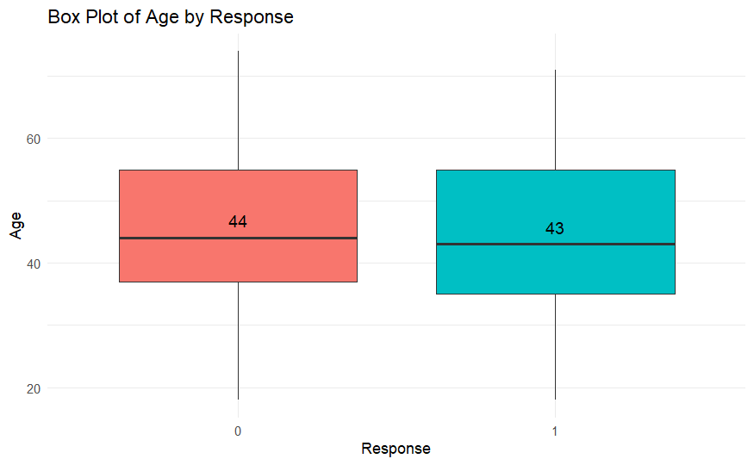
Initial Model
For customers who did not join the gold membership, the median age is 44 years old.
For customers who joined the gold membership, the median age is 43..
Almost no difference, likely not a strong predictor
Notes:
Update box plot with percentages

Slide 12
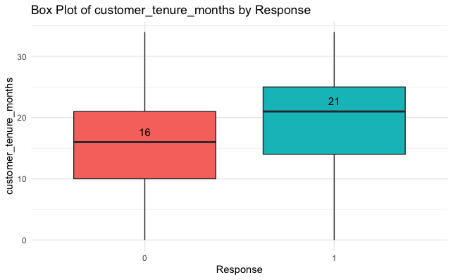
Initial Model
For customers who did not join the gold membership, the median tenure is 16 months.
For customers who joined the gold membership, the median tenure is 21 months.
Overall tenure range for Response = 1 group is higher.
Likely a strong predictor

Slide 13
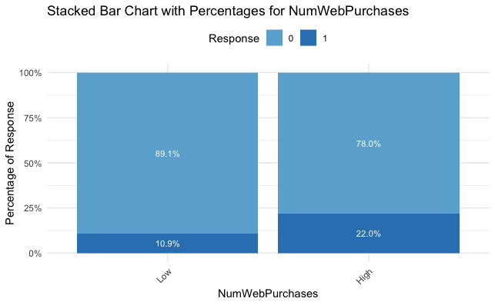
Initial Model
For customers whose number of purchases made through the website is low, 10.9% joined the membership while 89.1% didn’t.
For those purchasing more, 22% joined the membership while 78% didn’t.
Notes:
I just picked interesting ones which also shows a obvious gap between percentage distribution.

Slide 14
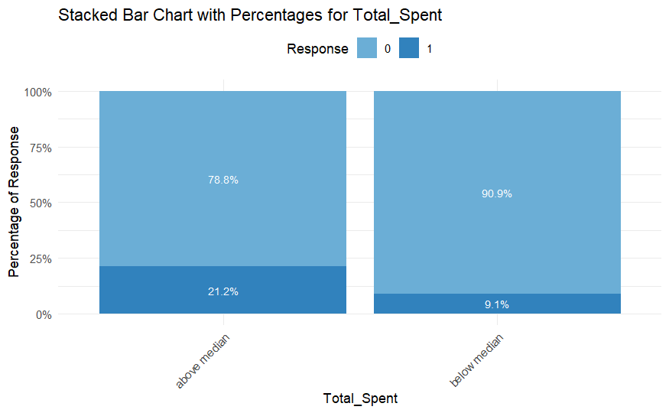
Initial Model
For customers whose spending is above the median, 21.2% joined the membership, while 78.8% did not.
For customers whose spending is below the median, only 9.1% joined the membership while a significantly larger proportion (90.9%) did not join.

Slide 15
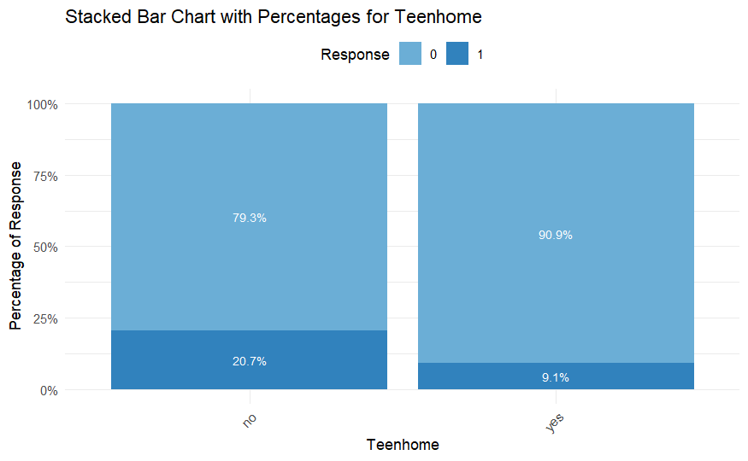
Initial Model
For customers those have teenagers in household, 9.1% joined the membership.
For those have no teenagers in household, a significant larger proportion of 20.7% joined.

Slide 16
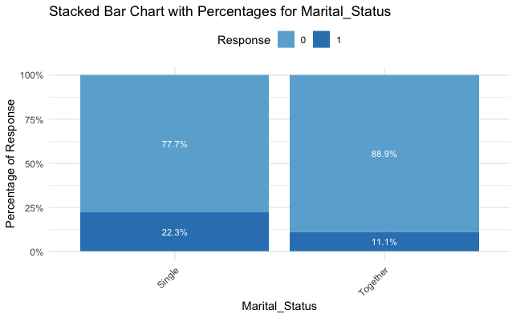
Initial Model
For customers those are single, 22.3% joined the membership.
For those are married or live together, 11.1% joined the membership.
Notes:
Update bar charts with percentages

Slide 17
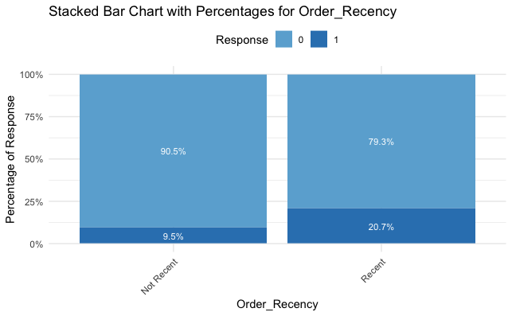
Initial Model
For customers those made purchase in previous 49 days, 20.7% joined the membership.
For those didn’t make purchase recently, only 9.5% joined the membership.

Slide 18
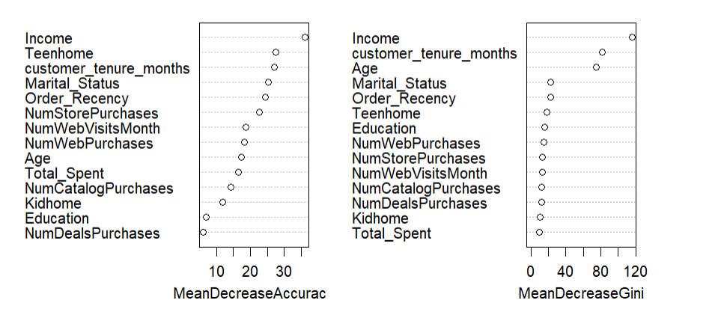
Random Forest
Notes:
Then we use random forest to do feature selection. The Random Forest Variable Importance Plot shows the importance or to say accuracy of each predictor in descending order. For example, Income is the dominant feature in predicting whether a customer joins the gold membership, and variables like teenhome, customer_tenure_months, Marital_Status and order recency are also fairly important.

Slide 19
Path Diagram
Income
Demographics
Teenhome
Marital_Status
Response
NumStorePurchases
Shopping Behavior
NumWebVisitsMonth
NumWebPurchases
Order_Recency
Others
customer_tenure_months
Notes:
Combined the visualization of boxplots, bar charts and the result of random forest, we have a potential path diagram for our initial model. We categorize the predictors into three main groups, demographics, shopping behaviours and others, each influencing the customer response in distinct ways.

Slide 20
Modeling Results
03

Slide 21
Initial Model
Variable Interaction | P-Value
Marital_StatusTogether:NumWebPurchasesHigh | 0.61
Marital_Status * NumWebPurchases
Not statistically significant
indicated by the high p-value
Remove the interaction term and try a new model
Notes:
The initial model included an interaction between Marital_Status and NumWebPurchases, but a p-value of 0.61 indicated it was not significant, so it was removed to simplify the model and focus on key predictors.

Slide 22
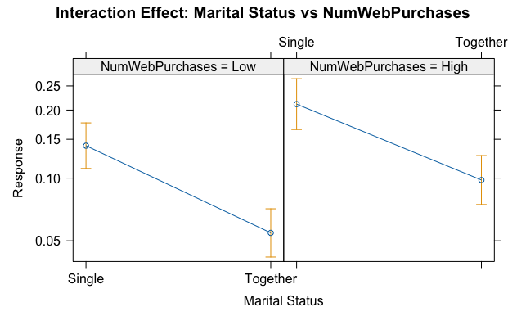
Initial Model
Notes:
The interaction plot is showing parallel lines indicating lack of significance between marital status and num web purchases

Slide 23
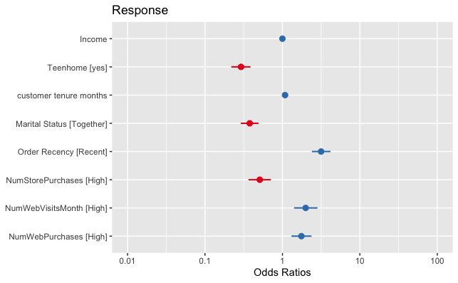
Model 2
Model Without the Previous Interaction
Null Deviance | Residual Deviance
1871.9 | 1494.3
Difference: | 377.6
Notes:
In this model we removed the interaction effect and all of our predictors become statistically significant. We see that in this model that the deviance reduction is 377.6 indicating improved fit.

Slide 24
Model 2
 |  | Confidence Interval |  | p-value
Predictor | Odds | 2.5% | 97.5% | 0
Income | 1.00 | 1.00 | 1.00 | 0
Teenhome yes | 0.29 | 0.22 | 0.39 | 0
customer_tenure_months | 1.08 | 1.06 | 1.10 | 0
Marital_Status Together | 0.38 | 0.29 | 0.49 | 0
Order_Recency Recent | 3.15 | 2.40 | 4.18 | 0
NumStorePurchasesHigh | 0.51 | 0.37 | 0.71 | 0
NumWebVisitsMonthHigh | 1.99 | 1.41 | 2.84 | 0
NumWebPurchasesHigh | 1.76 | 1.31 | 2.37 | 0
Notes:
Looking at the table, The predictors highlighted in blue indicate a reduced likelihood of membership, and the predictors outlined in green indicate a positive effect on membership likelihood. Note that income, while initially appearing to be a relevant predictor, was found to be not statistically significant, as its confidence interval included 1

Slide 25
Model 3
Variable | P-Value
NumStorePurchasesHigh | 0.85
NumWebVisitsMonthHigh | 0.99
Following the removal of interaction
The 2 variables above become insignificant
indicated by the high p-value
Remove these variables and try a new model
Notes:
When creating a new model removing income, we see that Number of store purchases and number of web visits become insignificant so we can remove these

Slide 26
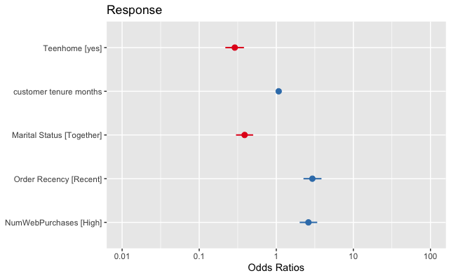
Model 4
Model Without the 2 Variables from Model 3
Null Deviance | Residual Deviance
1871.9 | 1569.3
Difference: | 302.6
AIC | 1581.3
Notes:
When creating a model without Numwebvisits and numstorepurchases, all of our predictors are sigifniciant. Additionally we see that our deviance reduction is 302.6 indicating Improved Fit.

Slide 27
Model 4
 |  | Confidence Interval |  | p-value
Predictor | Odds | 2.5% | 97.5% | 0
Teenhome yes | 0.29 | 0.22 | 0.39 | 0
customer_tenure_months | 1.08 | 1.06 | 1.10 | 0
Marital_Status Together | 0.39 | 0.30 | 0.50 | 0
Order_Recency Recent | 2.94 | 2.25 | 3.86 | 0
NumWebPurchasesHigh | 2.61 | 2.01 | 3.40 | 0
Notes:
Looking at the table, all of the odds ratios and their confidence intervals look fine, and the blue indicates a reduced likelihood and the green indicates a positive effect

Slide 28
Model 4
Model Without the 2 Variables from Model 3
Predictor | VIF
Teenhome | 1.07
customer_tenure_months | 1.03
Marital_Status | 1.02
Order_Recency | 1.03
NumWebPurchases | 1.08
* All VIF values are under 5
Notes:
When running VIF, all preidctors have a vif under 5 indicating that there is no multicollinearity

Slide 29
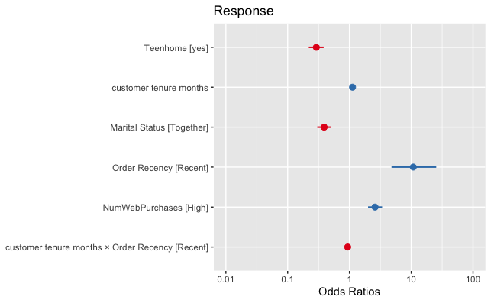
Model 5
Model 4 + Interaction: customer_tenure_months*Order_Recency
Variable Interaction | P-Value
Customer_tenure_months: Order_RecencyRecent | 0
Null Deviance | Residual Deviance
1871.9 | 1557.8
Difference: | 314.1
AIC | 1571.8
Notes:
In this model, we introduced an interaction between Customer Tenure and Order Recency and we see that The interaction term (p < 0.05) revealed that tenure effects were amplified when recent orders were present.

Slide 30
Model 5
 |  | Confidence Interval |  | p-value
Predictor | Odds | 2.5% | 97.5% | 0
Teenhome yes | 0.29 | 0.22 | 0.39 | 0
customer_tenure_months | 1.12 | 1.09 | 1.16 | 0
Marital_Status Together | 0.39 | 0.30 | 0.50 | 0
Order_Recency Recent | 10.79 | 4.79 | 25.39 | 0
NumWebPurchasesHigh | 2.60 | 2.00 | 3.38 | 0
customer_tenure_months:Order_RecencyRecent | 0.94 | 0.89 | 0.97 | 0
Notes:
After adding the interaction effect, the odds ratio for recency rose to 10.79, indicating that recent purchasers are 10.79 times more likely to buy a gold membership, assuming customer tenure is at the reference level. However, for recent purchasers, the odds decrease by 6% with each additional month of tenure, showing that the influence of recent purchases is stronger for newer customers and diminishes over time.

Slide 31
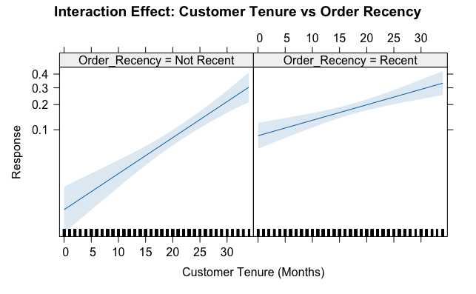
Model 5
Model 4 + Interaction: customer_tenure_months*Order_Recency
Notes:
We see that the slopes of the lines on the interaction plot are different indicating that the interaction effect is significant

Slide 32
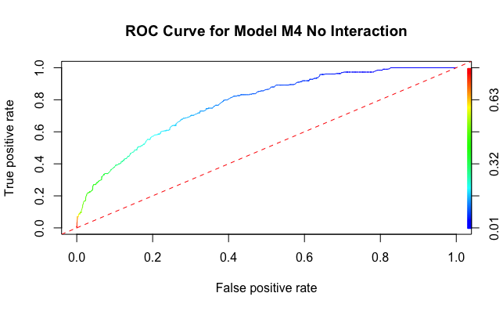
Measuring Accuracy Model 4
 | False | True
False | 512 | 143
True | 43 | 74
Accuracy | 0.76
Sensitivity | 0.63
Specificity | 0.78
Cutoff: 0.2
Notes:
When creating our ROC curve and confusion matrix for model 4 we see that accuracy is 76%, sensitivity the true positive rate is 63% and specificity is 78%. The ROC curve significantly deviates from the baseline, indicating that the model performs better than random chance

Slide 33
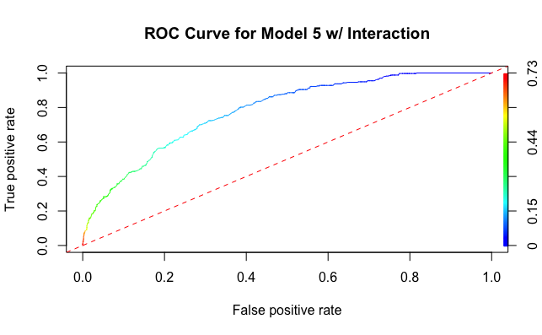
Measuring Accuracy Model 5
 | False | True
False | 532 | 123
True | 42 | 75
Accuracy | 0.79
Sensitivity | 0.64
Specificity | 0.81
Cutoff: 0.2
Notes:
We see that model 5 has slightly higher accuracy, specificity, and sensitivity compared to model 4

Slide 34
Cross Validation
Metric | *Model 4 | Model 5
Accuracy | 0.74 | 0.68
95% CI - Accuracy | (0.70, 0.78) | (0.63 0.72
Kappa | 0.30 | 0.21
McNemar's Test P-Value | 8.083e-12 | 3.951e-16
Sensitivity | 0.75 | 0.68
Specificity | 0.70 | 0.67
*Go with Model 4
Notes:
When running our cross validation, we see that model 4 has significantly better accuracy, sensitivity, and specificity than model 5. Additionally it has a higher Kappa value of 0.3 which indicates fair agreement. From the results of our cross validation we go with model 4 which does not contain an interaction term

Slide 35
Conclusions
04

Slide 36
Final Path Diagram
Demographics
Teenhome
Marital_Status
Response
Shopping Behavior
NumWebPurchases
Order_Recency
Others
customer_tenure_months
Notes:
Here is a diagram outlining all of our final predictors

Slide 37
Final Model
log(p/1-p) =
-1.24*Teenhome_Yes -0.95 * Marital_Status_Together +
1.08*Order_Recency_Recent + 0.96*NumWebPurchase_High +
0.07*customer_tenure_months
Pearson goodness-of-fit test:
2041.804 < 2309.208
Since the calculated value of Pearson Chi square (2041.804) is less than the critical value (2309.208), we fail to reject the null hypothesis, and conclude that the logistic model fits the data
Notes:
Outcome = log odds of the probability
Having a teenager at home decreases the log odds by 1.239 of getting the gold membership compared to the families that do not have a teenager.
Being married also decreases the log odds of buying the gold membership by 0.94 compared to not being married
Being a recent customer increases the log odds of buying the membership by 1.077 compared to those who have been customers for a longer period of time.
Having a high number of purchases increased the likelihood of buying the new membership by 0.959
Lastly, a one unit increase in customer tenure months decreases the log odds of buying the new membership by 0.078.

Slide 38
Model 4
 |  | Confidence Interval |  | p-value
Predictor | Odds | 2.5% | 97.5% | 0
Teenhome yes | 0.29 | 0.22 | 0.39 | 0
customer_tenure_months | 1.08 | 1.06 | 1.10 | 0
Marital_Status Together | 0.39 | 0.30 | 0.50 | 0
Order_Recency Recent | 2.94 | 2.25 | 3.86 | 0
NumWebPurchasesHigh | 2.61 | 2.01 | 3.40 | 0
Notes:
Keeping all else constant
-The odds of accepting the campaign is 71% less if you have teenagers at home compared if you do not have teenagers at home.
- Customer a one unit increases in customer tenure months increases the odds by 8%
-Similarly, the odds of accepting the campaign is 61% less if the customer is married.
-The odds of accepting the campaign is 2.94 times more if the order recency is recent.
-The odds of accepting the campaign is 2.61 times more when Num Purchase is High

Slide 39
Limitations
Small sample size
Not enough information on campaign details
Data Accuracy
Data Skewness
Notes:
Data Accuracy: We do not have exact information when the data is provided, so till date calculation for age and customer tenure is based on assumption of 12/2014, the latest date in database for customer enrollment.

Slide 40
Insights Summary and Future Steps
Adding more variables regarding shopping behavior:
Time spent browning
Coupon reduction rate
Seasonal trends
Scalability:
Test the model with larger datasets from Subsequent years to evaluate scalability and consistency

Slide 41
Thank You!

