Slide 1
Content-based Movies Recommendation System
INFO H410 - Techniques of AI
Aya Iftissen
Souha Belhadj Rhouma
Salma Namouri
Start
2024 - 2025

Slide 2
TABLE OF CONTENTS
01
02
03
Types of Recommendation Systems
Content-based Recommendation Approach
Methodology
04
05
06
Recommendation Algorithm
Result
Conclusion
01
02
03
04
05
06

Slide 3
01
Types of Recommendation Systems
01

Slide 4
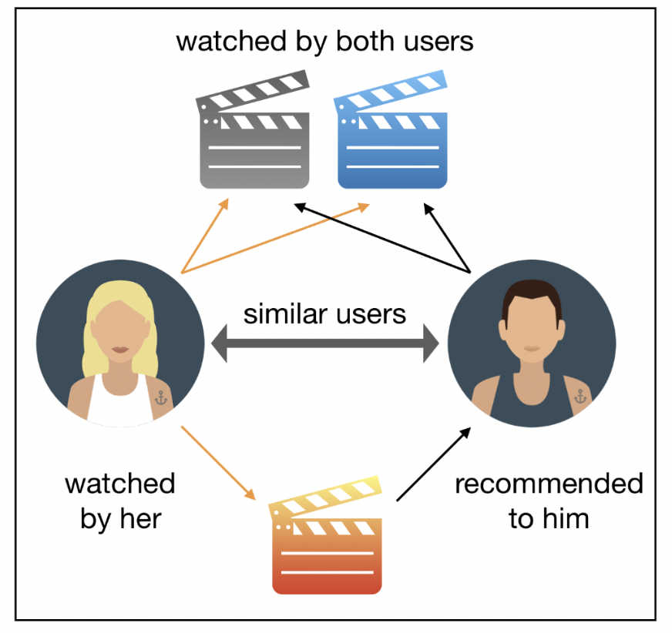
Collaborative-based
Recommends items based on user behavior or item similarity
Two main types:
User-based: Finds users similar to you and recommends what they liked
Item-based: Finds items similar to what you've liked and recommends them
Limits:
Cold Start Problems
Missing values

Slide 5
Knowledge-based
Recommend items based on explicit user preferences and constraints
Suitable when user-item interaction data is scarce (Cold Start)
Uses domain knowledge and logical rules to match user needs
Does not rely on historical behavior or user ratings
Limits:
Requires extensive domain knowledge
May not adapt automatically over time unless combined with learning methods

Slide 6
Content-based Flitering
02

Slide 7
Content-based
Definition
Core idea
Recommends items by comparing the features of the items with a user’s past preferences
Each item (movie) is represented using its intrinsic features rather than user behavior

Slide 8
Content-based
Advantages
No need for other users' data (works for a single user)
Personalized recommendations based on user-specific preferences
Limits
Can’t recommend items that are dissimilar to what the user has liked (no serendipity)

Slide 9
Methodology
03

Slide 10
Data Extraction & Preprocessing
Data collection
Data preprocessing
Source: TMDB 5000 Movie Dataset downloaded from Kaggle
Clean and transform raw movie data for vectorization and similarity analysis
Created a unified "tags" column capturing key movie characteristics
Text Normalization
Stemming: Reduced words to their root forms

Slide 11
Feature extraction
Goal
Vectorization Process
Convert movie descriptions into a structured, numerical format for similarity computation
Used CountVectorizer to transform text into numerical vectors
Limited vocabulary to the 5000 most frequent words
Resulting Representation
Formed the basis for computing cosine similarity between movies

Slide 12
Cosine similarity computation
Used cosine similarity to measure similarity between movie vectors
Interpretation
Score close to 1 → movies are very similar
Score close to 0 → movies are dissimilar
Similarity Matrix
To avoid recomputation, matrix is stored using Python’s pickle module for efficient reuse

Slide 13
Recommendation Algorithm
04

Slide 14
Movie index retrieval and similarity extraction
Retrieve the index of the selected movie from the pre-processed dataset
Extracts the score of similarity between selected movie and others from the dataset
Then, rank similar movies by classifying the list of similarity scores in descending order

Slide 15

Top N recommendation
Select top 5 most similar movies
P.s. we exclude the user’s selected movie

Slide 16
Results
05

Slide 17
Run the project

Slide 18
Conclusion
06

Slide 19
To conclude
Developed a content-based movie recommender using NLP and cosine similarity to compute relationships between movies based on metadata, without requiring labeled data or supervised learning.
Demonstrates core unsupervised ML principles like feature extraction and similarity-based decision-making, forming a solid base for scaling to hybrid or deep learning-based recommenders.

Slide 20
Hope you enjoyed watching

